Slide 1

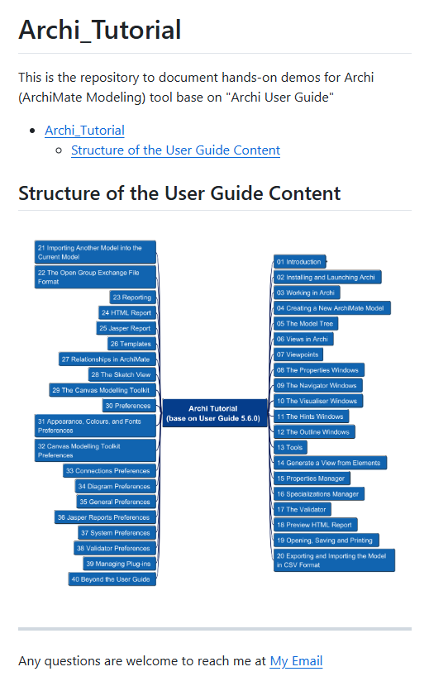


Archi® Tool Tutorial base on User Guide 5.6.0
001
Opening

Slide 2
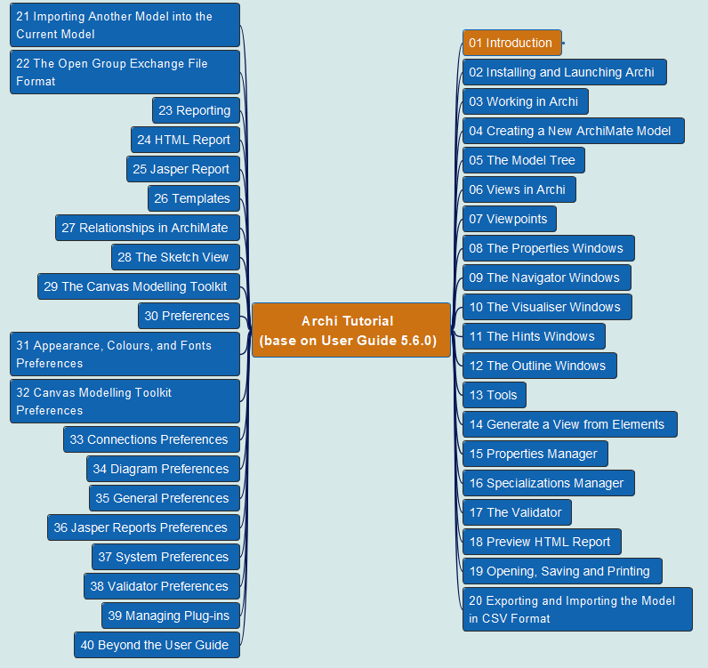
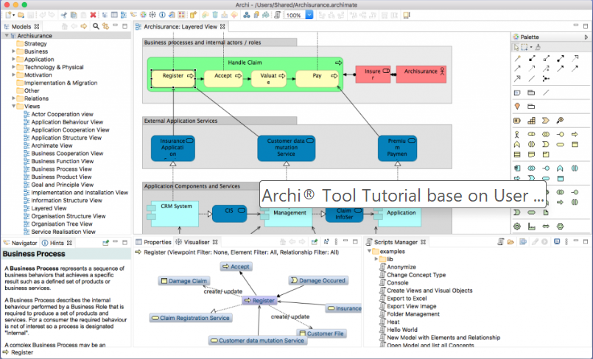
Archi® Tool Tutorial base on User Guide 5.6.0
002
CH01 Introduction

Slide 3
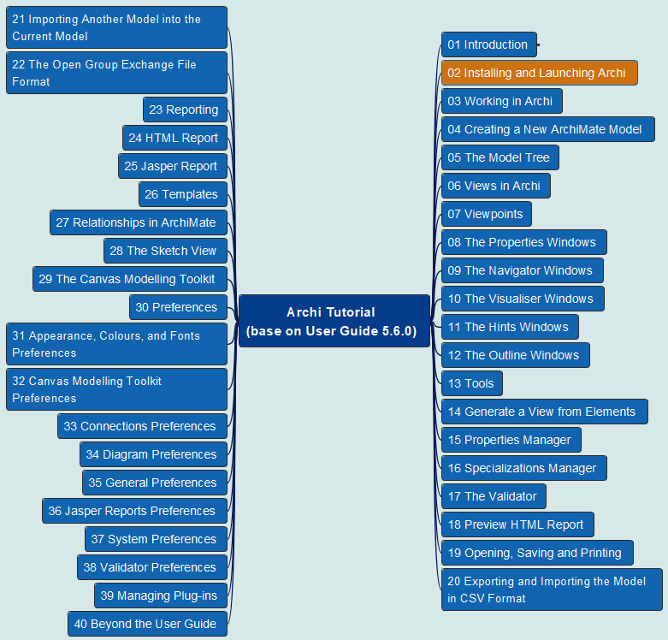
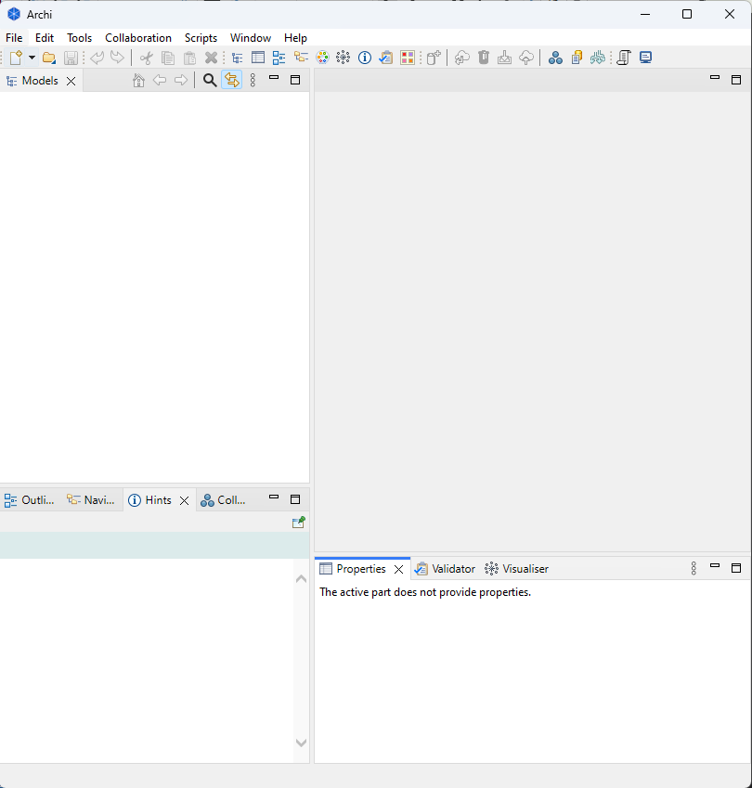
Archi® Tool Tutorial base on User Guide 5.6.0
003
CH02 Installing and Launching Archi

Slide 4
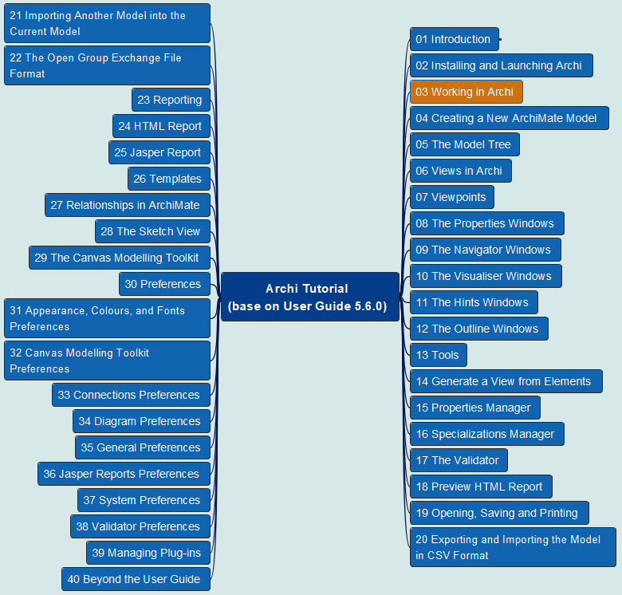
Archi® Tool Tutorial base on User Guide 5.6.0
004
CH03 Working in Archi
Windows and Tabs
Undo/Redo *
Cheat Sheets
Getting Help

Slide 5
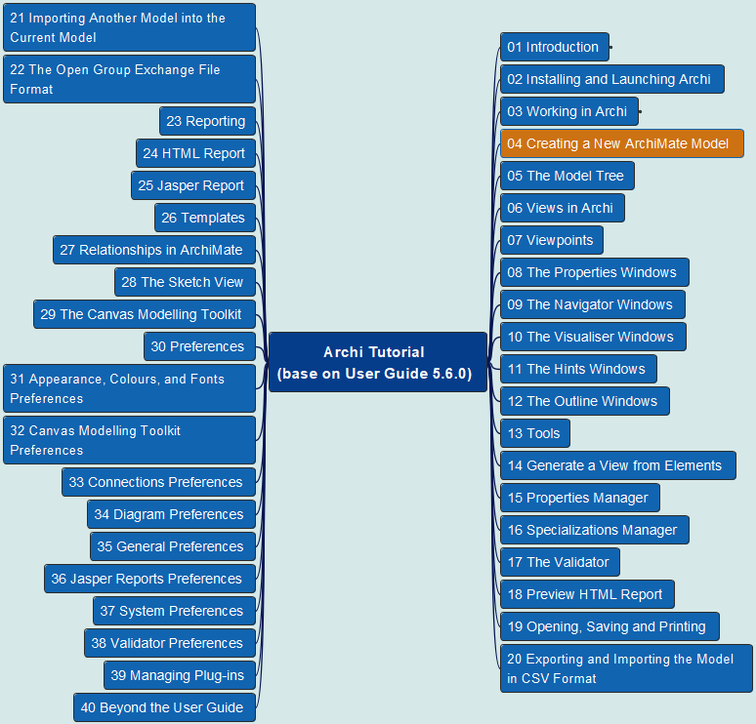
Archi® Tool Tutorial base on User Guide 5.6.0
005
CH04 Creating a New ArchiMate Model

Slide 6
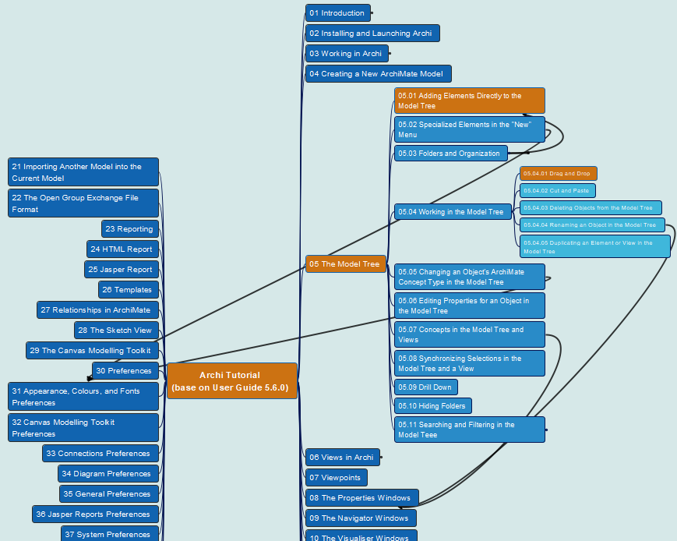
Archi® Tool Tutorial base on User Guide 5.6.0
006
CH05 Model Tree
05.01 Adding Elements to the Model Tree
05.04.01 Drag and Drop

Slide 7
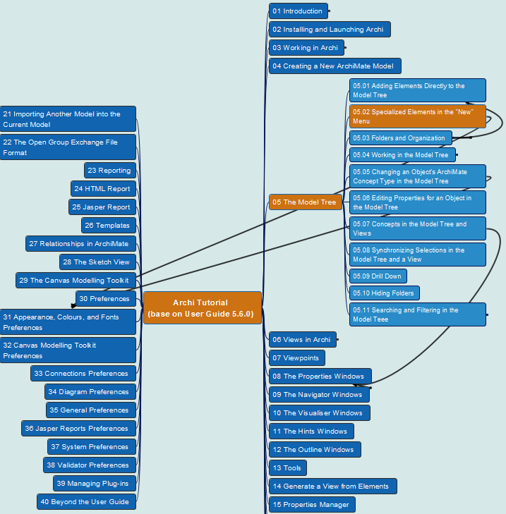
Archi® Tool Tutorial base on User Guide 5.6.0
007
CH05 Model Tree
05.02 Specialized Elements in the “New” Menu

Slide 8
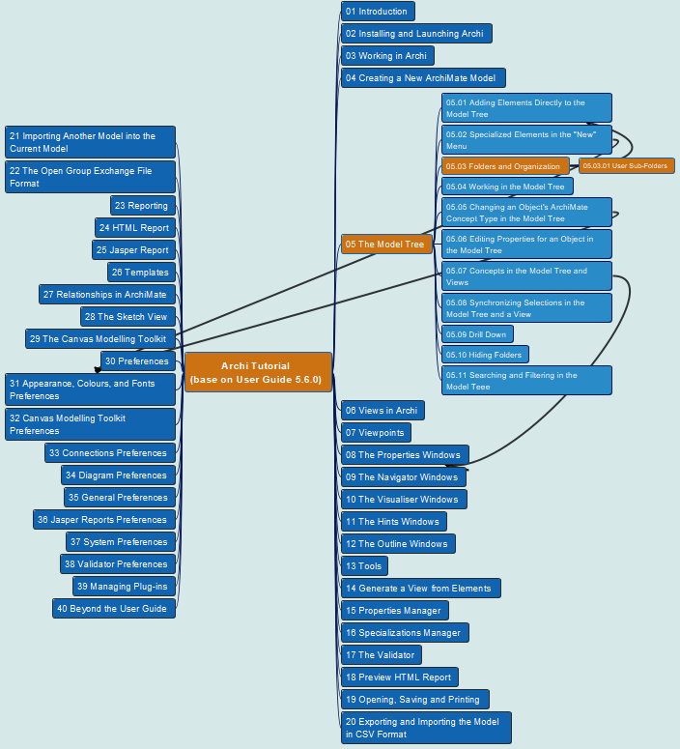
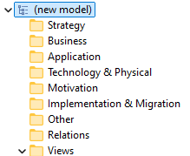
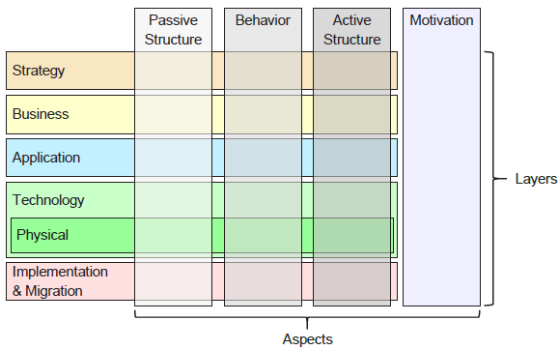
Archi® Tool Tutorial base on User Guide 5.6.0
008
CH05 Model Tree
05.03 Folders and Organization
05.03.01 User Sub-Folders

Slide 9
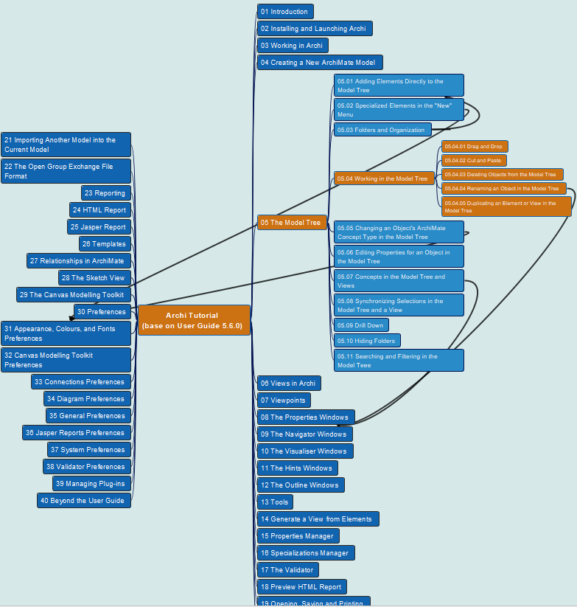
Archi® Tool Tutorial base on User Guide 5.6.0
009
CH05 Model Tree
05.04 Working in Model Tree
05.04.01 Drag and Drop
05.04.02 Cut and Paste
05.04.03 Deleting Objects from the Model Tree
05.04.04 Renaming and Object in the Model Tree
05.14.05 Duplicating an Element or View in the Model Tree

Slide 10
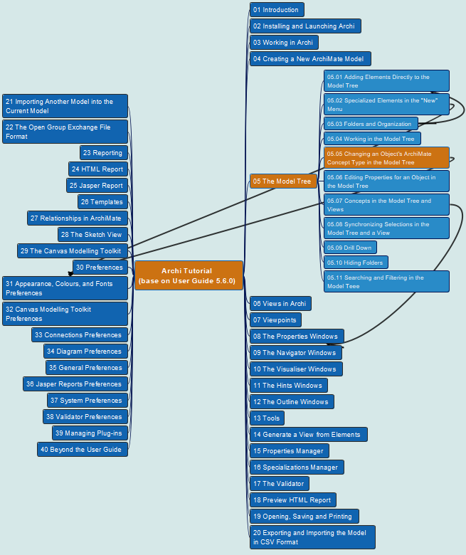
Archi® Tool Tutorial base on User Guide 5.6.0
010
CH05 Model Tree
05.05 Changing an Object’s ArchiMate Concept Type in the Model Tree

Slide 11

Archi® Tool Tutorial base on User Guide 5.6.0
011
CH05 Model Tree
05.06 Editing Properties for an Object in the Model Tree

Slide 12
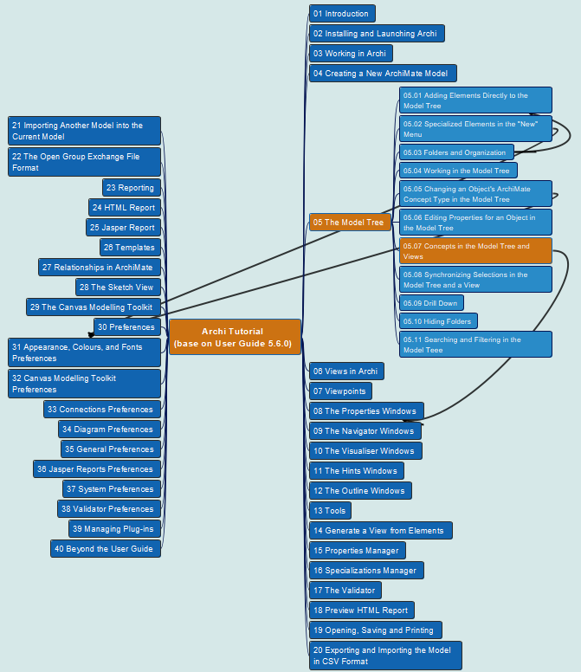
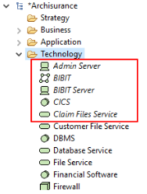
Archi® Tool Tutorial base on User Guide 5.6.0
012
CH05 Model Tree
05.07 Concepts in the Model Tree and Views

Slide 13

Archi® Tool Tutorial base on User Guide 5.6.0
013
CH05 Model Tree
05.08 Synchronizing Selections in the Model Tree and a View

Slide 14
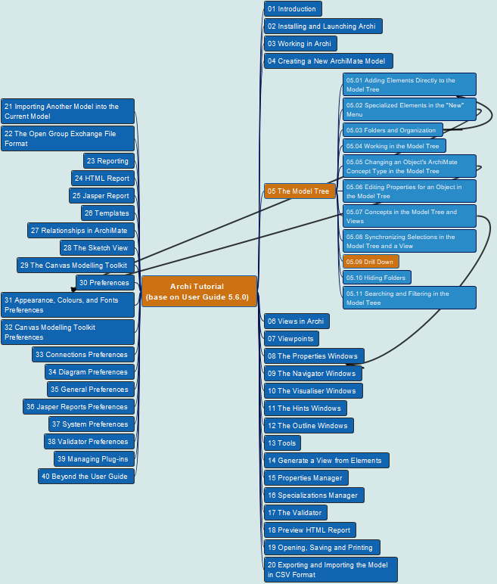

Archi® Tool Tutorial base on User Guide 5.6.0
014
CH05 Model Tree
05.09 Drill Down

Slide 15



Archi® Tool Tutorial base on User Guide 5.6.0
015
CH05 Model Tree
05.10 Hiding Folders

Slide 16
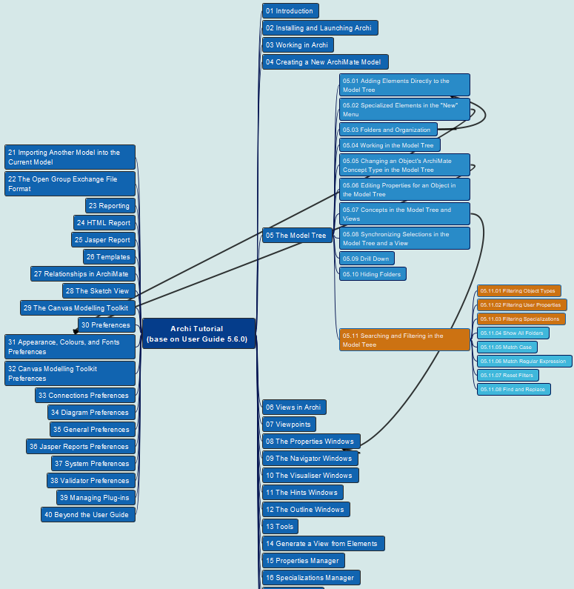
Archi® Tool Tutorial base on User Guide 5.6.0
016
CH05 Model Tree
05.11 Searching and Filtering in the Model Tree
05.11.01 Filtering Object Types
05.11.02 Filtering User Properties
05.11.03 Filtering Specializations

Slide 17
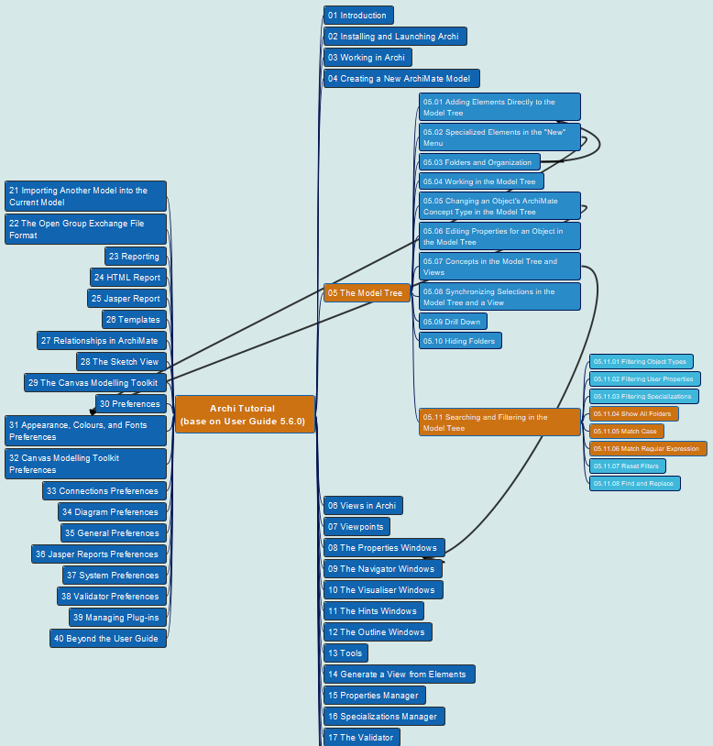
Archi® Tool Tutorial base on User Guide 5.6.0
017
CH05 Model Tree
05.11 Searching and Filtering in the Model Tree
05.11.04 Show All Folders
05.11.05 Match Case
05.11.06 Match Regular Expression

Slide 18
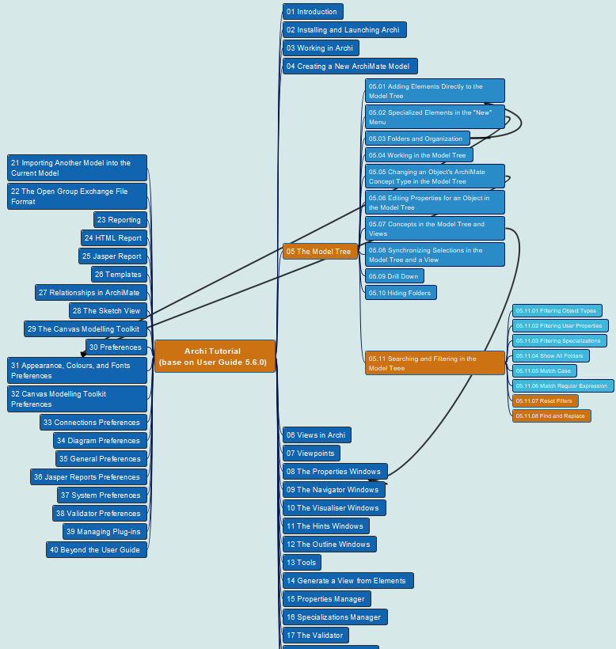
Archi® Tool Tutorial base on User Guide 5.6.0
018
CH05 Model Tree
05.11 Searching and Filtering in the Model Tree
05.11.07 Reset Filters
05.11.08 Find and Replace

Slide 19
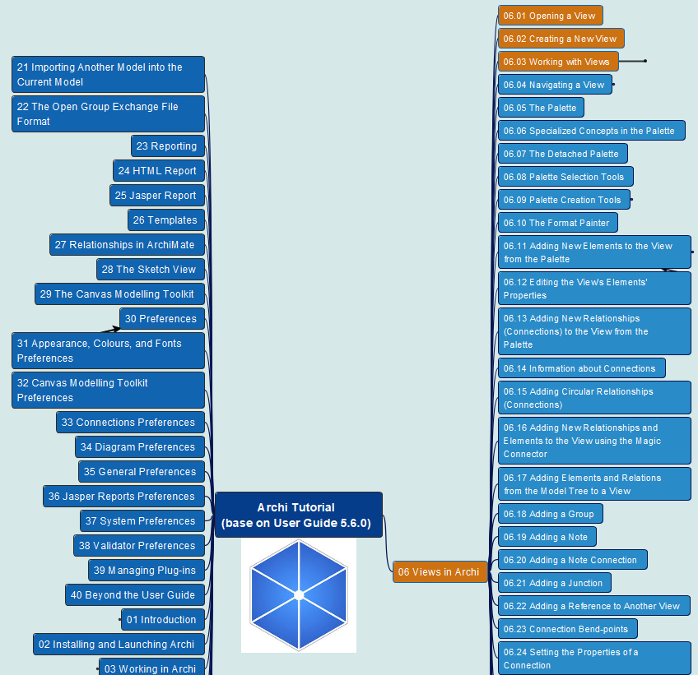
Archi® Tool Tutorial base on User Guide 5.6.0
019
CH06 Archi Views
06.01 Opening a View
06.02 Creating a New View
06.03 Working with Views

Slide 20
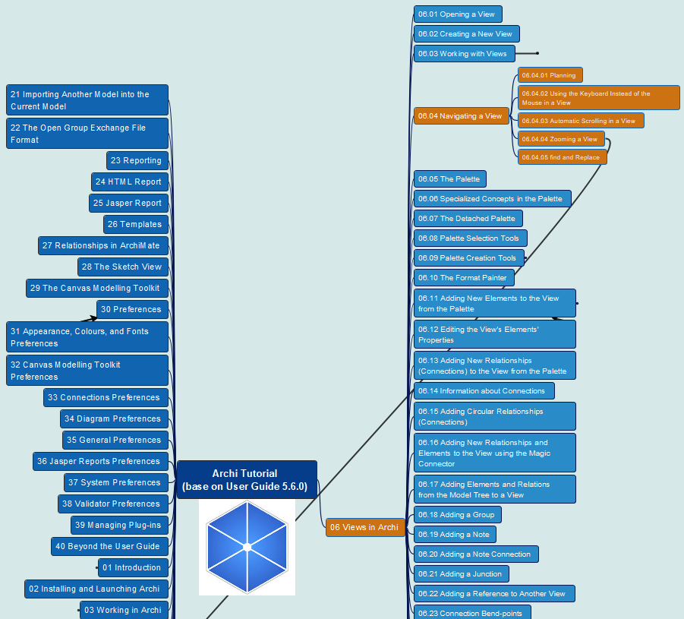
Archi® Tool Tutorial base on User Guide 5.6.0
020
CH06 Archi Views
06.04 Navigating a View
Panning
Using Keyboard
Auto-Scrolling
Zooming
Fine and Replace

Slide 21
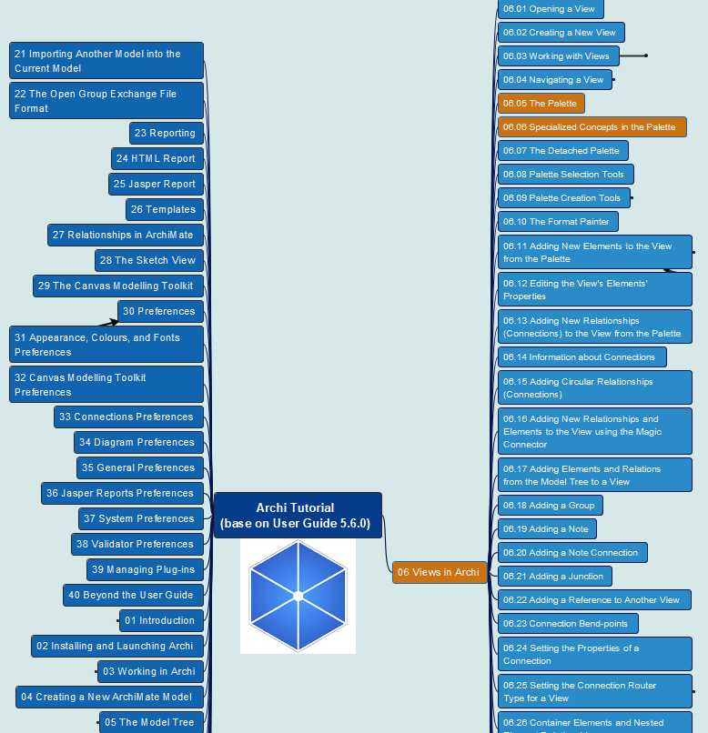
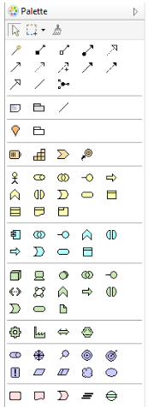
Archi® Tool Tutorial base on User Guide 5.6.0
021
CH06 Archi Views
06.05 The Palette
06.06 Specialized Concepts in Palette

Slide 22
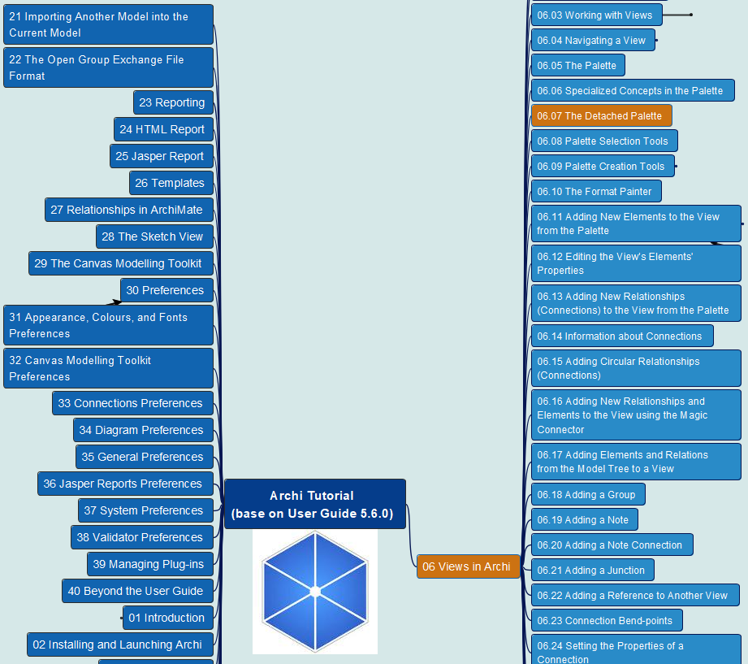
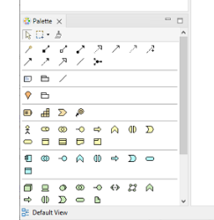
Archi® Tool Tutorial base on User Guide 5.6.0
022
CH06 Archi Views
06.07 The Detached Palette

Slide 23
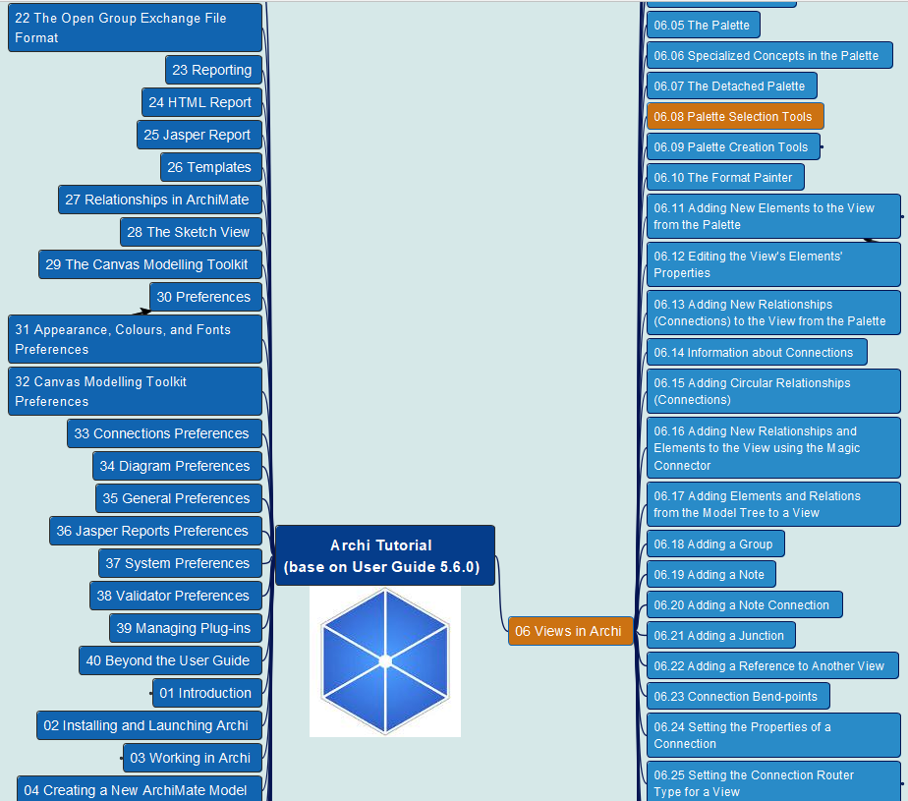
Archi® Tool Tutorial base on User Guide 5.6.0
023
CH06 Archi Views
06.08 Palette Selection Tools

Slide 24
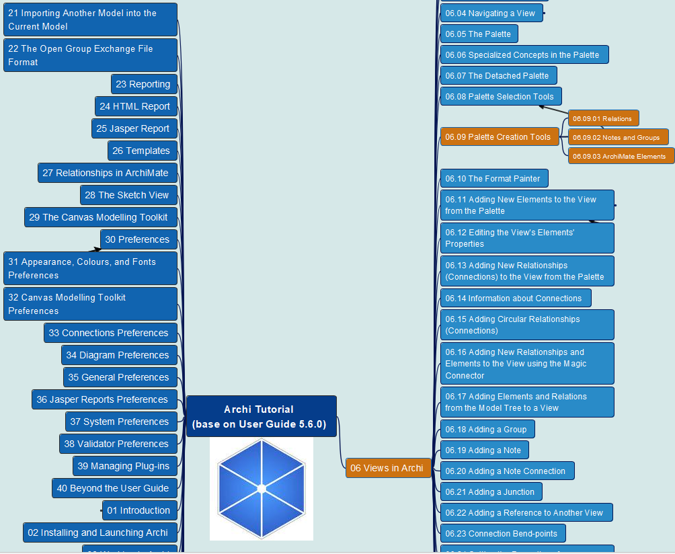
Archi® Tool Tutorial base on User Guide 5.6.0
024
CH06 Archi Views
06.09 Palette Creation Tools
Relations
Notes and Groups
ArchiMate Elements

