Slide 1

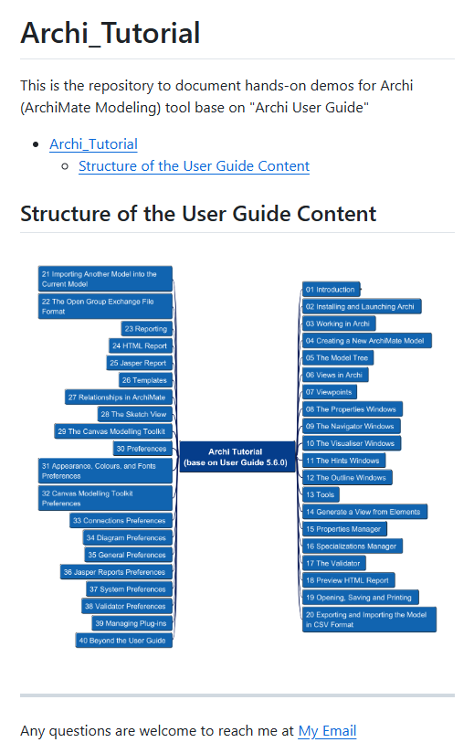


Archi® Tool Tutorial base on User Guide 5.6.0
001
Opening

Slide 2
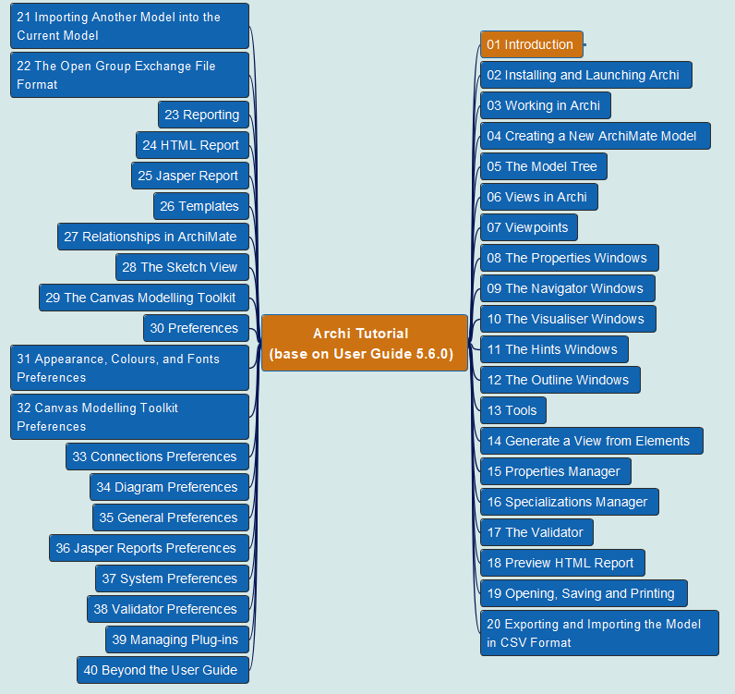
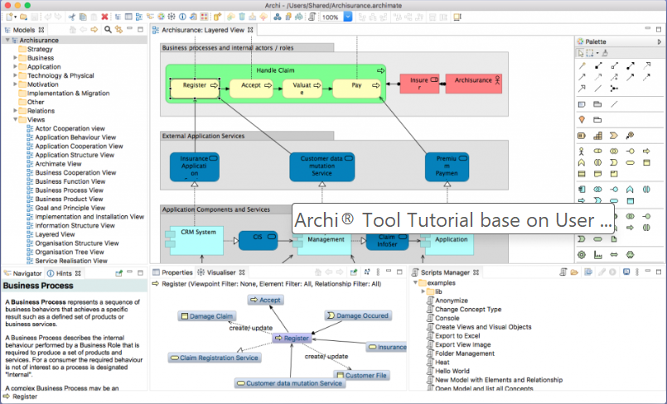
Archi® Tool Tutorial base on User Guide 5.6.0
002
CH01 Introduction

Slide 3
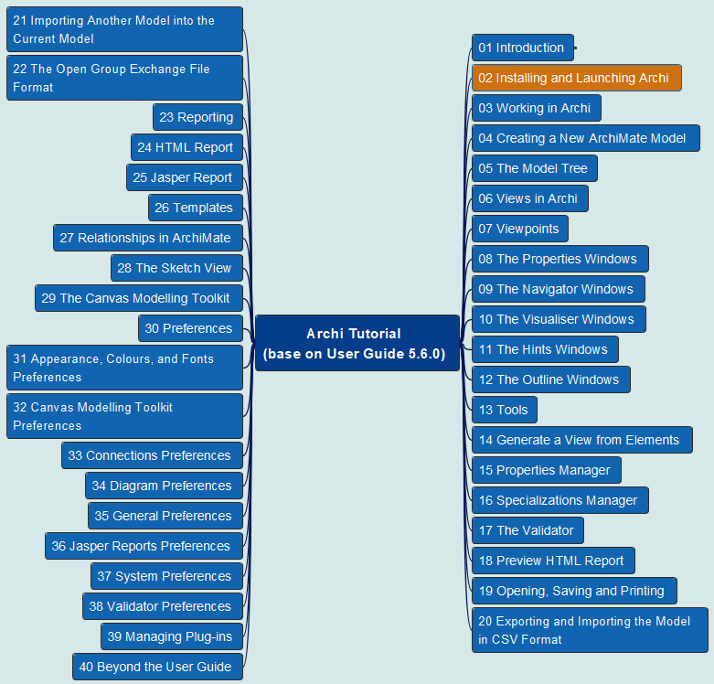
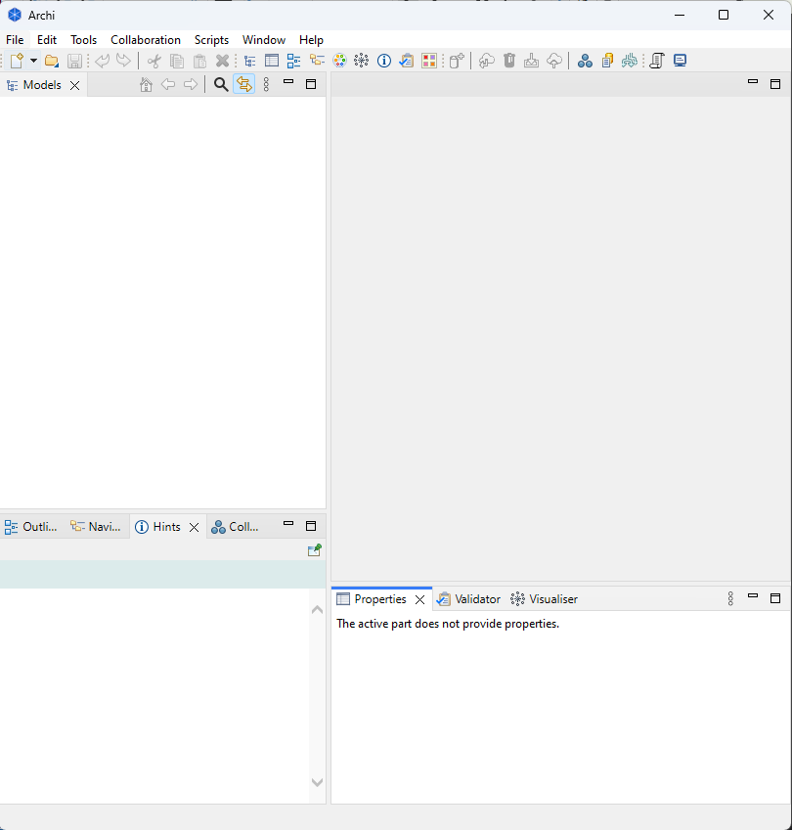
Archi® Tool Tutorial base on User Guide 5.6.0
003
CH02 Installing and Launching Archi

Slide 4
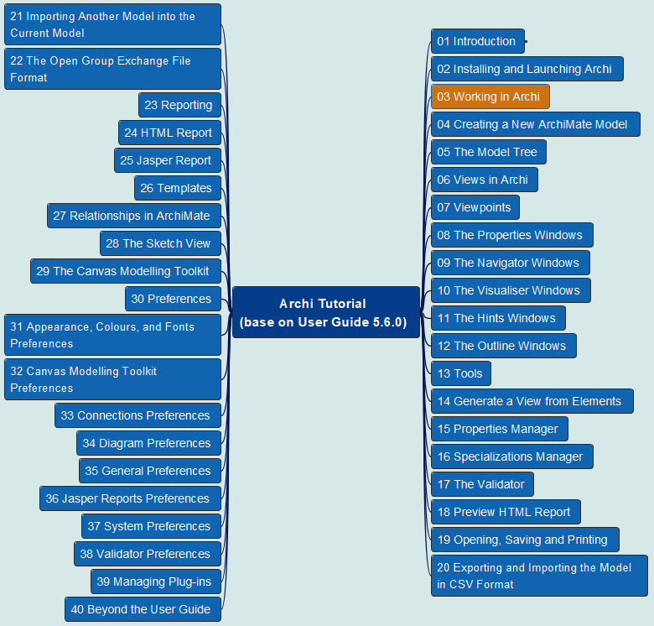
Archi® Tool Tutorial base on User Guide 5.6.0
004
CH03 Working in Archi
Windows and Tabs
Undo/Redo *
Cheat Sheets
Getting Help

Slide 5
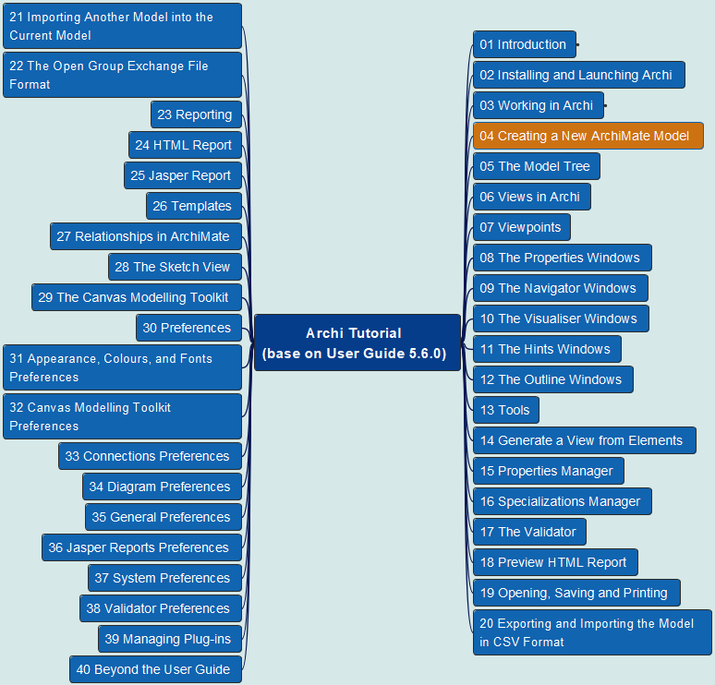
Archi® Tool Tutorial base on User Guide 5.6.0
005
CH04 Creating a New ArchiMate Model

Slide 6
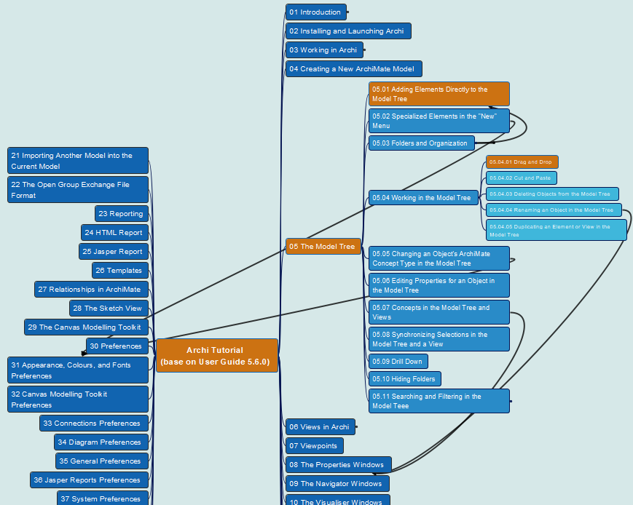
Archi® Tool Tutorial base on User Guide 5.6.0
006
CH05 Model Tree
05.01 Adding Elements to the Model Tree
05.04.01 Drag and Drop

Slide 7
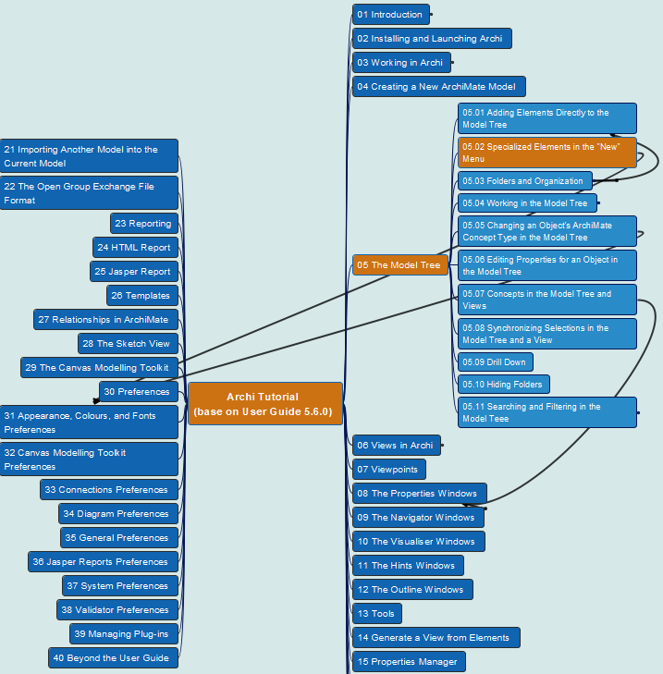
Archi® Tool Tutorial base on User Guide 5.6.0
007
CH05 Model Tree
05.02 Specialized Elements in the “New” Menu

Slide 8
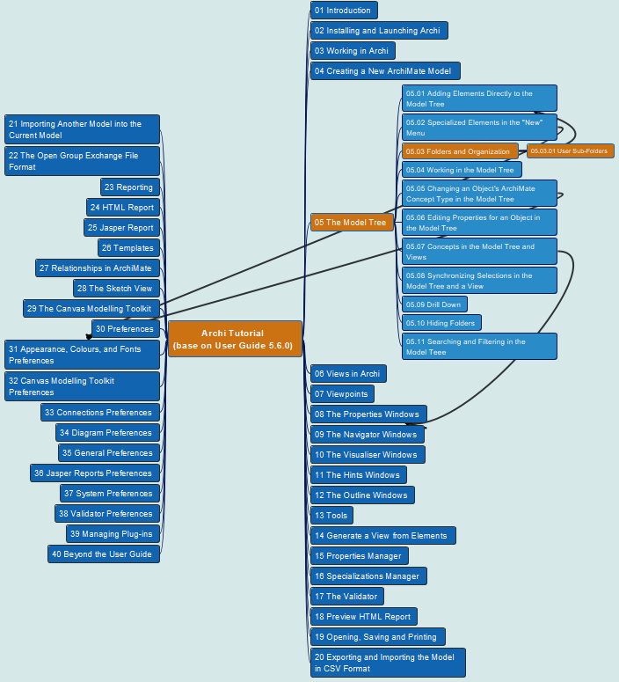
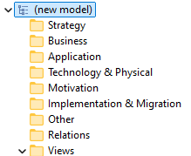
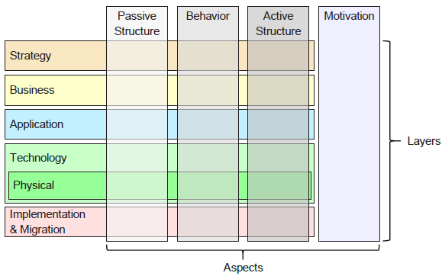
Archi® Tool Tutorial base on User Guide 5.6.0
008
CH05 Model Tree
05.03 Folders and Organization
05.03.01 User Sub-Folders

Slide 9
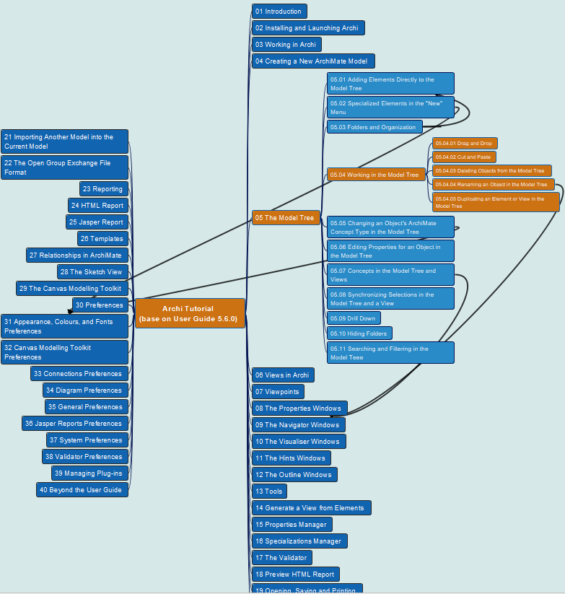
Archi® Tool Tutorial base on User Guide 5.6.0
009
CH05 Model Tree
05.04 Working in Model Tree
05.04.01 Drag and Drop
05.04.02 Cut and Paste
05.04.03 Deleting Objects from the Model Tree
05.04.04 Renaming an Object in the Model Tree
05.14.05 Duplicating an Element or View in the Model Tree

Slide 10
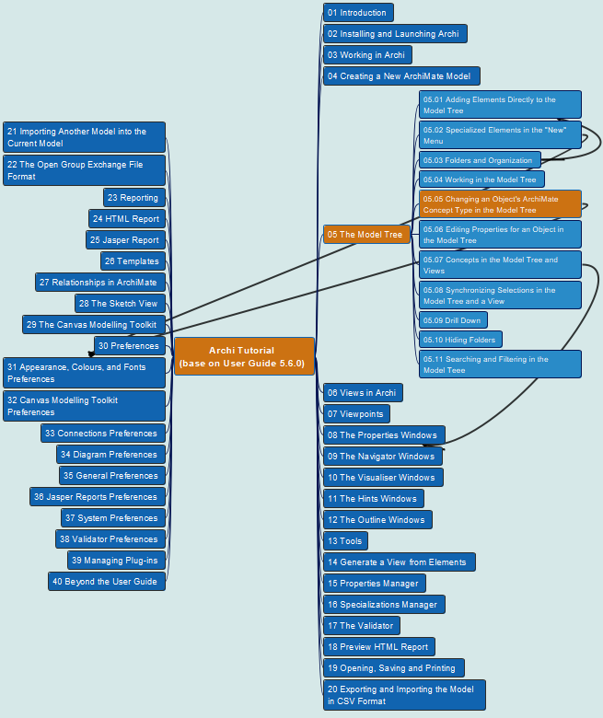
Archi® Tool Tutorial base on User Guide 5.6.0
010
CH05 Model Tree
05.05 Changing an Object’s ArchiMate Concept Type in the Model Tree

Slide 11

Archi® Tool Tutorial base on User Guide 5.6.0
011
CH05 Model Tree
05.06 Editing Properties for an Object in the Model Tree

Slide 12
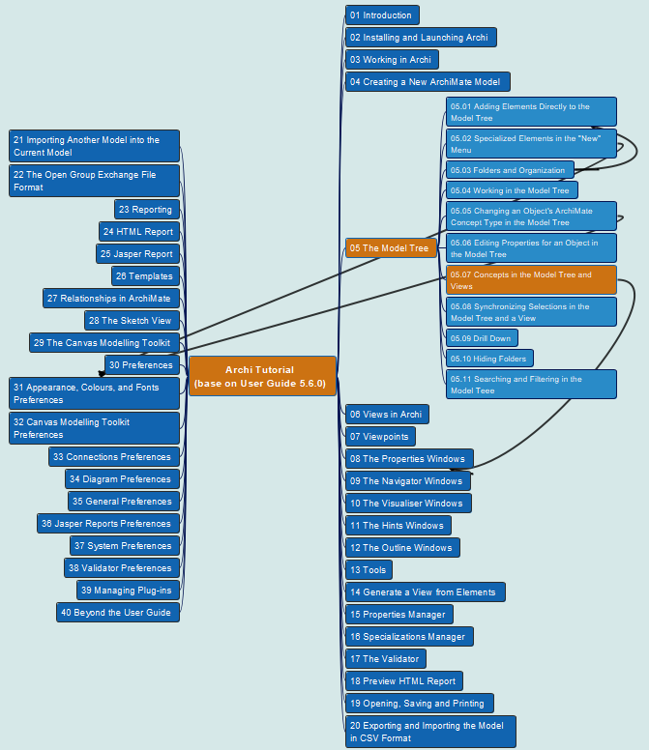
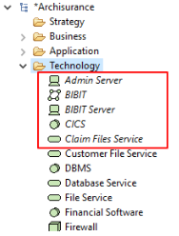
Archi® Tool Tutorial base on User Guide 5.6.0
012
CH05 Model Tree
05.07 Concepts in the Model Tree and Views

Slide 13

Archi® Tool Tutorial base on User Guide 5.6.0
013
CH05 Model Tree
05.08 Synchronizing Selections in the Model Tree and a View

Slide 14
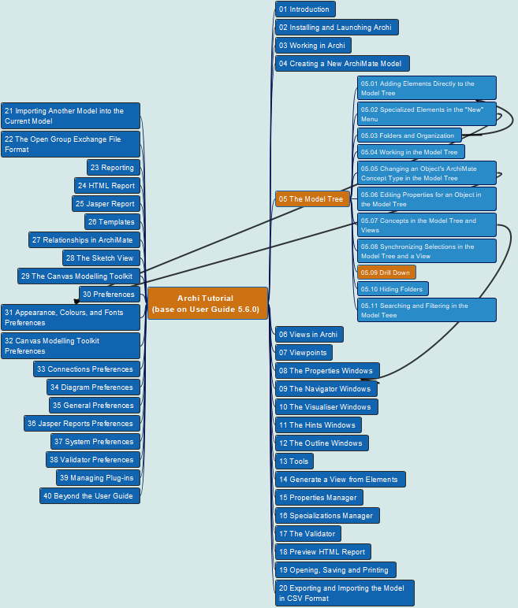

Archi® Tool Tutorial base on User Guide 5.6.0
014
CH05 Model Tree
05.09 Drill Down

Slide 15



Archi® Tool Tutorial base on User Guide 5.6.0
015
CH05 Model Tree
05.10 Hiding Folders

Slide 16
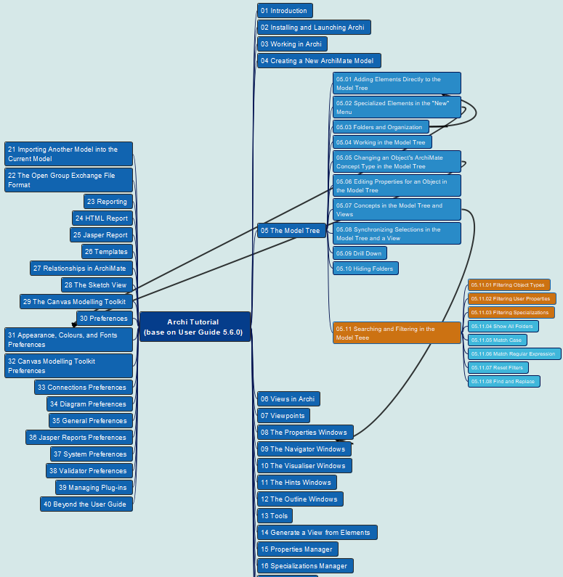
Archi® Tool Tutorial base on User Guide 5.6.0
016
CH05 Model Tree
05.11 Searching and Filtering in the Model Tree
05.11.01 Filtering Object Types
05.11.02 Filtering User Properties
05.11.03 Filtering Specializations

Slide 17
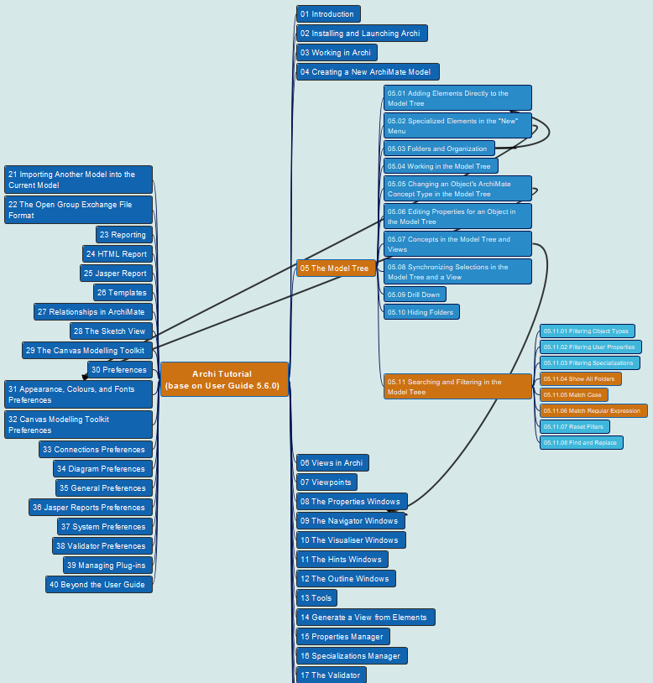
Archi® Tool Tutorial base on User Guide 5.6.0
017
CH05 Model Tree
05.11 Searching and Filtering in the Model Tree
05.11.04 Show All Folders
05.11.05 Match Case
05.11.06 Match Regular Expression

Slide 18
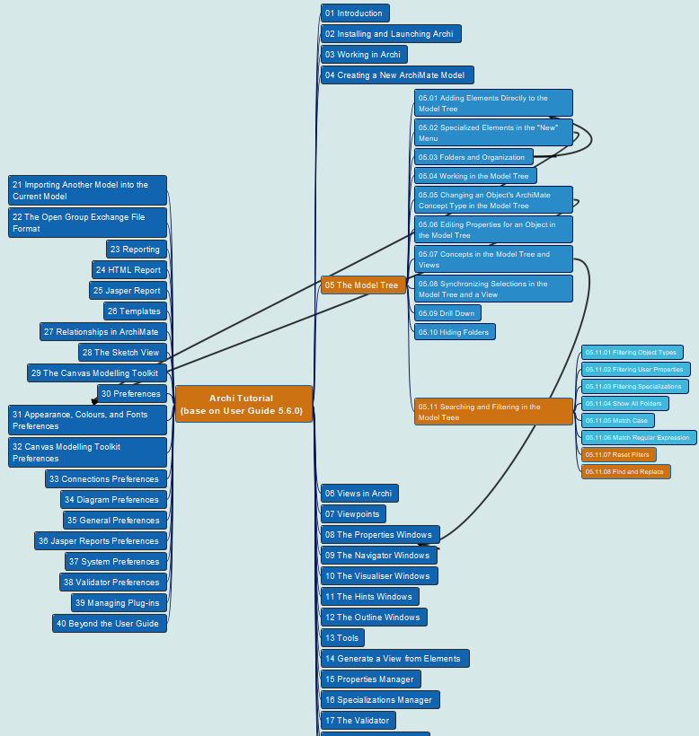
Archi® Tool Tutorial base on User Guide 5.6.0
018
CH05 Model Tree
05.11 Searching and Filtering in the Model Tree
05.11.07 Reset Filters
05.11.08 Find and Replace

Slide 19
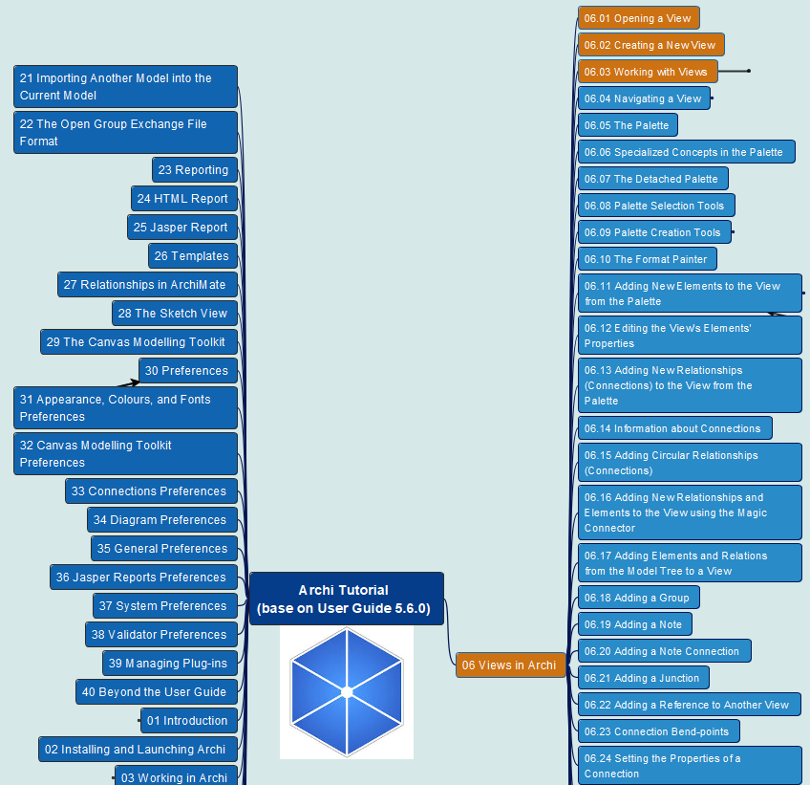
Archi® Tool Tutorial base on User Guide 5.6.0
019
CH06 Archi Views
06.01 Opening a View
06.02 Creating a New View
06.03 Working with Views

Slide 20
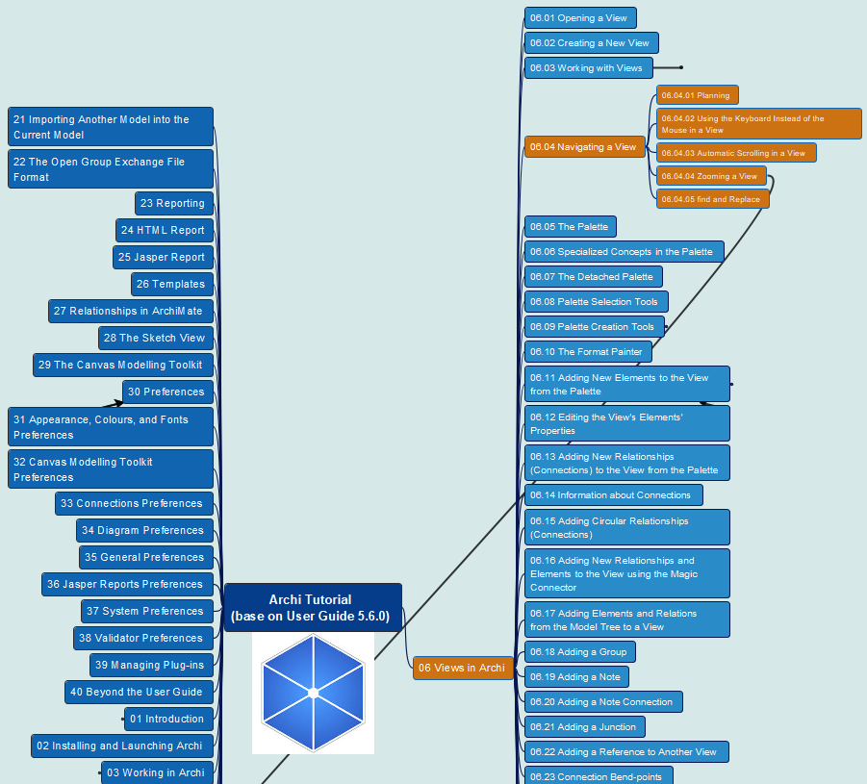
Archi® Tool Tutorial base on User Guide 5.6.0
020
CH06 Archi Views
06.04 Navigating a View
Panning
Using Keyboard
Auto-Scrolling
Zooming
Find and Replace

Slide 21
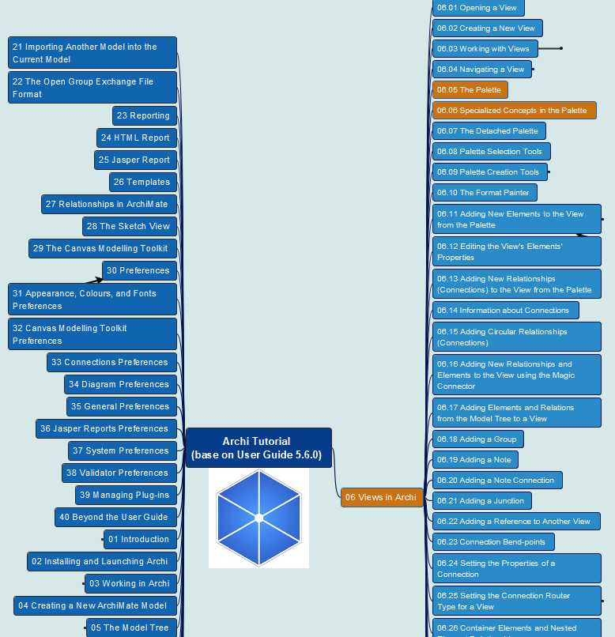
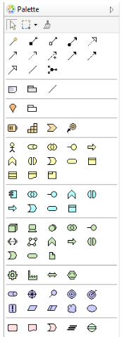
Archi® Tool Tutorial base on User Guide 5.6.0
021
CH06 Archi Views
06.05 The Palette
06.06 Specialized Concepts in Palette

Slide 22
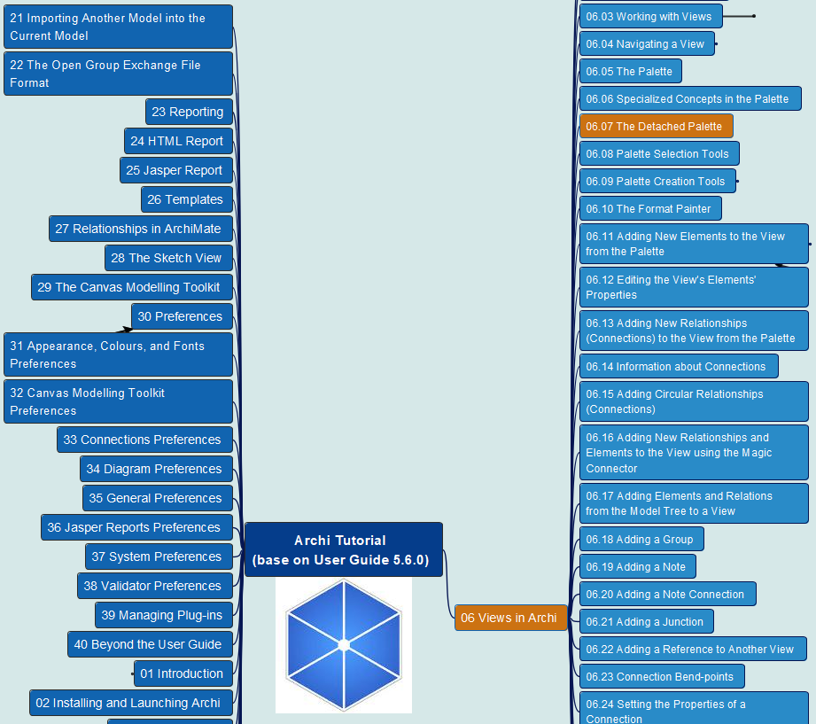
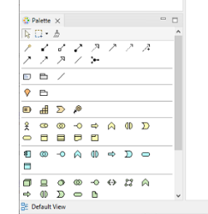
Archi® Tool Tutorial base on User Guide 5.6.0
022
CH06 Archi Views
06.07 The Detached Palette

Slide 23
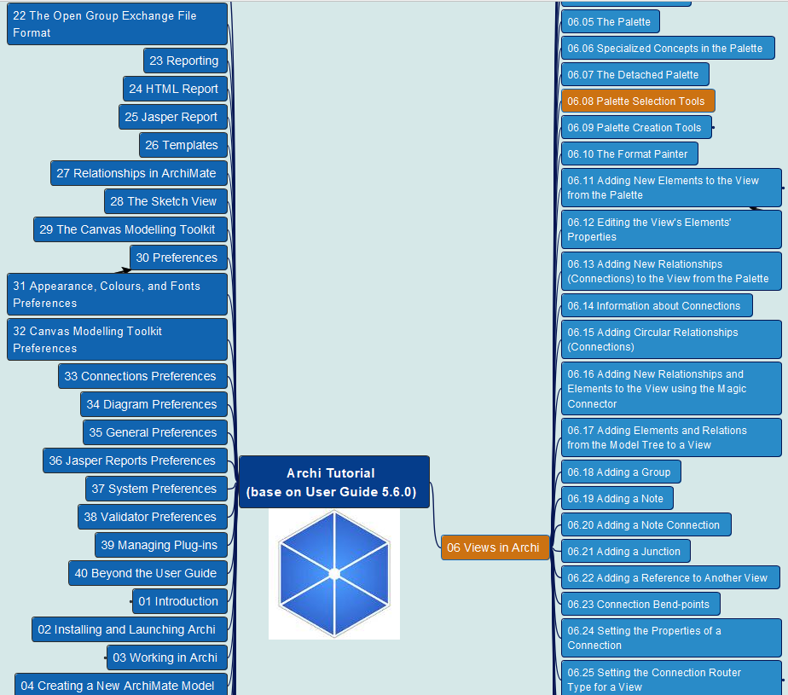
Archi® Tool Tutorial base on User Guide 5.6.0
023
CH06 Archi Views
06.08 Palette Selection Tools

Slide 24
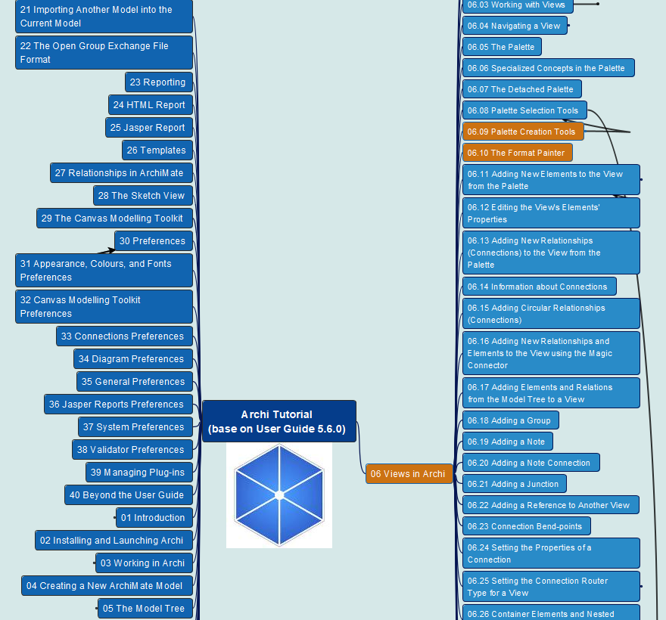
Archi® Tool Tutorial base on User Guide 5.6.0
024
CH06 Archi Views
06.09 Palette Creation Tools
Relations
Notes and Groups
ArchiMate Elements
06.10 The Format Painter

Slide 25
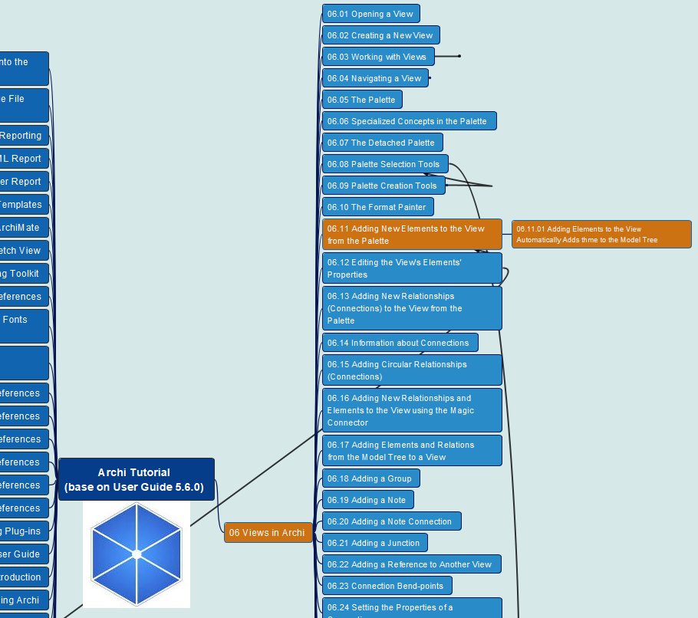
Archi® Tool Tutorial base on User Guide 5.6.0
025
CH06 Archi Views
06.11 Adding New Elements to the View from the Palette

Slide 26
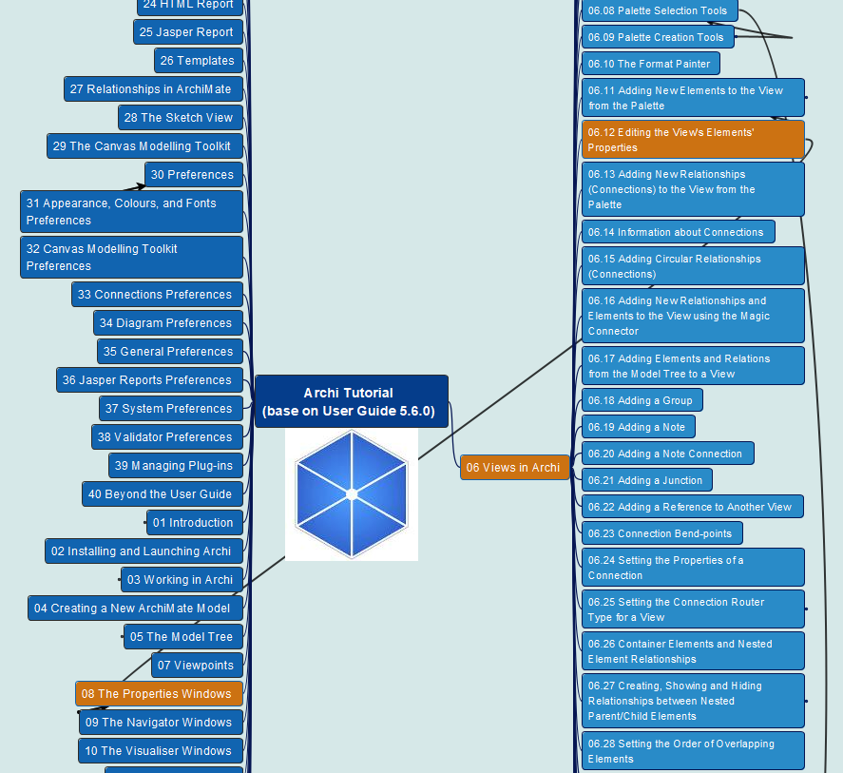
Archi® Tool Tutorial base on User Guide 5.6.0
026
CH06 Archi Views
06.12 Editing the View’s Elements’ Properties

Slide 27
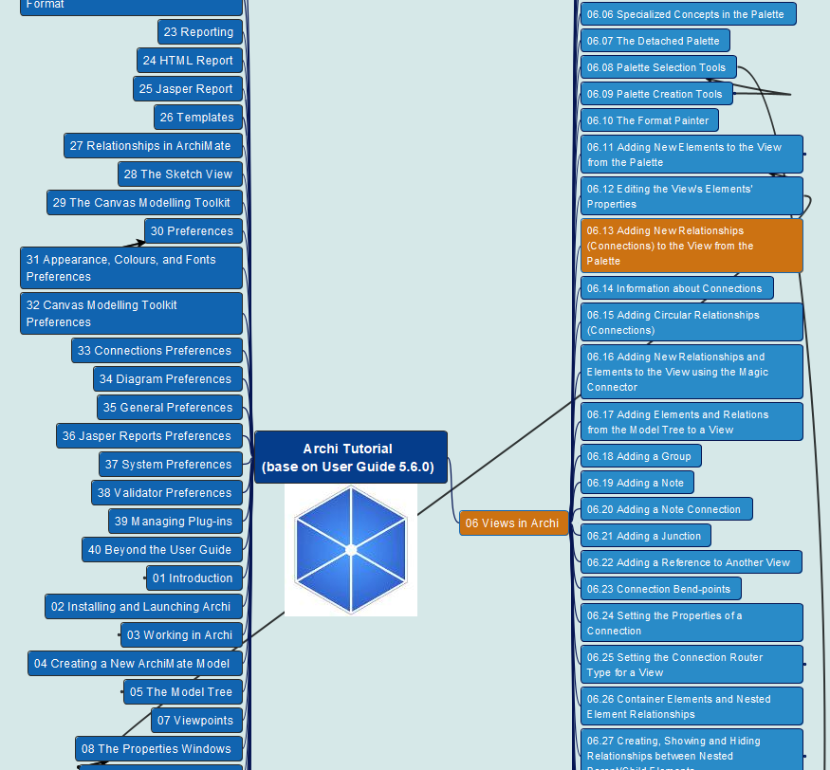
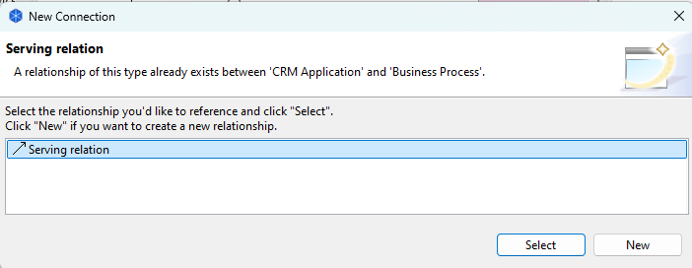
Archi® Tool Tutorial base on User Guide 5.6.0
027
CH06 Archi Views
06.13 Adding New Relationships (Connections) to the View from the Palette

Slide 28
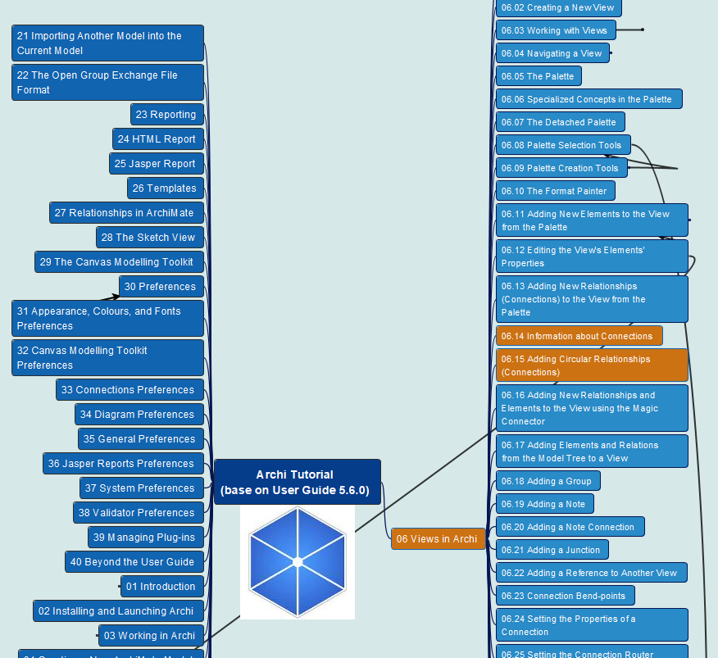
Archi® Tool Tutorial base on User Guide 5.6.0
028
CH06 Archi Views
06.14 Information about Connections
06.15 Adding Circular Relationships (Connections)

Slide 29
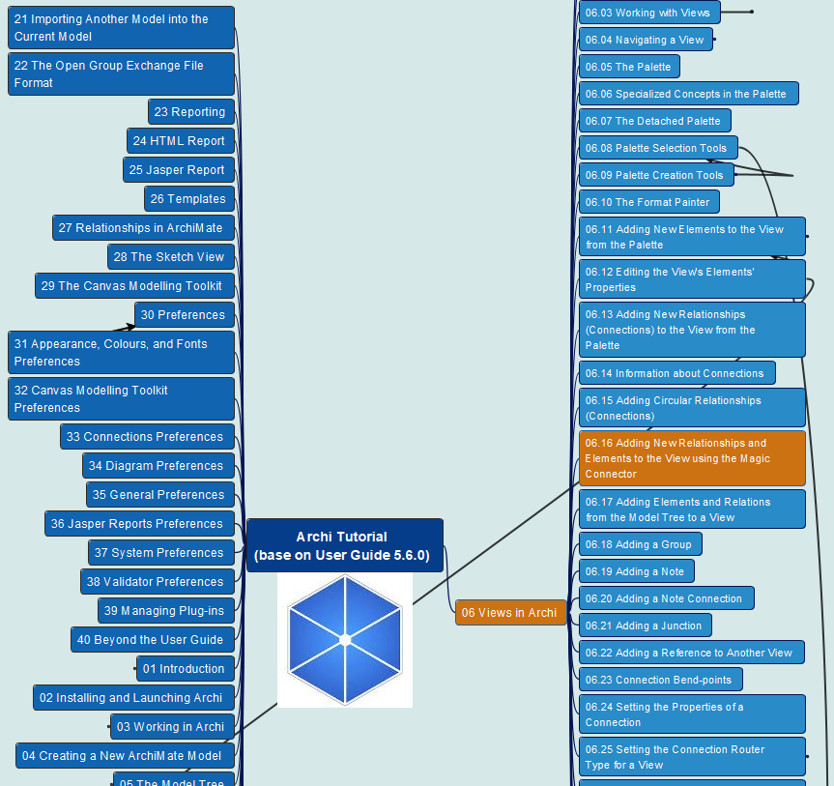
Archi® Tool Tutorial base on User Guide 5.6.0
029
CH06 Archi Views
06.16 Adding New Relationships and Elements to the View using the Magic Connector

Slide 30
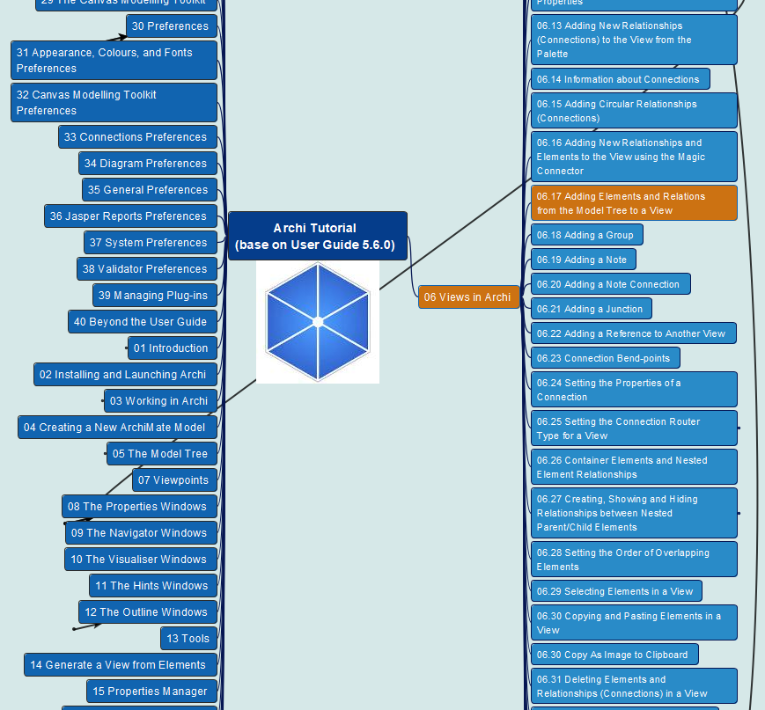
Archi® Tool Tutorial base on User Guide 5.6.0
030
CH06 Archi Views
06.17 Adding Elements and Relations from the Model Tree to a View

Slide 31
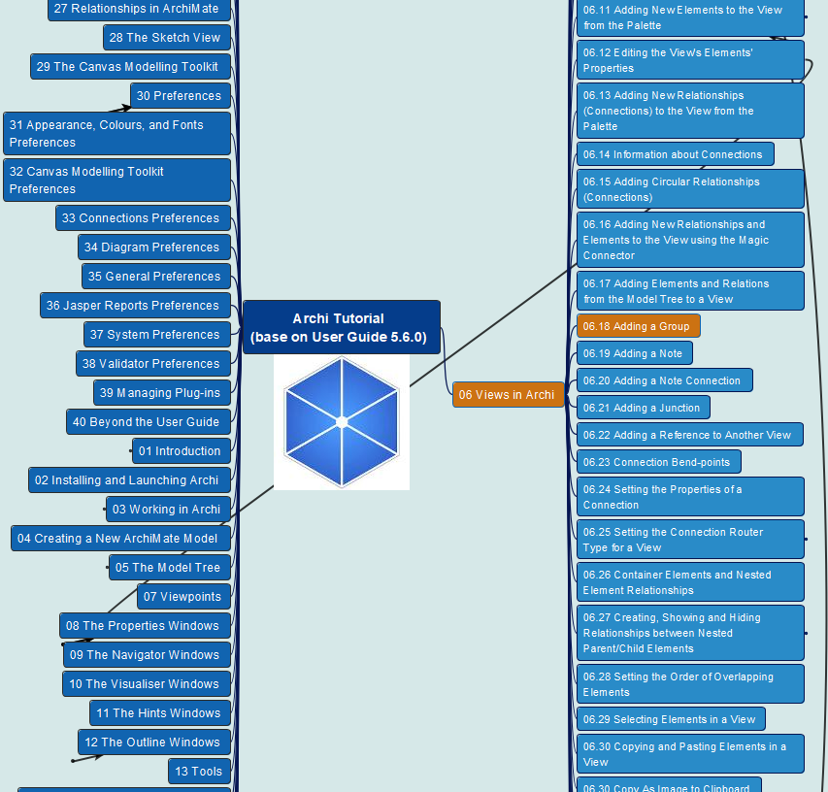
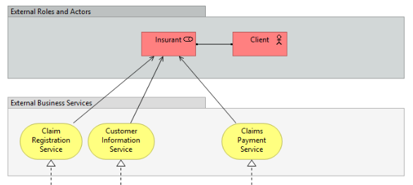
Archi® Tool Tutorial base on User Guide 5.6.0
031
CH06 Archi Views
06.18 Adding a Group

Slide 32
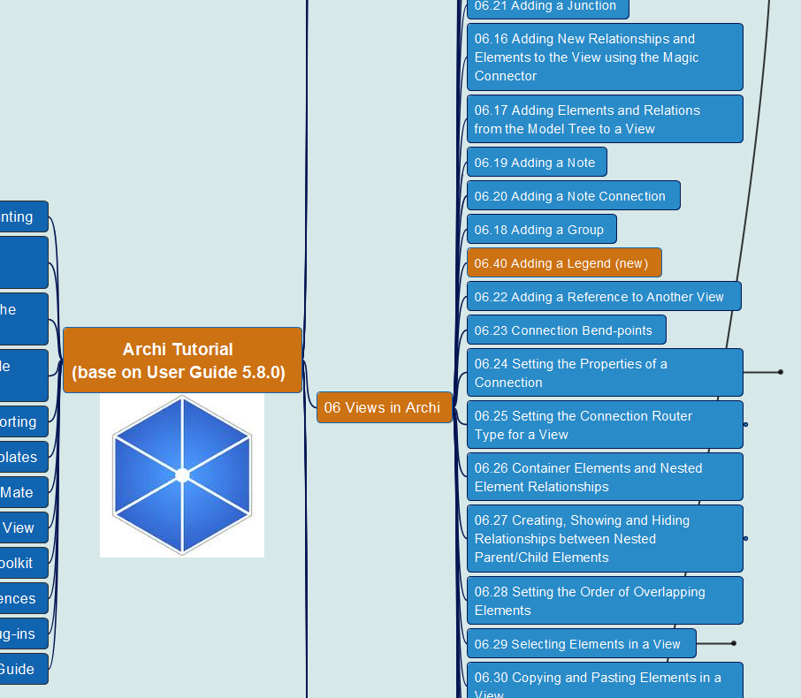
Archi® Tool Tutorial base on User Guide 5.8.0
090
06.40 Adding a Legend
(new in v5.8.0)

Slide 33
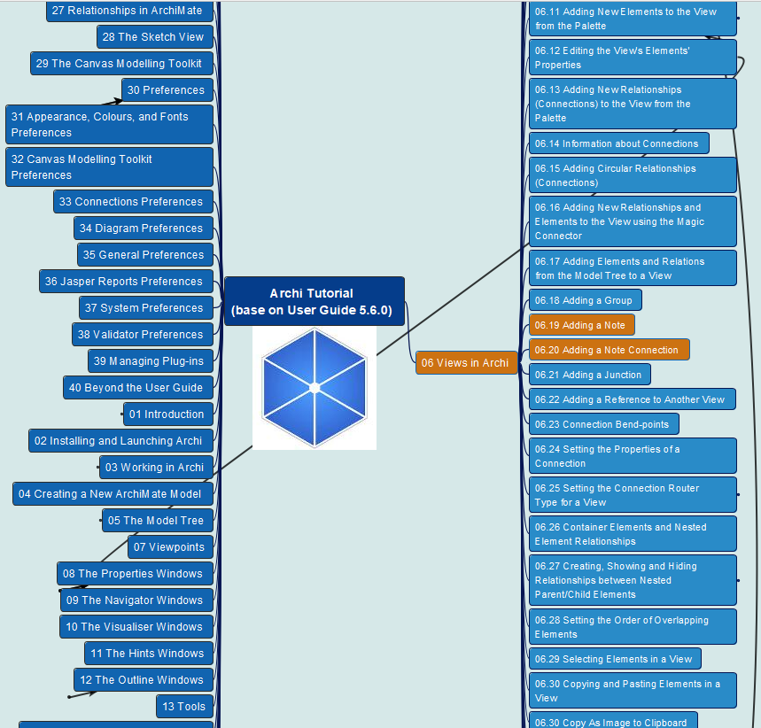
Archi® Tool Tutorial base on User Guide 5.6.0
032
CH06 Archi Views
06.19 Adding a Note
06.20 Adding a Note Connection

Slide 34
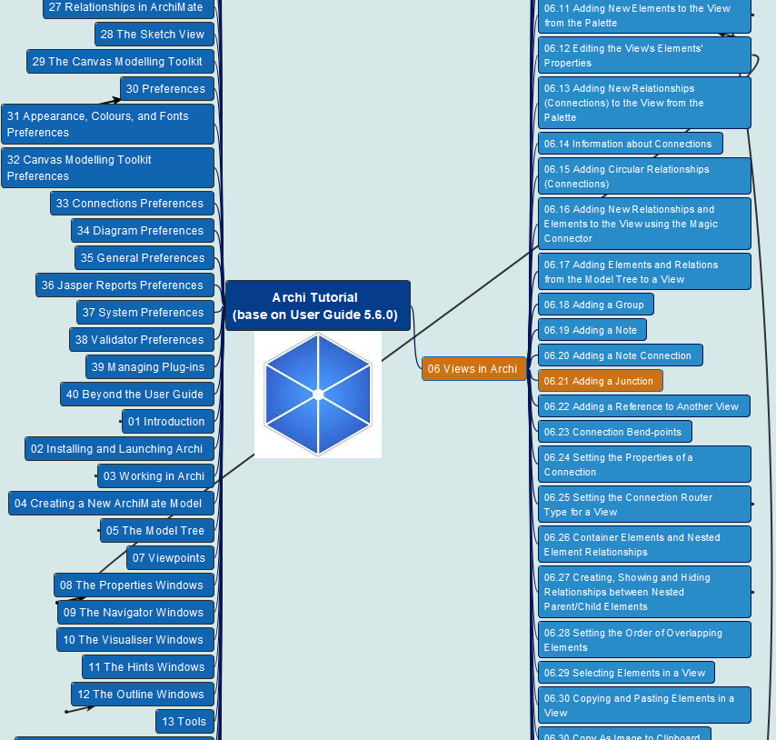
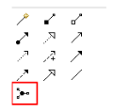
Archi® Tool Tutorial base on User Guide 5.6.0
033
CH06 Archi Views
06.21 Adding a Junction

Slide 35

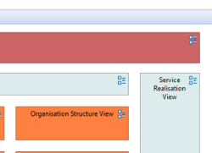
Archi® Tool Tutorial base on User Guide 5.6.0
034
CH06 Archi Views
06.22 Adding a Reference to Another View

Slide 36
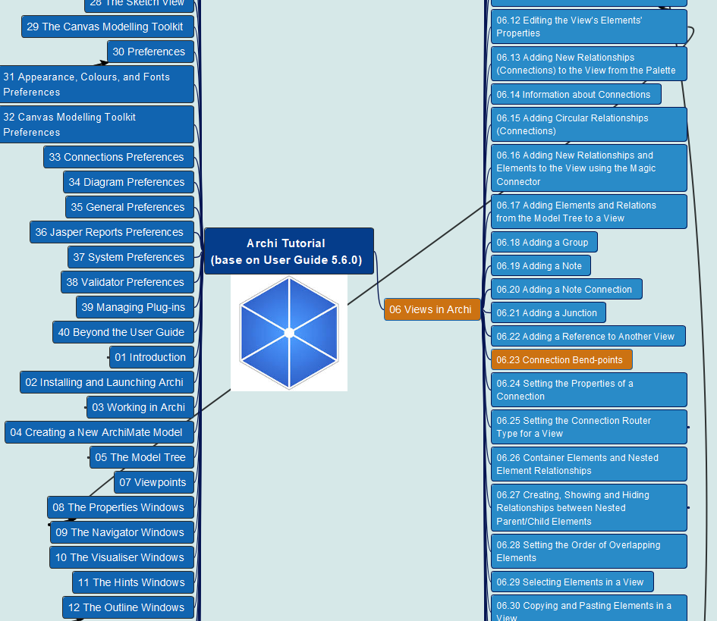

Archi® Tool Tutorial base on User Guide 5.6.0
035
CH06 Archi Views
06.23 Connection Bend-points

Slide 37
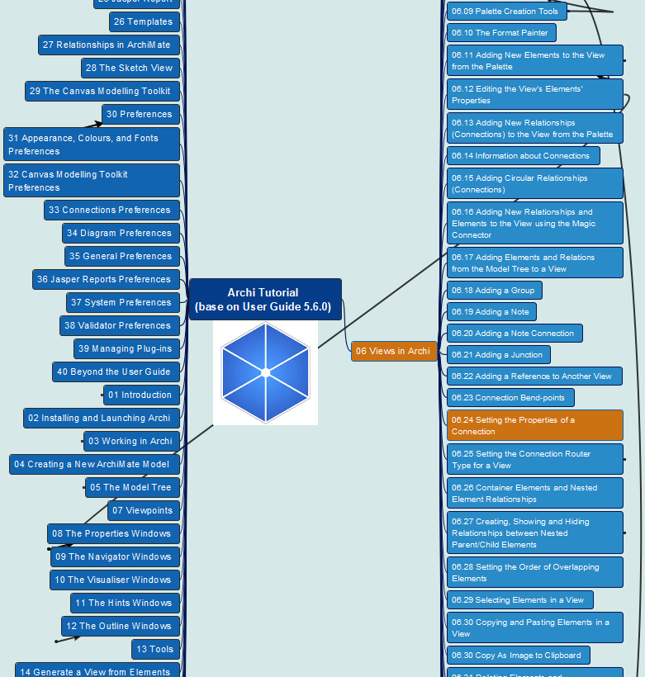
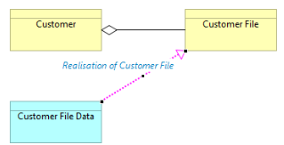
Archi® Tool Tutorial base on User Guide 5.6.0
036
CH06 Archi Views
06.24 Setting the Properties of a Connection

Slide 38
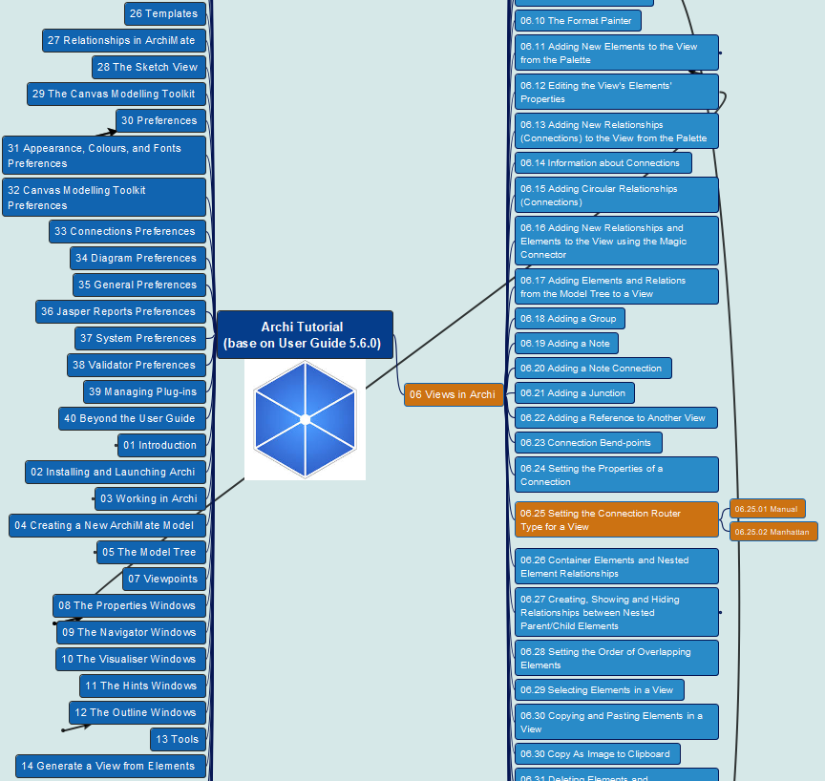
Archi® Tool Tutorial base on User Guide 5.6.0
037
CH06 Archi Views
06.25 Setting the Connection Router Type for a View
Manual
Manhattan (Manhattan routing)

Slide 39
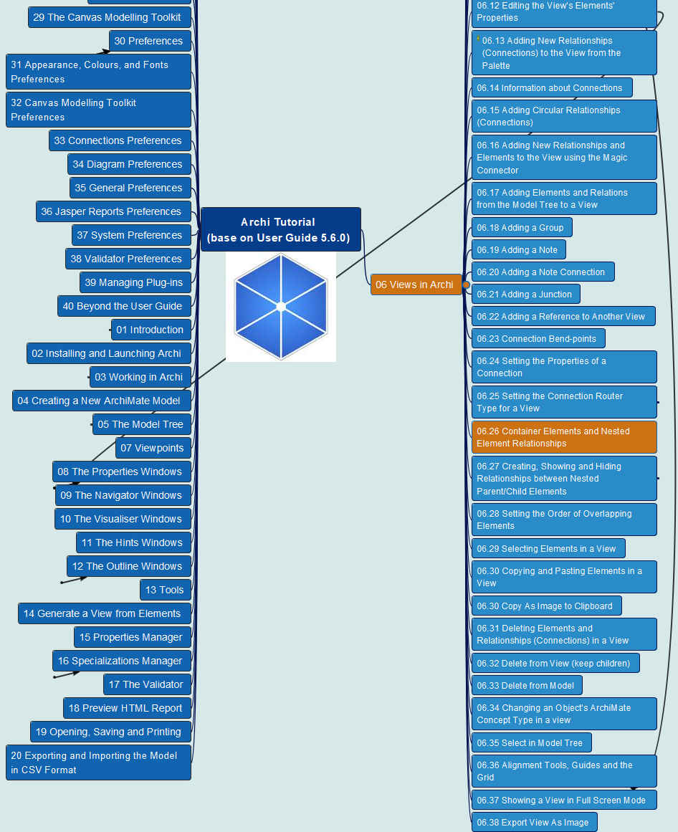
Archi® Tool Tutorial base on User Guide 5.6.0
038
CH06 Archi Views
06.26 Container Elements and Nested Element Relationships

Slide 40
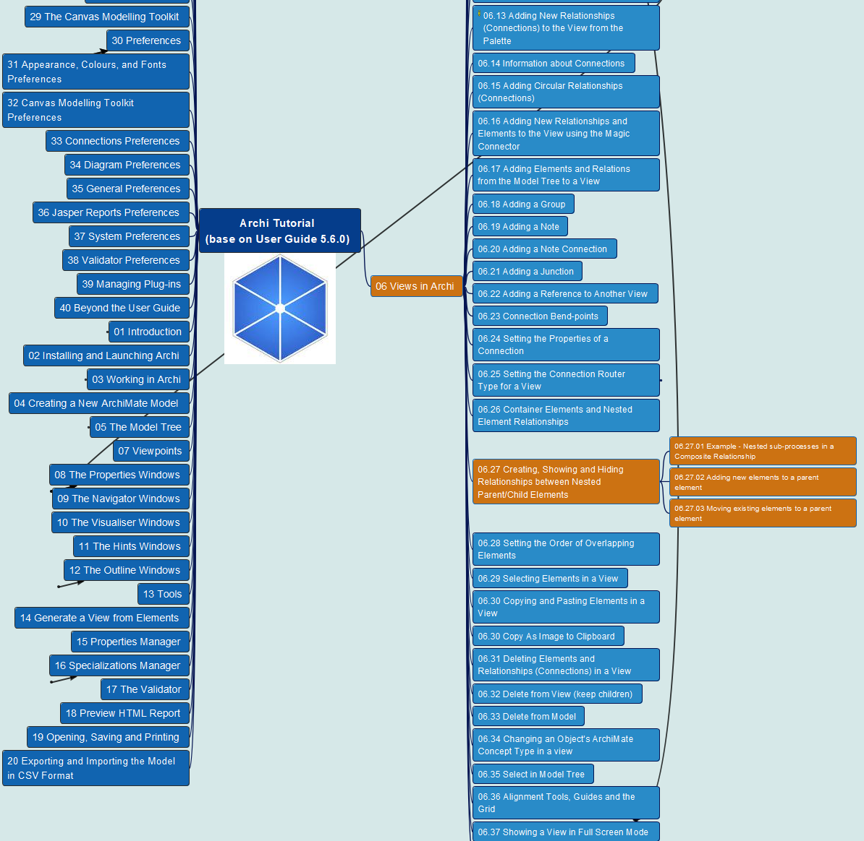
Archi® Tool Tutorial base on User Guide 5.6.0
039
CH06 Archi Views
06.27 Creating, Showing and Hiding Relationships between Nested Parent/Child Elements

Slide 41
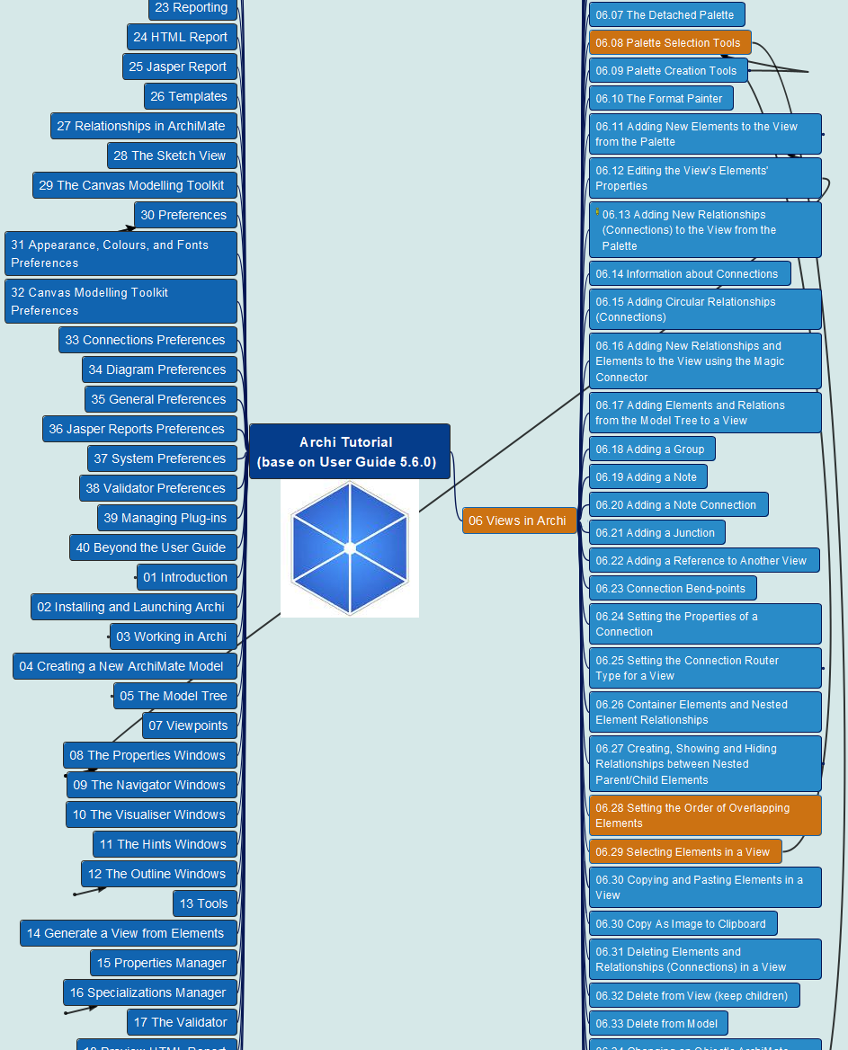
Archi® Tool Tutorial base on User Guide 5.6.0
040
CH06 Archi Views
06.28 Setting the Order of Overlapping Elements
06.29 Selecting Elements in a View

Slide 42
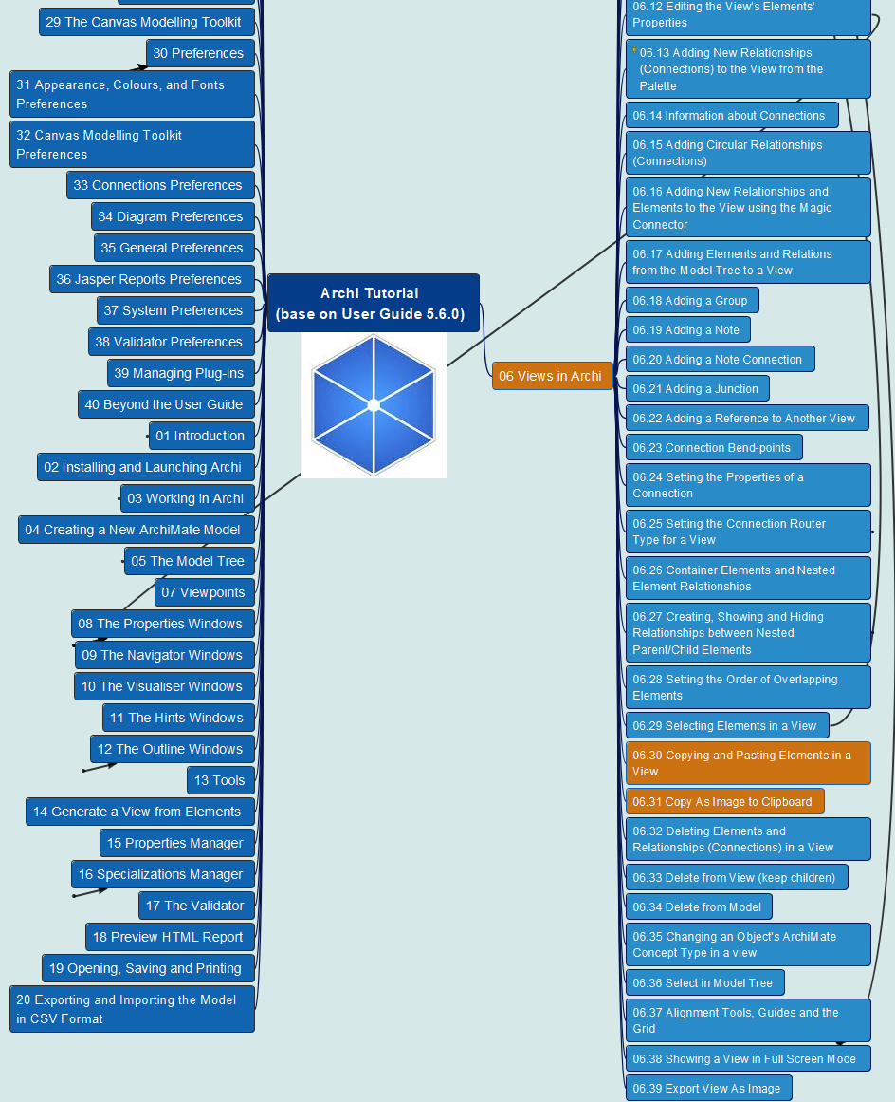
Archi® Tool Tutorial base on User Guide 5.6.0
041
CH06 Archi Views
06.30 Copying and Pasting Elements in a View
06.31 Copy As Image to Clipboard (Ctrl-Shift-C)

Slide 43


Archi® Tool Tutorial base on User Guide 5.6.0
042
CH06 Archi Views
06.32 Delete Elements and Relationships in a View
06.33 Delete from View (keep children)
06.34 Delete from Model

Slide 44

Archi® Tool Tutorial base on User Guide 5.6.0
043
CH06 Archi Views
06.35 Changing an Object’s ArchiMate Concept Type in a View
06.36 Select in Model Tree

Slide 45

Archi® Tool Tutorial base on User Guide 5.8.0
091
06.41 Select Objects of Same Type
(new in v5.8.0)

Slide 46


Archi® Tool Tutorial base on User Guide 5.6.0
044
CH06 Archi Views
06.37 Alignment Tools, Guides and the Grid

Slide 47

Archi® Tool Tutorial base on User Guide 5.6.0
045
CH06 Archi Views
06.38 Showing a View in Full Screen Mode
06.39 Export View As Image

Slide 48


Archi® Tool Tutorial base on User Guide 5.6.0
046
CH07 Viewpoints
07.01 Setting the Viewpoints
Every Viewpoint is a View from Point

Slide 49



Archi® Tool Tutorial base on User Guide 5.6.0
047
CH08 Properties
08.01 Model Properties

Slide 50


Archi® Tool Tutorial base on User Guide 5.6.0
048
CH08 Properties
08.02 Element Properties

Slide 51



Archi® Tool Tutorial base on User Guide 5.6.0
049
CH08 Properties
08.03 Element Appearance Properties
Appearance
Label

Slide 52



Archi® Tool Tutorial base on User Guide 5.6.0
050
CH08 Properties
08.03 Element Appearance Properties
Figure
Image

Slide 53


Archi® Tool Tutorial base on User Guide 5.6.0
051
CH08 Properties
08.04 Relationship Properties

Slide 54

Archi® Tool Tutorial base on User Guide 5.6.0
052
CH08 Properties
08.05 Relationship Connection Appearance Properties

Slide 55

Archi® Tool Tutorial base on User Guide 5.6.0
053
CH08 Properties
08.06 View Properties
08.07 View Reference Properties

Slide 56


Archi® Tool Tutorial base on User Guide 5.6.0
054
CH08 Properties
08.08 Folder Properties

Slide 57


Archi® Tool Tutorial base on User Guide 5.6.0
055
CH08 Properties
08.09 Note Properties

Slide 58


Archi® Tool Tutorial base on User Guide 5.6.0
056
CH08 Properties
08.10 Connection Properties

Slide 59


Archi® Tool Tutorial base on User Guide 5.6.0
057
CH08 Properties
08.11 Group Properties

Slide 60


Archi® Tool Tutorial base on User Guide 5.6.0
058
CH08 Properties
08.12 User Properties

Slide 61

Archi® Tool Tutorial base on User Guide 5.6.0
059
CH09 The Navigator Window

Slide 62


Archi® Tool Tutorial base on User Guide 5.6.0
060
CH10 The Visualizer Window

Slide 63


Archi® Tool Tutorial base on User Guide 5.6.0
061
CH11 The Hints Window

Slide 64


Archi® Tool Tutorial base on User Guide 5.6.0
062
CH12 The Outline Window

Slide 65


Archi® Tool Tutorial base on User Guide 5.6.0
063
CH13 Tools (Menu)
Generate View
Properties Manager
Specialization Manager

Slide 66

Archi® Tool Tutorial base on User Guide 5.6.0
064
CH13 Tools (Menu)
The Validator
Preview HTML Report
… More

Slide 67

Archi® Tool Tutorial base on User Guide 5.6.0
065
CH14 Opening, Saving and Printing

Slide 68


Archi® Tool Tutorial base on User Guide 5.6.0
066
CH15 Exporting and Importing the Model in CSV Format

Slide 69

Archi® Tool Tutorial base on User Guide 5.6.0
067
CH16 Importing Another Model into the Current Model

Slide 70

Archi® Tool Tutorial base on User Guide 5.6.0
068
CH17 The Open Group Exchange File Format

Slide 71


Archi® Tool Tutorial base on User Guide 5.6.0
069
CH18 Reporting
18.01 HTML Report

Slide 72


Archi® Tool Tutorial base on User Guide 5.6.0
070
CH18 Reporting
18.02 Jasper Report

Slide 73

Archi® Tool Tutorial base on User Guide 5.6.0
071
CH19 Templates
19.01 Creating a New Template
19.02 Creating a New Model from a Template
19.03 Managing your Templates

Slide 74


Archi® Tool Tutorial base on User Guide 5.6.0
072
CH20 Relationships in ArchiMate

Slide 75


Archi® Tool Tutorial base on User Guide 5.6.0
073
CH21 The Sketch View

Slide 76

Archi® Tool Tutorial base on User Guide 5.6.0
074
CH22 Canvas Modeling Toolkit
22.01 Getting Started

Slide 77

Archi® Tool Tutorial base on User Guide 5.6.0
075
CH22 Canvas Modeling Toolkit
22.02 Getting into the Details
For icon download, refer to https://www.iconfinder.com/

Slide 78

Archi® Tool Tutorial base on User Guide 5.6.0
076
CH22 Canvas Modeling Toolkit
22.03 Canvas Block

Slide 79


Archi® Tool Tutorial base on User Guide 5.6.0
077
CH22 Canvas Modeling Toolkit
22.04 Canvas Sticky

Slide 80


Archi® Tool Tutorial base on User Guide 5.6.0
078
CH22 Canvas Modeling Toolkit
22.05 Canvas Image

Slide 81


Archi® Tool Tutorial base on User Guide 5.6.0
079
CH22 Canvas Modeling Toolkit
22.06
Canvas Connection

Slide 82

Archi® Tool Tutorial base on User Guide 5.6.0
080
CH22 Canvas Modeling Toolkit
22.07 Adding Images to Objects

Slide 83

Archi® Tool Tutorial base on User Guide 5.6.0
081
CH22 Canvas Modeling Toolkit
22.08
Saving a Canvas as a Template

Slide 84

Archi® Tool Tutorial base on User Guide 5.6.0
082
CH22 Canvas Modeling Toolkit
22.09 Creating a New Canvas from a Template
22.10 Managing your Canvas Templates

Slide 85

Archi® Tool Tutorial base on User Guide 5.6.0
083
CH23 Preferences
23.01 Appearance
23.02 Canvas Toolkit

Slide 86

Archi® Tool Tutorial base on User Guide 5.6.0
084
CH23 Preferences
23.03 Connections

Slide 87

Archi® Tool Tutorial base on User Guide 5.6.0
085
CH23 Preferences
23.04 Diagram

Slide 88

Archi® Tool Tutorial base on User Guide 5.6.0
086
CH23 Preferences
23.05 General

Slide 89

Archi® Tool Tutorial base on User Guide 5.6.0
087
CH23 Preferences
23.06 Jasper Reports
23.07 System
23.08 Validator

Slide 90

Archi® Tool Tutorial base on User Guide 5.6.0
088
CH24 Managing Plug-ins
24.01 Plug-ins Manager
24.02 Manual Install

Slide 91


Archi® Tool Tutorial base on User Guide 5.6.0
089
CH25
Beyond
the User Guide

