Slide 1

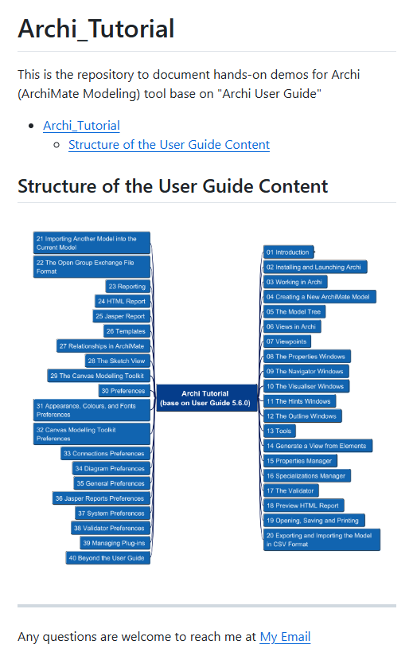


Archi® Tool Tutorial base on User Guide 5.6.0
001
Opening

Slide 2
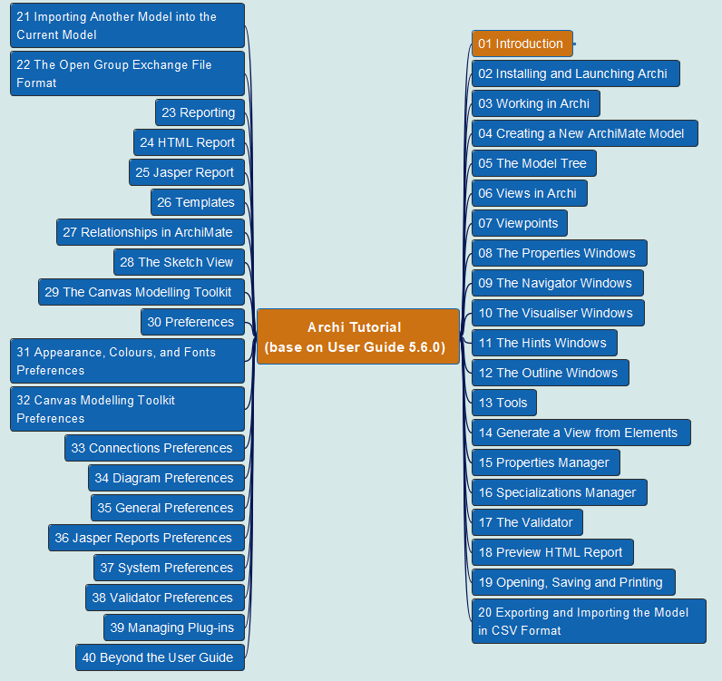
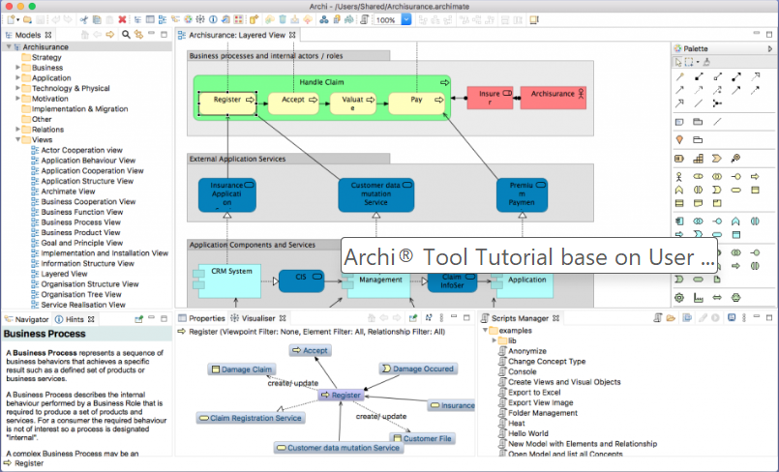
Archi® Tool Tutorial base on User Guide 5.6.0
002
CH01 Introduction

