Slide 1


jArchi - Archi Scripting
01
Archi Plug-In Tutorials

Slide 2
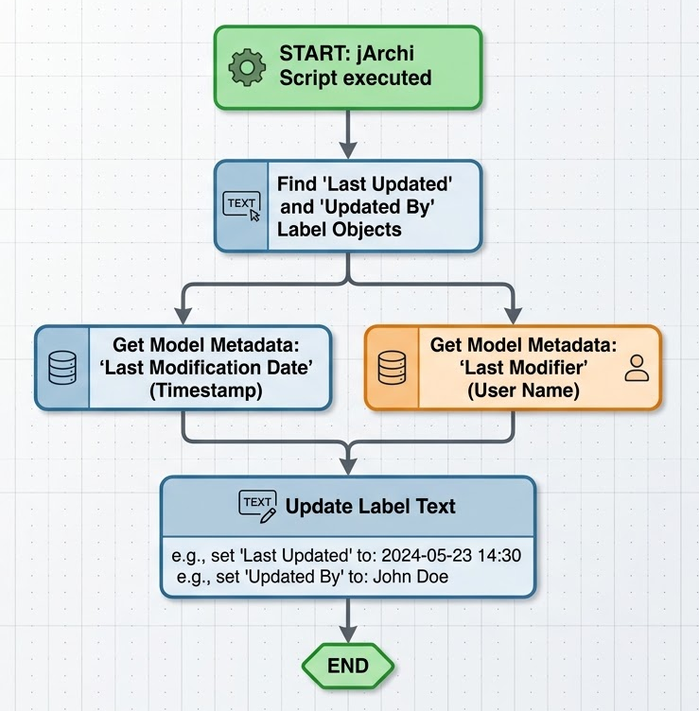
jArchi - Archi Scripting
Archi Plug-In
Add refreshed
'Last Updated at’
And
'Last Updated by’
in View label
https://github.com/yasenstar/Archi_Scripts

Slide 3


