Slide 1
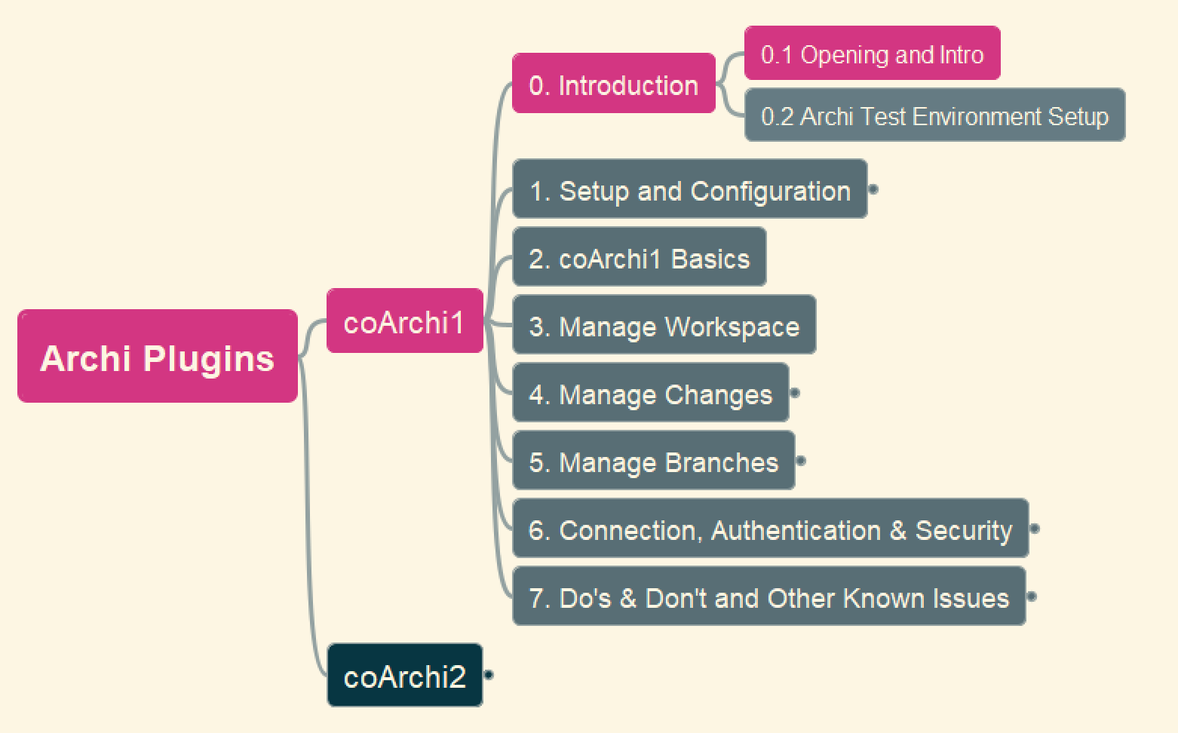


coArchi1 - Collaboration Plugin
01
Archi Plug-In Tutorials

Slide 2
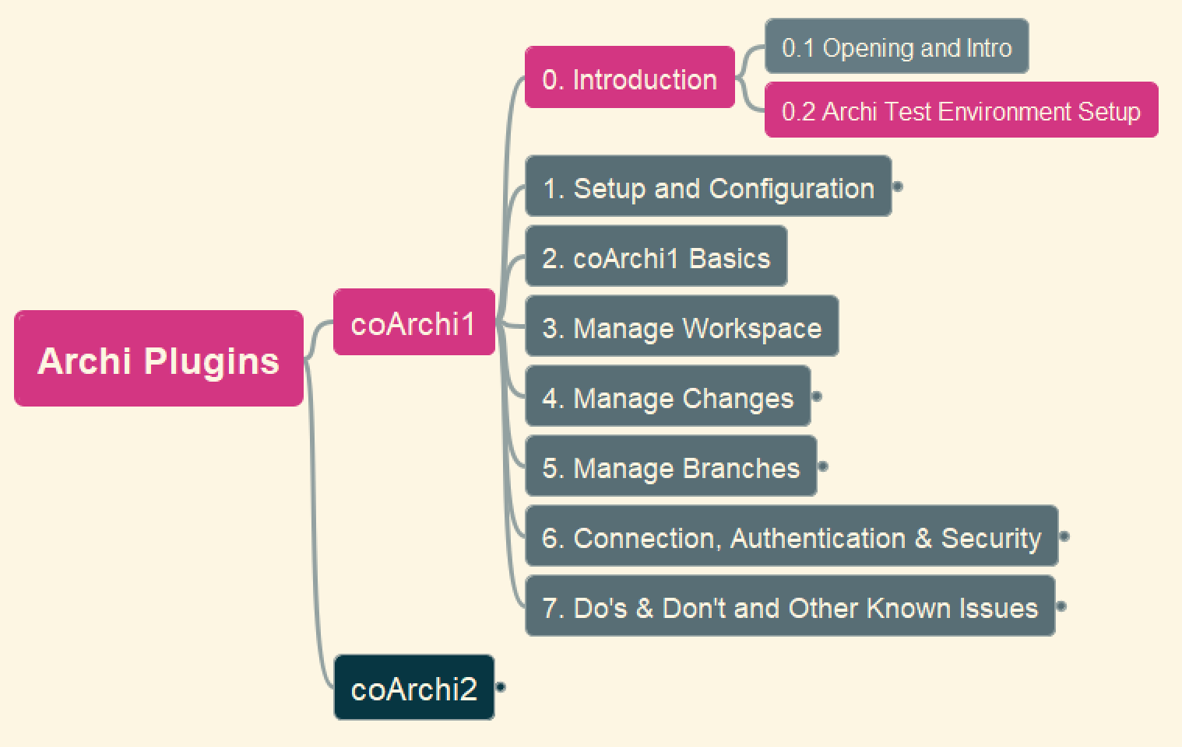

coArchi1 – 0. Introduction - 0.2 Archi Test Environments
02
Archi Plug-In Tutorials

Slide 3
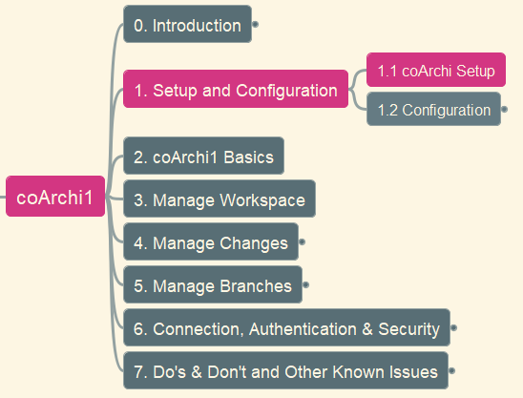
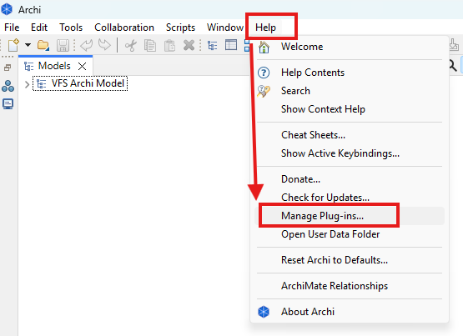
coArchi1 – 1. Setup & Config - 1.1 coArchi1 Setup
03
Archi Plug-In Tutorials

Slide 4
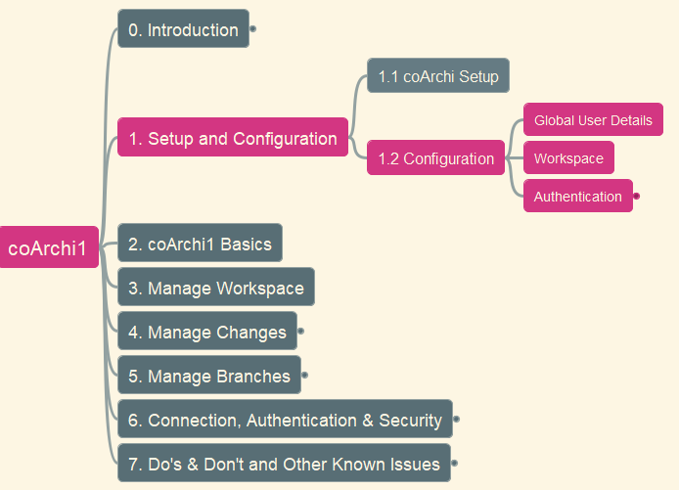
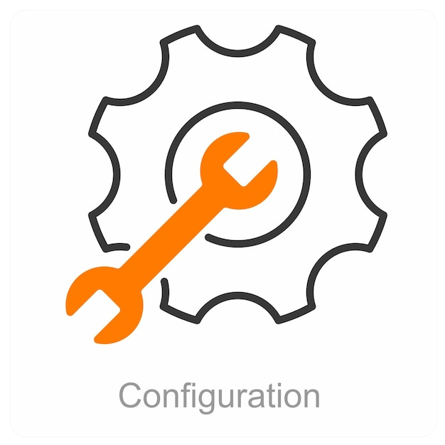
coArchi1 – 1. Setup & Config - 1.2 coArchi1 Configuration
04
Archi Plug-In Tutorials

Slide 5
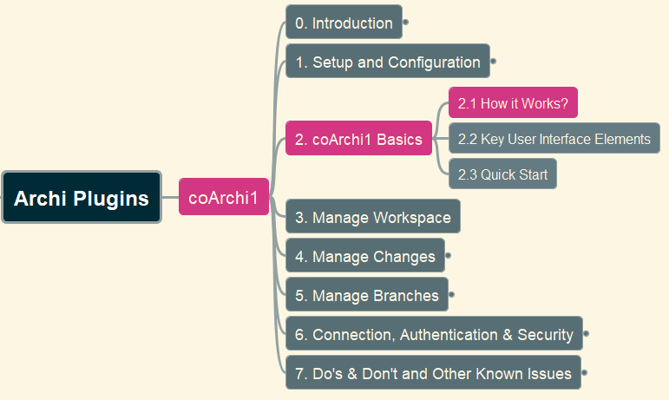

coArchi1 – 2. coArchi1 Basics - 2.1 How it Works?
05
Archi Plug-In Tutorials

Slide 6
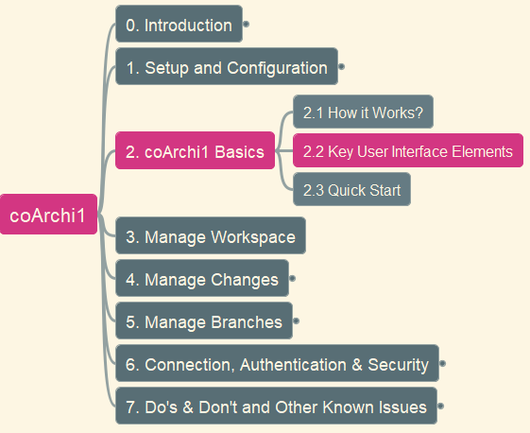
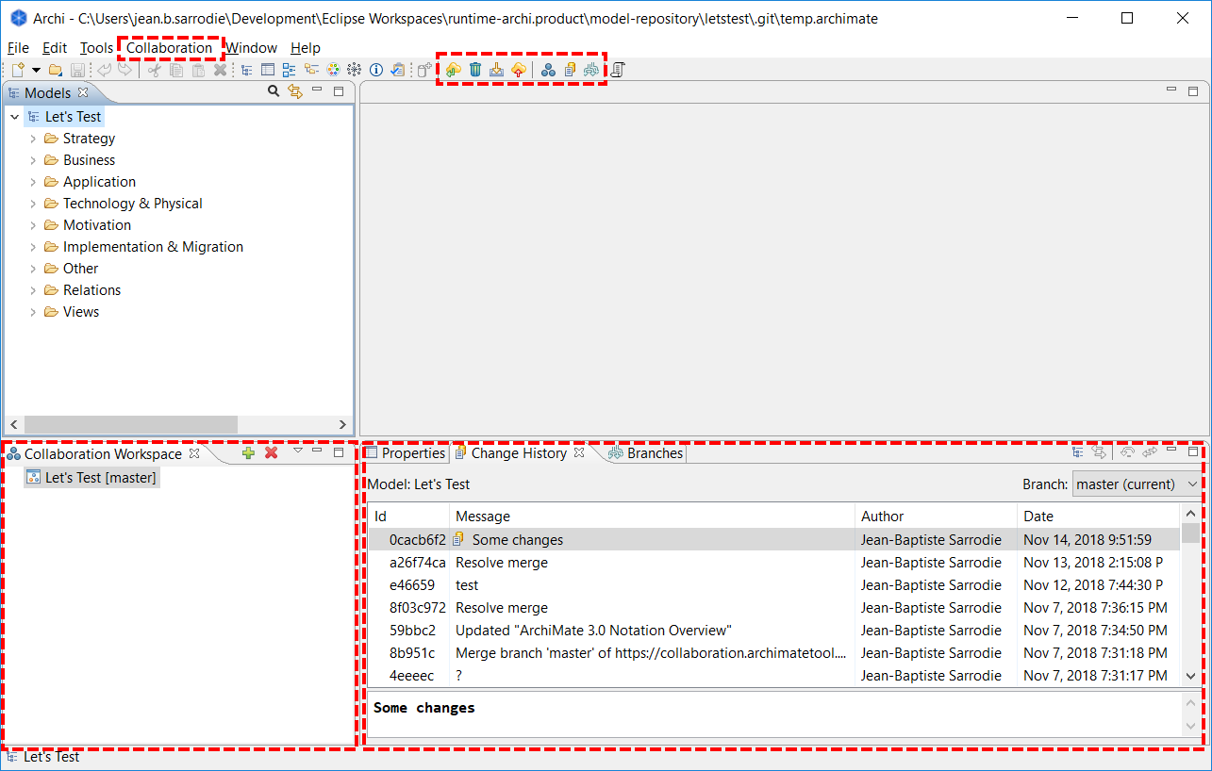
coArchi1 – 2. coArchi1 Basics - 2.2 Key User Interface Elements
06
Archi Plug-In Tutorials

Slide 7
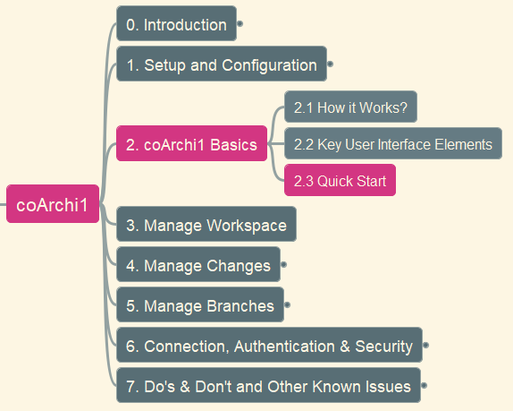

coArchi1 – 2. coArchi1 Basics - 2.3 Quick Start
07
Archi Plug-In Tutorials

Slide 8
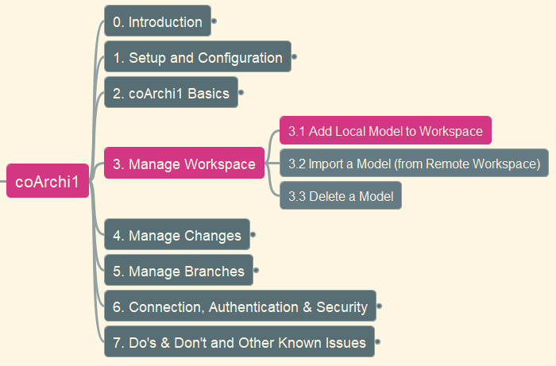
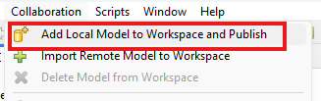
coArchi1 – 3. Manage Workspace - 3.1 Add Local Model to Workspace
08
Archi Plug-In Tutorials

Slide 9
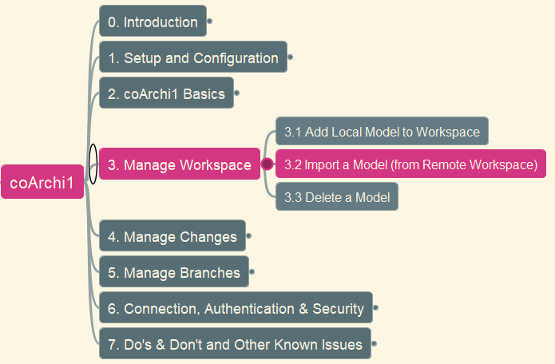
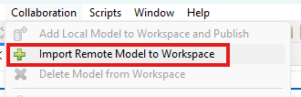
coArchi1 – 3. Manage Workspace - 3.2 Import a Model
09
Archi Plug-In Tutorials

Slide 10
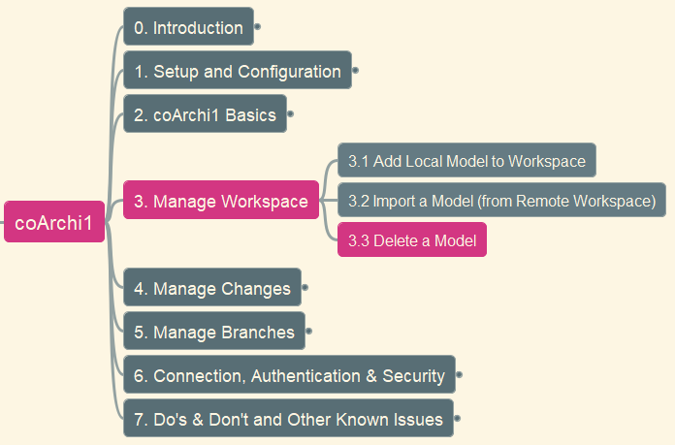
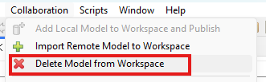
coArchi1 – 3. Manage Workspace - 3.3 Delete a Model
10
Archi Plug-In Tutorials

Slide 11
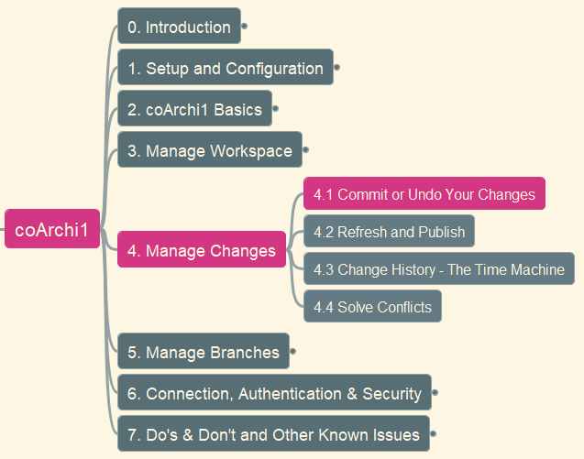
coArchi1 – 4. Manage Changes - 4.1 Commit or Undo Your Changes
11
Archi Plug-In Tutorials

Slide 12

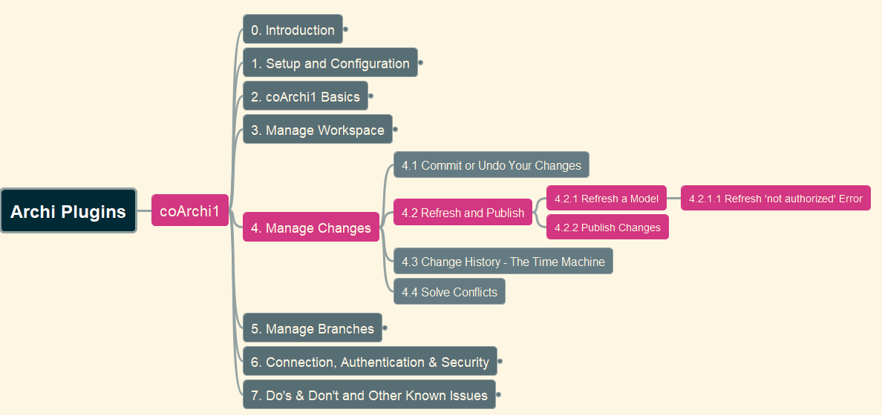


coArchi1 – 4. Manage Changes - 4.2 Refresh and Publish
12
Archi Plug-In Tutorials

Slide 13
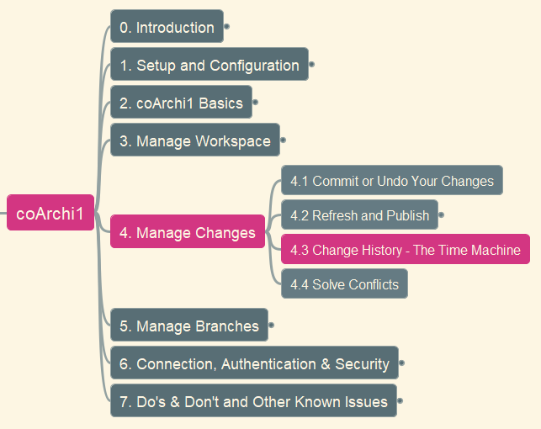

coArchi1 – 4. Manage Changes - 4.3 Change History – Time Machine
13
Archi Plug-In Tutorials

Slide 14
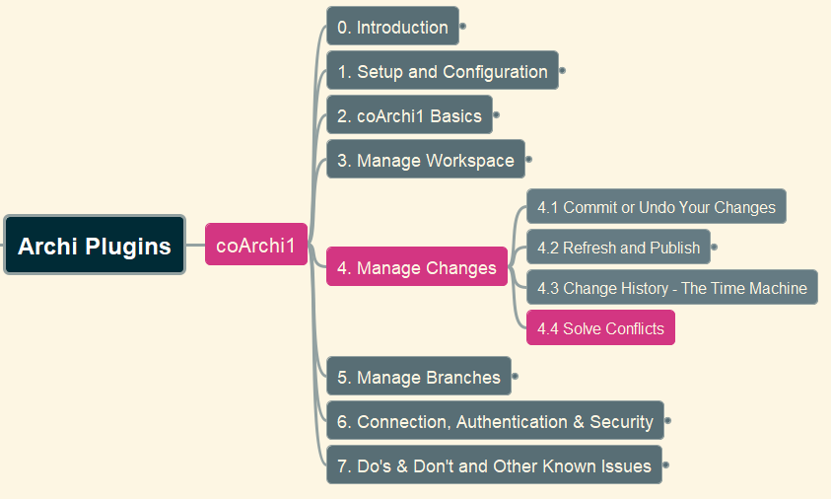

coArchi1 – 4. Manage Changes - 4.4 Solve Conflicts – Scenario 1
14
Archi Plug-In Tutorials

Slide 15
coArchi1 – 4. Manage Changes - 4.4 Solve Conflicts – Scenario 2
15
Archi Plug-In Tutorials

Slide 16
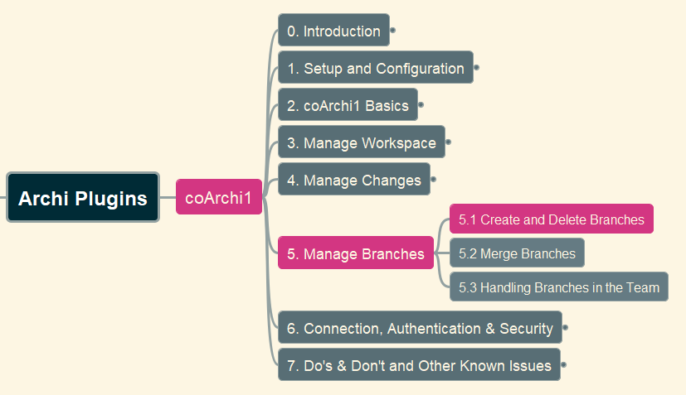
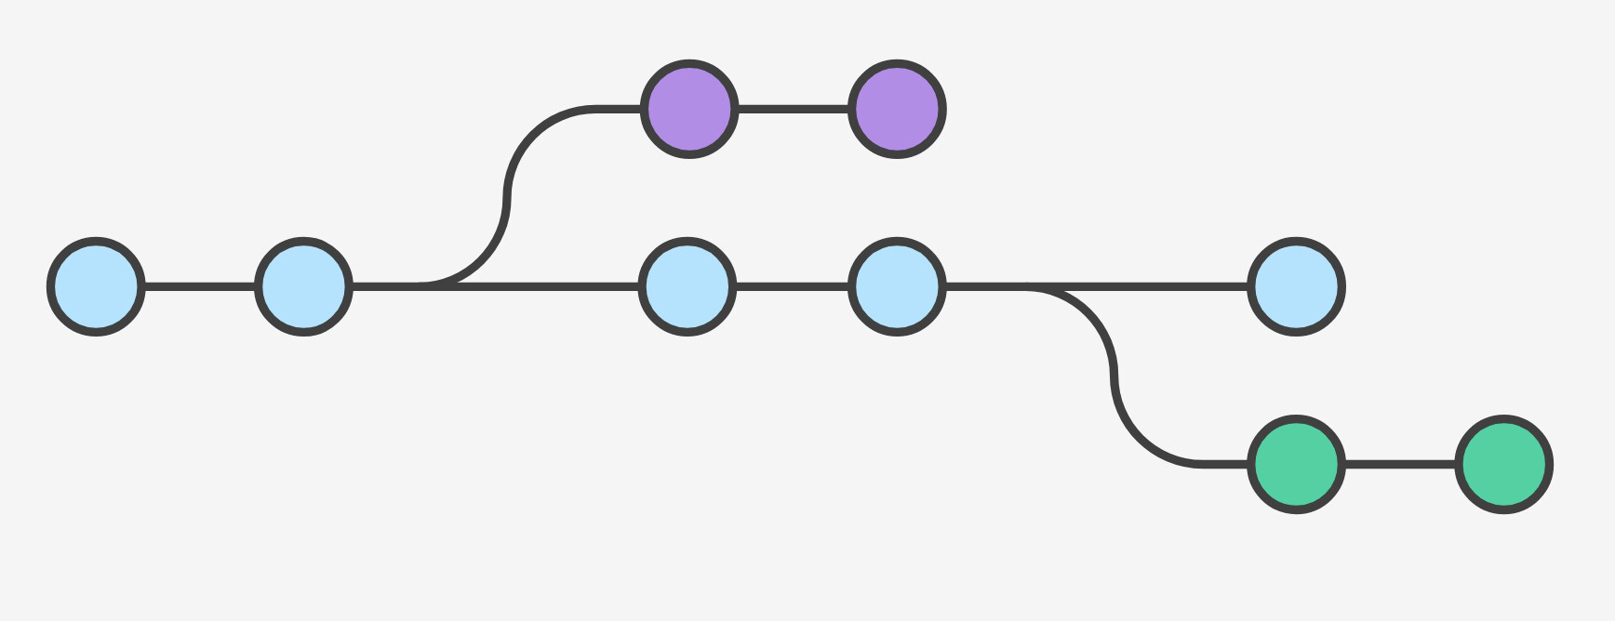
coArchi1 – 5. Manage Branches - 5.1 Create and Delete Branches
16
Archi Plug-In Tutorials

Slide 17
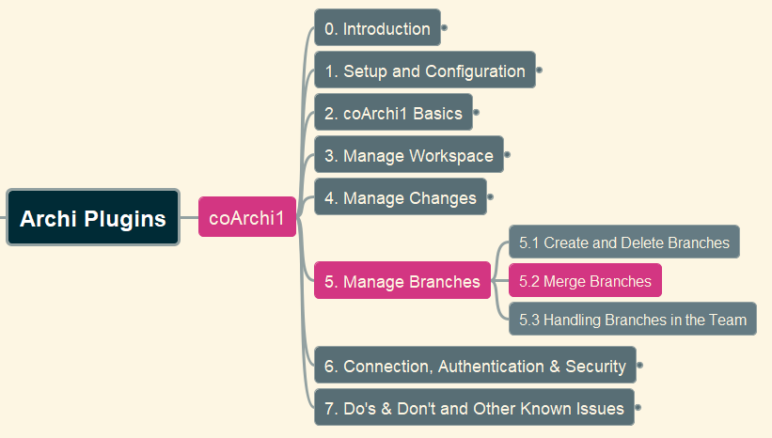
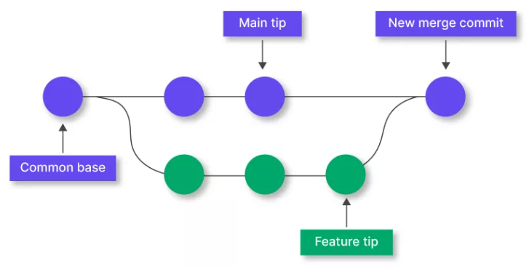
coArchi1 – 5. Manage Branches - 5.2 Merge Branches
17
Archi Plug-In Tutorials

Slide 18
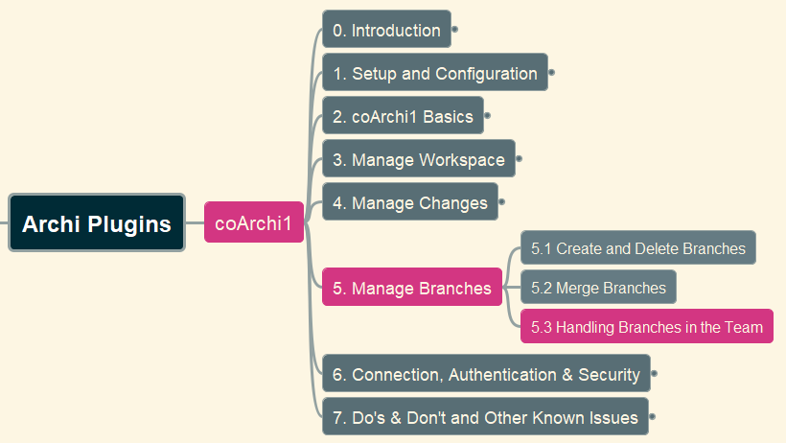

coArchi1 – 5. Manage Branches - 5.3 Handling Branches in the Team
18
Archi Plug-In Tutorials

Slide 19
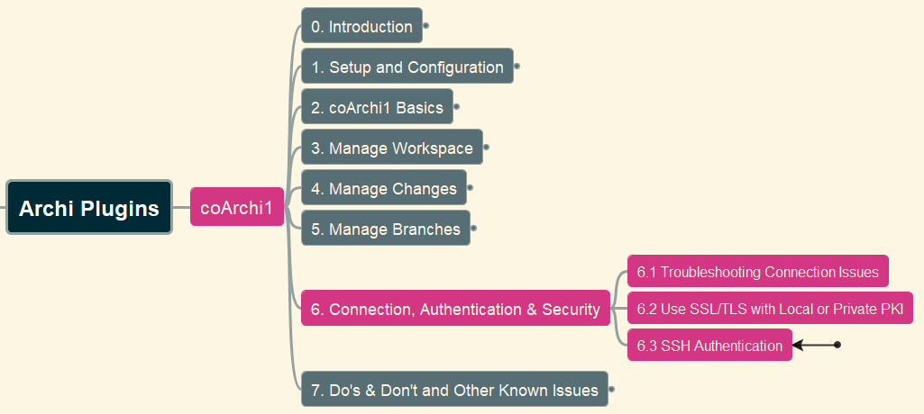
coArchi1 – 6. Connection, Authentication & Security
19
Archi Plug-In Tutorials

Slide 20
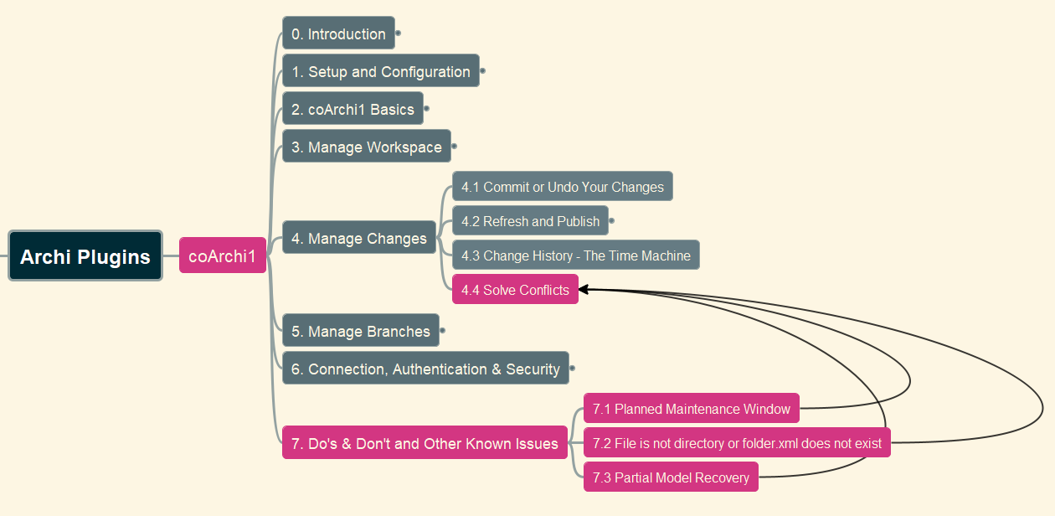
coArchi1 – 7. Do’s & Don’t and Other Known Issues
20
Archi Plug-In Tutorials

Slide 21
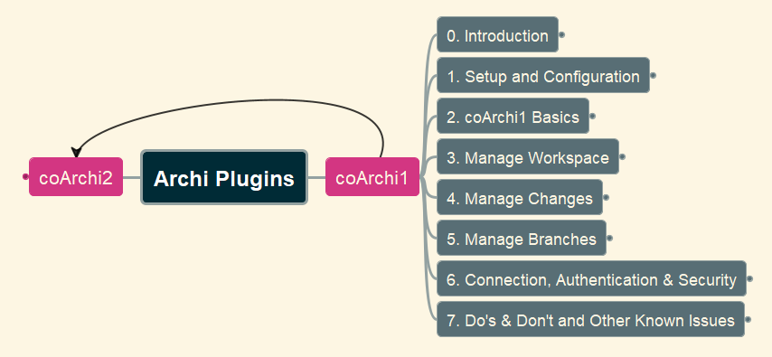
coArchi1 – Summary
21
Archi Plug-In Tutorials

Slide 22
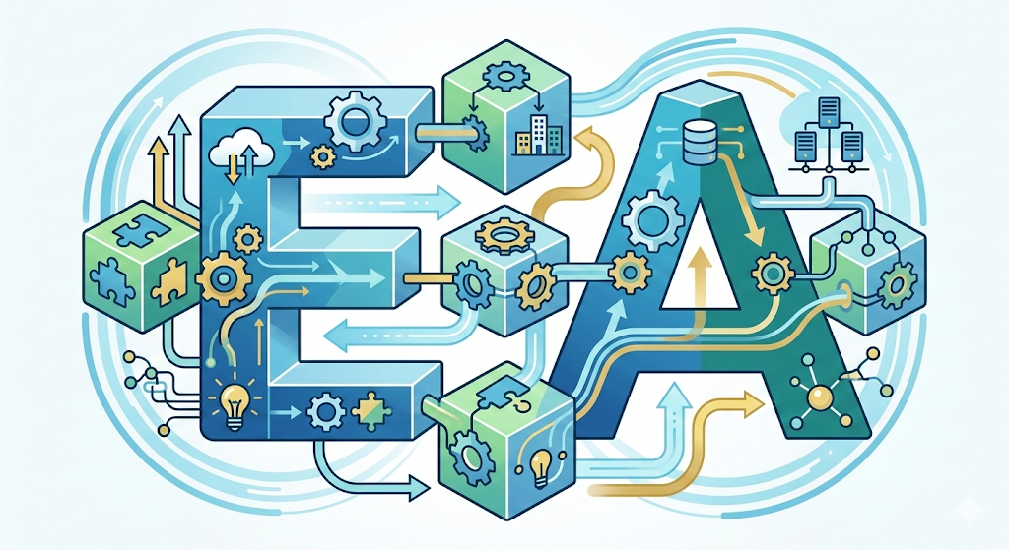
1

Slide 23

1

