Slide 1


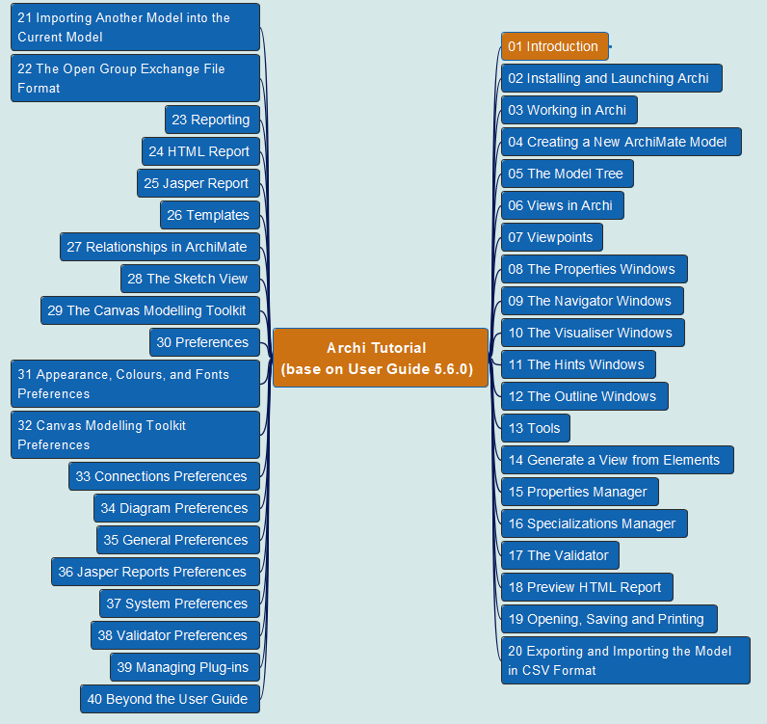
Archi® Tool Tutorial base on User Guide 5.6.0
001
Opening and Introduction

