Slide 1

MyJasperReport
20 Sep 2025 13:13:44

Slide 2
Purpose
This is also used to show in HTML Report
MyJasperReport
2
/ 9

Slide 3
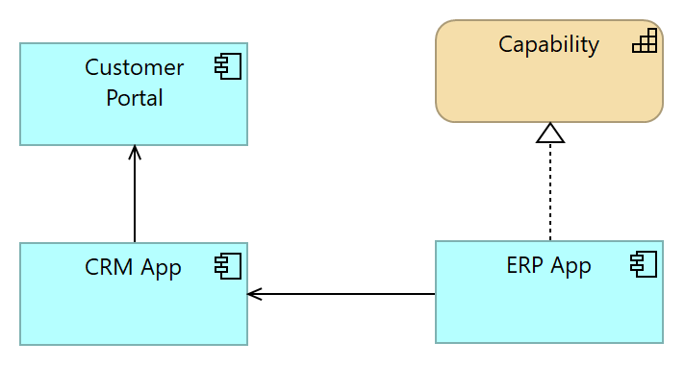
Views
Application Landscape
No viewpoint
Elements
Element
Type
Capability
Capability
CRM App
Application Component
Customer Portal
Application Component
ERP App
Application Component
MyJasperReport
3
/ 9

Slide 4
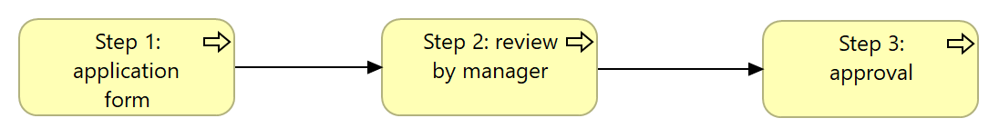
Ref View
No viewpoint
Elements
Element
Type
Step 1: application form
Business Process
Step 2: review by manager
Business Process
Step 3: approval
Business Process
MyJasperReport
4
/ 9

Slide 5
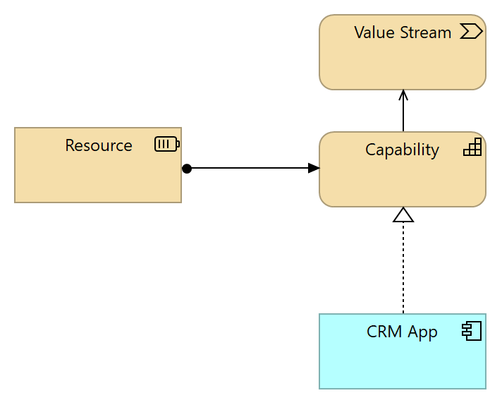
Strategy View
No viewpoint
Elements
Element
Type
Capability
Capability
CRM App
Application Component
Resource
Resource
Value Stream
Value Stream
MyJasperReport
5
/ 9

Slide 6
Strategy Layer
Capability
Type
Capability
Capability
Type
Capability
Resource
Type
Resource
Value Stream
Type
Value Stream
MyJasperReport
6
/ 9

Slide 7
Business Layer
new step
Type
Business Process
Step 1: application form
Type
Business Process
Step 2: review by manager
Type
Business Process
Step 3: approval
Type
Business Process
MyJasperReport
7
/ 9

Slide 8
Application Layer
CRM App
Type
Application Component
Customer Portal
Type
Application Component
ERP App
Type
Application Component
_hide_from_export_
true
MyJasperReport
8
/ 9

Slide 9
Relations
Serving relation
Type
Serving relation
Source
Capability
Target
Value Stream
Assignment relation
Type
Assignment relation
Source
Resource
Target
Capability
Serving relation
Type
Serving relation
Source
CRM App
Target
Customer Portal
Serving relation
Type
Serving relation
Source
ERP App
Target
CRM App
Realization relation
Type
Realization relation
Source
ERP App
Target
Capability
Triggering relation
Type
Triggering relation
Source
Step 1: application form
Target
Step 2: review by manager
Triggering relation
Type
Triggering relation
Source
Step 2: review by manager
Target
Step 3: approval
Realization relation
Type
Realization relation
Source
CRM App
Target
Capability
MyJasperReport
9
/ 9

