Slide 1

Normal & Sketch
21 Sep 2025 09:06:27

Slide 2
Purpose
Normal & Sketch
2
/ 8

Slide 3
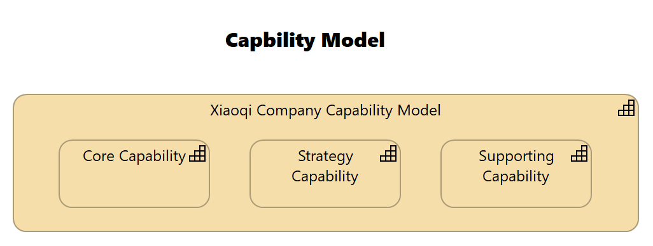
Views
Capbility Model
No viewpoint
Elements
Element
Type
Core Capability
Capability
Strategy Capability
Capability
Supporting Capability
Capability
Xiaoqi Company Capability Model
Capability
Normal & Sketch
3
/ 8

Slide 4
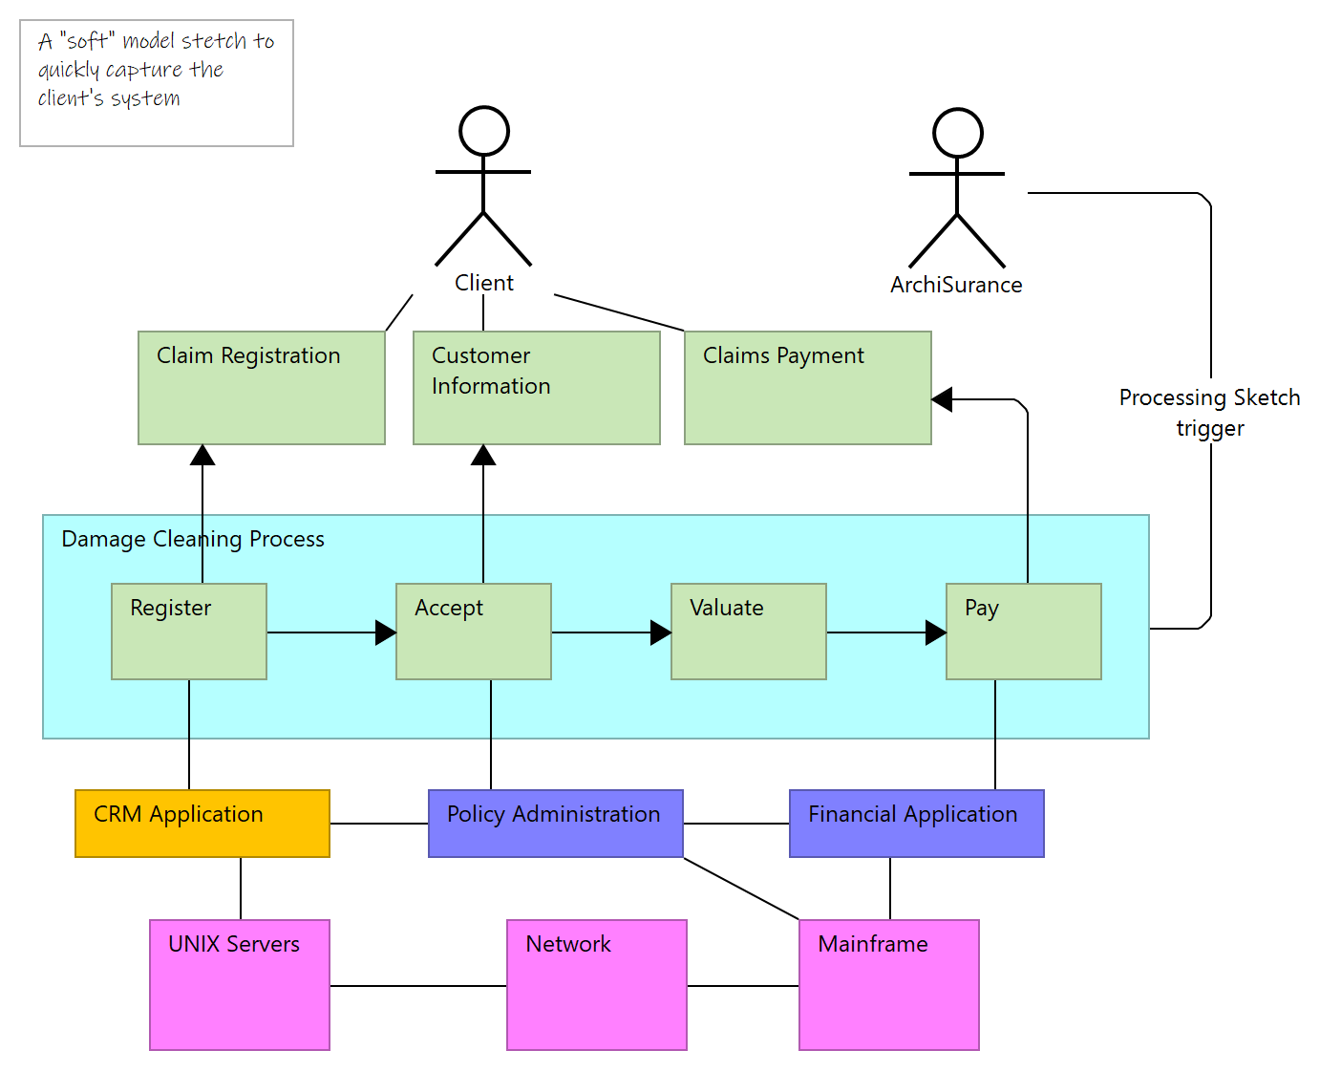
Processing Sketch
Documentation
Sketch Sample
Normal & Sketch
4
/ 8

Slide 5
Strategy Layer
Core Capability
Type
Capability
Strategy Capability
Type
Capability
Supporting Capability
Type
Capability
Xiaoqi Company Capability Model
Type
Capability
Normal & Sketch
5
/ 8

Slide 6
Application Layer
App 001
Type
Application Component
App 002
Type
Application Component
Normal & Sketch
6
/ 8

Slide 7
Technology & Physical Layer
AWS Cloud
Type
Communication Network
Azure Cloud
Type
Communication Network
Normal & Sketch
7
/ 8

Slide 8
Relations
Composition relation
Type
Composition relation
Source
Xiaoqi Company Capability Model
Target
Strategy Capability
Composition relation
Type
Composition relation
Source
Xiaoqi Company Capability Model
Target
Supporting Capability
Composition relation
Type
Composition relation
Source
Xiaoqi Company Capability Model
Target
Core Capability
Normal & Sketch
8
/ 8

