Slide 1
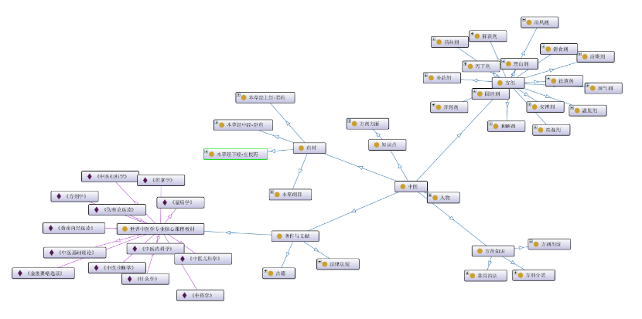
使用Protégé建立中国传统医学本体模型Ontology
Xiaoqi Zhao
GitHub: https://github.com/yasenstar/Traditional_Chinese_Medicine
Gitee: https://gitee.com/yasenstar/Traditional_Chinese_Medicine

