Slide 1
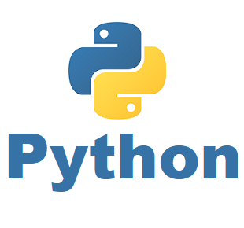
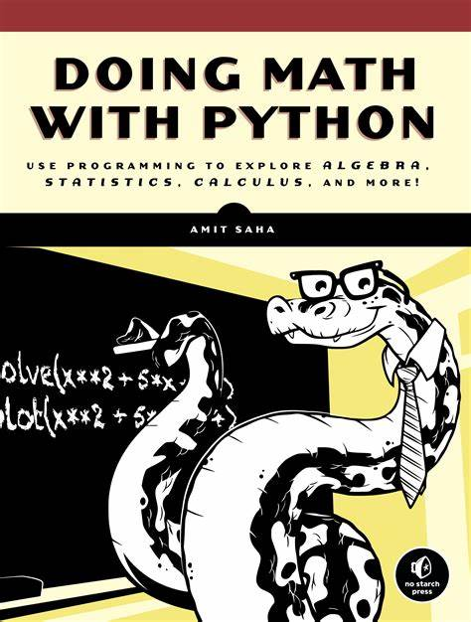
Doing Math with Python 001 – Opening and Intro
Learning by Practicing
GitHub: https://github.com/yasenstar/DoingMathWithPython

