Slide 1

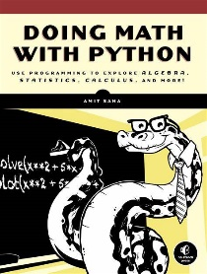

Doing Math with Python Opening and Intro
001
GitHub: https://github.com/yasenstar/DoingMathWithPython
Gitee: https://gitee.com/yasenstar/DoingMathWithPython
Yasen – Enterprise Architecture
YouTube: @yasenzhao

Slide 2
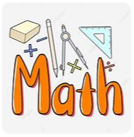
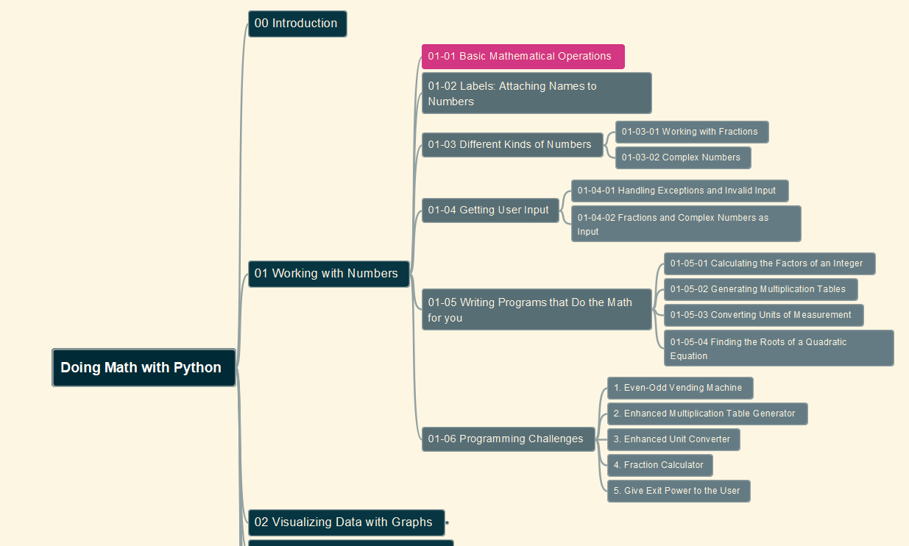
Doing Math with Python
002
Chapter 01: Working with Numbers
01-01 Basic Mathematical Operations
GitHub: https://github.com/yasenstar/DoingMathWithPython
Gitee: https://gitee.com/yasenstar/DoingMathWithPython
Yasen – Enterprise Architecture
YouTube: @yasenzhao

