Slide 1




Practice of using Archi plug-in: coArchi
Part One
Xiaoqi Zhao

Slide 2

Contents, and Questions …
What is coArchi? How to make it working in Archi?
How to manage the “master” branch with everyone’s working branches?
What is the good way to manage a global repository on ARCHI with projects? Should I create A git repo for the global repo and uses branches for projects or create also a repo by projects (thanks the question from Mohcine Aterhzaz)
How to reflect the different phases/states along with the architecture change in project? (good forum discussion: https://forum.archimatetool.com/index.php?topic=1153.msg7037#msg7037)
Other reflections of using coArchi in the team with 20+ modelers
Yasen – Enterprise Architecture
YouTube: @yasenzhao

Slide 3
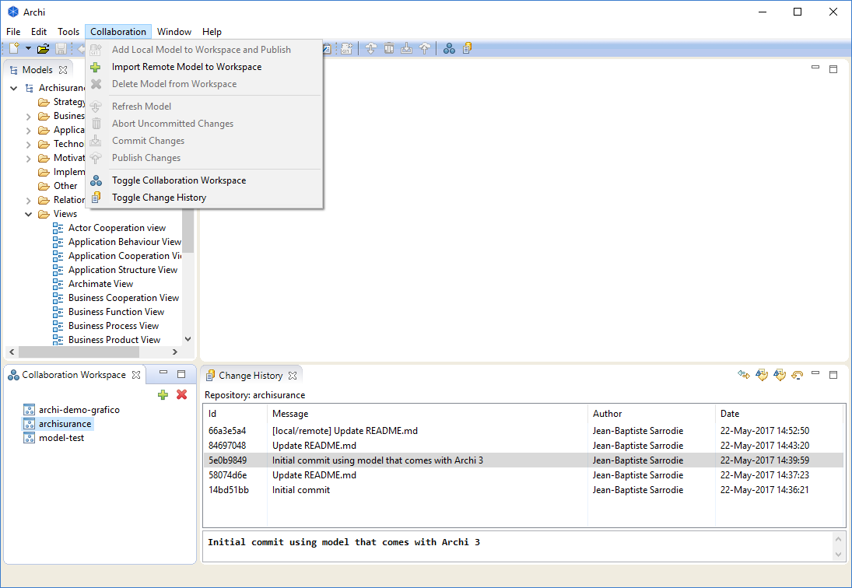

coArchi – Model Collaboration for Archi
Get coArchi from https://www.archimatetool.com/plugins/
GitHub project: https://github.com/archimatetool/archi-modelrepository-plugin
Wiki page: https://github.com/archimatetool/archi-modelrepository-plugin/wiki
Check out the Preferences tab in Archi’s Preferences dialog for global settings
Generally, you will need to have a new empty git repository already setup on a git server, but you can create and push to a GitBlit server
To add the model from the repository locally, select the first toolbar button in the plugin tab (the green cross). This will clone the repository and create a new blank model
Work as usual on your model and save it whenever you want
When you’re ready to commit your changes, then choose “Commit Changes” (this can be done offline)
When you’re ready to publish/share your work, then choose “Publish Changes”. In case of conflicts (the same concept changed and published by someone else) you’ll see a dialog window helping you to fix them.

Slide 4
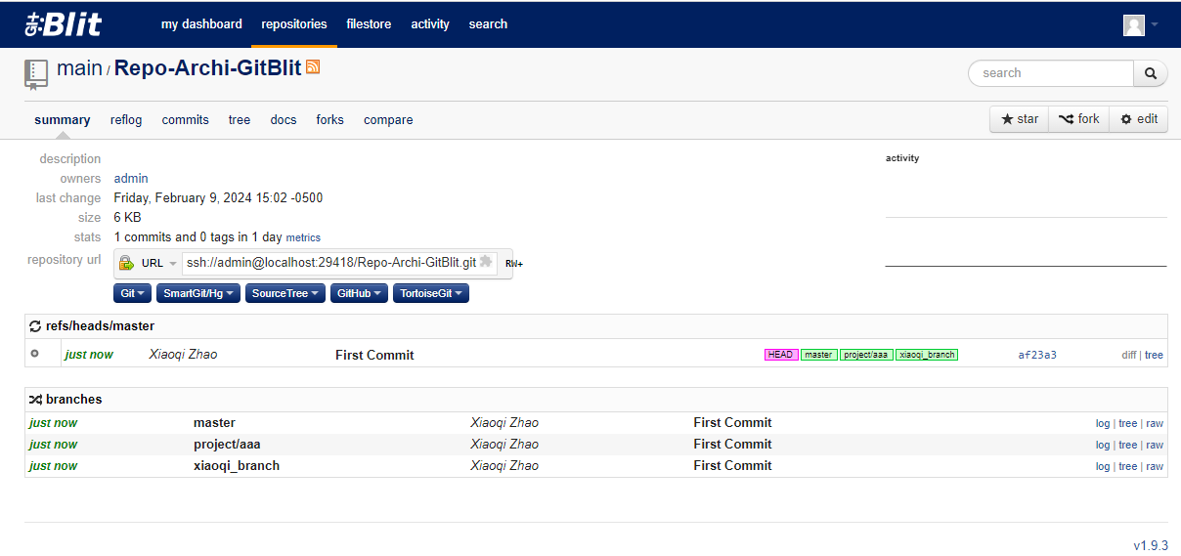
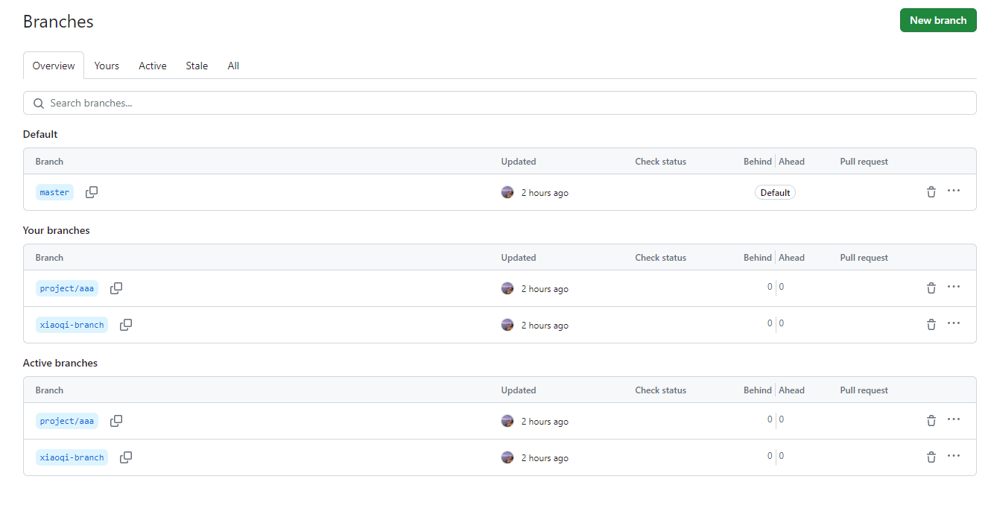
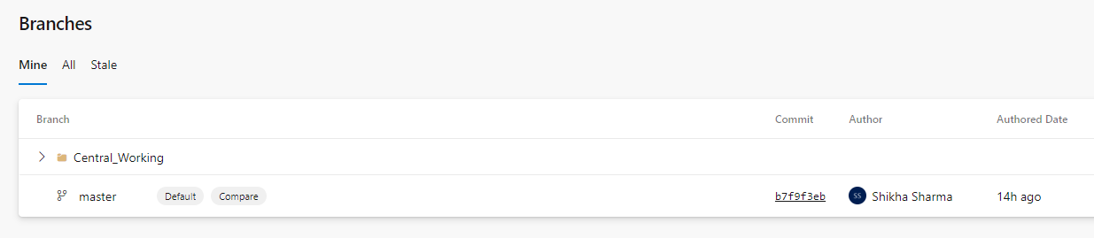
Connect coArchi to Remote Repo
Gitblit local server
Azure DevOps
GitHub

Slide 5
Practice of using Archi plug-in: coArchi
Part Two
Xiaoqi Zhao

Slide 6
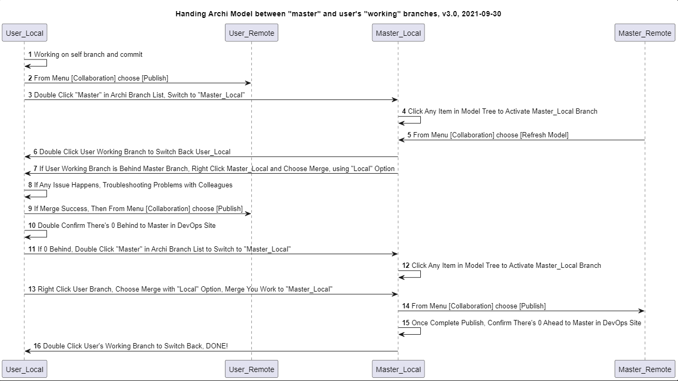

Slide 7
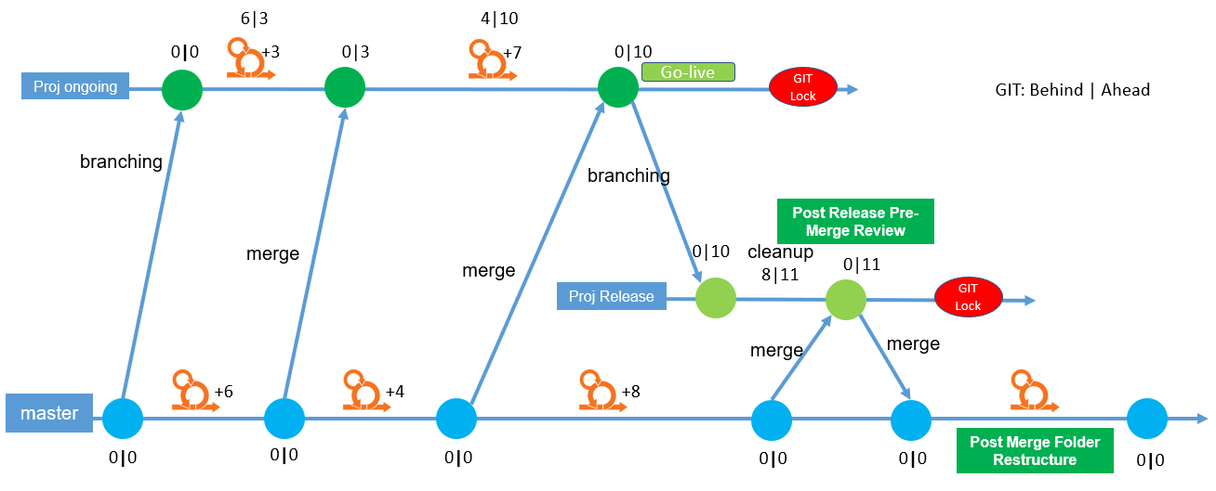
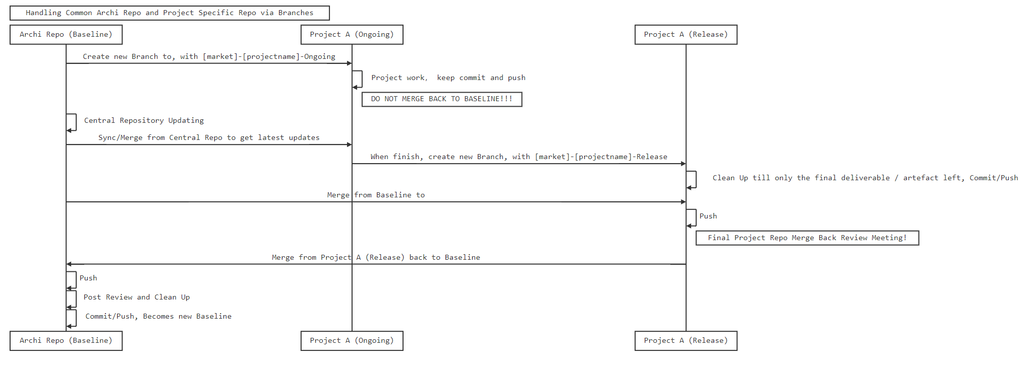
Manage Projects in coArchi – Approach 1
Pros
Clearer to control the artefacts in project mode
One way sync to project branch makes it possible for project inherit the “master” catalog
Multiple level of projects can be kept splitting in branches
Cons
Difficult for one project that have multiple architects working together
Would be “danger” in the post go-live merge back to master
Branch hierarchy is not clear in coArchi tree view as well as GitHub (Azure DevOps can show well)

Slide 8
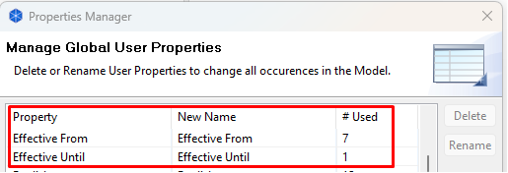
Manage Projects in coArchi – Approach 2
Not branching base on project, all projects are in the same repo
Branch are only used per modelers
The different project are in View project folder, it is soft-recommendation for modelers to manage the view naming
Create property to indicate status/state
For the elements / views in to-be state: add Property called "Effective From" with a date, in format like yyyy-mm-dd, no need to distinguish which phase, we just give indication one future date
For the elements / views passed the current date and as historical artefact: add Property called "Effective Until" with a date
Architect can use title of view to indicate states, e.g. as-is, phase 1, phase 2, …, to-be; while certain phase passed, architect need to maintain/update the view title in time to prevent mis-leading
Archi repository will keep (not delete) the historical elements/relations, gradually, those decommissioned objects will be added those “effective” properties then we will have better view

Slide 9
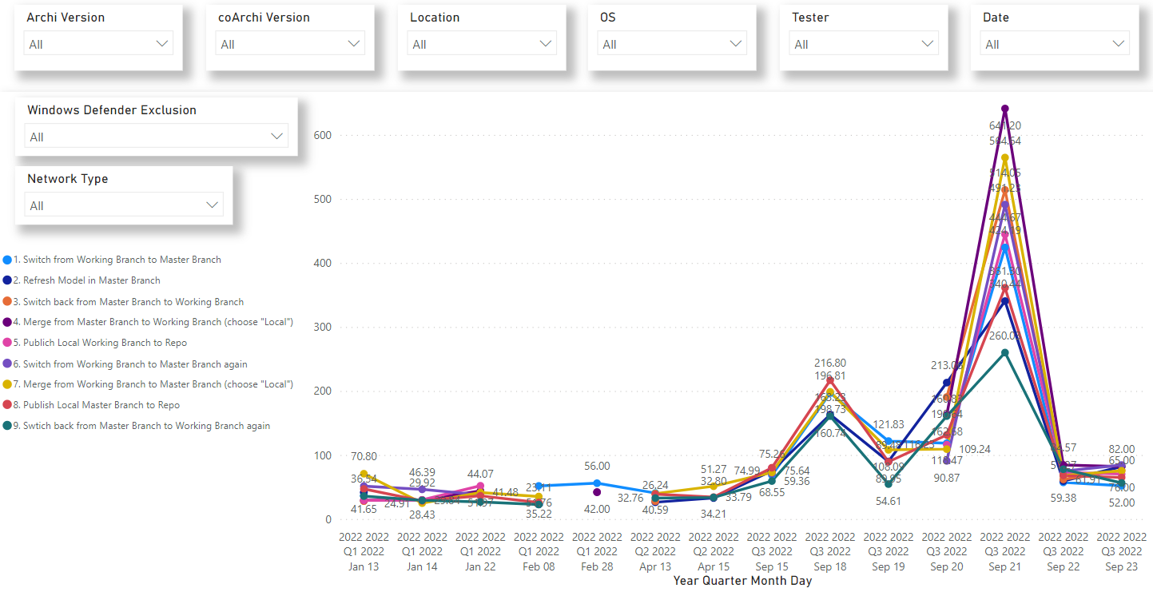
More Reflections – Performance

