Slide 1


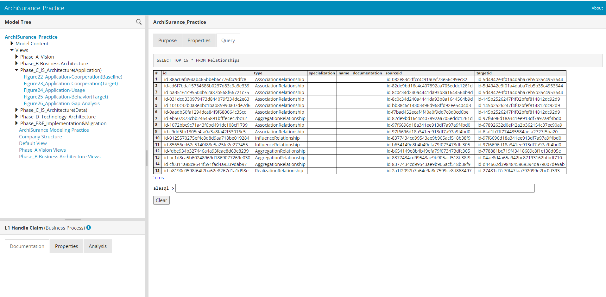

Archi HTML Exported Report
Understand Structure of Archi HTML Report
Query in Archi HTML Report with alasql
Analyze Archi HTML Report in Power BI
Xiaoqi Zhao

Slide 2
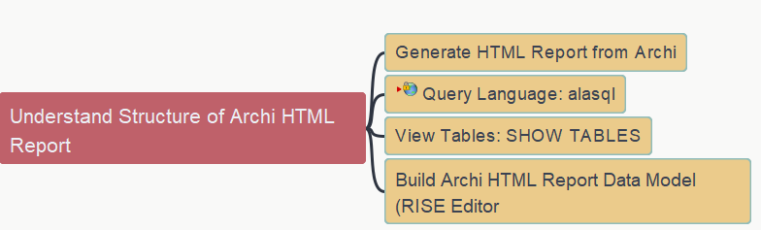
Understand Structure of Archi HTML Report
Archi HTML Report - 01
Xiaoqi Zhao

Slide 3
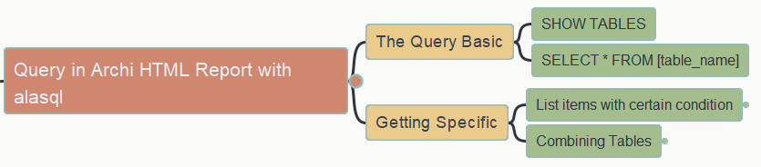
Query in Archi HTML Report with alasql
Archi HTML Report - 02
Xiaoqi Zhao
https://yasenstar.github.io/EA/architool/Query-Archi-HTML-Report.html
https://github.com/yasenstar/EA

Slide 4

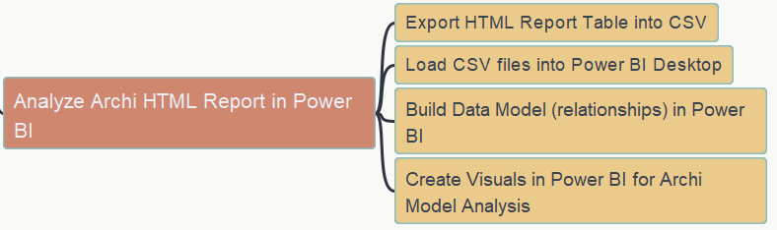
Analyze Archi HTML Report in Power BI
Archi HTML Report - 03
Xiaoqi Zhao

