Slide 1


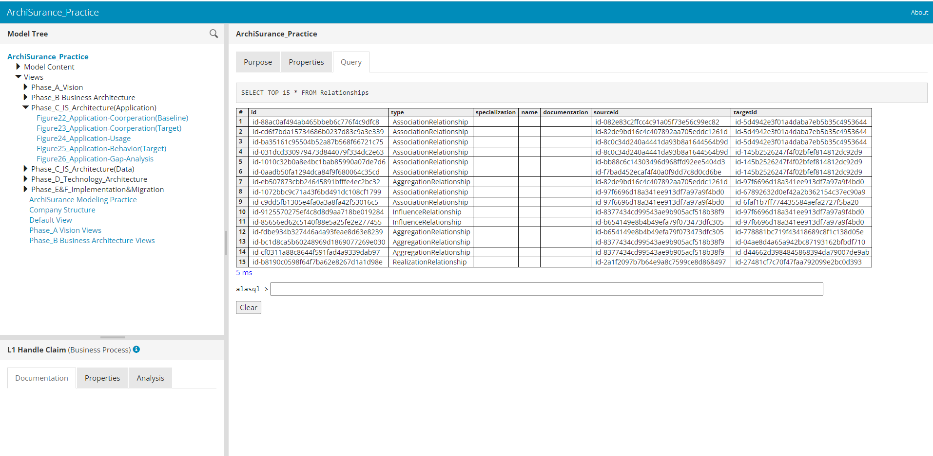

Archi HTML Exported Report
Understand Structure of Archi HTML Report
Query in Archi HTML Report with alasql
Analyze Archi HTML Report in Power BI
Xiaoqi Zhao

Slide 2
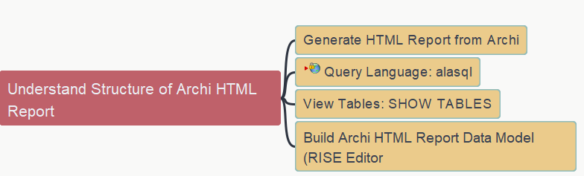
Understand Structure of Archi HTML Report
Archi HTML Report - 01
Xiaoqi Zhao

Slide 3
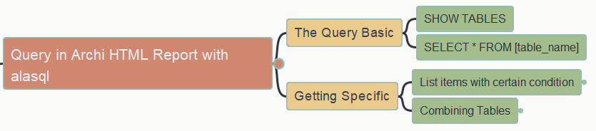
Query in Archi HTML Report with alasql
Archi HTML Report - 02
Xiaoqi Zhao
https://yasenstar.github.io/EA/architool/Query-Archi-HTML-Report.html
https://github.com/yasenstar/EA

Slide 4

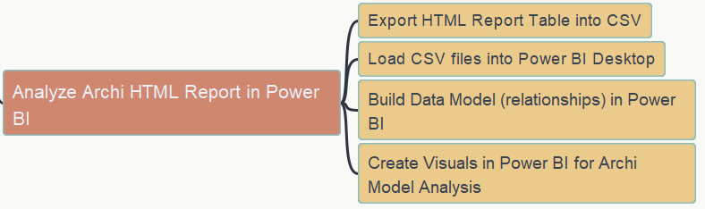
Analyze Archi HTML Report in Power BI
Archi HTML Report - 03
Xiaoqi Zhao

Slide 5
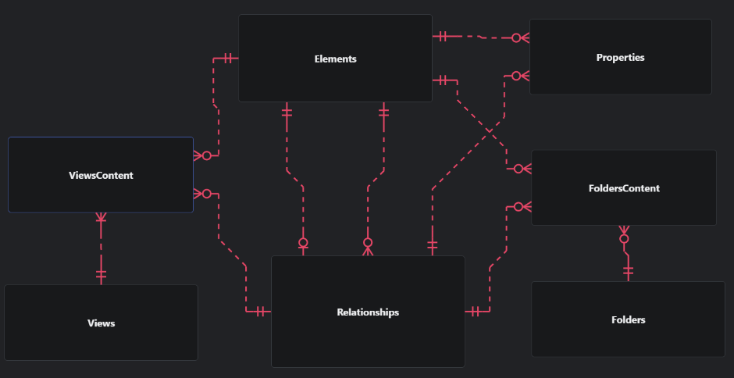
Archi HTML Report in ERD View
Archi HTML Report - 04
Xiaoqi Zhao

Slide 6

Q&A - Query on CRUD in FlowRelation
Archi HTML Report - 05

Slide 7
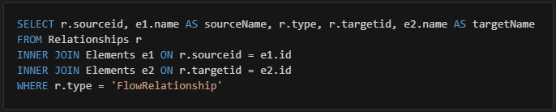
Question Got from Dave Gordon:
I am using the following statement to list the flow relationships.
Is it possible to extend upon this to obtain the color of the flow relationship lines, as the HTML do not identify the properties of the lines and this is used in Archi view to determine what type of CRUD operation (e.g Black=Create, Blue=Read, etc.) but not sure if the LineColor is stored with the HTML tables.

Slide 8
Investigation and Reflection
“lineColor” is one property attached to element / relationship in a view, NOT in Archi model repository
Archi HTML report doesn’t have those HTML-style properties exported since they display view as Image
In CRUD example, the way to use alasql to query those type information may need to model CRUD as Archi property
See live demo…

Slide 9




Interoperating via ArchiMate Open Exchange File
Archi Tool Usage
Xiaoqi Zhao

Slide 10
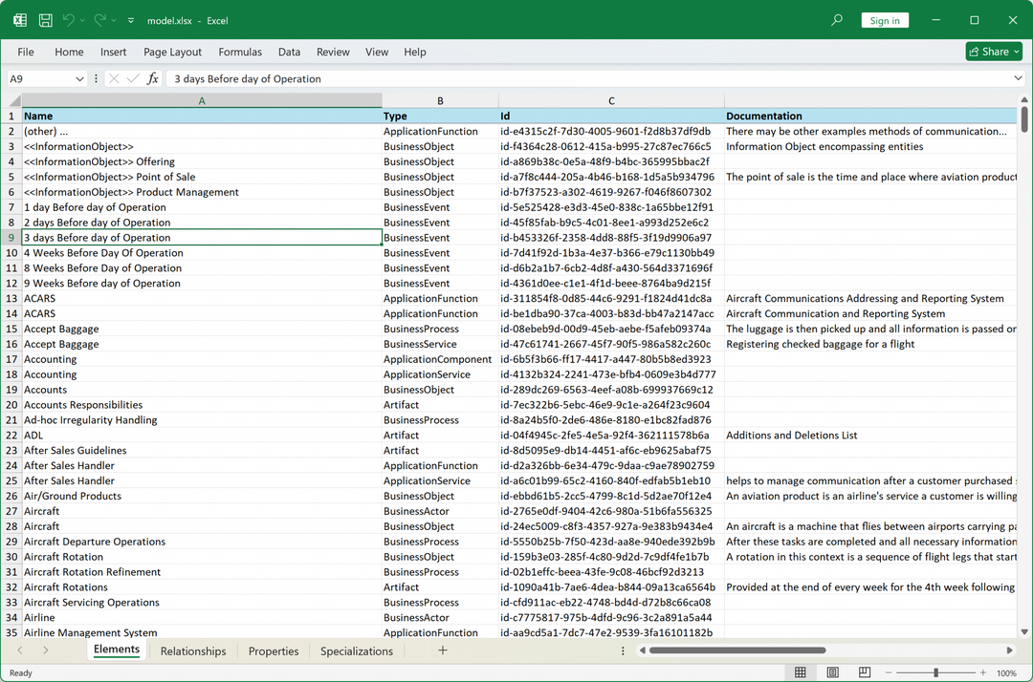

Archi’s Excel Export Plug-In 1.0.0 → 1.1.1 (Difference Need Aware)
Archi Tool Usage
Xiaoqi Zhao

