Slide 1


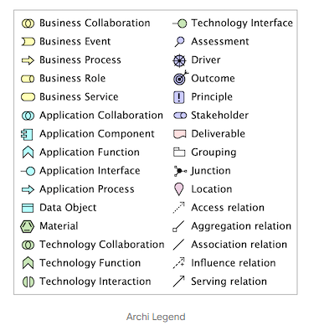
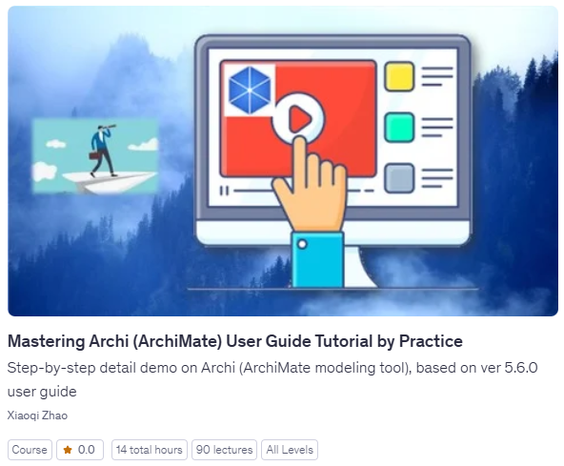
Archi 5.8.0 (Feb 16, 2026) Features Deep Dive
Feb 2026, Xiaoqi Zhao

Slide 2

New Features
Can now add Legends to ArchiMate Views with options for customising each instance. A Legend is a re-purposed Note figure and will appear as an empty Note if opened in earlier versions of Archi.
Add an option to show Specialization icons in the Models Tree (Preferences -> General)
Add an option to use alphanumeric sort order for labels containing numbers in the Models Tree (1, 2, 3, 10 instead of 1, 10, 2, 3) (Preferences -> General)
Junction figure
  now has separate line and fill colors
  now has user default fill colour in Colours Preferences page

Slide 3

Improvements – 1~10
Bundled Java Runtime is version 21.0.9+10 (Upgraded to Java Runtime v21 from Archi 5.6)
Optimisations to diagram drawing and caching of model information should result in less memory usage and faster drawing
Improvements and fixes to the help documentation and User Guide
The Colour Preferences page now shows user set colours with an asterisk
The Colour Preferences page now has “Expand All” and “Collapse All” options when right-clicking on the tree
Internal improvements and optimisations to the Colours Preferences page
The Image Manager dialog gallery will not stretch small images to fit (they are shown as original size)
The Image Manager dialog now responds to Enter and Escape key presses
The Image Manager dialog now loads images lazily with smaller images at the top
The New Model/Canvas From Template dialog now responds to Enter and Escape key presses

Slide 4
Improvements – 11~20
Model Tree search – show all Specializations in sub-menu, not just the ones in use
Model Tree search – update the Specializations menu and reset the Tree if a Specialization is modified, added or deleted
Model Tree search – sort Specializations by Elements then Relationships
Model Tree search – save settings when quitting app or closing the Model Tree
Model Tree search – add Refresh menu item
Opening many Views simultaneously is faster
Prompt for user confirmation if opening more than 100 Views at once
MS Edge is now on by default for the internal browser on Windows
Prevent duplicate Feature names (internally used)
Only save image files as required when saving a model in a coArchi2 repository

Slide 5
Improvements – 21~31
SVG export of a View now adds height and width attributes to the SVG file (already in 5.7)
[CSV Import] Support comments starting with # character
Figure icons can be used in other places (such as the Legend)
Preserve connection order when deleting/reconnecting connections (so that coArchi2 does not see this as a change in the model)
Ensure unique internal image names for image files (guards against different images with the same name)
Improvements to figure image drawing
Update Grid and Gallery widgets to newer versions
Some icons improved for hi-dpi screens
Show progress dialog when checking for new version
Limit HTTP redirect retries to 5 when using a Proxy server and authentication fails
Support pinch and zoom gesture in diagrams

Slide 6

Fixes
Fix FormatPainter not updating cursor on Linux X11
Fix SVG image export not properly filling oval figures
Many internal fixes and optimisations
Fix user set font reverting to default font on Mac when font scaling checkbox is selected in Preferences
Don’t show focus selection outline in Figures Preference Page on Windows
Fix Welcome window file not found if Archi is run from a different location
Use absolute path if -Ddata.location contains “..”

Slide 7
Want more Information?
Accelerate your Enterprise Architecture journey with these essential links.
Software Download: Get Archi 5.8 (upon release) at archimatetool.com/download
Documentation: Comprehensive User Guide included with your installation.
Video Training: Watch the curated YouTube Playlist (https://www.youtube.com/playlist?list=PL6DEHvciXKeXrv1A4AV2wy1RDv-Y5MRip) for visual walkthroughs.
Certified Learning: Enroll in the premium Udemy Course (https://www.udemy.com/course/archi-tool-user-guide-tutorial/?referralCode=B7FD975B5B8F58109B76) for a structured masterclass.

