Slide 1


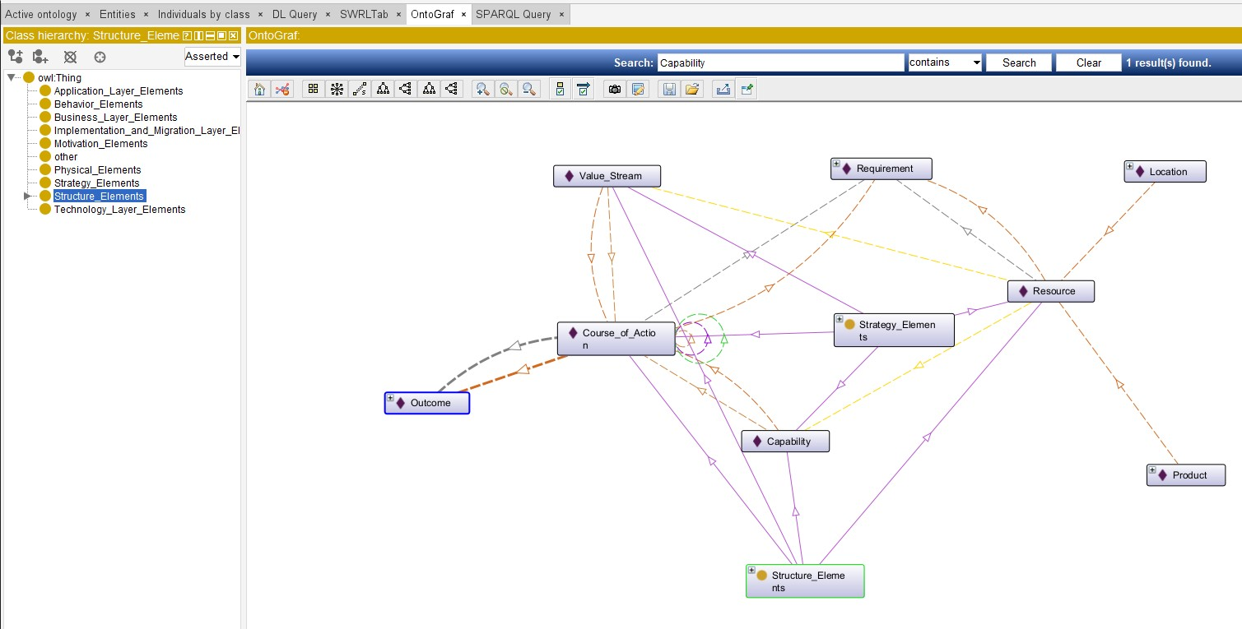
Ontology View of ArchiMate 3.2 Specification

Slide 2

