Slide 1




Practice of using Archi plug-in: coArchi
Xiaoqi Zhao

Slide 2

Contents, and Questions …
What is coArchi? How to make it working in Archi?
How to manage the “master” branch with everyone’s working branches?
How to reflect the different phases/states along with the architecture change in project?? (good forum discussion: https://forum.archimatetool.com/index.php?topic=1153.msg7037#msg7037)
What is the good way to manage a global repository on ARCHI with projects? Should I create A git repo for the global repo and uses branches for projects or create also a repo by projects (thanks question from Mohcine Aterhzaz)
Other reflections of using coArchi in the team with 20+ modelers
Yasen – Enterprise Architecture
YouTube: @yasenzhao

Slide 3
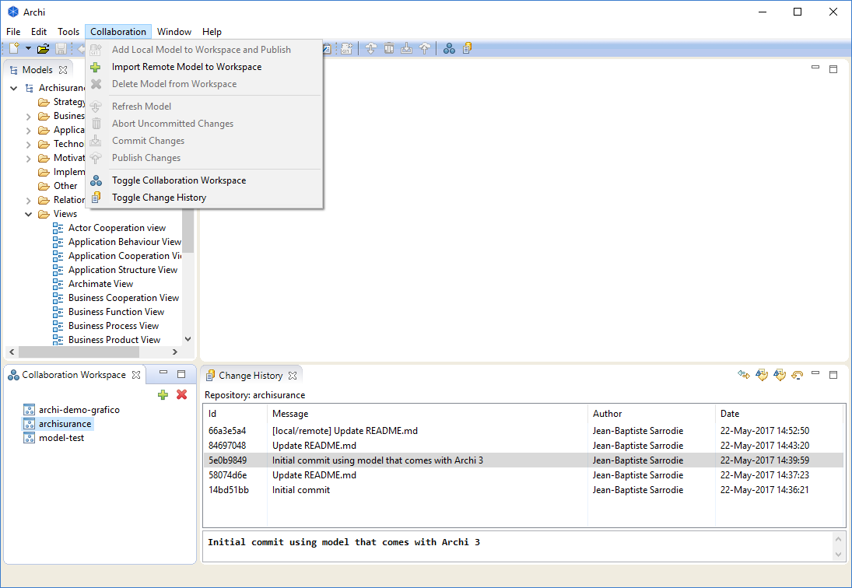
coArchi – Model Collaboration for Archi
Get coArchi from https://www.archimatetool.com/plugins/
GitHub project: https://github.com/archimatetool/archi-modelrepository-plugin
Wiki page: https://github.com/archimatetool/archi-modelrepository-plugin/wiki
Check out the Preferences tab in Archi’s Preferences dialog for global settings
Generally, you will need to have a new empty git repository already setup on a git server, but you can create and push to a GitBlit server
To add the model from the repository locally, select the first toolbar button in the plugin tab (the green cross). This will clone the repository and create a new blank model
Work as usual on your model and save it whenever you want
When you’re ready to commit your changes, then choose “Commit Changes” (this can be done offline)
When you’re ready to publish/share your work, then choose “Publish Changes”. In case of conflicts (the same concept changed and published by someone else) you’ll see a dialog window helping you to fix them.

