Slide 1



Archi 5.9.0 (Apr 14, 2026) Features Deep Dive
April 2026, Xiaoqi Zhao

Slide 2

New Features
Add “Invert Connection Direction” feature to reverse source and target ends of a connection
New Model Tree alphanumeric sort algorithm
Show parent folder paths in “Used in Views” and “Model Relations” analysis tables
Open Exchange Format now imports and exports Specialization names

Slide 3
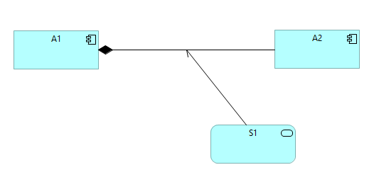
Invert Connection Direction
The original relationship should have valid inverse relationship per ArchiMate specification
The Name is required manually adjustment
The relationship codes are always inside the Source view element block
❶
❷

Slide 4

Improvements
Model Tree alphanumeric sort preference is off by default
Model Tree search – restore tree selection when clearing search filter and text
[CSV Import] Throw an exception if there are duplicate relations declared
Aggregation and Composition connection ends are drawn more accurately
Ensure icon images are not drawn slightly outside of a figure
Add an internal check on startup to ensure workbench part icons are correct when using different versions of Eclipse
Remove link in help contents to online ArchiMate 3.2 specification as it’s no longer “open”

Slide 5

Fixes
Fix disabling themes in preferences setting not working

Slide 6


Want more Information? Accelerate your Enterprise Architecture journey with these essential links.
Software Download:
Get Archi 5.9 (upon release) at archimatetool.com/download
Documentation:
Comprehensive User Guide included with your installation.
Video Training:
Watch the curated YouTube Playlist (https://www.youtube.com/playlist?list=PL6DEHvciXKeXrv1A4AV2wy1RDv-Y5MRip) for visual walkthroughs.
Certified Learning:
Enroll in the premium Udemy Course (https://www.udemy.com/course/archi-tool-user-guide-tutorial/?referralCode=B7FD975B5B8F58109B76) for a structured masterclass.

