Slide 1

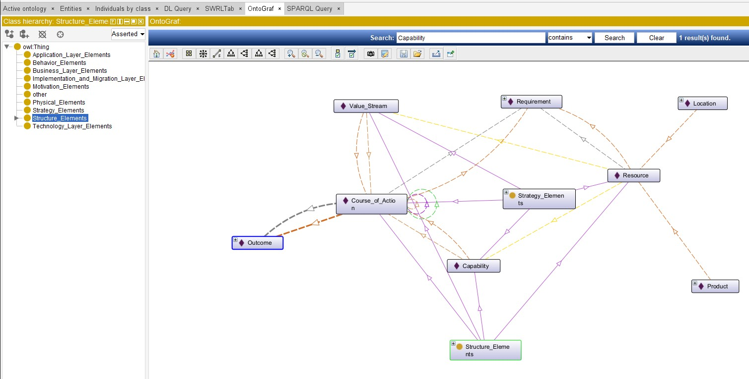
Ontology View of ArchiMate 3.2 Specification

Slide 2

