Slide 1

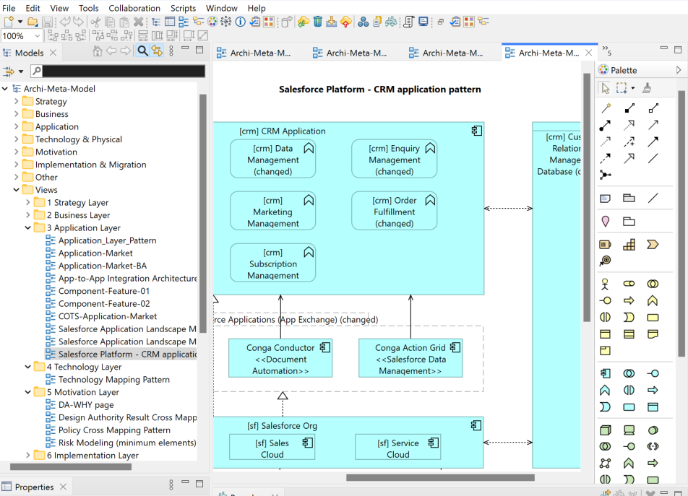
Archi 5.7.0 (Sept 23, 2025) Features Intro
December 2025, Xiaoqi Zhao

Slide 2
New Features
Add a preference to highlight the primary selected connection (Preferences -> Connections)
Add “Select Objects of Same Type” context menu action in Views
[Models Tree] Add an option for incremental tree node display (Preferences -> General)
[Models Tree] Add key binding support for Expand/Collapse All
Add key binding support for CSV Import/Export, XML Exchange Import/Export, and Model Import

Slide 3
Improvements
Connection bend point creation and move handles are now more distinctive
CSV Import/Export, XML Exchange Import/Export, and Model Import now use command handlers
All Import and Export Model bundles are now lazily loaded on demand
Use a better png image for the Palette View
[Help] Explain the format of imported CSV files (Reference: Forum #1675)
Improved handling of multiple workbench window shells
Optimisations to Navigator and Validator trees
Set the “Delete from Model” default key binding context to “In Archi Diagrams”
Don’t add the name of objects to Undo/Redo commands to avoid expanding menu width (Forum #1661)
The status bar displays the primary selected object in diagrams
Deprecate third-party Model Import and Export interfaces in favour of using Commands, Handlers and Menus

Slide 4
Fixes
Fix black search text when using the dark theme
Some fixes to managing drop-ins
Other internal improvements and fixes

