Slide 1



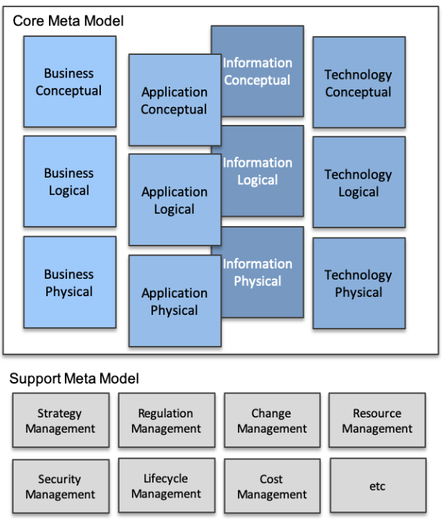
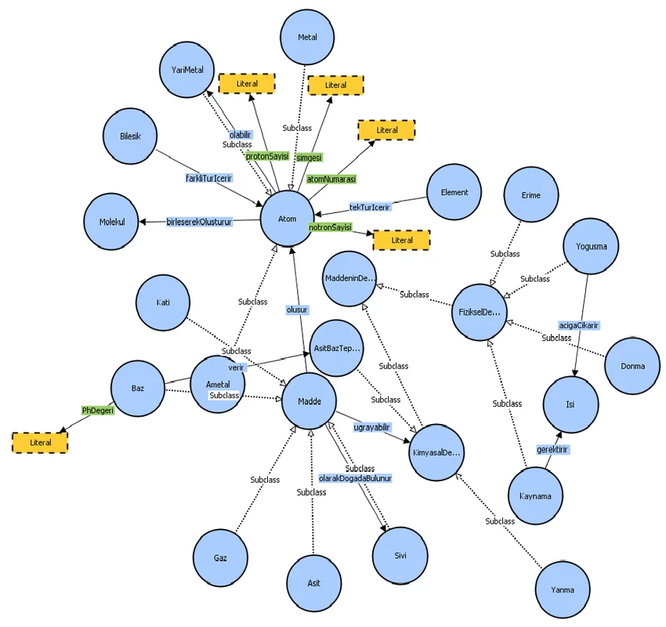


Master EAS Meta-Model in Ontology & Graph Perspective
001
Building Up Enterprise Architecture Meta-Model From Scratch
5.6+
3.5

Slide 2
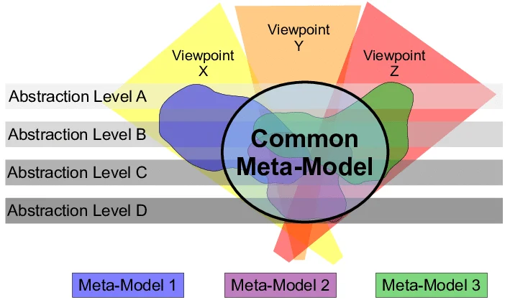
What is Metamodel?
002
A metamodel is a model of a model, and metamodeling is the process of generating such metamodels.
Metamodeling or meta-modeling is the analysis, construction, and development of the frames, rules, constraints, models, and theories applicable and useful for modeling a predefined class of problems.

Slide 3
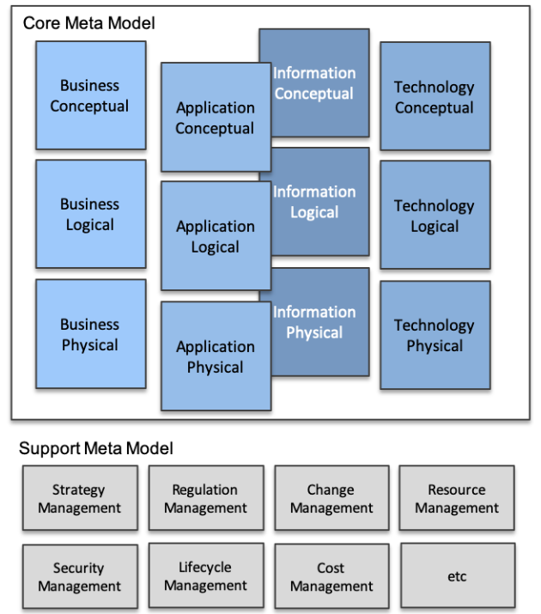
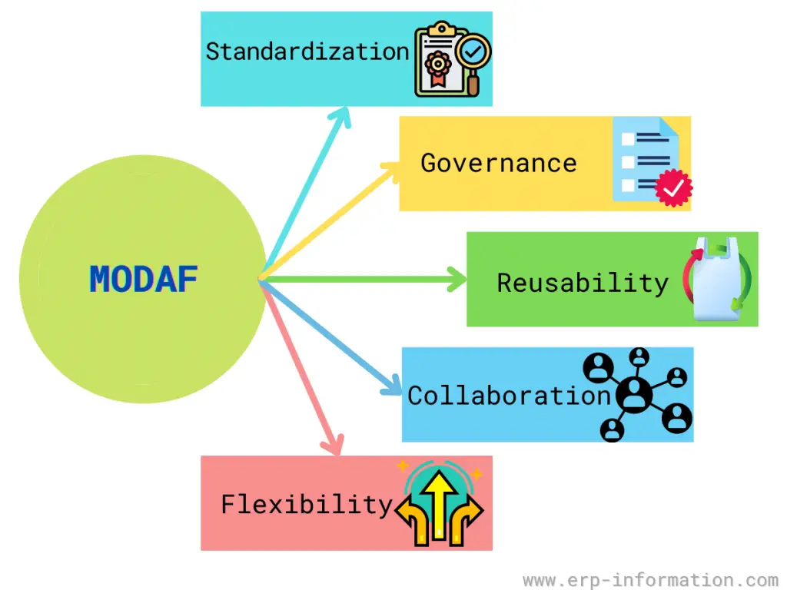

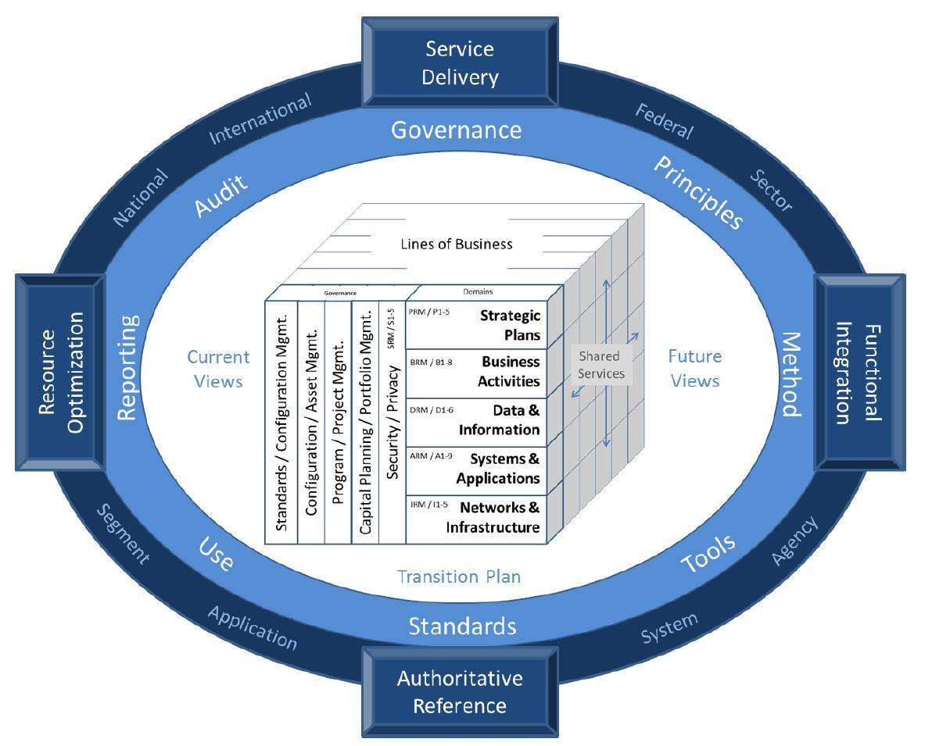
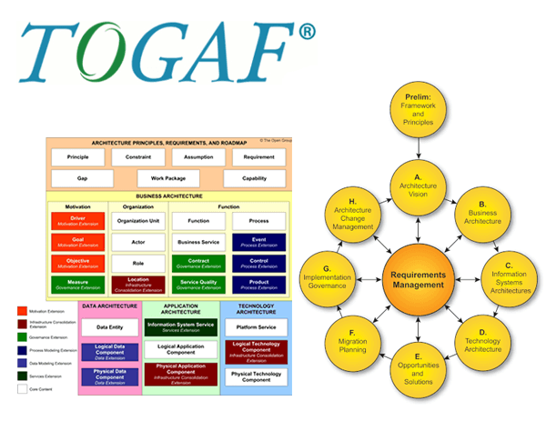
Understanding EAS Metamodel
003
MODAF: British Ministry of Defense Architecture Framework
FEAF: Federal Enterprise Architecture Framework
TOGAF: The Open Group Architecture Framework

Slide 4
Metamodel in Reference EA Frameworks
004
MODAF: British Ministry of Defense Architecture Framework
FEAF: Federal Enterprise Architecture Framework
TOGAF: The Open Group Architecture Framework

Slide 5

Setup Modeling Environment - Essential Open Source EA Tool
005

Slide 6

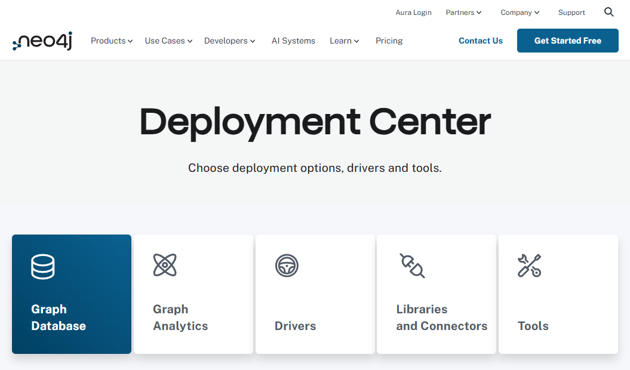
Setup Modeling Environment - Protégé & Neo4j
006

Slide 7

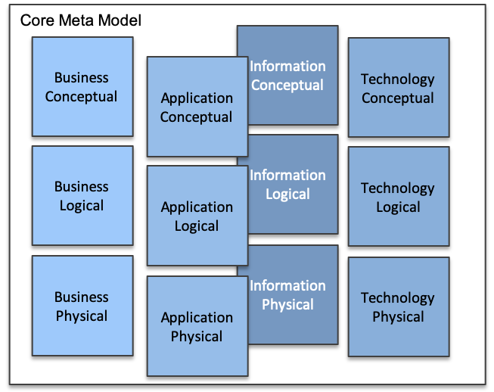
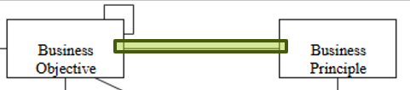
Essential EA Meta-Model - Business Conceptual - 01
007

Slide 8
Essential EA Meta-Model - Business Conceptual - 02
008

Slide 9
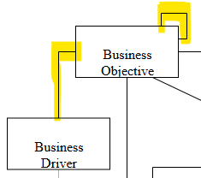
Essential EA Meta-Model - Business Conceptual - 03
009

Slide 10
Essential EA Meta-Model - Business Conceptual - 04
010

Slide 11
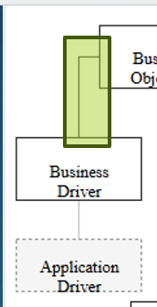
Essential EA Meta-Model - Business Conceptual - 05
011

Slide 12
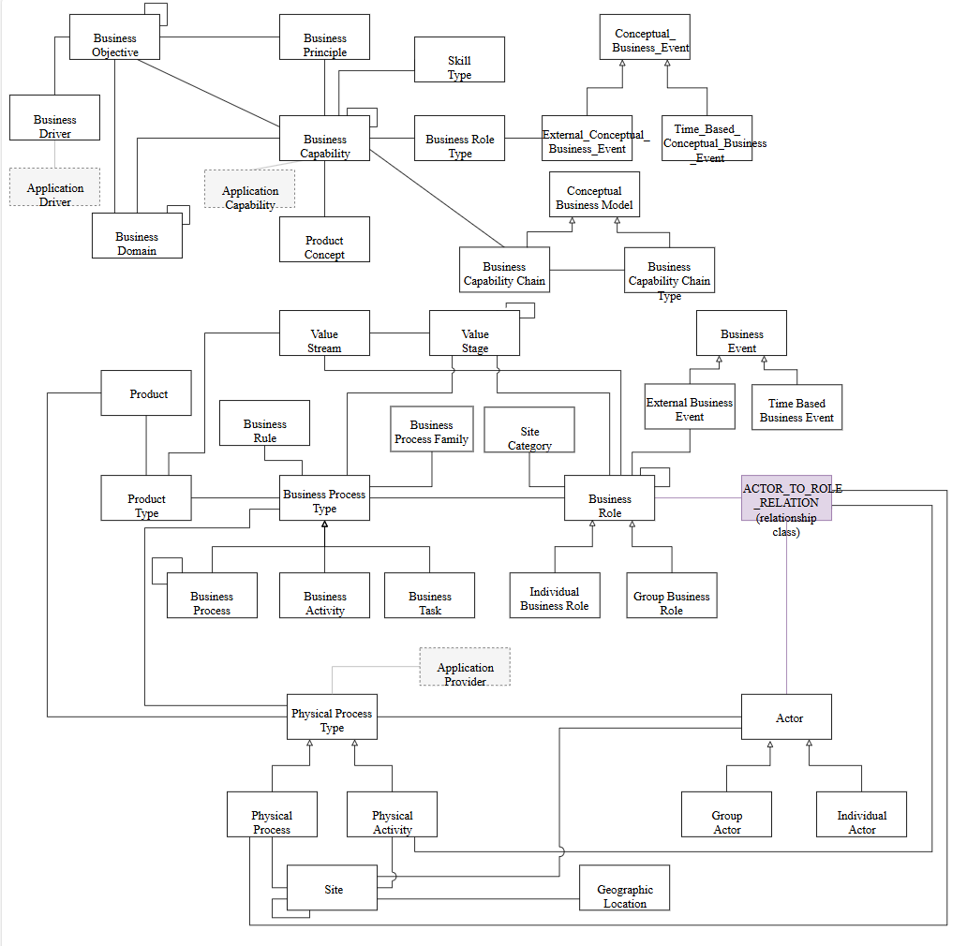

Slide 13
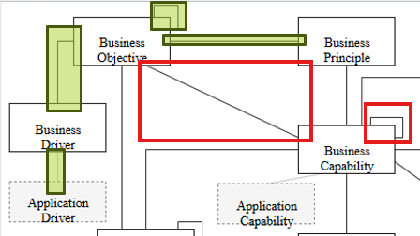
Essential EA Meta-Model - Business Conceptual - 06
012

Slide 15
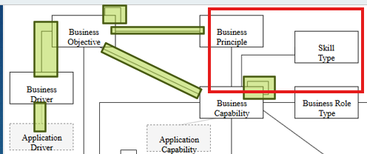
Essential EA Meta-Model - Business Conceptual - 07
013

Slide 17
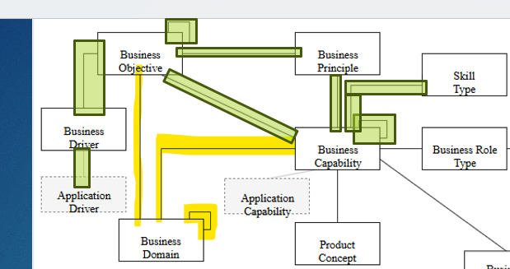
Essential EA Meta-Model - Business Conceptual - 08
014

Slide 19
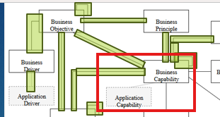
Essential EA Meta-Model - Business Conceptual - 09
015

Slide 21
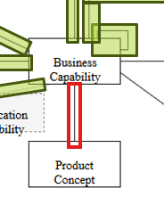
Essential EA Meta-Model - Business Conceptual - 10
016

Slide 23
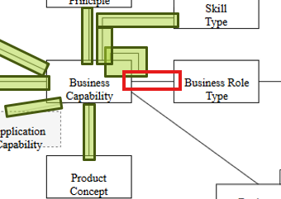
Essential EA Meta-Model - Business Conceptual - 11
017

Slide 24

Thank You!
someone@Example.com

