Slide 1



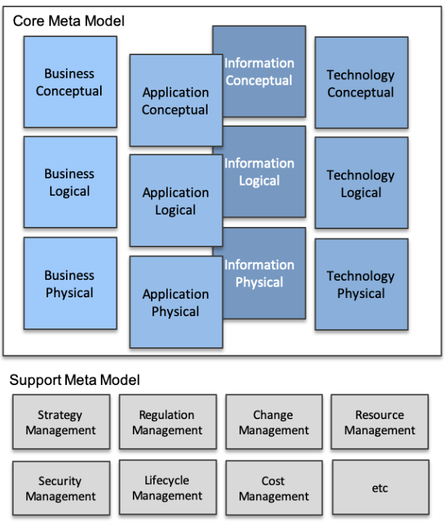
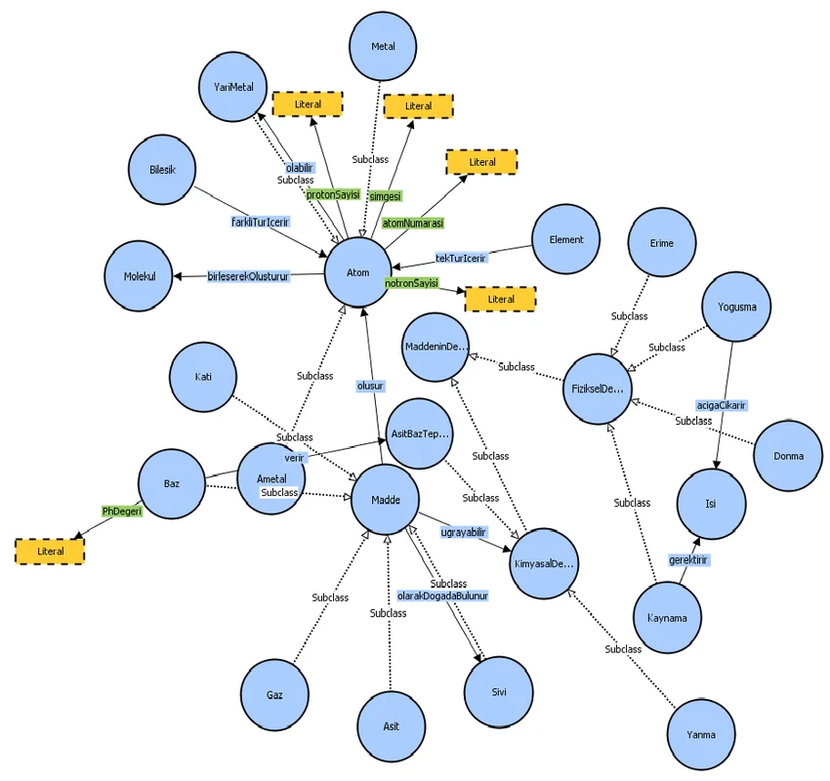


Master EAS Meta-Model in Ontology & Graph Perspective
001
Building Up Enterprise Architecture Meta-Model From Scratch
5.6+
3.5

Slide 2
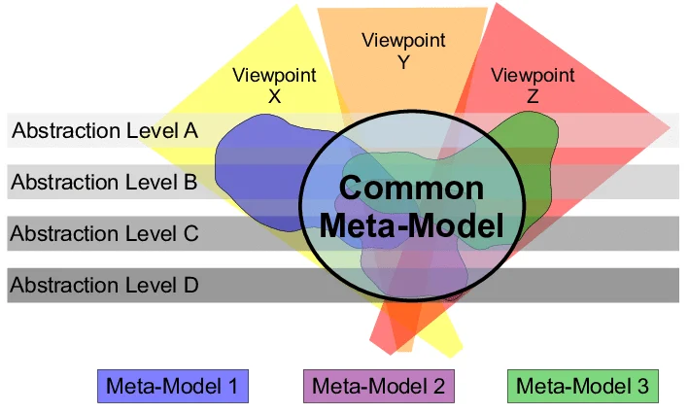
What is Metamodel?
002
A metamodel is a model of a model, and metamodeling is the process of generating such metamodels.
Metamodeling or meta-modeling is the analysis, construction, and development of the frames, rules, constraints, models, and theories applicable and useful for modeling a predefined class of problems.

Slide 3
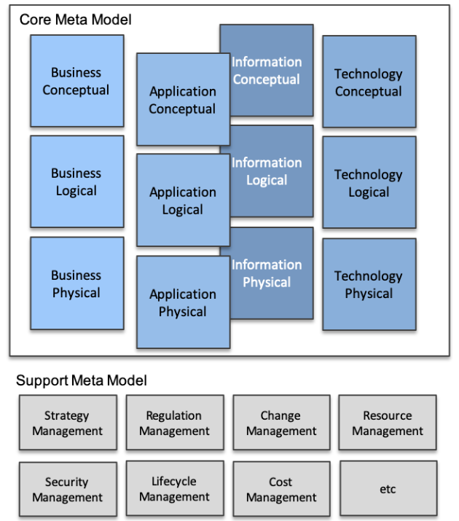
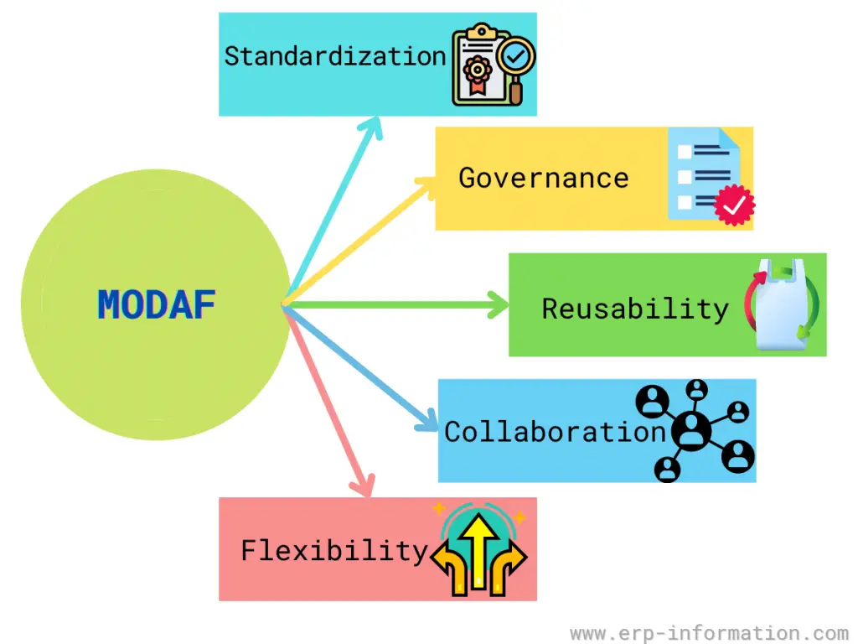

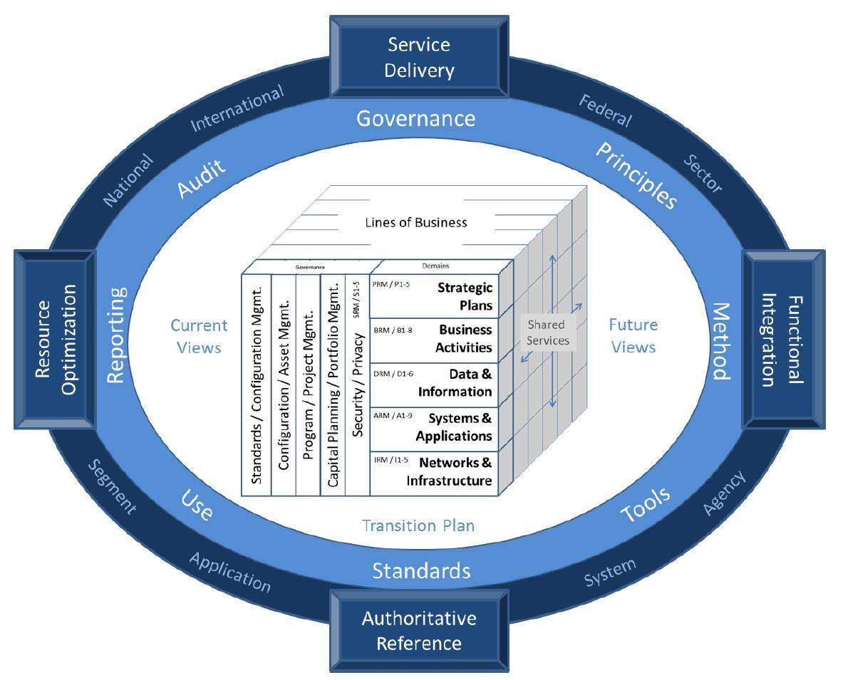
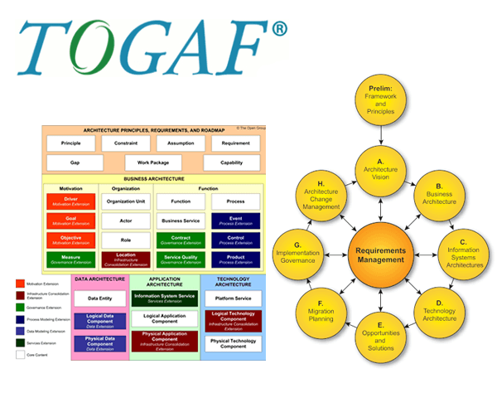
Understanding EAS Metamodel
003
MODAF: British Ministry of Defense Architecture Framework
FEAF: Federal Enterprise Architecture Framework
TOGAF: The Open Group Architecture Framework

Slide 4
Metamodel in Reference EA Frameworks
004
MODAF: British Ministry of Defense Architecture Framework
FEAF: Federal Enterprise Architecture Framework
TOGAF: The Open Group Architecture Framework

Slide 5

Setup Modeling Environment - Essential Open Source EA Tool
005

Slide 6


Setup Modeling Environment - Protégé & Neo4j
006

Slide 7

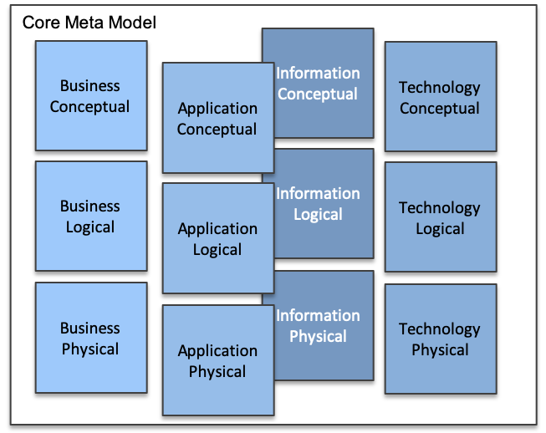
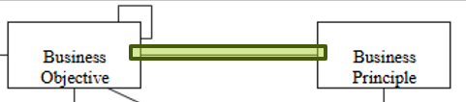
Essential EA Meta-Model - Business Layer - 01
007

Slide 8
Essential EA Meta-Model - Business Conceptual - 02
008

Slide 9
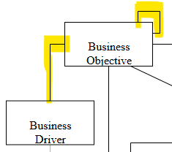
Essential EA Meta-Model - Business Layer - 03
009

Slide 10
Essential EA Meta-Model - Business Layer - 04
010

Slide 11
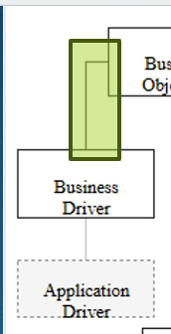
Essential EA Meta-Model - Business Layer - 05
011

Slide 12
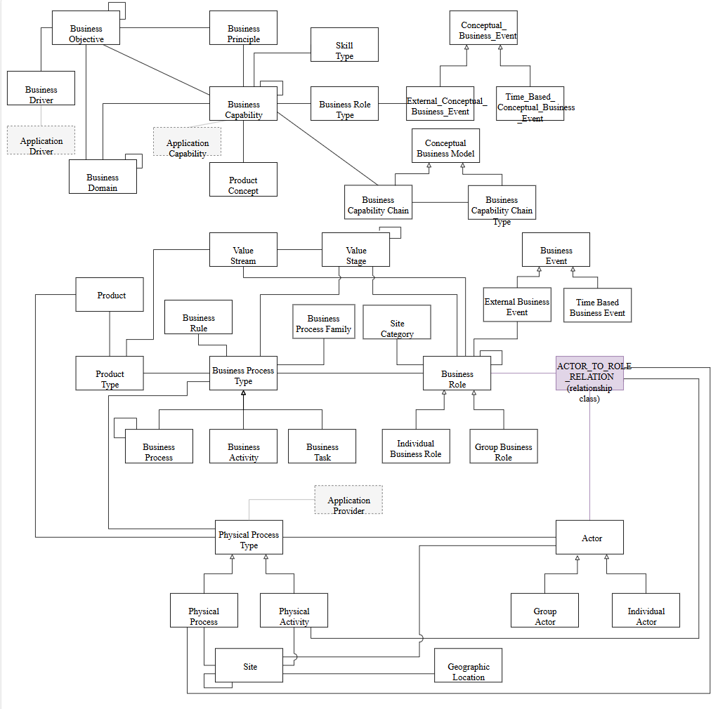

Slide 13
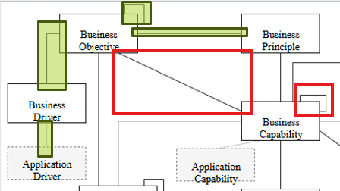
Essential EA Meta-Model - Business Layer - 06
012

Slide 15
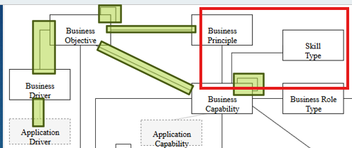
Essential EA Meta-Model - Business Layer - 07
013

Slide 17
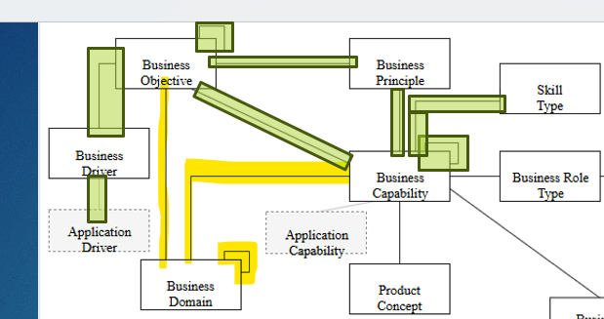
Essential EA Meta-Model - Business Layer - 08
014

Slide 19
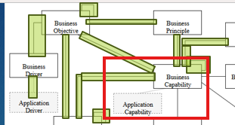
Essential EA Meta-Model - Business Layer - 09
015

Slide 21
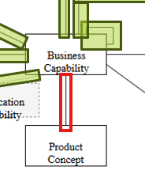
Essential EA Meta-Model - Business Layer - 10
016

Slide 23
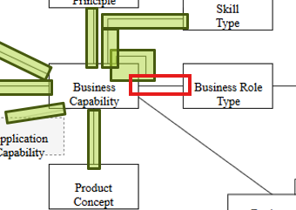
Essential EA Meta-Model - Business Layer - 11
017

Slide 25
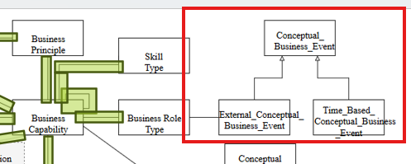
Essential EA Meta-Model - Business Layer - 12
018

Slide 27
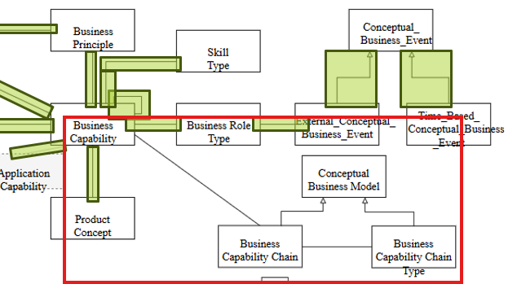
Essential EA Meta-Model - Business Layer - 13
019

Slide 29
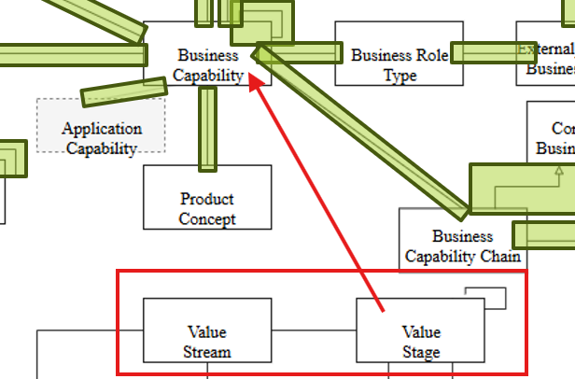
Essential EA Meta-Model - Business Layer - 14
020

Slide 31
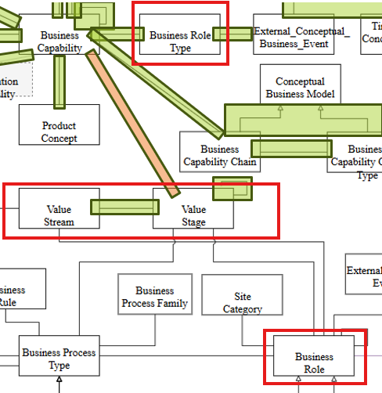
Essential EA Meta-Model - Business Layer - 15
021

Slide 33
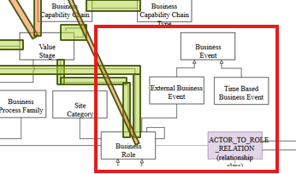
Essential EA Meta-Model - Business Layer - 16
022

Slide 34
·

Slide 35
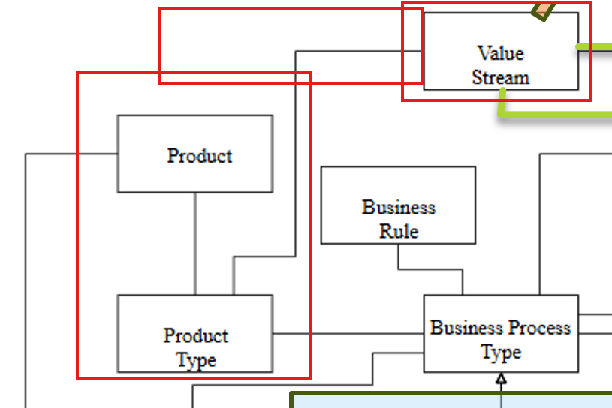
Essential EA Meta-Model - Business Layer - 17
023

Slide 36
·

Slide 37
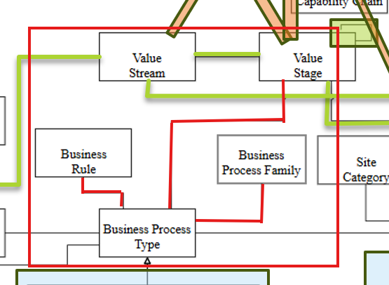
Essential EA Meta-Model - Business Layer - 18
024

Slide 38
·

Slide 39
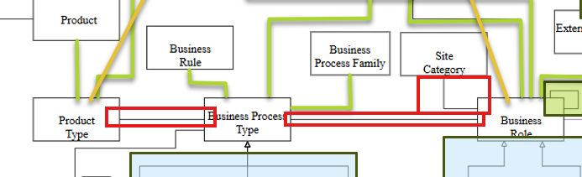
Essential EA Meta-Model - Business Layer - 19
025

Slide 40
·

Slide 41
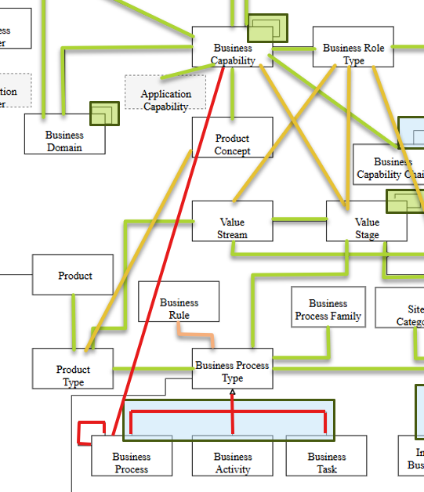
Essential EA Meta-Model - Business Layer - 20
026

Slide 42
·

Slide 43
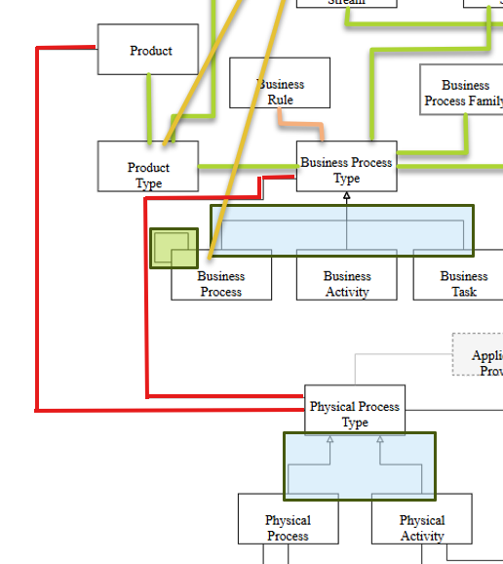
Essential EA Meta-Model - Business Layer - 21
027

Slide 44
·

Slide 45
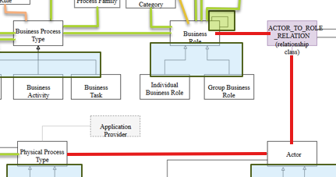
Essential EA Meta-Model - Business Layer - 22
028

Slide 46
·

Slide 47
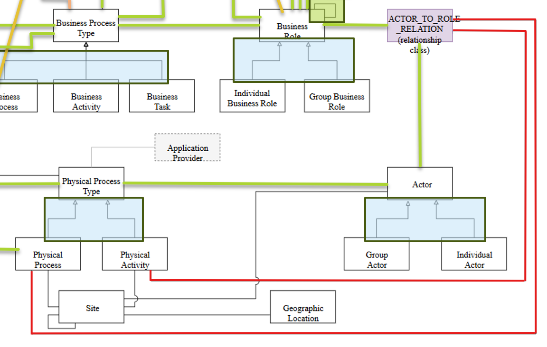
Essential EA Meta-Model - Business Layer - 23
029

Slide 48
·

Slide 49
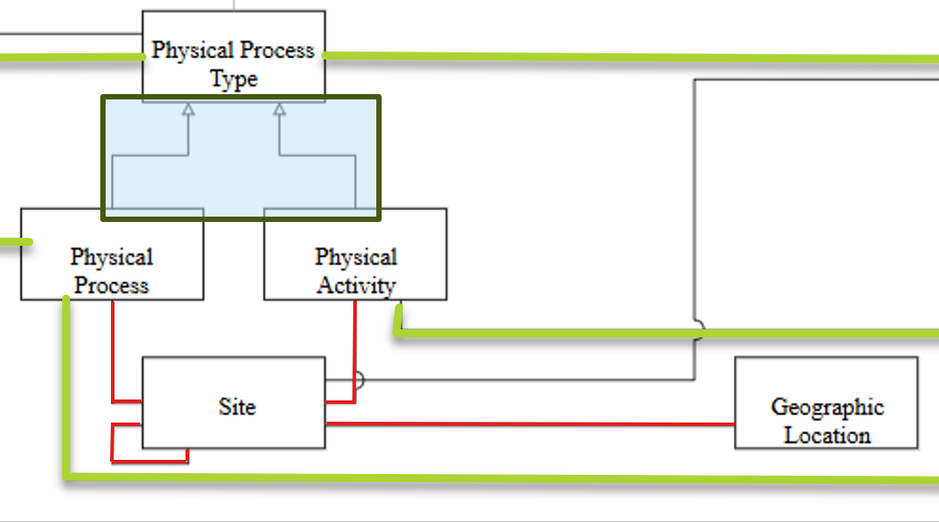
Essential EA Meta-Model - Business Layer - 24
030

Slide 50
·

Slide 51
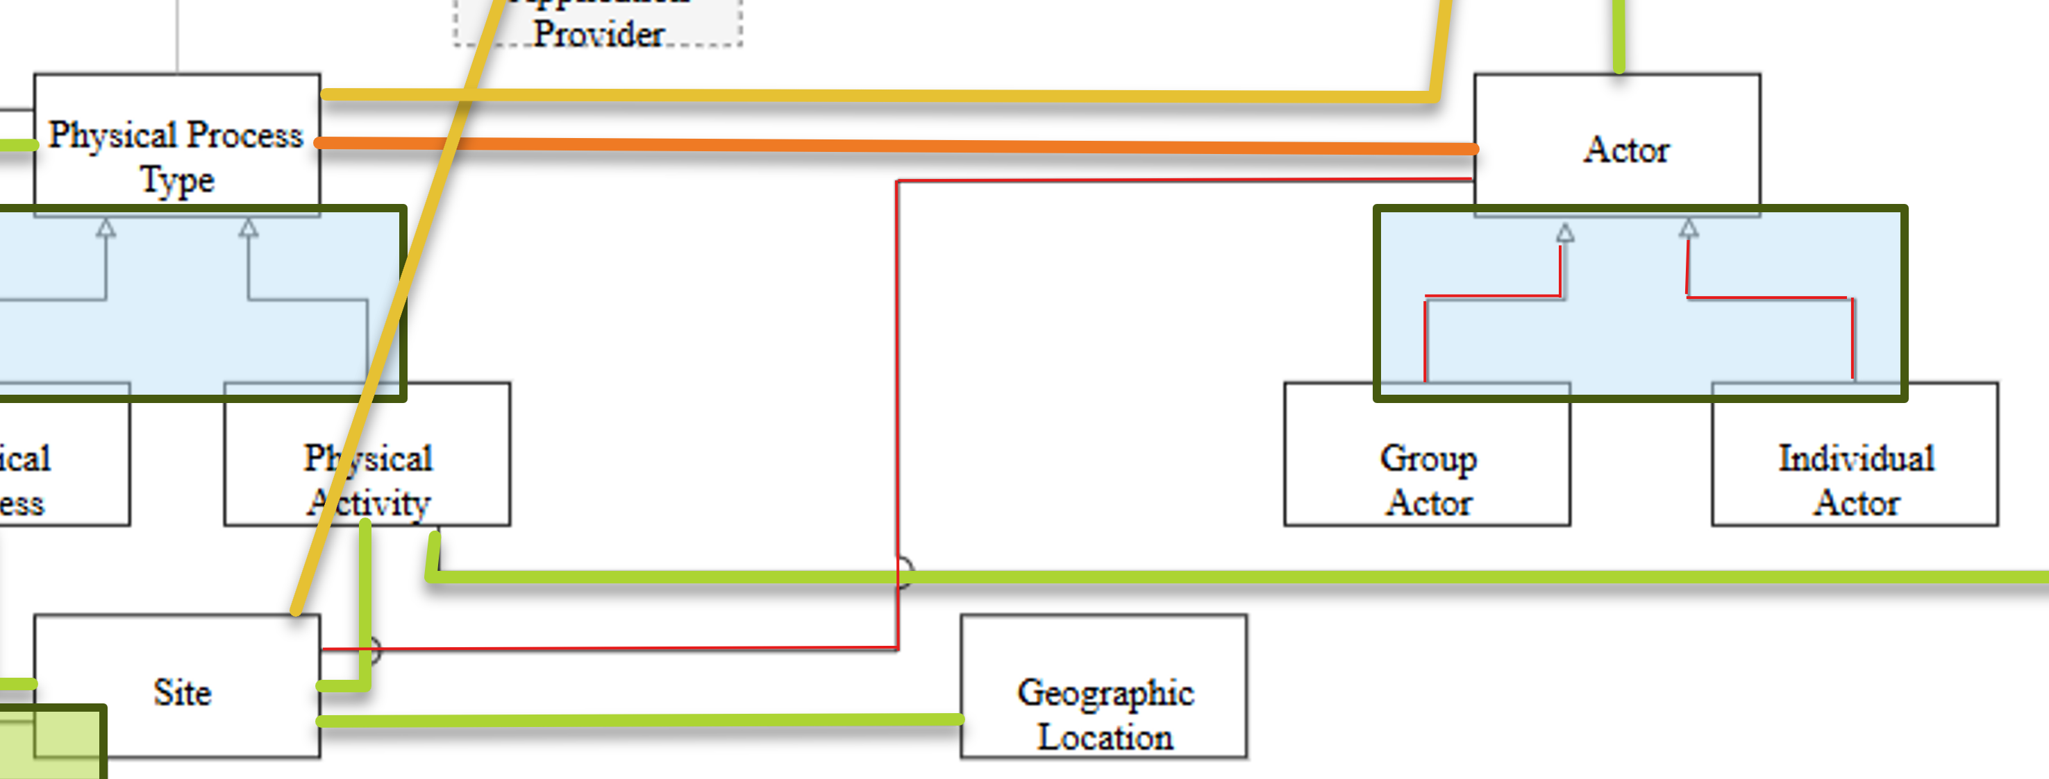
Essential EA Meta-Model - Business Layer - 25
031

Slide 52
·

Slide 53
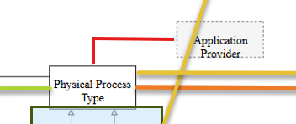
Essential EA Meta-Model - Business Layer - 26
032

Slide 54
·

Slide 55
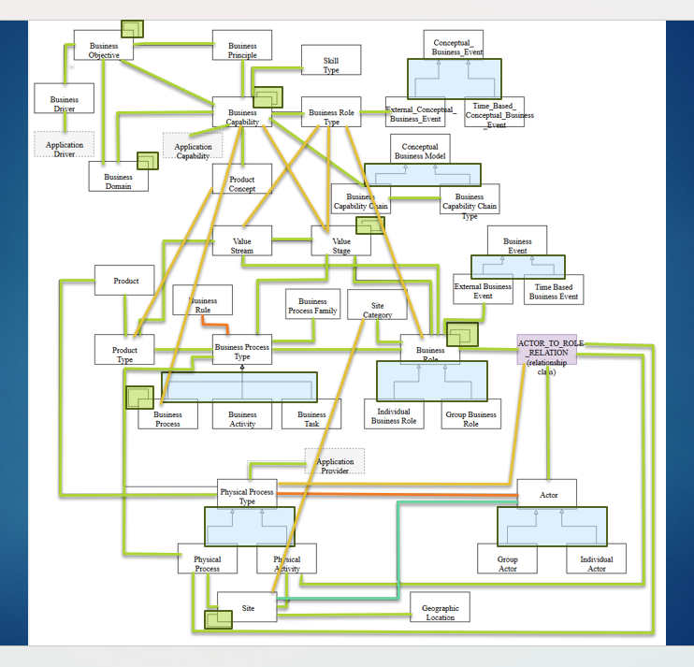
Essential EA Meta-Model - Business Layer - Summary
033

Slide 56
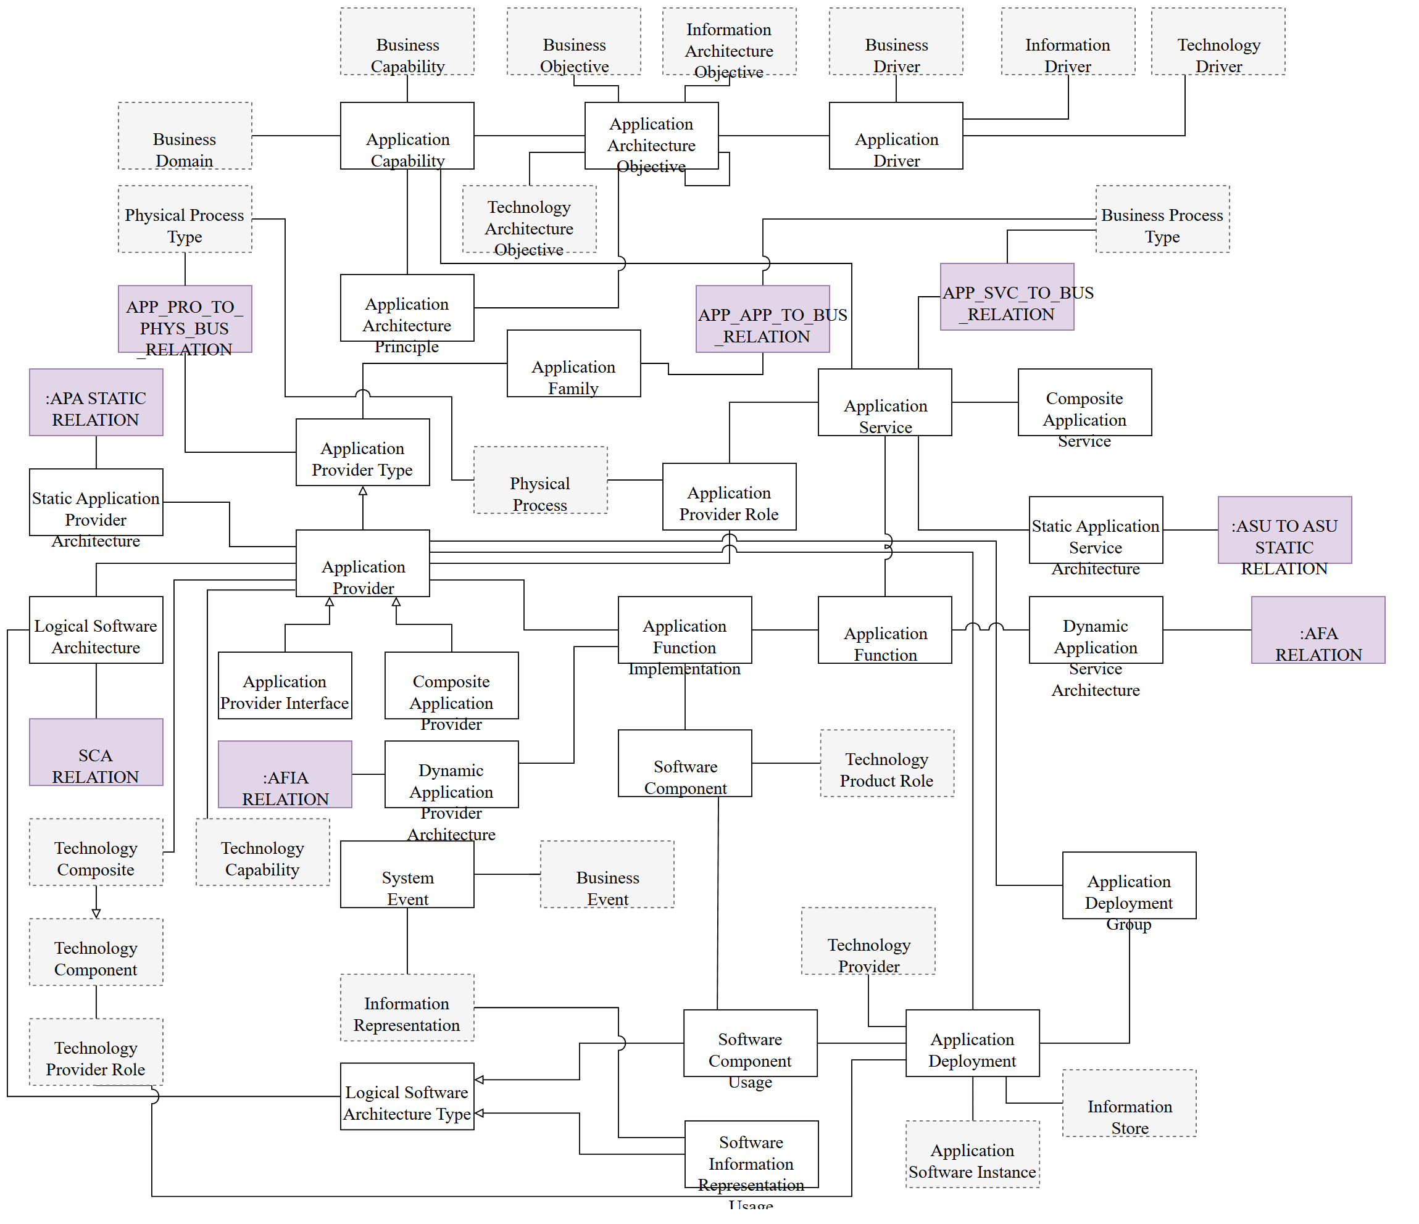

Essential EA Meta-Model - Application Layer

Slide 57
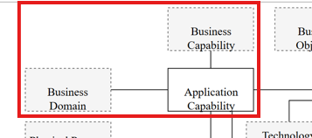
Essential EA Meta-Model - Application Layer - 01
034

Slide 58
Essential EA Meta-Model - Application Layer

Slide 59
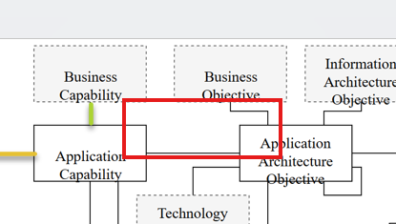
Essential EA Meta-Model - Application Layer - 02
035

Slide 60
Essential EA Meta-Model - Application Layer

Slide 61
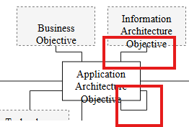
Essential EA Meta-Model - Application Layer - 03
036

Slide 62
Essential EA Meta-Model - Application Layer

Slide 63
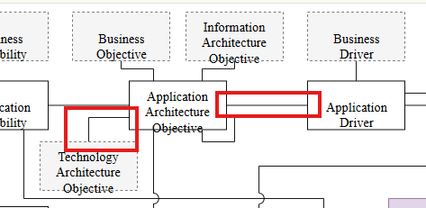
Essential EA Meta-Model - Application Layer - 04
037

Slide 64
Essential EA Meta-Model - Application Layer

Slide 65
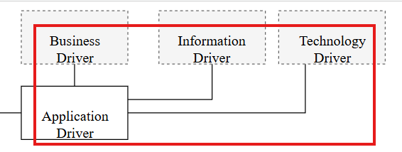
Essential EA Meta-Model - Application Layer - 05
038

Slide 66
Essential EA Meta-Model - Application Layer

Slide 67
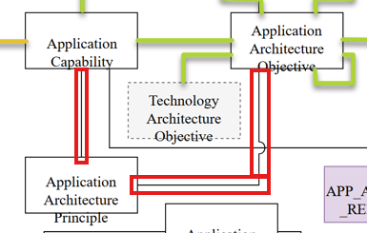
Essential EA Meta-Model - Application Layer - 06
039

Slide 68
Essential EA Meta-Model - Application Layer

Slide 69
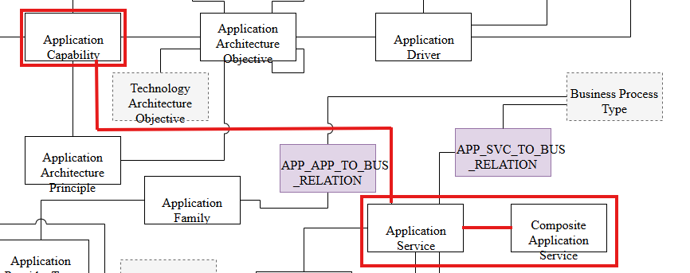
Essential EA Meta-Model - Application Layer - 07
040

Slide 70
Essential EA Meta-Model - Application Layer

Slide 71
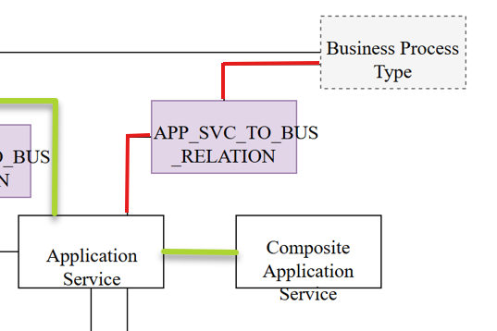
Essential EA Meta-Model - Application Layer - 08
041

Slide 72
Essential EA Meta-Model - Application Layer

Slide 73
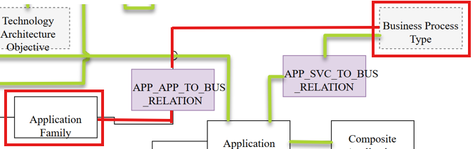
Essential EA Meta-Model - Application Layer - 09
042

Slide 74
Essential EA Meta-Model - Application Layer

Slide 75
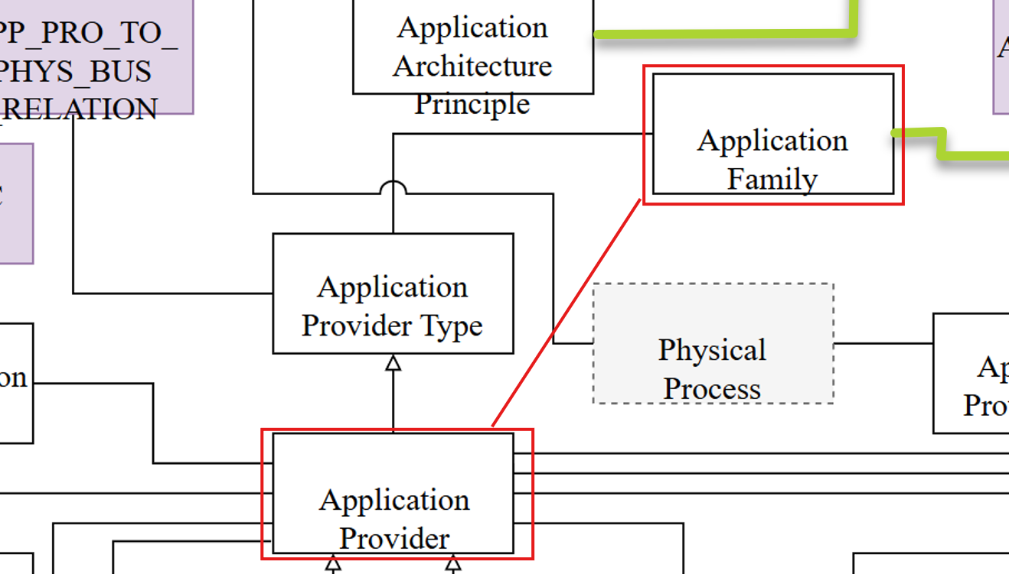
Essential EA Meta-Model - Application Layer - 10
043

Slide 76
Essential EA Meta-Model - Application Layer

Slide 77
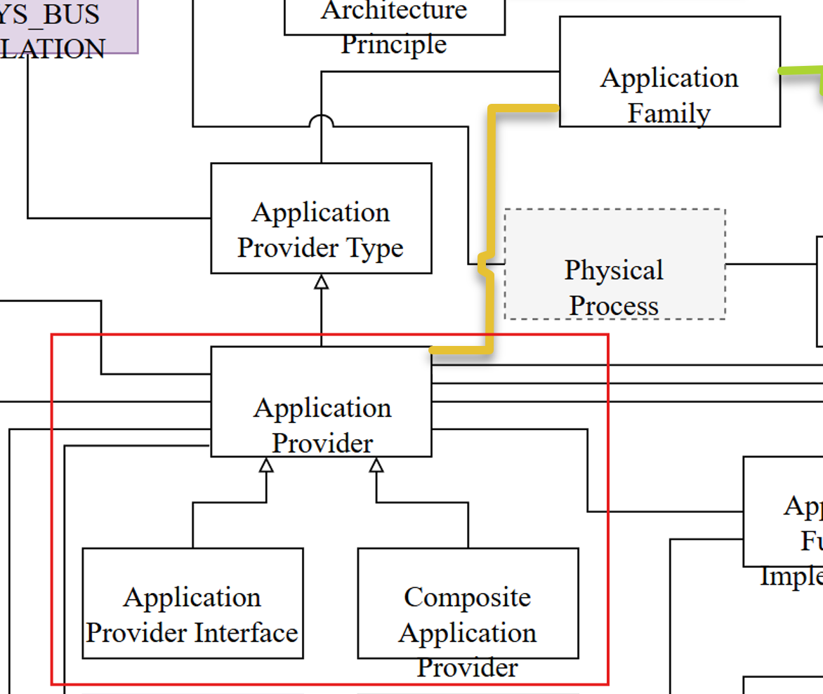
Essential EA Meta-Model - Application Layer - 11
044

Slide 78
Essential EA Meta-Model - Application Layer

Slide 79
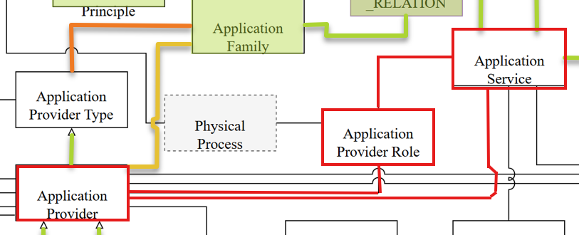
Essential EA Meta-Model - Application Layer - 12
045

Slide 80
Essential EA Meta-Model - Application Layer

Slide 81
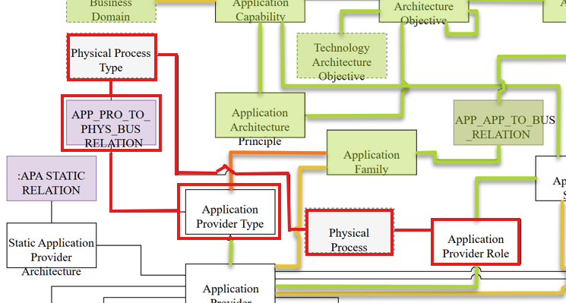
Essential EA Meta-Model - Application Layer - 13
046

Slide 82
Essential EA Meta-Model - Application Layer

Slide 83
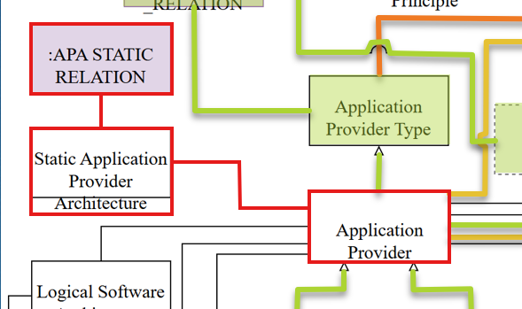
Essential EA Meta-Model - Application Layer - 14
047

Slide 84
Essential EA Meta-Model - Application Layer

Slide 85
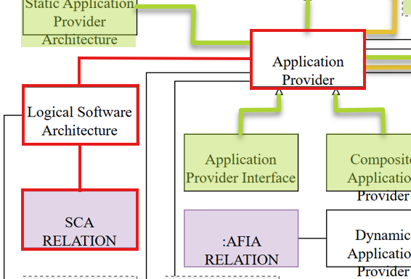
Essential EA Meta-Model - Application Layer - 15
048

Slide 86
Essential EA Meta-Model - Application Layer

Slide 87

Essential EA Meta-Model - Application Layer - 16
049

Slide 88
Essential EA Meta-Model - Application Layer

Slide 89

Essential EA Meta-Model - Application Layer - 17
050

Slide 90
Essential EA Meta-Model - Application Layer

Slide 91

Essential EA Meta-Model - Application Layer - 18
051

Slide 92
Essential EA Meta-Model - Application Layer

Slide 93

Essential EA Meta-Model - Application Layer - 19
052

Slide 94
Essential EA Meta-Model - Application Layer

Slide 95

Essential EA Meta-Model - Application Layer - 20
053

Slide 96
Essential EA Meta-Model - Application Layer

Slide 97

Essential EA Meta-Model - Application Layer - 21
054

Slide 98
Essential EA Meta-Model - Application Layer

Slide 99

Essential EA Meta-Model - Application Layer - 22
055

Slide 100
Essential EA Meta-Model - Application Layer

Slide 101

Essential EA Meta-Model - Application Layer - 23
056

Slide 102
Essential EA Meta-Model - Application Layer

Slide 103

Essential EA Meta-Model - Application Layer - 24
057

Slide 104
Essential EA Meta-Model - Application Layer

Slide 105

Essential EA Meta-Model - Application Layer - 25
058

Slide 106
Essential EA Meta-Model - Application Layer

Slide 107

Essential EA Meta-Model - Application Layer - 26
059

Slide 108
Essential EA Meta-Model - Application Layer

Slide 109

Essential EA Meta-Model - Application Layer - 27
060

Slide 110
Essential EA Meta-Model - Application Layer

Slide 111

Essential EA Meta-Model - Application Layer - 28
061

Slide 112
Essential EA Meta-Model - Application Layer

Slide 113

Essential EA Meta-Model - Application Layer - 29
062

Slide 114
Essential EA Meta-Model - Application Layer

Slide 115

Essential EA Meta-Model - Application Layer - 30
063

Slide 116
Essential EA Meta-Model - Application Layer

Slide 117

Essential EA Meta-Model - Application Layer - 31
064

Slide 118
Essential EA Meta-Model - Application Layer

Slide 119

Essential EA Meta-Model - Application Layer - 32
065

Slide 120
Essential EA Meta-Model - Application Layer

Slide 121

Essential EA Meta-Model - Application Layer - 33
066

Slide 122
Essential EA Meta-Model - Application Layer

Slide 123

Essential EA Meta-Model - Application Layer - 34
067

Slide 124
Essential EA Meta-Model - Application Layer

Slide 125

Essential EA Meta-Model - Application Layer - 35
068

Slide 126
Essential EA Meta-Model - Application Layer

Slide 127

Essential EA Meta-Model - Application Layer - 36
069

Slide 128
Essential EA Meta-Model - Application Layer

Slide 129

Essential EA Meta-Model - Application Layer - 37
070

Slide 130
Essential EA Meta-Model - Application Layer

Slide 131

Essential EA Meta-Model - Application Layer - 38
071

Slide 132
Essential EA Meta-Model - Application Layer

Slide 133


Essential EA Meta-Model - Application Layer - Summary
072

Slide 134

Essential EA Meta-Model - Information Layer - Opening
073

Slide 135

Essential EA Meta-Model - Information/Data Layer

Slide 136

Essential EA Meta-Model - Information Layer - 01
074

Slide 137
Essential EA Meta-Model - Information/Data Layer

Slide 138

Essential EA Meta-Model - Information Layer - 02
075

Slide 139
Essential EA Meta-Model - Information/Data Layer

Slide 140

Essential EA Meta-Model - Information Layer - 03
076

Slide 141
Essential EA Meta-Model - Information/Data Layer

Slide 142

Essential EA Meta-Model - Information Layer - 04
077

Slide 143
Essential EA Meta-Model - Information/Data Layer

Slide 144

Essential EA Meta-Model - Information Layer - 05
078

Slide 145
Essential EA Meta-Model - Information/Data Layer

Slide 146

Essential EA Meta-Model - Information Layer - 06
079

Slide 147
Essential EA Meta-Model - Information/Data Layer

Slide 148

Essential EA Meta-Model - Information Layer - 07
080

Slide 149
Essential EA Meta-Model - Information/Data Layer

Slide 150

Essential EA Meta-Model - Information Layer - 08
081

Slide 151
Essential EA Meta-Model - Information/Data Layer

Slide 152

Essential EA Meta-Model - Information Layer - 09
082

Slide 153
Essential EA Meta-Model - Information/Data Layer

Slide 154

Essential EA Meta-Model - Information Layer - 10
083

Slide 155
Essential EA Meta-Model - Information/Data Layer

Slide 156

Essential EA Meta-Model - Information Layer - 11
084

Slide 157
Essential EA Meta-Model - Information/Data Layer

Slide 158

Essential EA Meta-Model - Information Layer - 12
085

Slide 159
Essential EA Meta-Model - Information/Data Layer

Slide 160
Essential EA Meta-Model - Information Layer - 13
086

Slide 161

Thank You!
someone@Example.com

Slide 162


