Slide 1



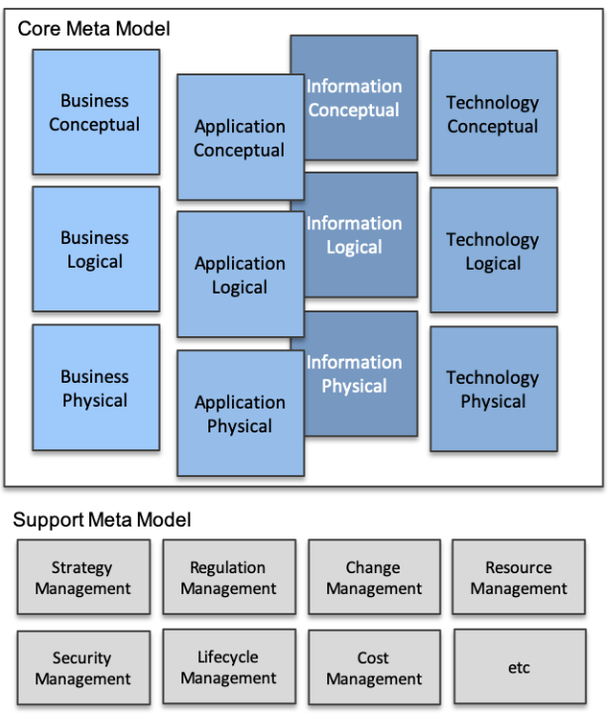
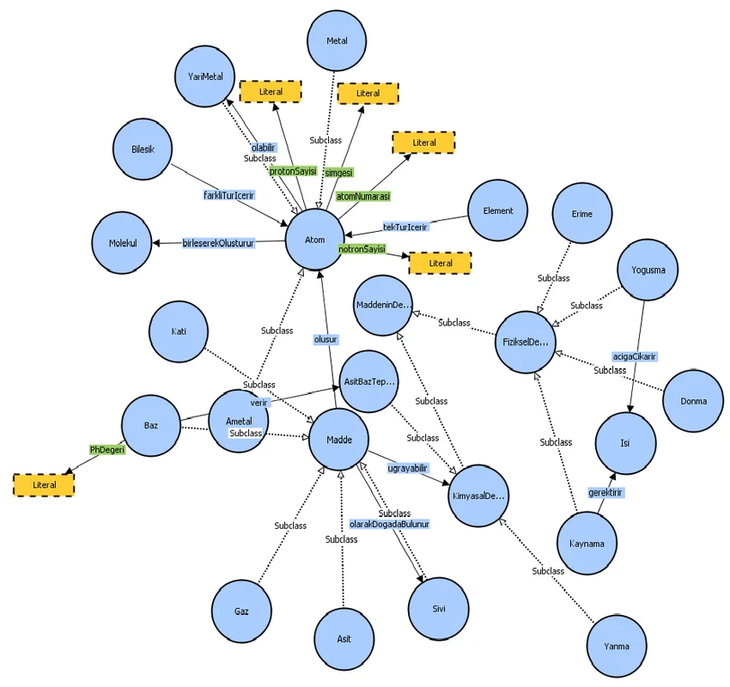


Master EAS Meta-Model in Ontology & Graph Perspective
001
Building Up Enterprise Architecture Meta-Model From Scratch
5.6+
3.5

Slide 2
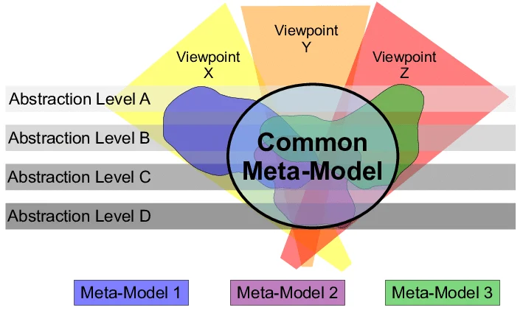
What is Metamodel?
002
A metamodel is a model of a model, and metamodeling is the process of generating such metamodels.
Metamodeling or meta-modeling is the analysis, construction, and development of the frames, rules, constraints, models, and theories applicable and useful for modeling a predefined class of problems.

Slide 3
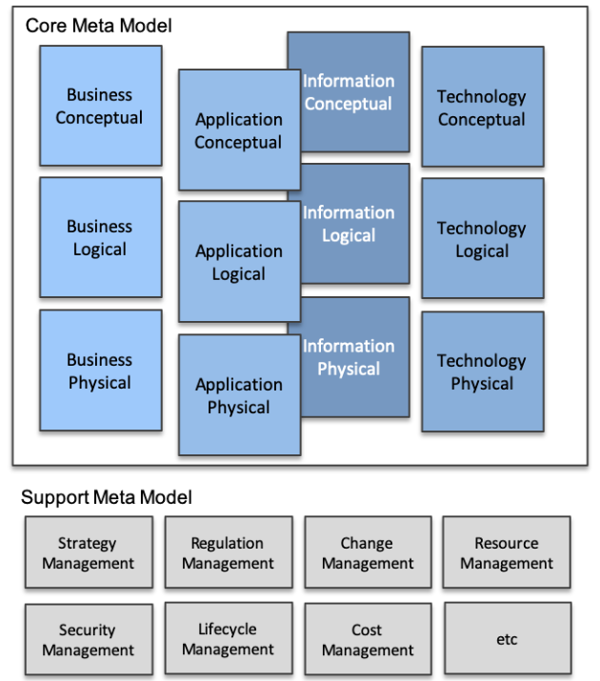
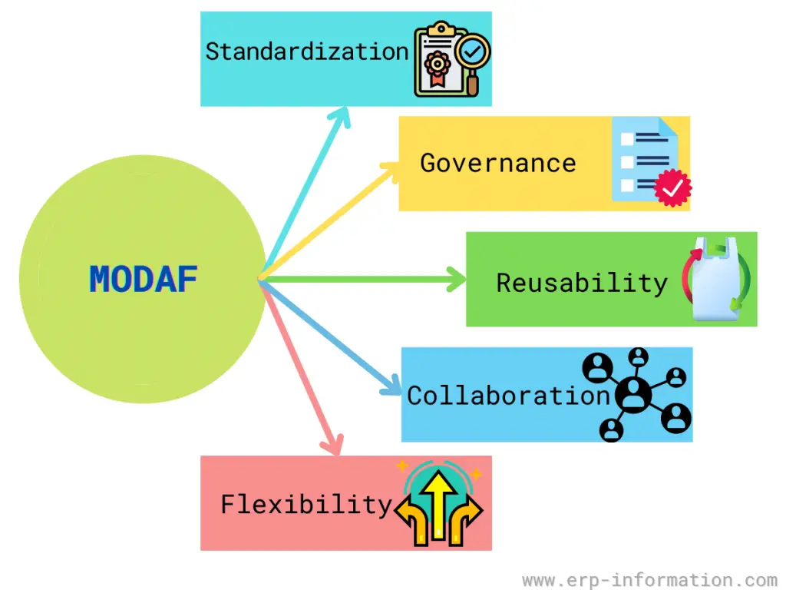

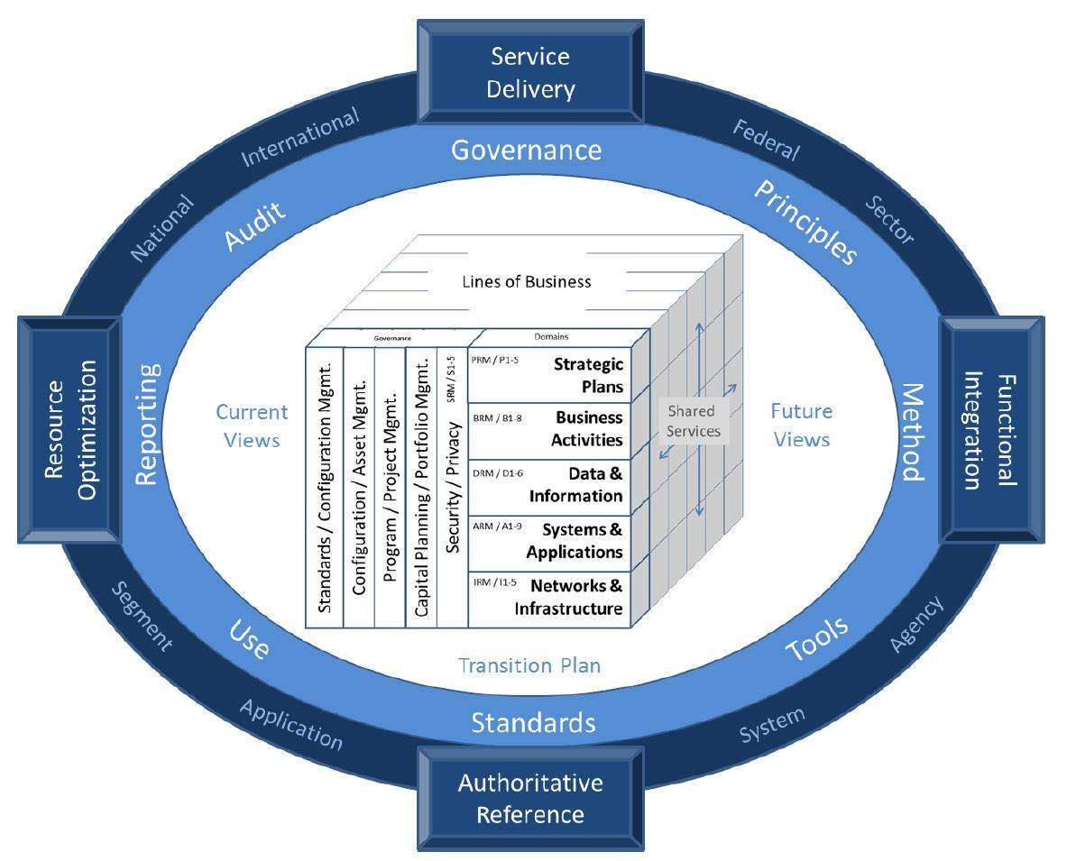
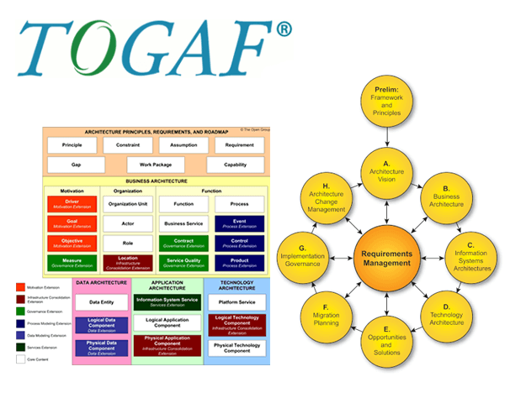
Understanding EAS Metamodel
003
MODAF: British Ministry of Defense Architecture Framework
FEAF: Federal Enterprise Architecture Framework
TOGAF: The Open Group Architecture Framework

Slide 4
Metamodel in Reference EA Frameworks
004
MODAF: British Ministry of Defense Architecture Framework
FEAF: Federal Enterprise Architecture Framework
TOGAF: The Open Group Architecture Framework

Slide 5

Setup Modeling Environment - Essential Open Source EA Tool
005

Slide 6


Setup Modeling Environment - Protégé & Neo4j
006

Slide 7

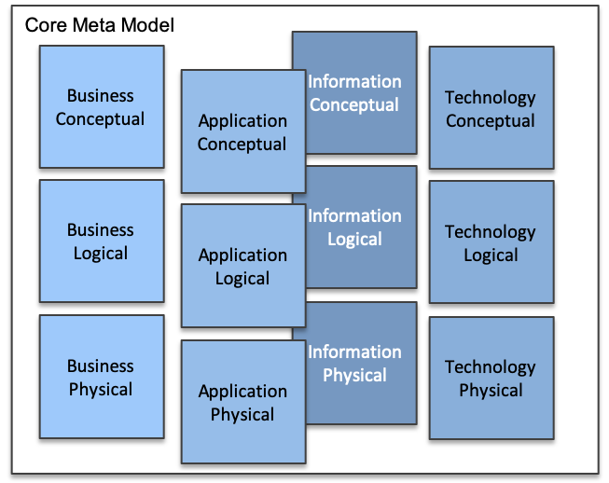
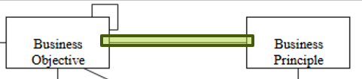
Essential EA Meta-Model - Business Layer - 01
007

Slide 8
Essential EA Meta-Model - Business Conceptual - 02
008

Slide 9
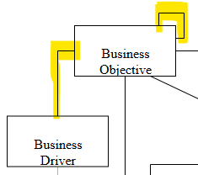
Essential EA Meta-Model - Business Layer - 03
009

Slide 10
Essential EA Meta-Model - Business Layer - 04
010

Slide 11
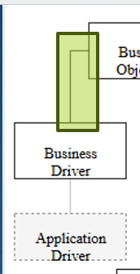
Essential EA Meta-Model - Business Layer - 05
011

Slide 12
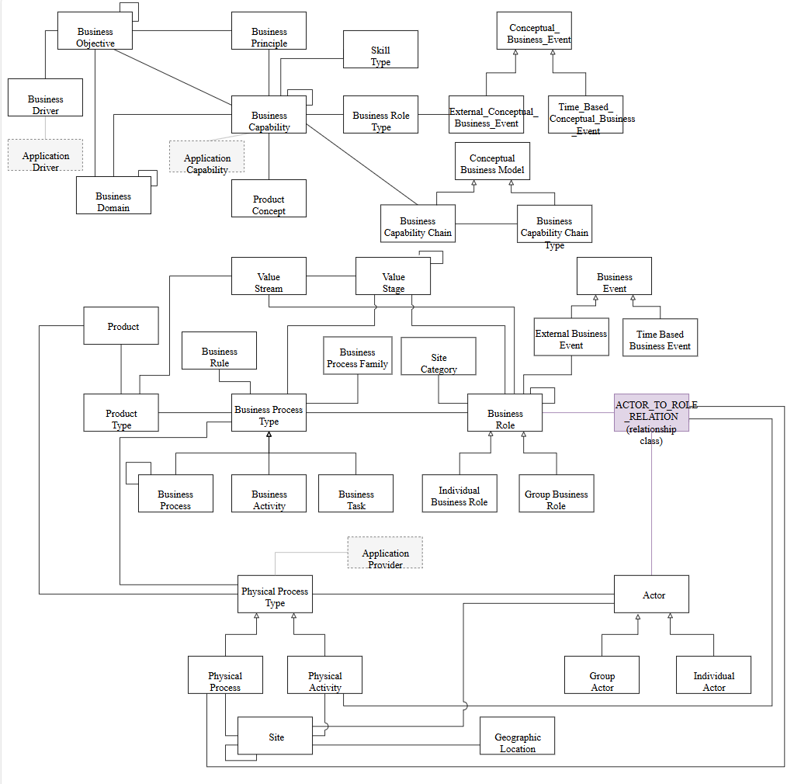

Slide 13
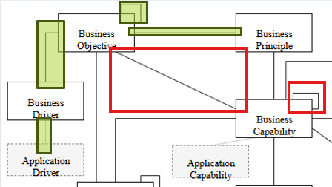
Essential EA Meta-Model - Business Layer - 06
012

Slide 15
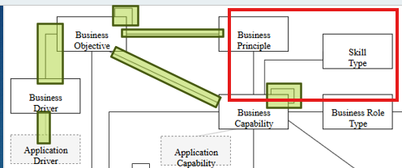
Essential EA Meta-Model - Business Layer - 07
013

Slide 17
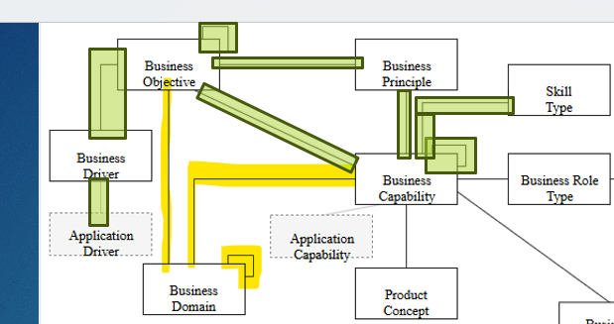
Essential EA Meta-Model - Business Layer - 08
014

Slide 19
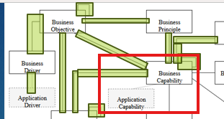
Essential EA Meta-Model - Business Layer - 09
015

Slide 21
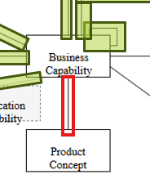
Essential EA Meta-Model - Business Layer - 10
016

Slide 23
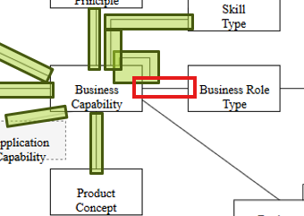
Essential EA Meta-Model - Business Layer - 11
017

Slide 25
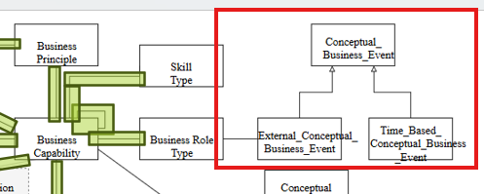
Essential EA Meta-Model - Business Layer - 12
018

Slide 27
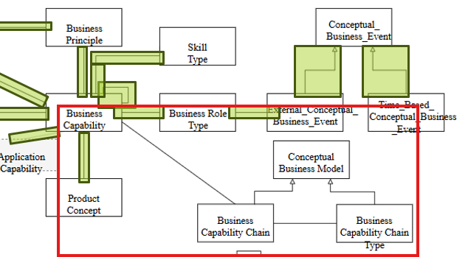
Essential EA Meta-Model - Business Layer - 13
019

Slide 29
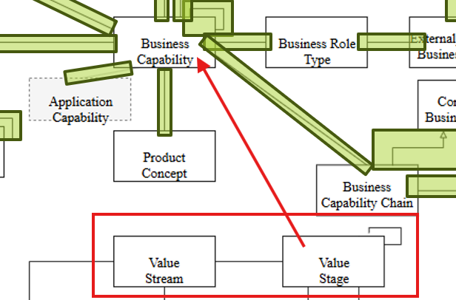
Essential EA Meta-Model - Business Layer - 14
020

Slide 31
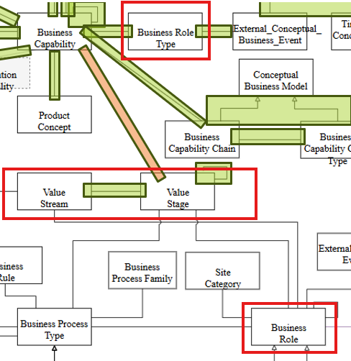
Essential EA Meta-Model - Business Layer - 15
021

Slide 33
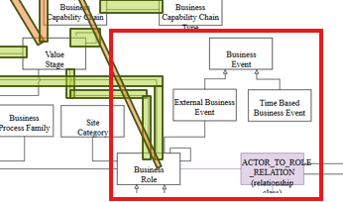
Essential EA Meta-Model - Business Layer - 16
022

Slide 34
·

Slide 35
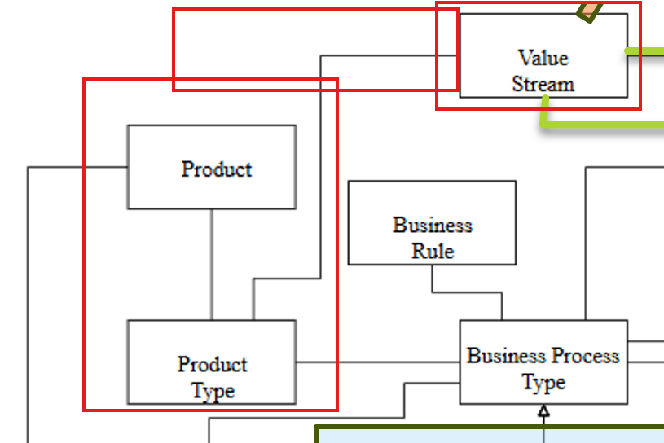
Essential EA Meta-Model - Business Layer - 17
023

Slide 36
·

Slide 37
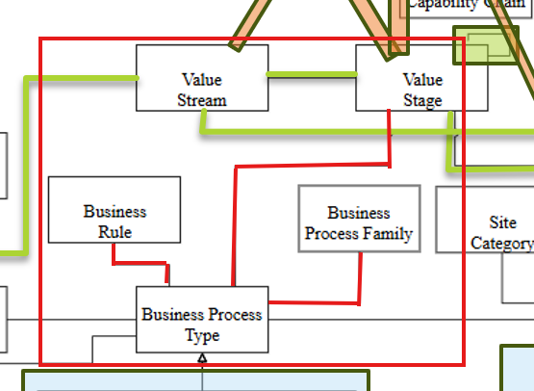
Essential EA Meta-Model - Business Layer - 18
024

Slide 38
·

Slide 39
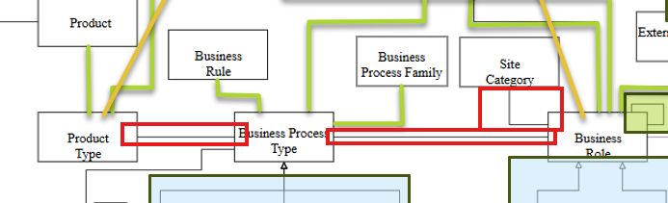
Essential EA Meta-Model - Business Layer - 19
025

Slide 40
·

Slide 41
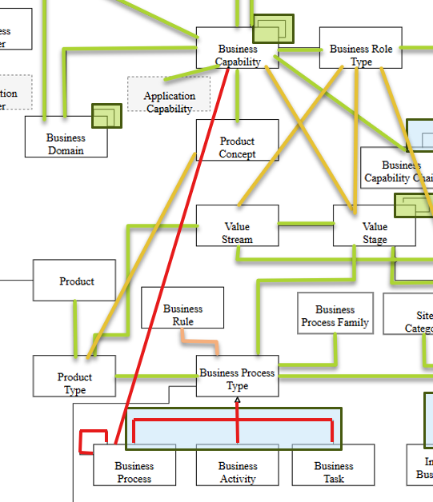
Essential EA Meta-Model - Business Layer - 20
026

Slide 42
·

Slide 43
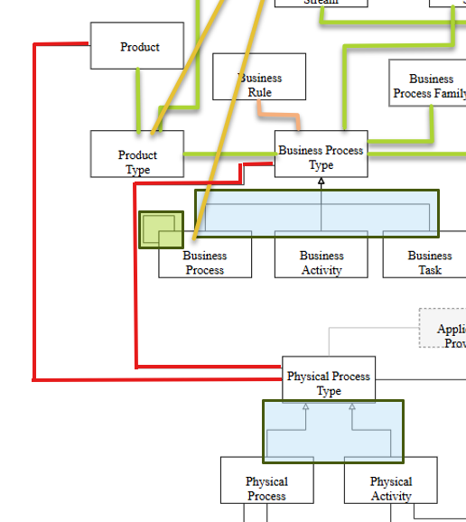
Essential EA Meta-Model - Business Layer - 21
027

Slide 44
·

Slide 45
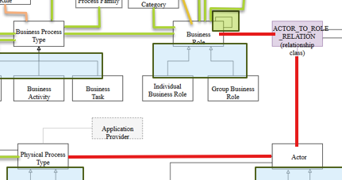
Essential EA Meta-Model - Business Layer - 22
028

Slide 46
·

Slide 47
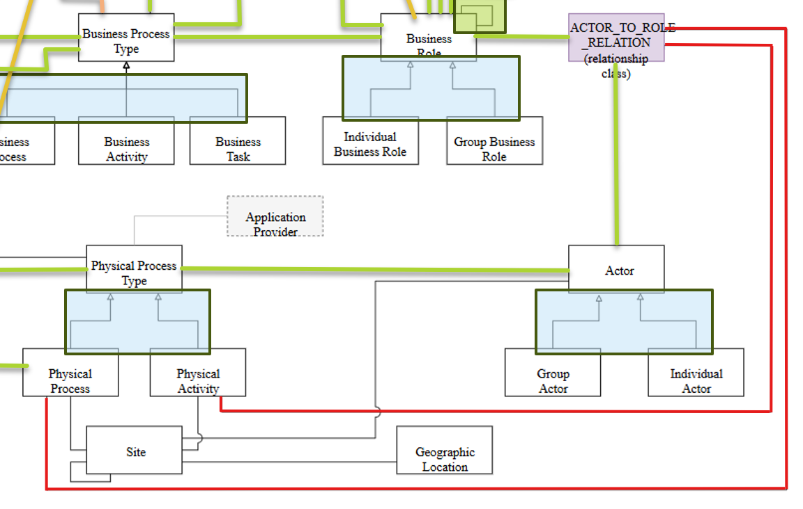
Essential EA Meta-Model - Business Layer - 23
029

Slide 48
·

Slide 49
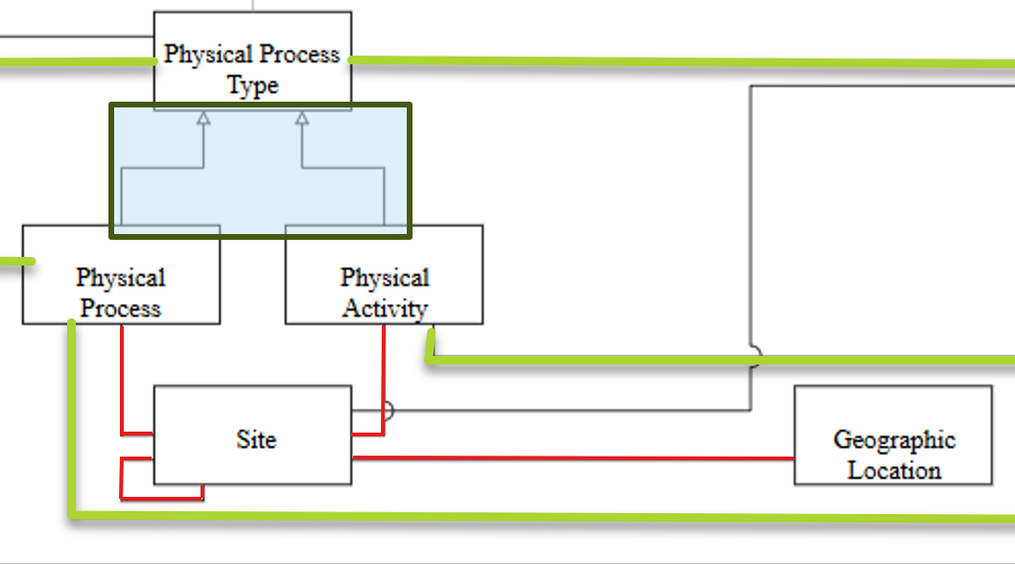
Essential EA Meta-Model - Business Layer - 24
030

Slide 50
·

Slide 51
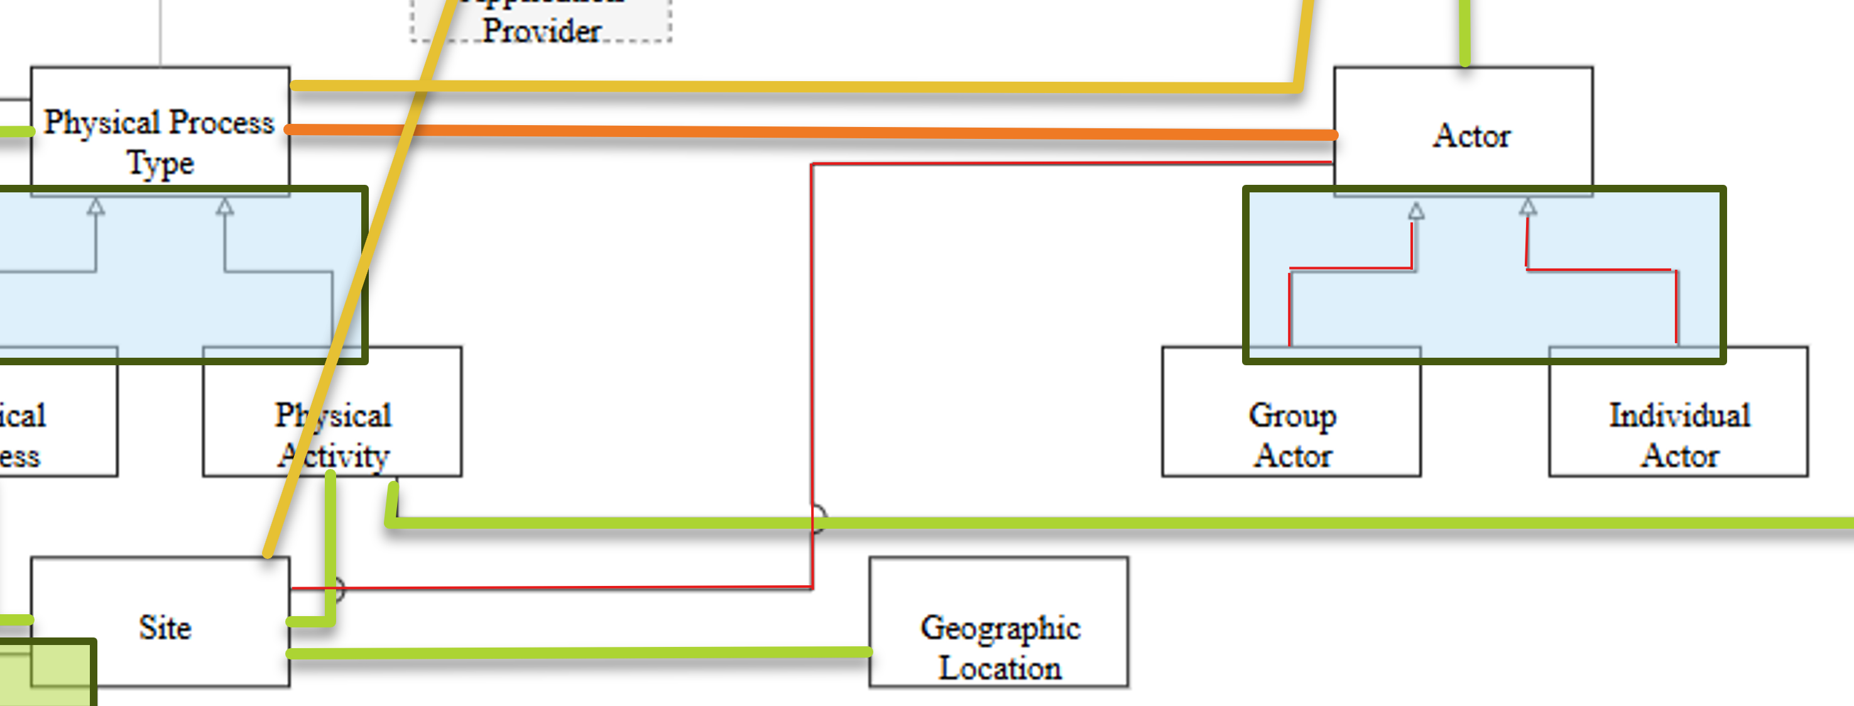
Essential EA Meta-Model - Business Layer - 25
031

Slide 52
·

Slide 53
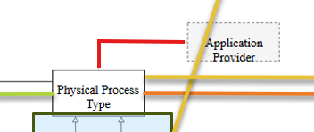
Essential EA Meta-Model - Business Layer - 26
032

Slide 54
·

Slide 55
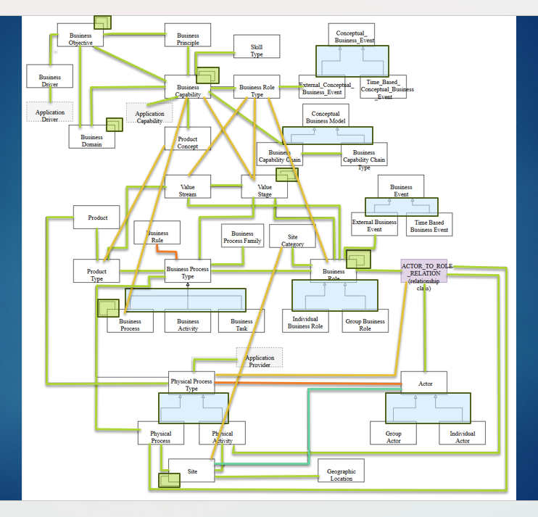
Essential EA Meta-Model - Business Layer - Summary
033

Slide 56
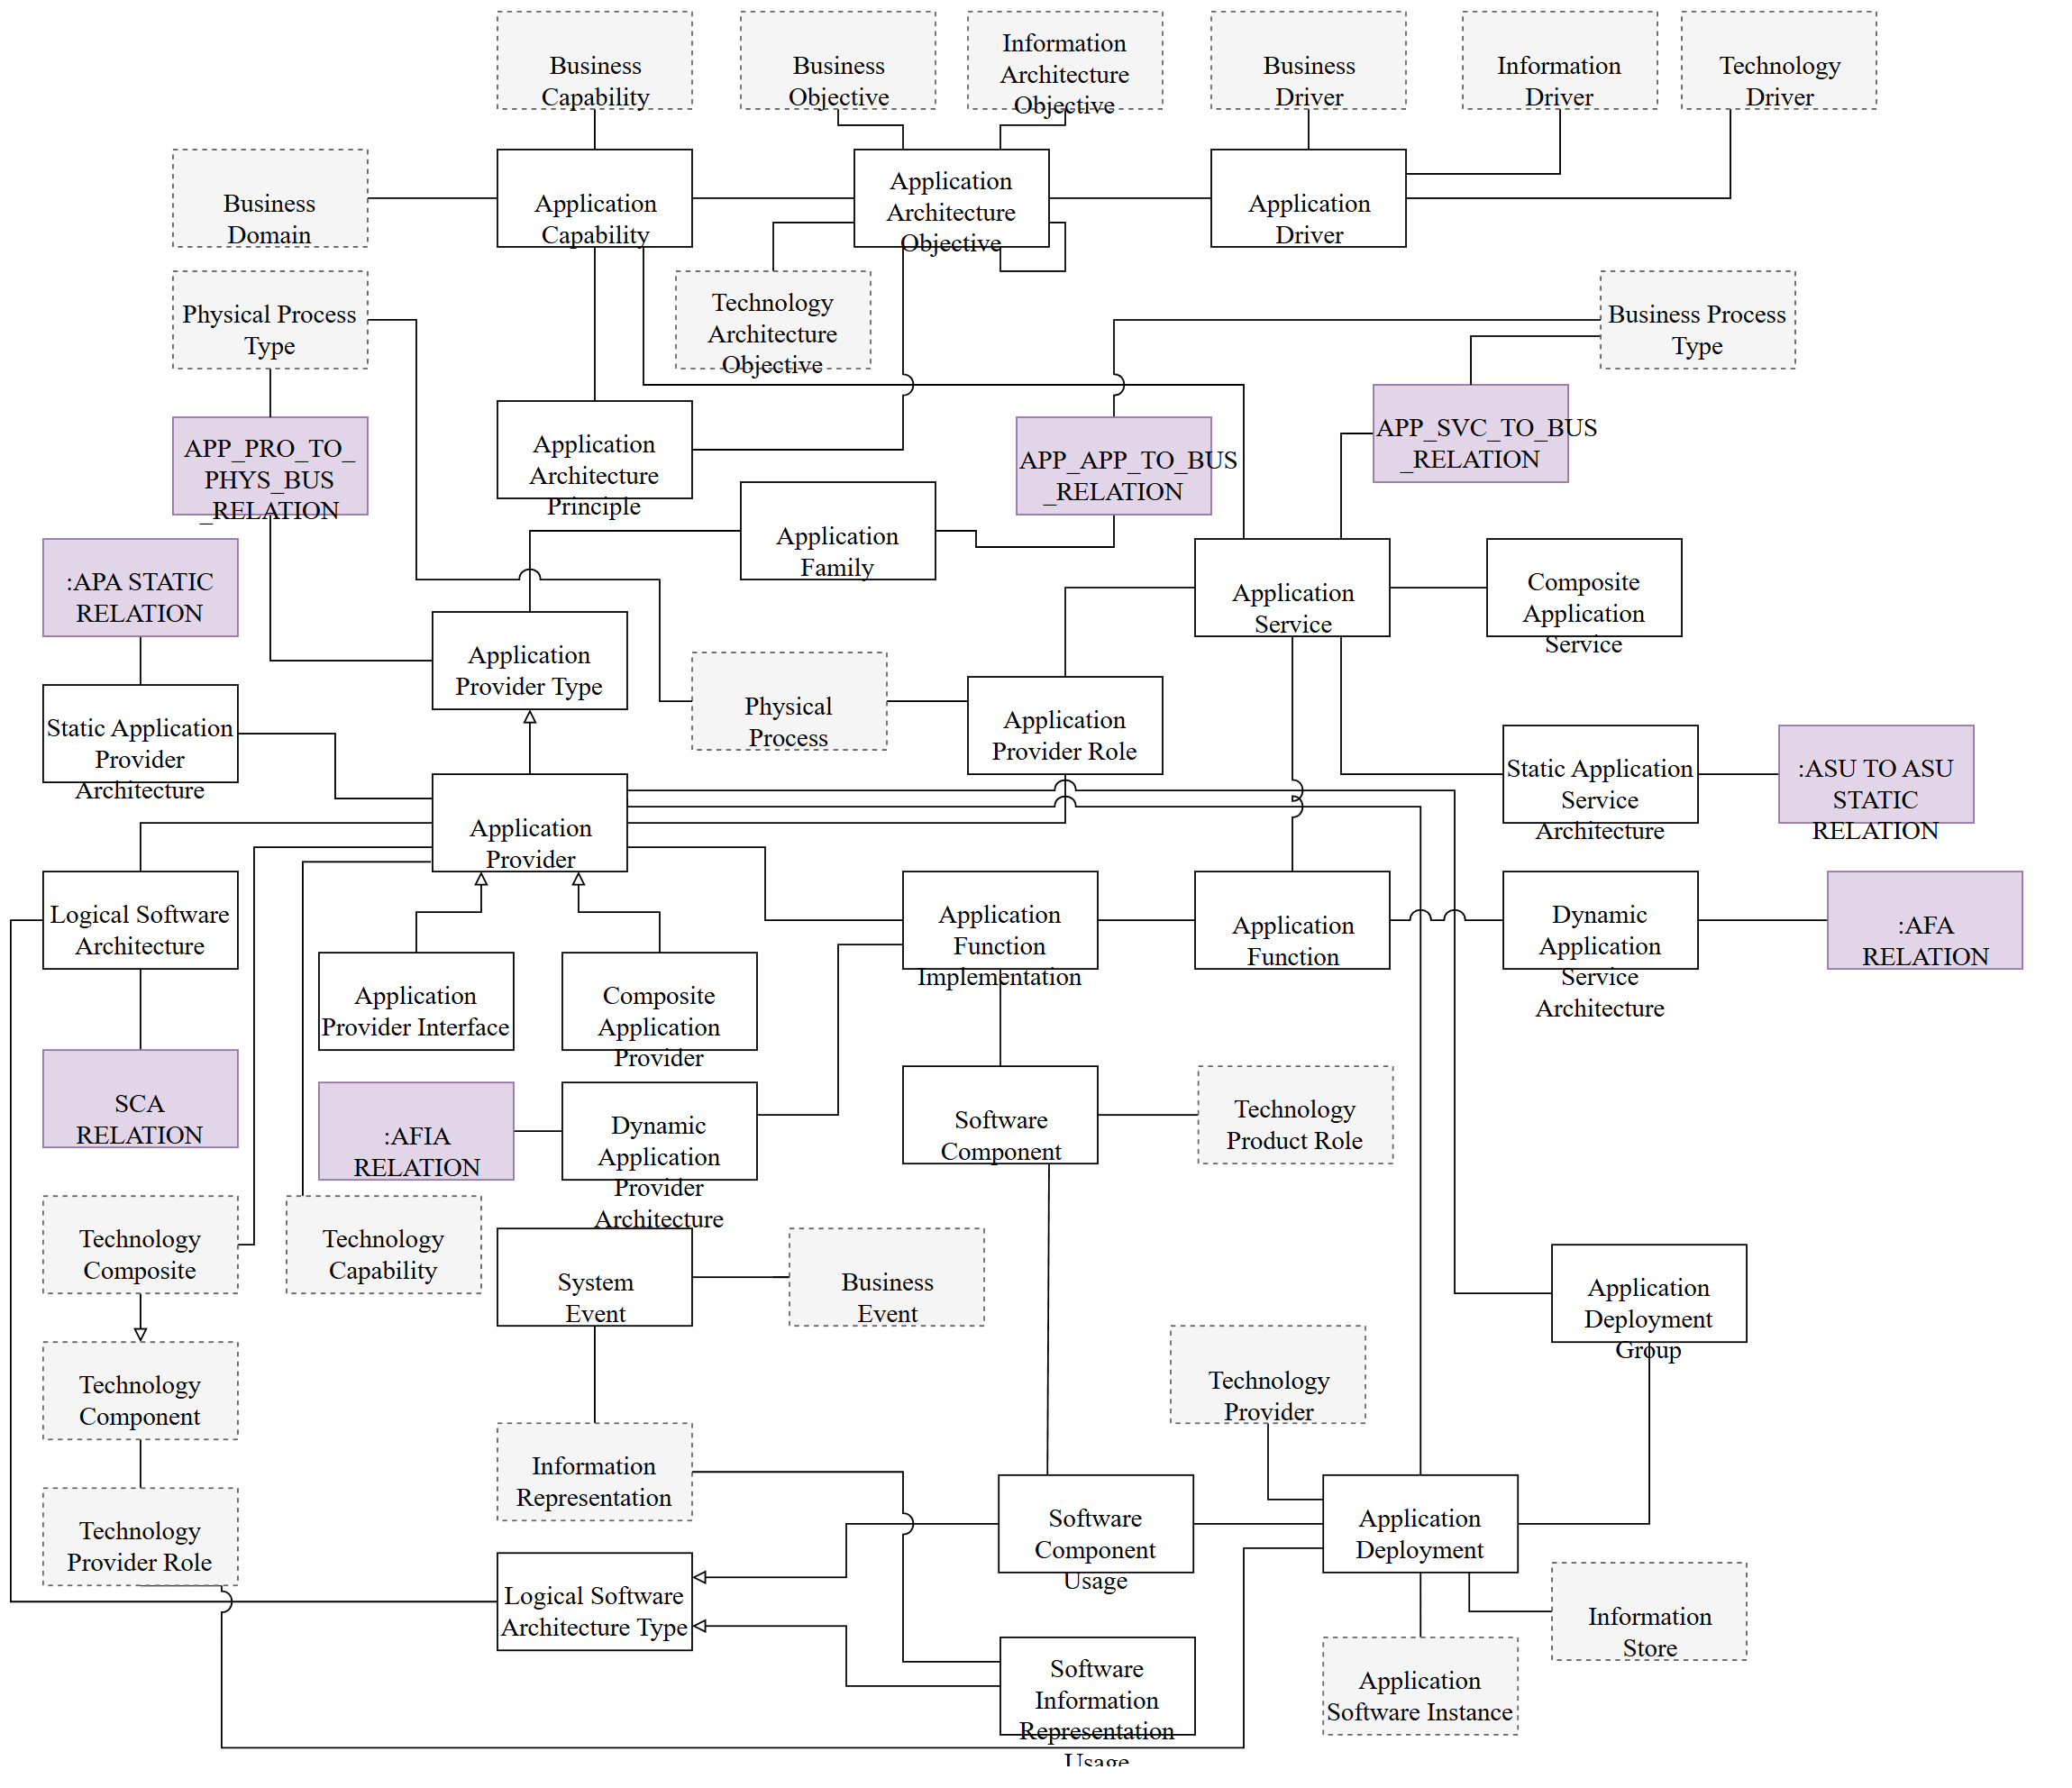

Essential EA Meta-Model - Application Layer

Slide 57
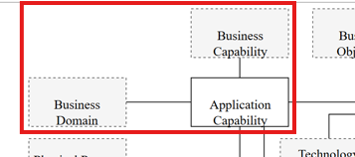
Essential EA Meta-Model - Application Layer - 01
034

Slide 58
Essential EA Meta-Model - Application Layer

Slide 59
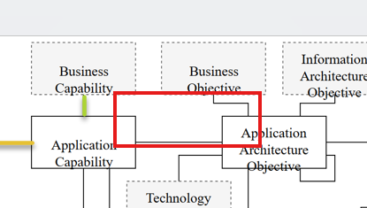
Essential EA Meta-Model - Application Layer - 02
035

Slide 60
Essential EA Meta-Model - Application Layer

Slide 61
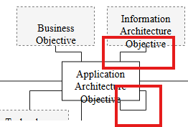
Essential EA Meta-Model - Application Layer - 03
036

Slide 62
Essential EA Meta-Model - Application Layer

Slide 63
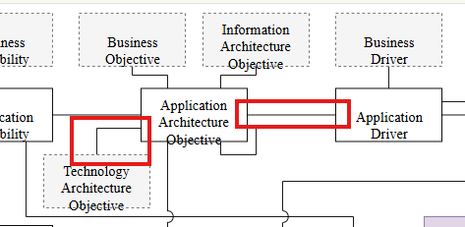
Essential EA Meta-Model - Application Layer - 04
037

Slide 64
Essential EA Meta-Model - Application Layer

Slide 65
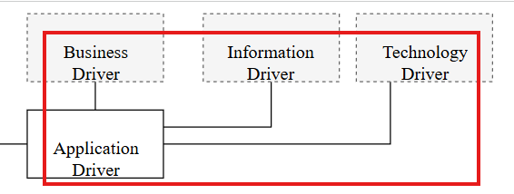
Essential EA Meta-Model - Application Layer - 05
038

Slide 66
Essential EA Meta-Model - Application Layer

Slide 67
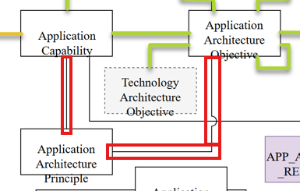
Essential EA Meta-Model - Application Layer - 06
039

Slide 68
Essential EA Meta-Model - Application Layer

Slide 69
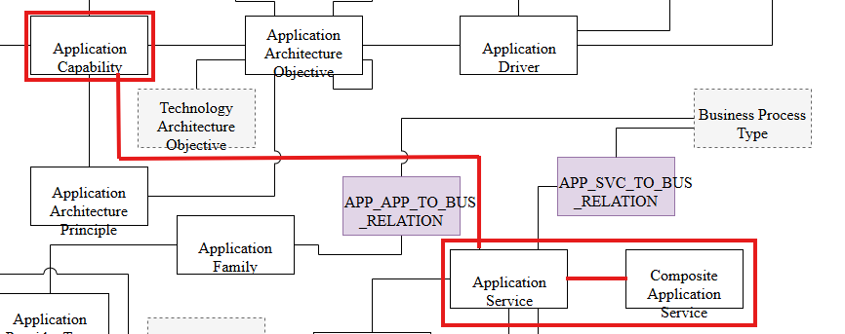
Essential EA Meta-Model - Application Layer - 07
040

Slide 70
Essential EA Meta-Model - Application Layer

Slide 71
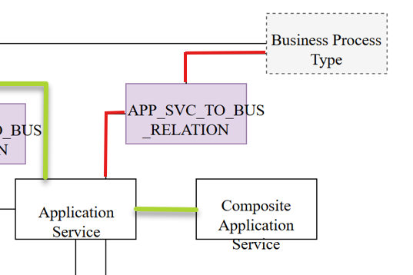
Essential EA Meta-Model - Application Layer - 08
041

Slide 72
Essential EA Meta-Model - Application Layer

Slide 73
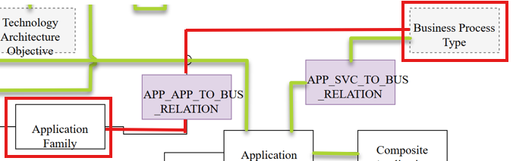
Essential EA Meta-Model - Application Layer - 09
042

Slide 74
Essential EA Meta-Model - Application Layer

Slide 75
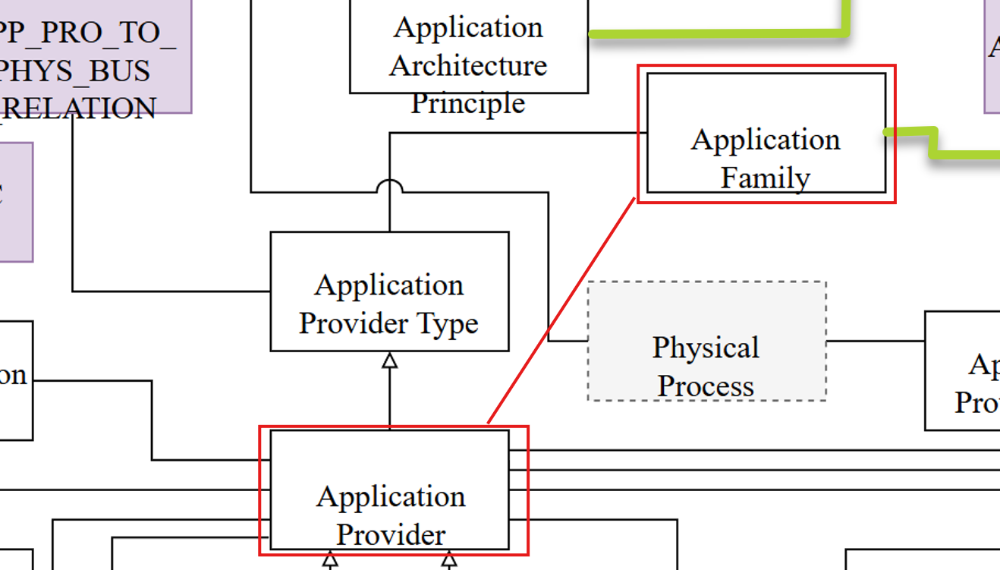
Essential EA Meta-Model - Application Layer - 10
043

Slide 76
Essential EA Meta-Model - Application Layer

Slide 77
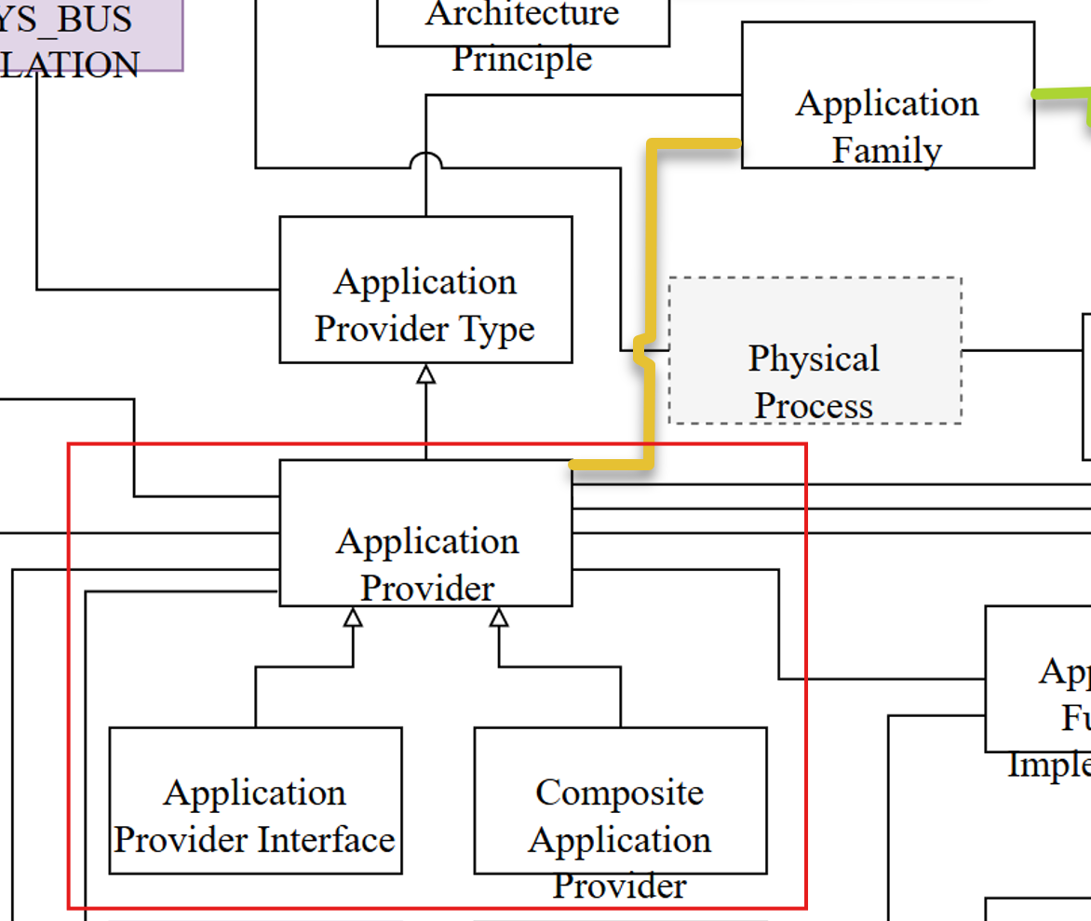
Essential EA Meta-Model - Application Layer - 11
044

Slide 78
Essential EA Meta-Model - Application Layer

Slide 79
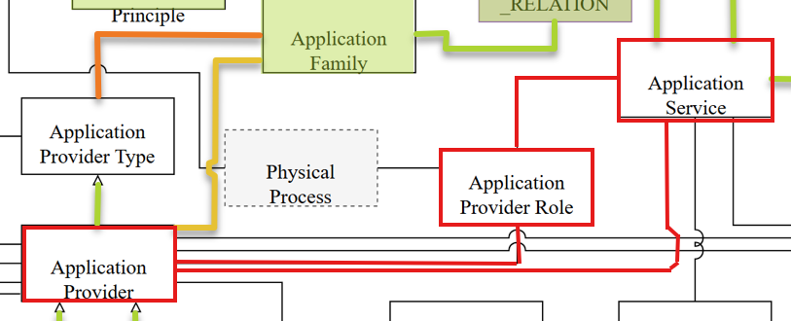
Essential EA Meta-Model - Application Layer - 12
045

Slide 80
Essential EA Meta-Model - Application Layer

Slide 81
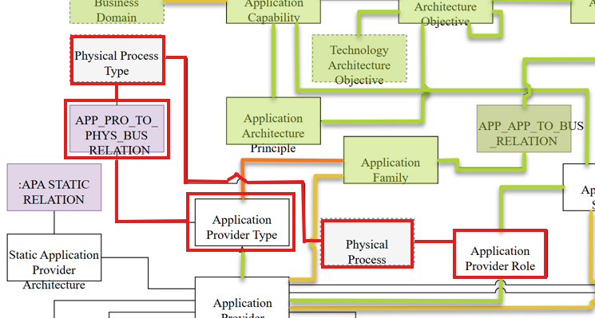
Essential EA Meta-Model - Application Layer - 13
046

Slide 82
Essential EA Meta-Model - Application Layer

Slide 83
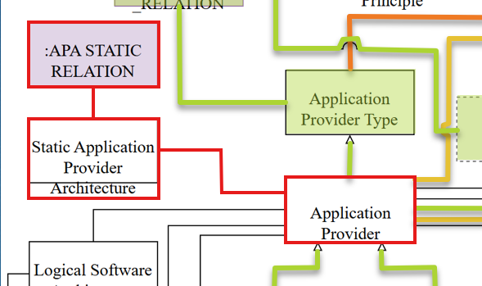
Essential EA Meta-Model - Application Layer - 14
047

Slide 84
Essential EA Meta-Model - Application Layer

Slide 85
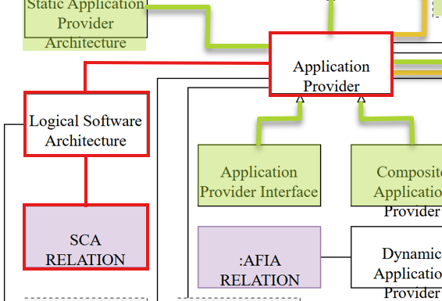
Essential EA Meta-Model - Application Layer - 15
048

Slide 86
Essential EA Meta-Model - Application Layer

Slide 87

Thank You!
someone@Example.com

Slide 88


