Slide 1


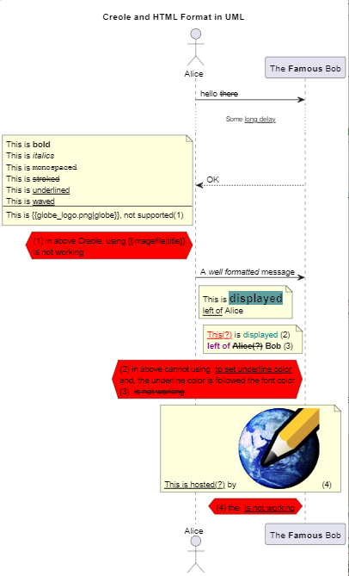
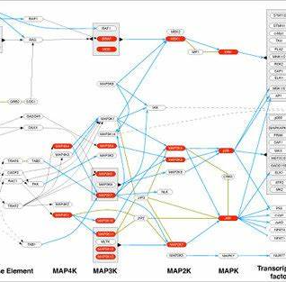
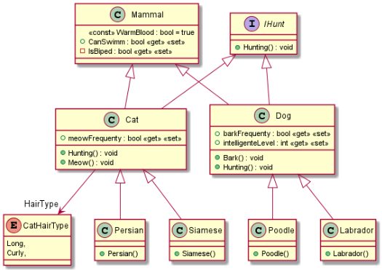
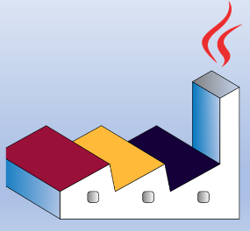

Slide 2
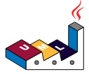

PlantUML in Action
000
Opening and Introduction
GitHub: https://github.com/yasenstar/PlantUML_in_Action
Yasen – Enterprise Architecture
YouTube: @yasenzhao

Slide 3
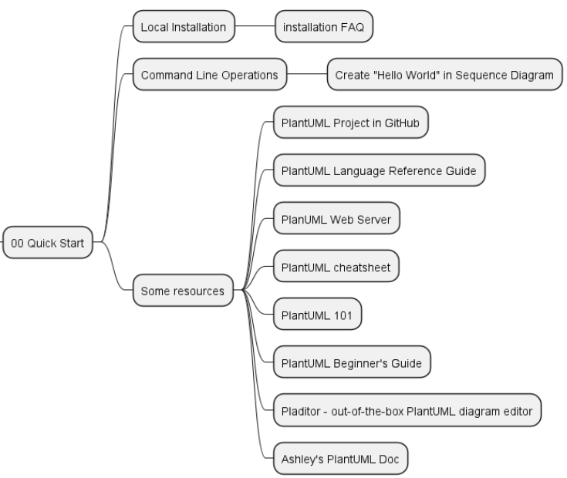
PlantUML in Action
001
PlantUML Quick Starts
Utilizing a simple and intuitive language, users can effortlessly draft various types of diagrams.
Yasen – Enterprise Architecture
YouTube: @yasenzhao
GitHub: https://github.com/yasenstar/PlantUML_in_Action

Slide 4
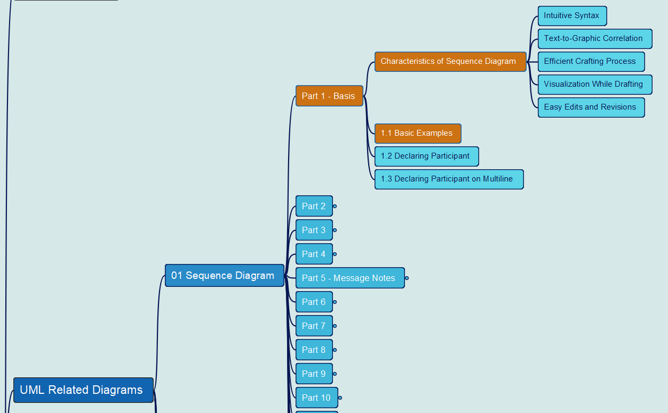
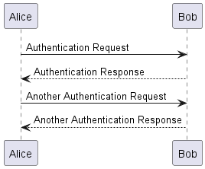
PlantUML in Action
002
1. Sequence Diagram
1.1 Basic Examples
Yasen – Enterprise Architecture
YouTube: @yasenzhao
GitHub: https://github.com/yasenstar/PlantUML_in_Action

Slide 5
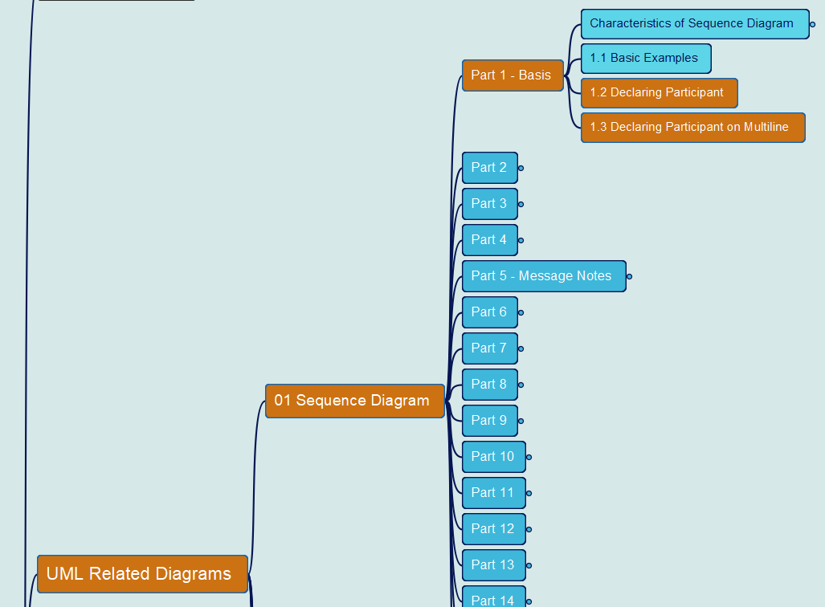
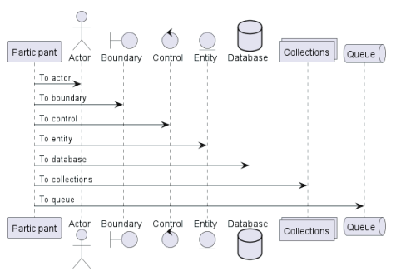
PlantUML in Action
003
1. Sequence Diagram
1.2 Declaring Participant
1.3 Declaring Participant on Multiline
Yasen – Enterprise Architecture
YouTube: @yasenzhao
GitHub: https://github.com/yasenstar/PlantUML_in_Action

Slide 6
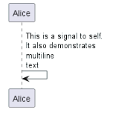
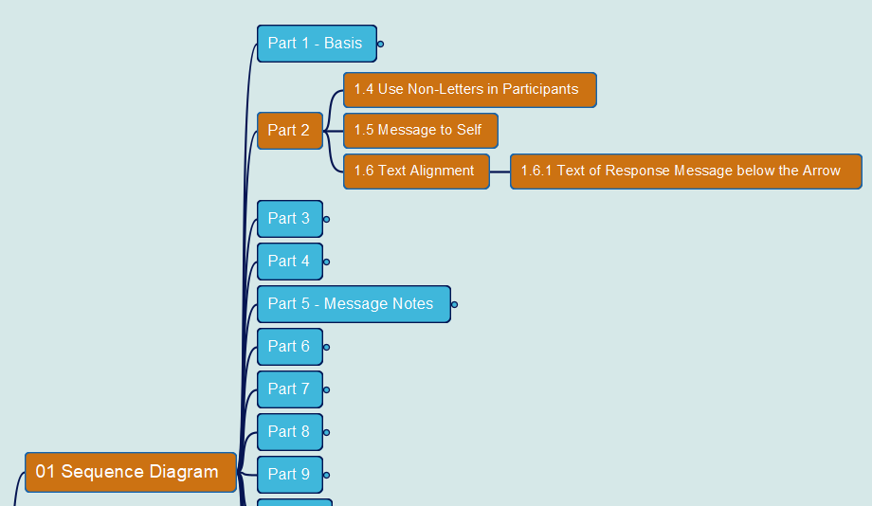
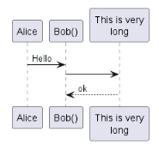
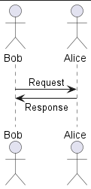
PlantUML in Action
004
1. Sequence Diagram
1.4 Use Non-Letters in Participants
1.5 Message to Self
1.6 Text Alignment
Yasen – Enterprise Architecture
YouTube: @yasenzhao
GitHub: https://github.com/yasenstar/PlantUML_in_Action

Slide 7
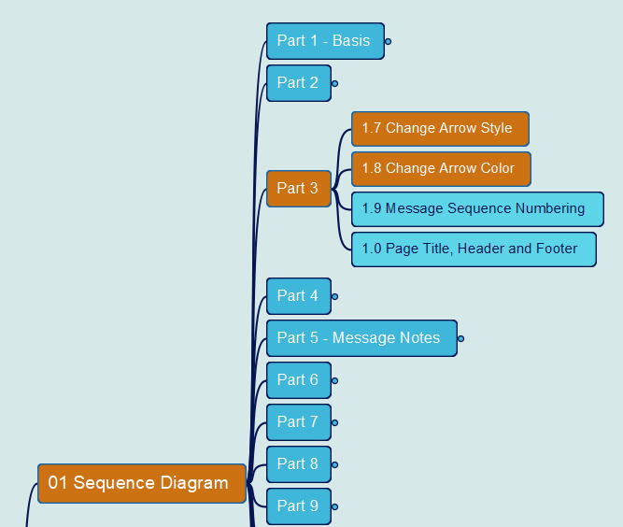


PlantUML in Action
005
1. Sequence Diagram
1.7 Change Arrow Style
1.8 Change Arrow Color
Yasen – Enterprise Architecture
YouTube: @yasenzhao
GitHub: https://github.com/yasenstar/PlantUML_in_Action

Slide 8
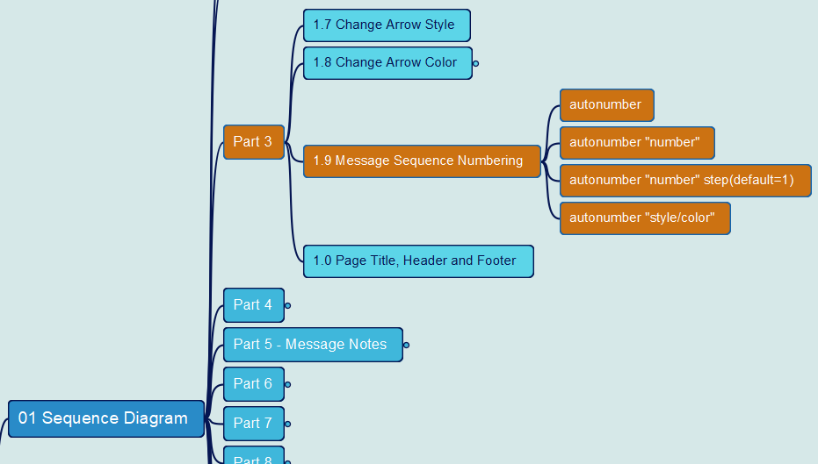
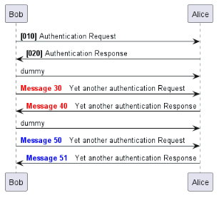
PlantUML in Action
006
1. Sequence Diagram
1.9 Message Sequence Numbering
Yasen – Enterprise Architecture
YouTube: @yasenzhao
GitHub: https://github.com/yasenstar/PlantUML_in_Action

Slide 9
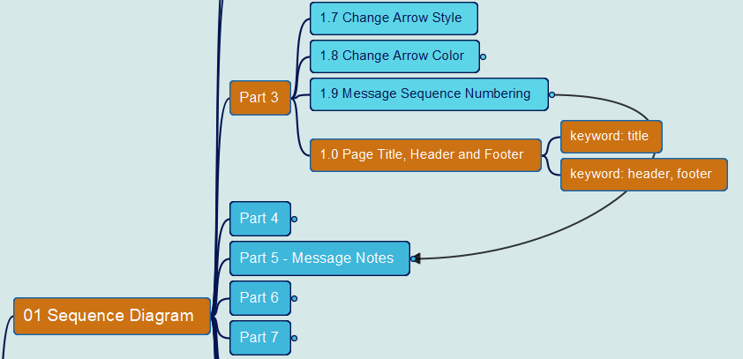
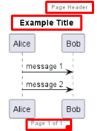
PlantUML in Action
007
1. Sequence Diagram
1.10 Page Title, Header and Footer
Yasen – Enterprise Architecture
YouTube: @yasenzhao
GitHub: https://github.com/yasenstar/PlantUML_in_Action

Slide 10
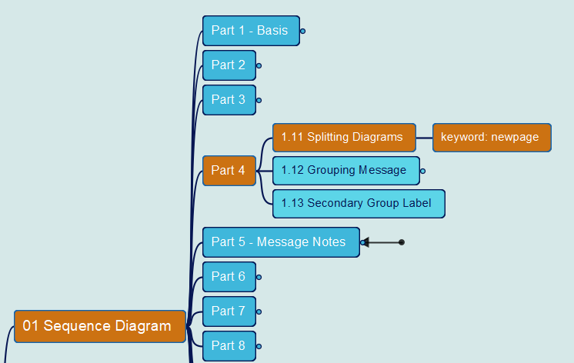
PlantUML in Action
008
1. Sequence Diagram
1.11 Splitting Diagrams
Yasen – Enterprise Architecture
YouTube: @yasenzhao
GitHub: https://github.com/yasenstar/PlantUML_in_Action

Slide 11
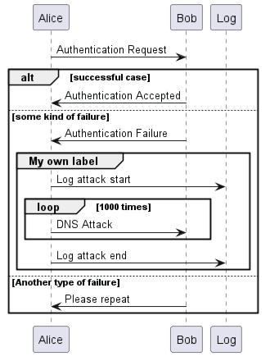
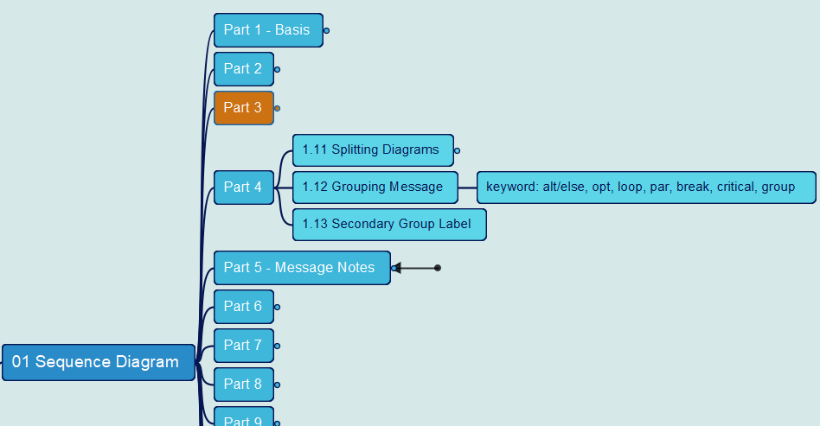
PlantUML in Action
009
1. Sequence Diagram
1.12 Grouping Message
Yasen – Enterprise Architecture
YouTube: @yasenzhao
GitHub: https://github.com/yasenstar/PlantUML_in_Action

Slide 12
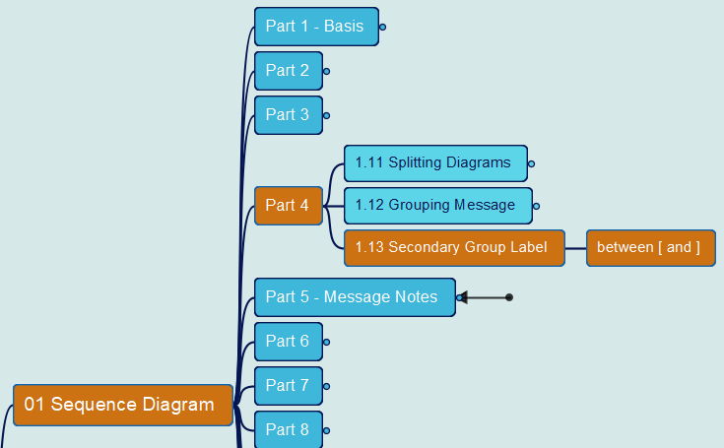
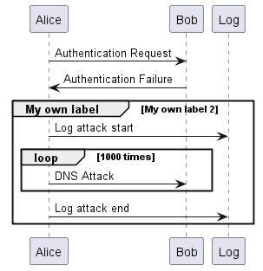
PlantUML in Action
010
1. Sequence Diagram
1.13 Secondary Group Label
Yasen – Enterprise Architecture
YouTube: @yasenzhao
GitHub: https://github.com/yasenstar/PlantUML_in_Action

Slide 13
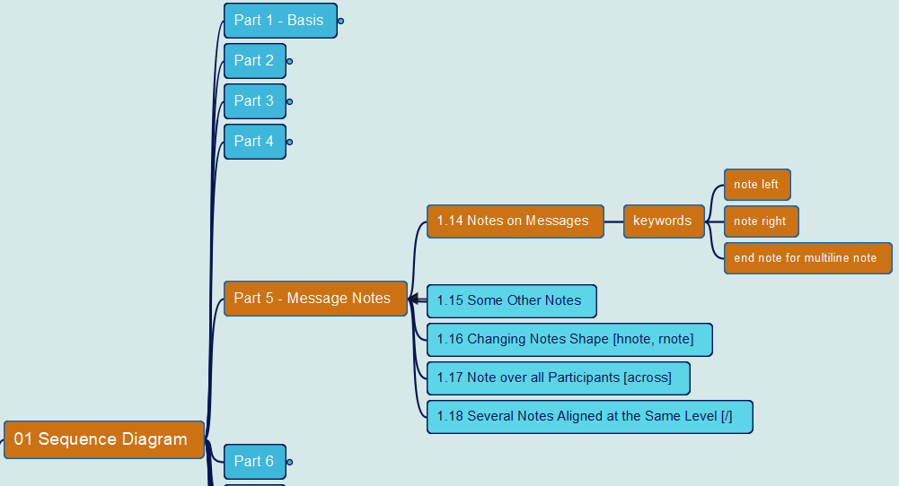
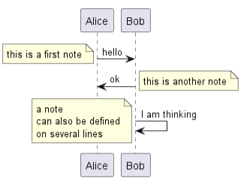
PlantUML in Action
011
1. Sequence Diagram
1.14 Notes on Messages
Yasen – Enterprise Architecture
YouTube: @yasenzhao
GitHub: https://github.com/yasenstar/PlantUML_in_Action

Slide 14
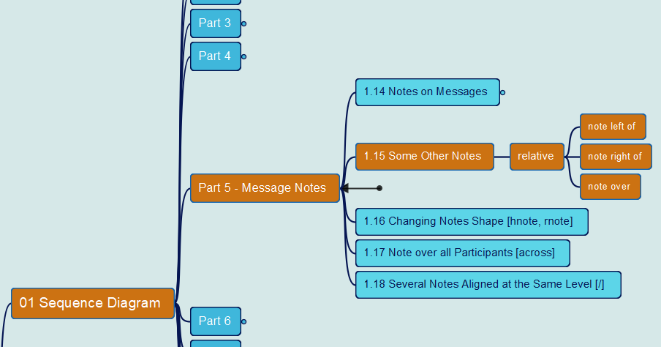
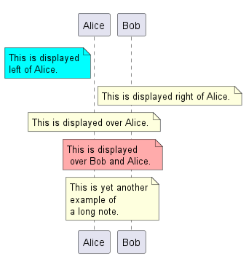
PlantUML in Action
012
1. Sequence Diagram
1.15 Some Other Notes
Yasen – Enterprise Architecture
YouTube: @yasenzhao
GitHub: https://github.com/yasenstar/PlantUML_in_Action

Slide 15
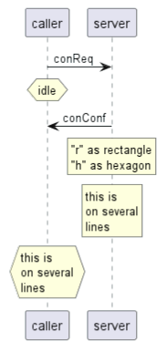
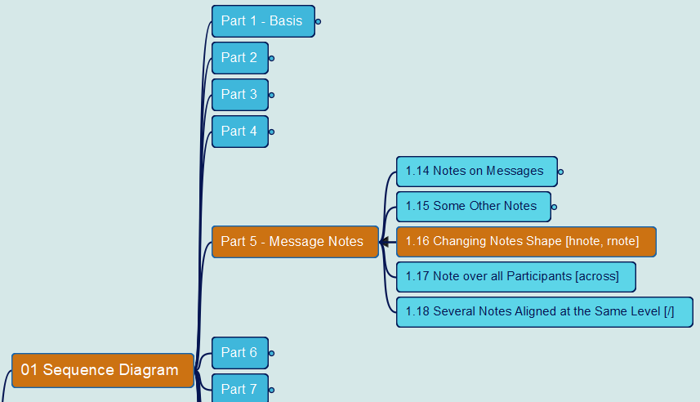
PlantUML in Action
013
1. Sequence Diagram
1.16 Changing Notes Shape
Yasen – Enterprise Architecture
YouTube: @yasenzhao
GitHub: https://github.com/yasenstar/PlantUML_in_Action

Slide 16
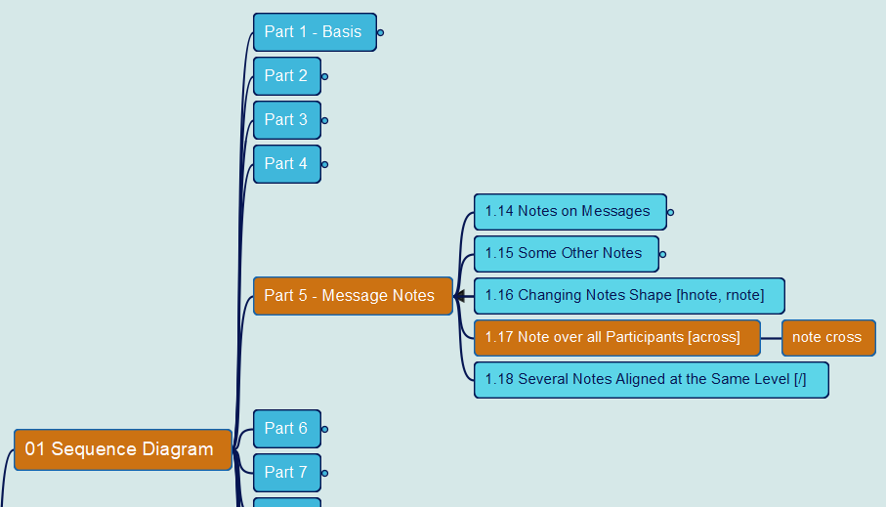
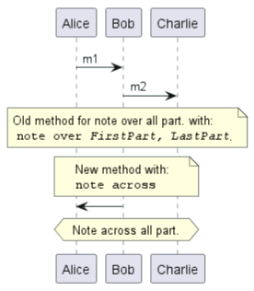
PlantUML in Action
014
1. Sequence Diagram
1.17 Note over all Participants
Yasen – Enterprise Architecture
YouTube: @yasenzhao
GitHub: https://github.com/yasenstar/PlantUML_in_Action

Slide 17
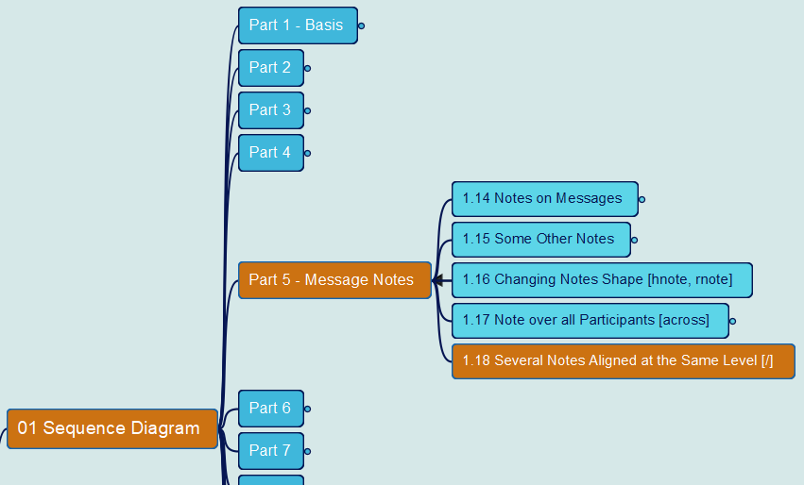
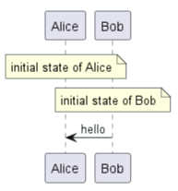
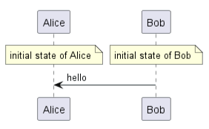
PlantUML in Action
015
1. Sequence Diagram
1.18 Several Notes aligned at the Same Level
Yasen – Enterprise Architecture
YouTube: @yasenzhao
GitHub: https://github.com/yasenstar/PlantUML_in_Action

Slide 18
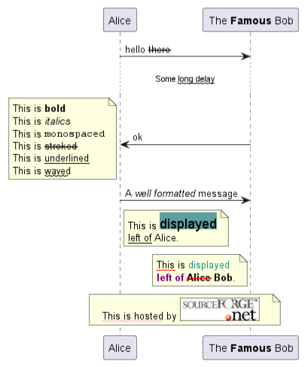
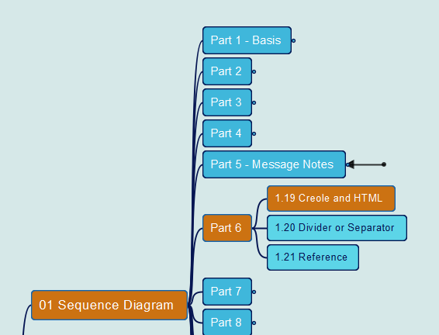
PlantUML in Action
016
1. Sequence Diagram
1.19 Creole and HTML
Yasen – Enterprise Architecture
YouTube: @yasenzhao
GitHub: https://github.com/yasenstar/PlantUML_in_Action

Slide 19
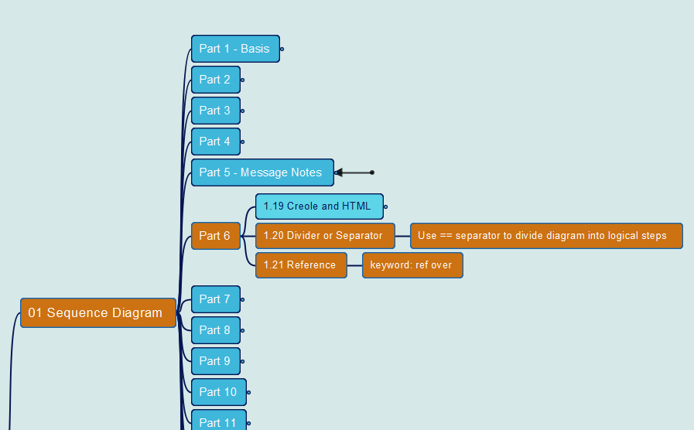
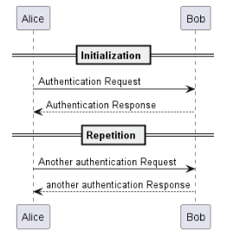
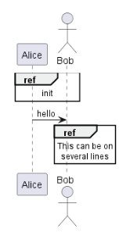
PlantUML in Action
017
1. Sequence Diagram
1.20 Divider or Separator 1.21 Reference
Yasen – Enterprise Architecture
YouTube: @yasenzhao
GitHub: https://github.com/yasenstar/PlantUML_in_Action

Slide 20
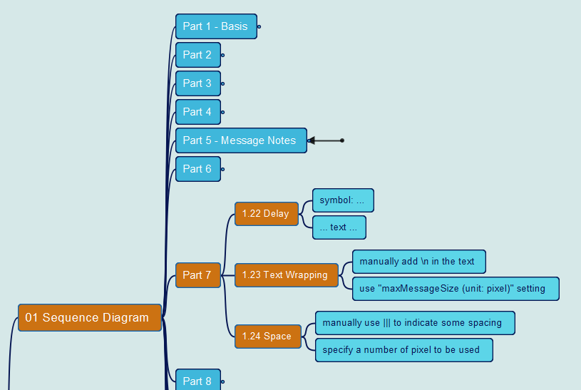
PlantUML in Action
018
1. Sequence Diagram
1.22 Delay 1.23 Text Wrapping 1.24 Space
Yasen – Enterprise Architecture
YouTube: @yasenzhao
GitHub: https://github.com/yasenstar/PlantUML_in_Action

Slide 21
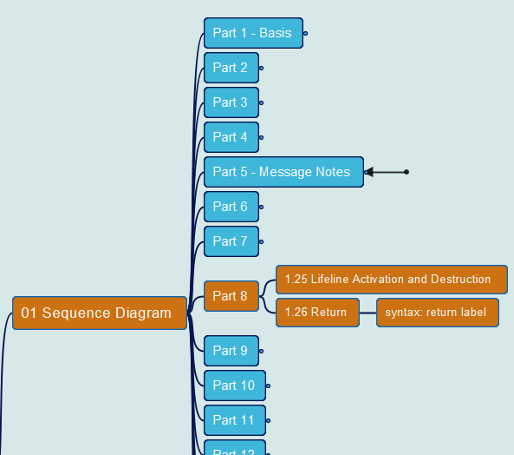
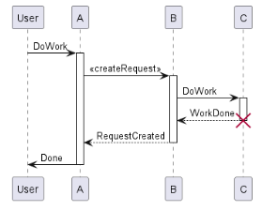
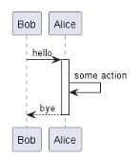
PlantUML in Action
019
1. Sequence Diagram
1.25 Lifeline Activation and Destruction
1.26 Return
Yasen – Enterprise Architecture
YouTube: @yasenzhao
GitHub: https://github.com/yasenstar/PlantUML_in_Action

Slide 22
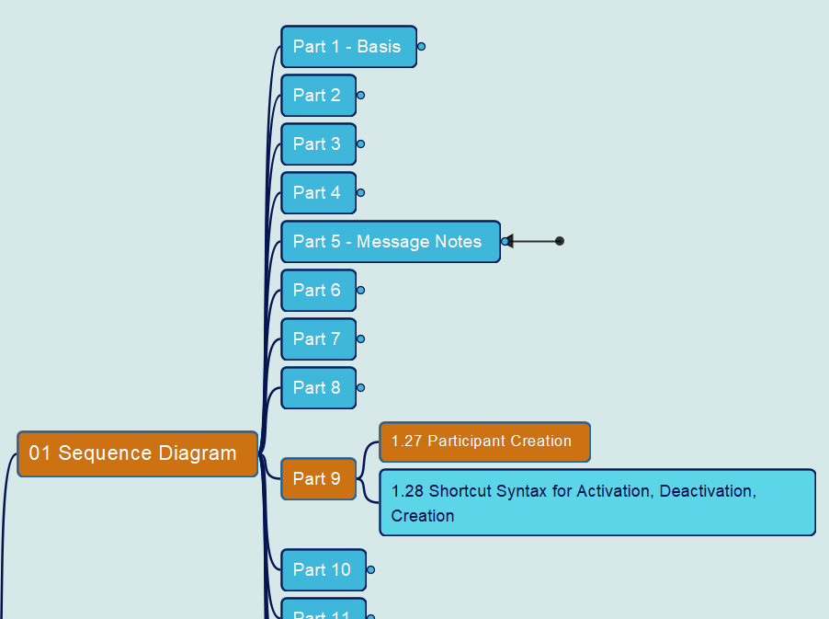
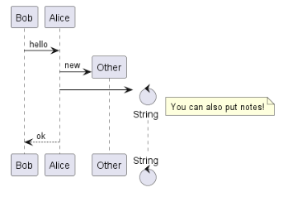
PlantUML in Action
020
1. Sequence Diagram
1.27 Participant Creation
Yasen – Enterprise Architecture
YouTube: @yasenzhao
GitHub: https://github.com/yasenstar/PlantUML_in_Action

Slide 23
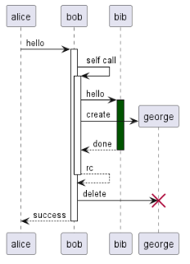
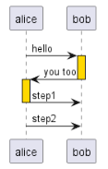
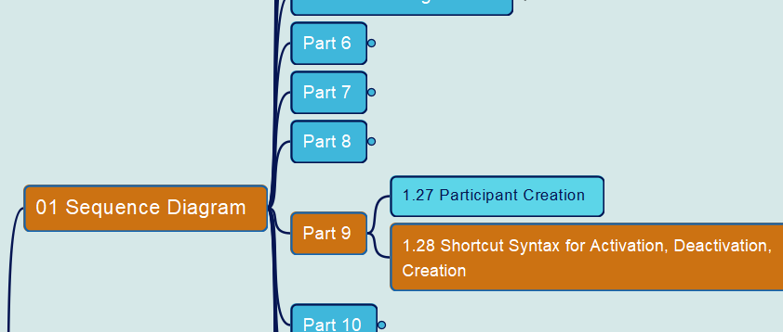
PlantUML in Action
021
1. Sequence Diagram
1.28 Shortcut Syntax
Yasen – Enterprise Architecture
YouTube: @yasenzhao
GitHub: https://github.com/yasenstar/PlantUML_in_Action

