Slide 1


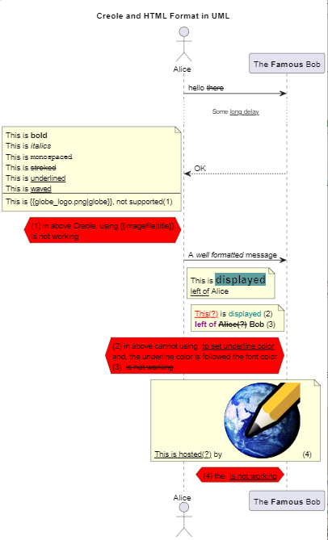
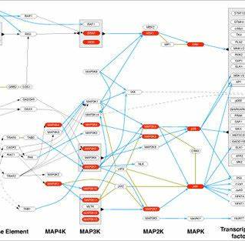
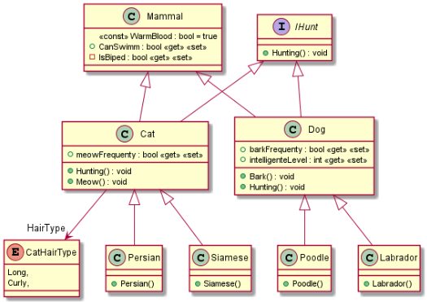
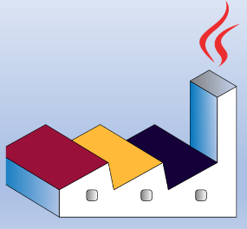

Slide 2


PlantUML in Action
000
Opening and Introduction
GitHub: https://github.com/yasenstar/PlantUML_in_Action
Yasen – Enterprise Architecture
YouTube: @yasenzhao

Slide 3
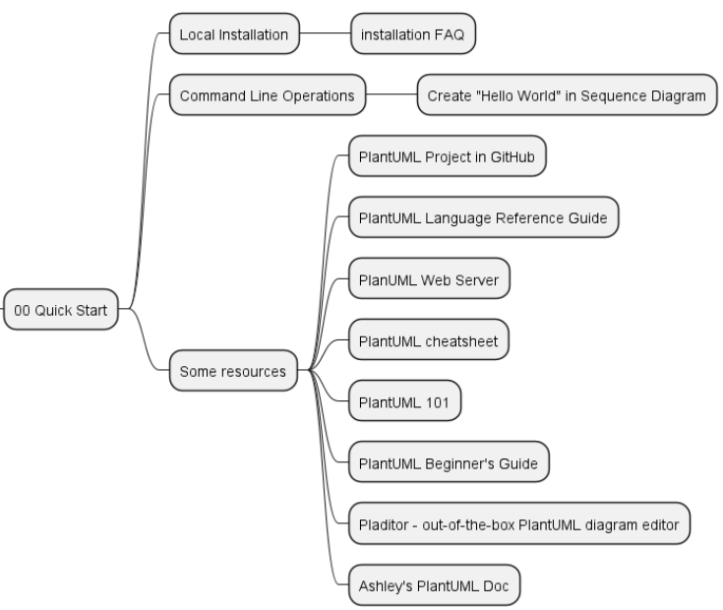
PlantUML in Action
001
PlantUML Quick Starts
Utilizing a simple and intuitive language, users can effortlessly draft various types of diagrams.
Yasen – Enterprise Architecture
YouTube: @yasenzhao
GitHub: https://github.com/yasenstar/PlantUML_in_Action

Slide 4
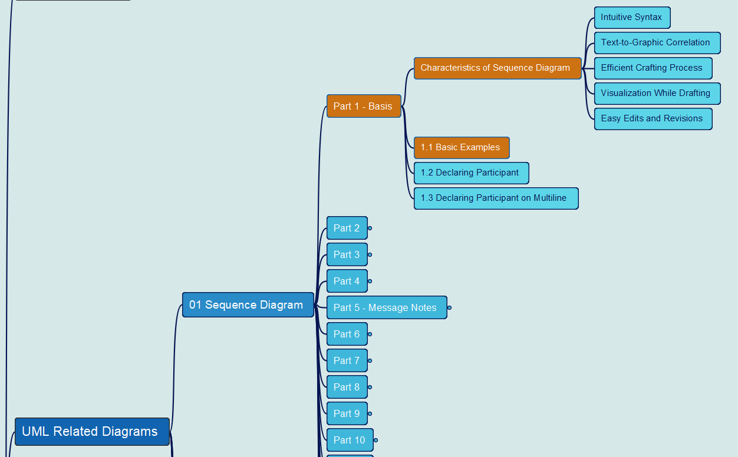
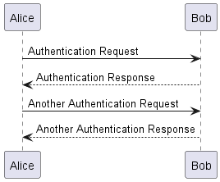
PlantUML in Action
002
1. Sequence Diagram
1.1 Basic Examples
Yasen – Enterprise Architecture
YouTube: @yasenzhao
GitHub: https://github.com/yasenstar/PlantUML_in_Action

Slide 5
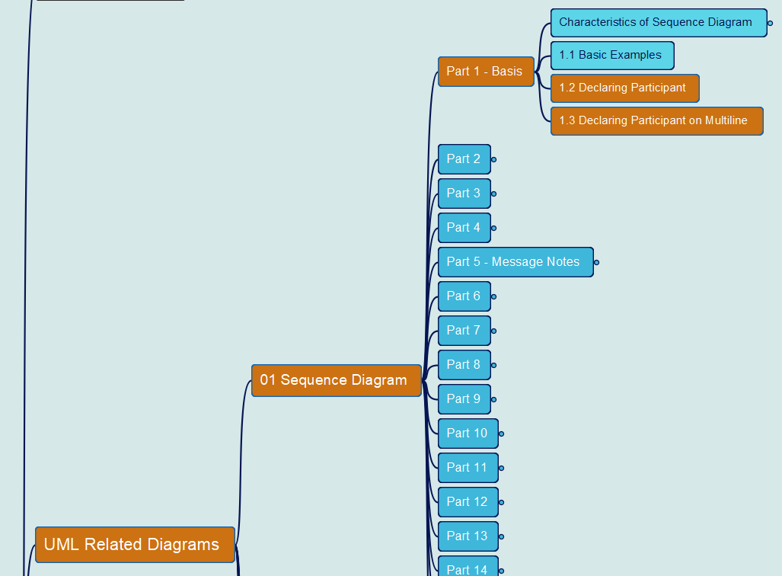
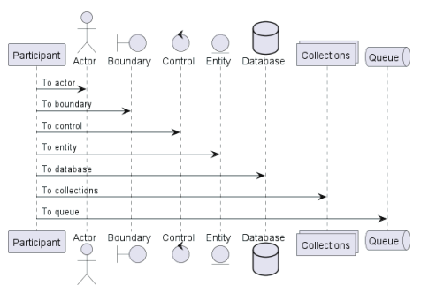
PlantUML in Action
003
1. Sequence Diagram
1.2 Declaring Participant
1.3 Declaring Participant on Multiline
Yasen – Enterprise Architecture
YouTube: @yasenzhao
GitHub: https://github.com/yasenstar/PlantUML_in_Action

Slide 6
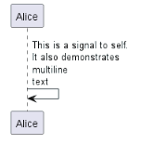
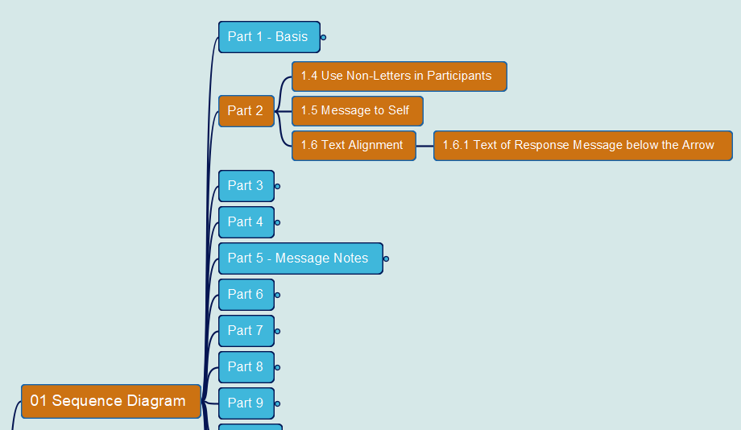
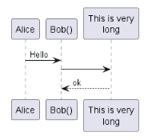
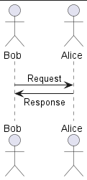
PlantUML in Action
004
1. Sequence Diagram
1.4 Use Non-Letters in Participants
1.5 Message to Self
1.6 Text Alignment
Yasen – Enterprise Architecture
YouTube: @yasenzhao
GitHub: https://github.com/yasenstar/PlantUML_in_Action

Slide 7
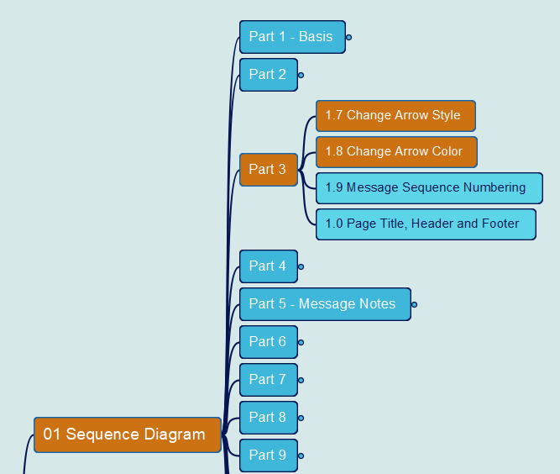


PlantUML in Action
005
1. Sequence Diagram
1.7 Change Arrow Style
1.8 Change Arrow Color
Yasen – Enterprise Architecture
YouTube: @yasenzhao
GitHub: https://github.com/yasenstar/PlantUML_in_Action

Slide 8
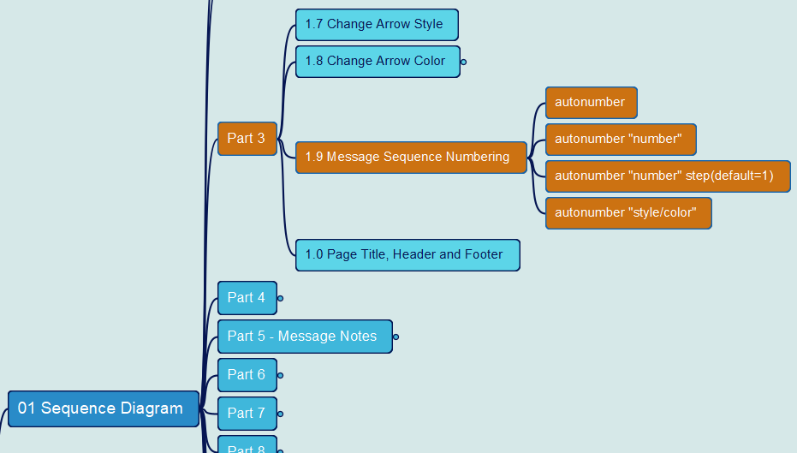
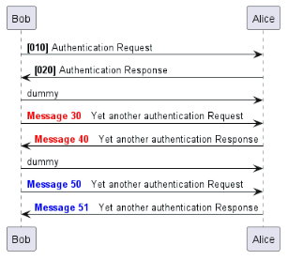
PlantUML in Action
006
1. Sequence Diagram
1.9 Message Sequence Numbering
Yasen – Enterprise Architecture
YouTube: @yasenzhao
GitHub: https://github.com/yasenstar/PlantUML_in_Action

Slide 9
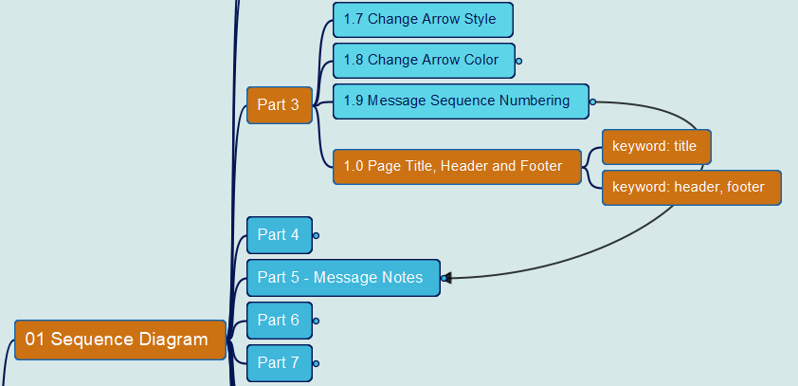
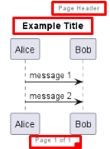
PlantUML in Action
007
1. Sequence Diagram
1.10 Page Title, Header and Footer
Yasen – Enterprise Architecture
YouTube: @yasenzhao
GitHub: https://github.com/yasenstar/PlantUML_in_Action

Slide 10
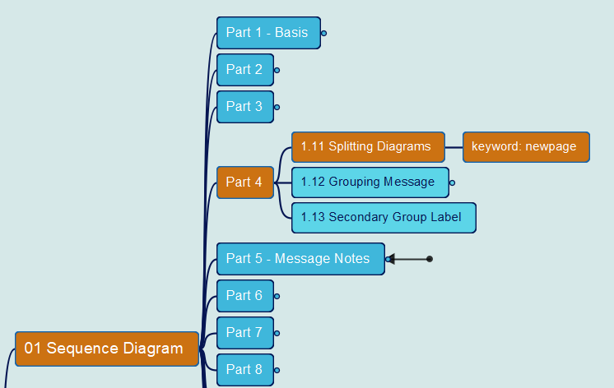
PlantUML in Action
008
1. Sequence Diagram
1.11 Splitting Diagrams
Yasen – Enterprise Architecture
YouTube: @yasenzhao
GitHub: https://github.com/yasenstar/PlantUML_in_Action

Slide 11
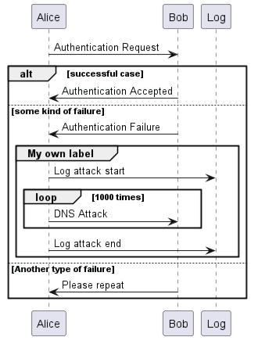
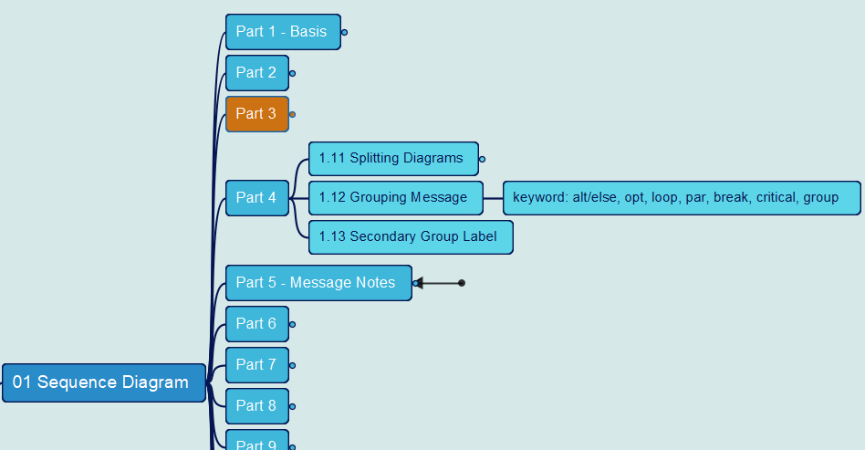
PlantUML in Action
009
1. Sequence Diagram
1.12 Grouping Message
Yasen – Enterprise Architecture
YouTube: @yasenzhao
GitHub: https://github.com/yasenstar/PlantUML_in_Action

Slide 12
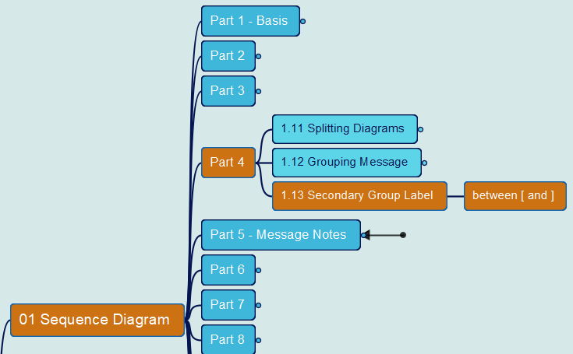
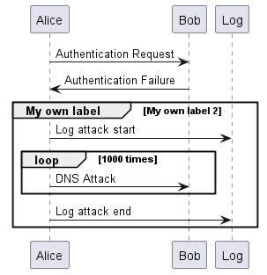
PlantUML in Action
010
1. Sequence Diagram
1.13 Secondary Group Label
Yasen – Enterprise Architecture
YouTube: @yasenzhao
GitHub: https://github.com/yasenstar/PlantUML_in_Action

Slide 13
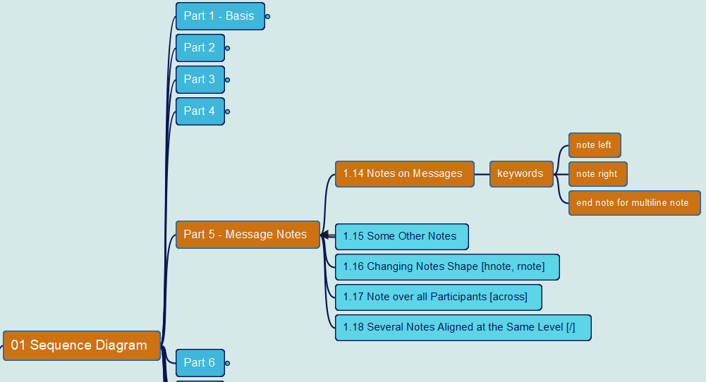
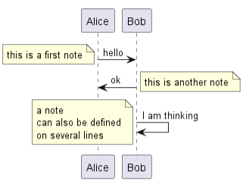
PlantUML in Action
011
1. Sequence Diagram
1.14 Notes on Messages
Yasen – Enterprise Architecture
YouTube: @yasenzhao
GitHub: https://github.com/yasenstar/PlantUML_in_Action

Slide 14
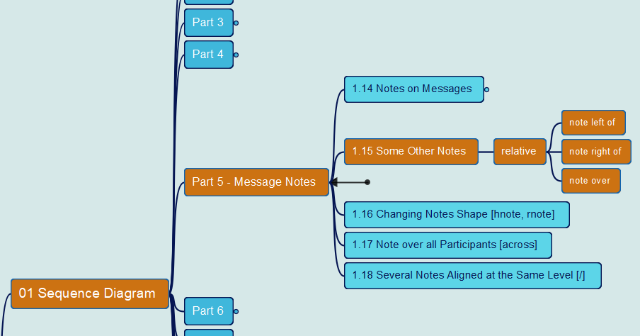
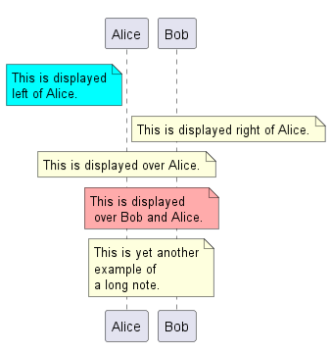
PlantUML in Action
012
1. Sequence Diagram
1.15 Some Other Notes
Yasen – Enterprise Architecture
YouTube: @yasenzhao
GitHub: https://github.com/yasenstar/PlantUML_in_Action

Slide 15
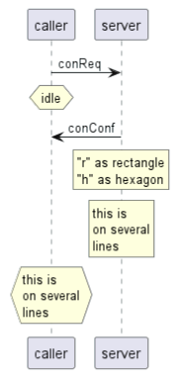
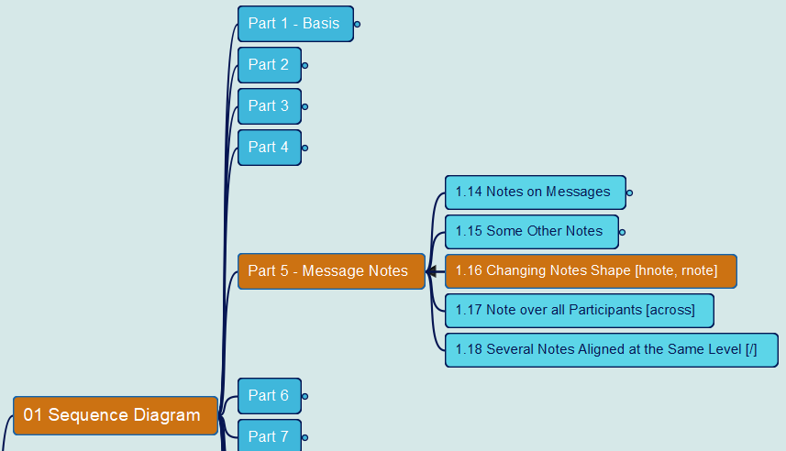
PlantUML in Action
013
1. Sequence Diagram
1.16 Changing Notes Shape
Yasen – Enterprise Architecture
YouTube: @yasenzhao
GitHub: https://github.com/yasenstar/PlantUML_in_Action

Slide 16
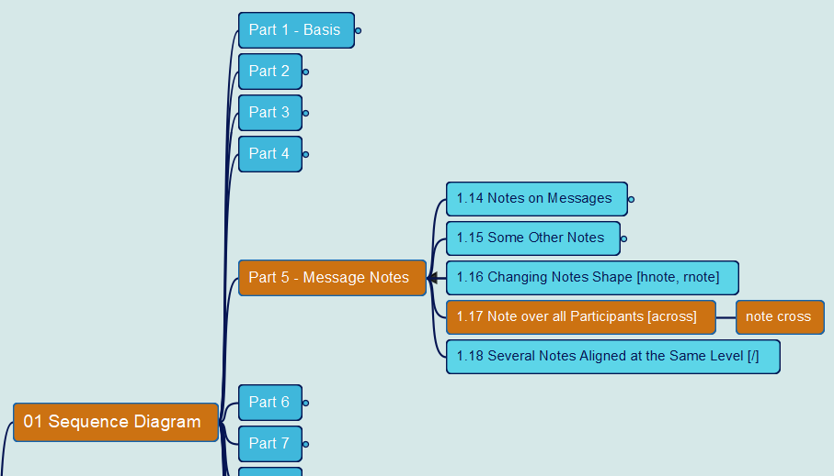
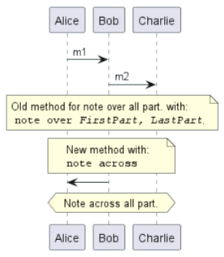
PlantUML in Action
014
1. Sequence Diagram
1.17 Note over all Participants
Yasen – Enterprise Architecture
YouTube: @yasenzhao
GitHub: https://github.com/yasenstar/PlantUML_in_Action

Slide 17
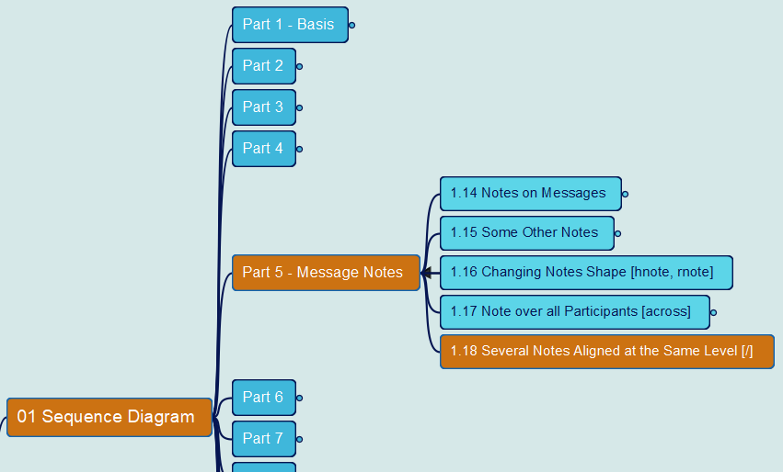
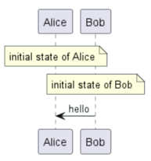
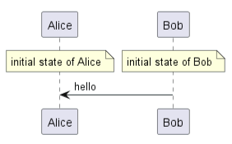
PlantUML in Action
015
1. Sequence Diagram
1.18 Several Notes aligned at the Same Level
Yasen – Enterprise Architecture
YouTube: @yasenzhao
GitHub: https://github.com/yasenstar/PlantUML_in_Action

Slide 18
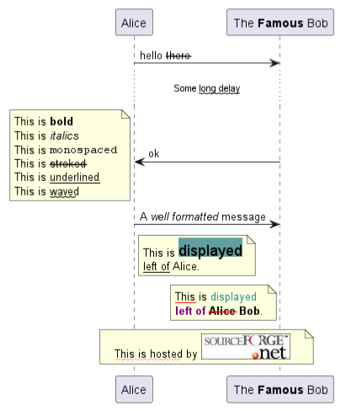
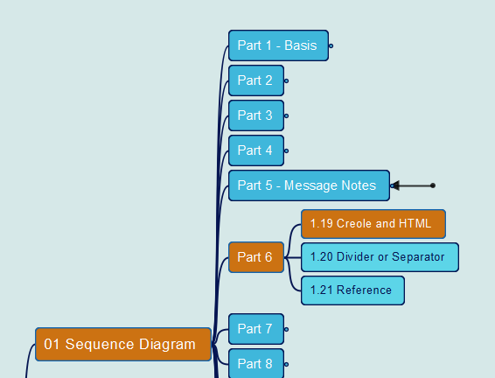
PlantUML in Action
016
1. Sequence Diagram
1.19 Creole and HTML
Yasen – Enterprise Architecture
YouTube: @yasenzhao
GitHub: https://github.com/yasenstar/PlantUML_in_Action

Slide 19
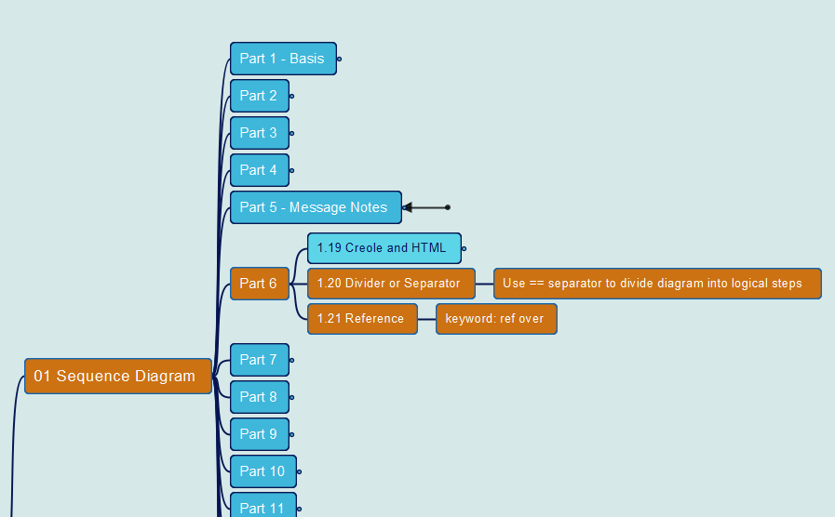
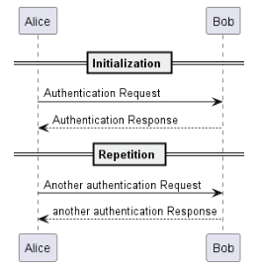
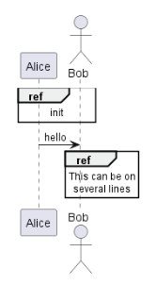
PlantUML in Action
017
1. Sequence Diagram
1.20 Divider or Separator 1.21 Reference
Yasen – Enterprise Architecture
YouTube: @yasenzhao
GitHub: https://github.com/yasenstar/PlantUML_in_Action

Slide 20
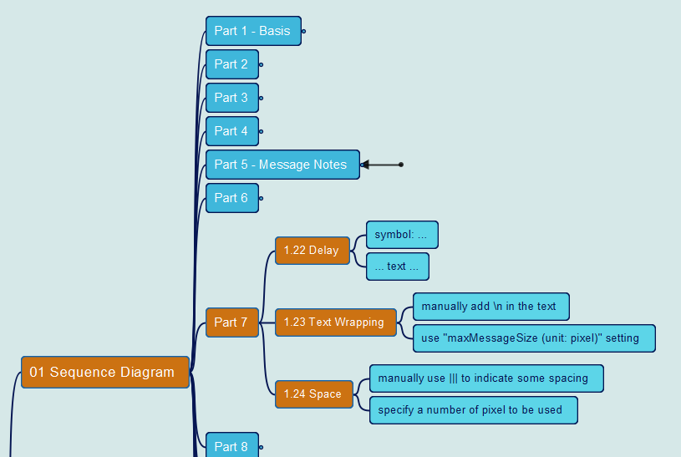
PlantUML in Action
018
1. Sequence Diagram
1.22 Delay 1.23 Text Wrapping 1.24 Space
Yasen – Enterprise Architecture
YouTube: @yasenzhao
GitHub: https://github.com/yasenstar/PlantUML_in_Action

Slide 21
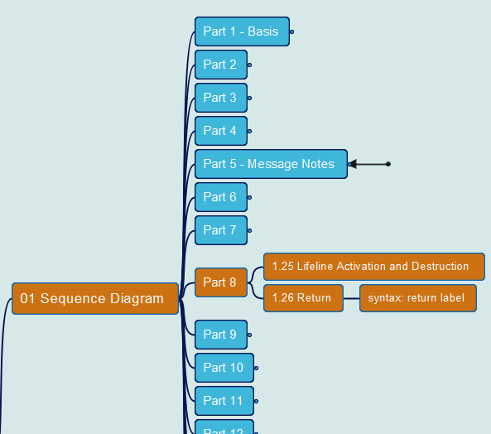
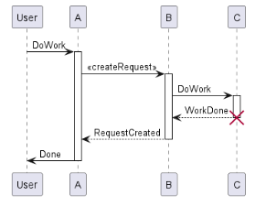
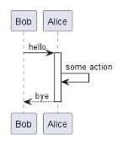
PlantUML in Action
019
1. Sequence Diagram
1.25 Lifeline Activation and Destruction
1.26 Return
Yasen – Enterprise Architecture
YouTube: @yasenzhao
GitHub: https://github.com/yasenstar/PlantUML_in_Action

Slide 22
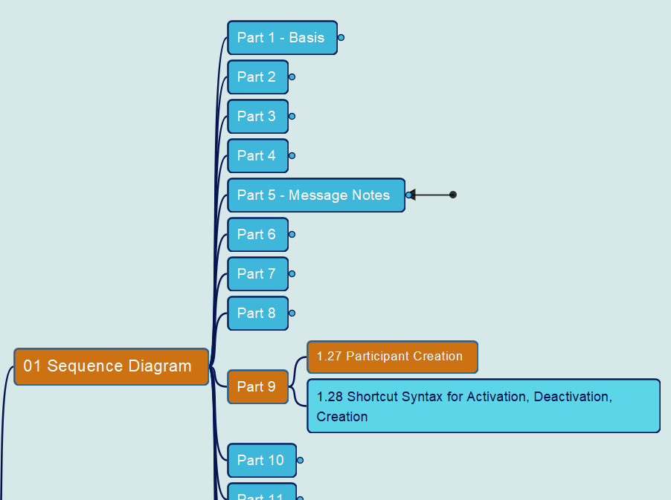
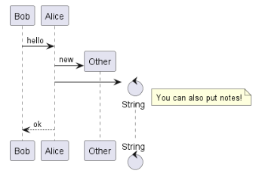
PlantUML in Action
020
1. Sequence Diagram
1.27 Participant Creation
Yasen – Enterprise Architecture
YouTube: @yasenzhao
GitHub: https://github.com/yasenstar/PlantUML_in_Action

Slide 23
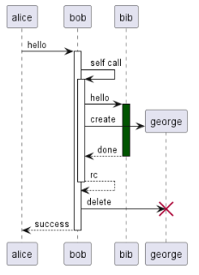
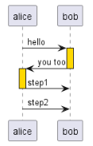
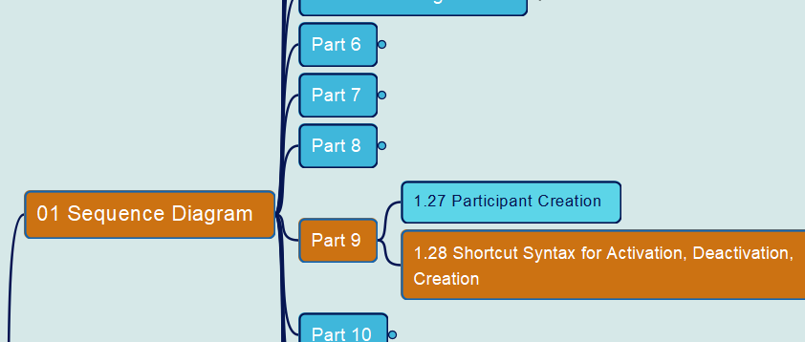
PlantUML in Action
021
1. Sequence Diagram
1.28 Shortcut Syntax
Yasen – Enterprise Architecture
YouTube: @yasenzhao
GitHub: https://github.com/yasenstar/PlantUML_in_Action

Slide 24
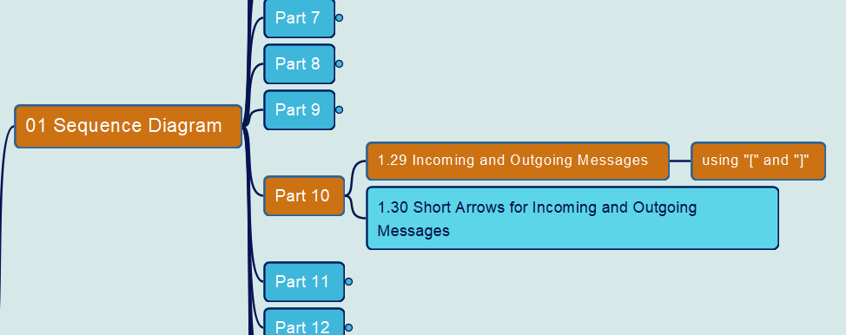
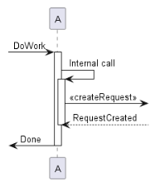

PlantUML in Action
022
1. Sequence Diagram
1.29 Incoming and Outgoing Messages
Yasen – Enterprise Architecture
YouTube: @yasenzhao
GitHub: https://github.com/yasenstar/PlantUML_in_Action

Slide 25


PlantUML in Action
023
1. Sequence Diagram
1.30 Short Arrows
Yasen – Enterprise Architecture
YouTube: @yasenzhao
GitHub: https://github.com/yasenstar/PlantUML_in_Action

Slide 26


PlantUML in Action
024
1. Sequence Diagram
1.31 Anchors and Duration
Yasen – Enterprise Architecture
YouTube: @yasenzhao
GitHub: https://github.com/yasenstar/PlantUML_in_Action

Slide 27


PlantUML in Action
025
1. Sequence Diagram
1.32 Stereotypes and Spots
Yasen – Enterprise Architecture
YouTube: @yasenzhao
GitHub: https://github.com/yasenstar/PlantUML_in_Action

Slide 28

PlantUML in Action
026
1. Sequence Diagram
1.33 More Information on Titles
Yasen – Enterprise Architecture
YouTube: @yasenzhao
GitHub: https://github.com/yasenstar/PlantUML_in_Action

Slide 29



PlantUML in Action
027
1. Sequence Diagram
1.34 Participants Encompass
1.35 Removing Foot Boxes
Yasen – Enterprise Architecture
YouTube: @yasenzhao
GitHub: https://github.com/yasenstar/PlantUML_in_Action

Slide 30



PlantUML in Action
028
1. Sequence Diagram
1.36 Skinparam
Yasen – Enterprise Architecture
YouTube: @yasenzhao
GitHub: https://github.com/yasenstar/PlantUML_in_Action

Slide 31


PlantUML in Action
029
1. Sequence Diagram
1.37 Changing Padding
Yasen – Enterprise Architecture
YouTube: @yasenzhao
GitHub: https://github.com/yasenstar/PlantUML_in_Action

Slide 32


PlantUML in Action
030
1. Sequence Diagram
1.38 Appendix: Arrow Types
Yasen – Enterprise Architecture
YouTube: @yasenzhao
GitHub: https://github.com/yasenstar/PlantUML_in_Action

Slide 33

PlantUML in Action
031
1. Sequence Diagram
1.39 Specific SkinParameter
Yasen – Enterprise Architecture
YouTube: @yasenzhao
GitHub: https://github.com/yasenstar/PlantUML_in_Action

Slide 34



PlantUML in Action
032
1. Sequence Diagram
1.40 Hide Unlinked Participant
Yasen – Enterprise Architecture
YouTube: @yasenzhao
GitHub: https://github.com/yasenstar/PlantUML_in_Action

Slide 35


PlantUML in Action
033
1. Sequence Diagram
1.41 Color a Group Message
Yasen – Enterprise Architecture
YouTube: @yasenzhao
GitHub: https://github.com/yasenstar/PlantUML_in_Action

Slide 36



PlantUML in Action
034
1. Sequence Diagram
1.42 Mainframe 1.43 Slanted or Odd Arrows
Yasen – Enterprise Architecture
YouTube: @yasenzhao
GitHub: https://github.com/yasenstar/PlantUML_in_Action

Slide 37



PlantUML in Action
035
2. Use Case Diagram
2.1 Use Cases 2.2 Actors
Yasen – Enterprise Architecture
YouTube: @yasenzhao
GitHub: https://github.com/yasenstar/PlantUML_in_Action

Slide 38


Slide 39




PlantUML in Action
036
2. Use Case Diagram
2.3 Change Actor Style
Yasen – Enterprise Architecture
YouTube: @yasenzhao
GitHub: https://github.com/yasenstar/PlantUML_in_Action

Slide 40


PlantUML in Action
037
2. Use Case Diagram
2.4 Usecases Description
Yasen – Enterprise Architecture
YouTube: @yasenzhao
GitHub: https://github.com/yasenstar/PlantUML_in_Action

Slide 41


PlantUML in Action
038
2. Use Case Diagram
2.5 Use Package
Yasen – Enterprise Architecture
YouTube: @yasenzhao
GitHub: https://github.com/yasenstar/PlantUML_in_Action

Slide 42


PlantUML in Action
039
2. Use Case Diagram
2.6 Basic Example for Use Case
Yasen – Enterprise Architecture
YouTube: @yasenzhao
GitHub: https://github.com/yasenstar/PlantUML_in_Action

Slide 43


PlantUML in Action
040
2. Use Case Diagram
2.7 Extension
Yasen – Enterprise Architecture
YouTube: @yasenzhao
GitHub: https://github.com/yasenstar/PlantUML_in_Action

Slide 44


PlantUML in Action
041
2. Use Case Diagram
2.8 Using notes in Use Case
Yasen – Enterprise Architecture
YouTube: @yasenzhao
GitHub: https://github.com/yasenstar/PlantUML_in_Action

