Slide 1

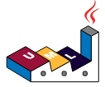

PlantUML in Action
000
Opening and Introduction
GitHub: https://github.com/yasenstar/PlantUML_in_Action
Yasen – Enterprise Architecture
YouTube: @yasenzhao

Slide 2
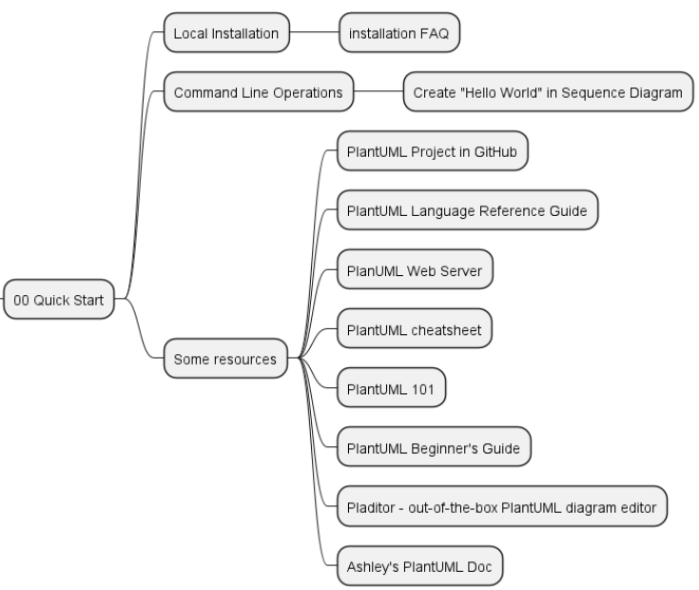
PlantUML in Action
001
PlantUML Quick Starts
Utilizing a simple and intuitive language, users can effortlessly draft various types of diagrams.
Yasen – Enterprise Architecture
YouTube: @yasenzhao
GitHub: https://github.com/yasenstar/PlantUML_in_Action

Slide 3
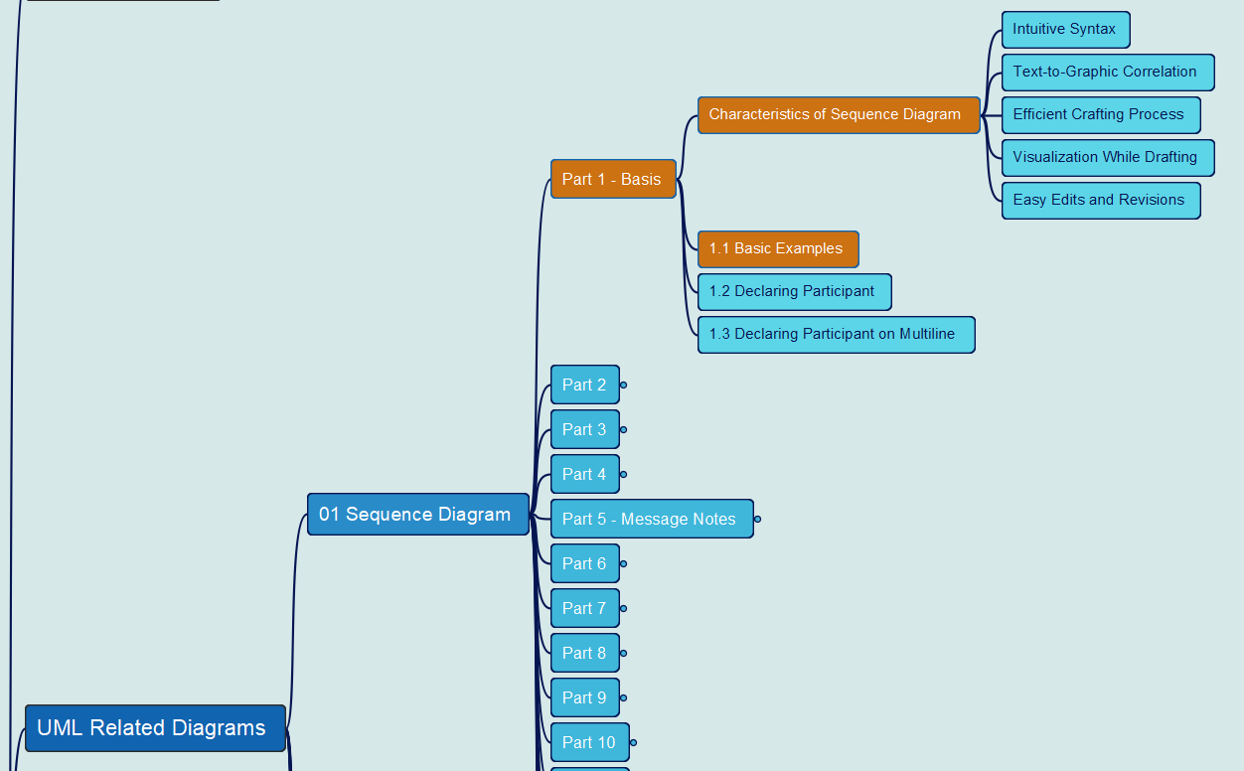
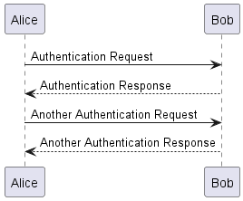
PlantUML in Action
002
1. Sequence Diagram
1.1 Basic Examples
Yasen – Enterprise Architecture
YouTube: @yasenzhao
GitHub: https://github.com/yasenstar/PlantUML_in_Action

Slide 4
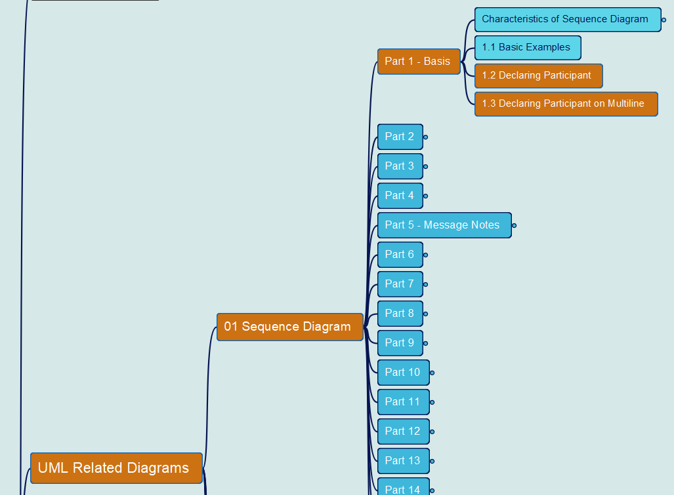
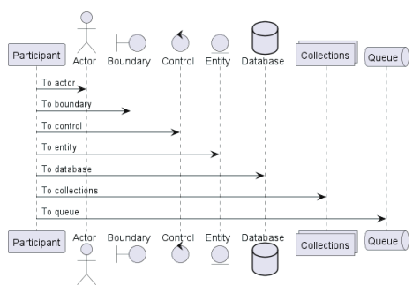
PlantUML in Action
003
1. Sequence Diagram
1.2 Declaring Participant
1.3 Declaring Participant on Multiline
Yasen – Enterprise Architecture
YouTube: @yasenzhao
GitHub: https://github.com/yasenstar/PlantUML_in_Action

