Slide 1
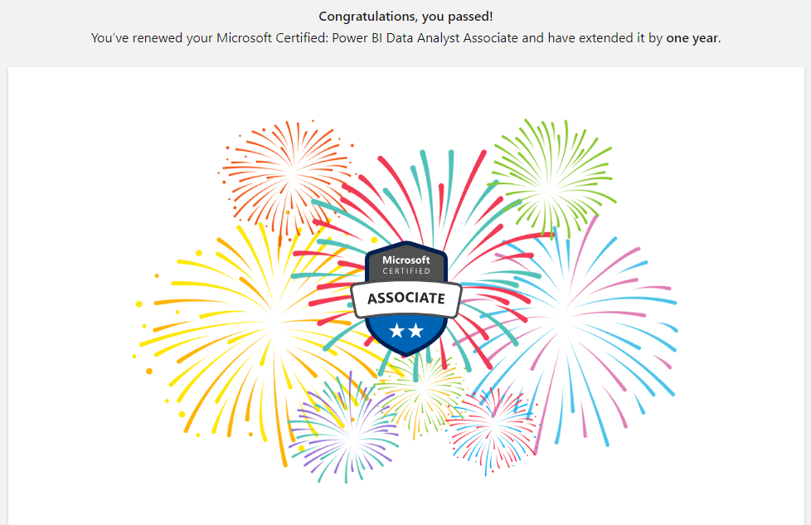

Slide 2
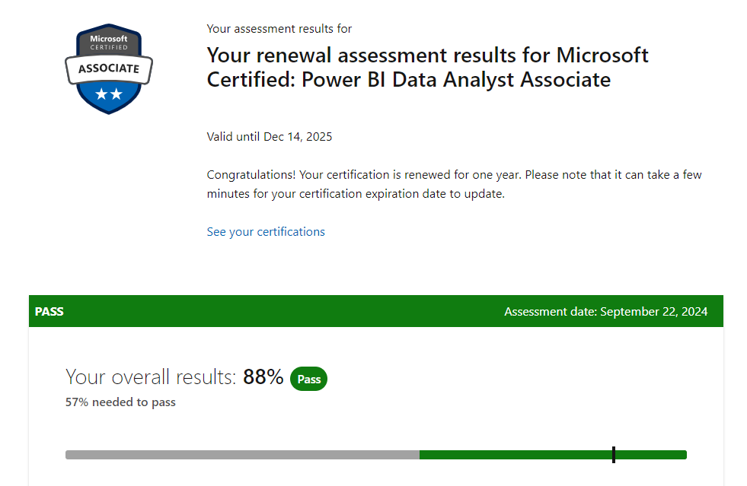

Slide 3
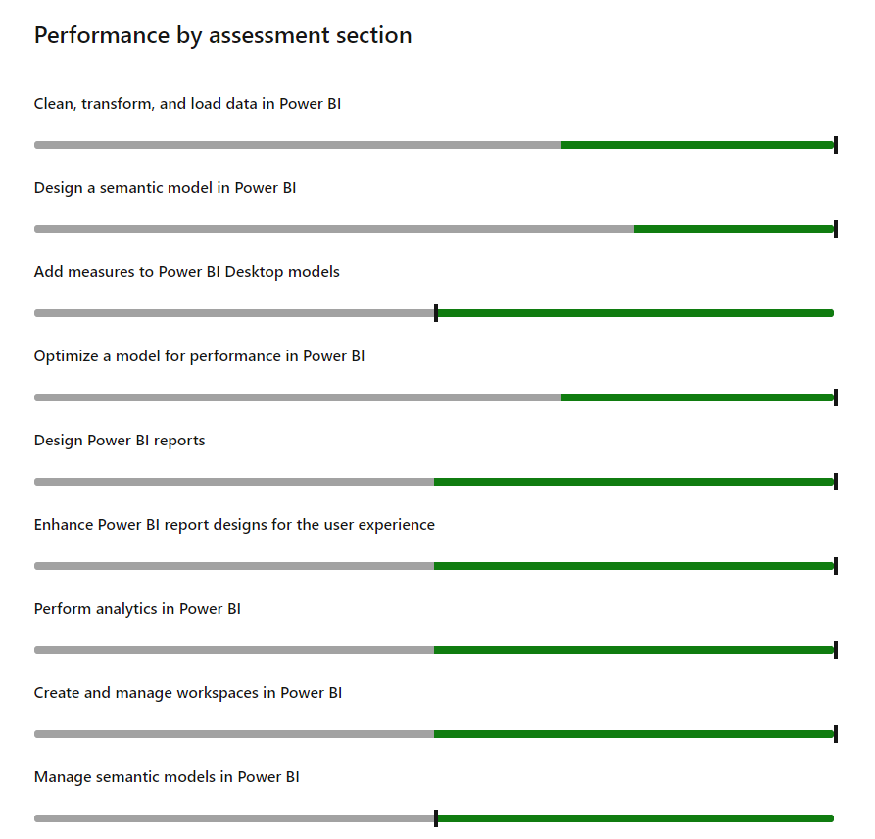

Slide 4


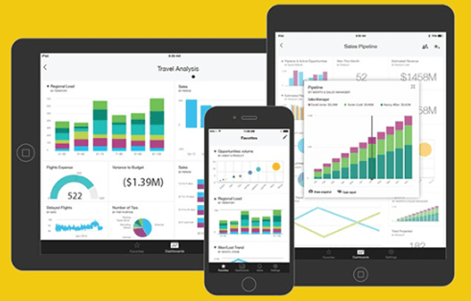

Slide 5
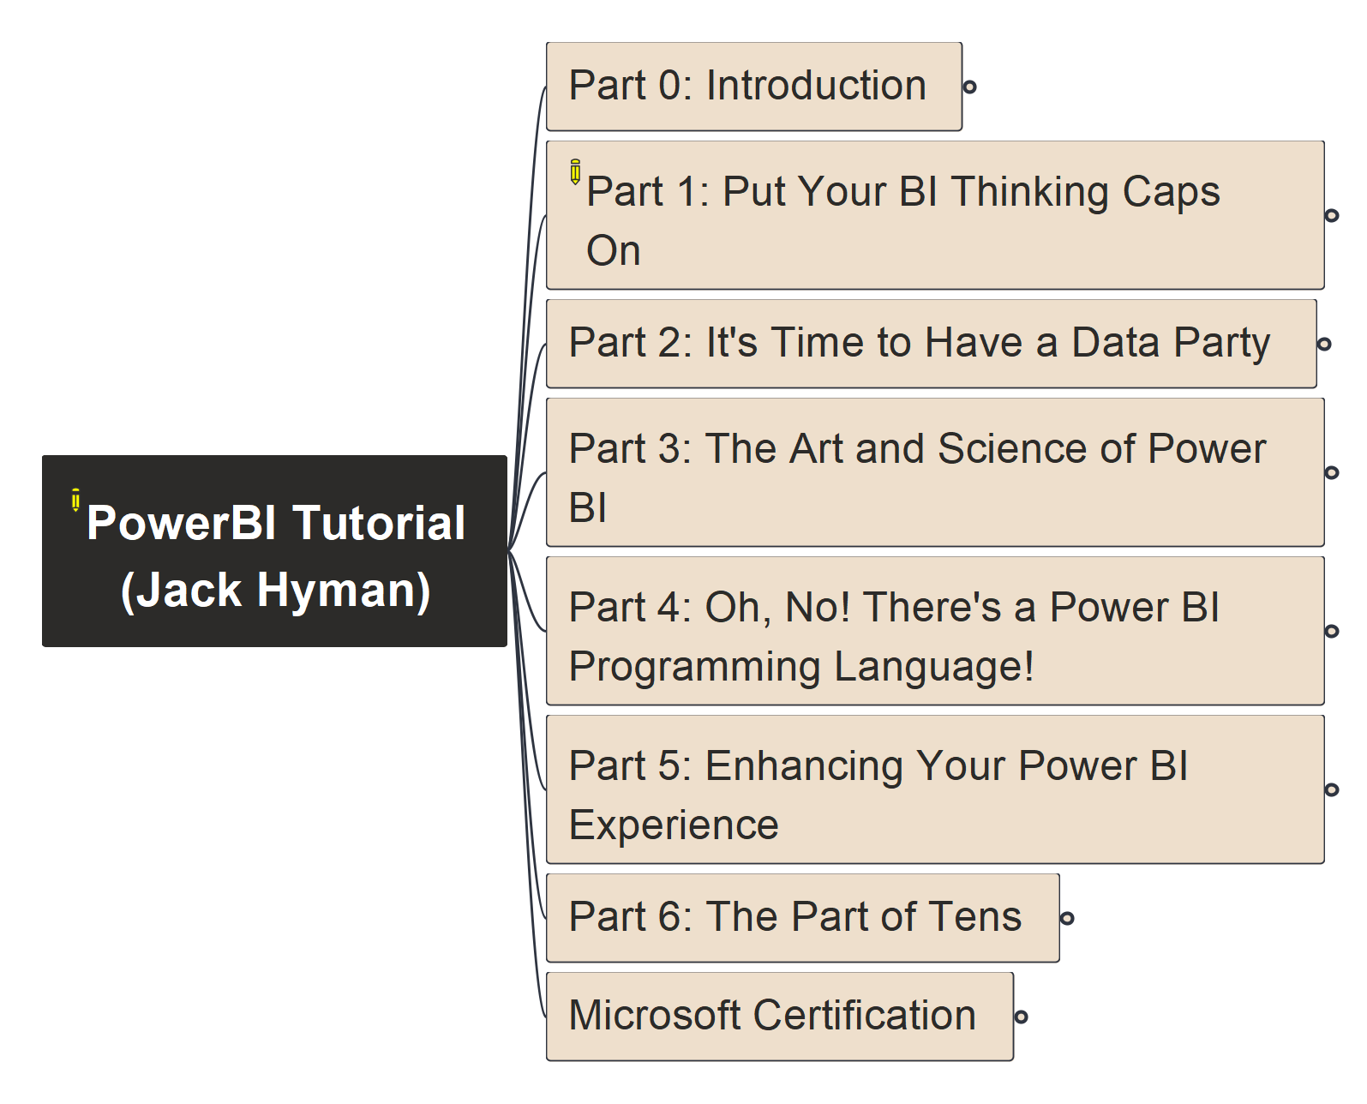

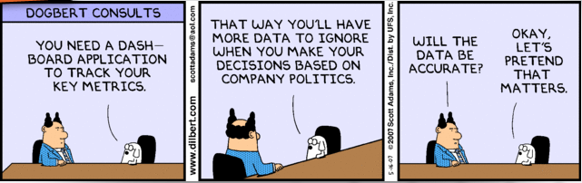
Power BI Tutorial
000
Opening
&
Welcome
Repository: https://github.com/yasenstar/PowerBI_Tutorial

Slide 6
Power BI Tutorial
001
Part 0 Introduction
Repository: https://github.com/yasenstar/PowerBI_Tutorial

