Slide 1
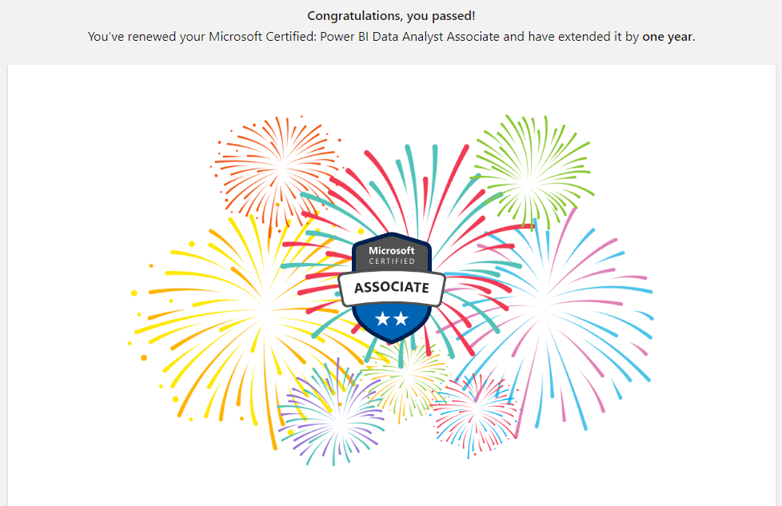

Slide 2
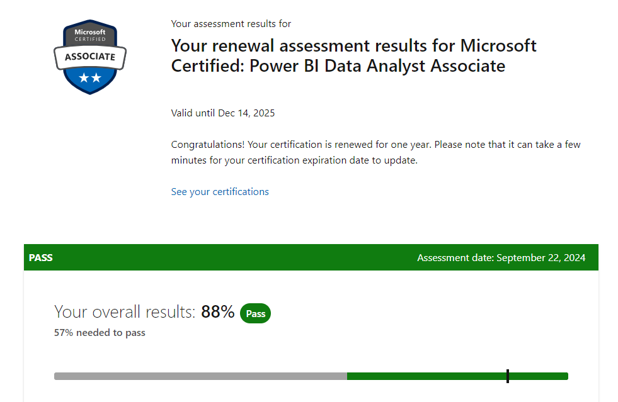

Slide 3
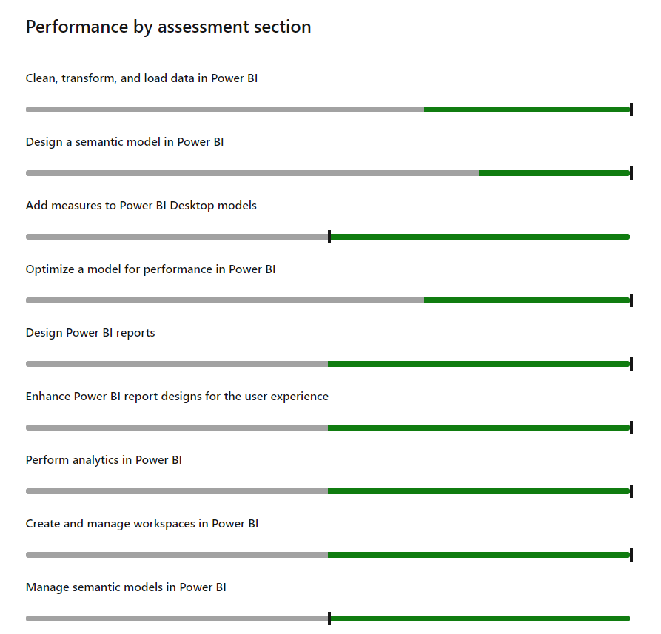

Slide 4

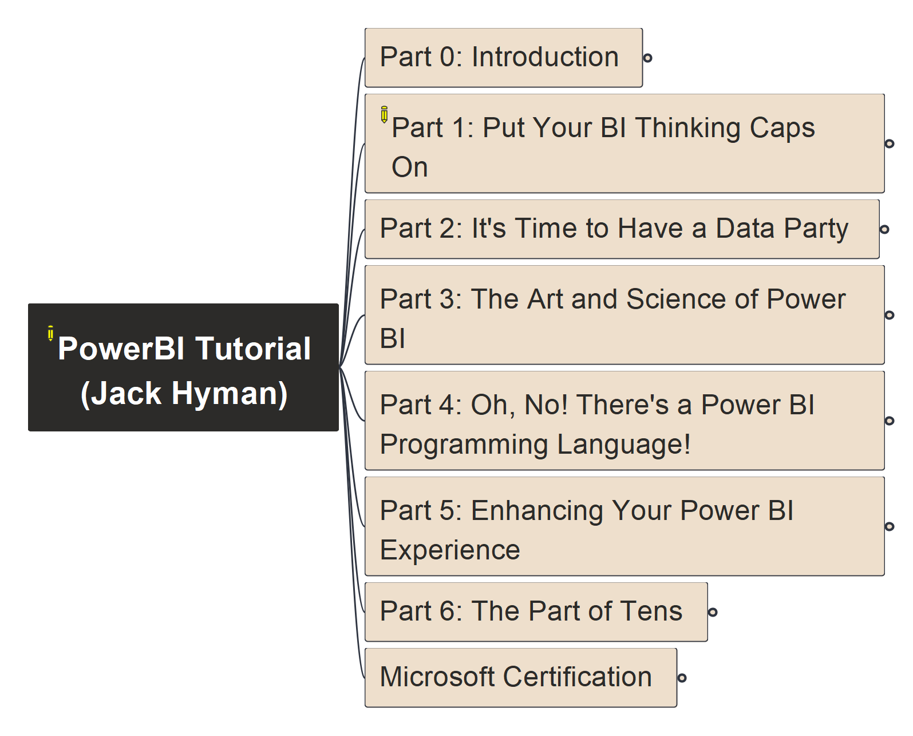

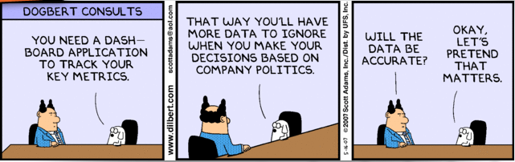
Power BI Tutorial
000
Opening
&
Welcome
Repository: https://github.com/yasenstar/PowerBI_Tutorial

Slide 5
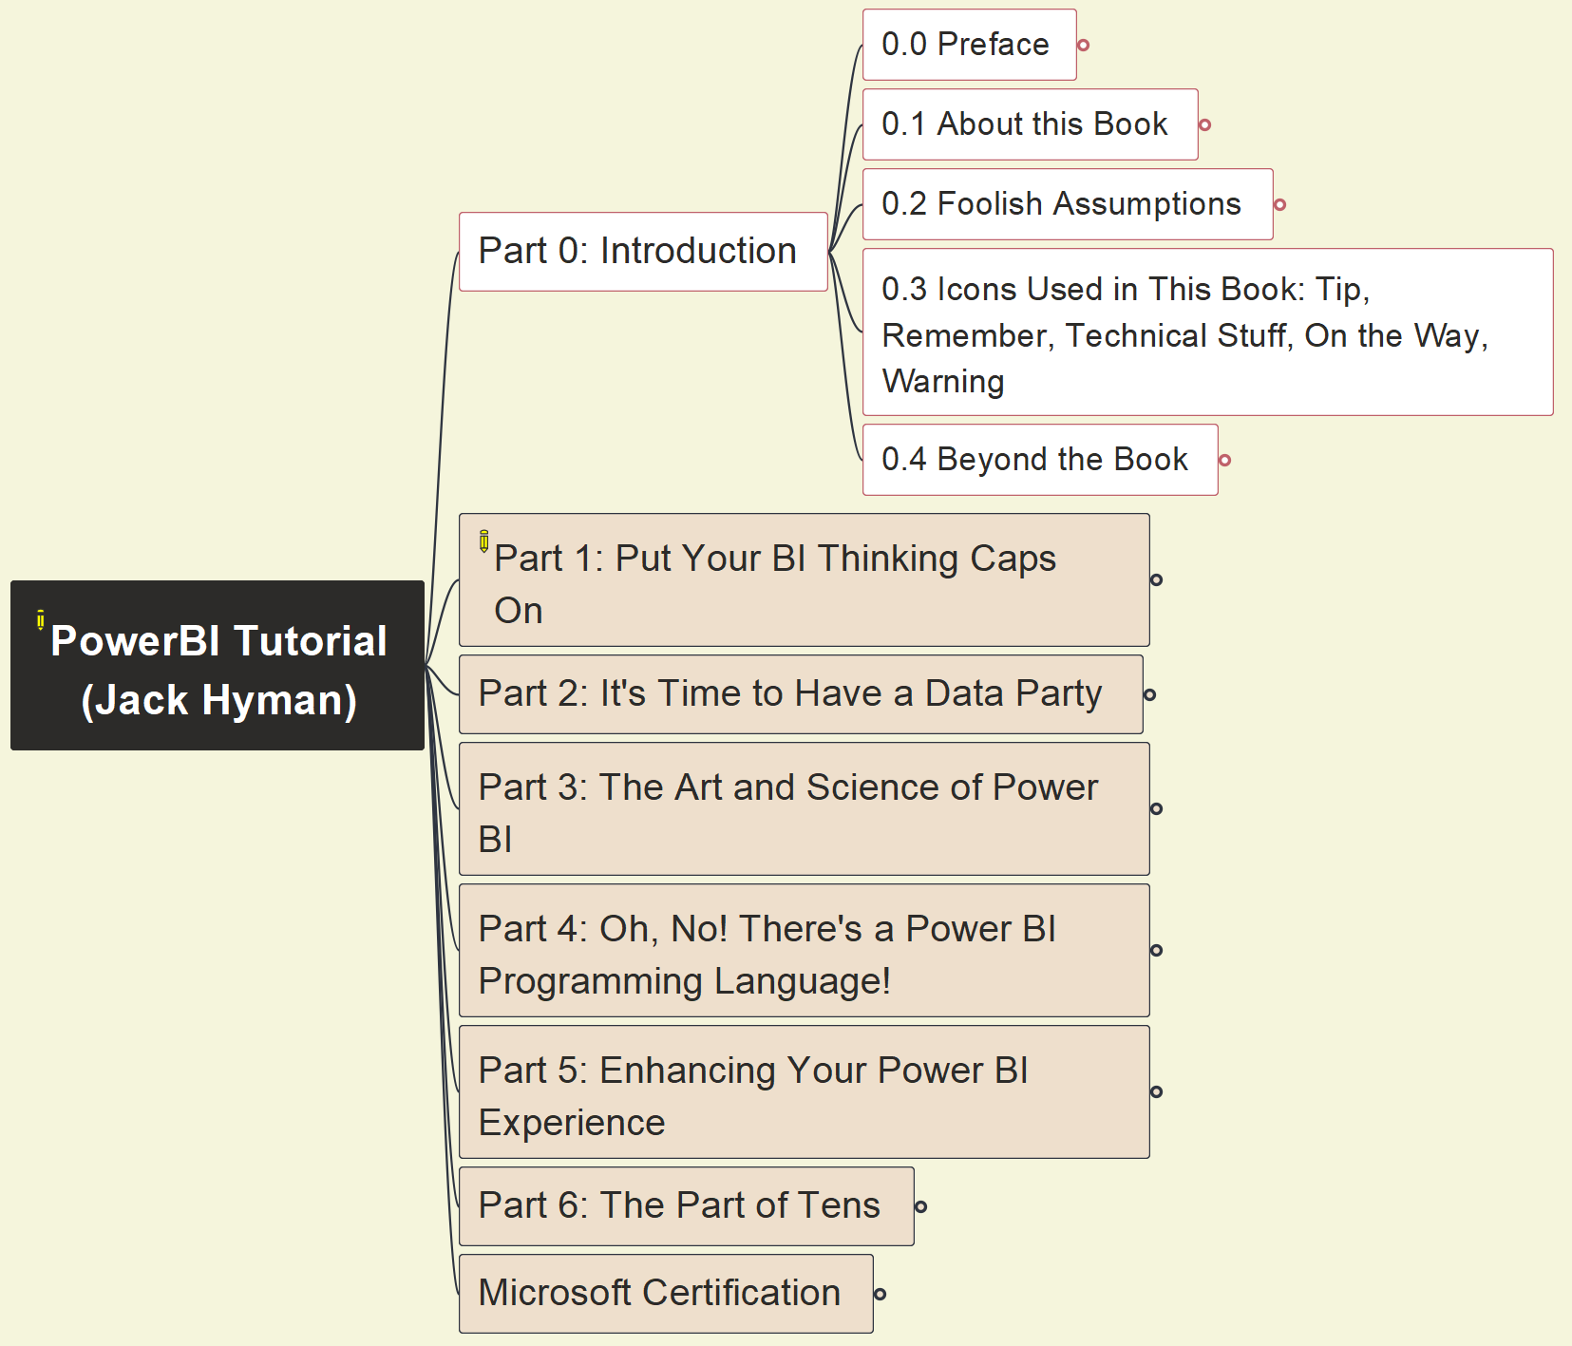
Power BI Tutorial
001
Part 0 Introduction
Repository: https://github.com/yasenstar/PowerBI_Tutorial

Slide 6
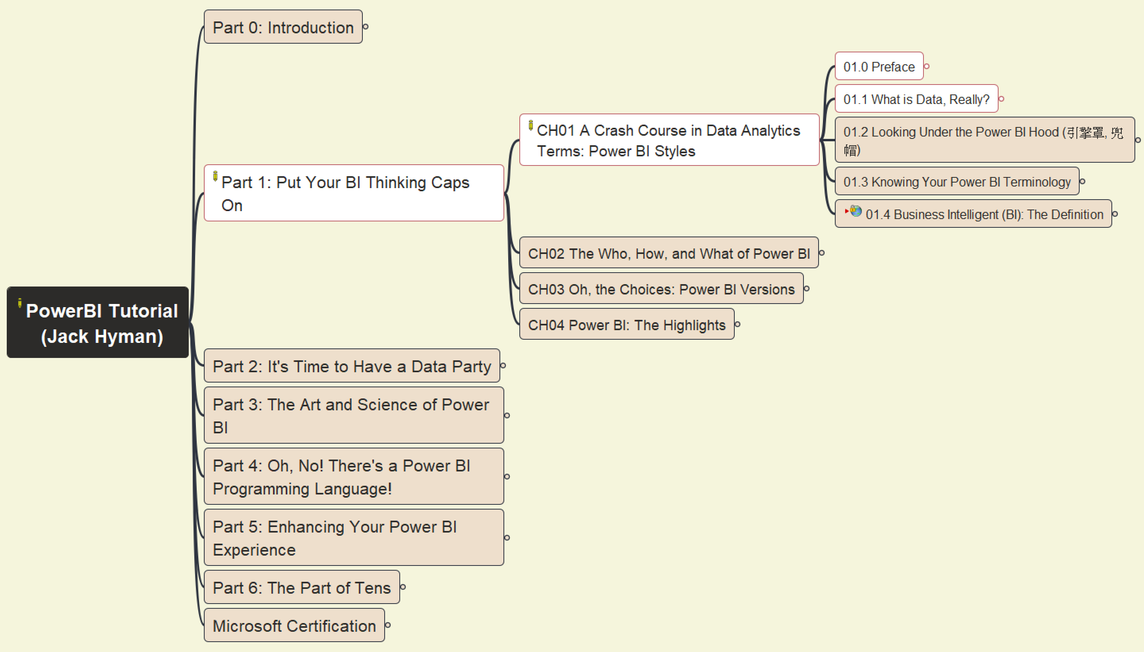
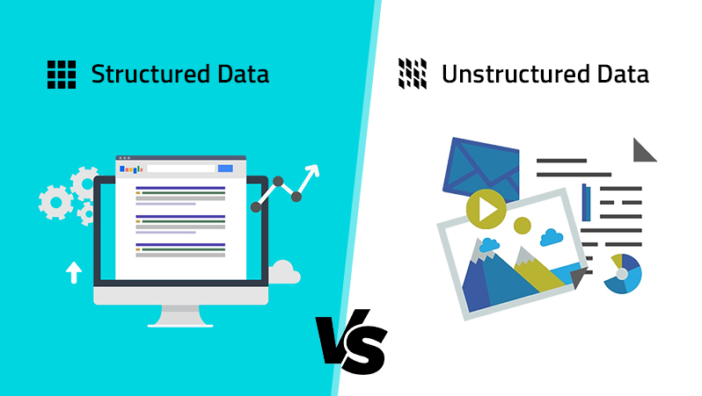
Power BI Tutorial
002
Part 1. Put Your BI Thinking Caps On
Chapter 01: Data Analytics Terms (1)
Repository: https://github.com/yasenstar/PowerBI_Tutorial

Slide 7
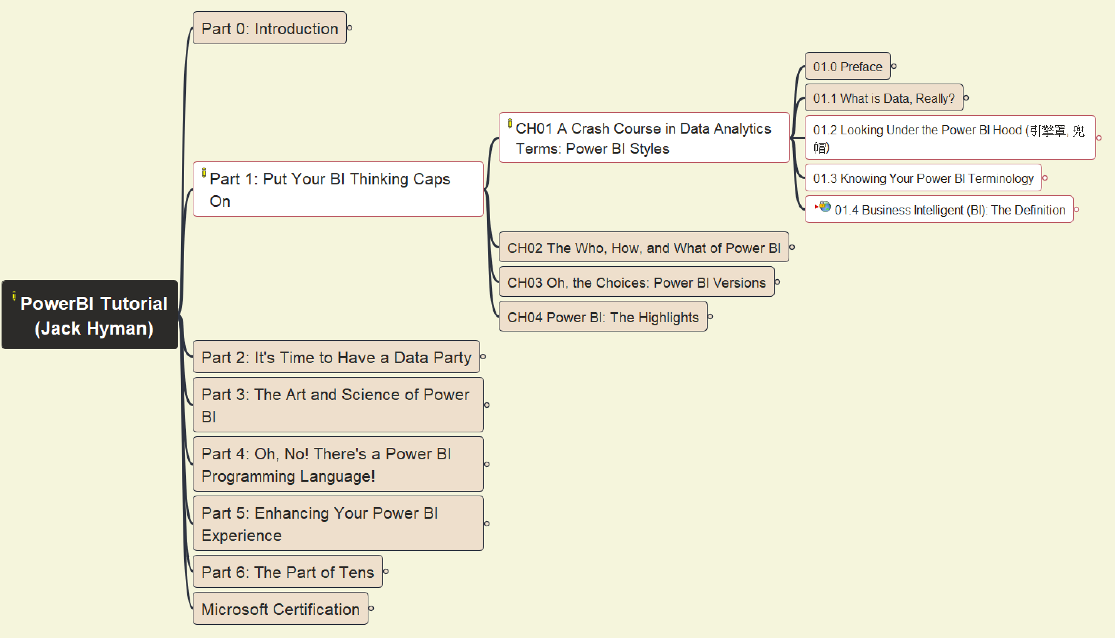
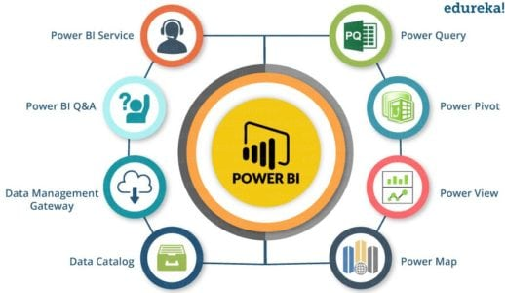
Power BI Tutorial
003
Part 1. Put Your BI Thinking Caps On
Chapter 01: Data Analytics Terms (2)
Repository: https://github.com/yasenstar/PowerBI_Tutorial

Slide 8
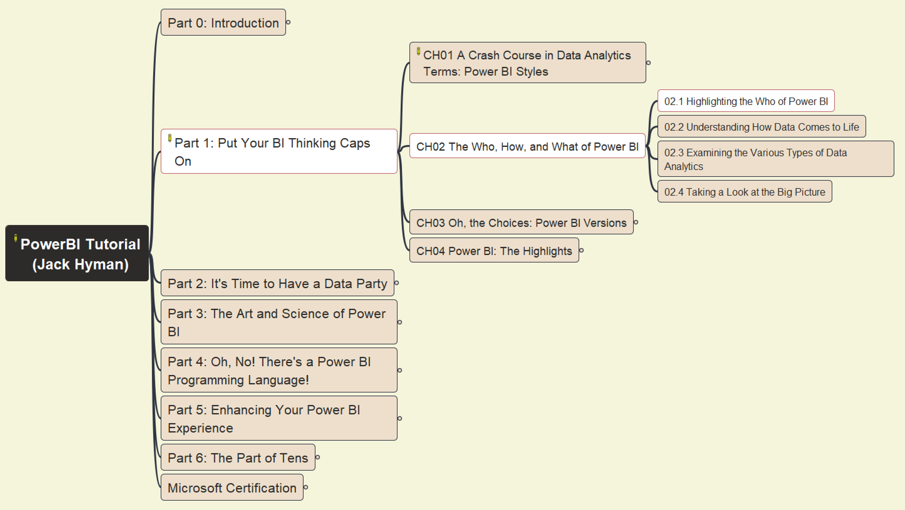

Power BI Tutorial
004
Part 1. Put Your BI Thinking Caps On
Chapter 02: Who, How, What (1)
DATA RELATED ROLE
Repository: https://github.com/yasenstar/PowerBI_Tutorial

Slide 9
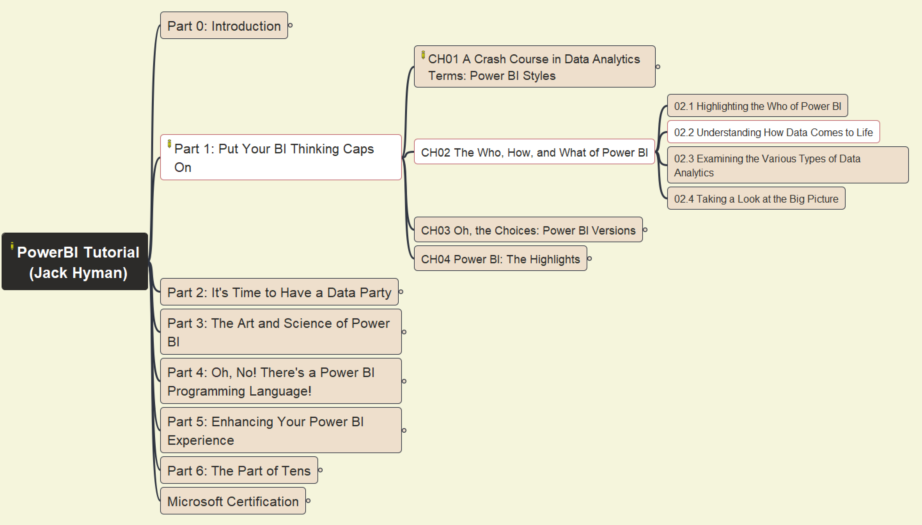
Power BI Tutorial
005
Part 1. Put Your BI Thinking Caps On
Chapter 02: Who, How, What (2)
Prepare
Model
Visualize
Analyze
Manage
Repository: https://github.com/yasenstar/PowerBI_Tutorial

Slide 10
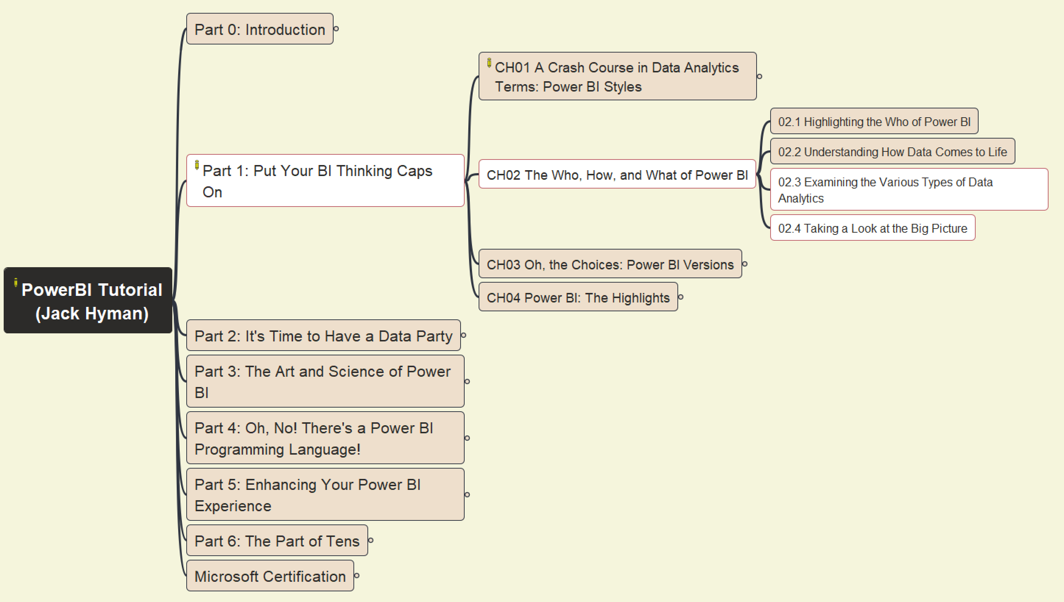

Power BI Tutorial
006
Part 1. Put Your BI Thinking Caps On
Chapter 02: Who, How, What (3)
Repository: https://github.com/yasenstar/PowerBI_Tutorial

Slide 11
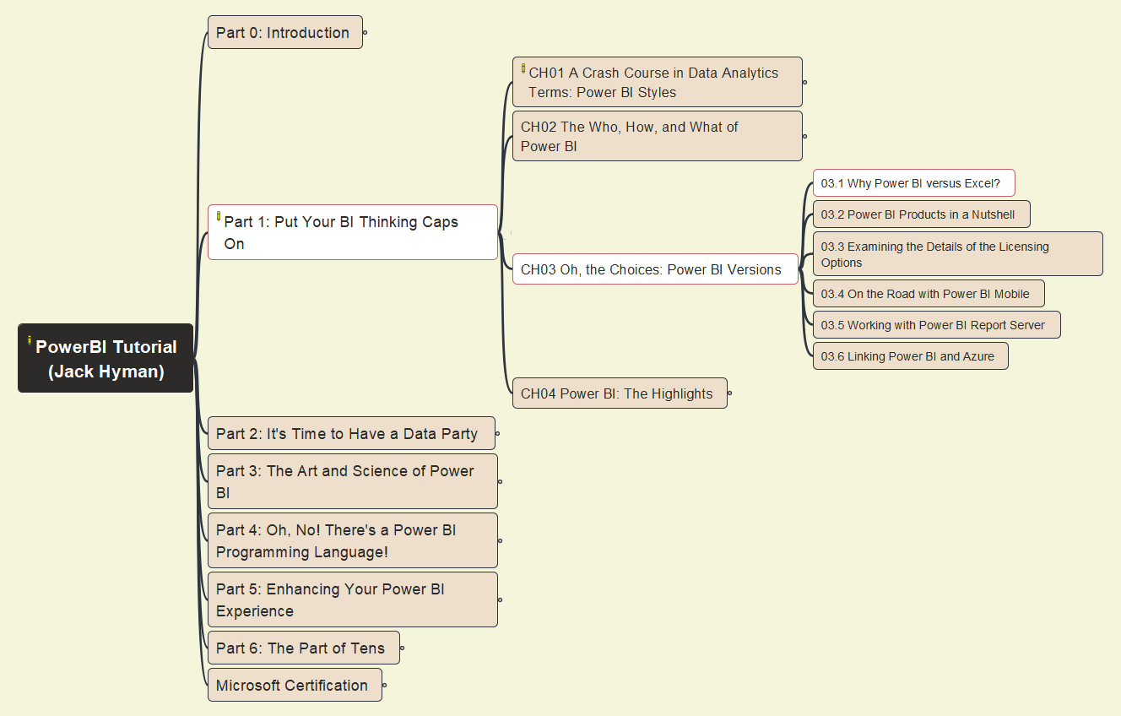

Power BI Tutorial
007
Part 1. Put Your BI Thinking Caps On
Chapter 03: Choices of Power BI – (1)
Repository: https://github.com/yasenstar/PowerBI_Tutorial

Slide 12
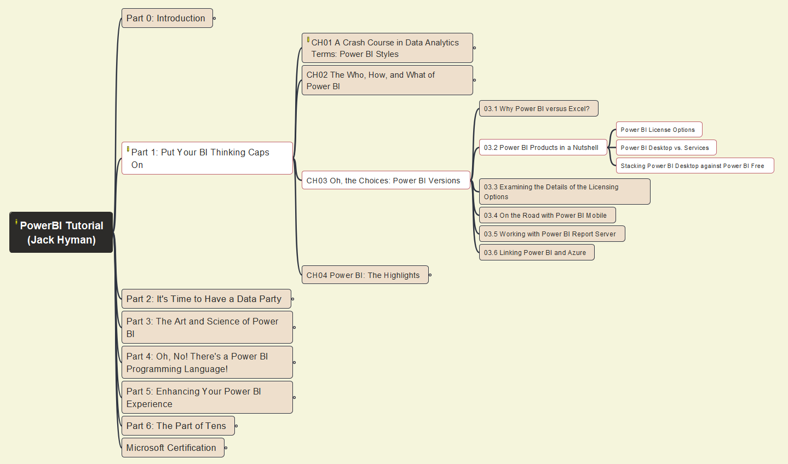

Power BI Tutorial
008
Part 1. Put Your BI Thinking Caps On
Chapter 03: Choices of Power BI – (2)
Repository: https://github.com/yasenstar/PowerBI_Tutorial

Slide 13
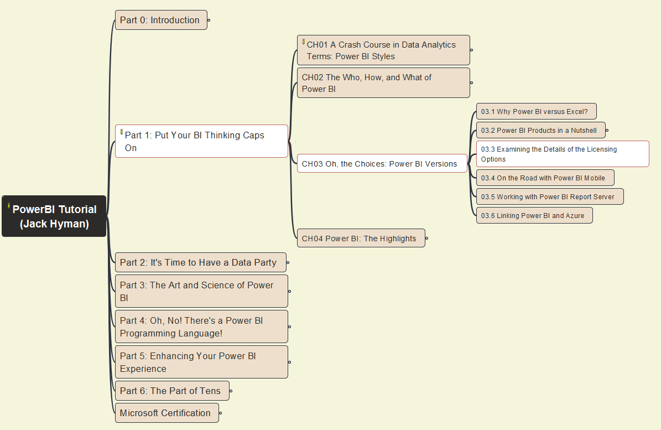

Power BI Tutorial
009
Part 1. Put Your BI Thinking Caps On
Chapter 03: Choices of Power BI – (3)
Free
Pro
Premium
Repository: https://github.com/yasenstar/PowerBI_Tutorial

Slide 14
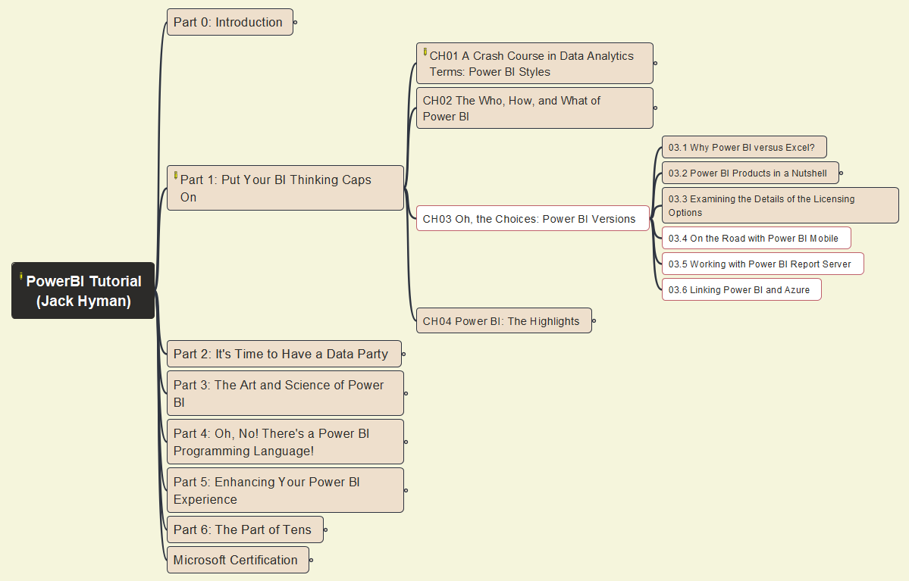



Power BI Tutorial
010
Part 1. Put Your BI Thinking Caps On
Chapter 03: Choices of Power BI – (4)
Repository: https://github.com/yasenstar/PowerBI_Tutorial

Slide 15
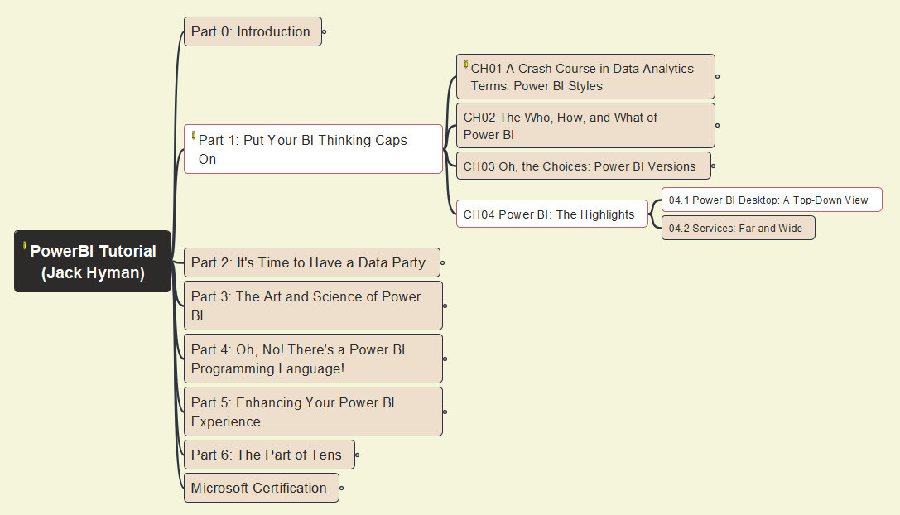
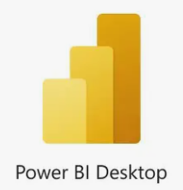
Power BI Tutorial
011
Part 1. Put Your BI Thinking Caps On
Chapter 04: Power BI Highlights – (1)
Repository: https://github.com/yasenstar/PowerBI_Tutorial

Slide 16
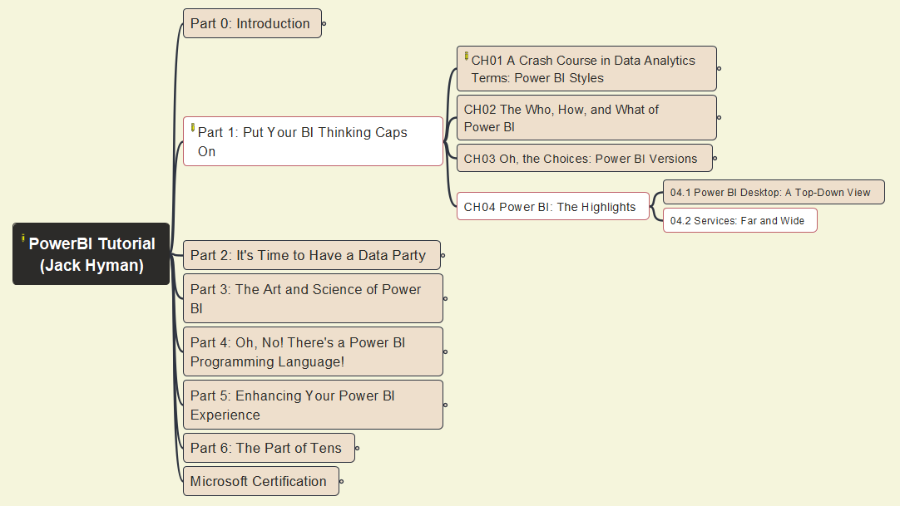

Power BI Tutorial
012
Part 1. Put Your BI Thinking Caps On
Chapter 04: Power BI Highlights – (1)
Repository: https://github.com/yasenstar/PowerBI_Tutorial

Slide 17
Power BI Tutorial
013
Part 2. Time to a Data Party
Chapter 05: Preparing Data Sources
Repository: https://github.com/yasenstar/PowerBI_Tutorial

Slide 18

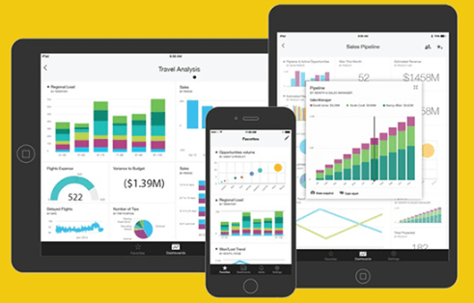

Slide 19


