Slide 1

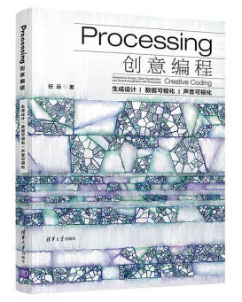
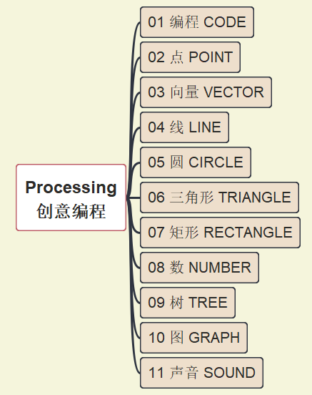
Processing 创意编程
001
https://github.com/yasenstar/Processing_Programming
生成设计 | 数据可视化 | 声音可视化

Slide 2

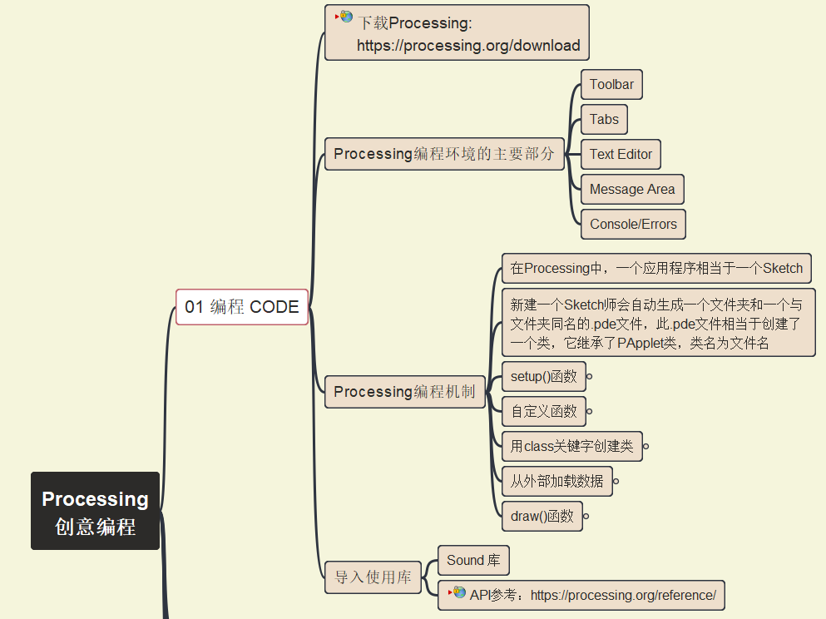
Processing 编程机制
002
https://github.com/yasenstar/Processing_Programming

Slide 3
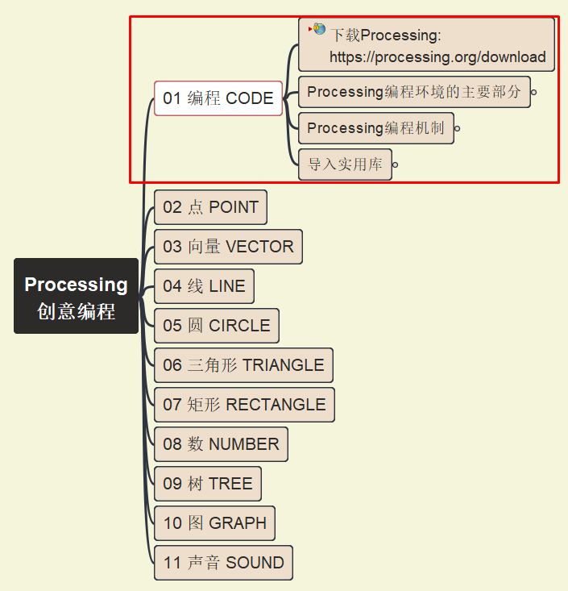
Processing 第一段代码
003
https://github.com/yasenstar/Processing_Programming

Slide 4
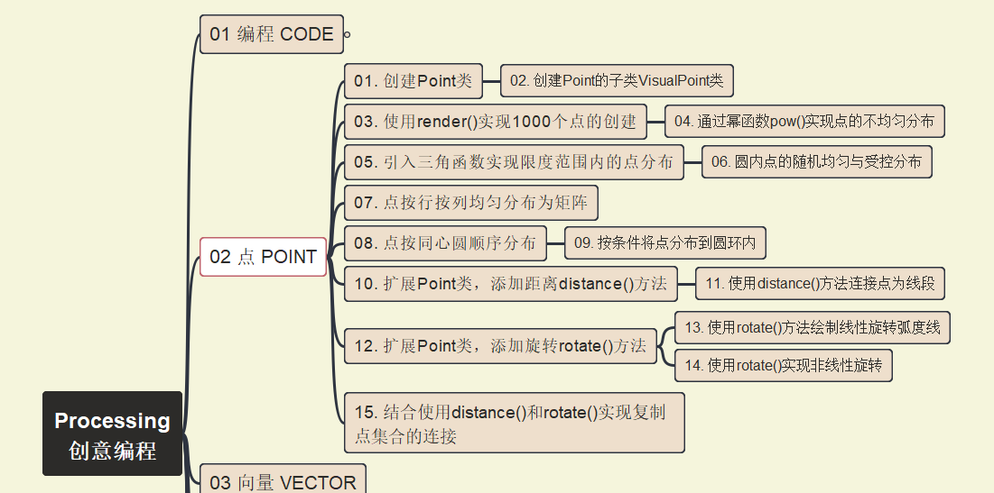
Processing 点 Point
004
https://github.com/yasenstar/Processing_Programming

Slide 5
Processing 点 Point
005
https://github.com/yasenstar/Processing_Programming

Slide 6
Processing 点 Point
006
https://github.com/yasenstar/Processing_Programming

Slide 7
Processing 点 Point
007
https://github.com/yasenstar/Processing_Programming

Slide 8
Processing 点 Point
008
https://github.com/yasenstar/Processing_Programming

Slide 9
Processing 点 Point
009
https://github.com/yasenstar/Processing_Programming

