Slide 1

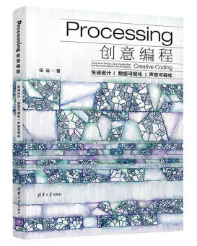
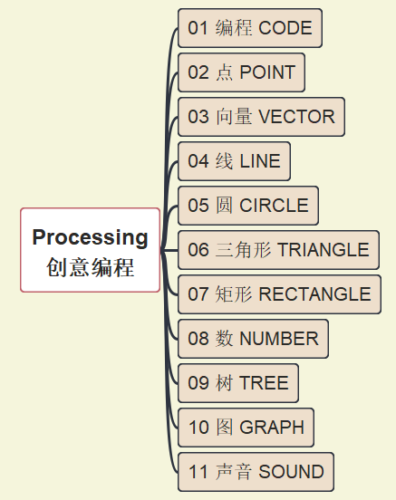
Processing 创意编程
001
https://github.com/yasenstar/Processing_Programming
生成设计 | 数据可视化 | 声音可视化

Slide 2

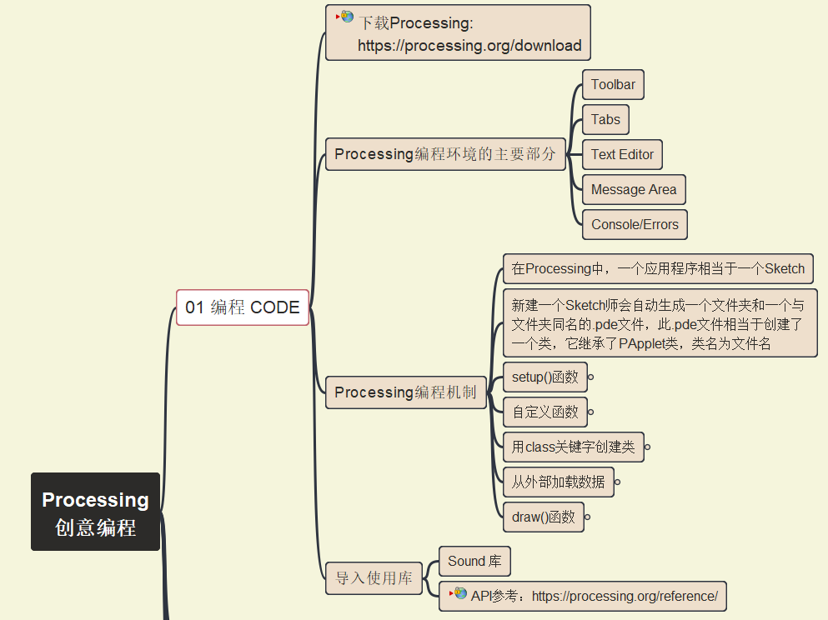
Processing 编程机制
002
https://github.com/yasenstar/Processing_Programming

Slide 3
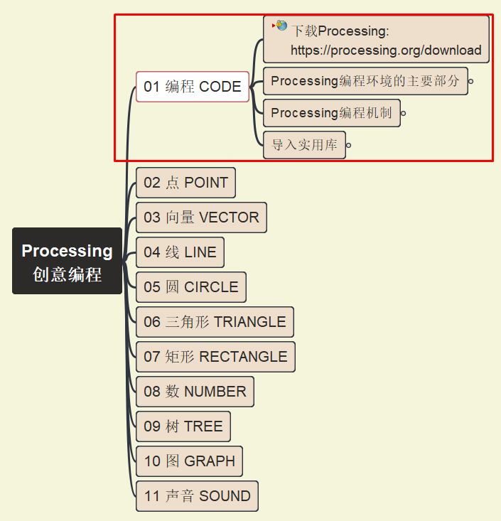
Processing 第一段代码
003
https://github.com/yasenstar/Processing_Programming

Slide 4
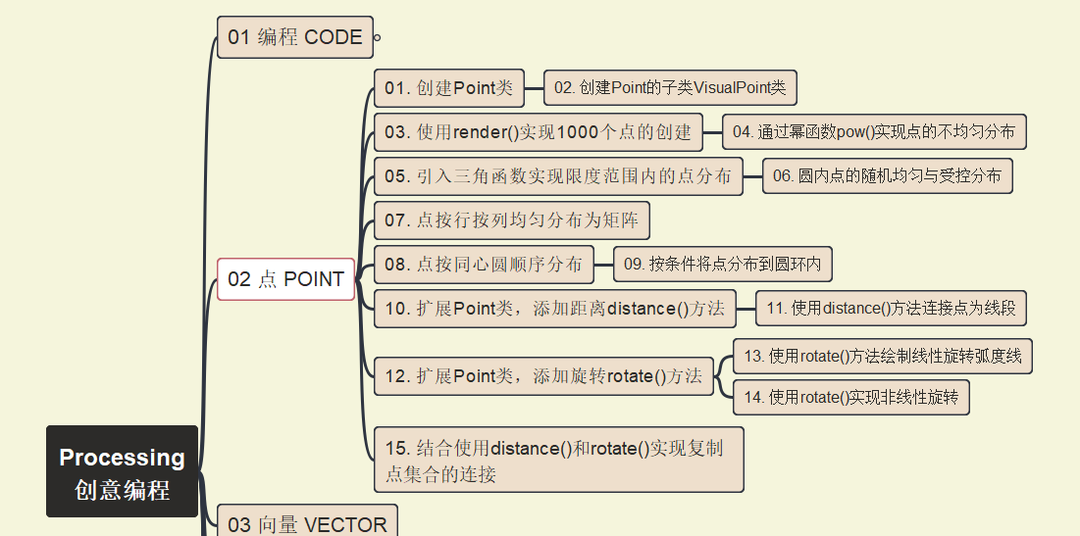
Processing 点 Point
004
https://github.com/yasenstar/Processing_Programming

Slide 5
Processing 点 Point
005
https://github.com/yasenstar/Processing_Programming

Slide 6
Processing 点 Point
006
https://github.com/yasenstar/Processing_Programming

Slide 7
Processing 点 Point
007
https://github.com/yasenstar/Processing_Programming

Slide 8
Processing 点 Point
008
https://github.com/yasenstar/Processing_Programming

Slide 9
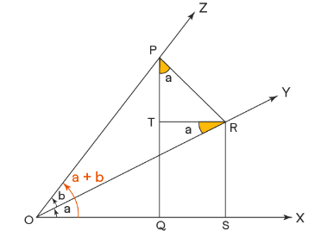
补充知识：坐标系旋转公式 1) cos(a+b) = cos(A)  Cos(B) – Sin(A)  Sin(B)
cos(a+b)
= OQ / OP
= (OS – QS) / OP
= OS / OP – QS / OP
= OS / OP – TR / OP
= OS/OR  OR/OP - TR/PR  PR/OP
= cos(a)  cos(b) - sin(a)  sin(b)

Slide 10
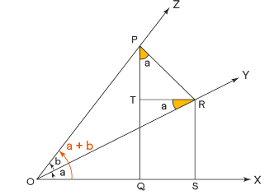
补充知识：坐标系旋转公式 2) Sin(a+b) = cos(A)Cos(B) – Sin(A)Sin(B)
sin(a+b)
= PQ/OP
= (PT + TQ) / OP
= PT/OP + TQ/OP
= PT/OP + RS/OP
= PT/PR  PR/OP + RS/OR  OR/OP
= cos(a)  sin(b) + sin(a)  cos(b)

Slide 11
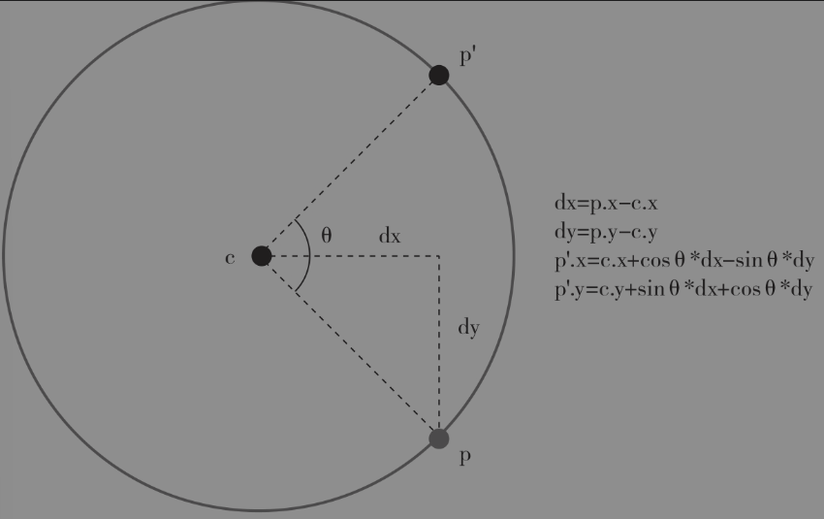
补充知识：坐标系旋转公式 圆弧上的旋转
以圆心为原点，半径为 r
P点相对圆心坐标为 (p.x-c.x, p.y-c.y) = (dx, dy)
P’点相对圆心坐标为 (p’.x-c.x, p’.y-c.y)
Θ = a
p’. x-c.x = r  cos(a+b) = r  cos(a)cos(b) – r  sin(a)sin(b) = cos(a)  dx – sin(a)  dy = cos(Θ)  dx – sin(Θ)  dy
p’. y-c.y = r  sin(a+b) = r  sin(a)cos(b) + r  cos(a)sin(b) = sin(a)  dx + cos(a)  dy = sin(Θ)  dx + cos(Θ)  dy
a
b

Slide 12
Processing 点 Point
009
https://github.com/yasenstar/Processing_Programming

