Slide 1


Cover page
啊哈C语言
-- 逻辑的挑战
001 – 开篇与介绍
By Xiaoqi Zhao
GitHub: https://github.com/yasenstar/aha-C

Slide 2
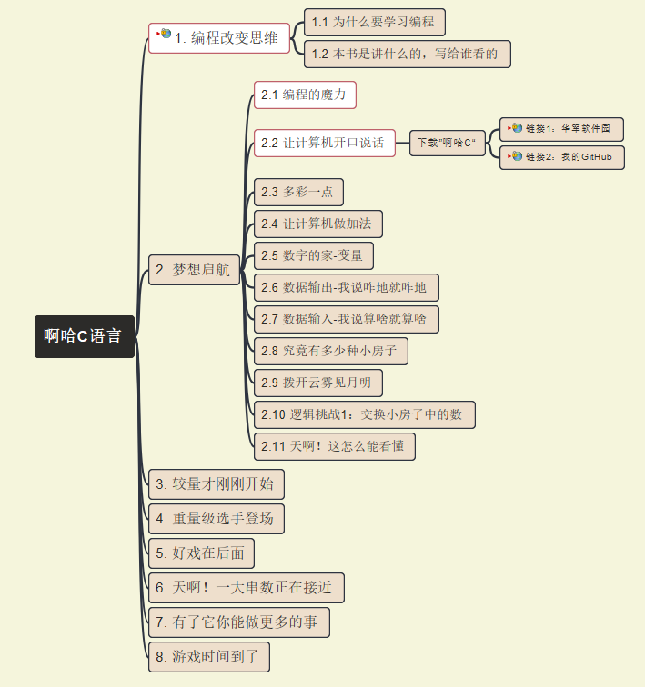
001 – 开篇与介绍

Slide 3
Cover page
啊哈C语言
-- 逻辑的挑战
002 – 啊哈C编译器安装
By Xiaoqi Zhao
GitHub: https://github.com/yasenstar/aha-C

Slide 4

Cover page
啊哈C语言
-- 逻辑的挑战
003 – 多彩一点儿
By Xiaoqi Zhao
GitHub: https://github.com/yasenstar/aha-C Gitee: https://gitee.com/yasenstar/aha-C

Slide 5
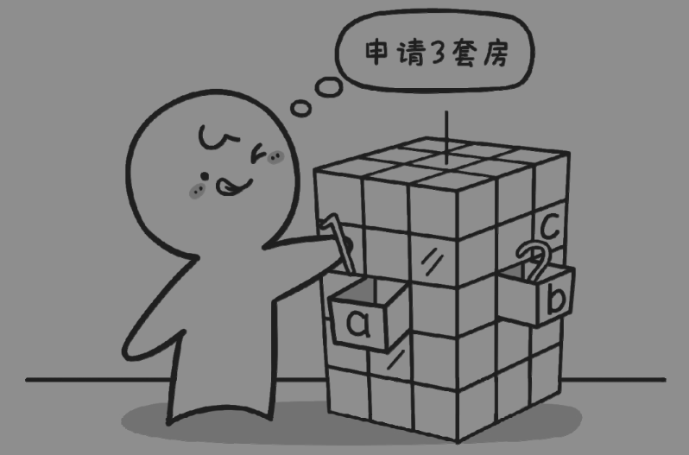
Cover page
啊哈C语言
-- 逻辑的挑战
004 – 让计算机做加法
By Xiaoqi Zhao
GitHub: https://github.com/yasenstar/aha-C Gitee: https://gitee.com/yasenstar/aha-C

Slide 6
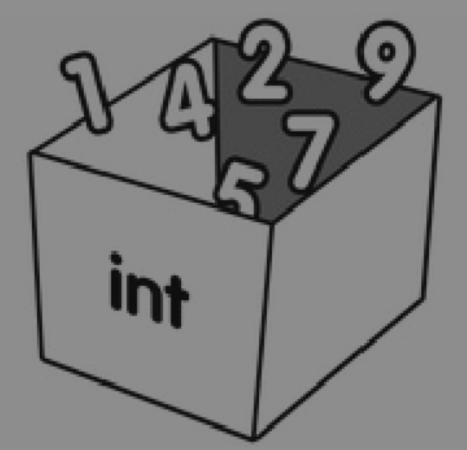

Cover page
啊哈C语言
-- 逻辑的挑战
005 – 数字的家-变量
By Xiaoqi Zhao
GitHub: https://github.com/yasenstar/aha-C Gitee: https://gitee.com/yasenstar/aha-C

Slide 7
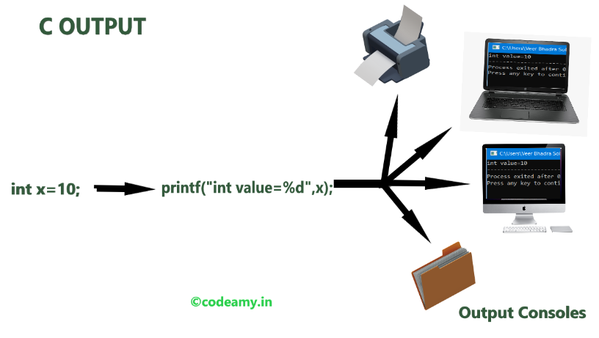
Cover page
啊哈C语言
-- 逻辑的挑战
006 – 数据输出
By Xiaoqi Zhao
GitHub: https://github.com/yasenstar/aha-C Gitee: https://gitee.com/yasenstar/aha-C

Slide 8

Cover page
啊哈C语言
-- 逻辑的挑战
007 – 数据输入
By Xiaoqi Zhao
GitHub: https://github.com/yasenstar/aha-C Gitee: https://gitee.com/yasenstar/aha-C

Slide 9

Cover page
啊哈C语言
-- 逻辑的挑战
008 – 有多少种小房子？
By Xiaoqi Zhao
GitHub: https://github.com/yasenstar/aha-C Gitee: https://gitee.com/yasenstar/aha-C

