Slide 1
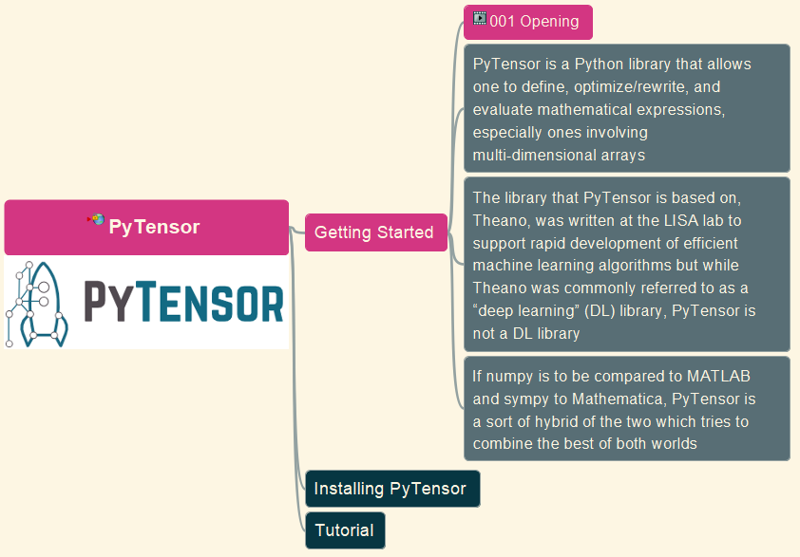


Learn PyTensor – Opening and Intro
001

Slide 2
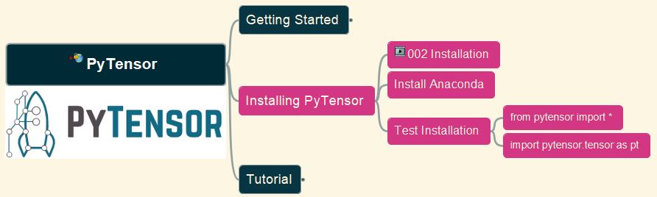
Installing PyTensor
Learn PyTensor
002

