Slide 1



Modeling ArchiSurance in Essential EAS
001
Opening and Introduction

Slide 2
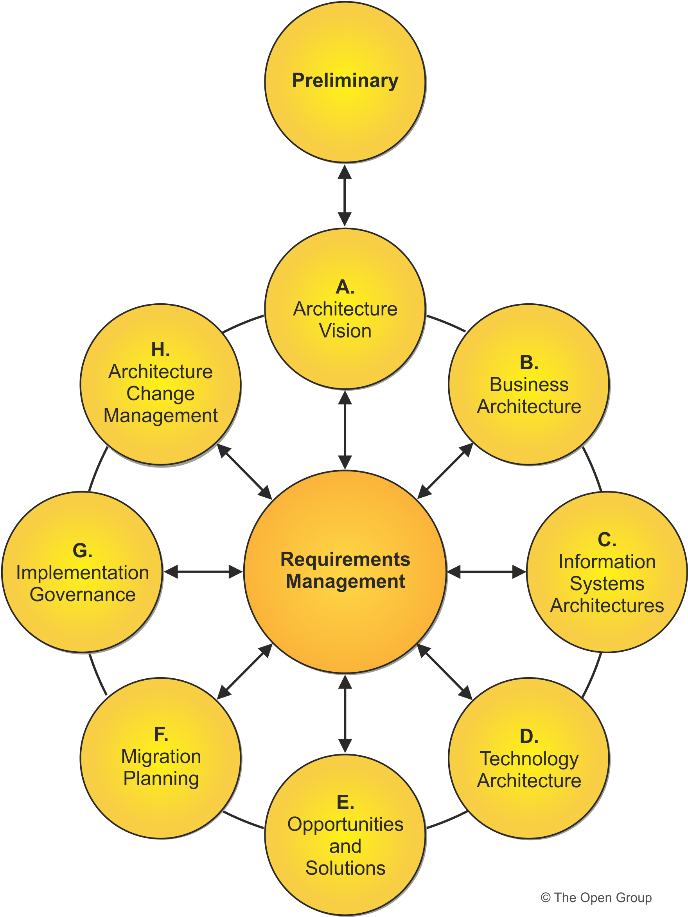
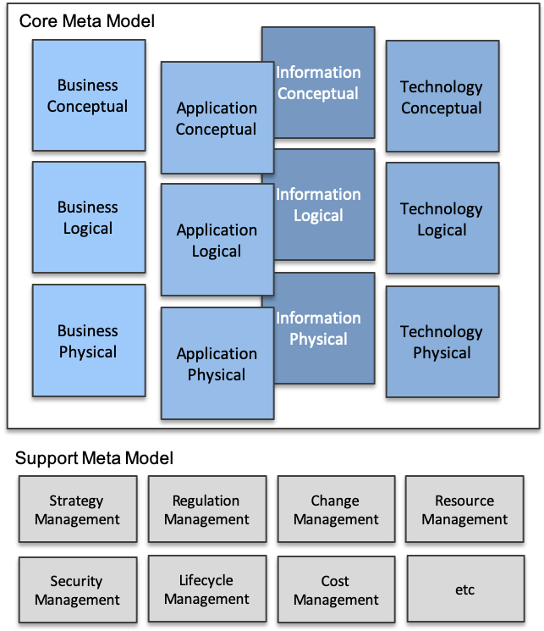
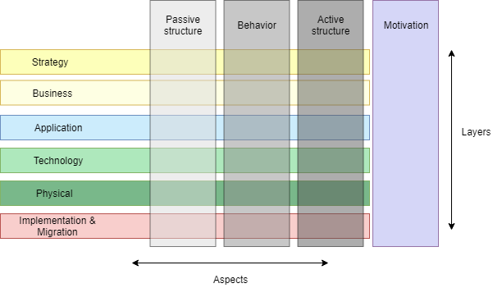
Meta-Model: TOGAF, ArchiMate and Essential

Slide 3
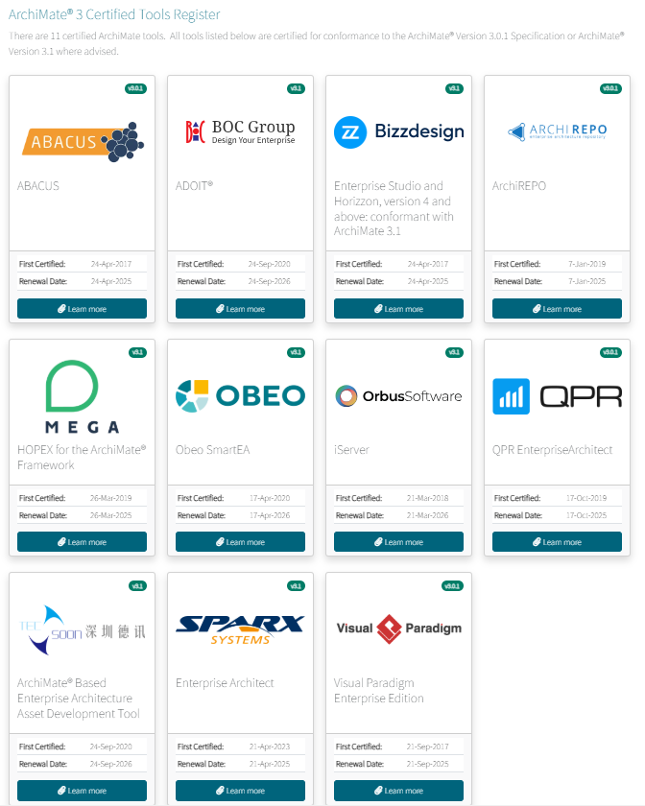
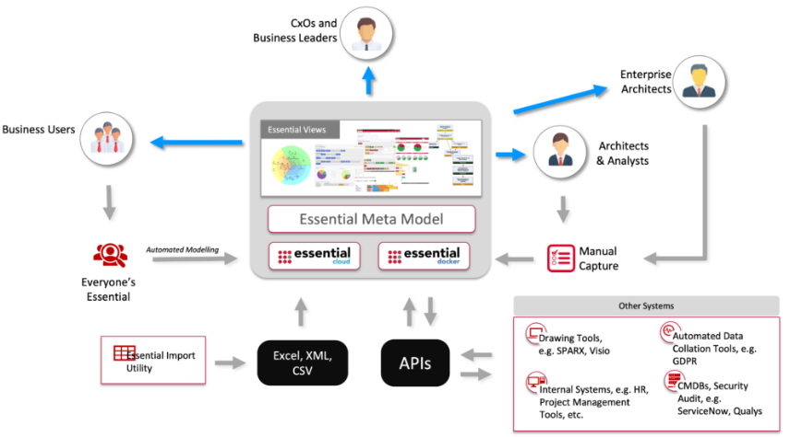
Modeling Tools
ArchiMate Modeling Tool
Abacus
BOC Group
BizzDesign
ArcihRepo
MEGA
OBEO
OrbusSoftware
QPR
Soon
SPARX Systems
Visual Paradigm
Archi
The Essential Eco System

Slide 4
Our Course Structure
Base on ArchiSurance (later ArchiMetal) contents: Phase A to Phase F
Use my earlier ArchiSurance model (by Archi) as the reference
Demo per diagram in ArchiSurance and analyze the proper meta-model relations can be modeled in Essential
Create accumulated Essential modeling project and store in GitHub per topic
Demo how to populate to the built-in Essential views, or if needed, customize views via certain coding
Use FreePlane to track the detail points so that you can trace back on the modeling steps
After all, learning by practicing, and keep fun!

Slide 5

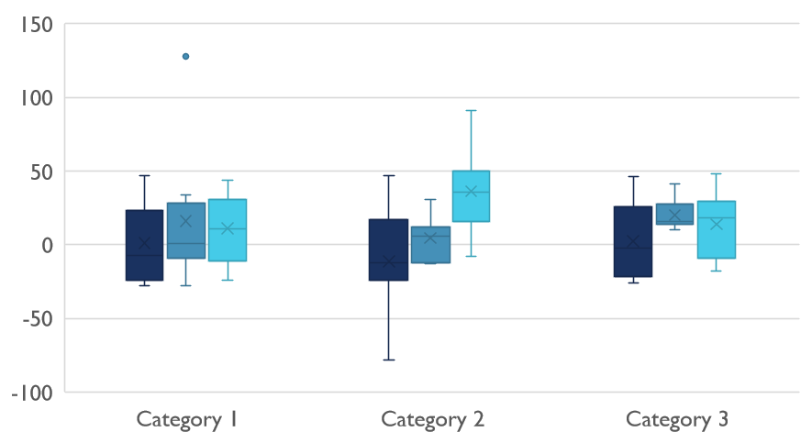
Competitive Landscape
002

