Slide 1
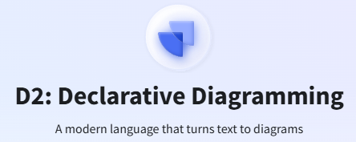
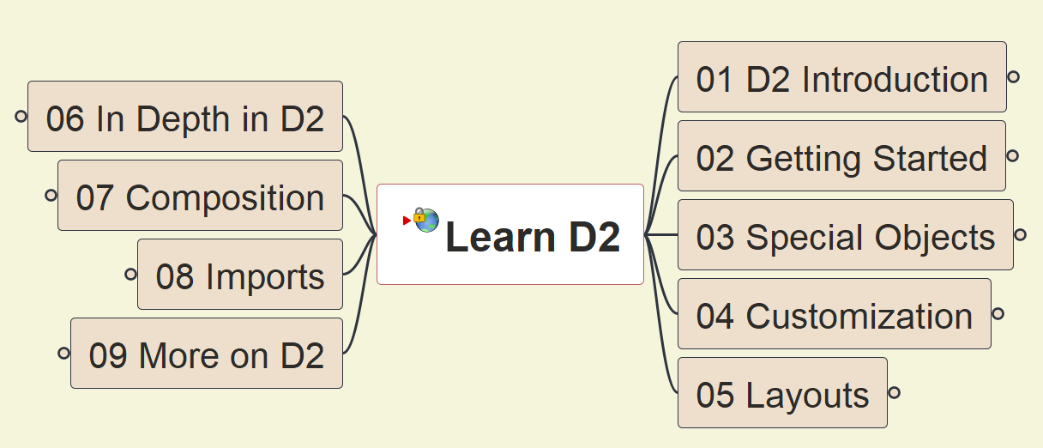
D2 Tutorial
001
Opening and Introduction

Slide 2
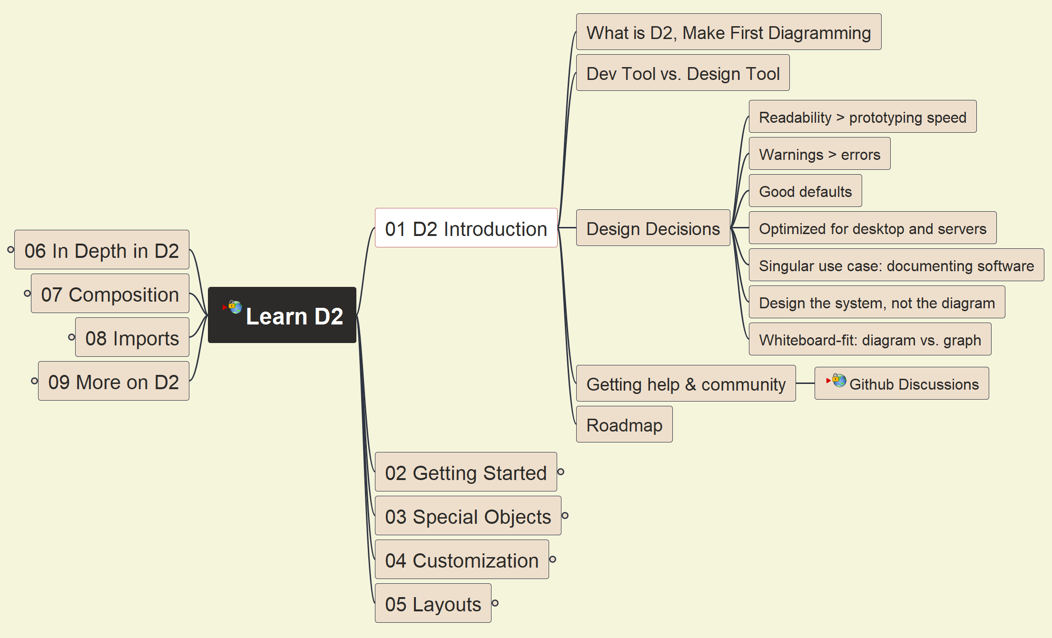
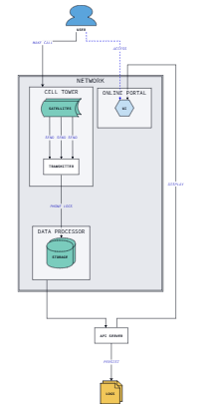

D2 Introduction
002

Slide 3
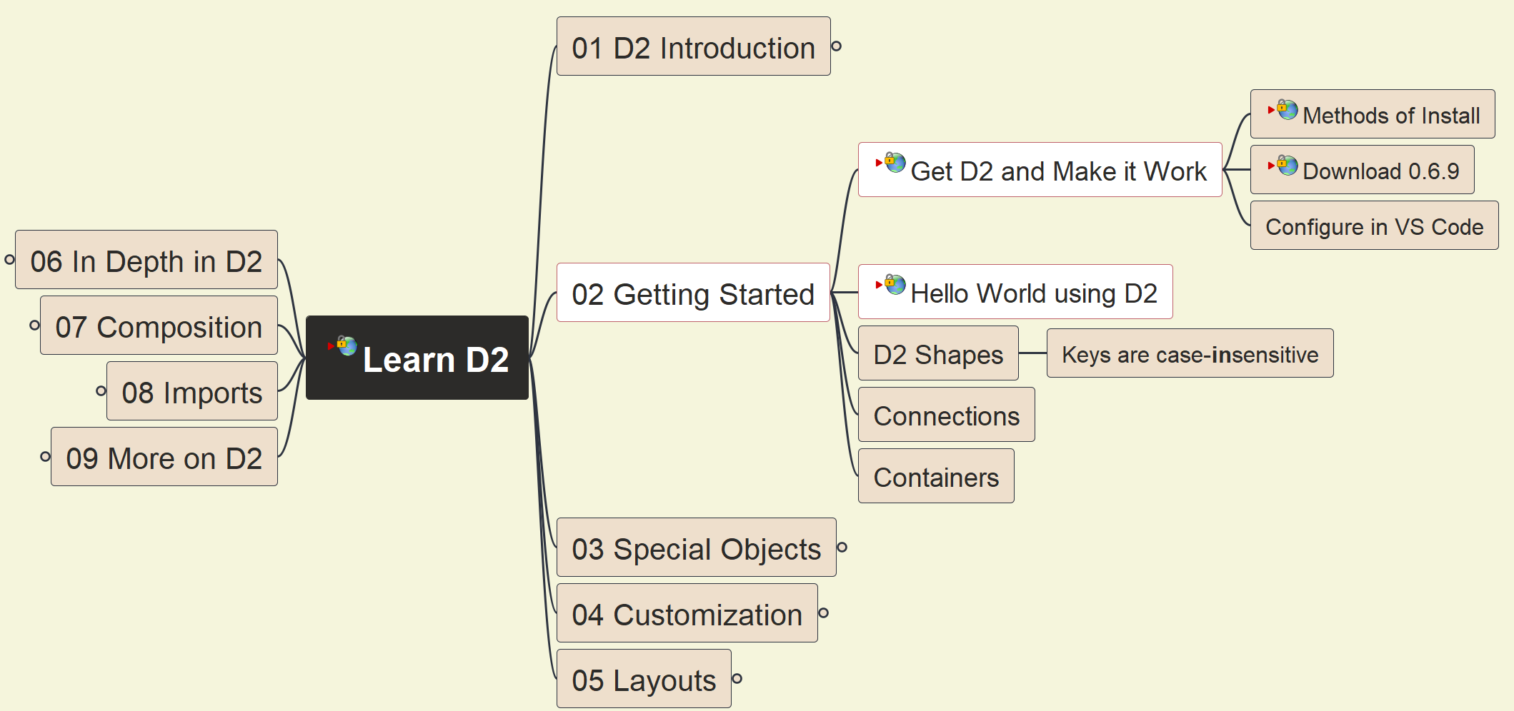
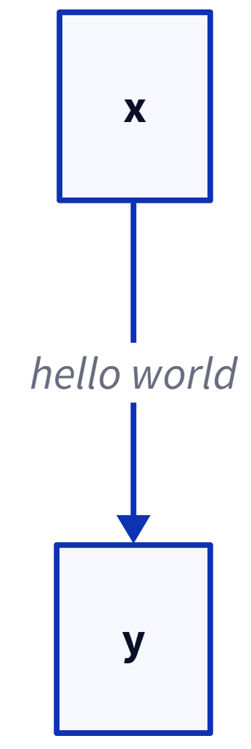
Get D2 and Make it Work
003

Slide 4
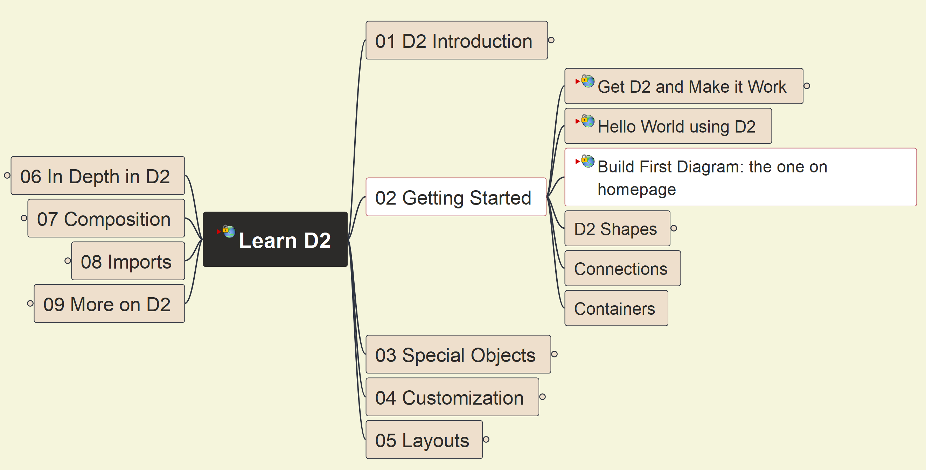
Make your First D2 Diagram
004

Slide 5
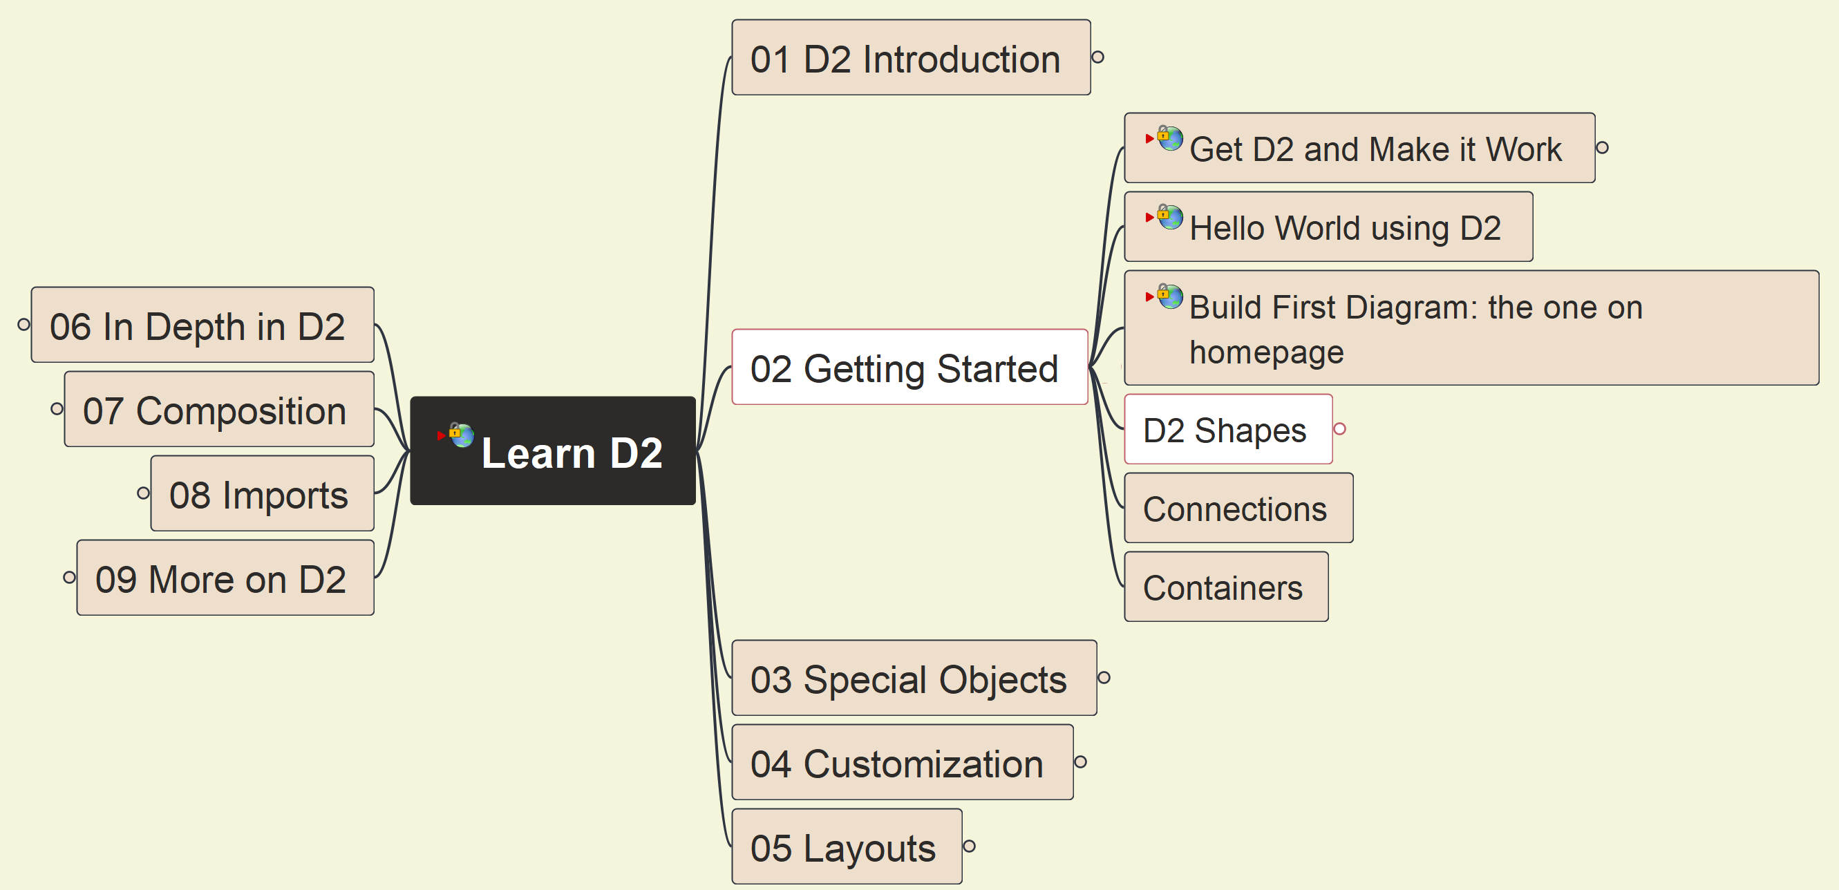
Getting Started: Shapes
005

Slide 6
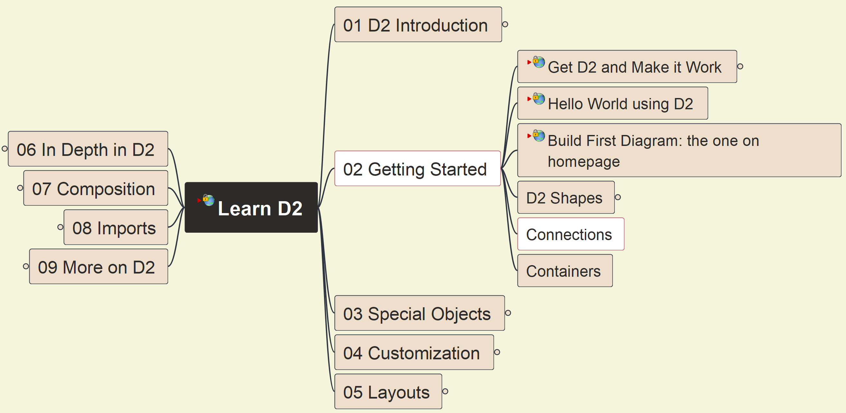

Getting Started: Connections - 1
006

Slide 7
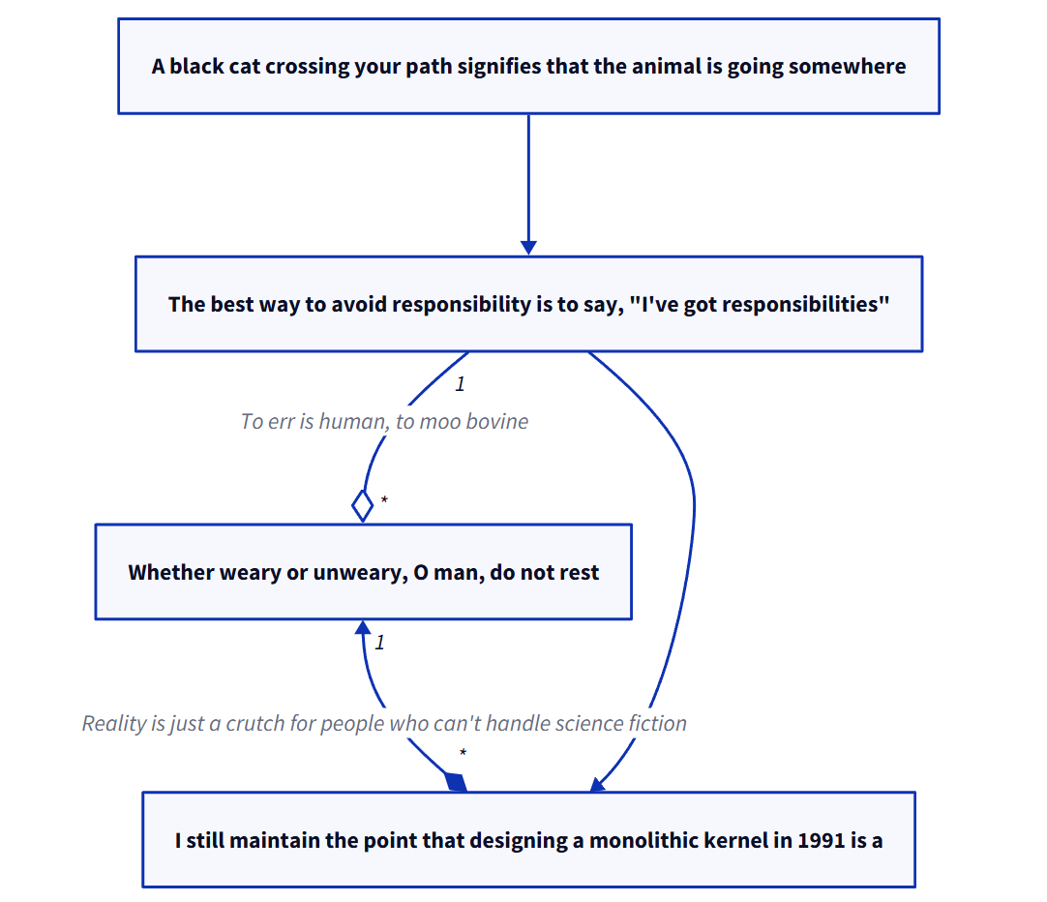
Getting Started: Connections - 2
007

Slide 8
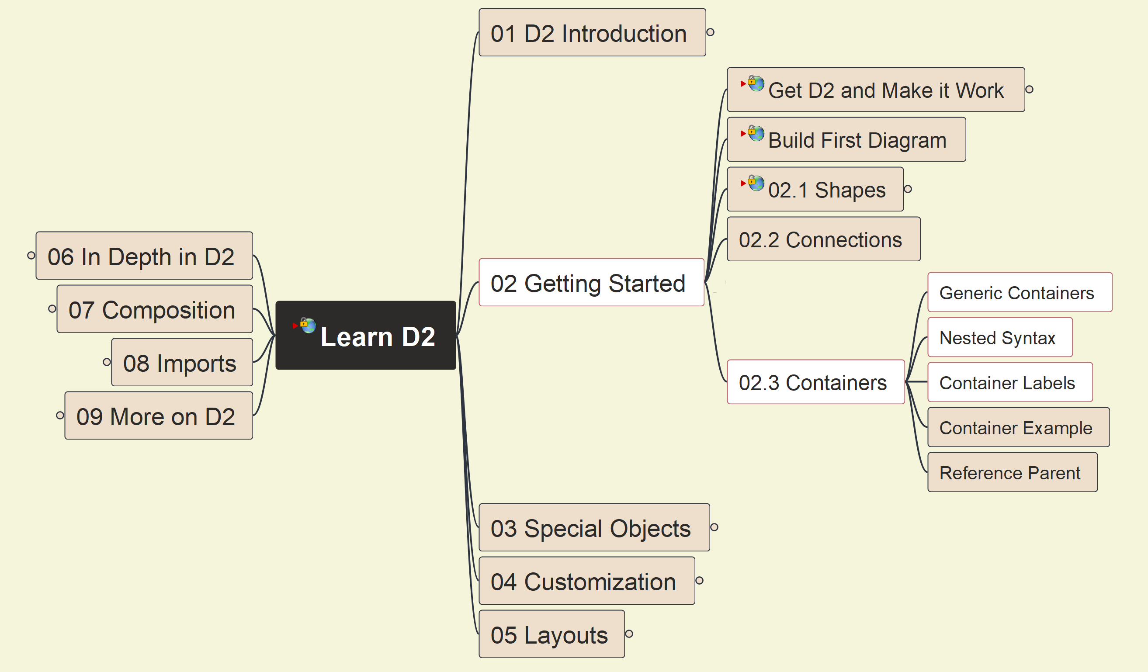
Getting Started: Containers - 1
008

Slide 9
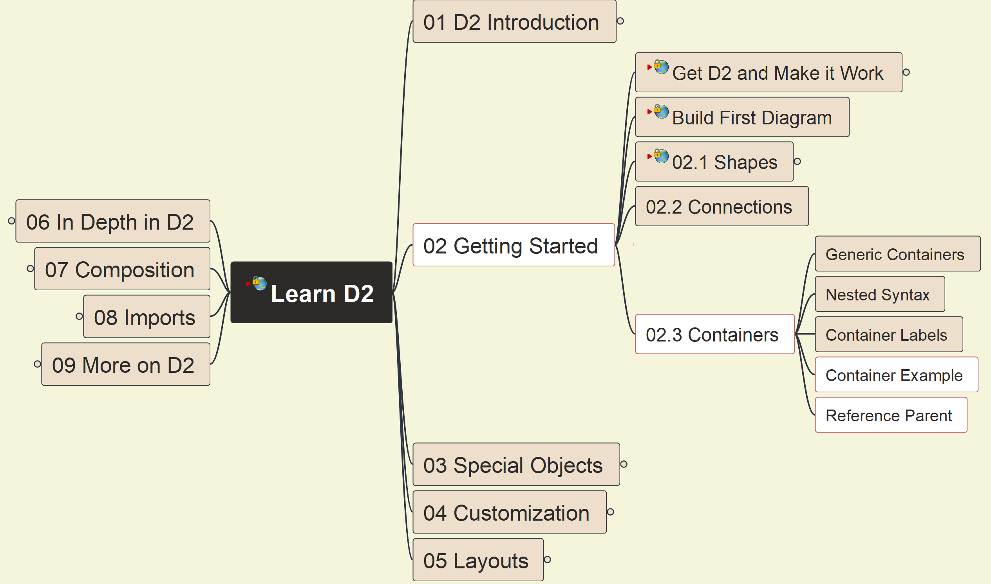
Getting Started: Containers - 2
009

Slide 10
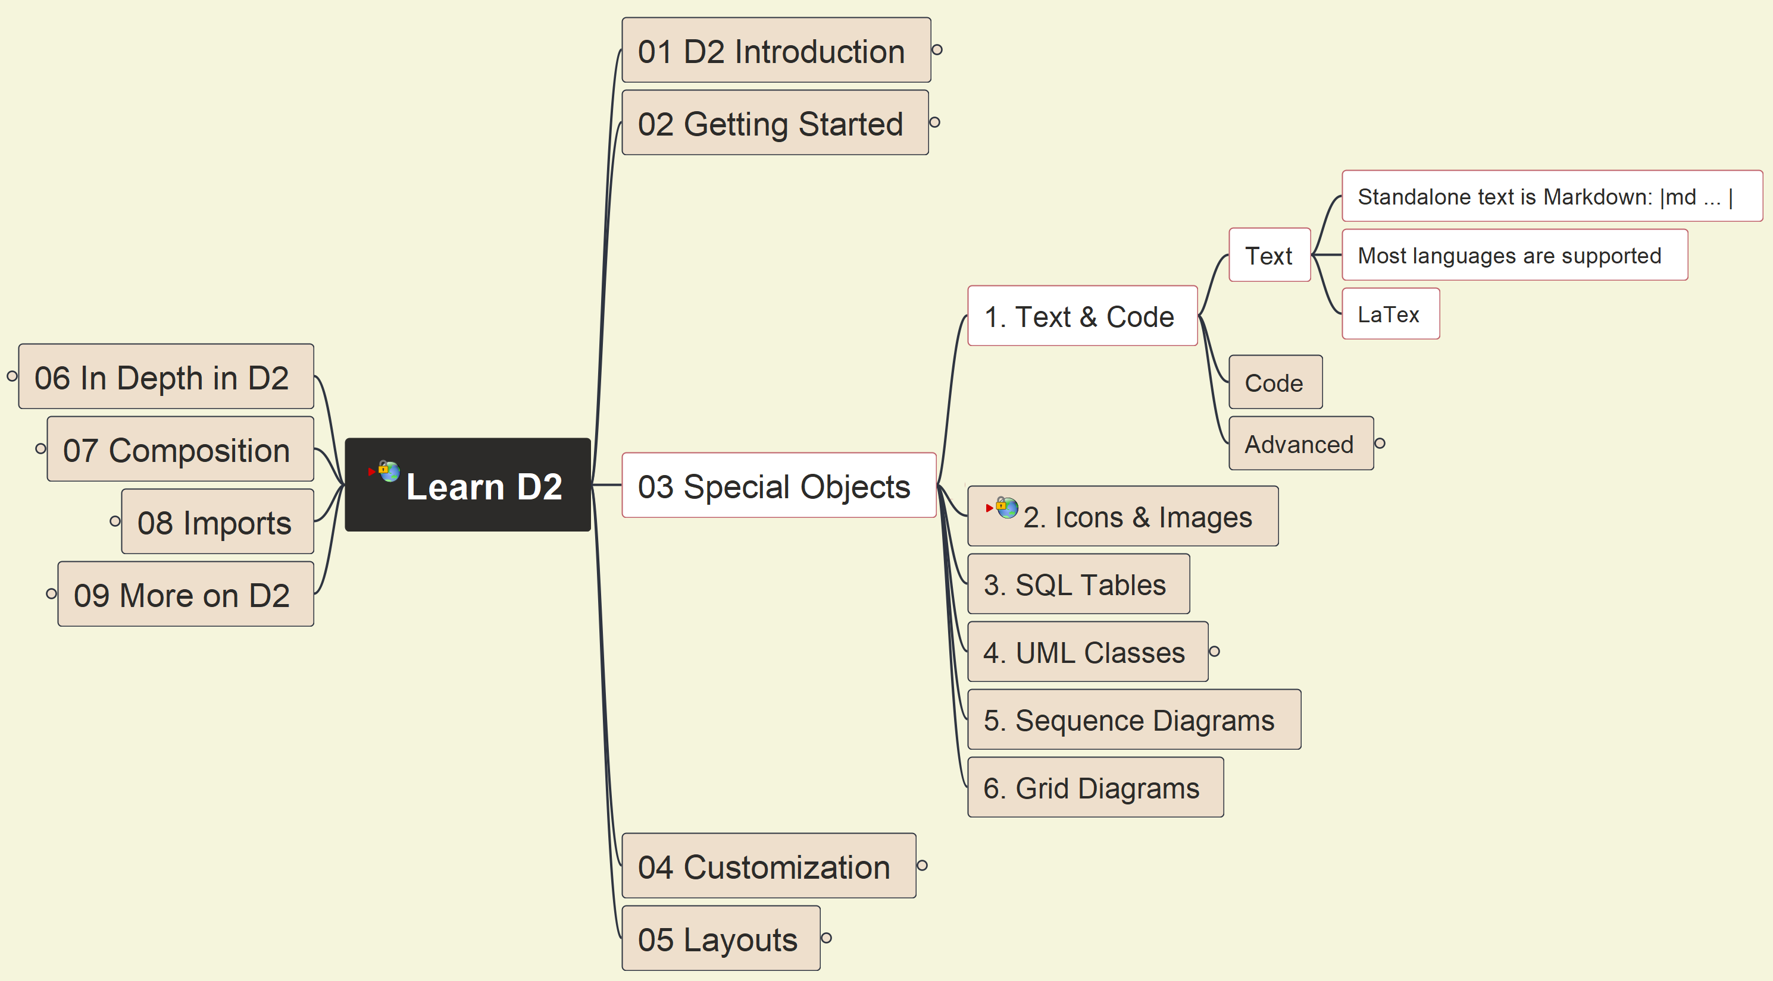
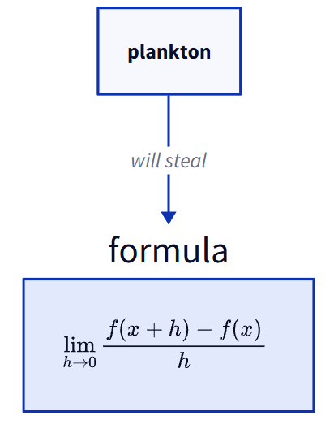
3. Special Objects: 1. Text & Code (1)
010

Slide 11
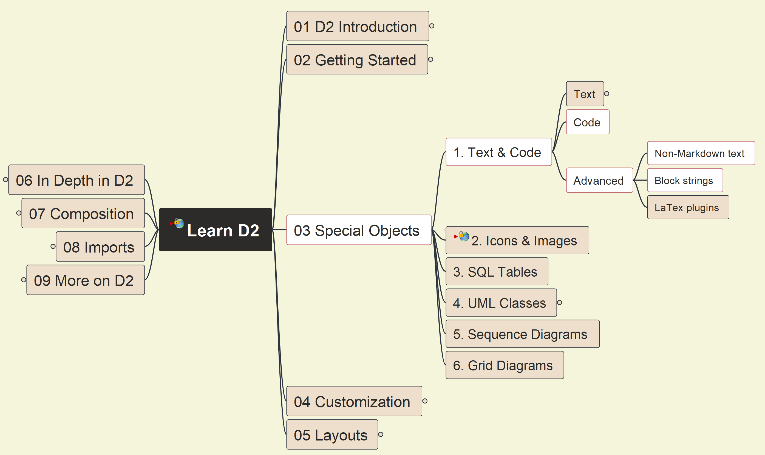
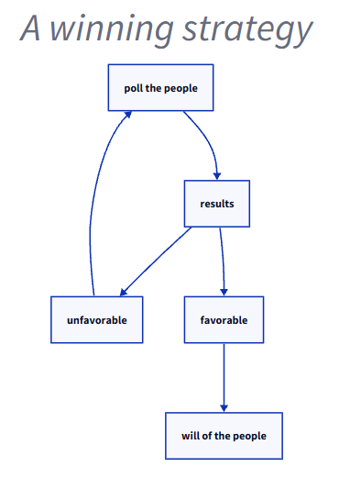
3. Special Objects: 1. Text & Code (2)
011

Slide 12
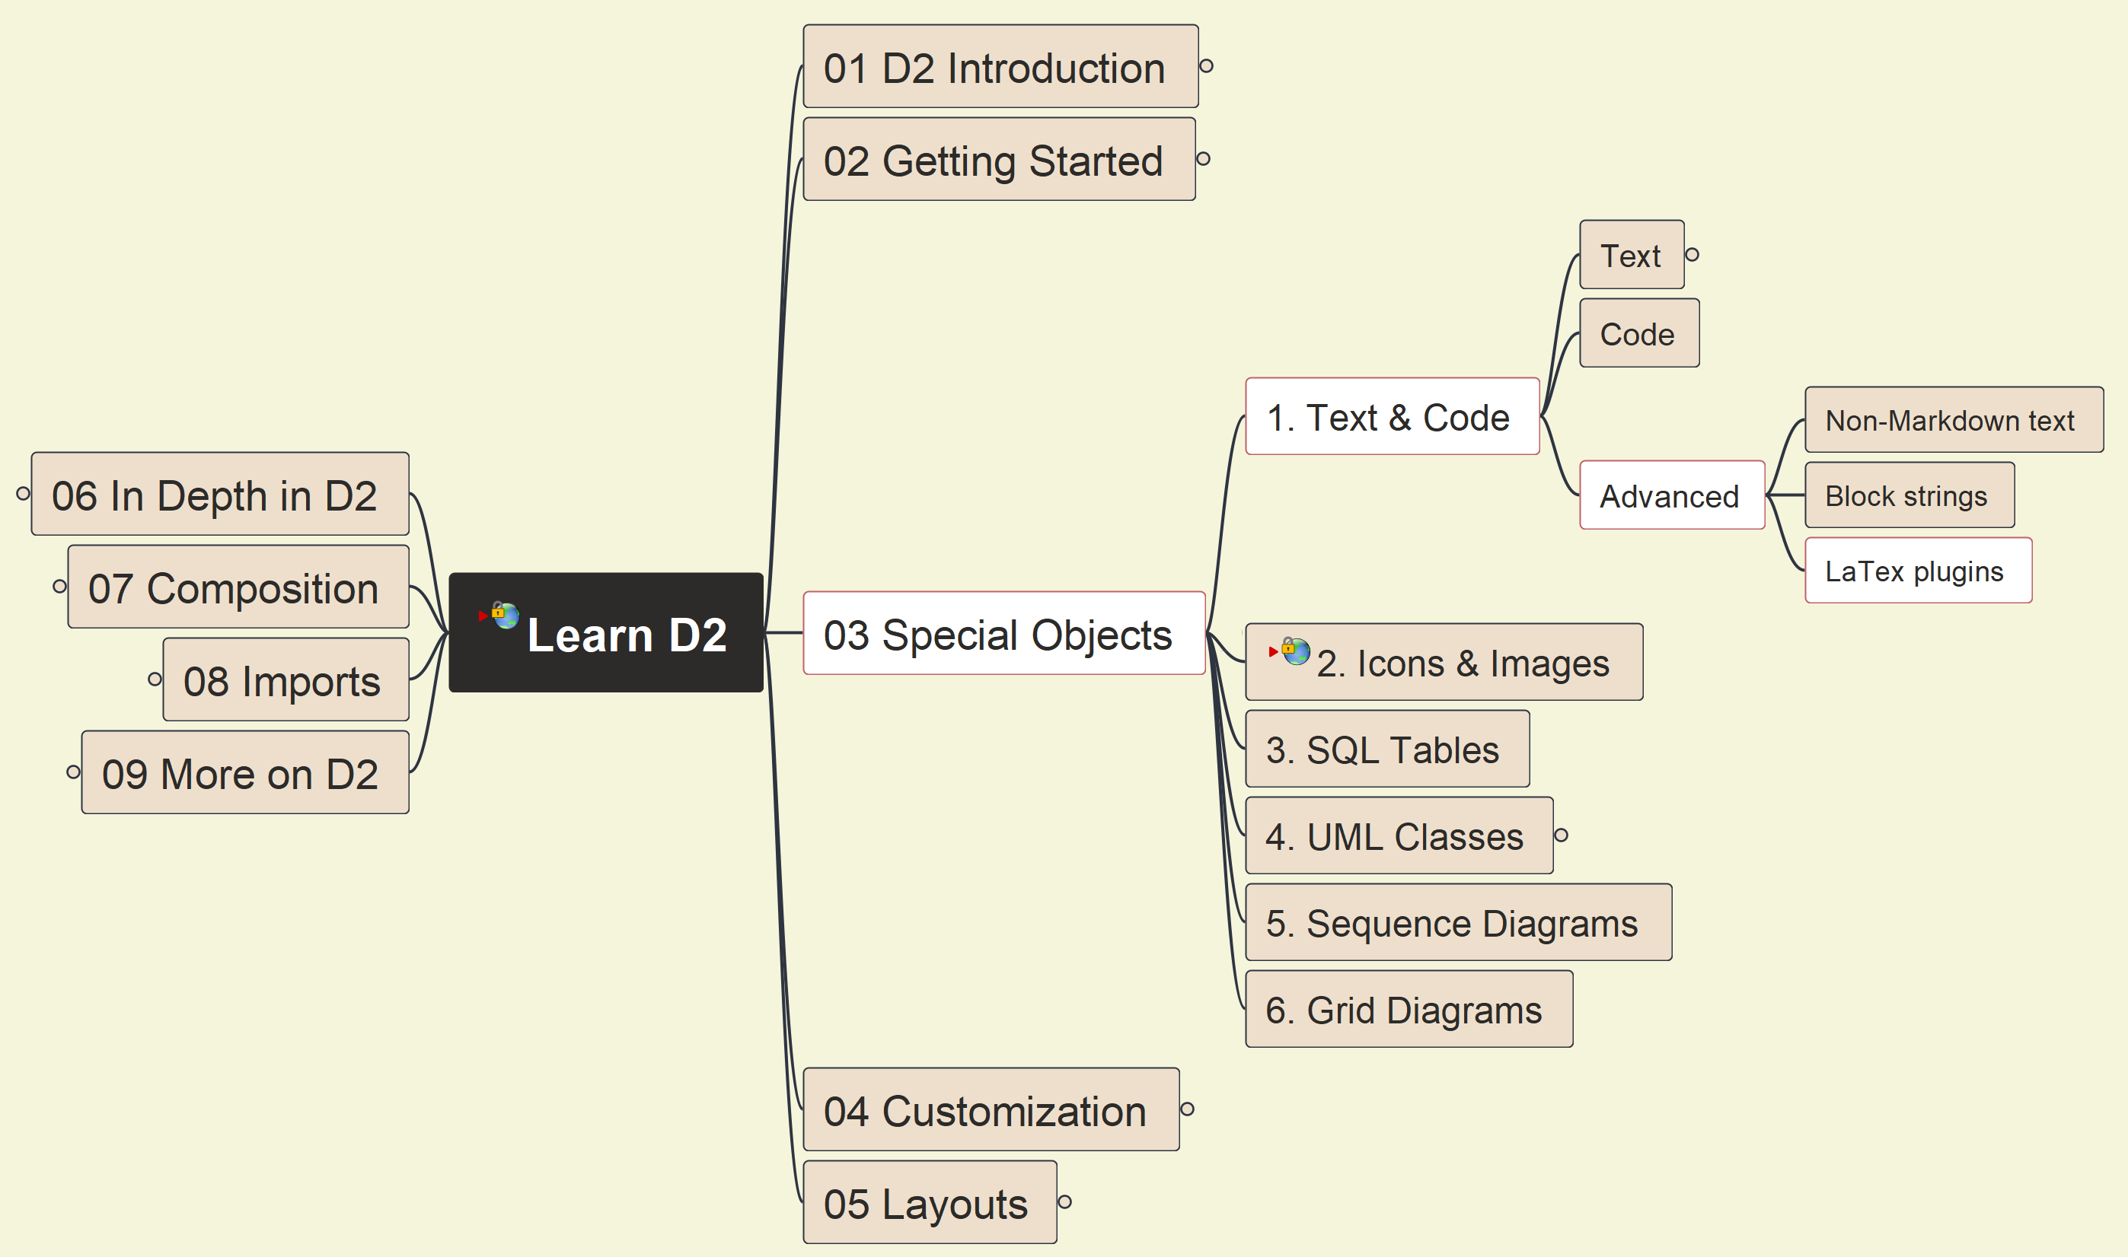
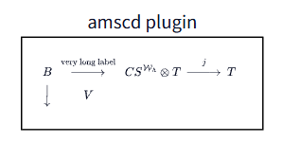
3. Special Objects: 1. Text & Code (3)
012

Slide 13
3. Special Objects: 2. Icons & Images
013

Slide 14
