Slide 1
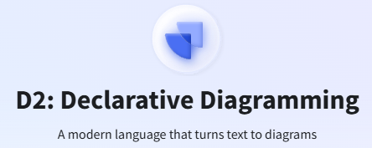
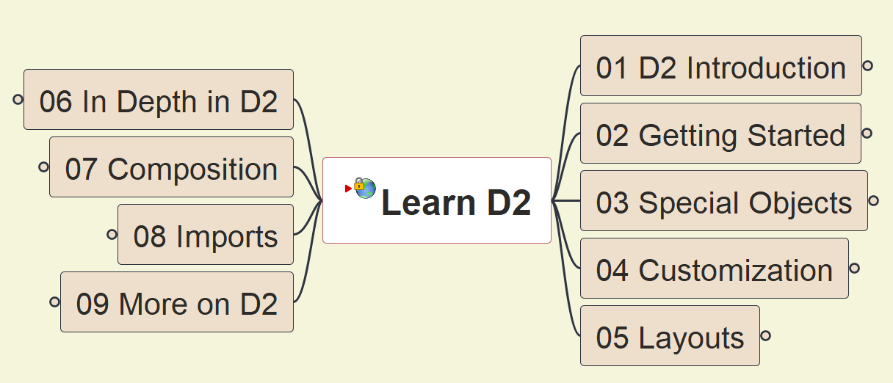
D2 Tutorial
001
Opening and Introduction

Slide 2
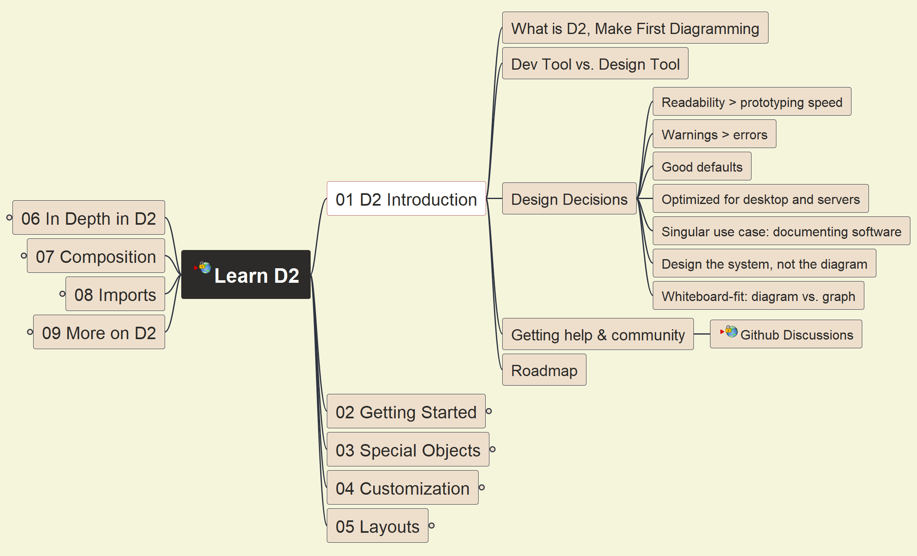
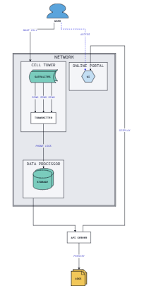

D2 Introduction
002

Slide 3
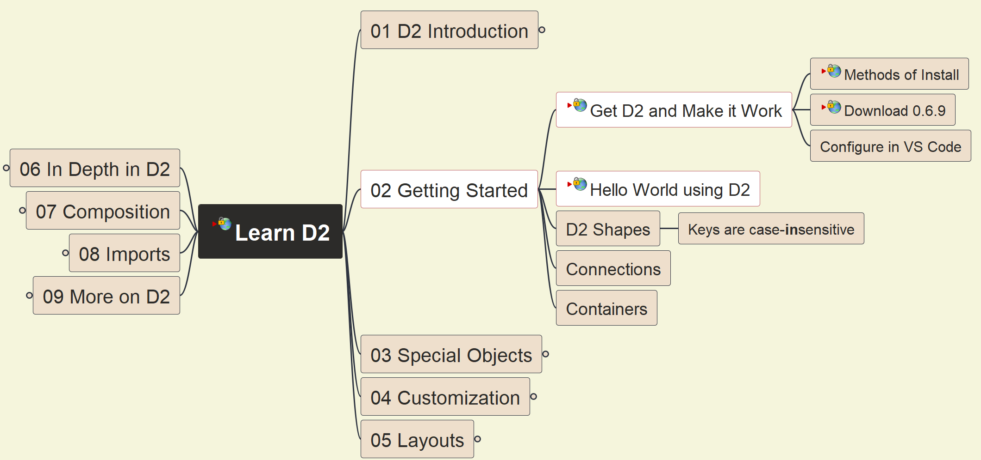
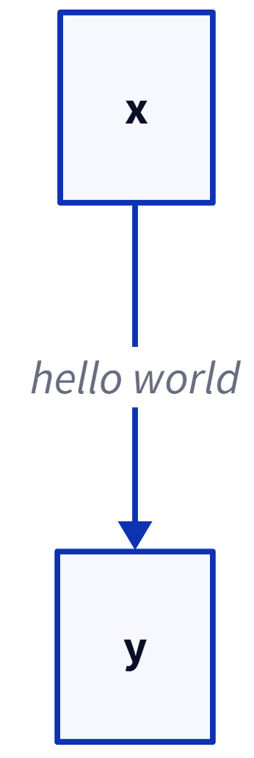
Get D2 and Make it Work
003

Slide 4
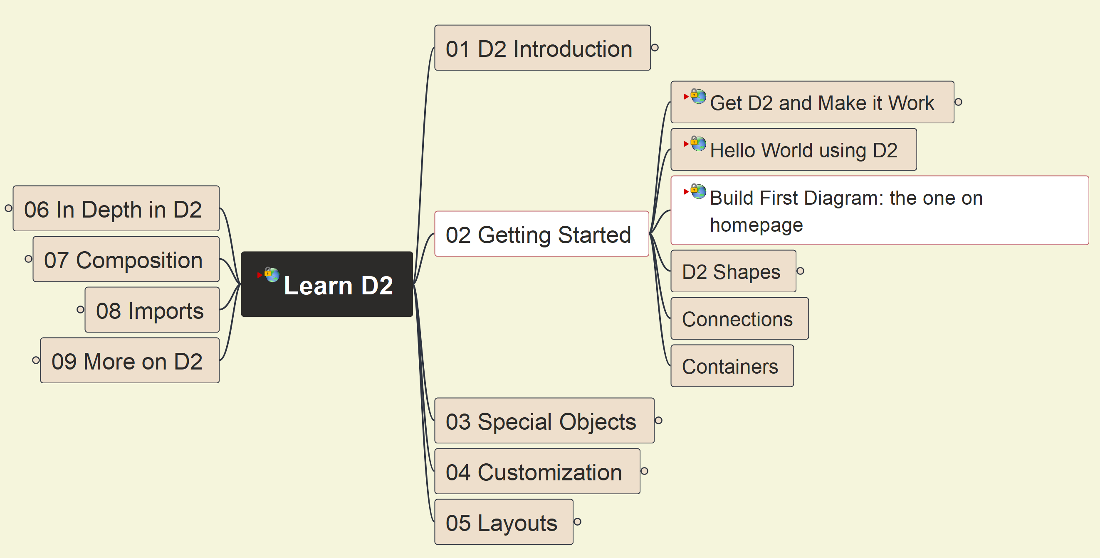
Make your First D2 Diagram
004

Slide 5
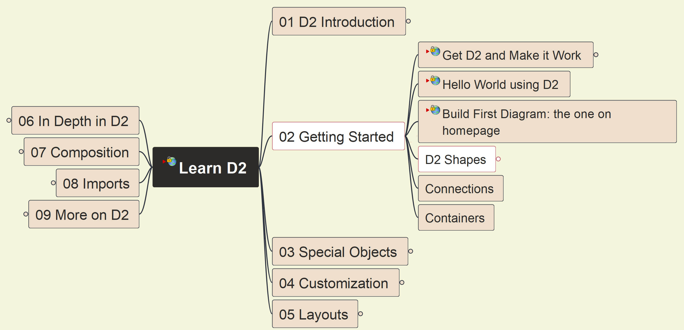
Getting Started: Shapes
005

Slide 6
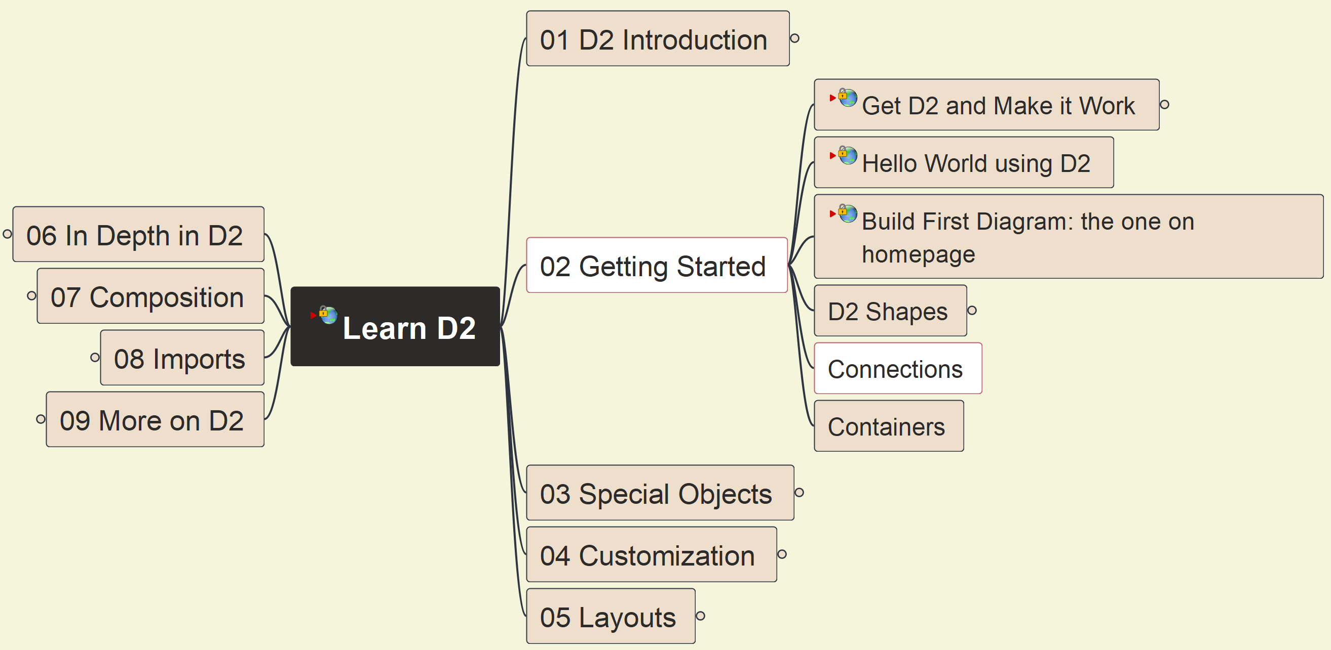
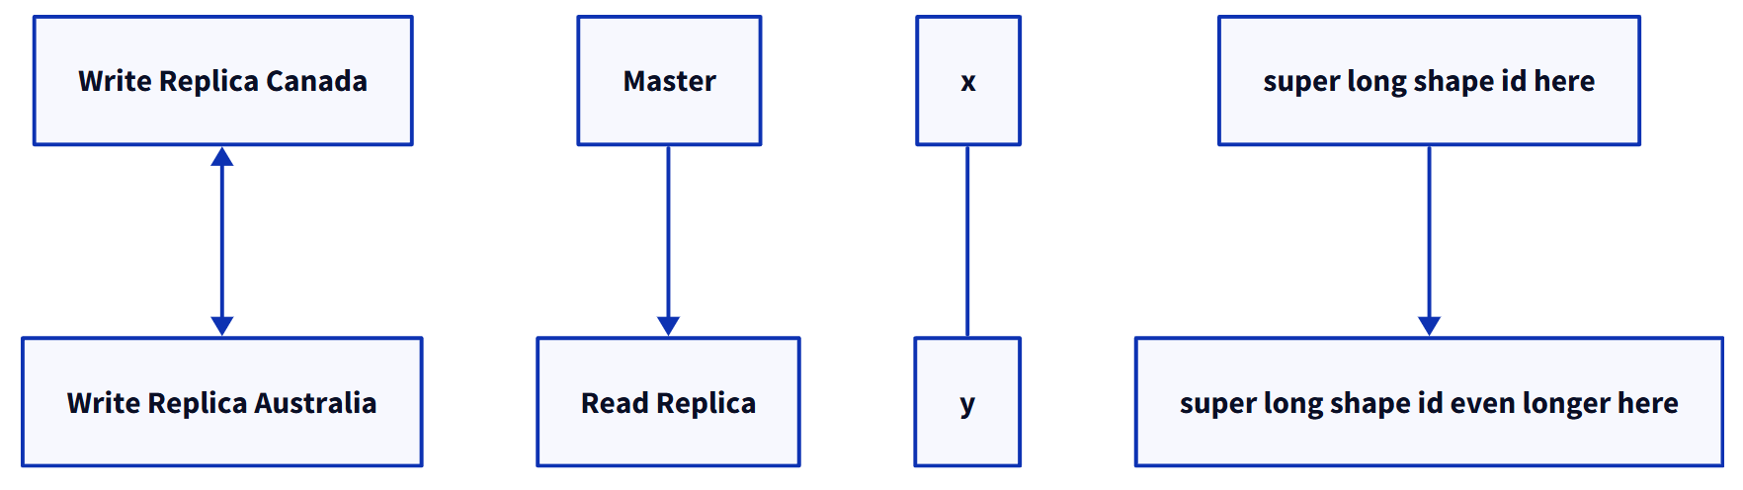
Getting Started: Connections - 1
006

Slide 7
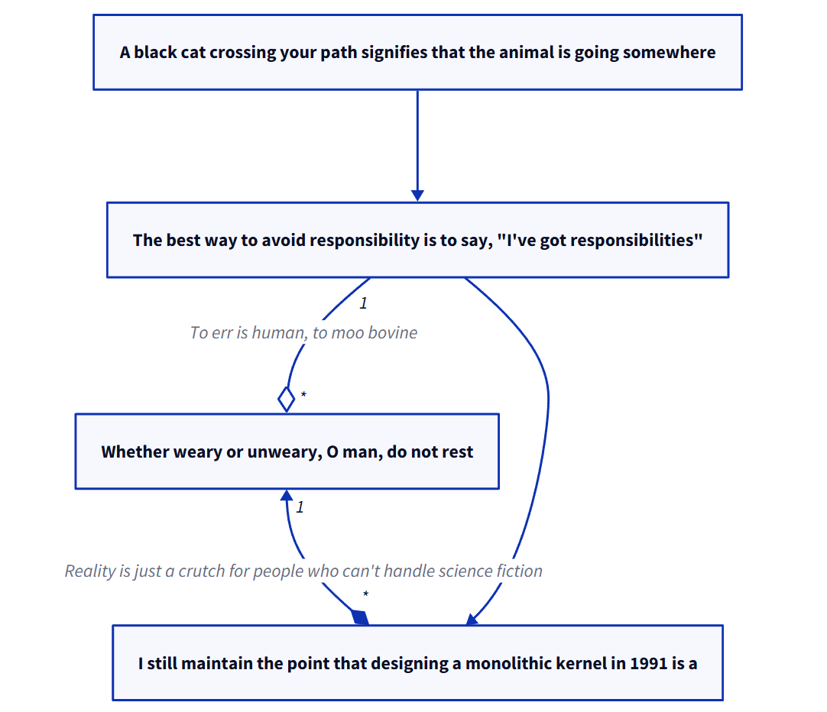
Getting Started: Connections - 2
007

Slide 8
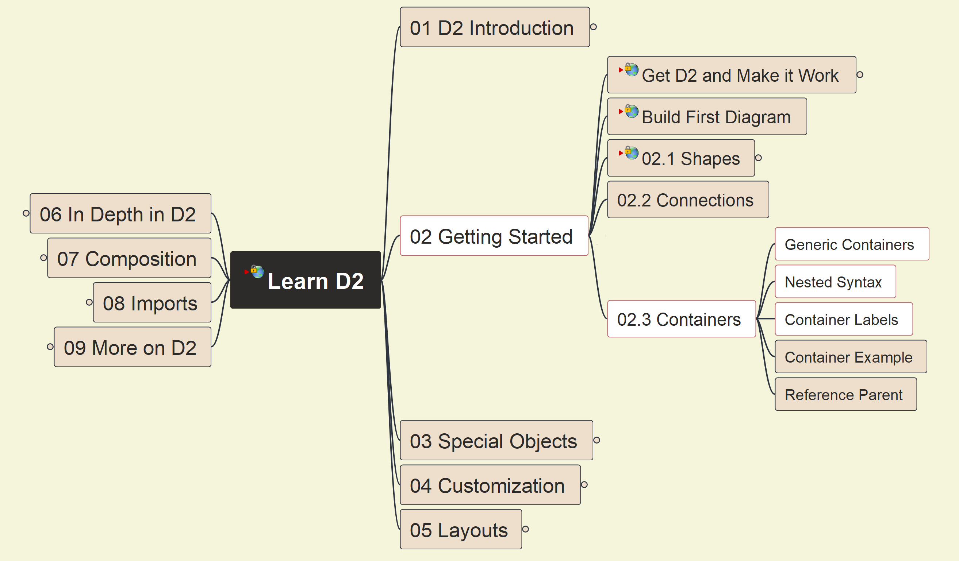
Getting Started: Containers - 1
008

Slide 9
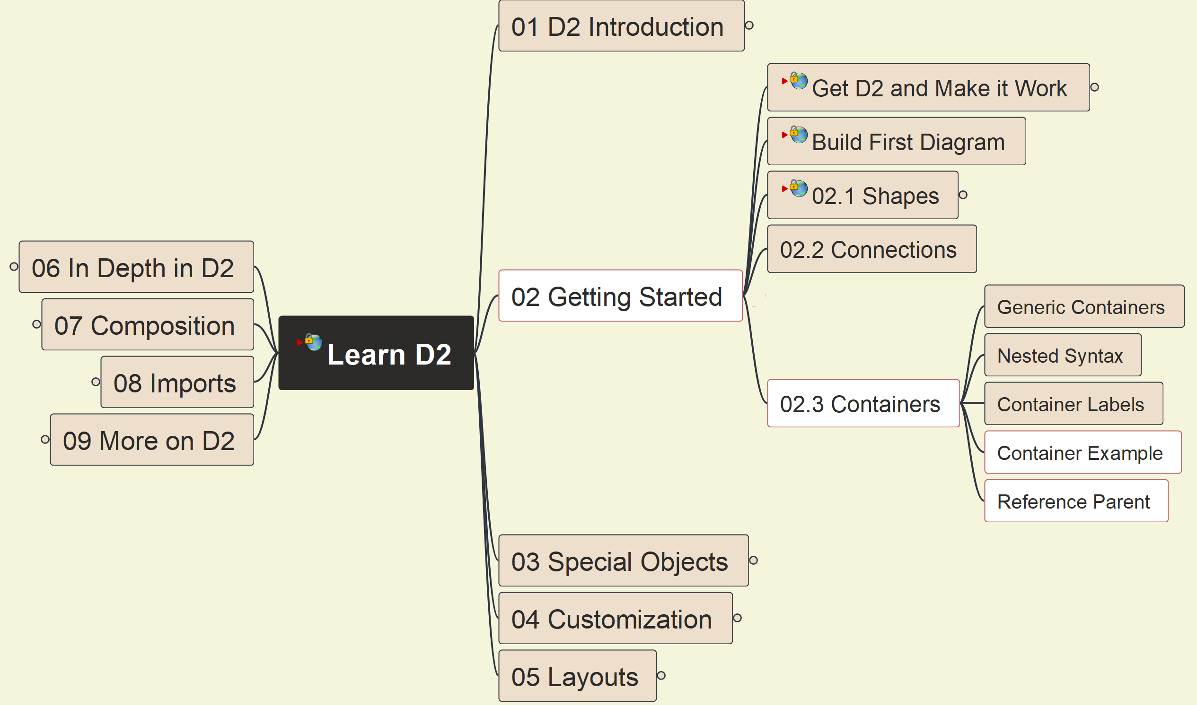
Getting Started: Containers - 2
009

Slide 10
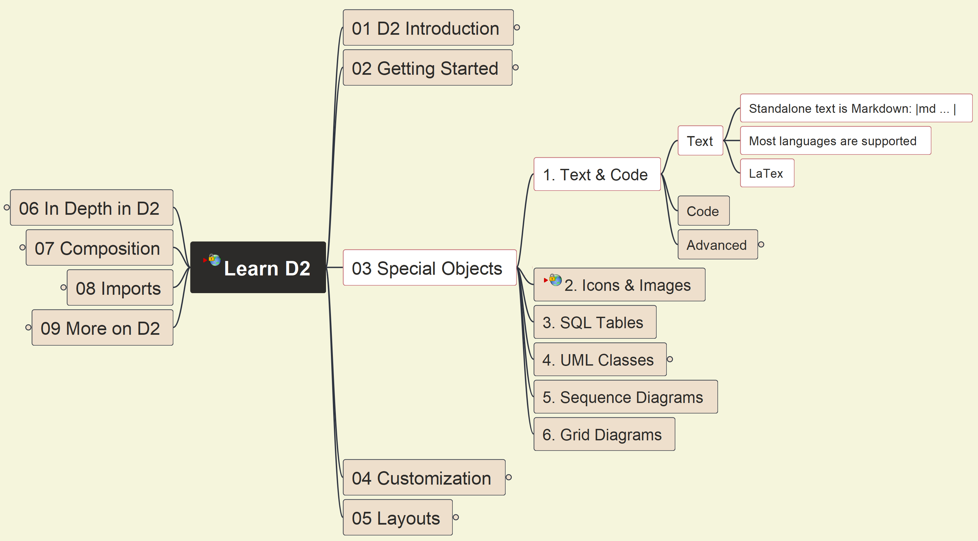
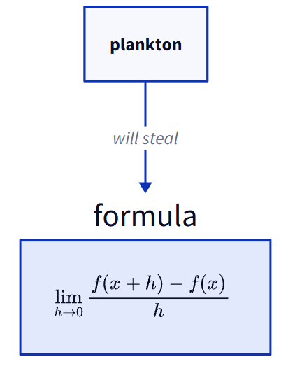
3. Special Objects: 3.1 Text & Code (1)
D2-010

Slide 11
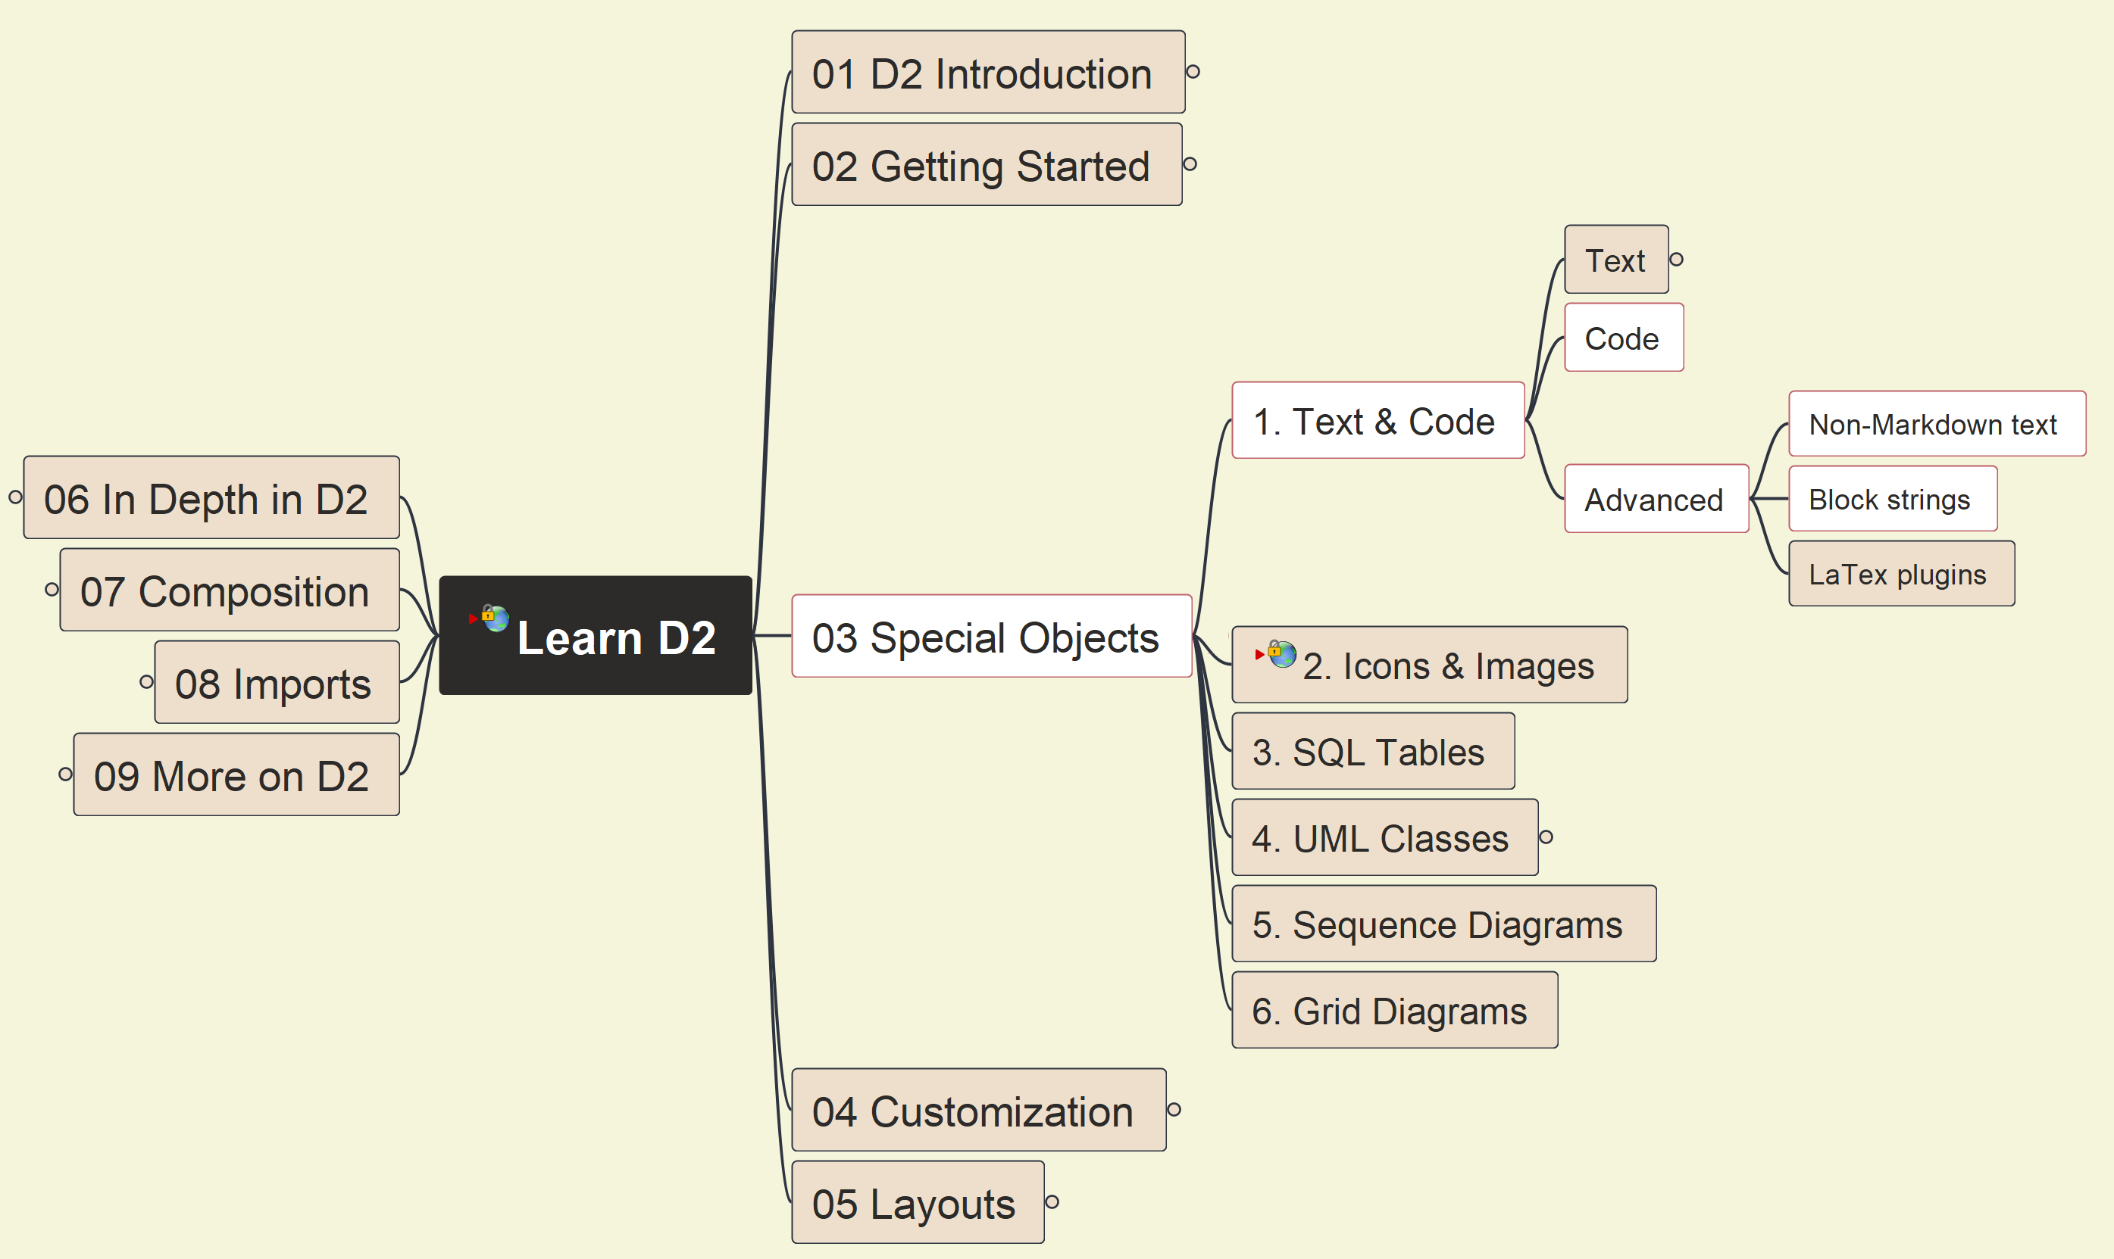
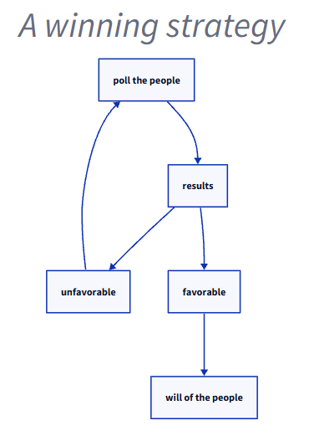
3. Special Objects: 3.1 Text & Code (2)
D2-011

Slide 12
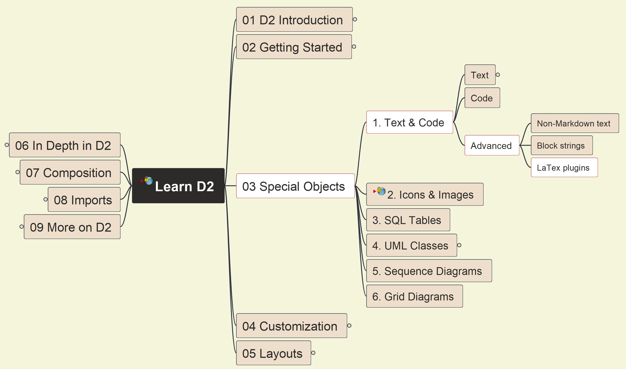
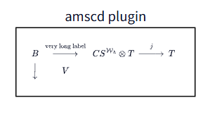
3. Special Objects: 3.1 Text & Code (3)
012

Slide 13
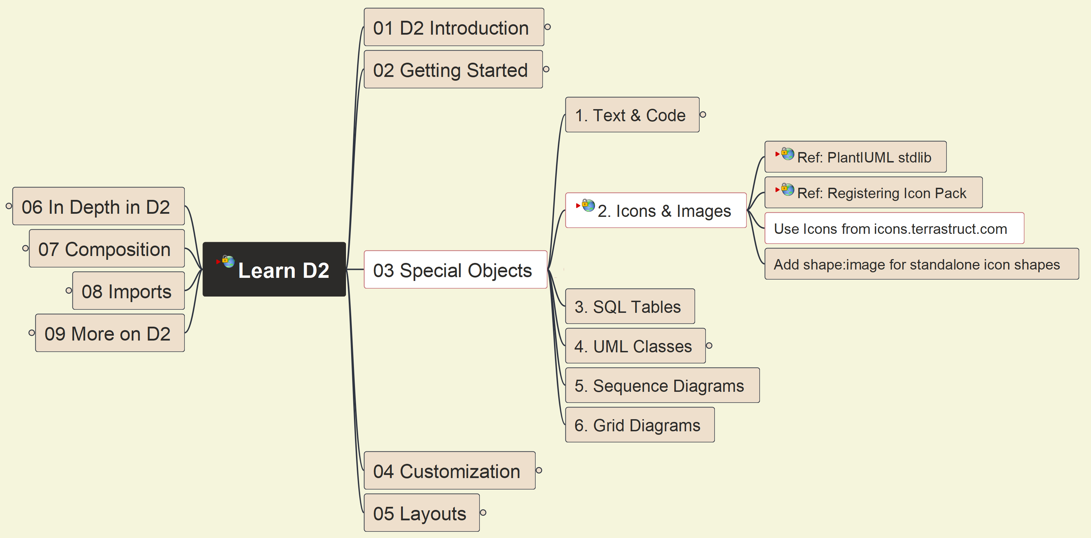
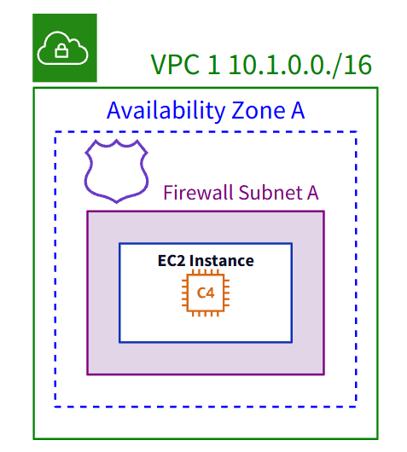
3. Special Objects: 3.2 Icons & Images (1)
013

Slide 14
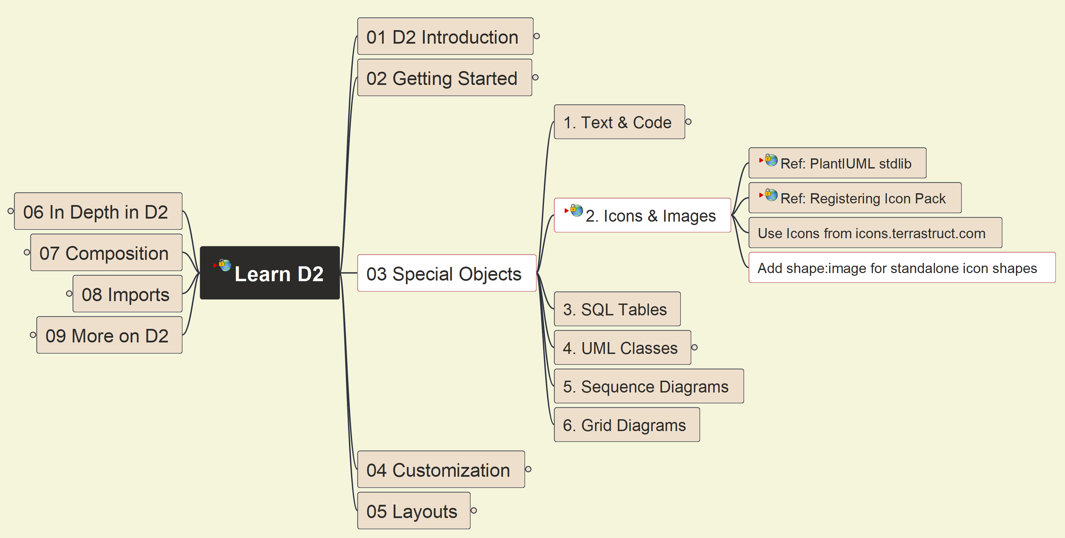
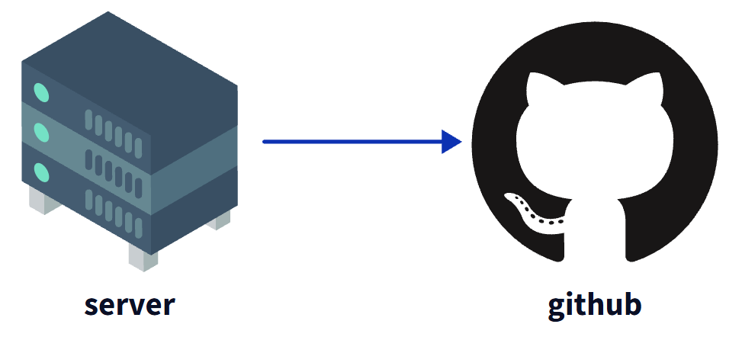
3. Special Objects: 3.2 Icons & Images (2)
014

Slide 15
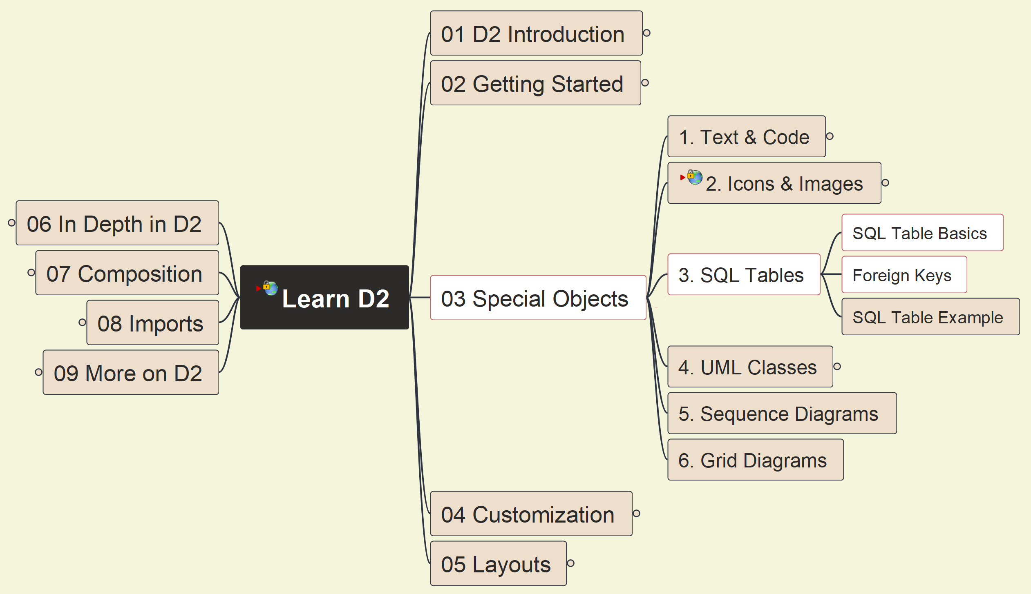
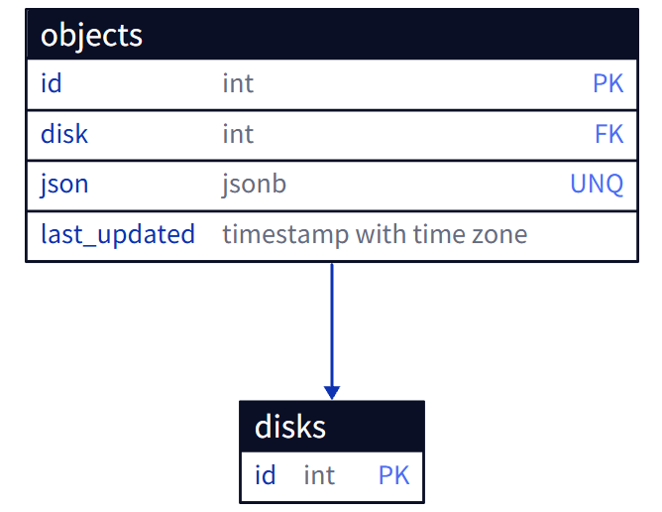
3. Special Objects: 3.3 SQL Tables (1)
015

Slide 16
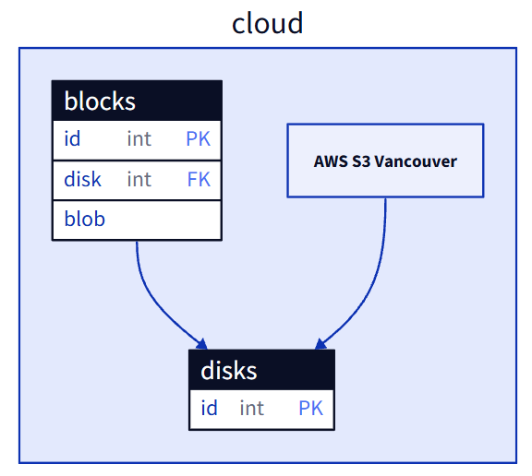
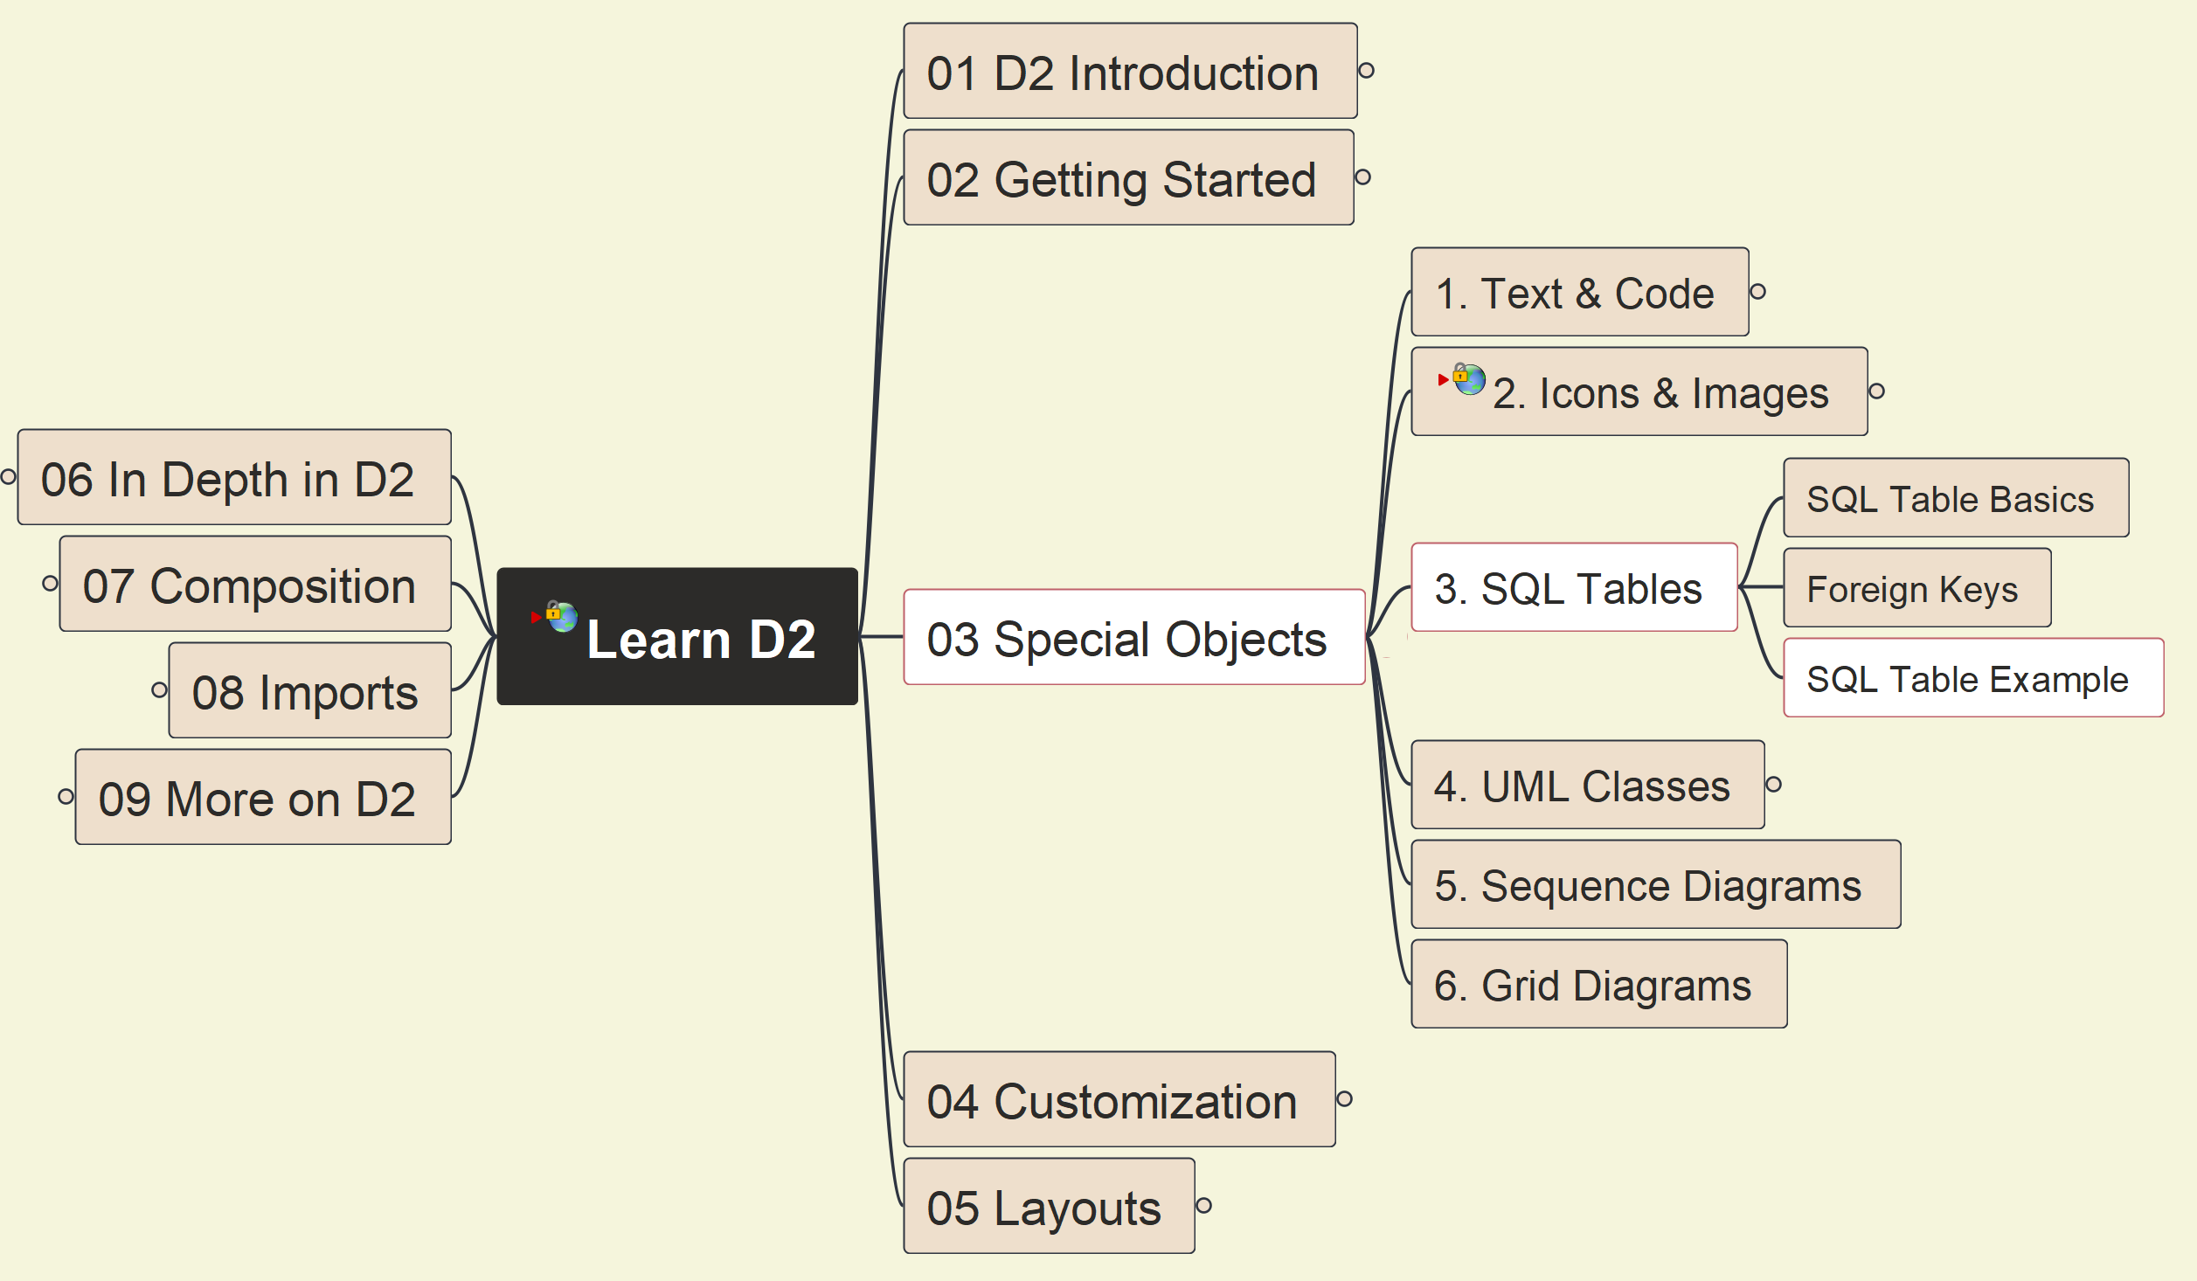
3. Special Objects: 3.3 SQL Tables (2)
016

Slide 17
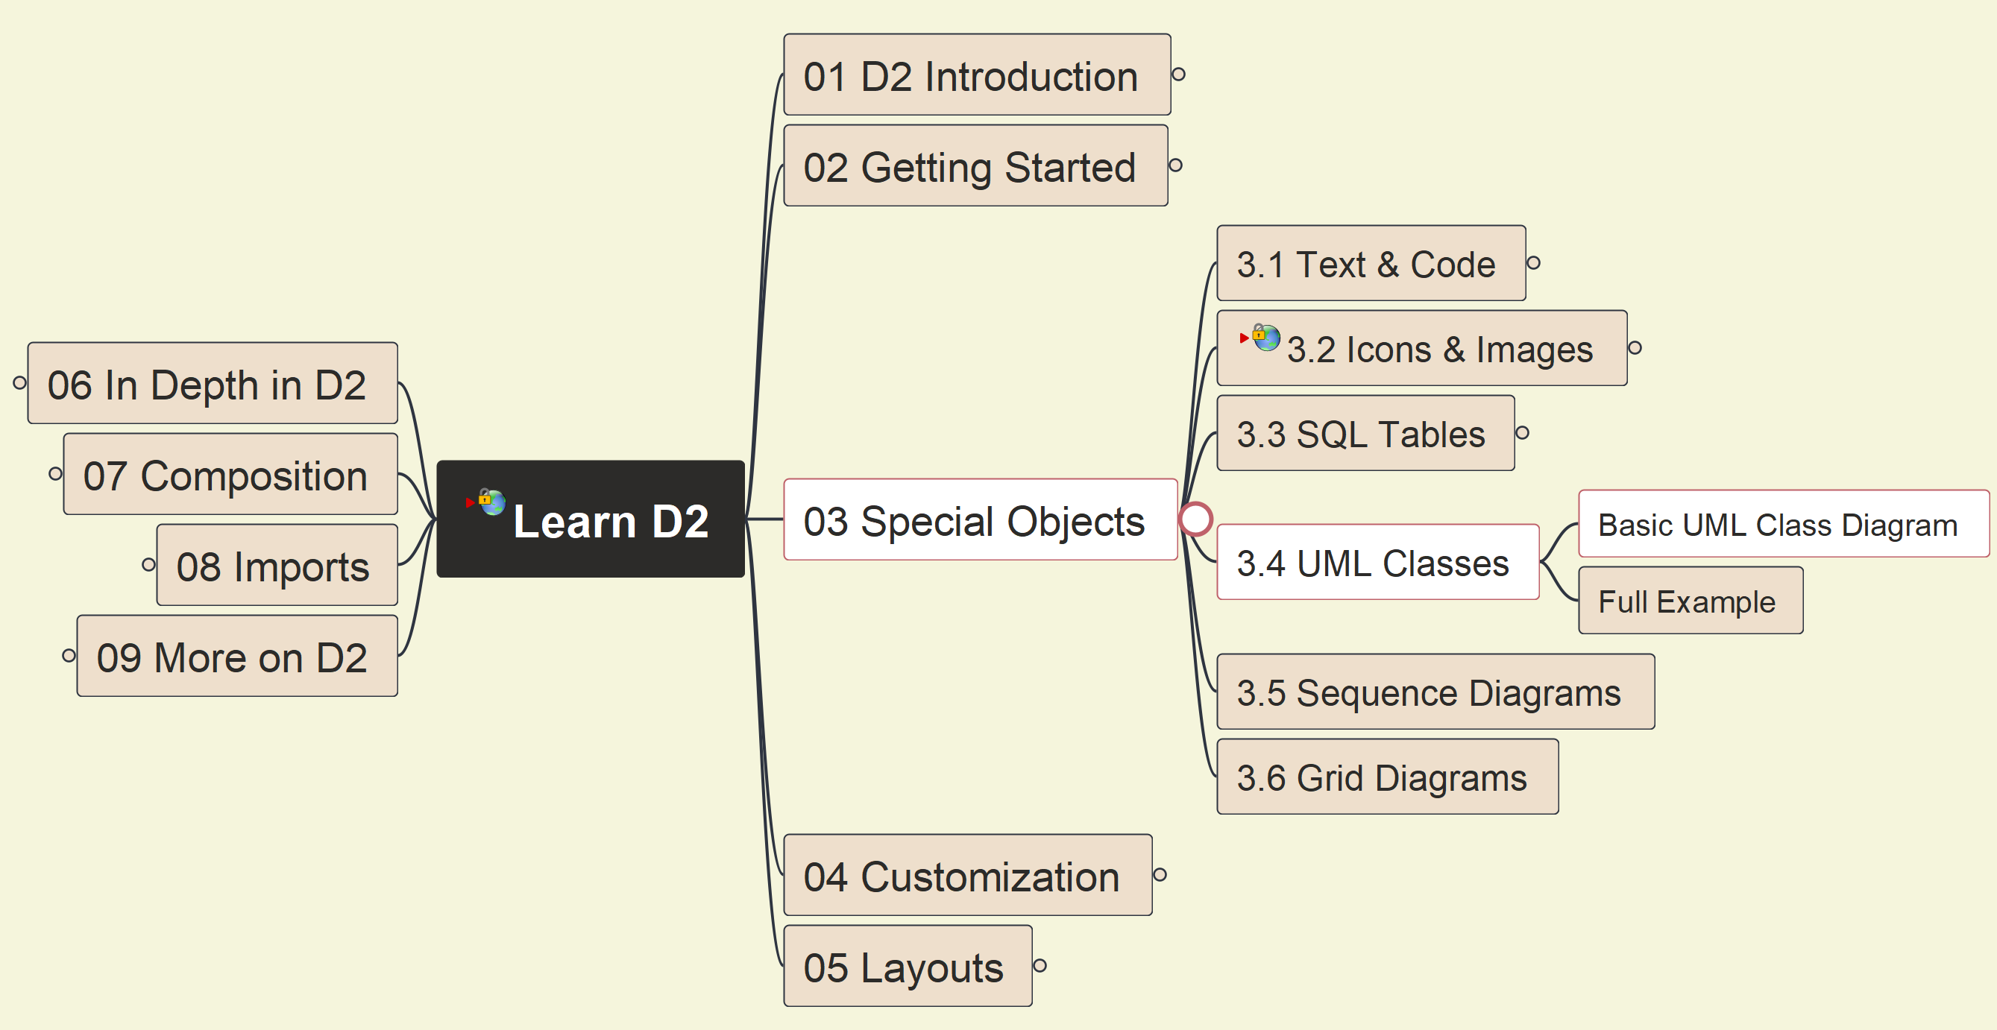
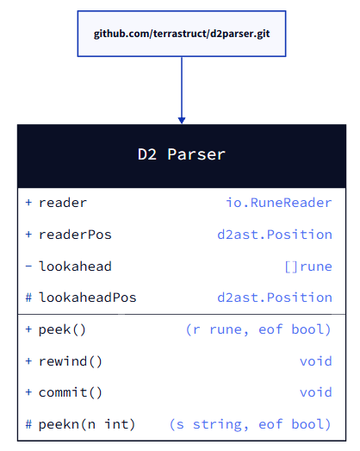
3. Special Objects: 3.4 UML Classes (1)
017

Slide 18
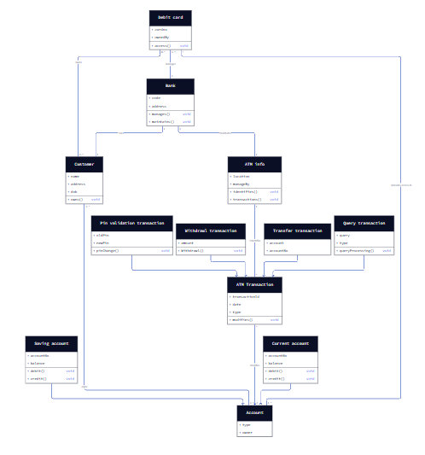
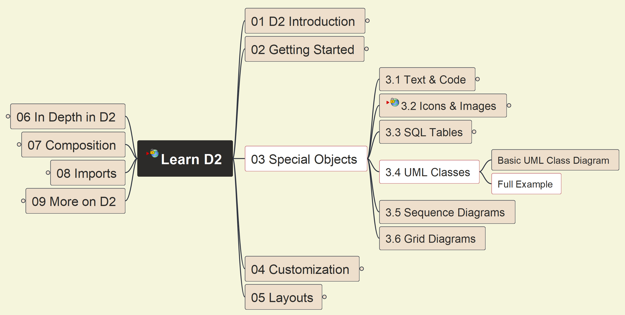
3. Special Objects: 3.4 UML Classes (2)
018

Slide 19
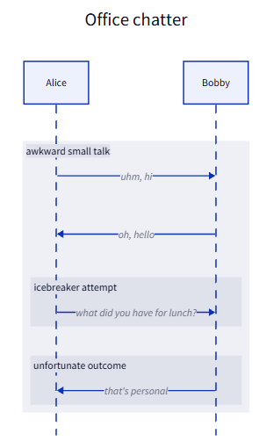
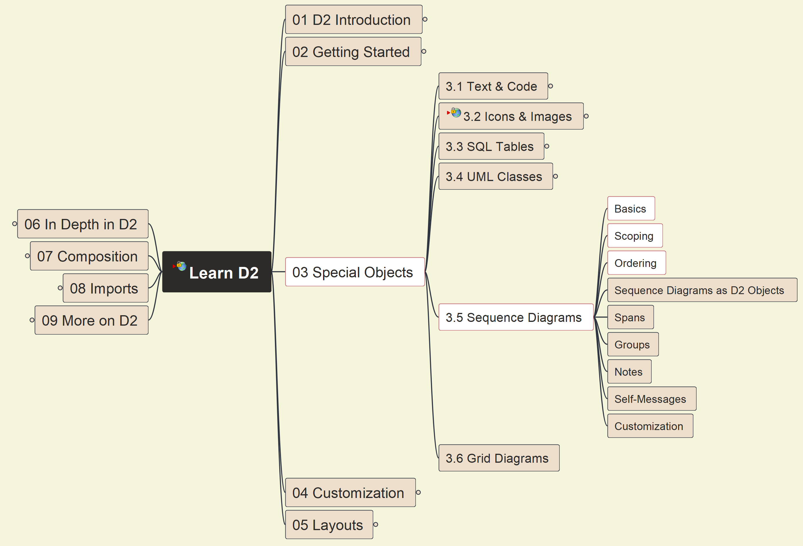
3. Special Objects: 3.5 Sequence Diagrams (1)
019

Slide 20
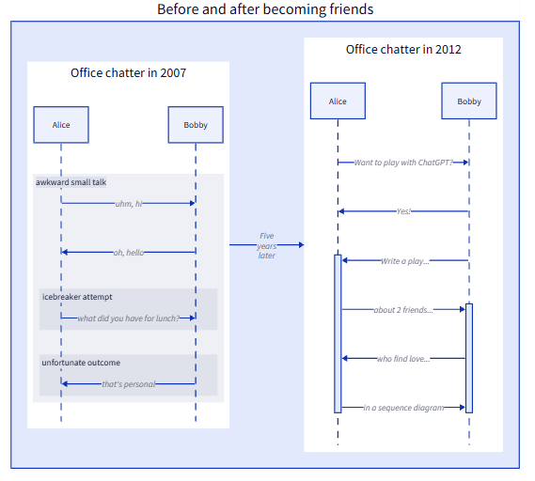
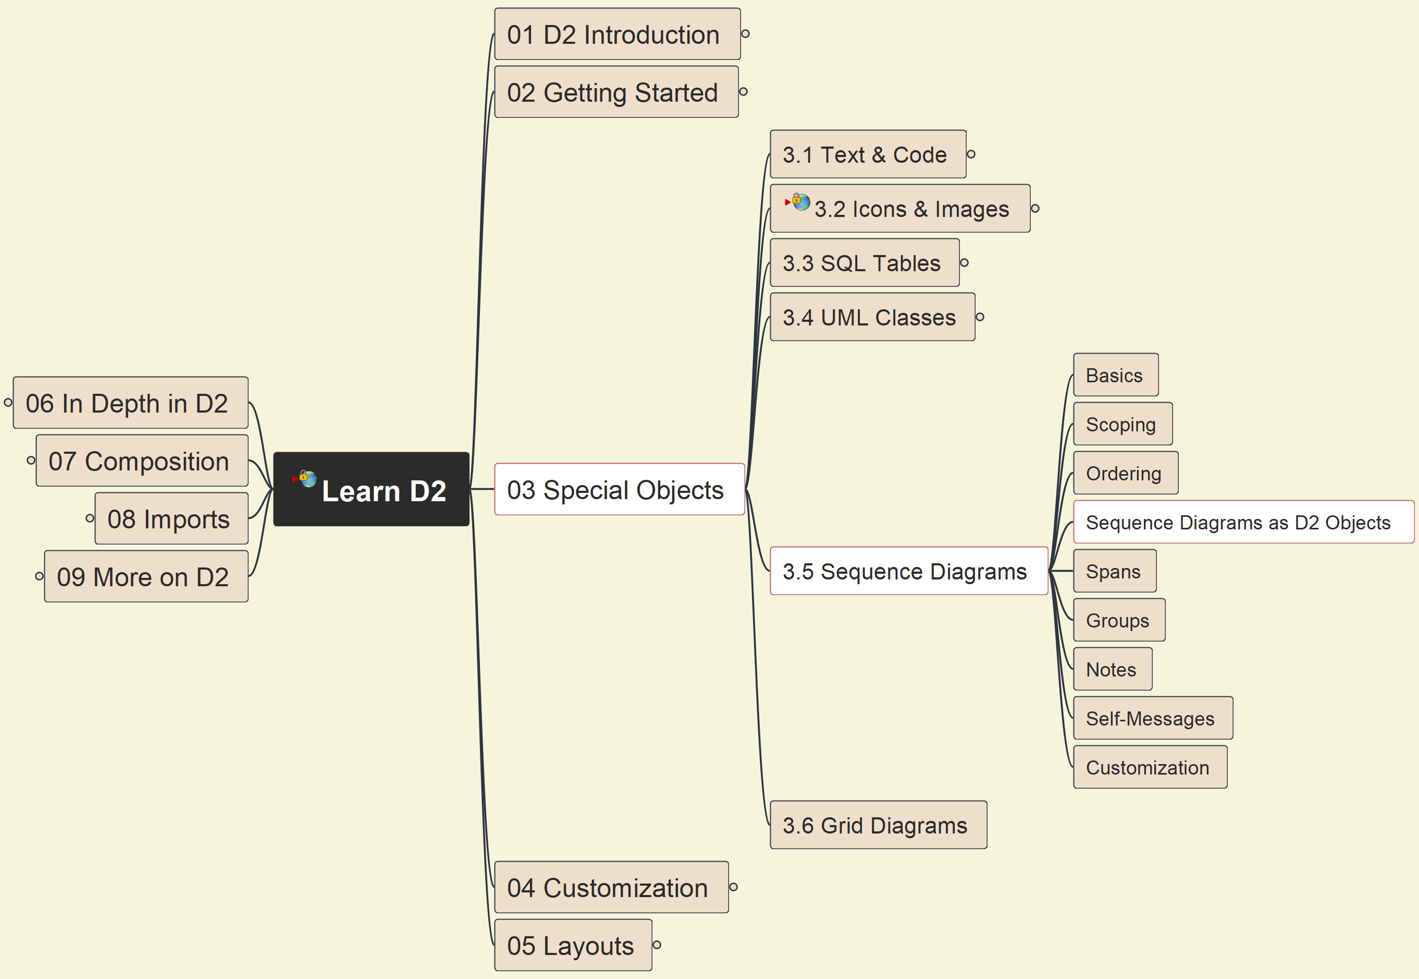
3. Special Objects: 3.5 Sequence Diagrams (2)
020

Slide 21
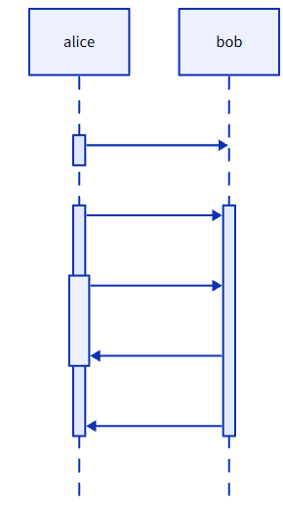
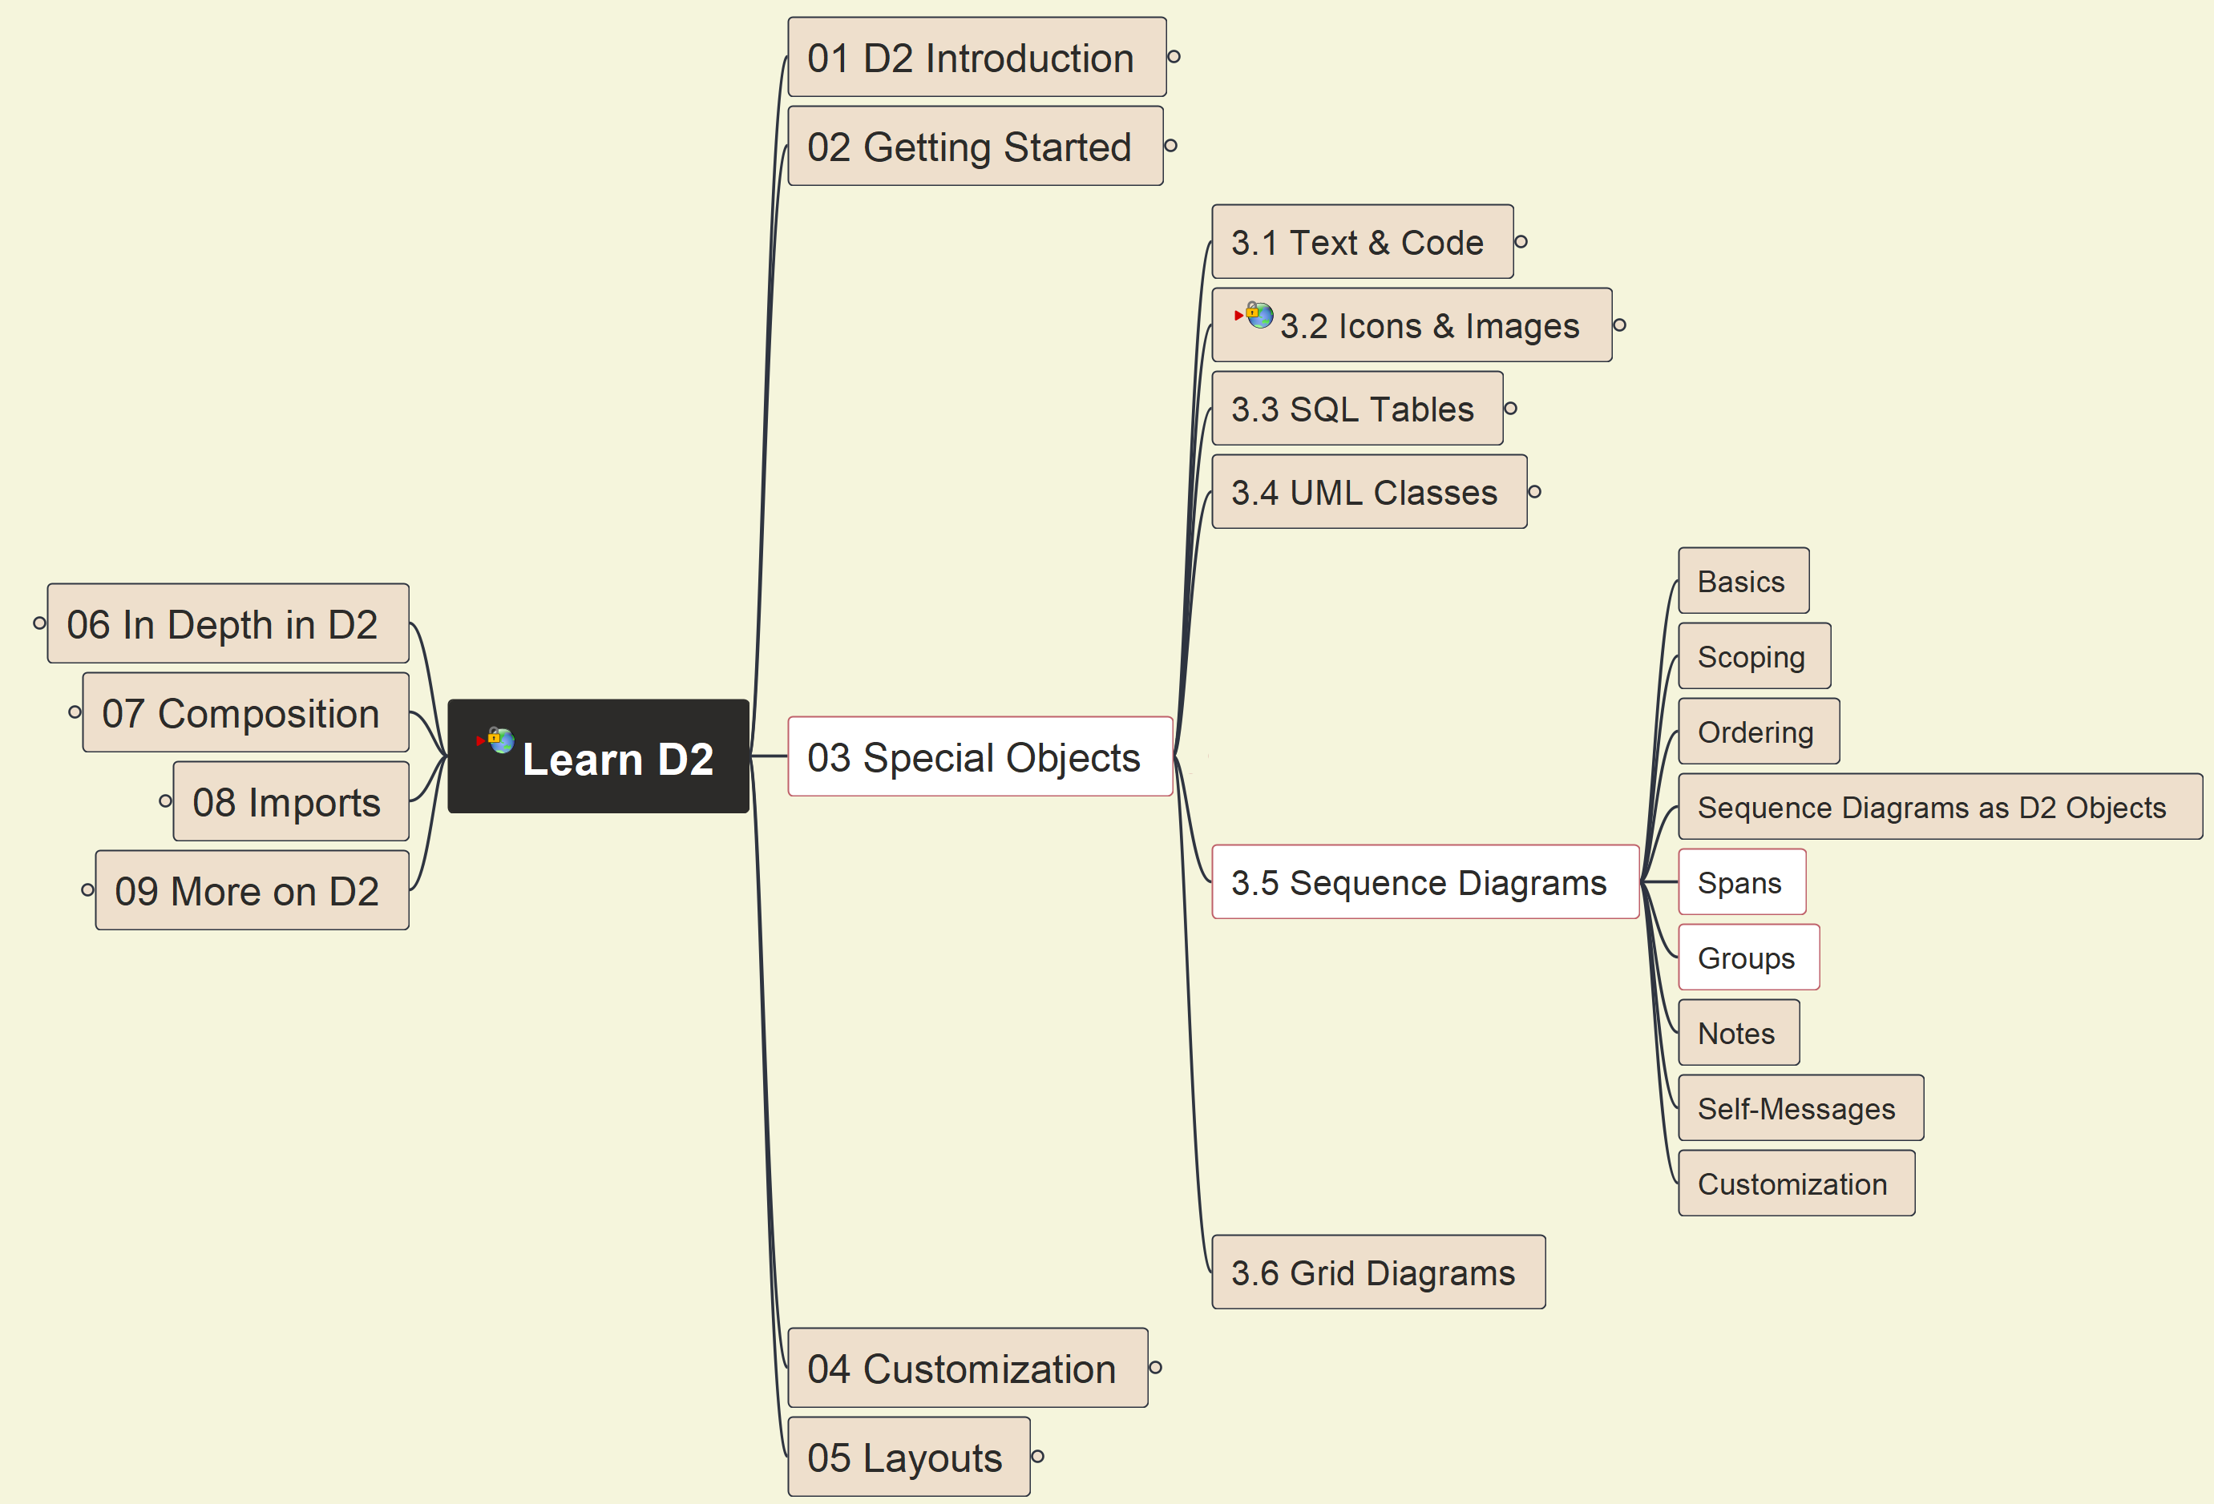
3. Special Objects: 3.5 Sequence Diagrams (3)
021

Slide 22
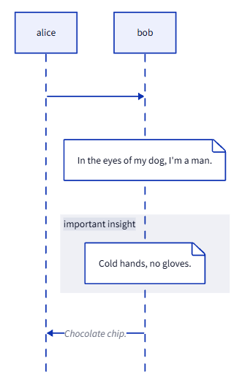
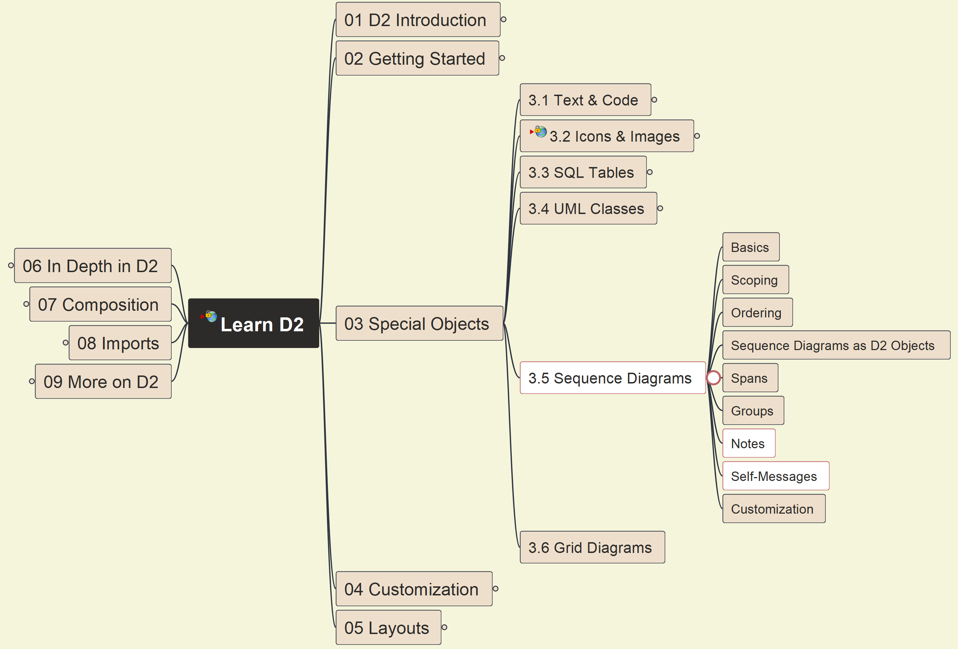
3. Special Objects: 3.5 Sequence Diagrams (4)
022

Slide 23
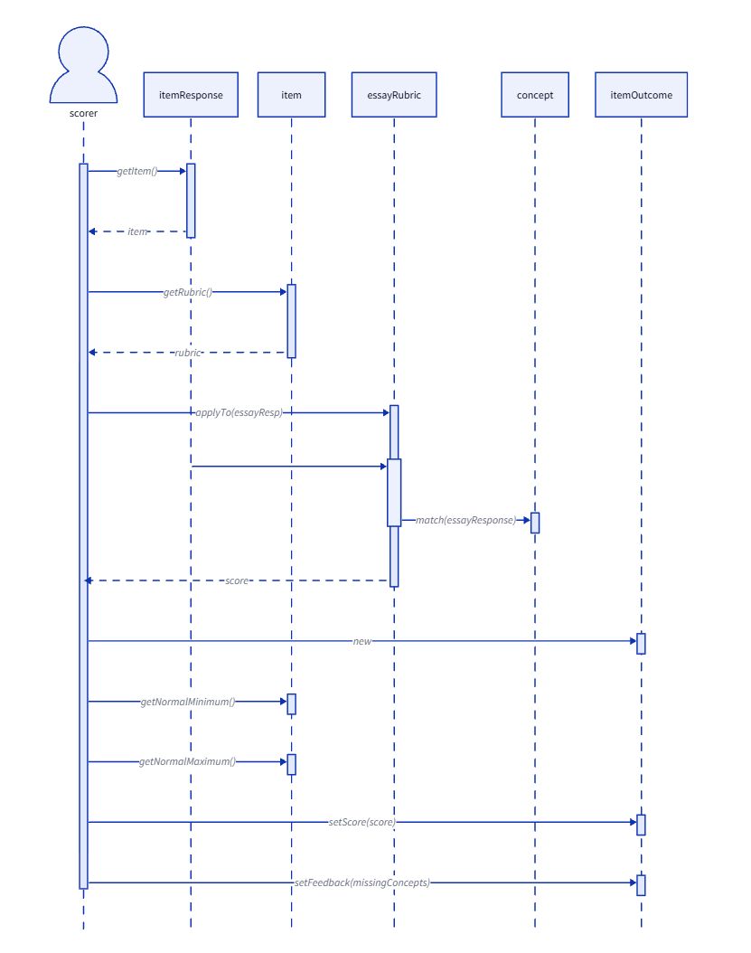
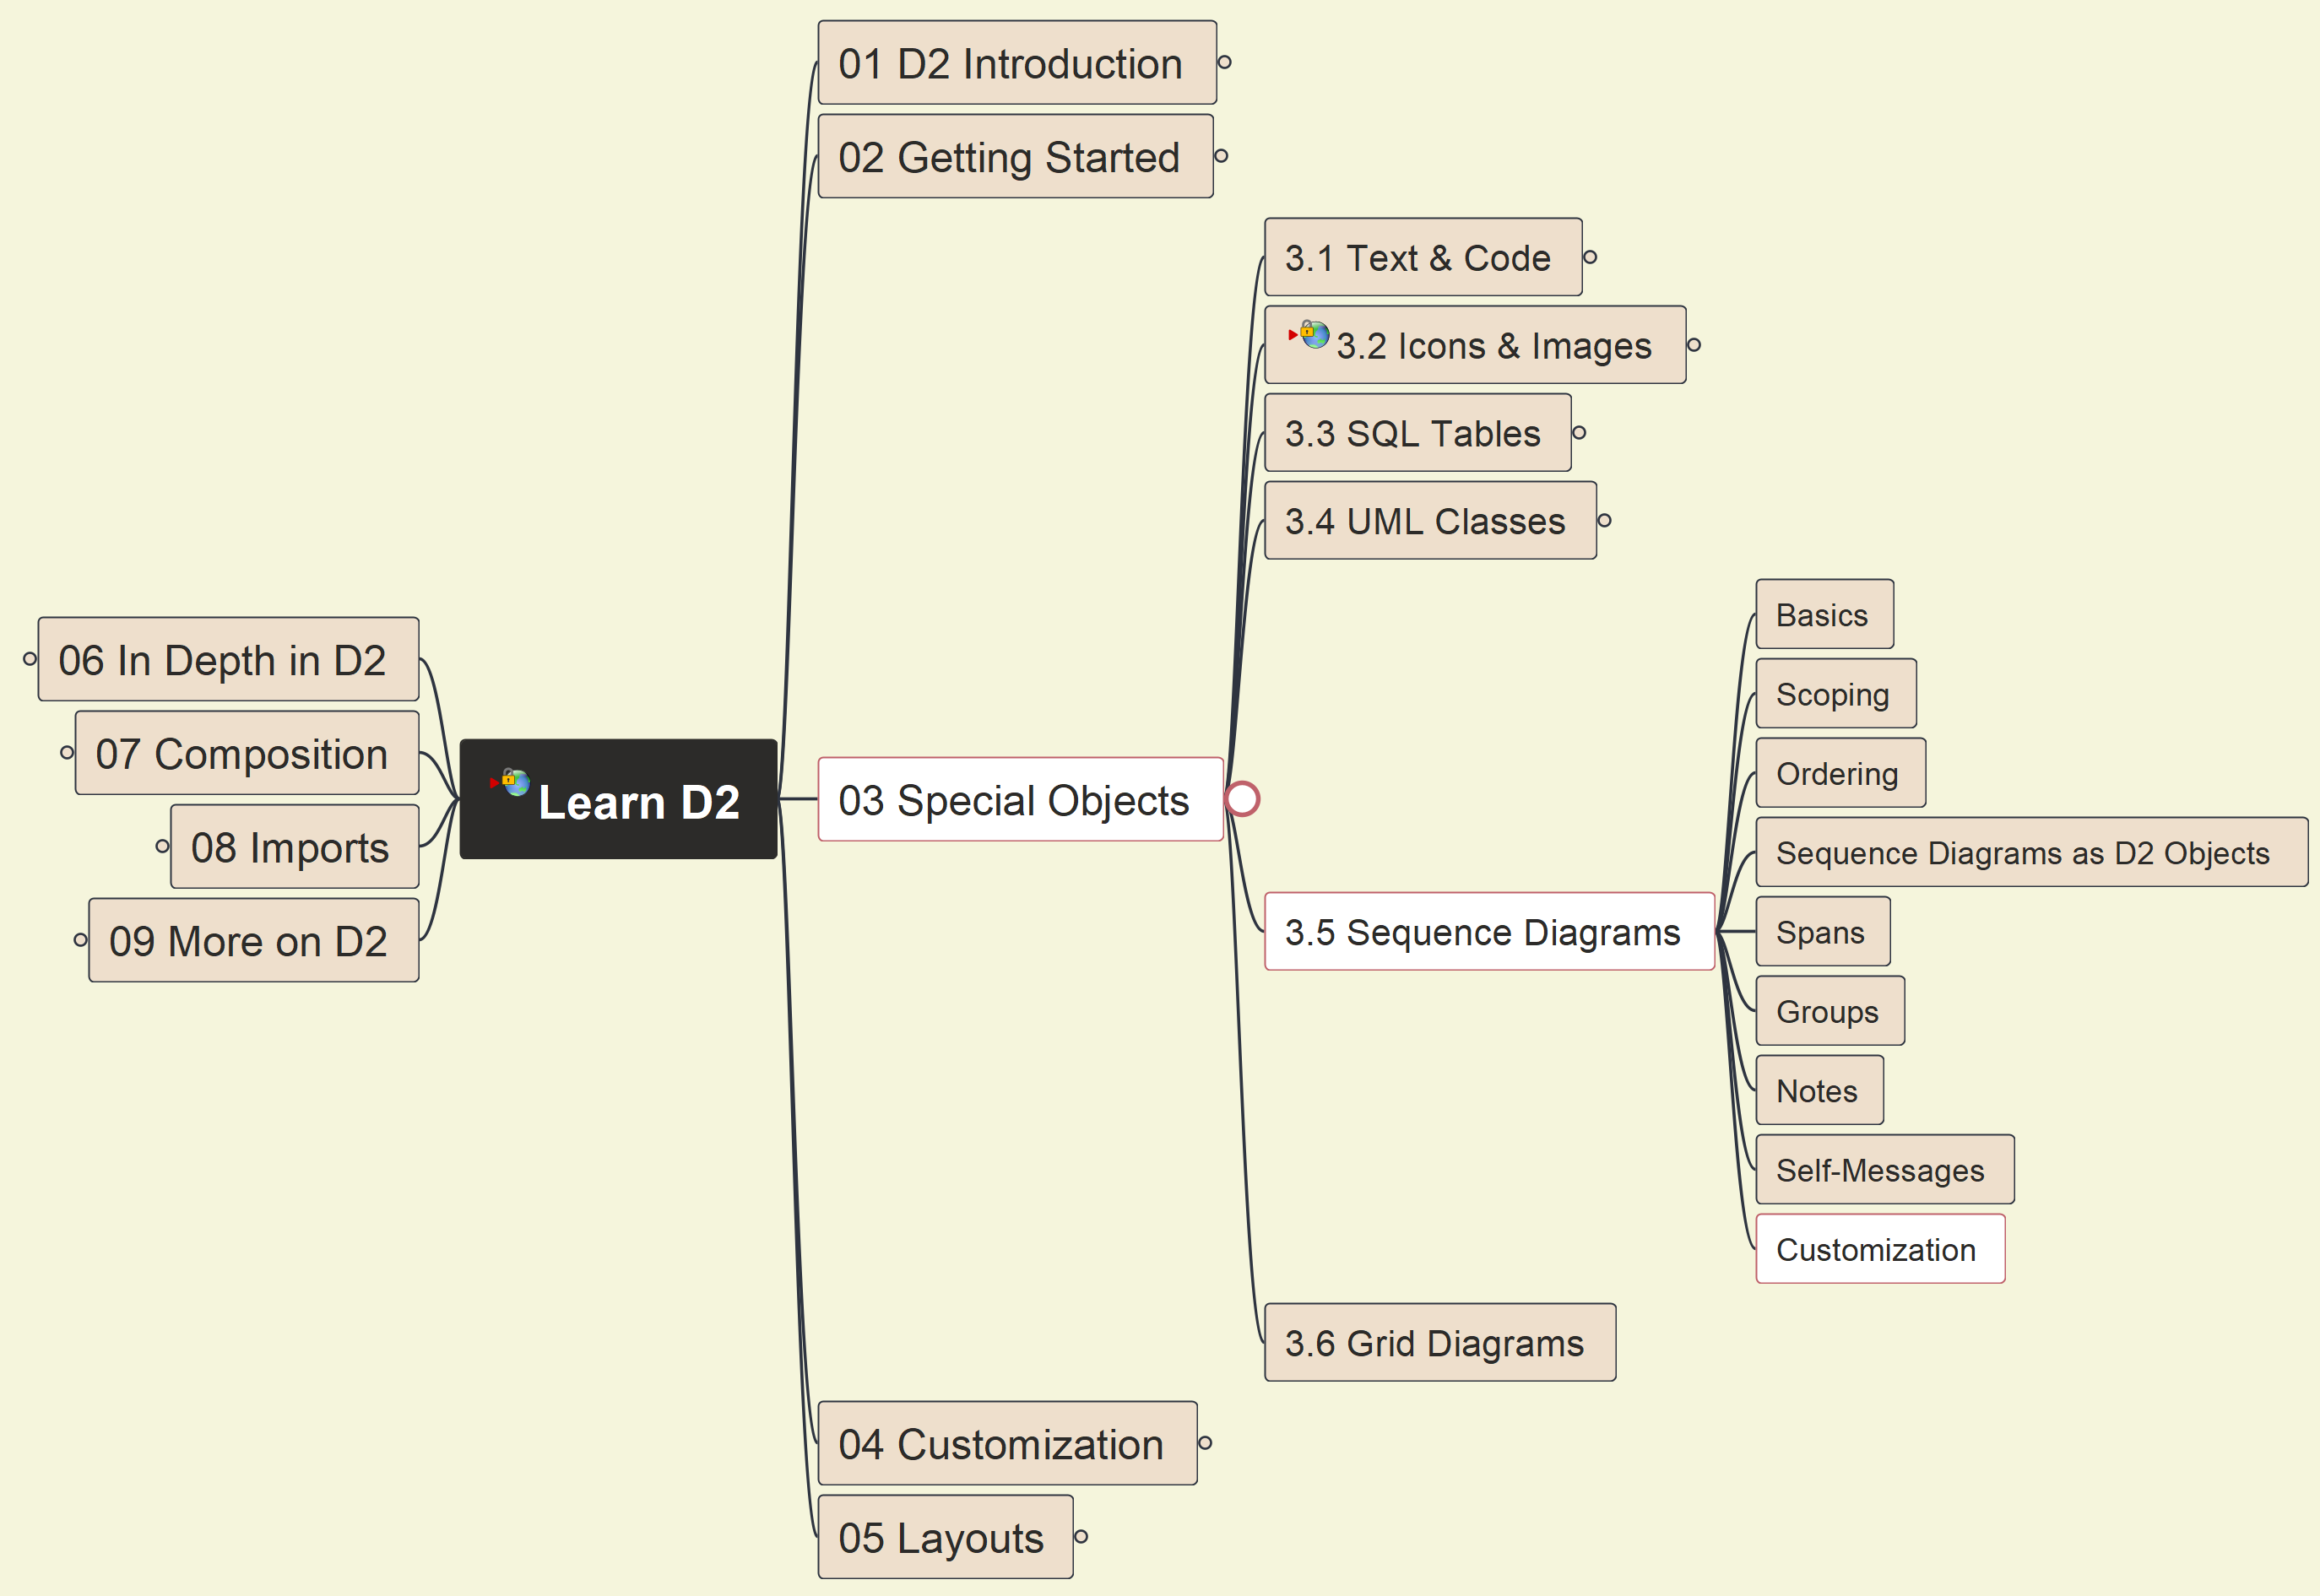
3. Special Objects: 3.5 Sequence Diagrams (5)
023

Slide 24
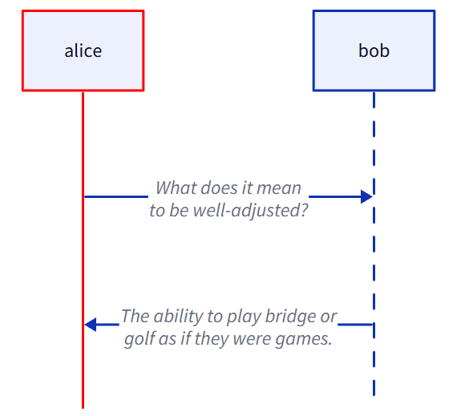
3. Special Objects: 3.5 Sequence Diagrams (6)
024

Slide 25
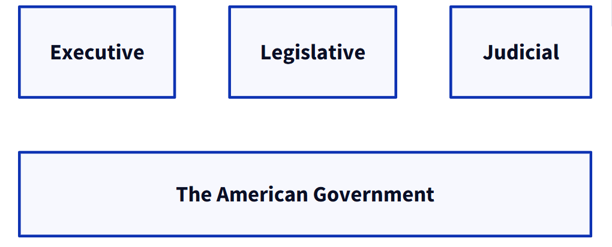
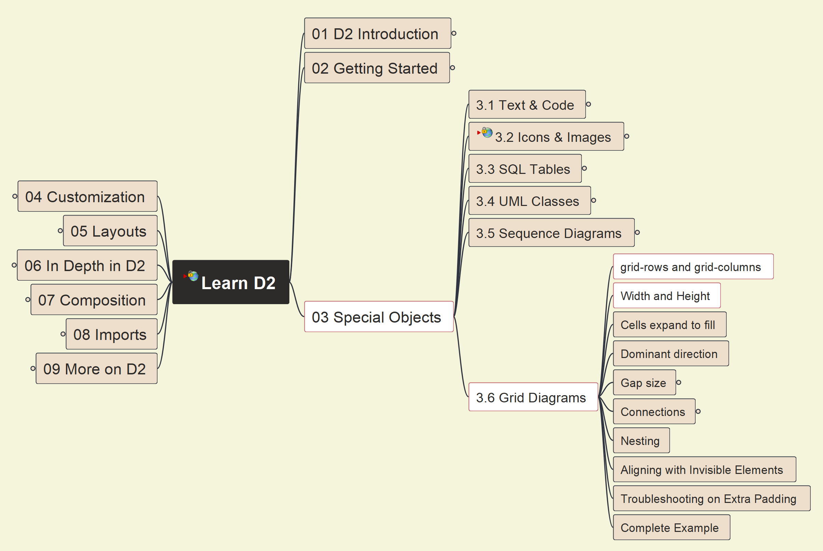
3. Special Objects: 3.6 Grid Diagrams (1)
025

Slide 26
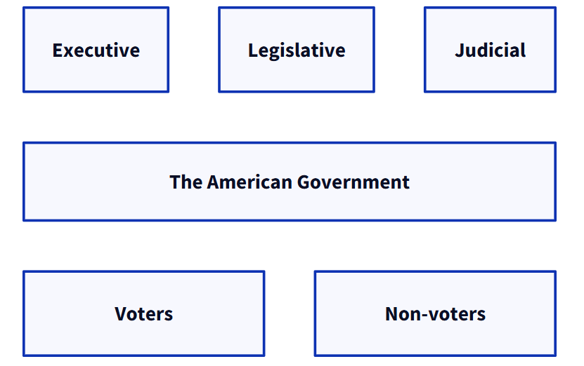
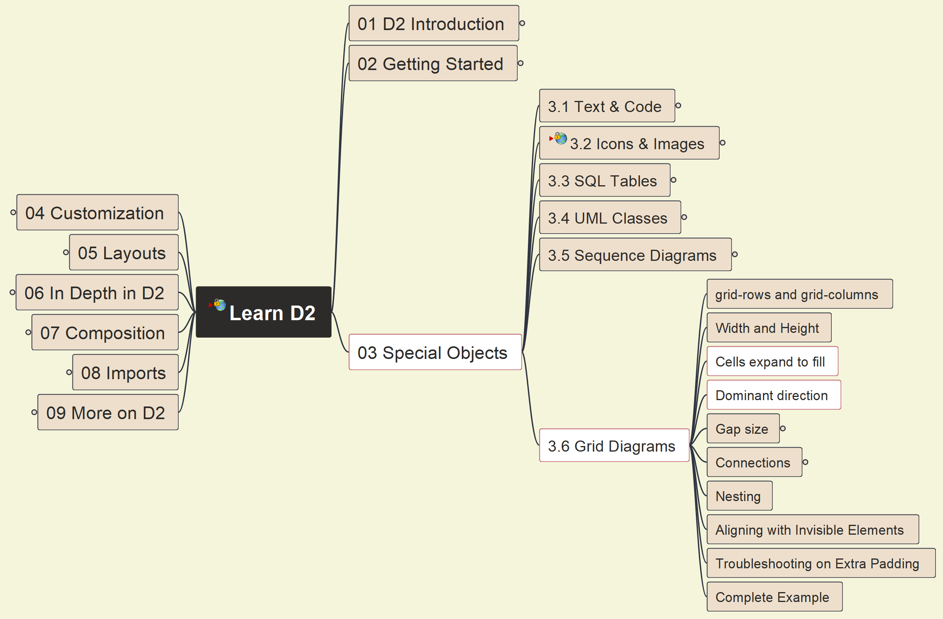
3. Special Objects: 3.6 Grid Diagrams (2)
026

Slide 27
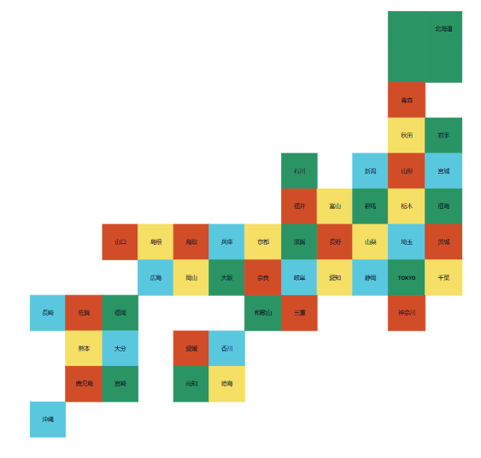
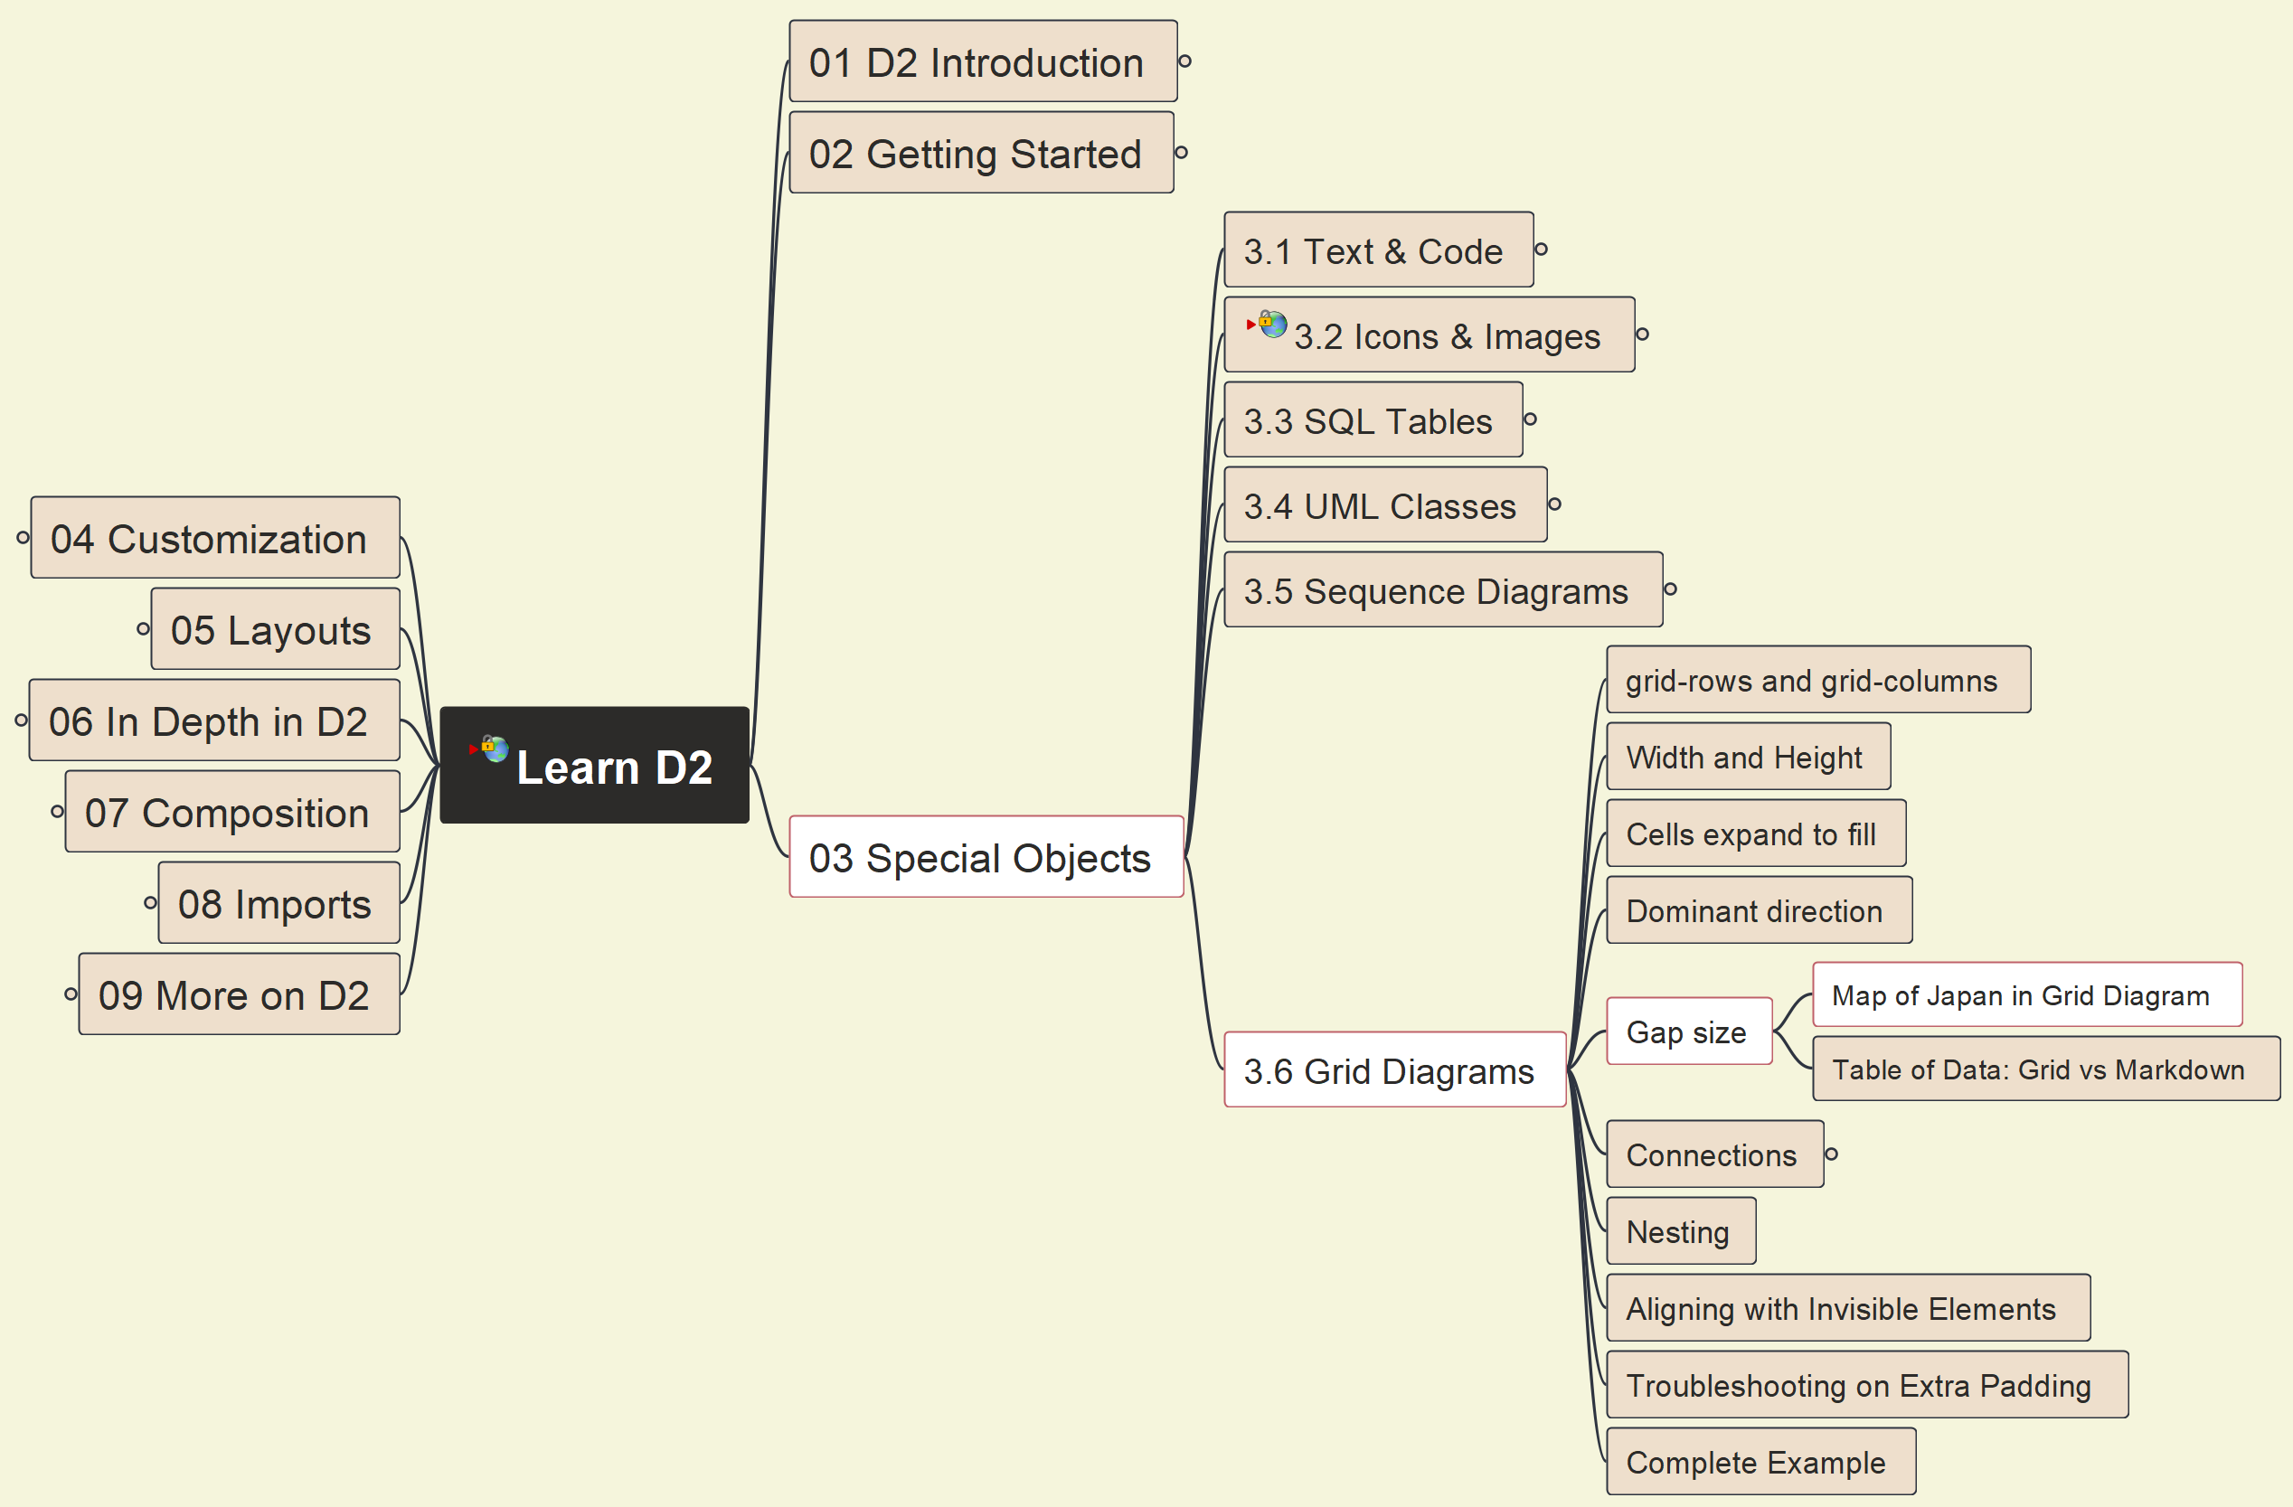
3. Special Objects: 3.6 Grid Diagrams (3)
027

Slide 28
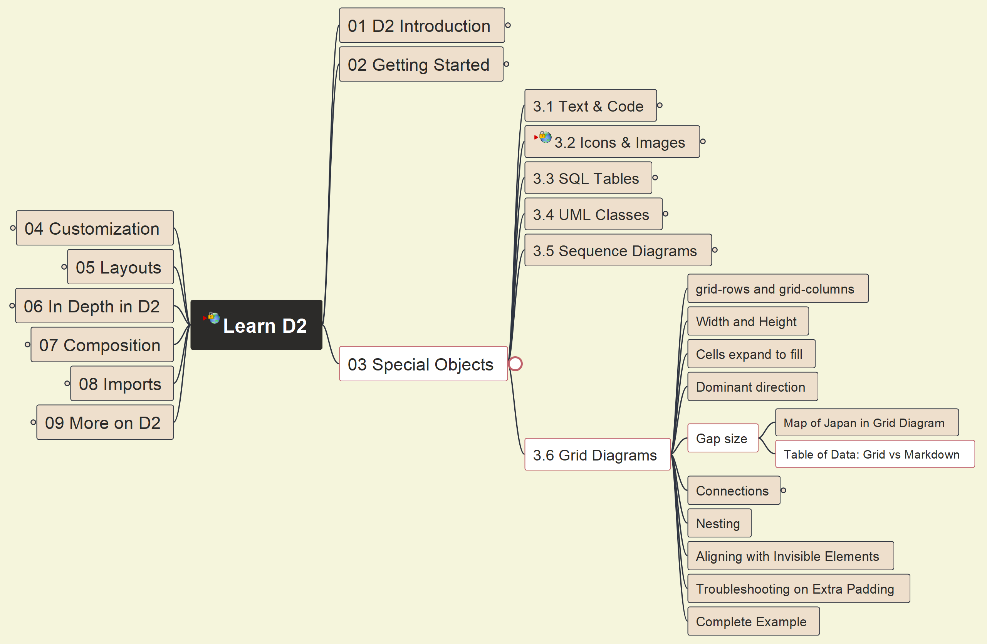
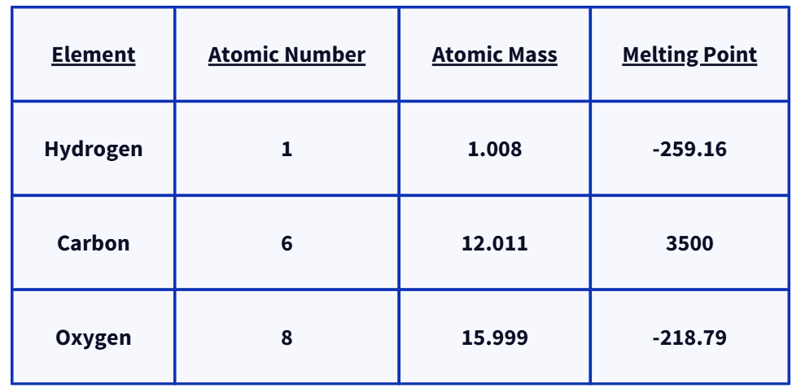
3. Special Objects: 3.6 Grid Diagrams (4)
028

Slide 29


3. Special Objects: 3.6 Grid Diagrams (5)
029

Slide 30


3. Special Objects: 3.6 Grid Diagrams (6)
030

Slide 31


3. Special Objects: 3.6 Grid Diagrams (7)
031

Slide 32


3. Special Objects: 3.6 Grid Diagrams (8)
032

Slide 33


3. Special Objects: 3.6 Grid Diagrams (9)
033

Slide 34


3. Special Objects: 3.6 Grid Diagrams (10)
034

Slide 35


3. Special Objects: 3.6 Grid Diagrams (11)
035

Slide 36


Closing and Summary
036

