Slide 1
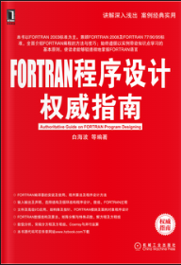
Fortran Programming 001 – 开篇
Xiaoqi Zhao
GitHub: https://github.com/yasenstar/learn_fortran​

Slide 2
Fortran Programming 002 – 编译器与开发环境
Xiaoqi Zhao
GitHub: https://github.com/yasenstar/learn_fortran​

