Slide 1

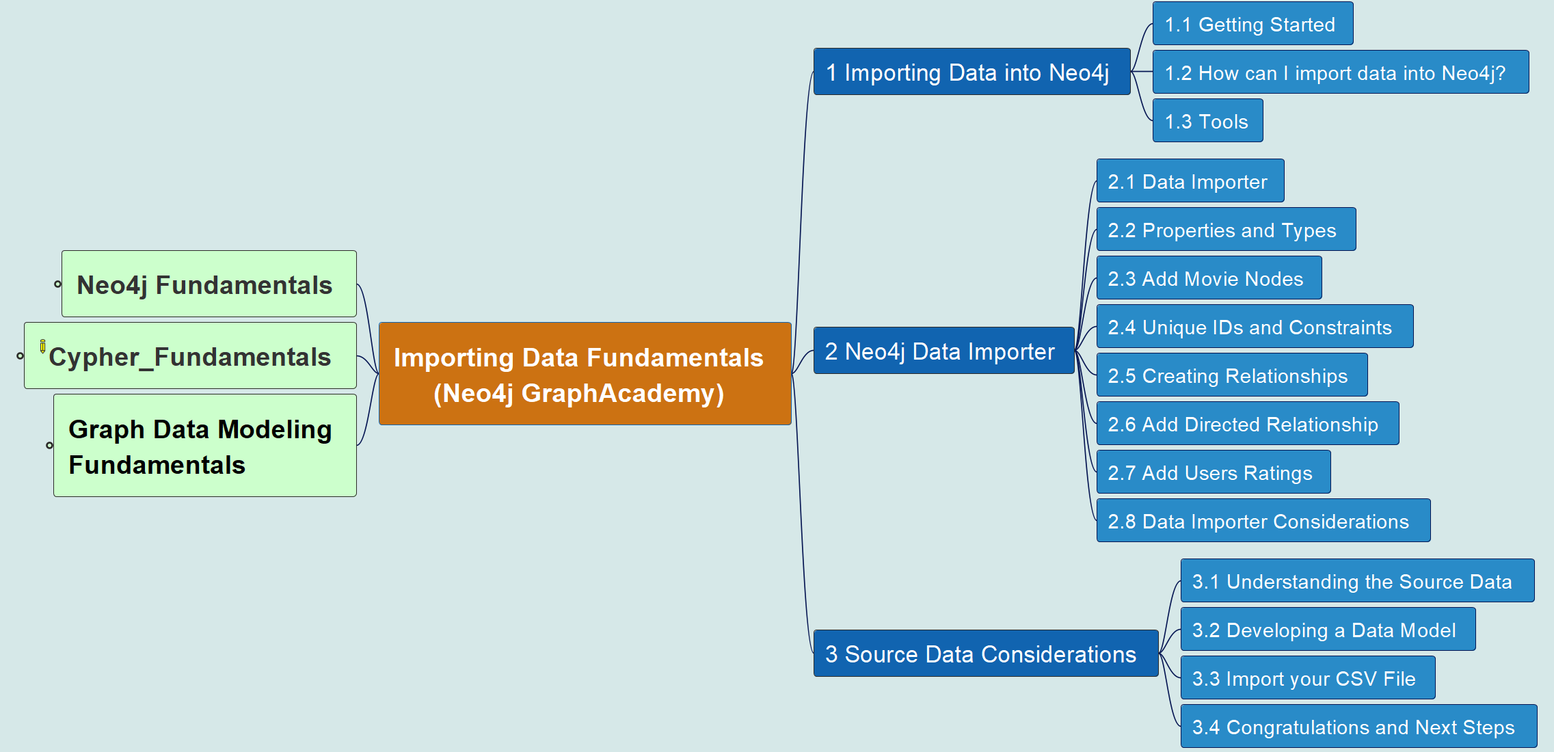
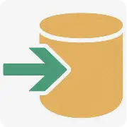

Importing Data Fundamentals
00
Opening &
Introduction

Slide 2
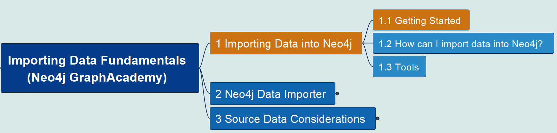

1.1 Getting Started
Importing Data Fundamentals
01

Slide 3
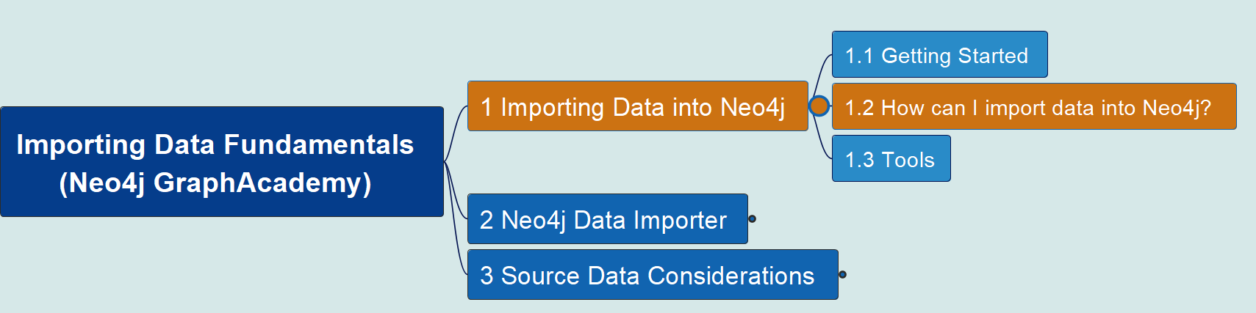
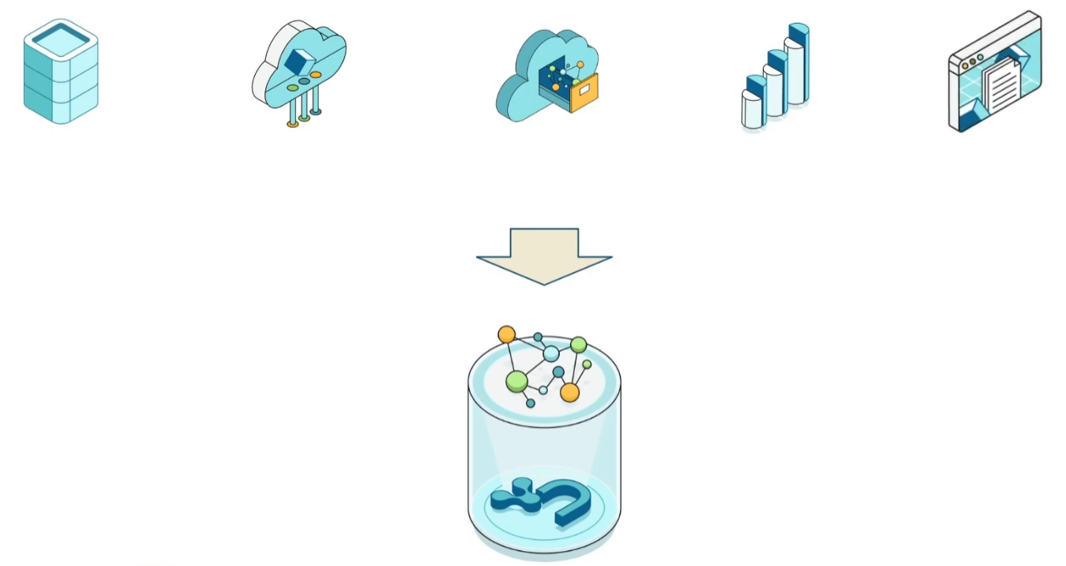
1.2 How can I Import?
Importing Data Fundamentals
02

Slide 4
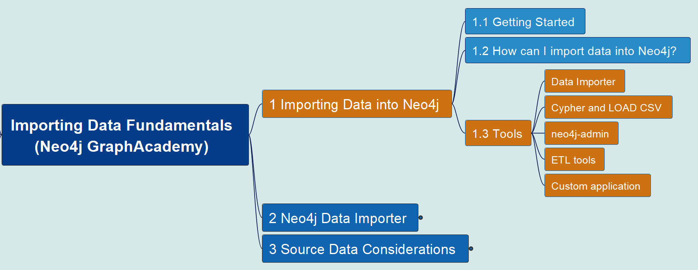

1.3 Data Importing Tools
Importing Data Fundamentals
03

Slide 5
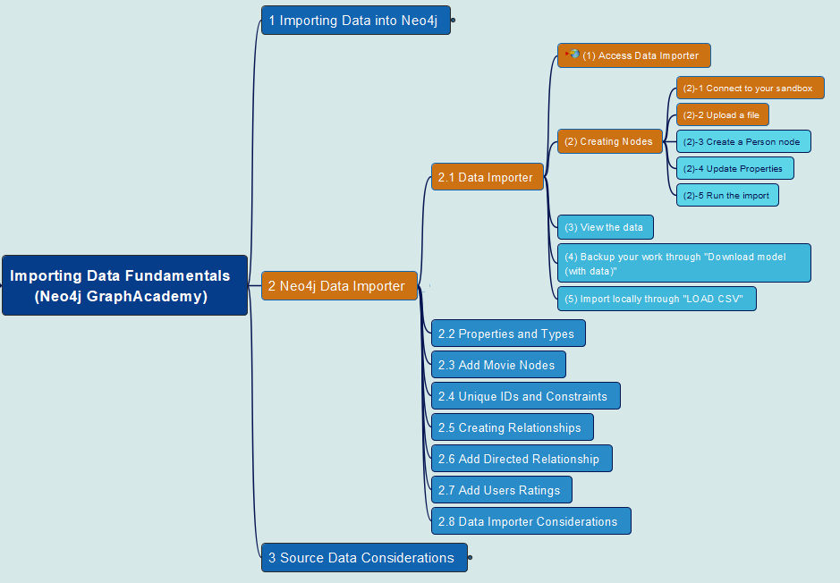

2.1 Data Importer – Part 1
Importing Data Fundamentals
04

Slide 6
2.1 Data Importer – Part 1 (cont.)
Importing Data Fundamentals
05

Slide 7
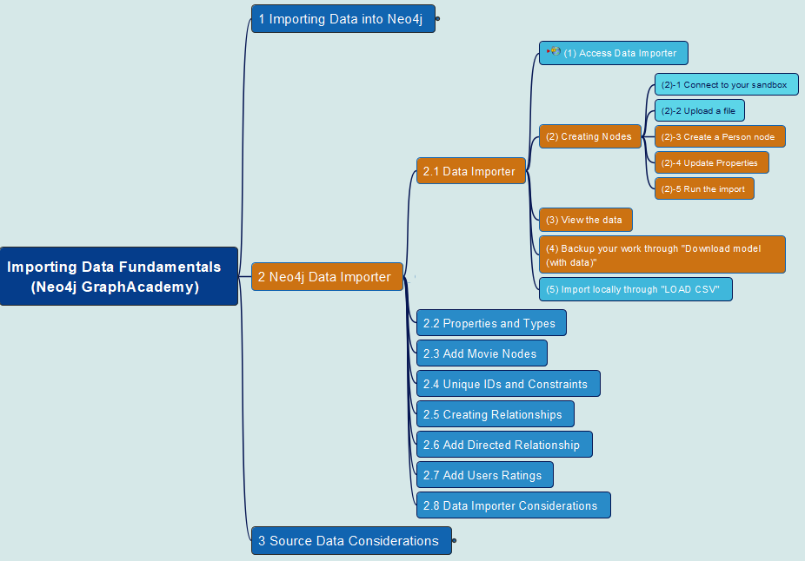
2.1 Data Importer – Part 2
Importing Data Fundamentals
06

Slide 8
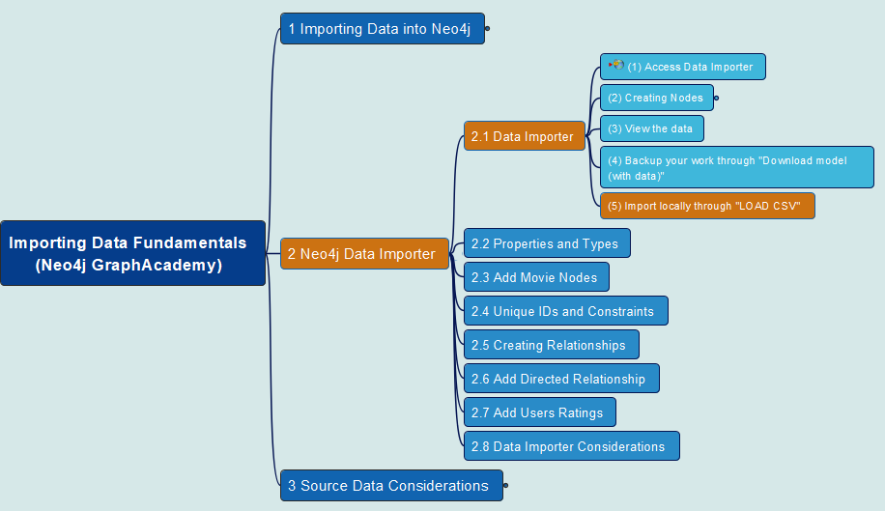
2.1 Data Importer – Part 3
Importing Data Fundamentals
07

Slide 9
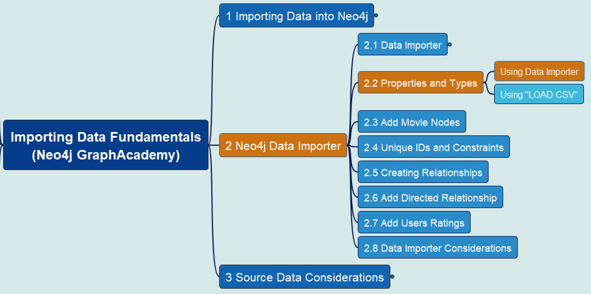
2.2 Properties and Types – Part 1
Importing Data Fundamentals
08

Slide 10
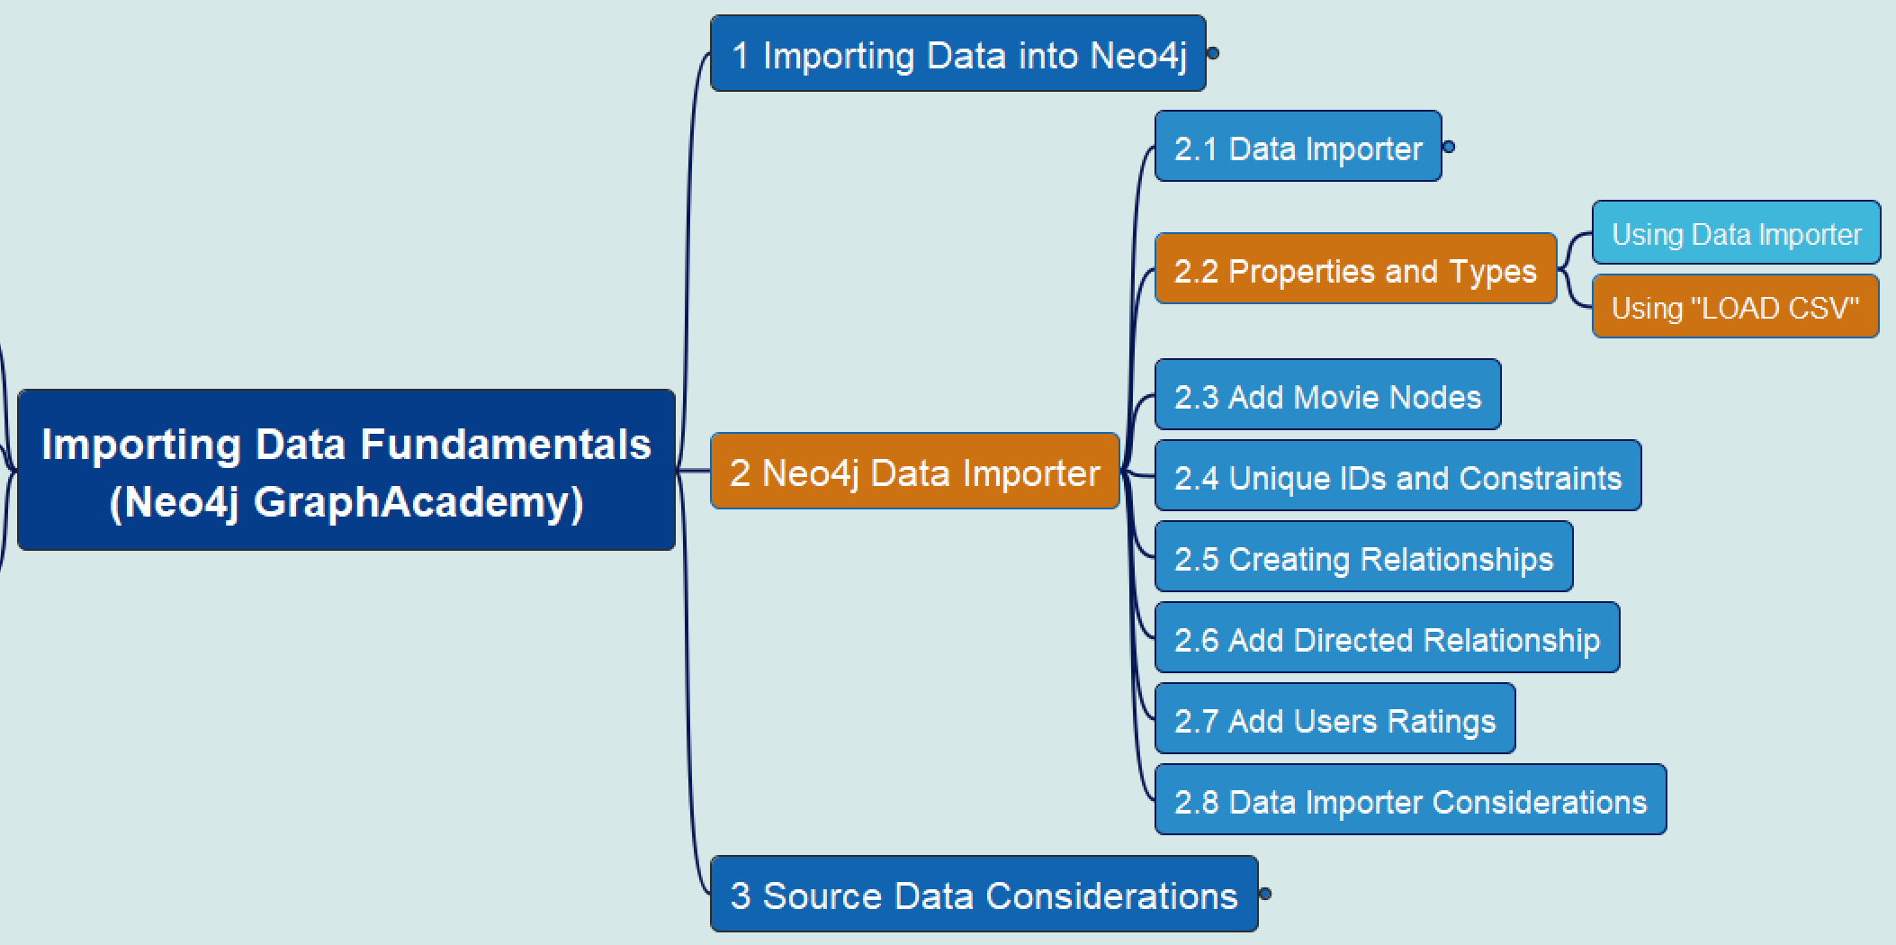
2.2 Properties and Types – Part 2
Importing Data Fundamentals
09

Slide 11
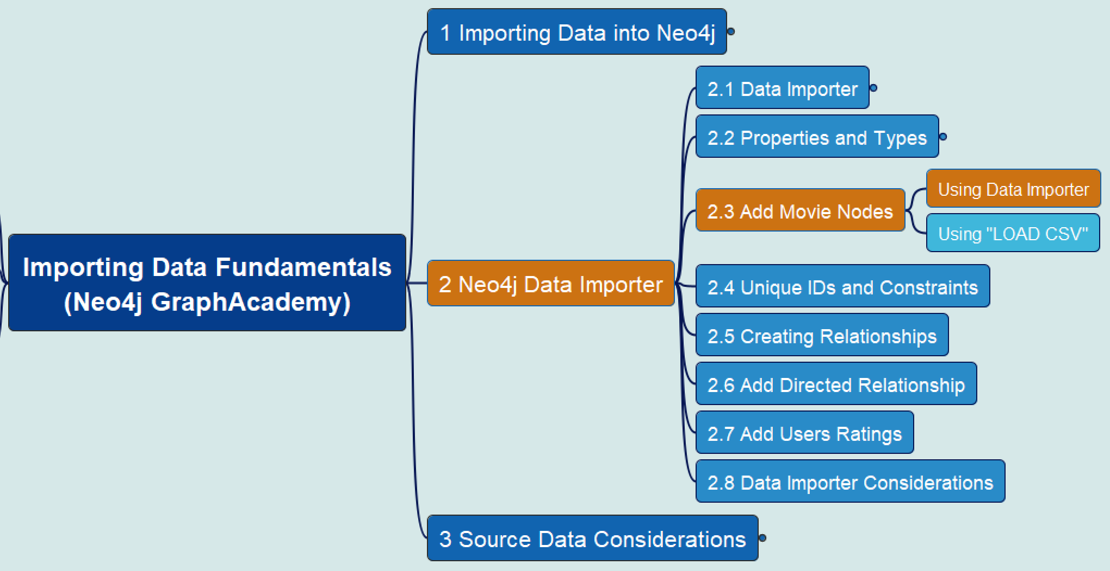
2.3 Add Movie Nodes – Part 1
Importing Data Fundamentals
10

Slide 12
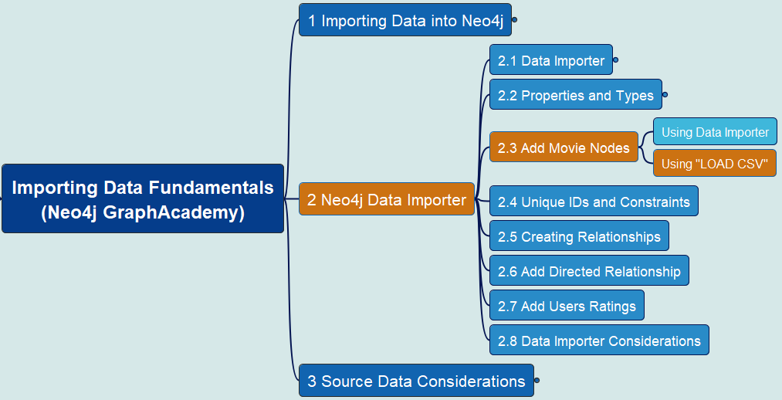
2.3 Add Movie Nodes – Part 2
Importing Data Fundamentals
11

Slide 13
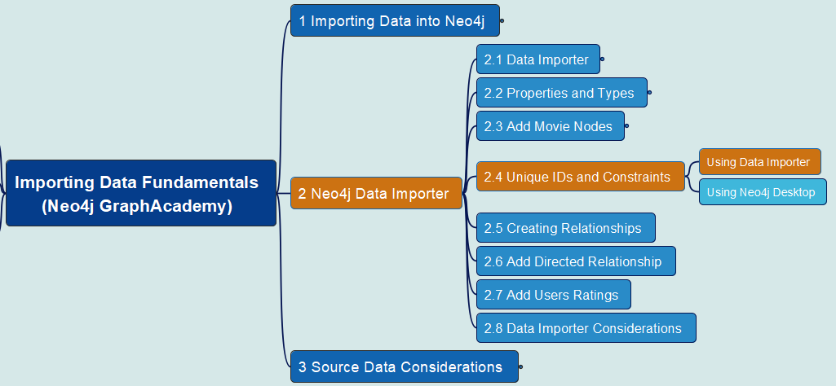
2.4 Unique IDs and Constraints – Part 1 – Use Data Importer
Importing Data Fundamentals
12

Slide 14
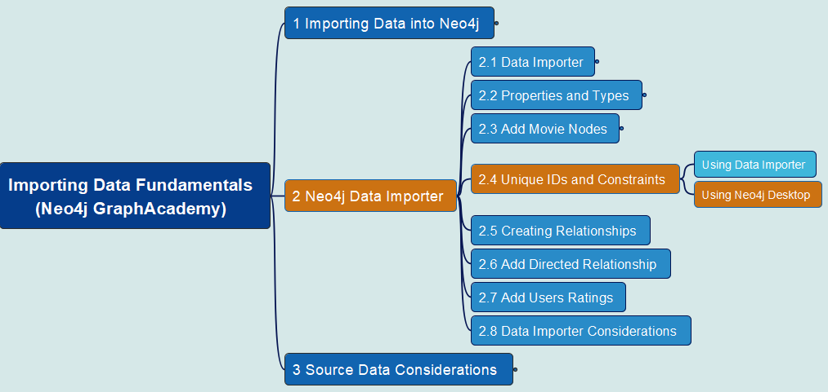
2.4 Unique IDs and Constraints – Part 2 – Use Neo4j Desktop
Importing Data Fundamentals
13

Slide 15
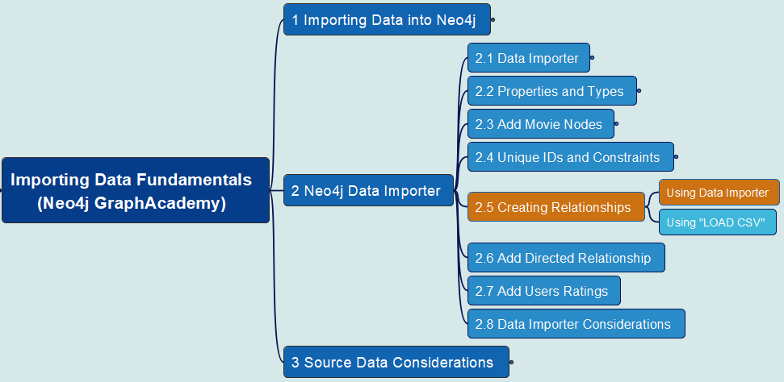
2.5 Create Relationships – Part 1 – Use Data Importer
Importing Data Fundamentals
14

Slide 16
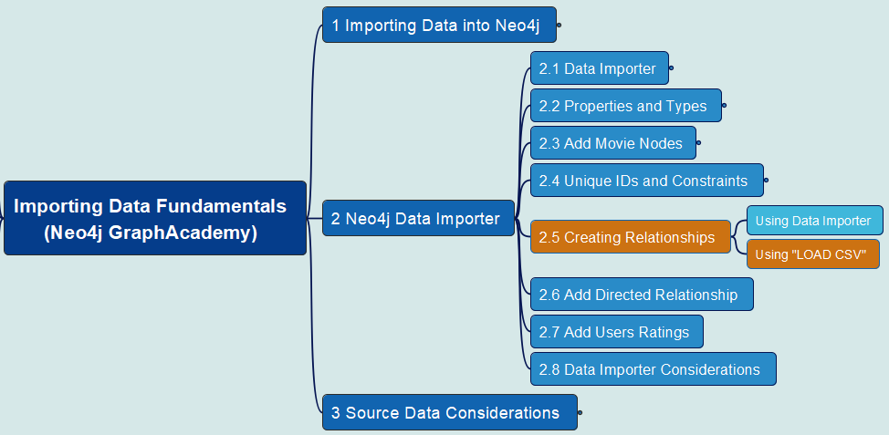
2.5 Create Relationships – Part 2 – Use LOAD CSV
Importing Data Fundamentals
15

Slide 17
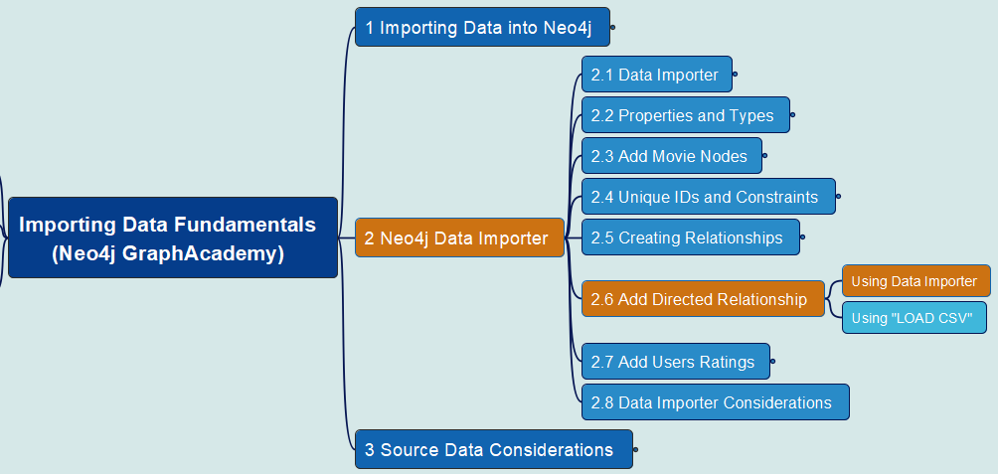
2.6 Add DIRECTED Relationship – Part 1 – Use Data Importer
Importing Data Fundamentals
16

Slide 18
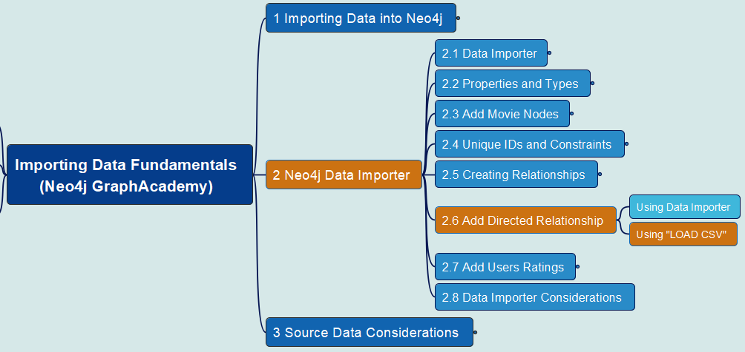
2.6 Add DIRECTED Relationship – Part 2 – Use LOAD CSV
Importing Data Fundamentals
17

Slide 19
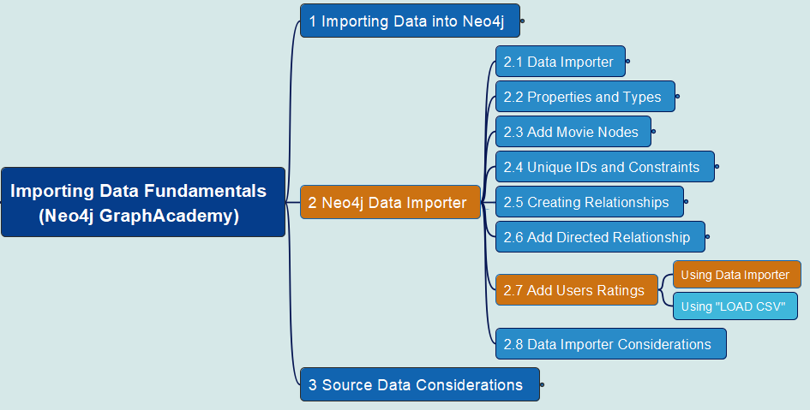
2.7 Add User Rating – Part 1 – Use Data Importer
Importing Data Fundamentals
18

Slide 20
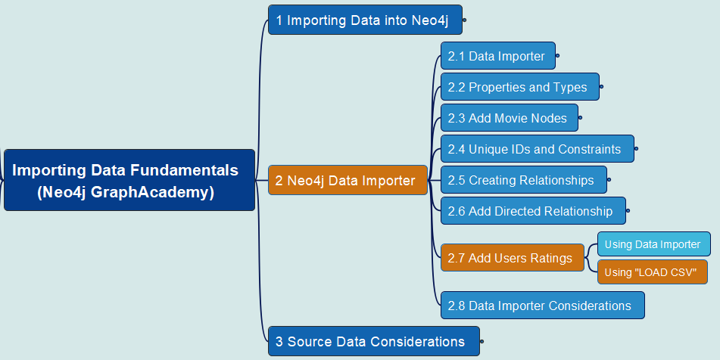
2.7 Add User Rating – Part 2 – Use LOAD CSV
Importing Data Fundamentals
19

Slide 21
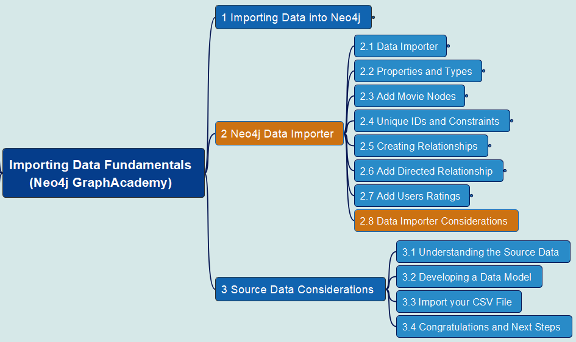
2.8 Data Importer Consideration
Importing Data Fundamentals
20

Slide 22
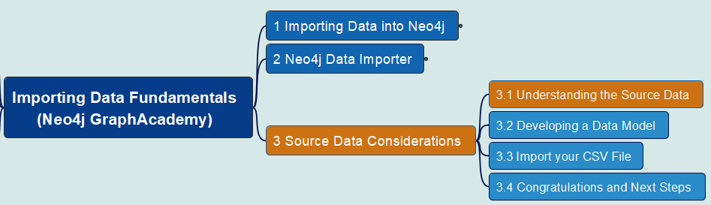
3.1 Understand Source Data
Importing Data Fundamentals
21

Slide 23
Course Summary
99
Intermediate
Intermediate Cypher Queries
Cypher Aggregations
Importing CSV data into Neo4j
Cypher Indexes and Constraints
Neo4j & GenerativeAI Fundamentals
Introduction to Vector Indexes and Unstructured Data
Building Neo4j Applications with Spring Data
Using Neo4j with Python
Building Neo4j Applications with Node.js
Building Neo4j Application with TypeScript
Developing with Neo4j MCP Tools
Using Neo4j with Java
Using Neo4j with Go
Building Neo4j Applications with .NET
Introducion to Neo4j & GraphGL
Beginners
Neo4j Fundamentals
Cypher Fundamentals
Graph Data Modeling Fundamentals
Importing Data Fundamentals
Aura Fundamentals
Advanced
Using Neo4j with LangChain
Build a Neo4j-backed Chatbot using Python
Build a Neo4j-backed Chatbot with TypeScript
Building Knowledge Graphs with LLMs
Path Finding with GDS
Neo4j Graph Data Science Fundamentals
Neo4j Graph Data Science Certification
Introduction to Neo4j Graph Data Science
Neo4j Certified Professional
Cypher Patterns
Cypher Statement Processing

Slide 24
