Slide 1

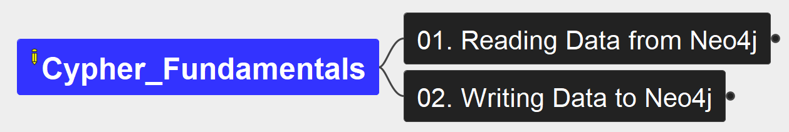
Cypher Fundamentals
00
Opening &
Introduction

Slide 2
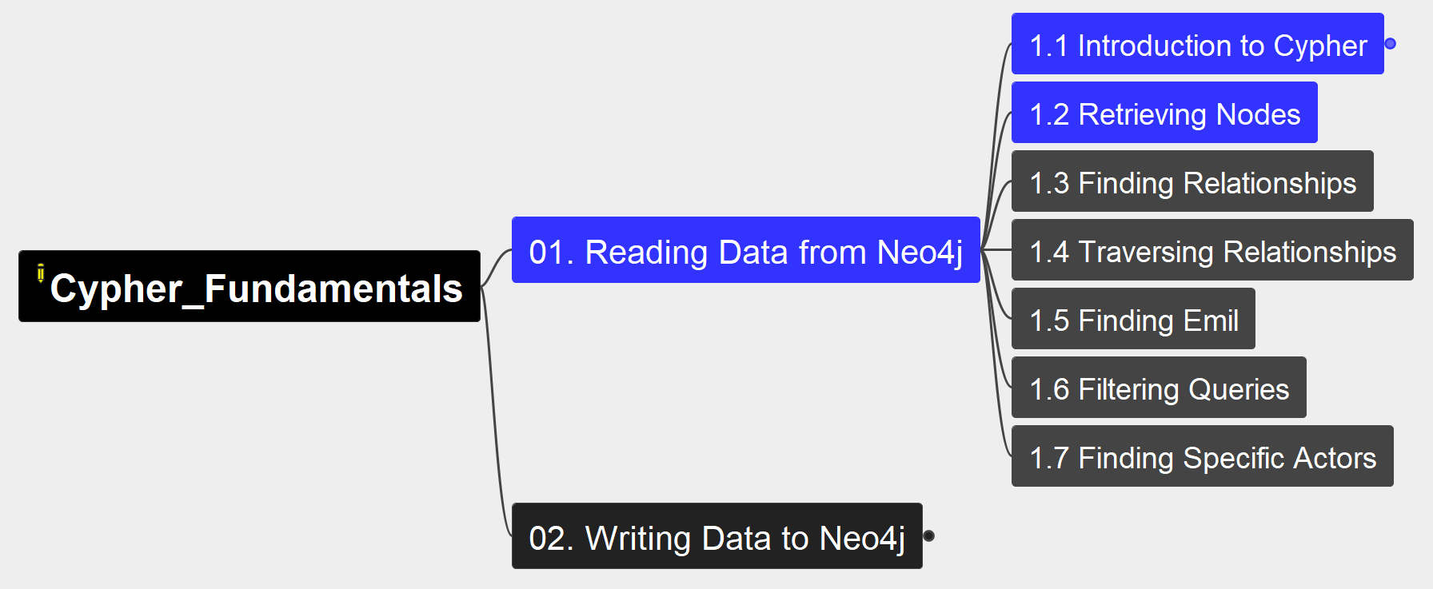
1. Reading Data from Neo4j
Cypher Fundamentals
01

Slide 3
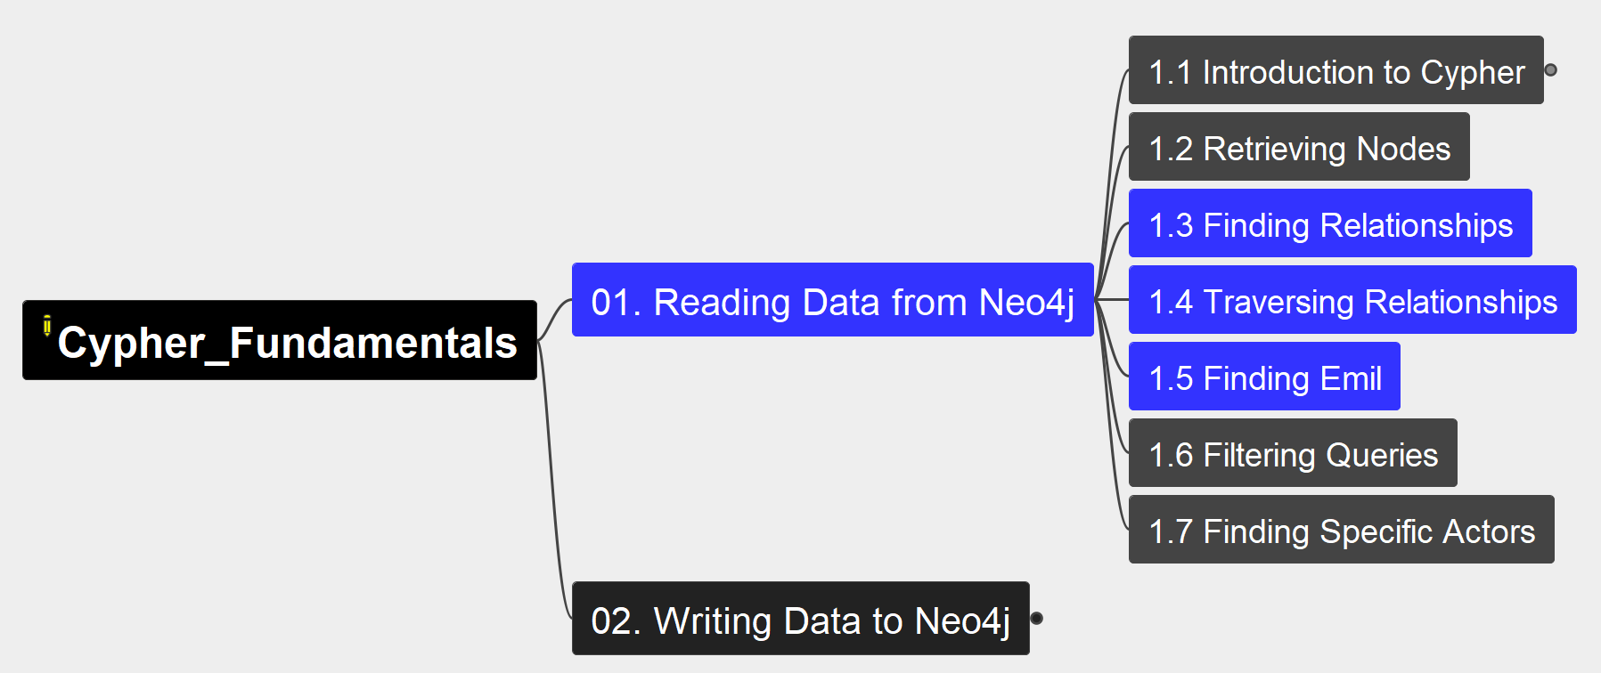
1. Reading Data from Neo4j
Cypher Fundamentals
02

Slide 4
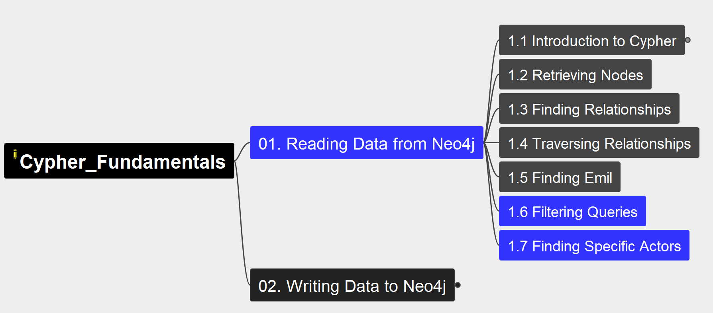
1. Reading Data from Neo4j
Cypher Fundamentals
03

Slide 5
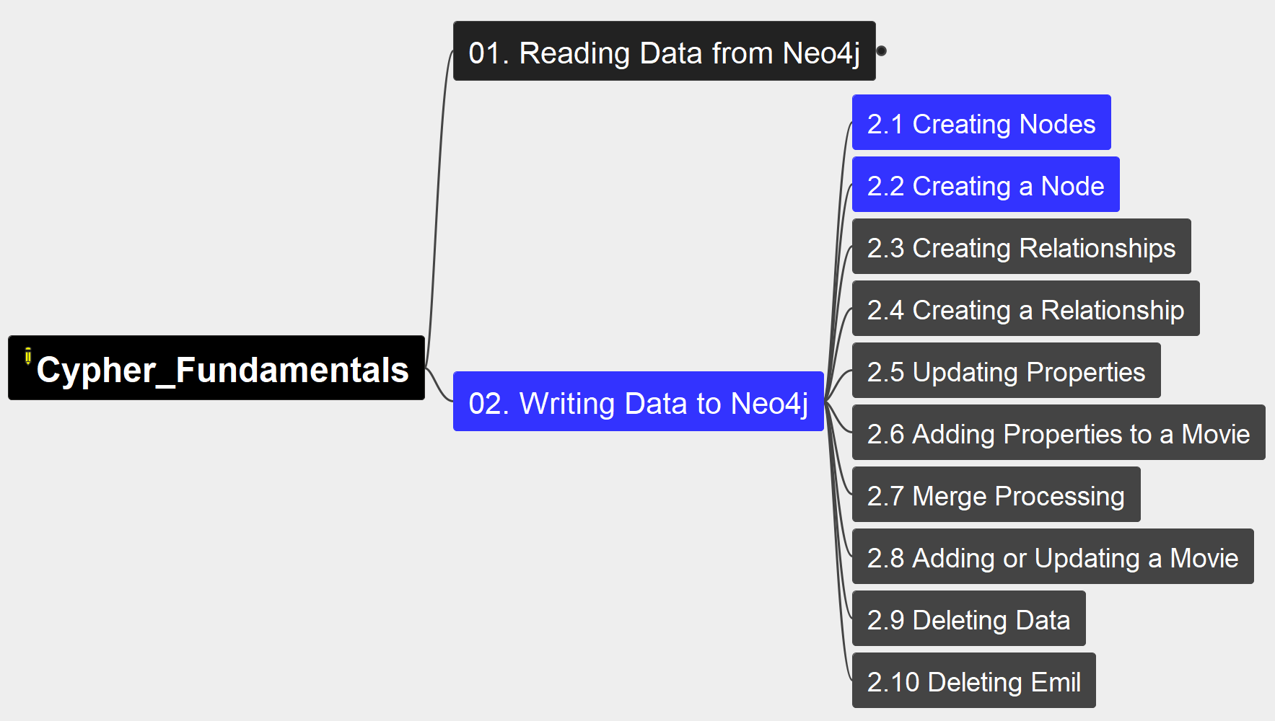
2. Writing Data to Neo4j
Cypher Fundamentals
04

Slide 6
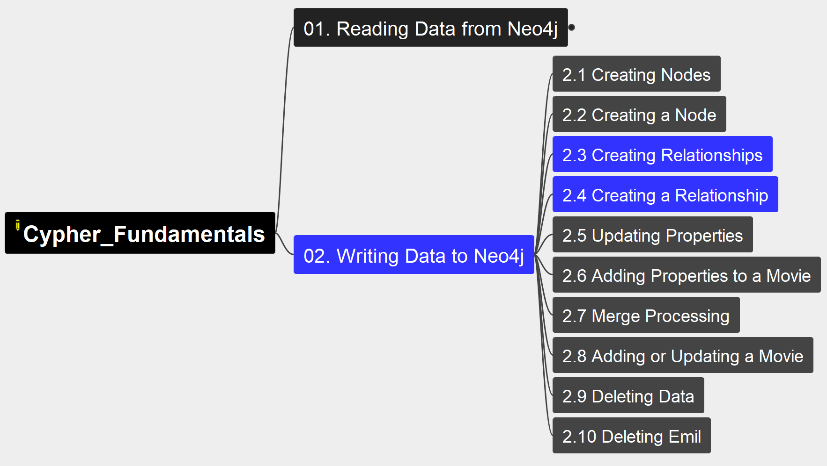
2. Writing Data to Neo4j
Cypher Fundamentals
05

Slide 7
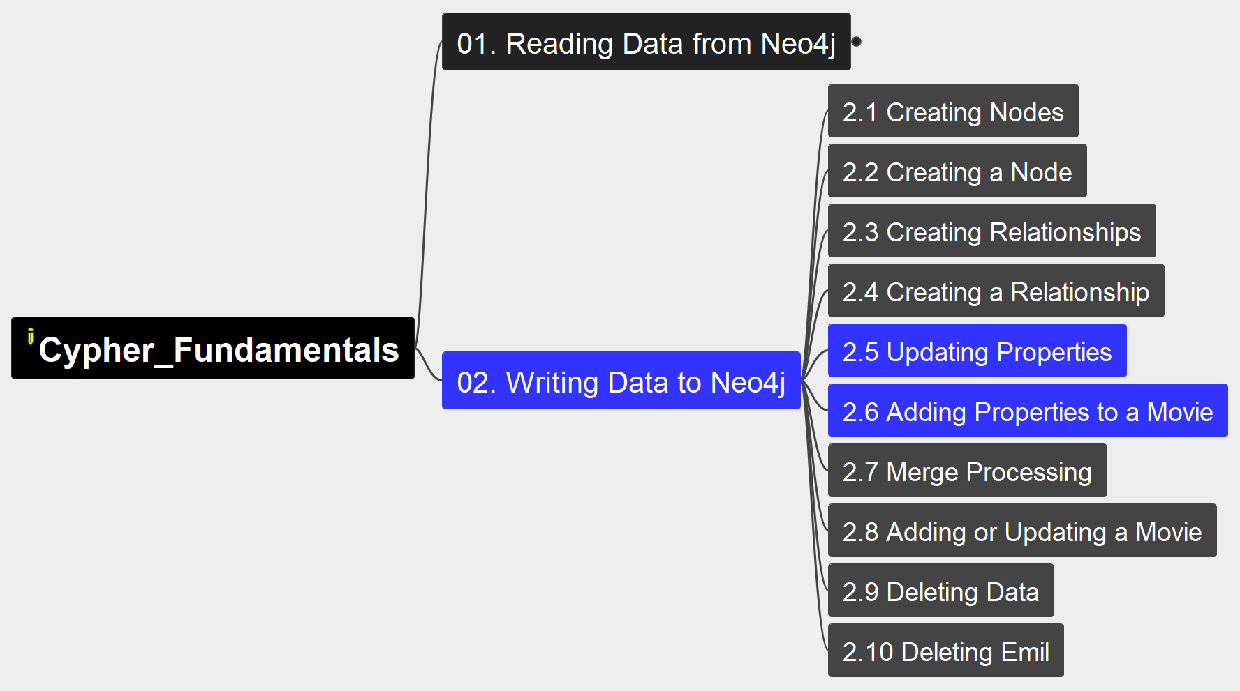
2. Writing Data to Neo4j
Cypher Fundamentals
06

Slide 8
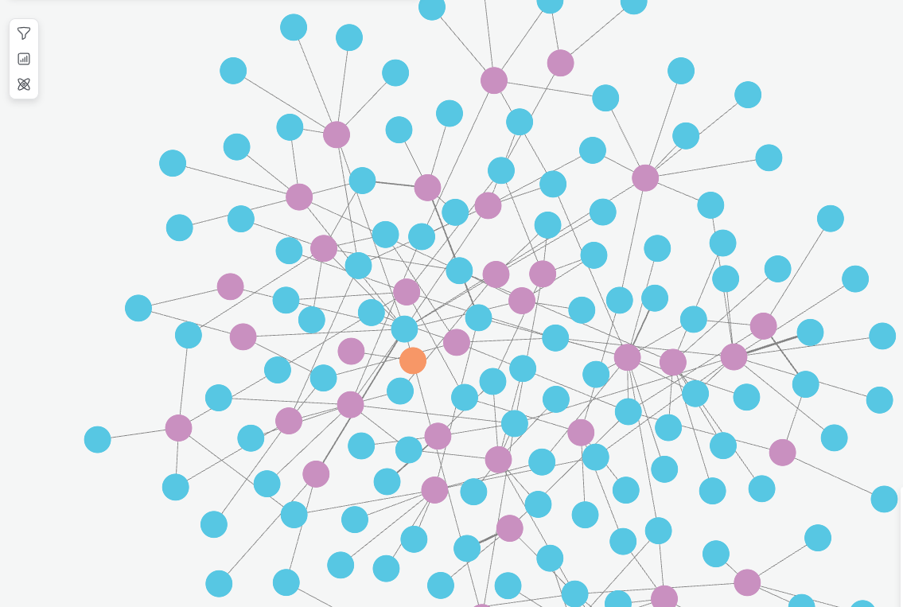

2

