Slide 1

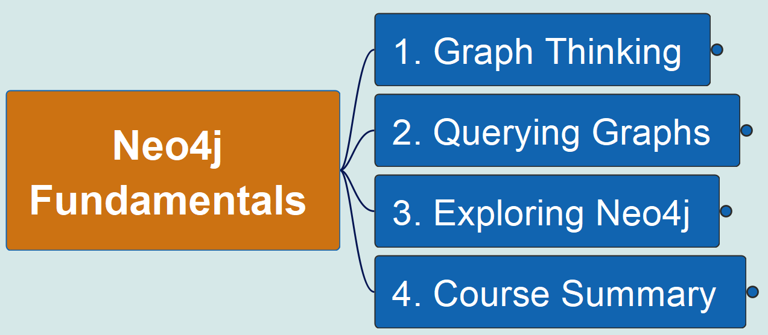
Neo4j Fundamentals
00
Opening &
Introduction
Reference Material:
https://github.com/yasenstar/learn_graphdb/tree/main/neo4j/neo4j_fundamentals

Slide 2
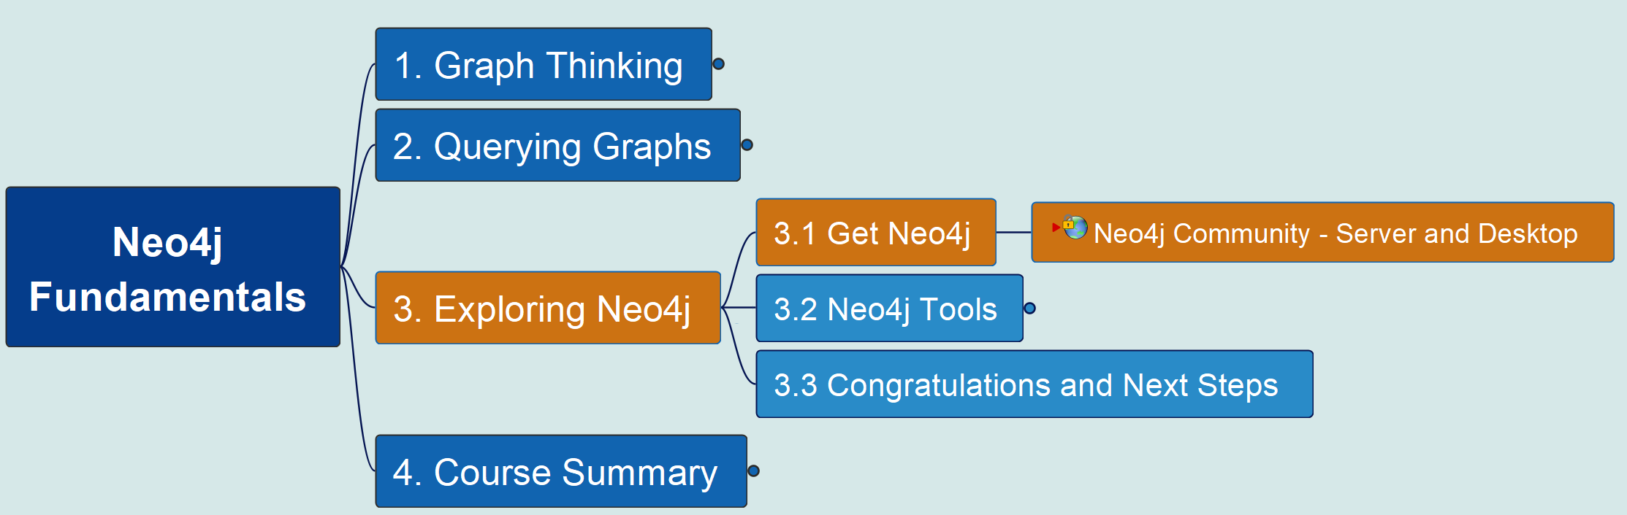
3. Exploring Neo4j 3.1 Get Neo4j
Neo4j Fundamentals
01
工欲善其事 必先利其器
To do a good job, one must first sharpen one's tools.

Slide 3
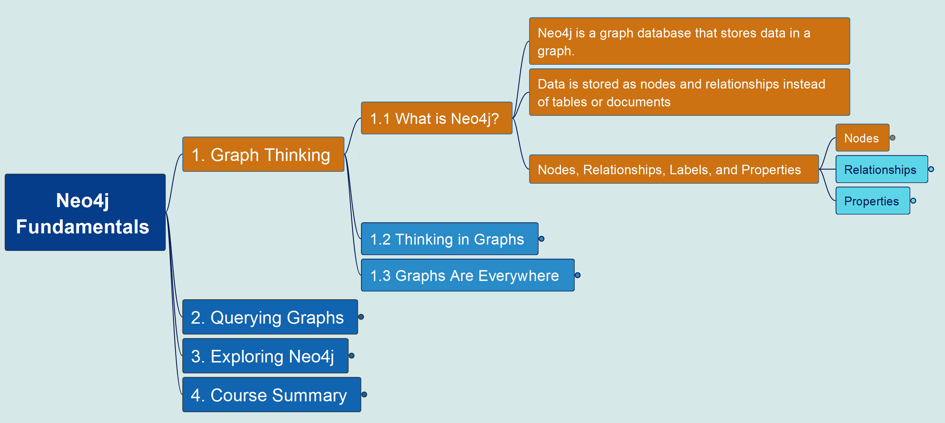
1. Graph Thinking 1.1 What is Neo4j? – Create a Node
Neo4j Fundamentals
02

Slide 4
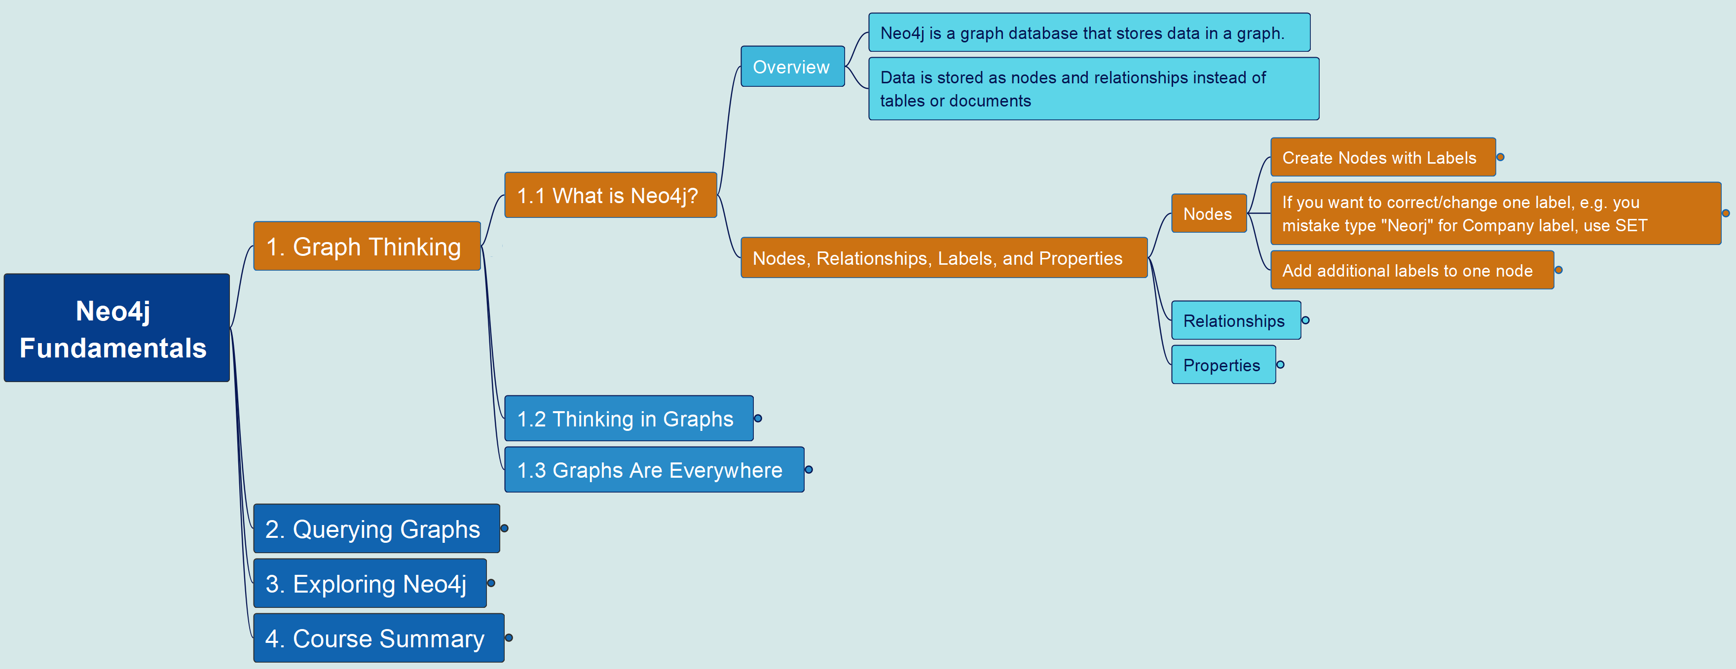
1. Graph Thinking 1.1 What is Neo4j? – Create more Nodes
Neo4j Fundamentals
03

Slide 5
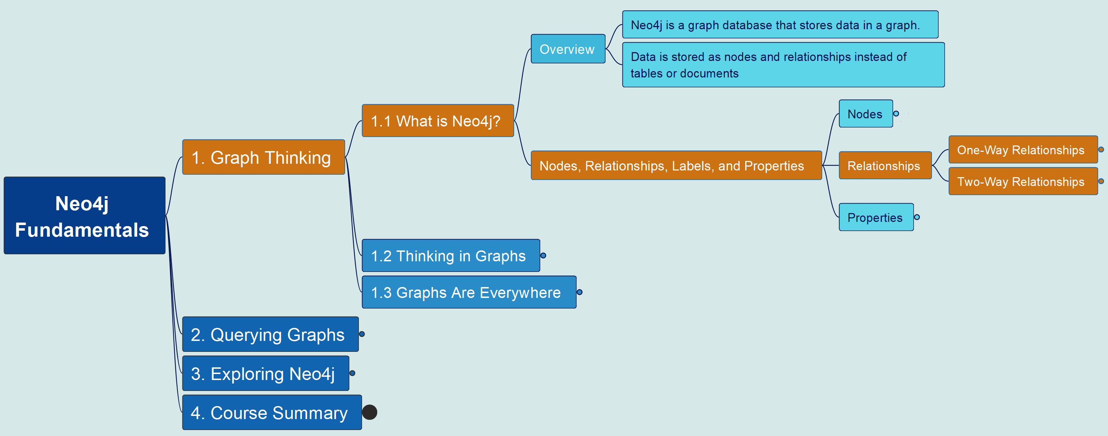
1. Graph Thinking 1.1 What is Neo4j? – Create Relationships
Neo4j Fundamentals
04

Slide 6
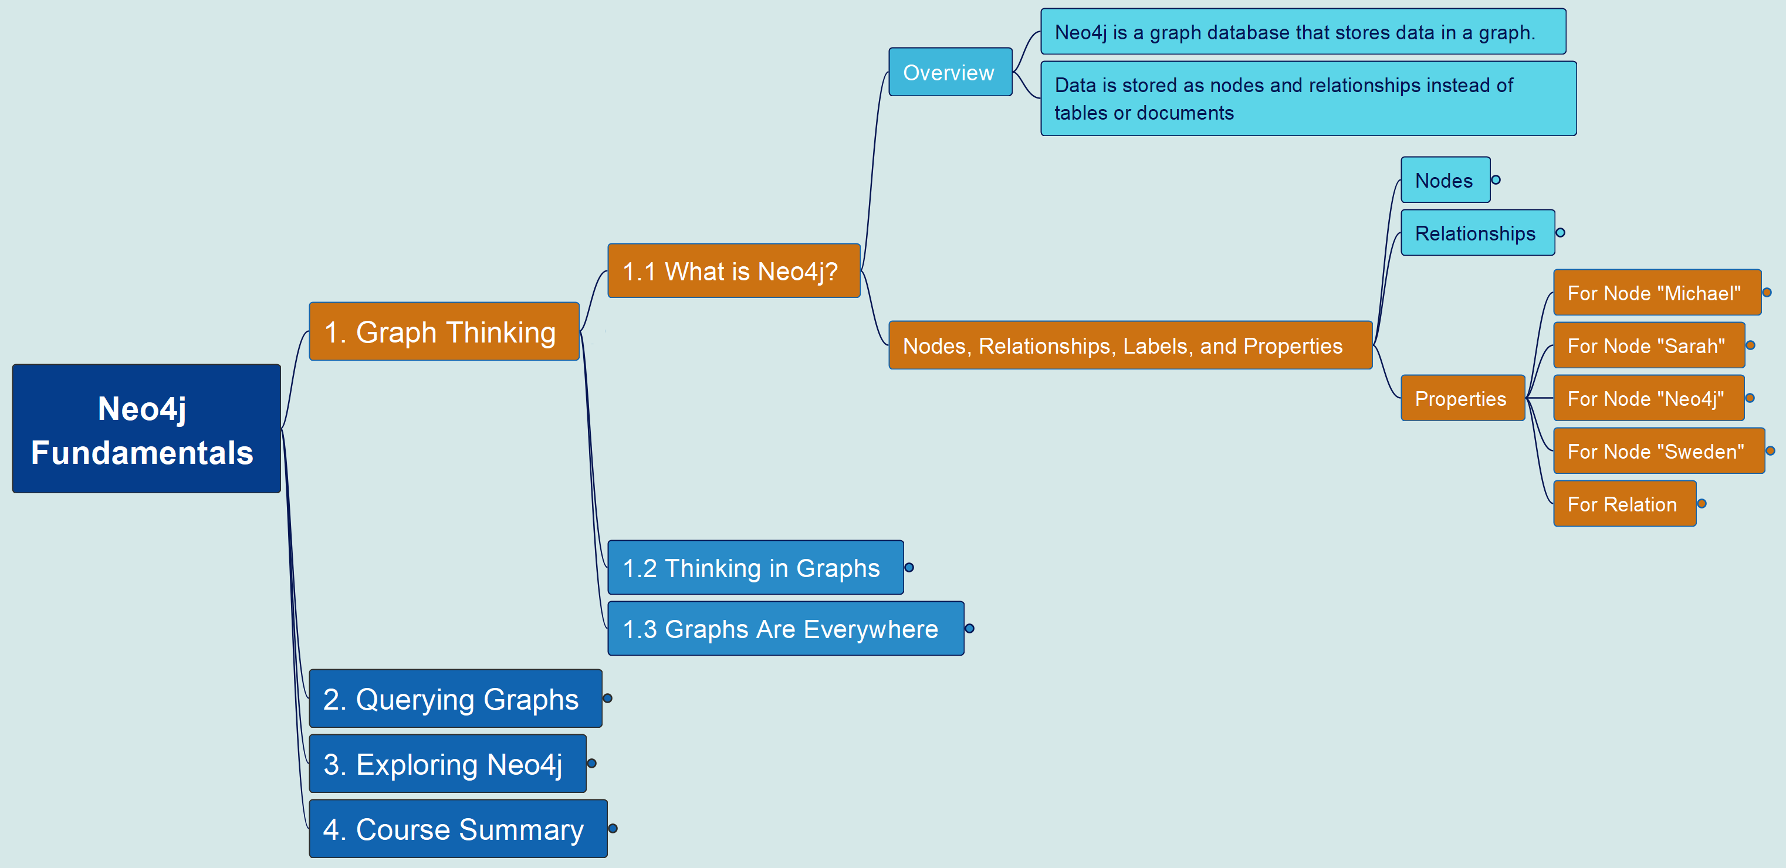
1. Graph Thinking 1.1 What is Neo4j? – Create Properties
Neo4j Fundamentals
05

Slide 7
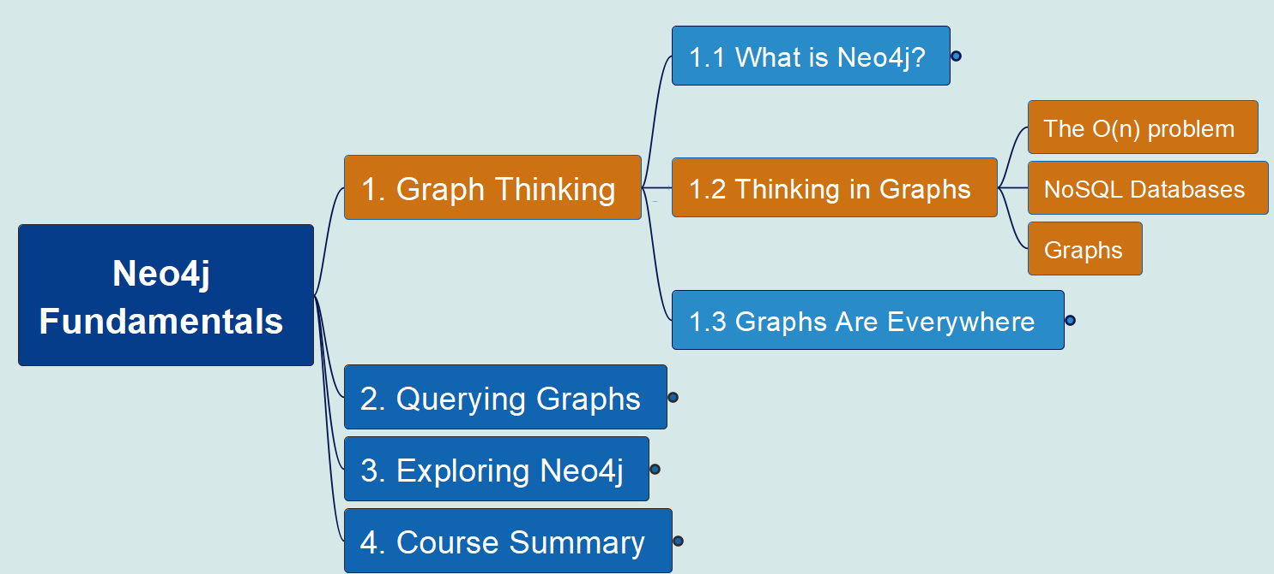
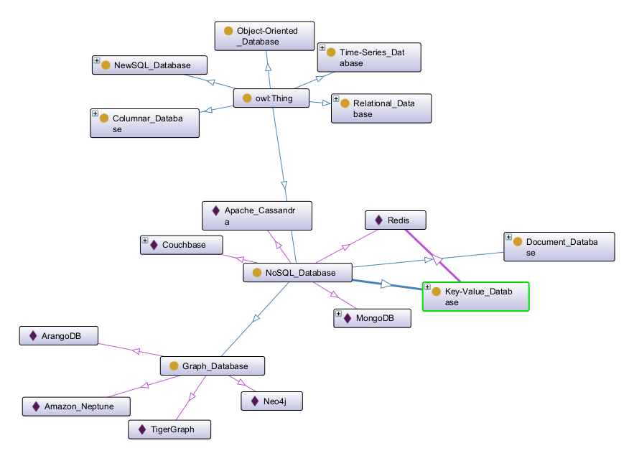
1. Graph Thinking 1.2 Thinking In Graphs
Neo4j Fundamentals
06

Slide 8
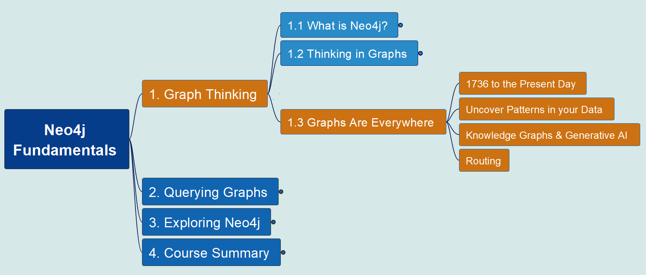
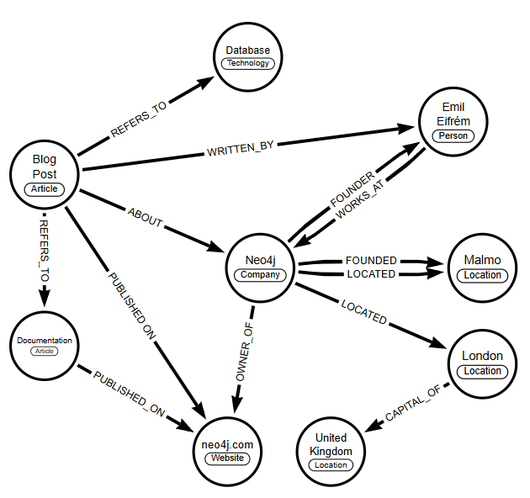
1. Graph Thinking 1.3 Graphs are Everywhere
Neo4j Fundamentals
07

