Slide 1

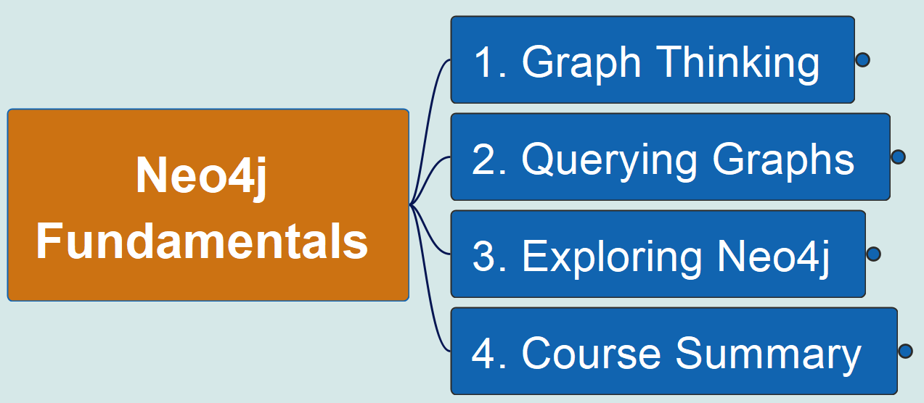
Neo4j Fundamentals
00
Opening &
Introduction
Reference Material:
https://github.com/yasenstar/learn_graphdb/tree/main/neo4j/neo4j_fundamentals

Slide 2
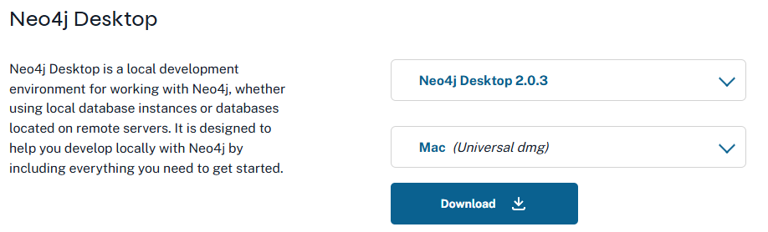
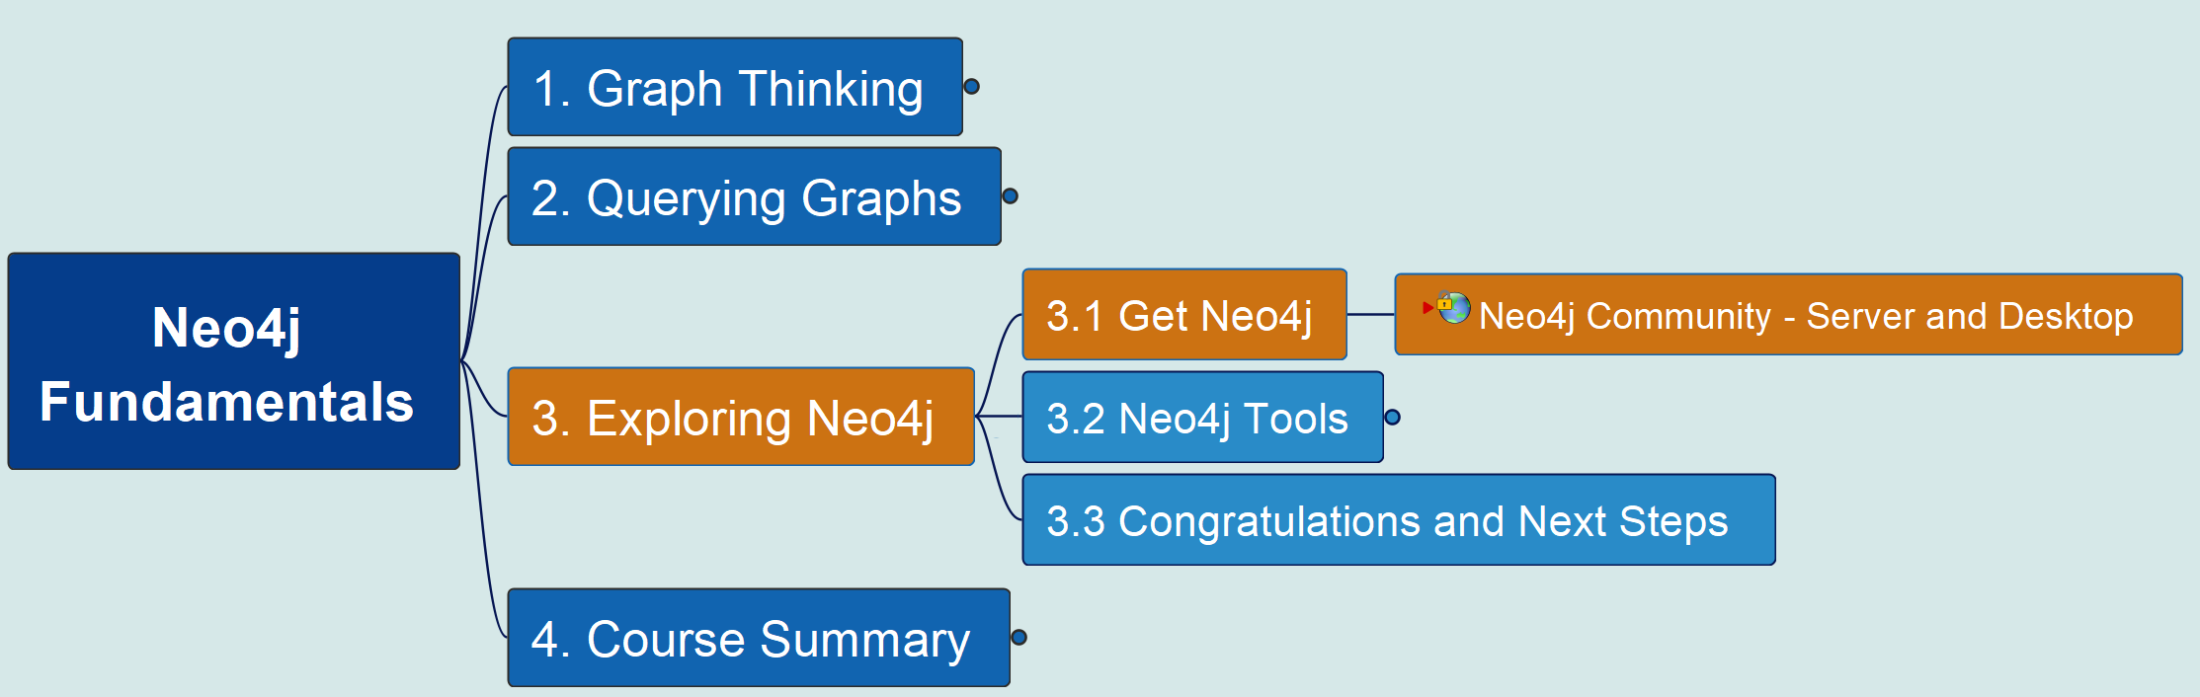
3. Exploring Neo4j 3.1 Get Neo4j
Neo4j Fundamentals
01

Slide 3
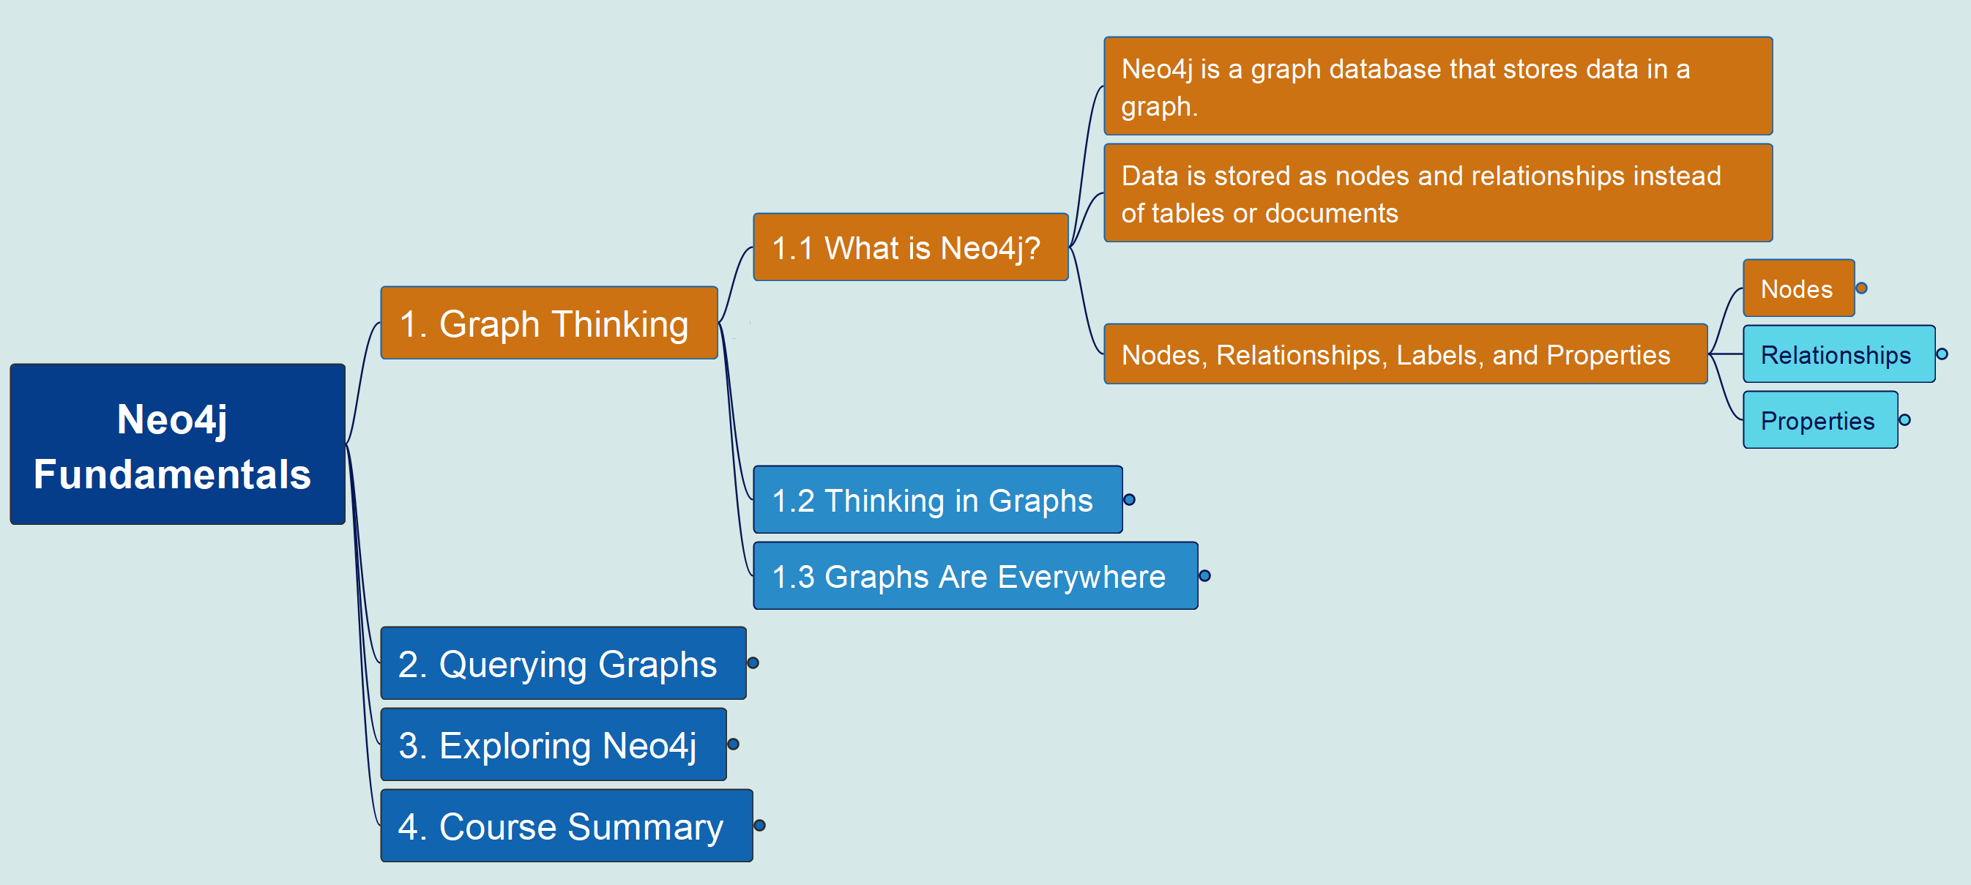
1. Graph Thinking 1.1 What is Neo4j? – Create a Node
Neo4j Fundamentals
02

