Slide 1

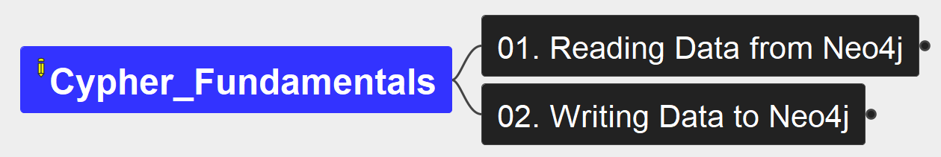
Cypher Fundamentals
00
Opening &
Introduction

Slide 2
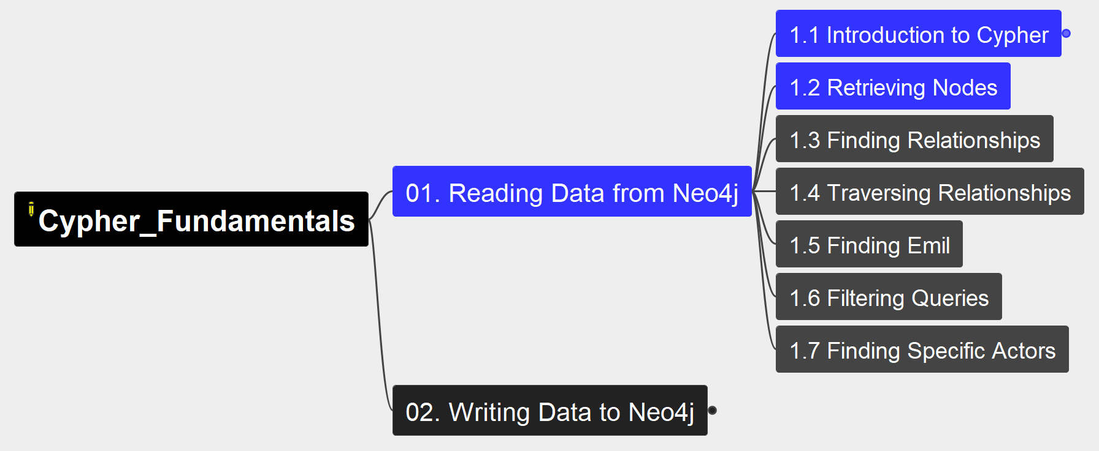
1. Reading Data from Neo4j
Cypher Fundamentals
01

Slide 3
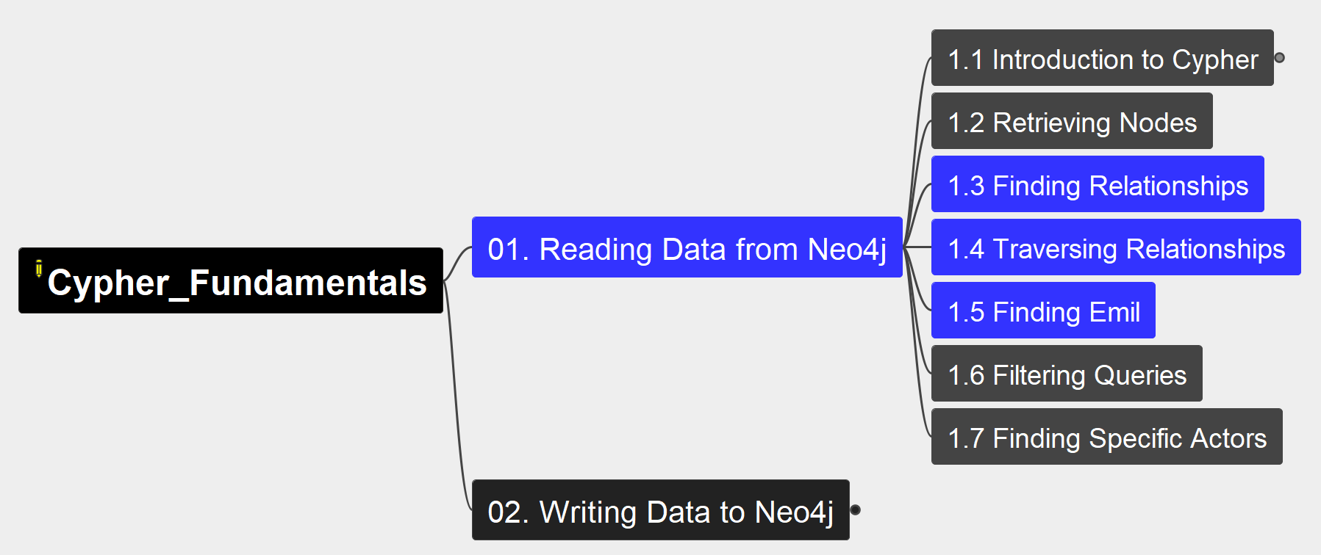
1. Reading Data from Neo4j
Cypher Fundamentals
02

Slide 4
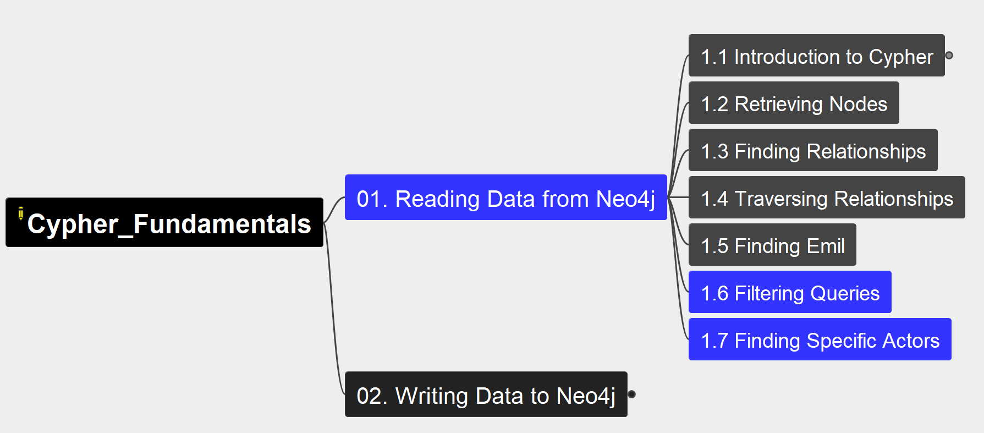
1. Reading Data from Neo4j
Cypher Fundamentals
03

Slide 5
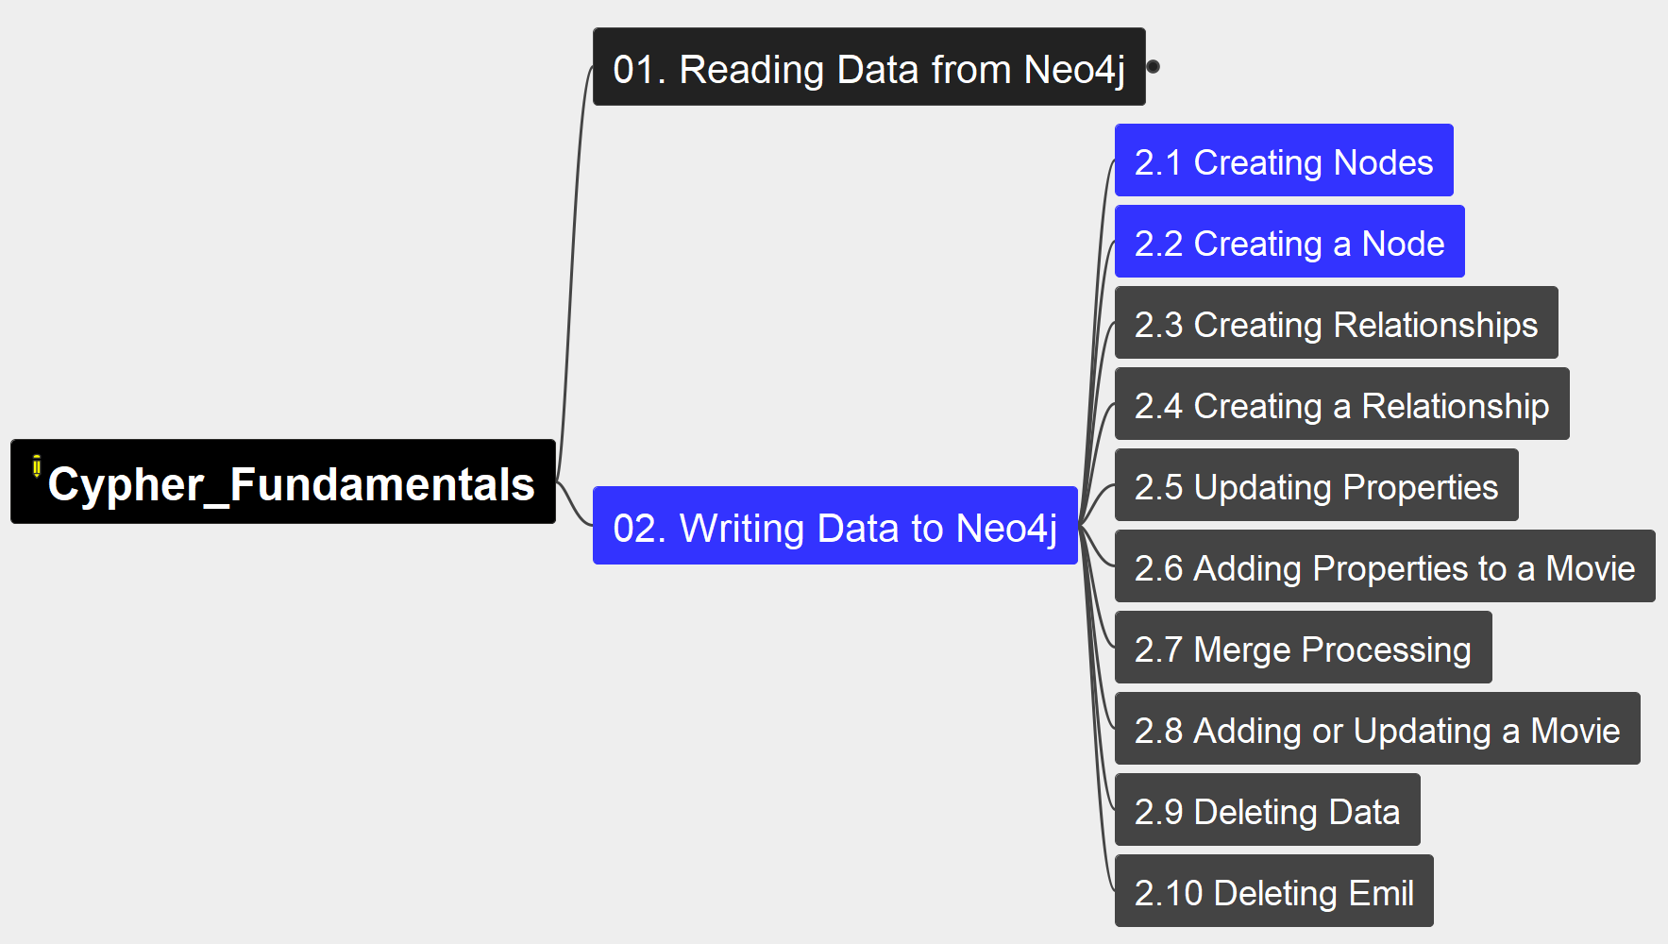
2. Writing Data to Neo4j
Cypher Fundamentals
04

Slide 6
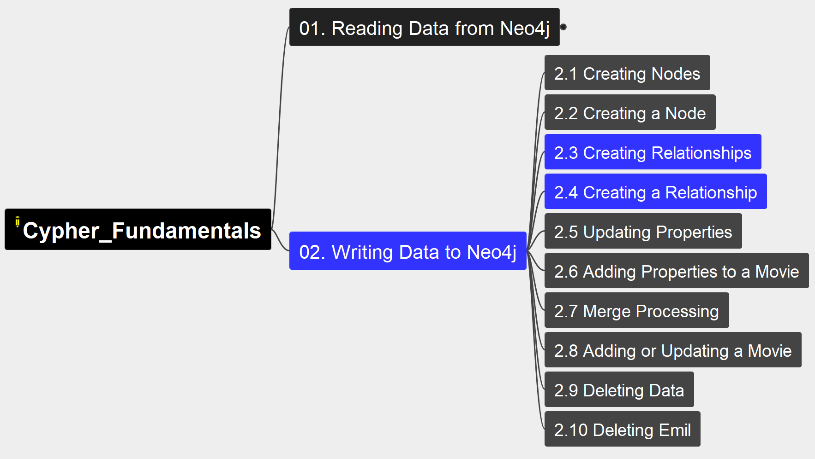
2. Writing Data to Neo4j
Cypher Fundamentals
05

Slide 7
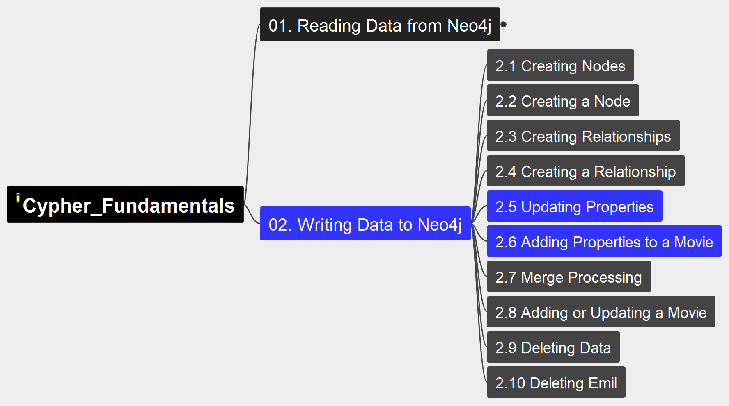
2. Writing Data to Neo4j
Cypher Fundamentals
06

Slide 8
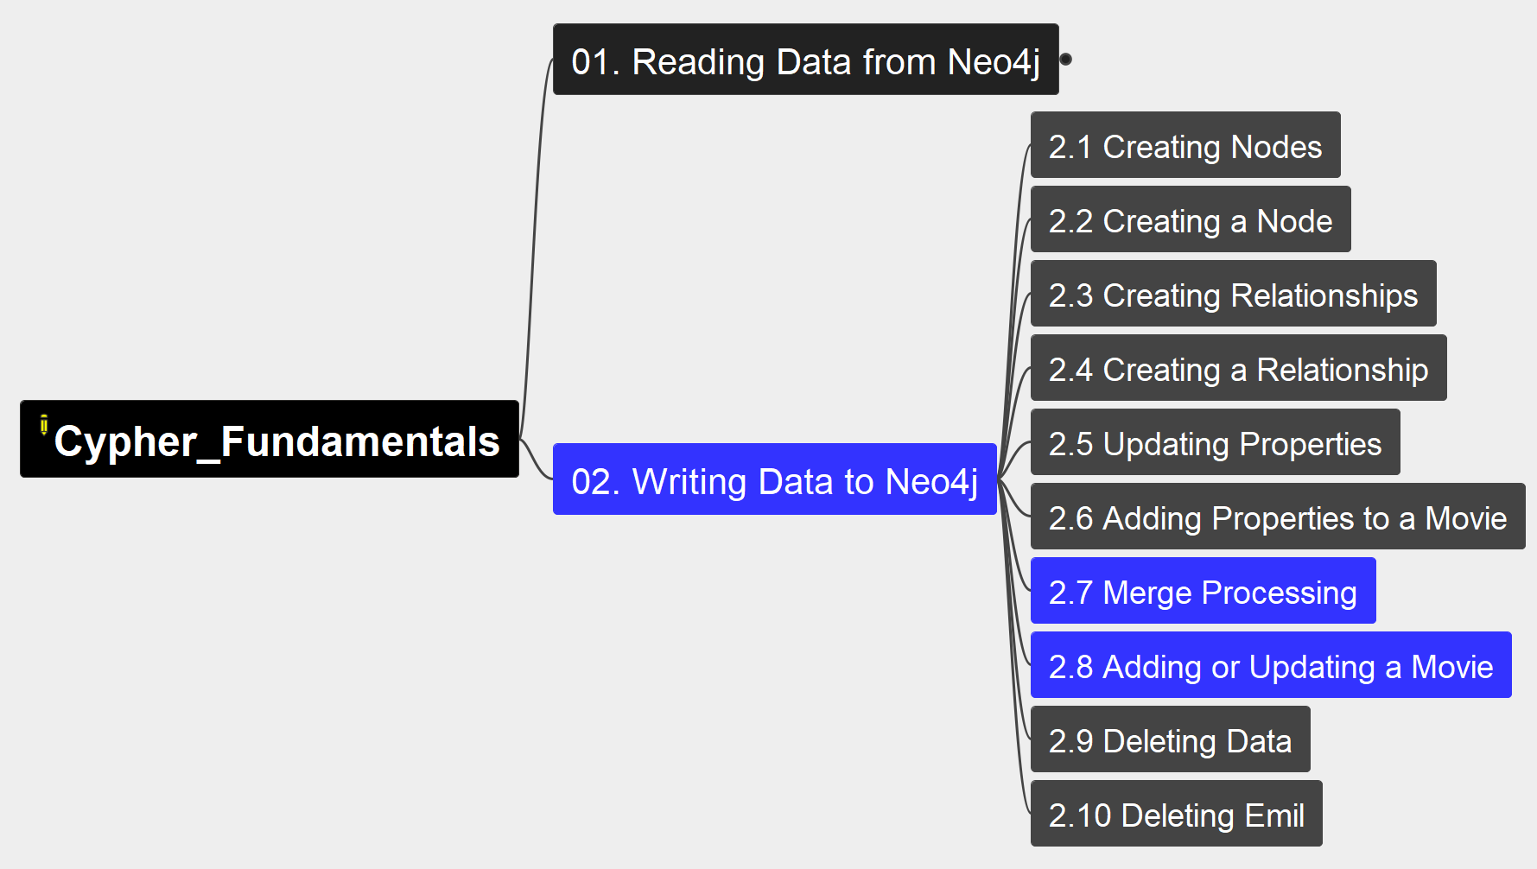
2. Writing Data to Neo4j
Cypher Fundamentals
07

Slide 9
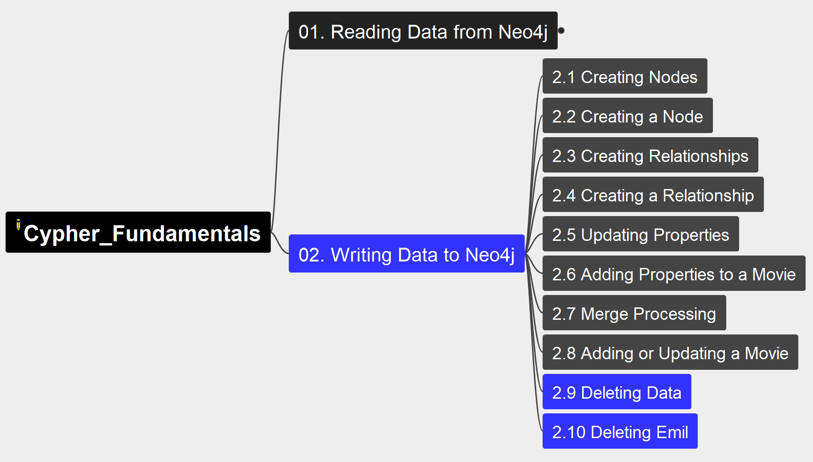
2. Writing Data to Neo4j
Cypher Fundamentals
08

Slide 10
Course Summary
Cypher Fundamentals
09
Intermediate
Intermediate Cypher Queries
Cypher Aggregations
Importing CSV data into Neo4j
Cypher Indexes and Constraints
Neo4j & GenerativeAI Fundamentals
Introduction to Vector Indexes and Unstructured Data
Building Neo4j Applications with Spring Data
Using Neo4j with Python
Building Neo4j Applications with Node.js
Building Neo4j Application with TypeScript
Developing with Neo4j MCP Tools
Using Neo4j with Java
Using Neo4j with Go
Building Neo4j Applications with .NET
Introducion to Neo4j & GraphGL
Beginners
Neo4j Fundamentals
Cypher Fundamentals
Graph Data Modeling Fundamentals
Importing Data Fundamentals
Aura Fundamentals
Advanced
Using Neo4j with LangChain
Build a Neo4j-backed Chatbot using Python
Build a Neo4j-backed Chatbot with TypeScript
Building Knowledge Graphs with LLMs
Path Finding with GDS
Neo4j Graph Data Science Fundamentals
Neo4j Graph Data Science Certification
Introduction to Neo4j Graph Data Science
Neo4j Certified Professional
Cypher Patterns
Cypher Statement Processing

Slide 11
