Slide 1

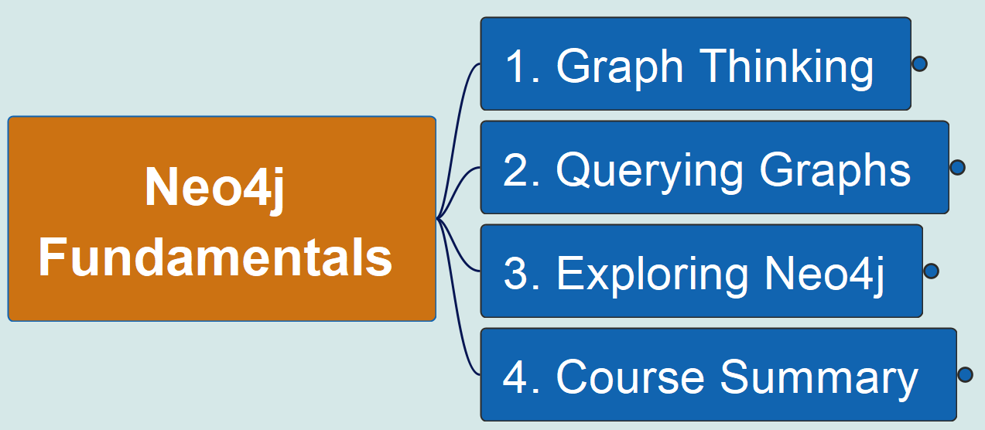
Neo4j Fundamentals
00
Opening &
Introduction
Reference Material:
https://github.com/yasenstar/learn_graphdb/tree/main/neo4j/neo4j_fundamentals

Slide 2
Title and Content Layout with List
Add your first bullet point here
Add your second bullet point here
Add your third bullet point here

