Slide 1



REACT Foundations
00
00
Introduction

Slide 2
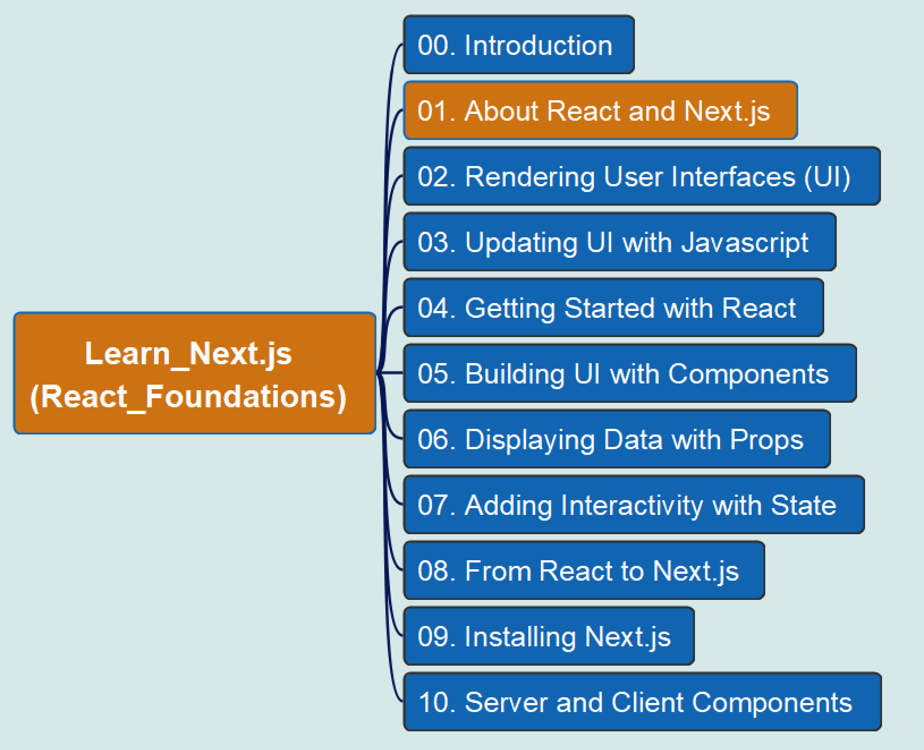
REACT Foundations
01
About React and Next.js

Slide 3
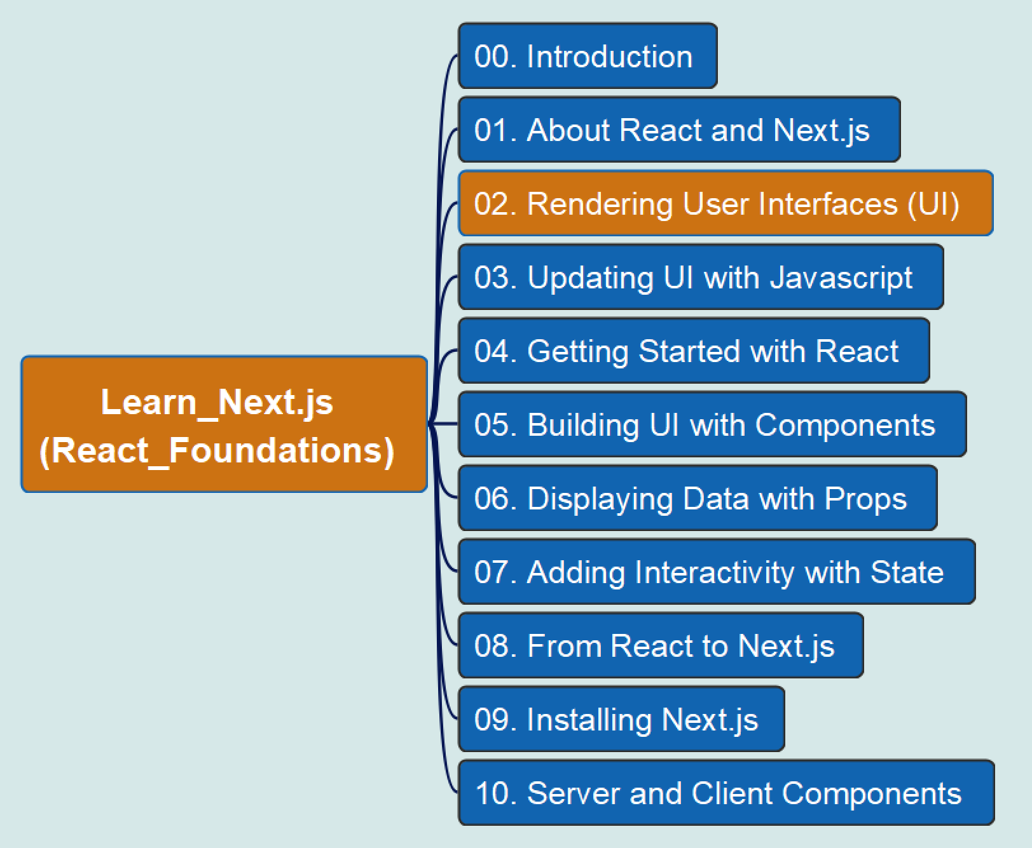
REACT Foundations
02
Rendering User Interfaces (UI)

Slide 4
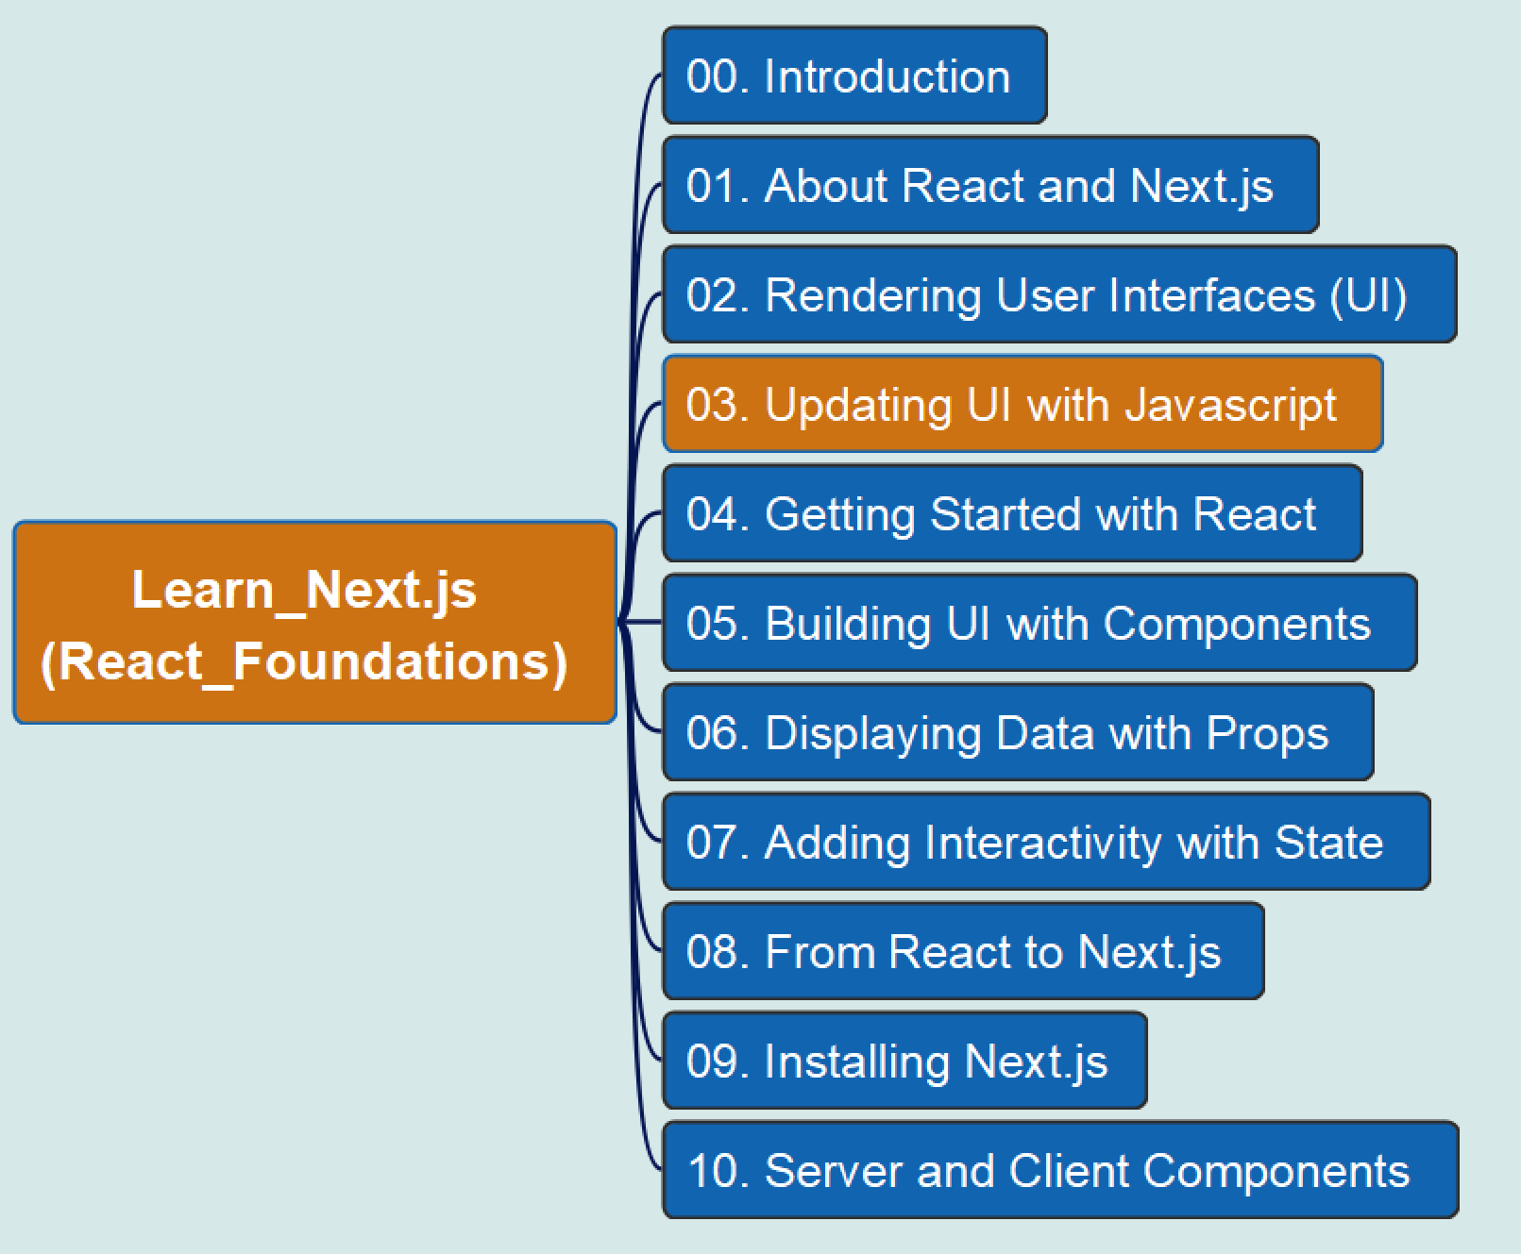
REACT Foundations
03
Updating UI with JavaScript

Slide 5
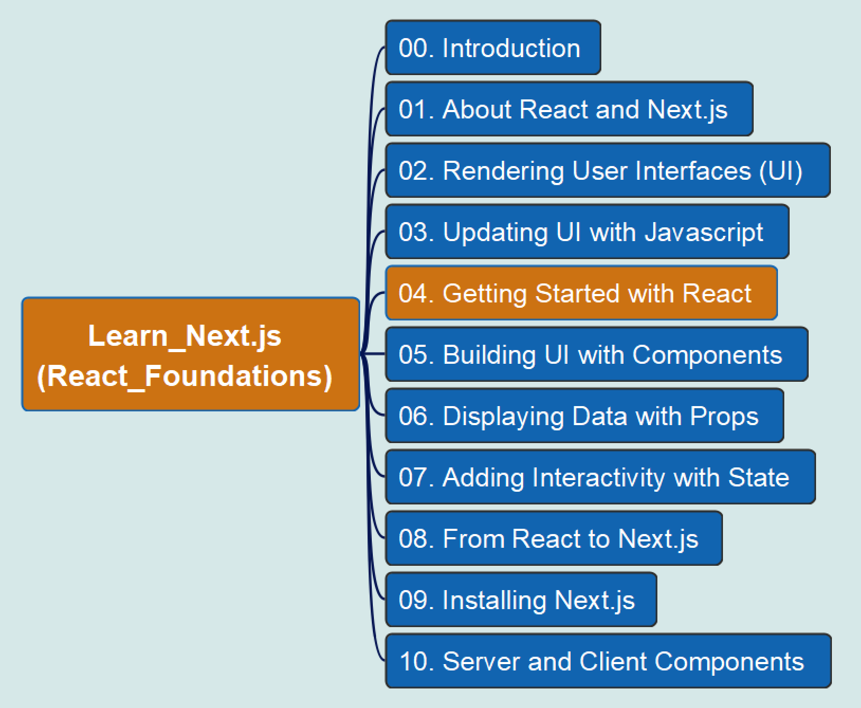
REACT Foundations
04
Getting Started with React

Slide 6
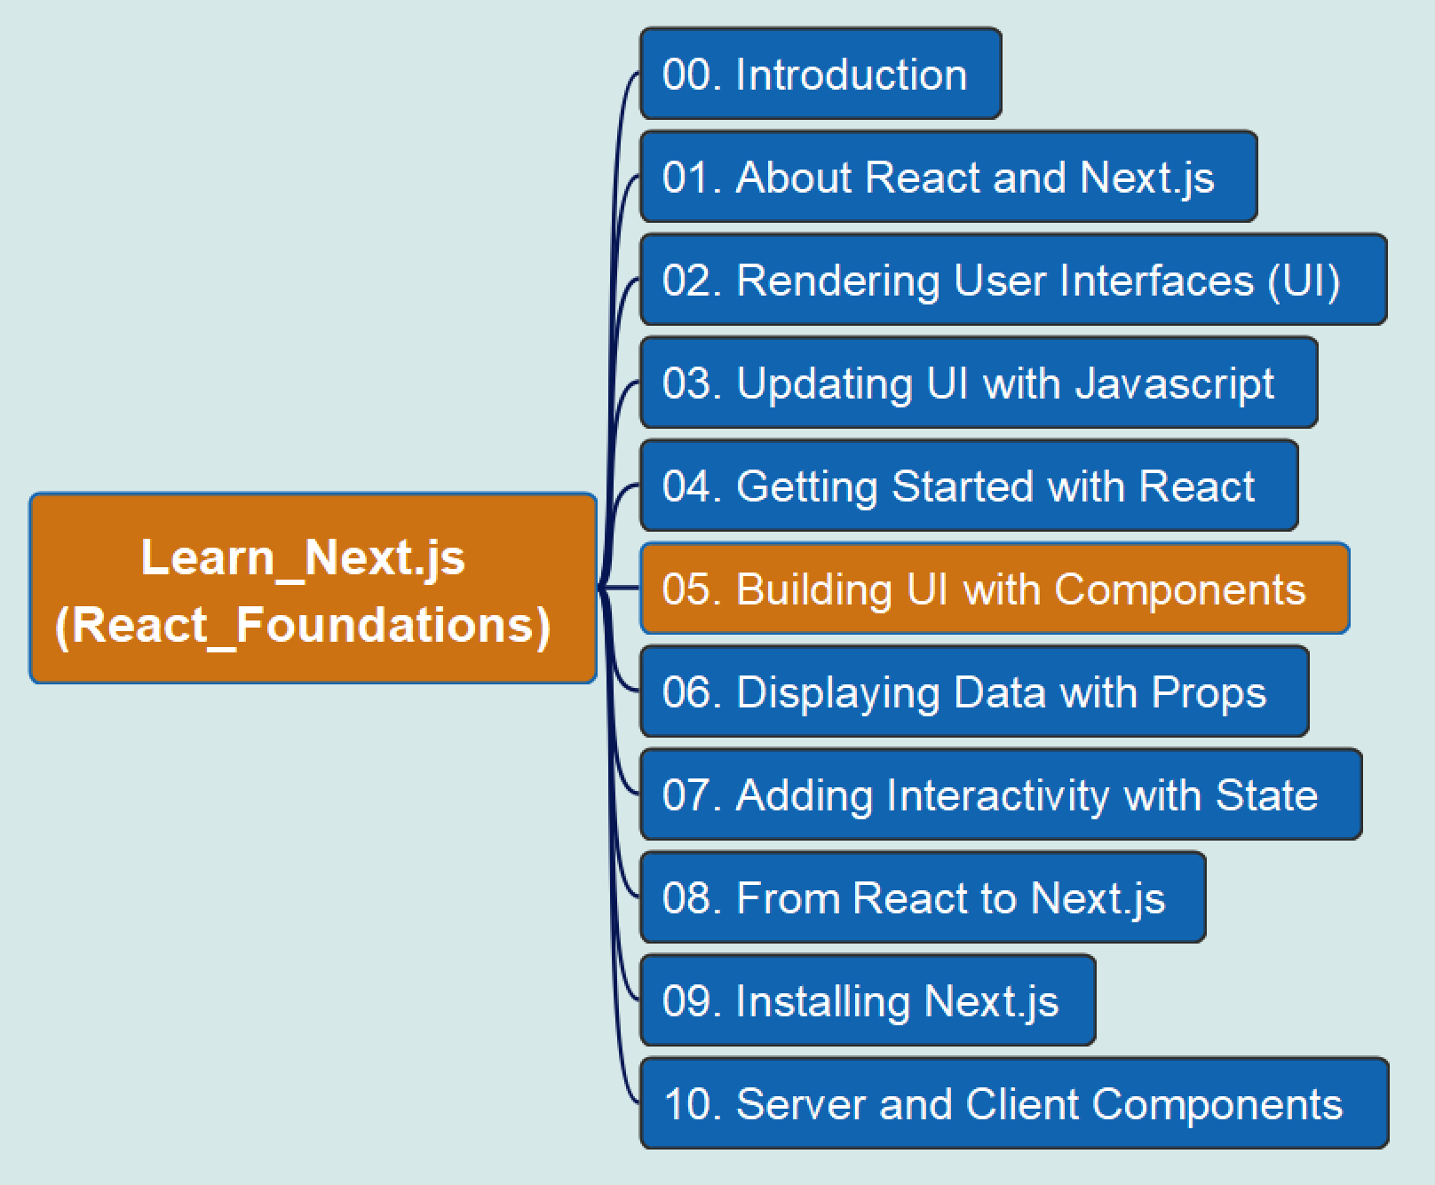
REACT Foundations
05
Building UI with Components

Slide 7
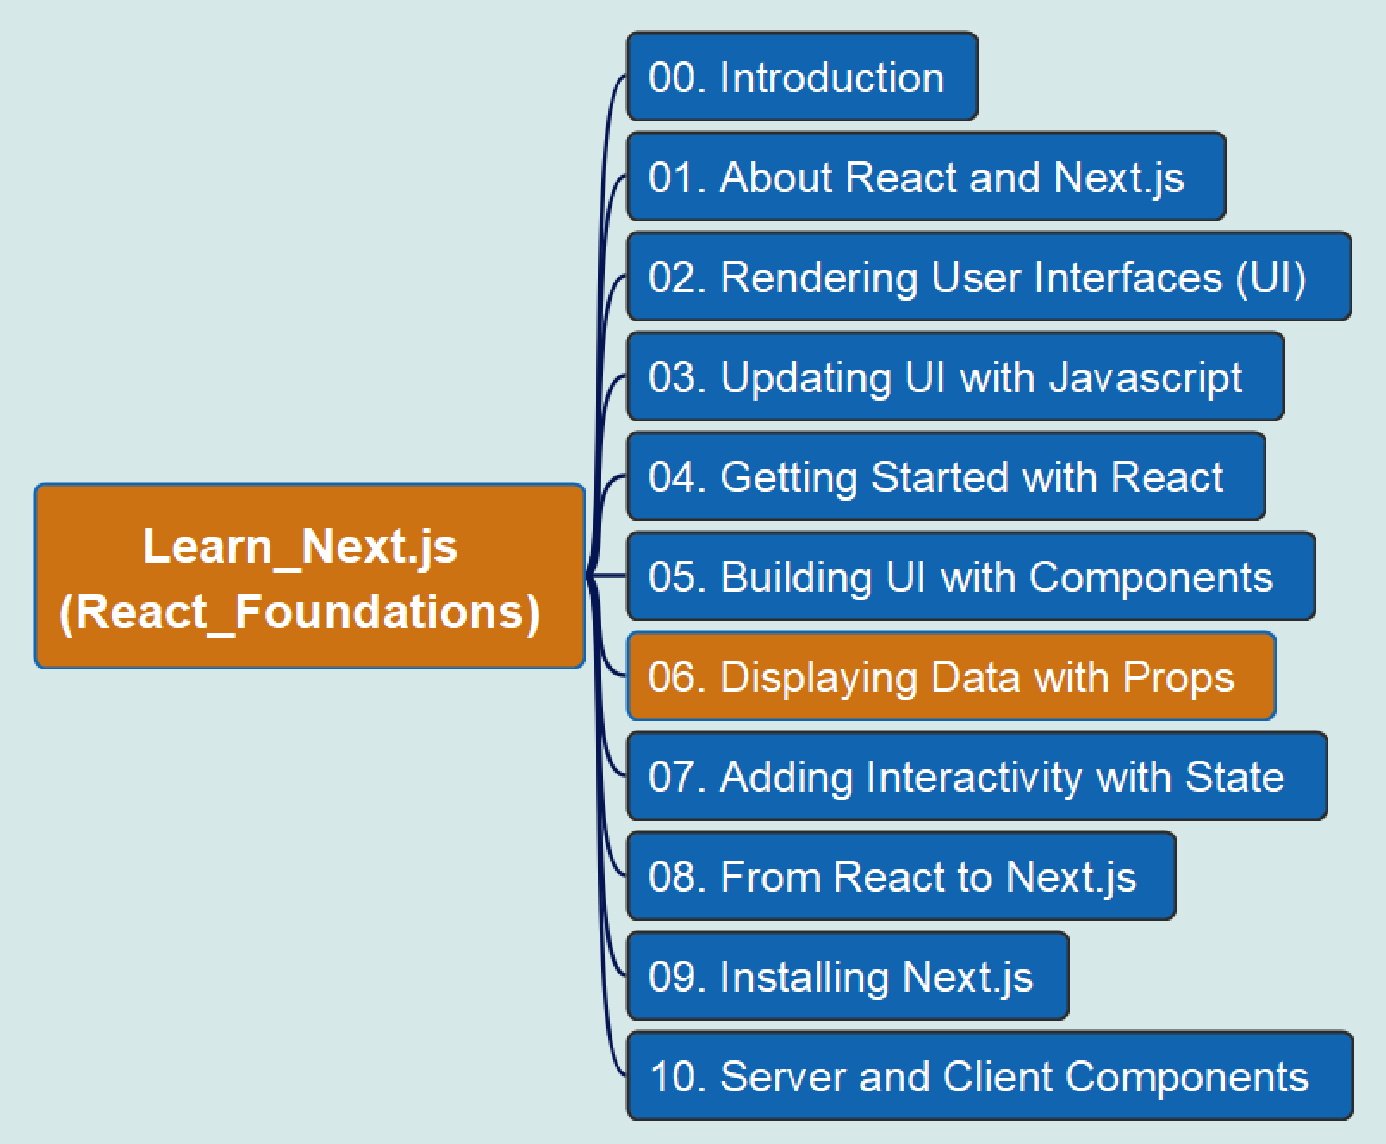
REACT Foundations
06
Displaying Data with Props

Slide 8
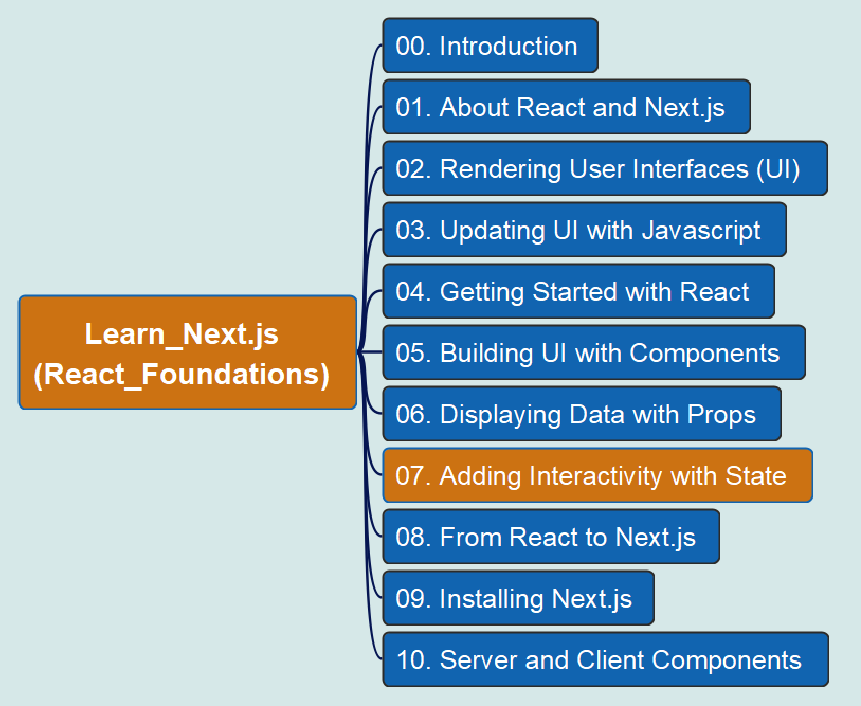
REACT Foundations
07
Adding Interactivity with State

Slide 9
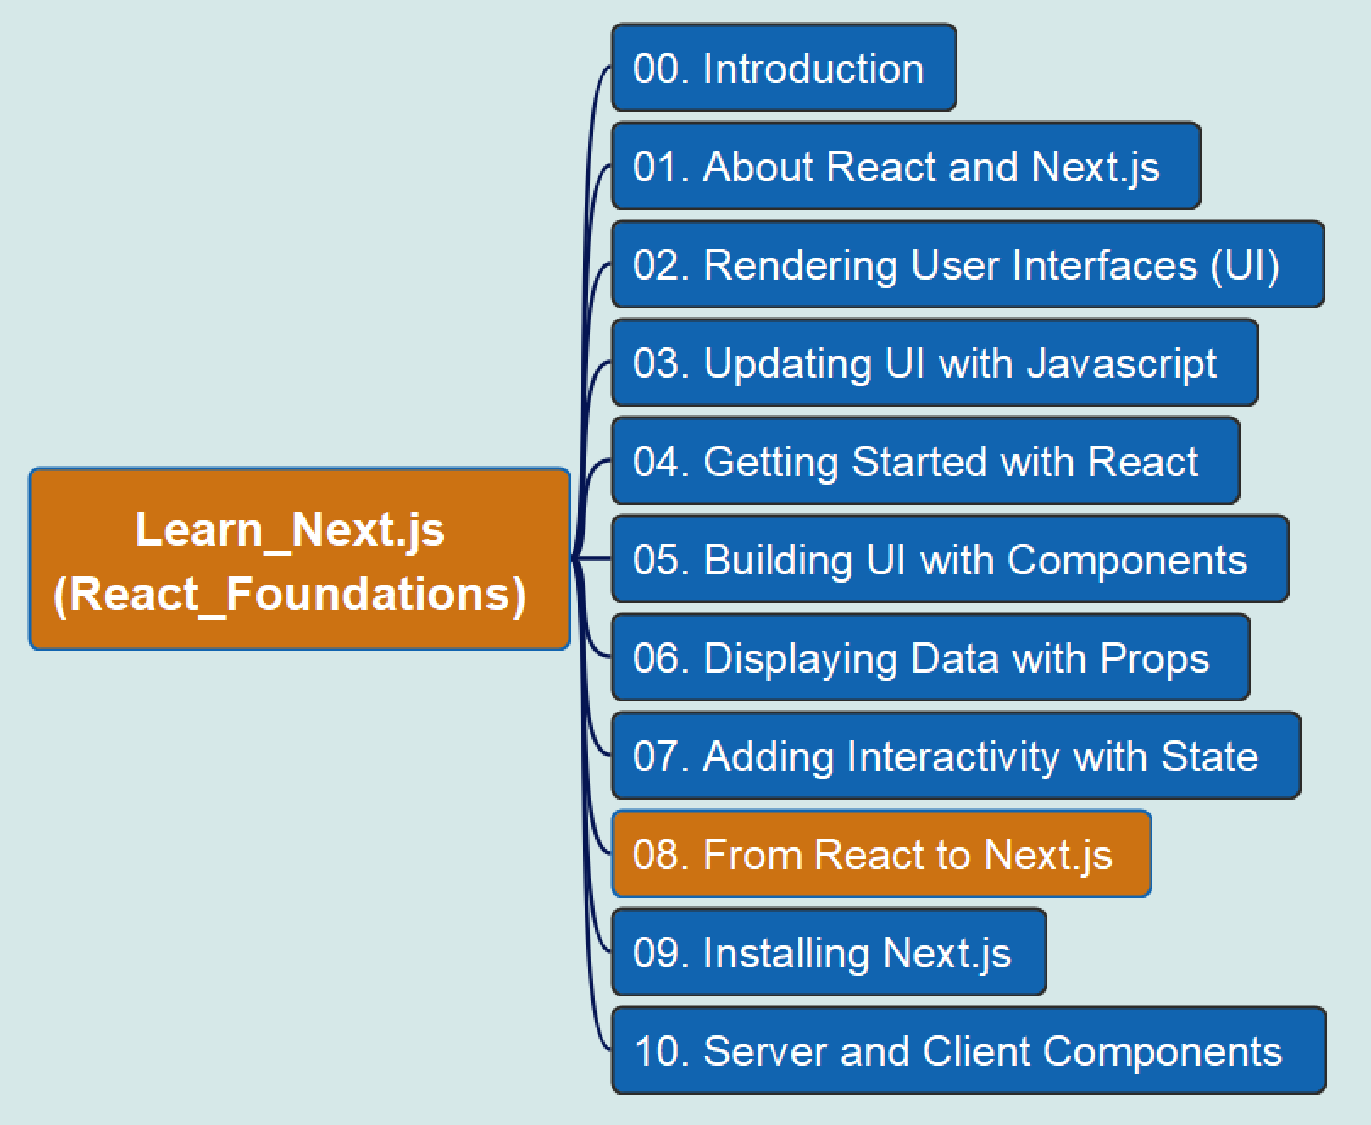
REACT Foundations
08
From React to Next.js

Slide 10
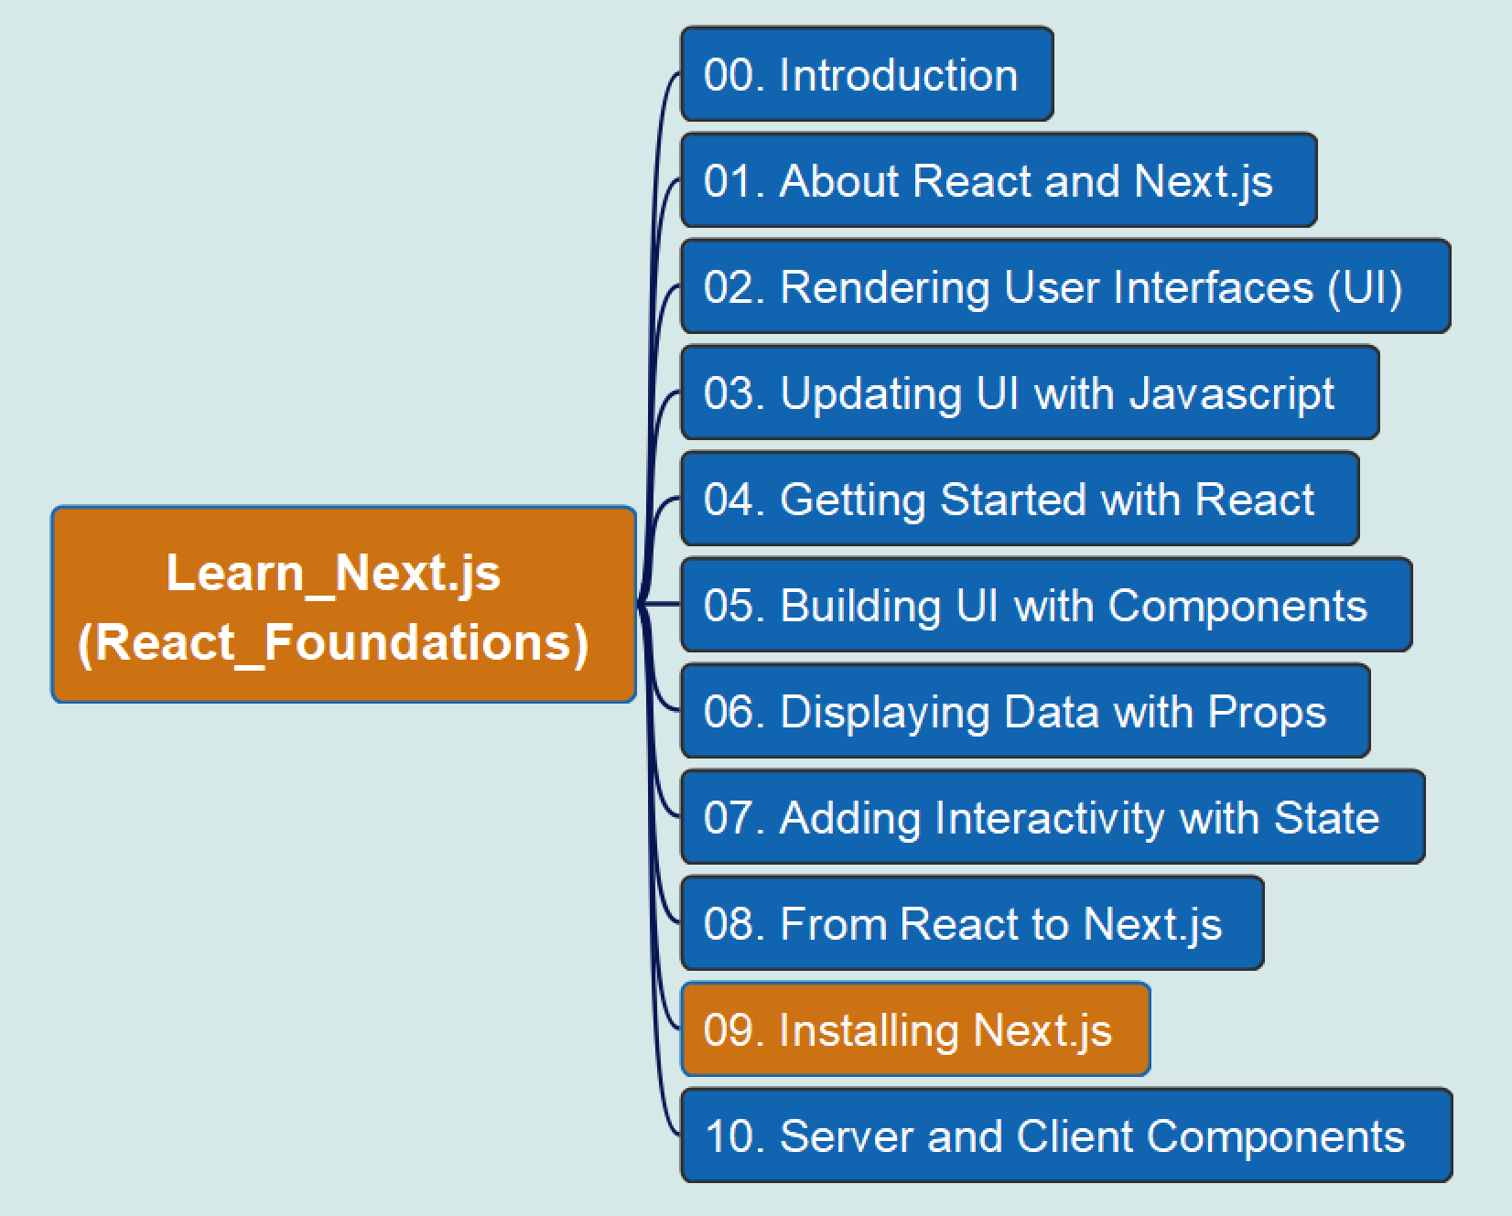
REACT Foundations
09
Installing Next.js

Slide 11
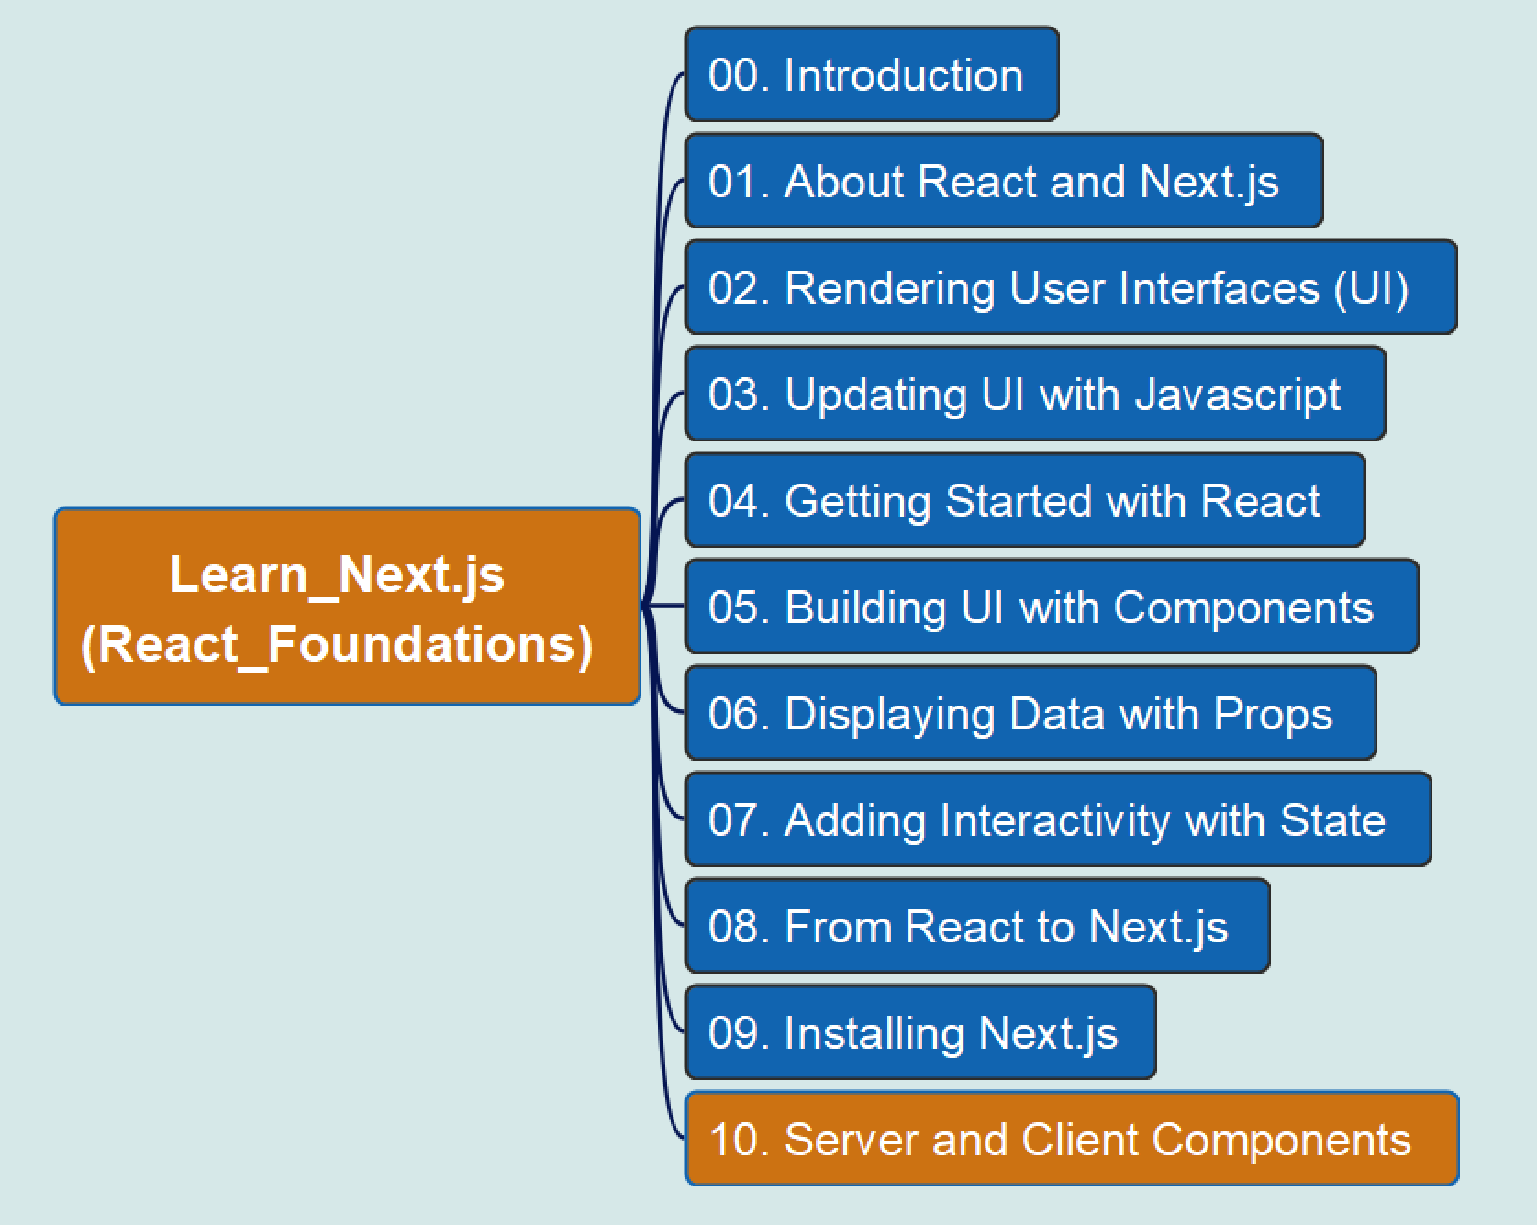
REACT Foundations
10
Server and Client Components

