Slide 1

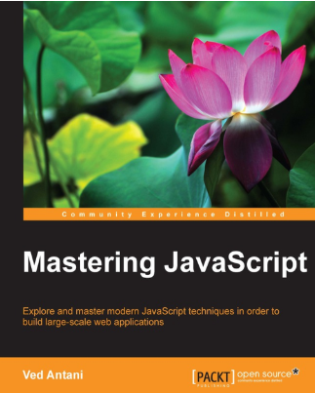
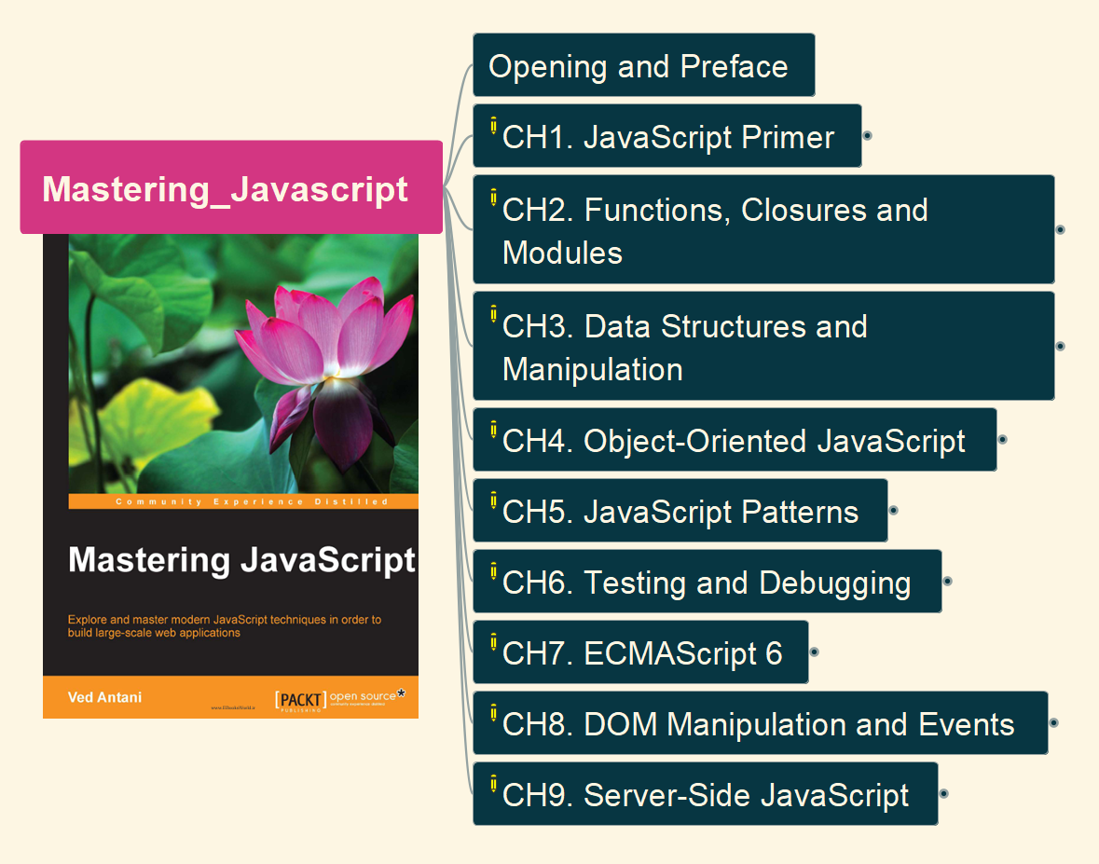
Mastering JavaScript
001
Opening and Introduction

Slide 2
002

