Slide 1



REACT Foundations
00
00
Introduction
Learn Next.js

Slide 2
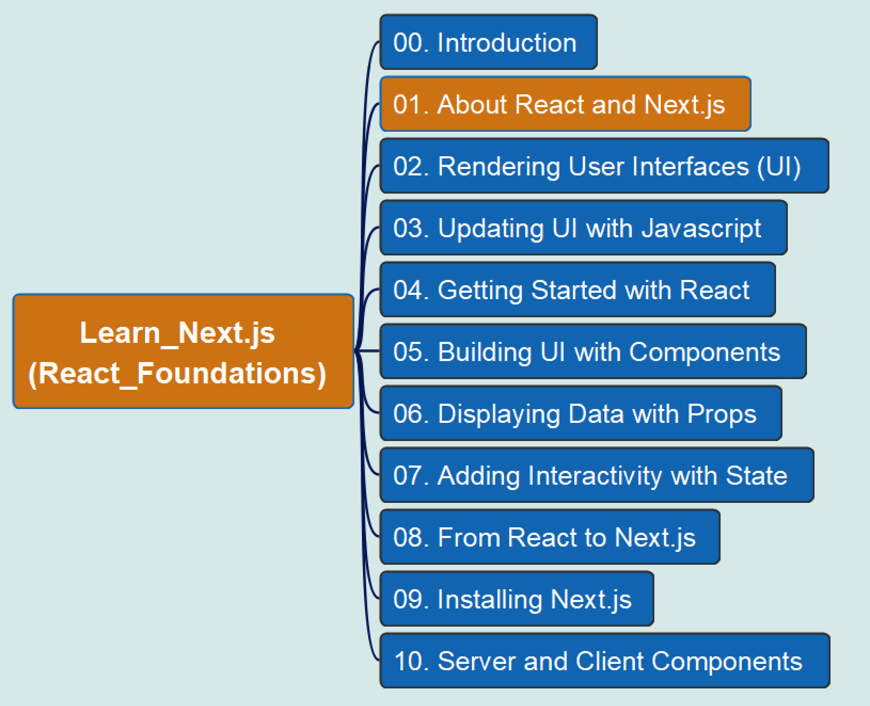
REACT Foundations
01
1. About React and Next.js
Learn Next.js

Slide 3
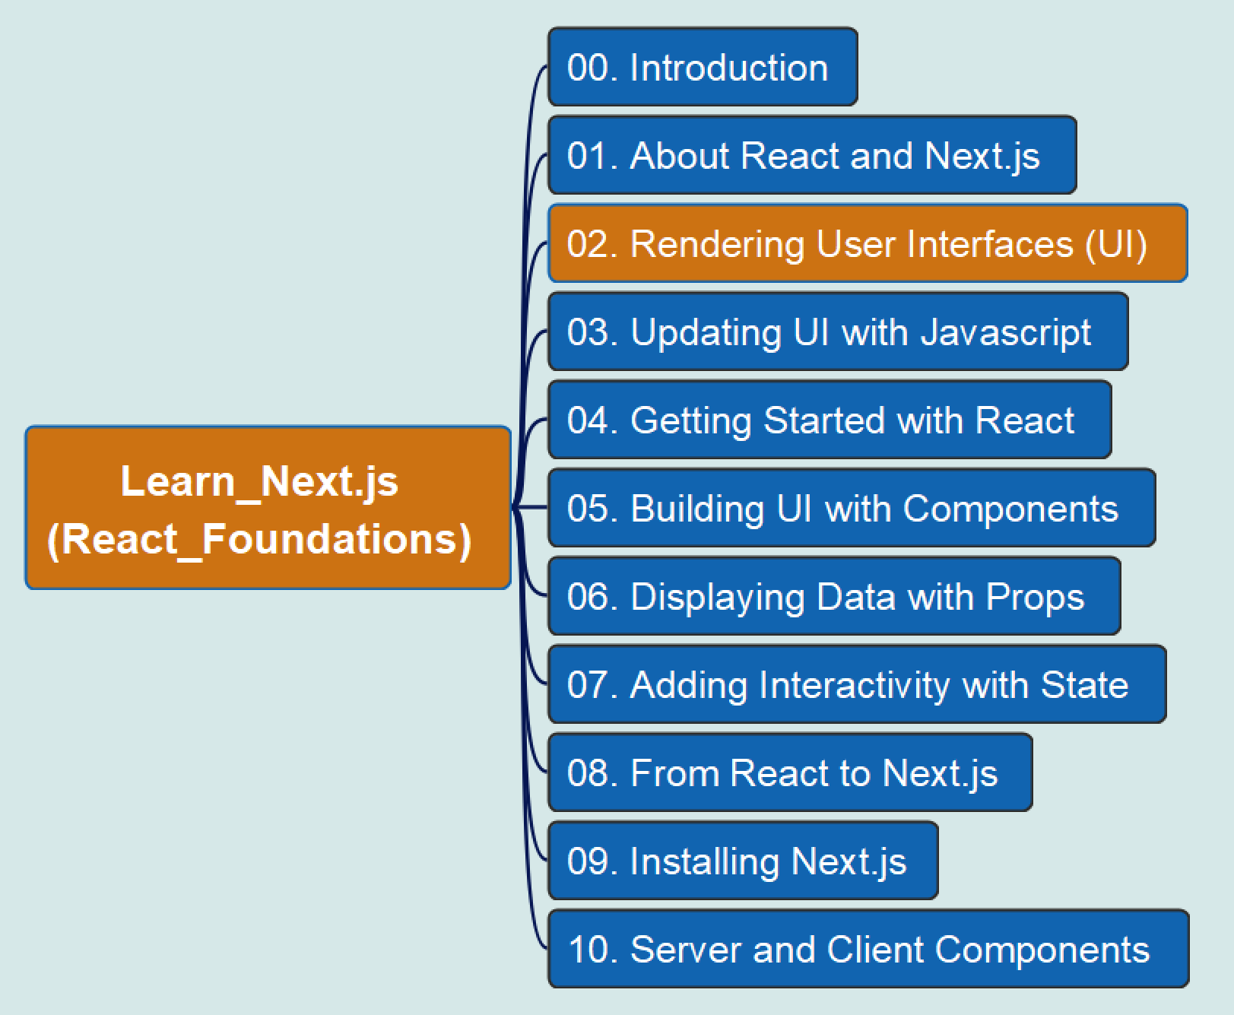
REACT Foundations
02
2. Rendering User Interfaces (UI)
Learn Next.js

Slide 4
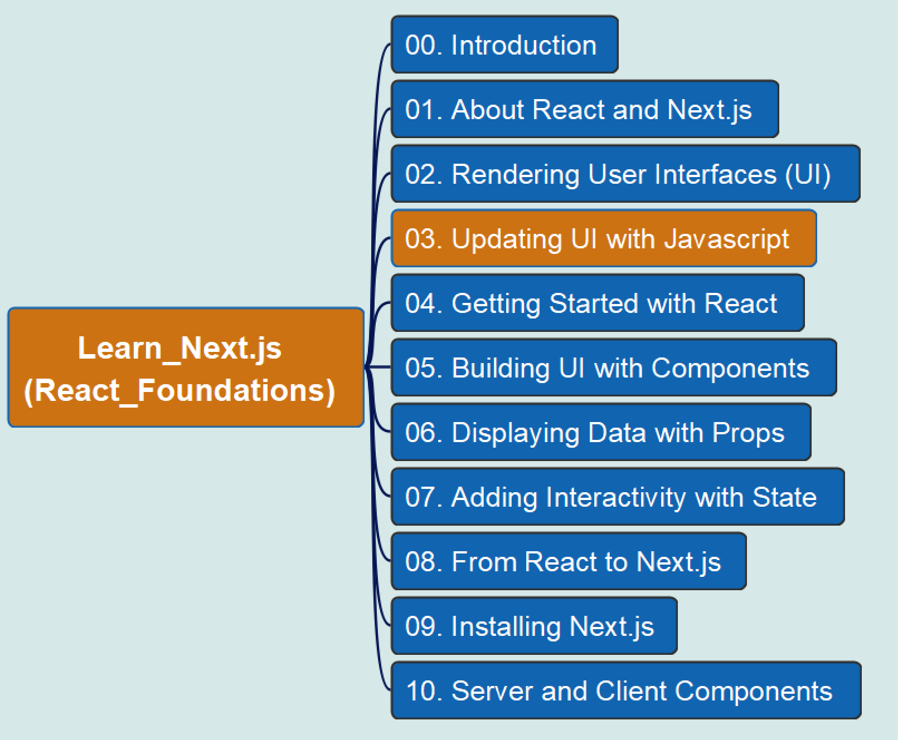
REACT Foundations
03
3. Updating UI with JavaScript
Learn Next.js

Slide 5
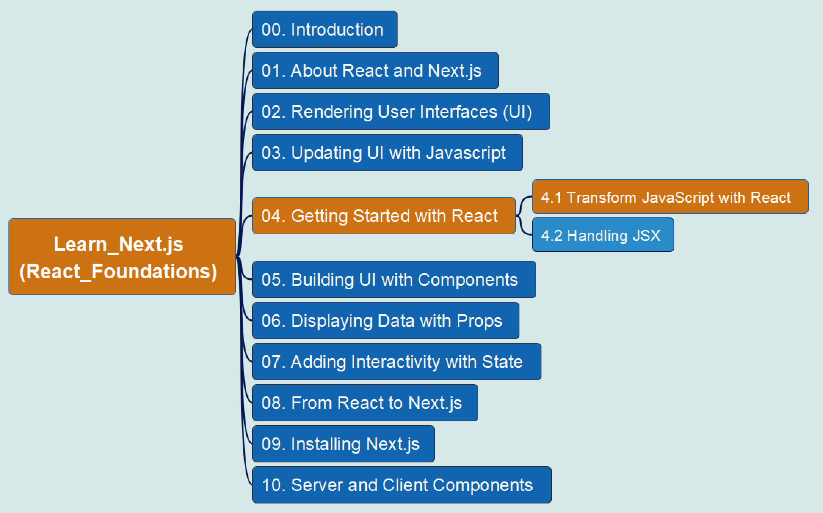
REACT Foundations
04
4. Getting Started with React
4.1 Transform with React
Learn Next.js

Slide 6
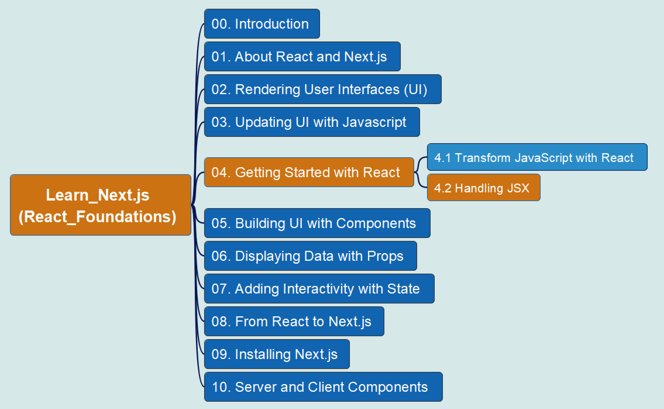
REACT Foundations
05
4. Getting Started with React
4.2 Handling JSX
Learn Next.js

Slide 7
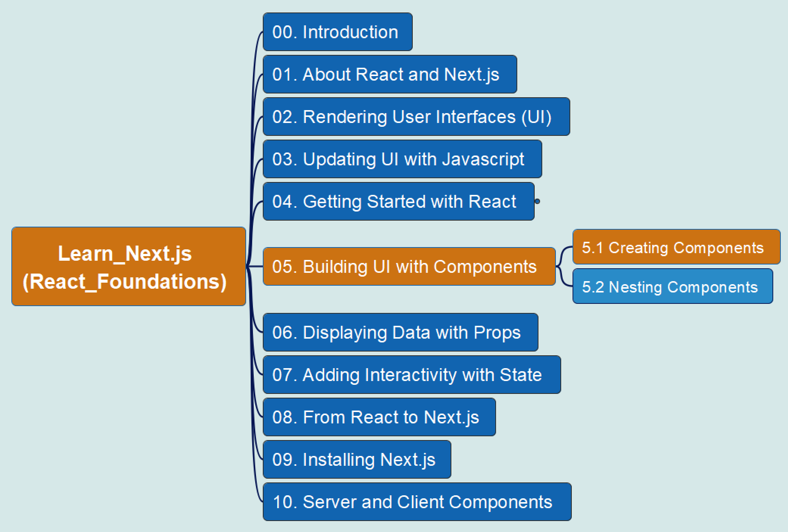
REACT Foundations
5. Building UI with Components – 5.1
06
Components
Props
State
Learn Next.js

Slide 8
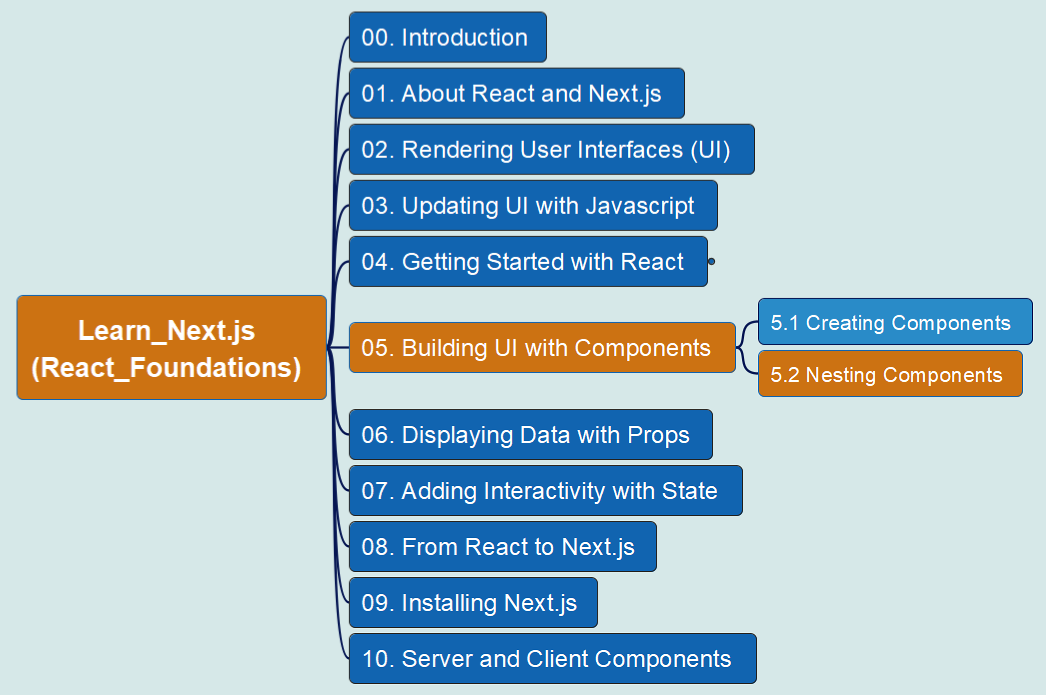
REACT Foundations
5. Building UI with Components – 5.2
07
Components
Props
State
Learn Next.js

Slide 9
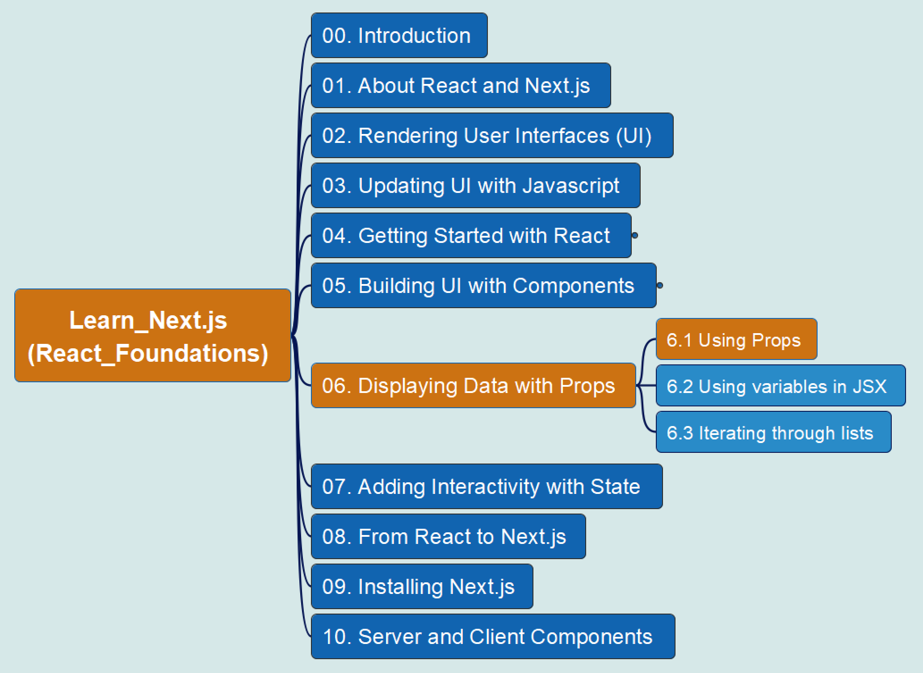
REACT Foundations
6. Displaying Data with Props
6.1 Using Props
08
Props
State
Components
Learn Next.js

Slide 10
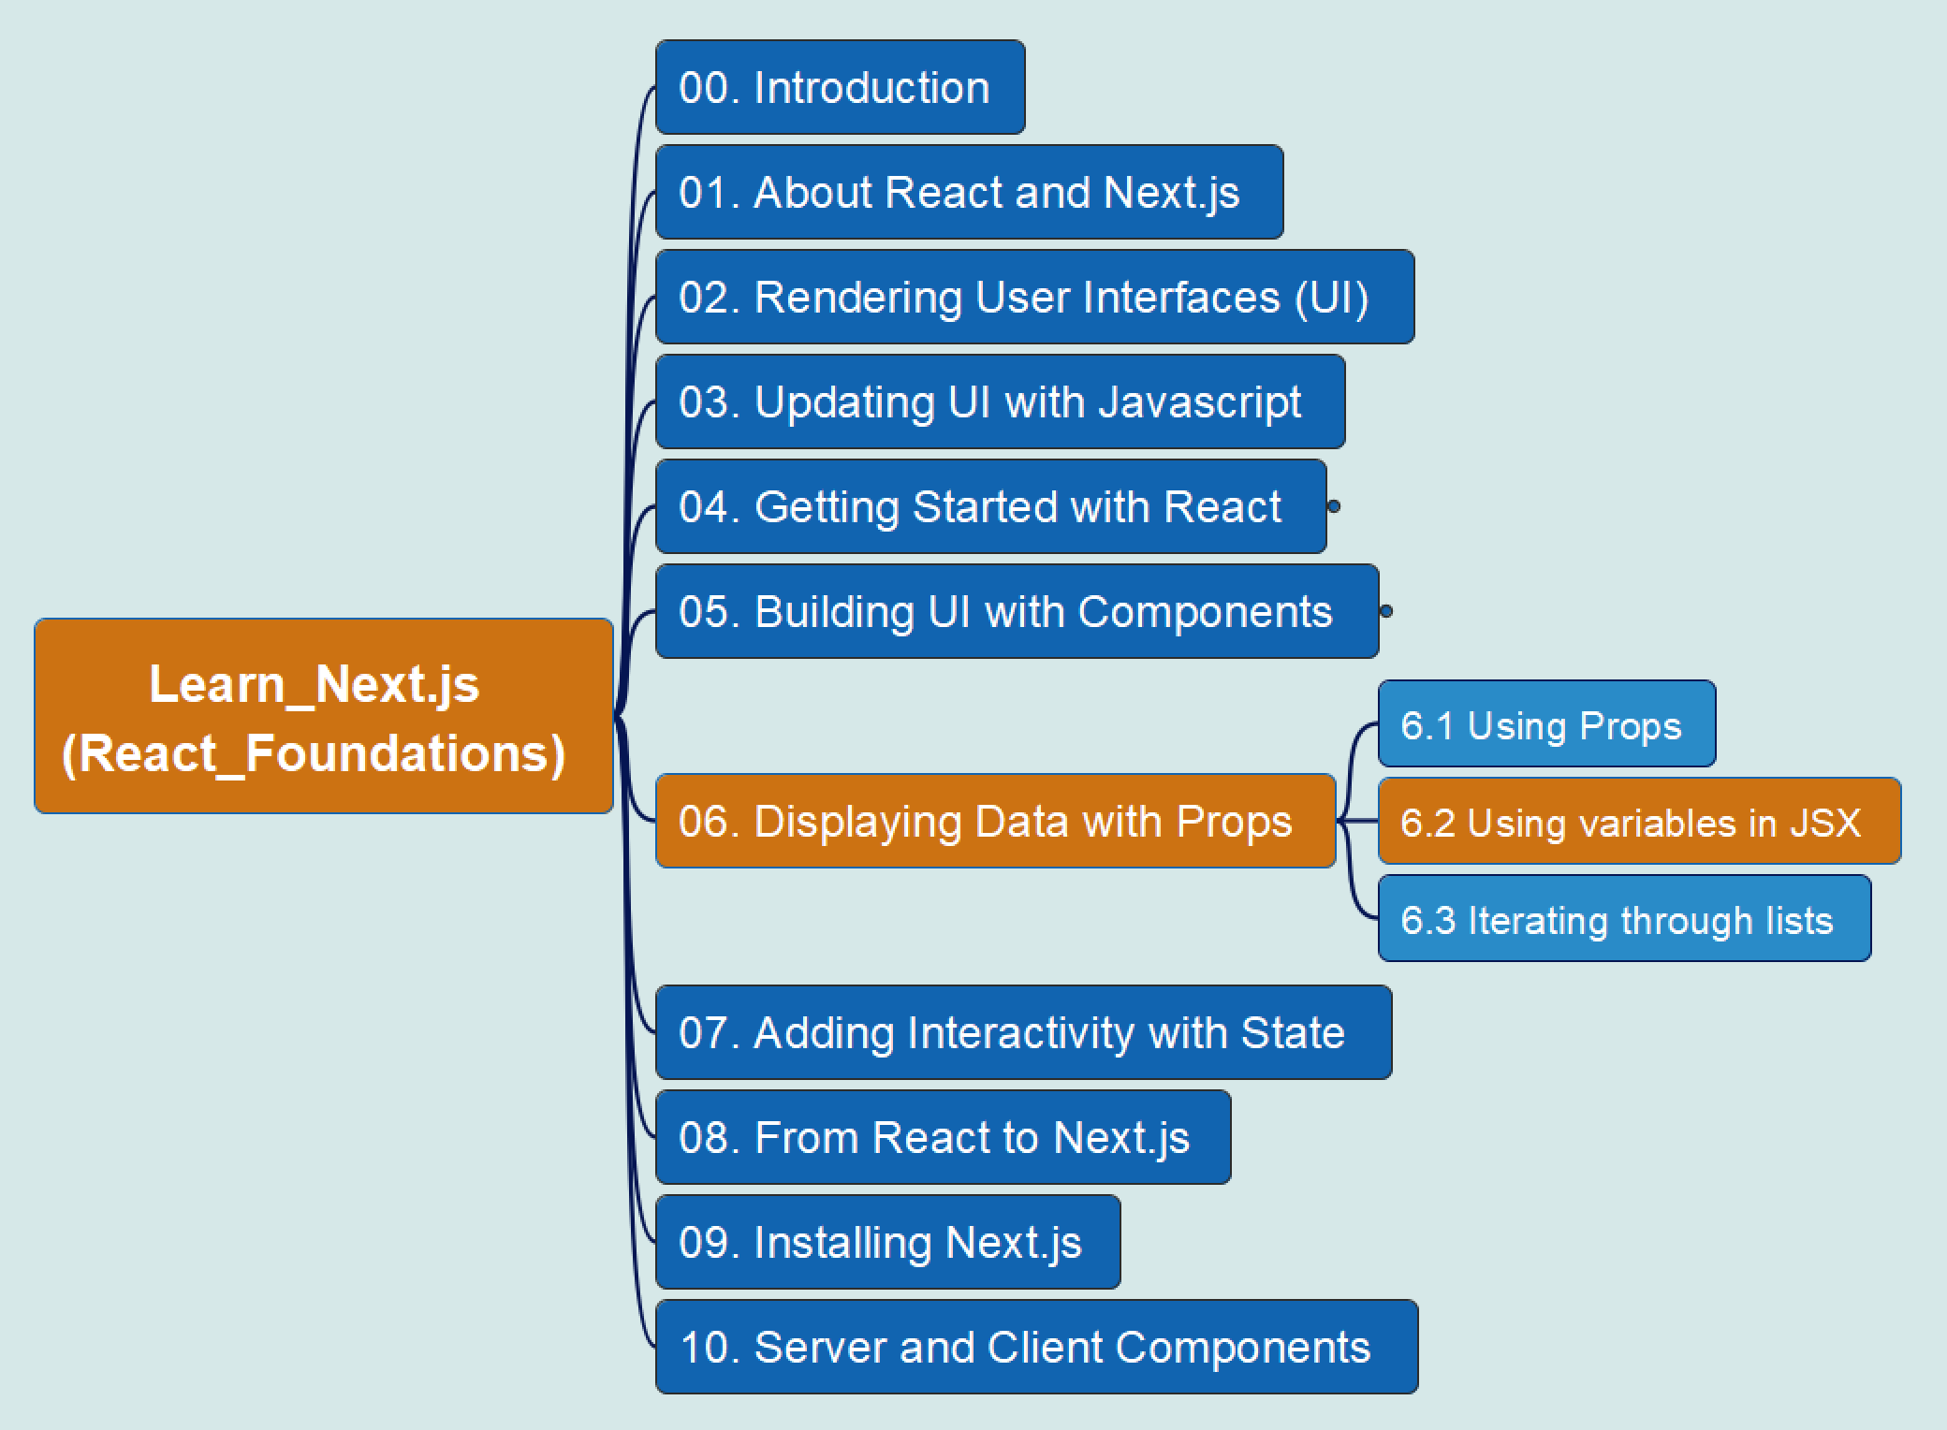
REACT Foundations
6. Displaying Data with Props
6.2 Using variables in JSX
09
Props
State
Components
Learn Next.js

Slide 11
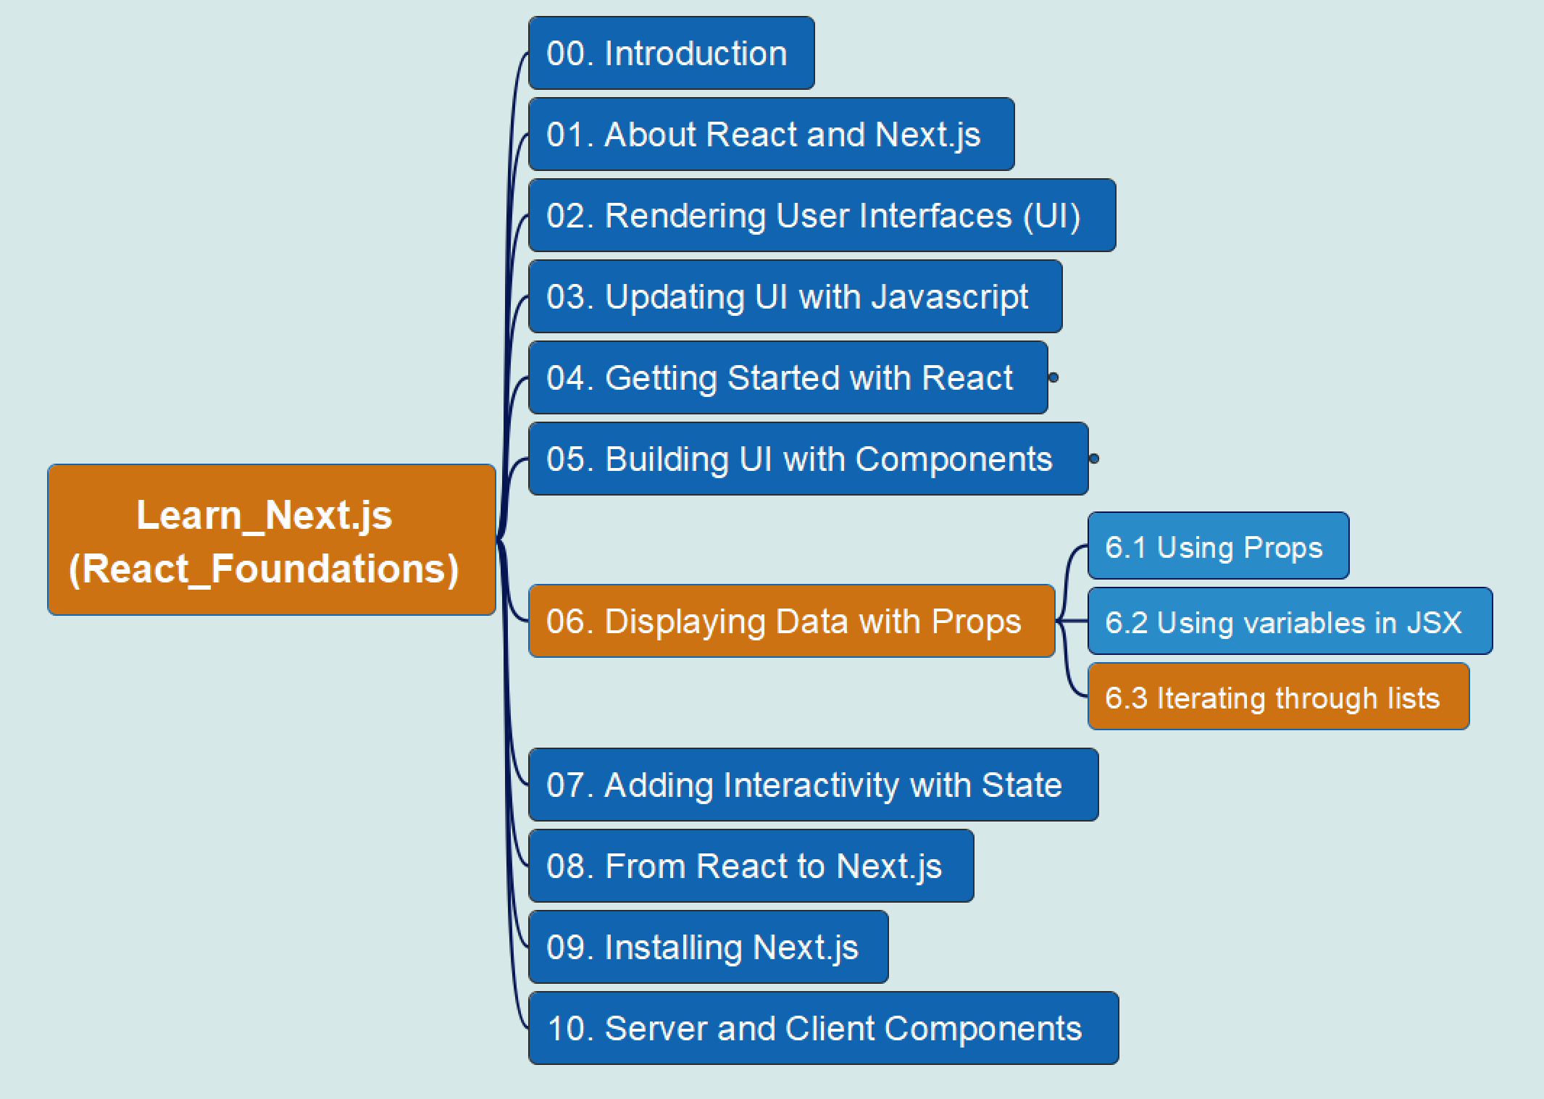
REACT Foundations
6. Displaying Data with Props
6.3 Iterating through Lists
10
Props
State
Components
Learn Next.js

Slide 12
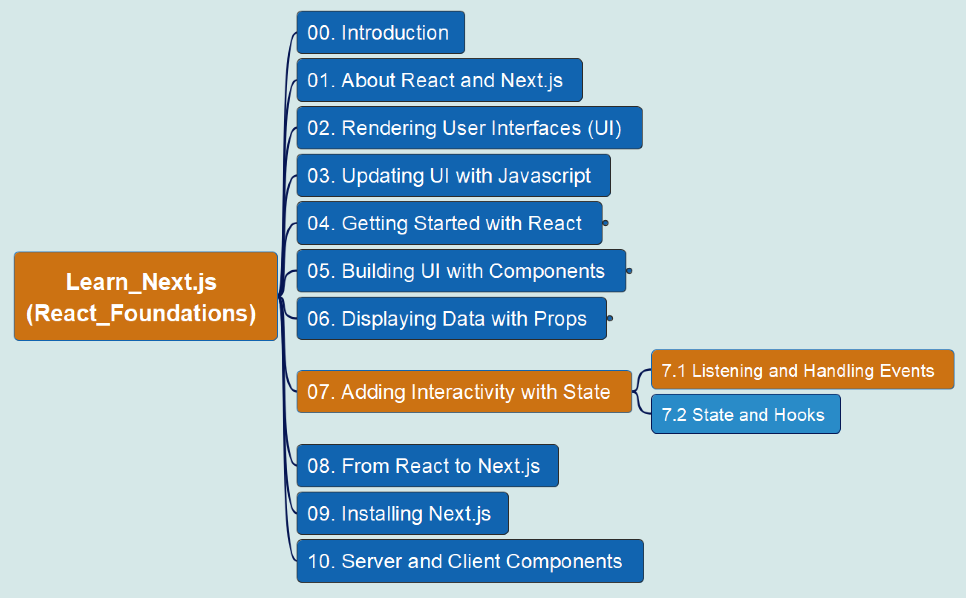
REACT Foundations
7. Adding Interactivity with State
7.1 Listening and Handling Events
11
State
Components
Props
Learn Next.js

Slide 13
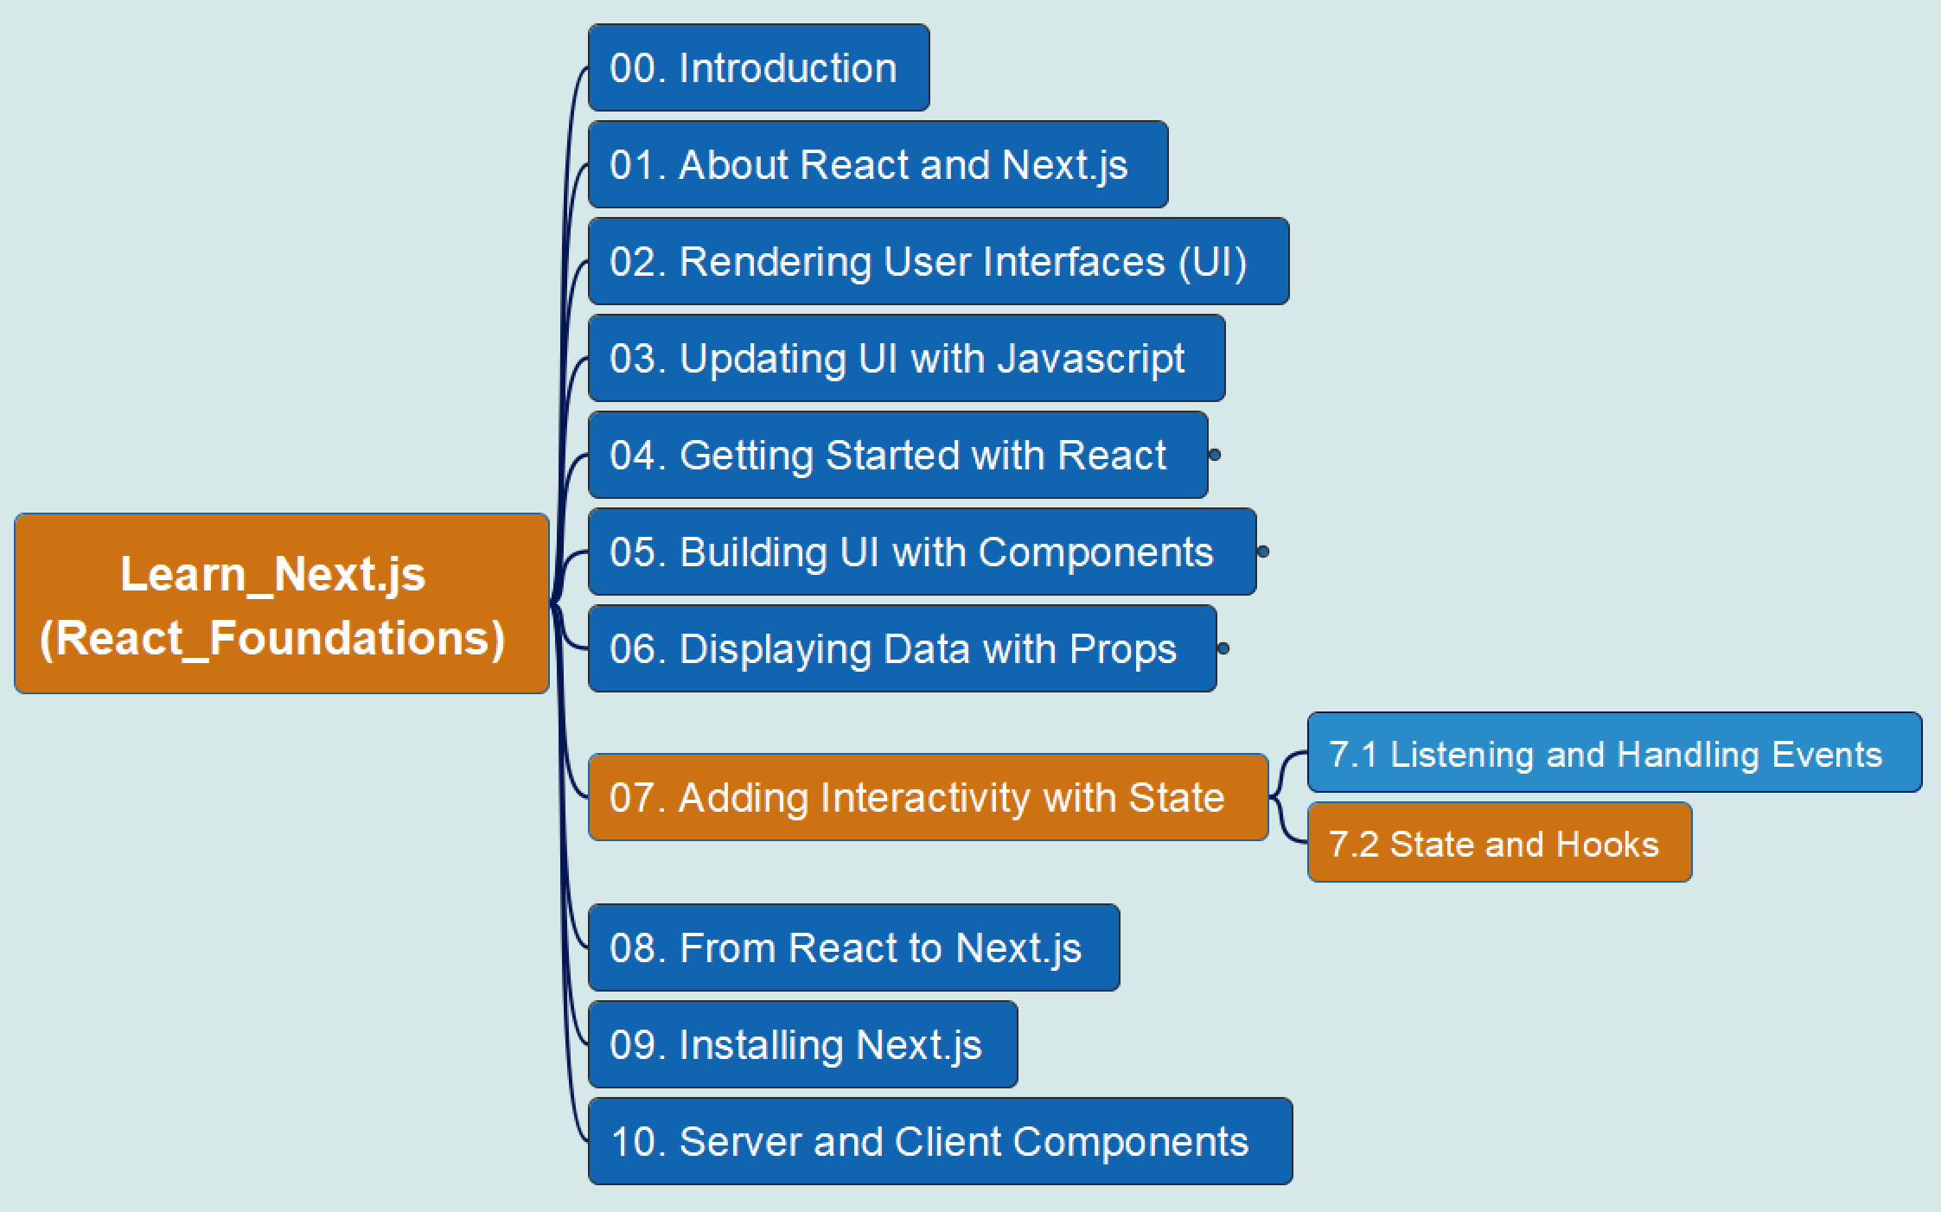
REACT Foundations
7. Adding Interactivity with State
7.2 State and Hooks
12
State
Components
Props
Learn Next.js

Slide 14
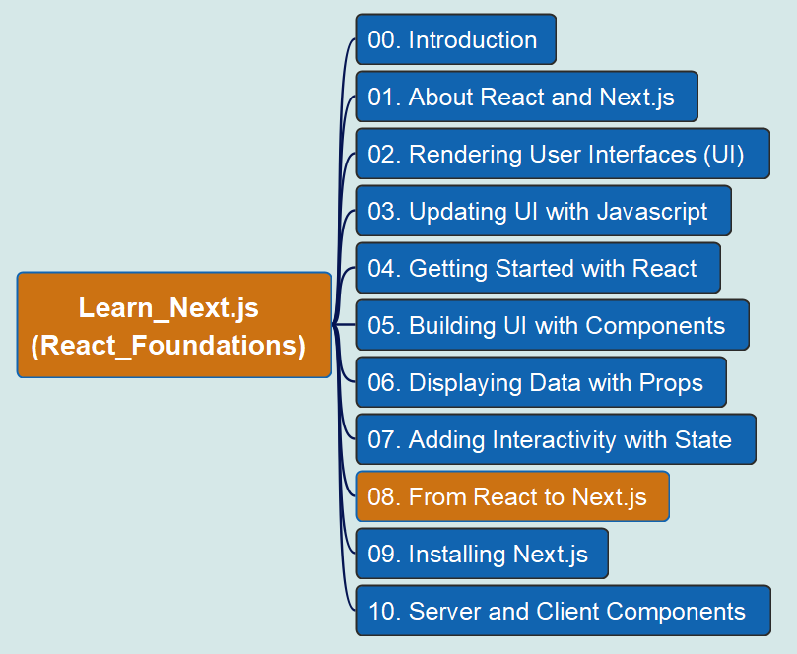

REACT Foundations
13
From React to Next.js
Learn Next.js

Slide 15
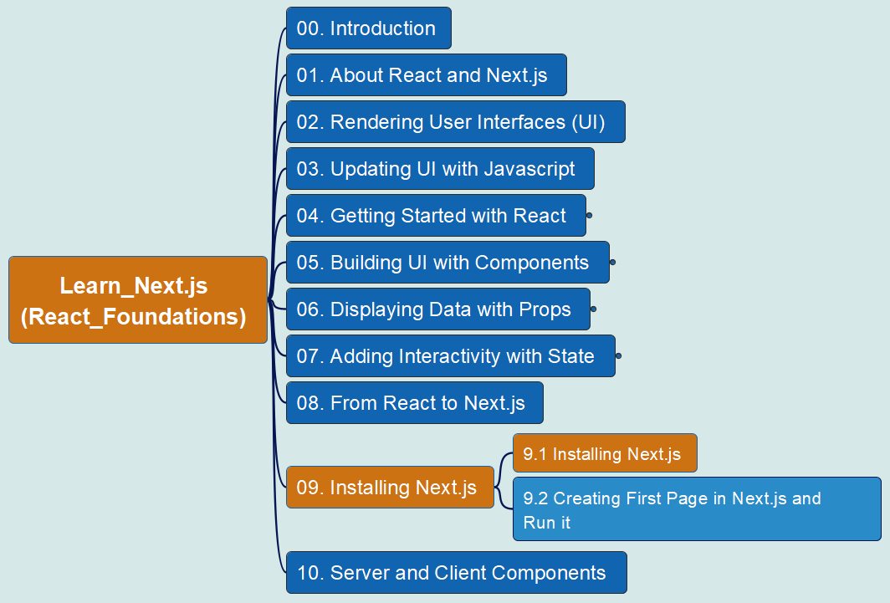
REACT Foundations
14
9. Installing Next.js – 9.1
Learn Next.js

Slide 16
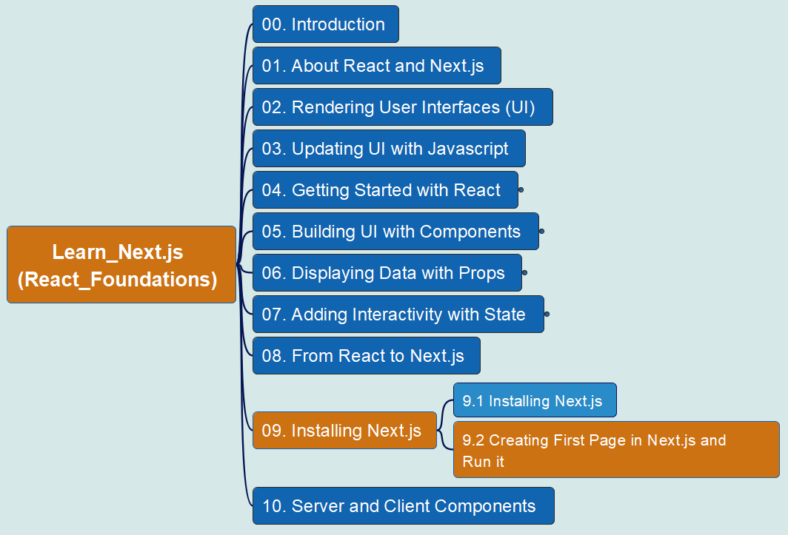
REACT Foundations
15
9. Installing Next.js
– 9.2 Creating first Page and Run it
Learn Next.js

Slide 17
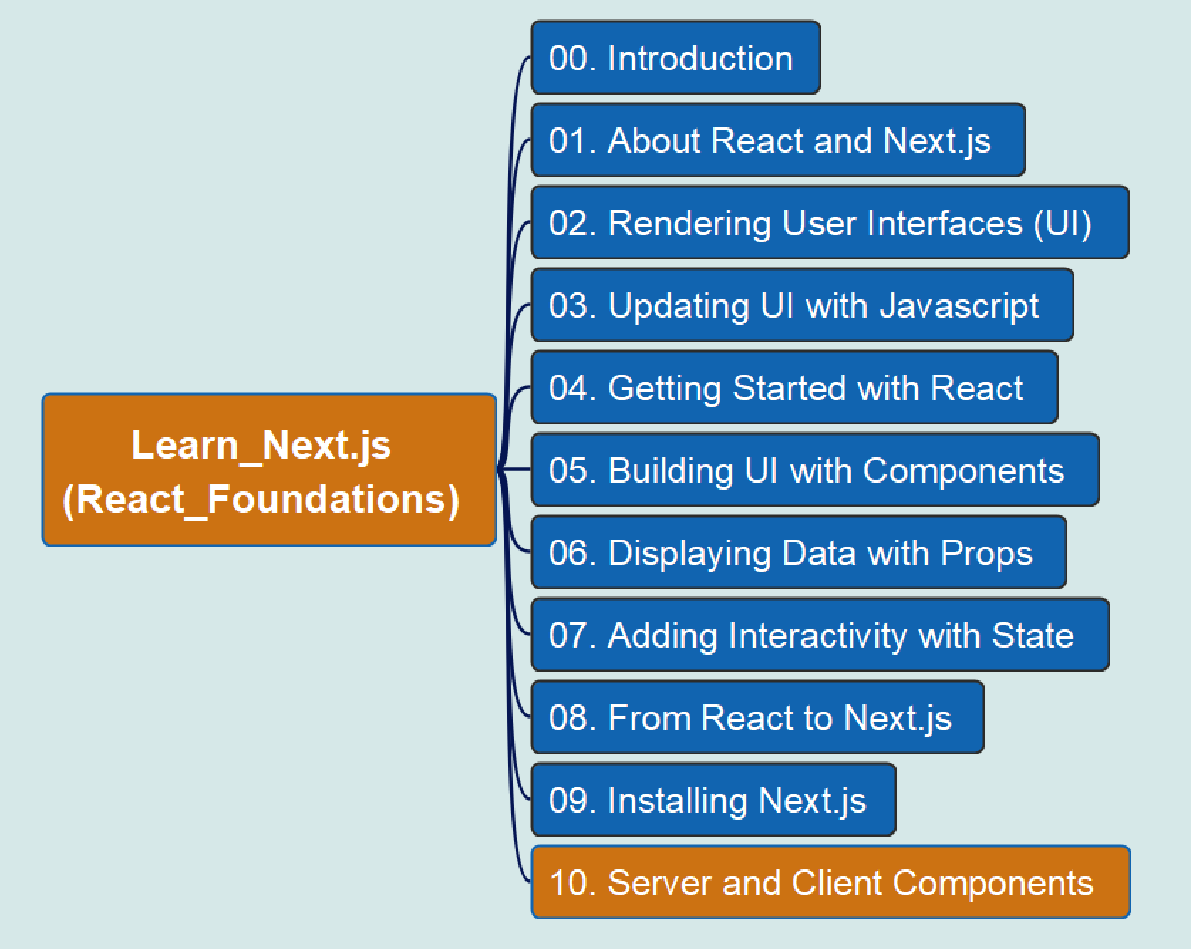
REACT Foundations
16
Server and Client Components
Learn Next.js

Slide 18

Learn Next.js
React Foundations
App Router
Pages Router
SEO

Slide 19




