Slide 1



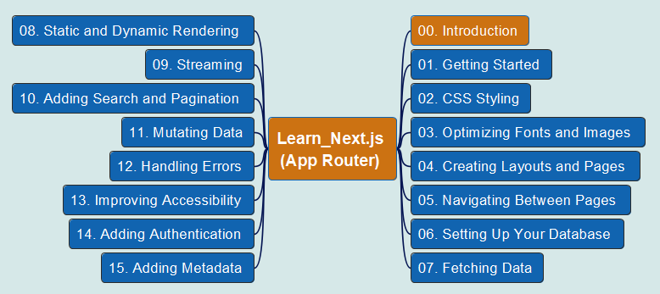

App Router
00
Introduction
Learn Next.js

Slide 2
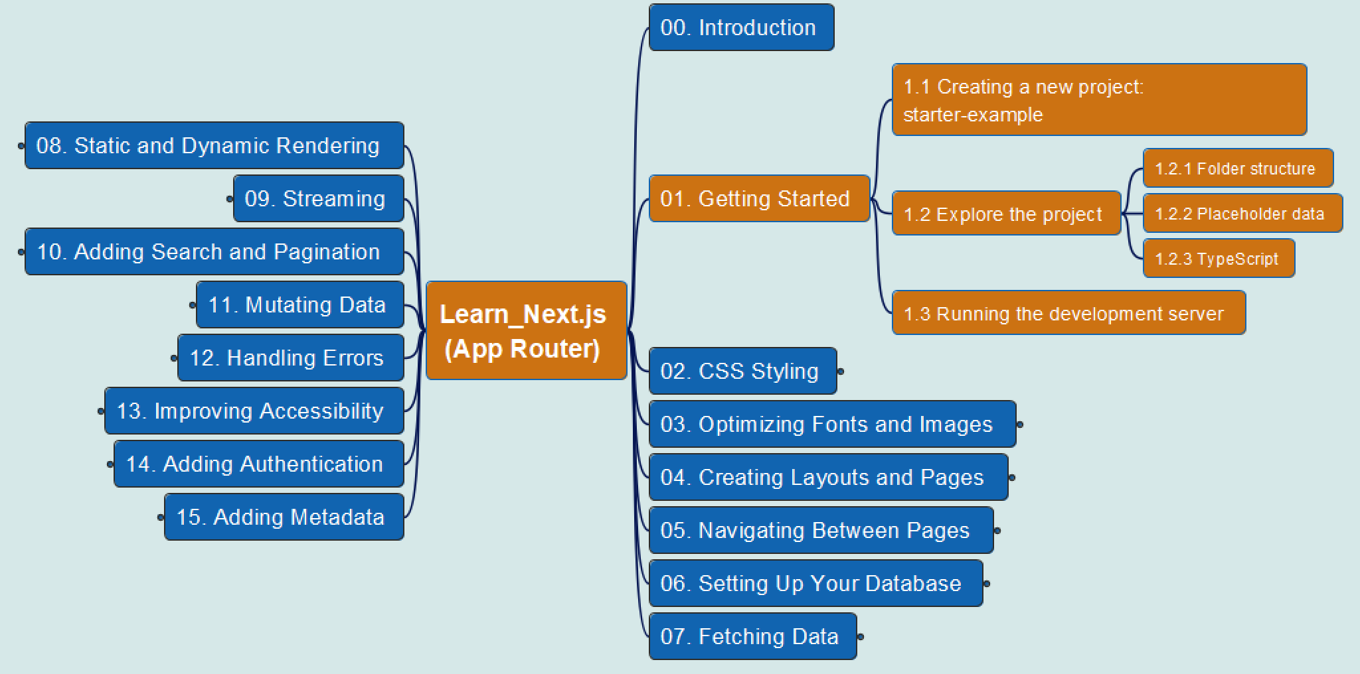
App Router
01
1. Getting Started

Slide 3
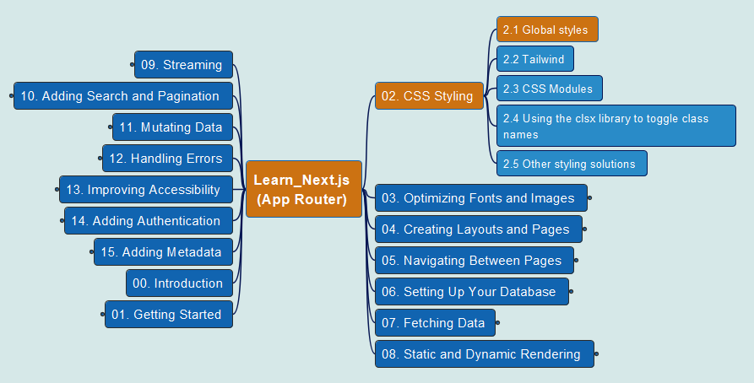
App Router
02
2. CSS Styling
2.1 Globel Styles

Slide 4
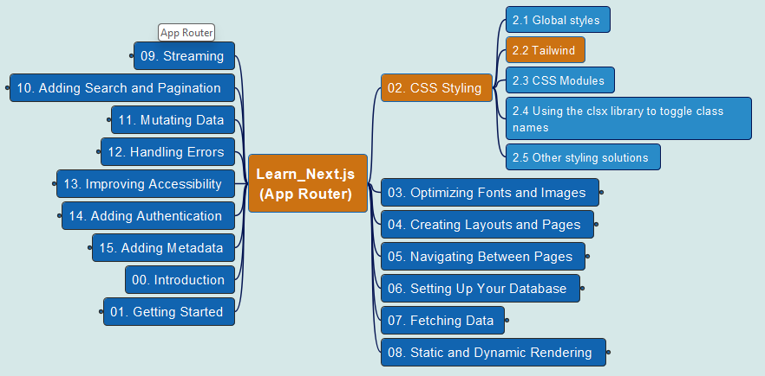

App Router
03
2. CSS Styling
2.2 Tailwind CSS

Slide 5
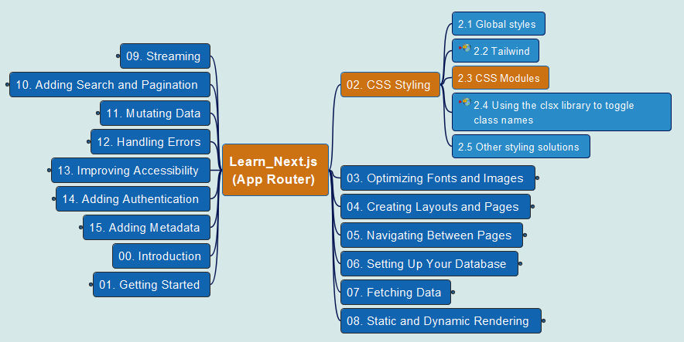
App Router
04
2. CSS Styling
2.3 CSS Modules

Slide 6
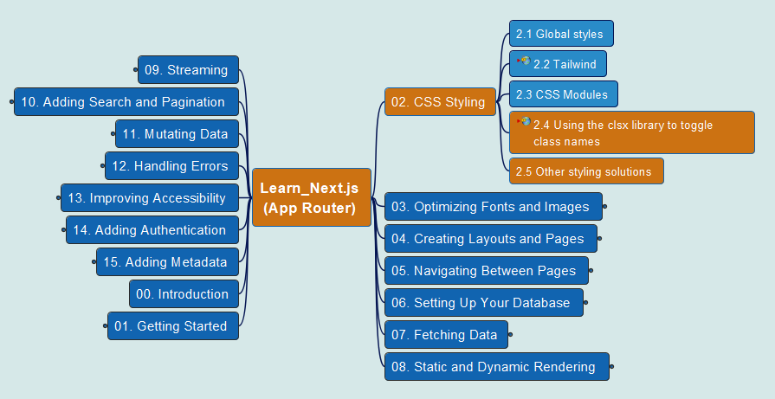
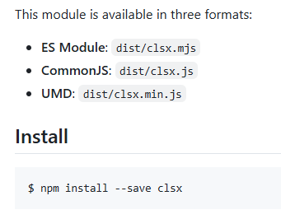
App Router
05
2. CSS Styling
2.4 “clsx” library 2.5 Others

Slide 7
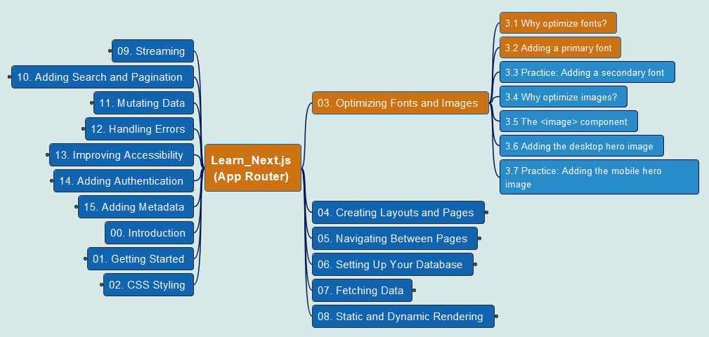
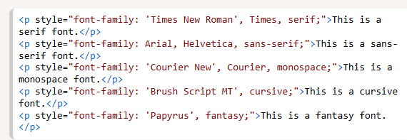
App Router
06
3. Optimizing Fonts and Images
3.1/3.2 Adding Primary Font

Slide 8
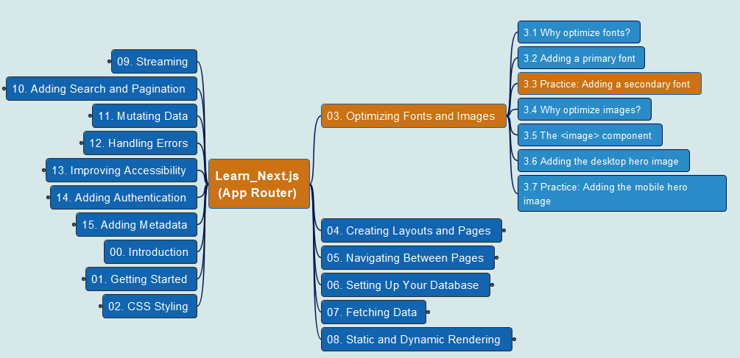
App Router
07
3. Optimizing Fonts and Images
3.3 Practice: Add a 2nd Font

Slide 9
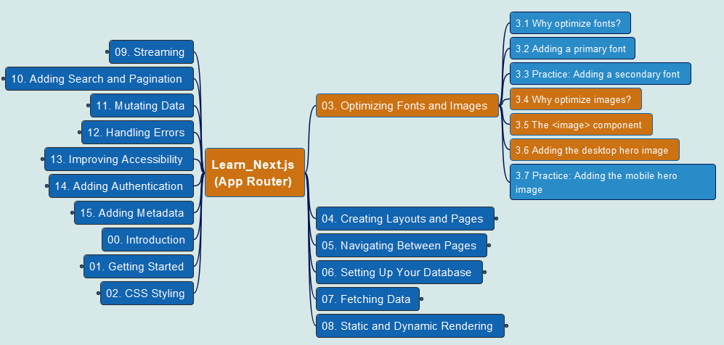
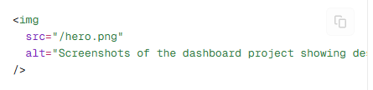
App Router
08
3. Optimizing Fonts and Images
3.4/3.5/3.6 Adding Desktop Hero Image

Slide 10
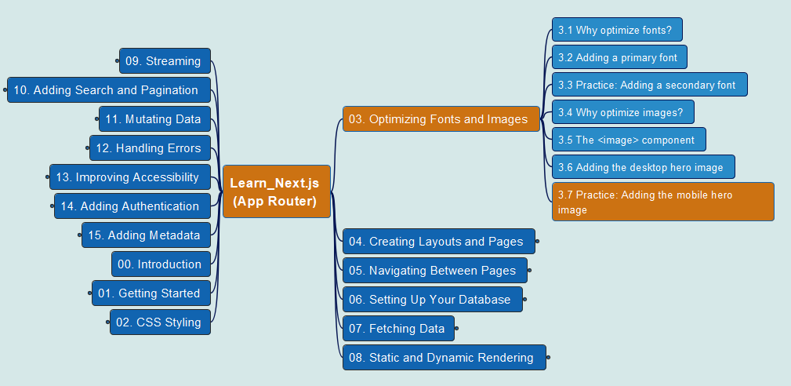
App Router
09
3. Optimizing Fonts and Images
3.7 Practice: Add Mobile Hero Image

Slide 11
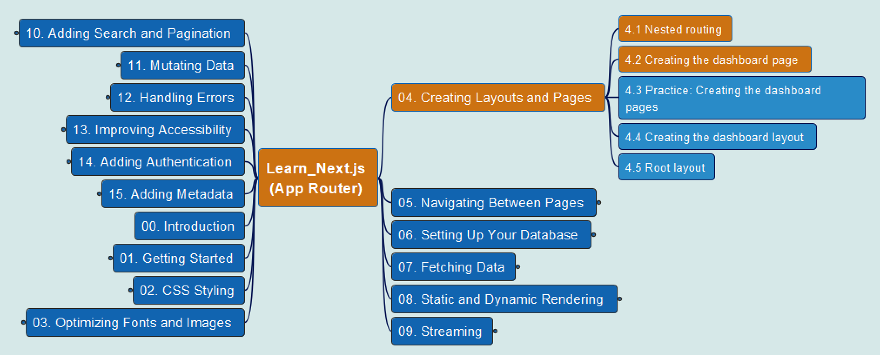
App Router
10
4. Creating Layouts & Pages
4.1 Nested routing 4.2 Create Page

Slide 12
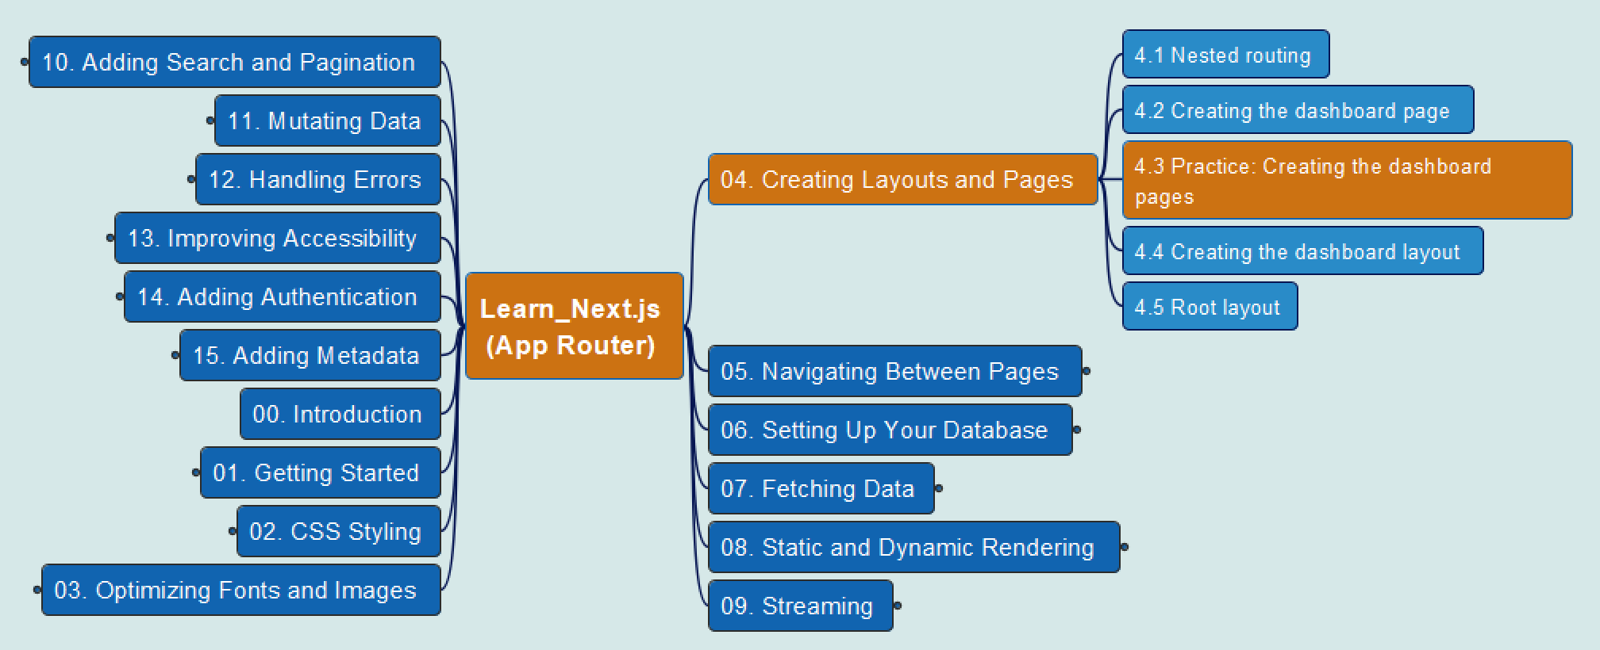
App Router
11
4. Creating Layouts & Pages
4.3 Practice: Create Dashboard Page

Slide 13
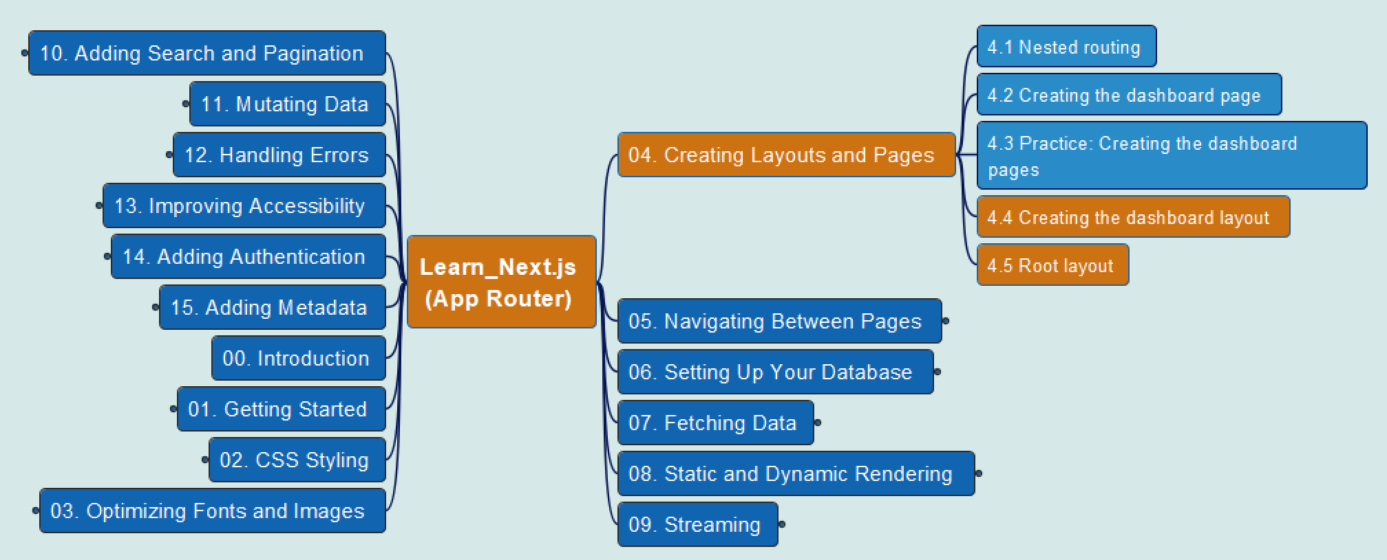
App Router
12
4. Creating Layouts & Pages
4.4 Create Dashboard Layout &
4.5 Root Layout

Slide 14
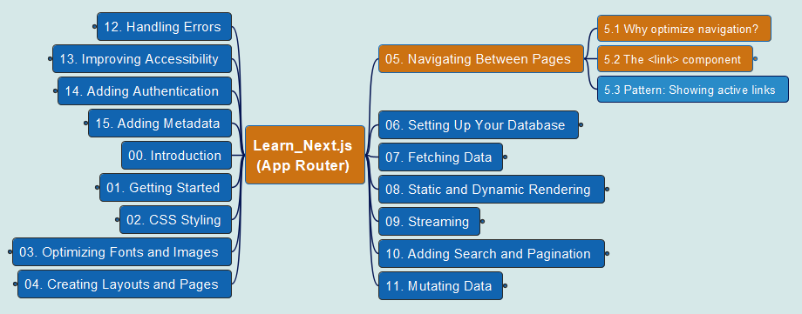
App Router
13
5. Navigating between Pages
5.1/5.2 The <link> component

Slide 15
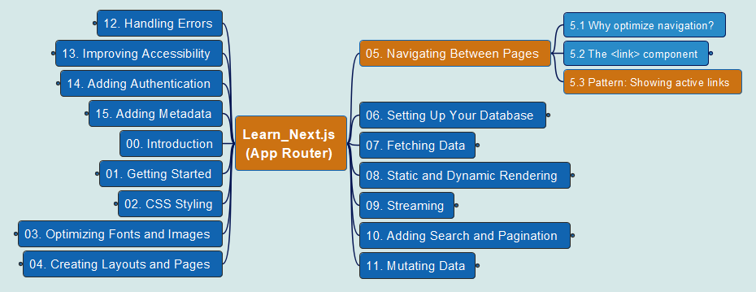
App Router
14
5. Navigating between Pages
5.3 Pattern: Showing active links

Slide 16
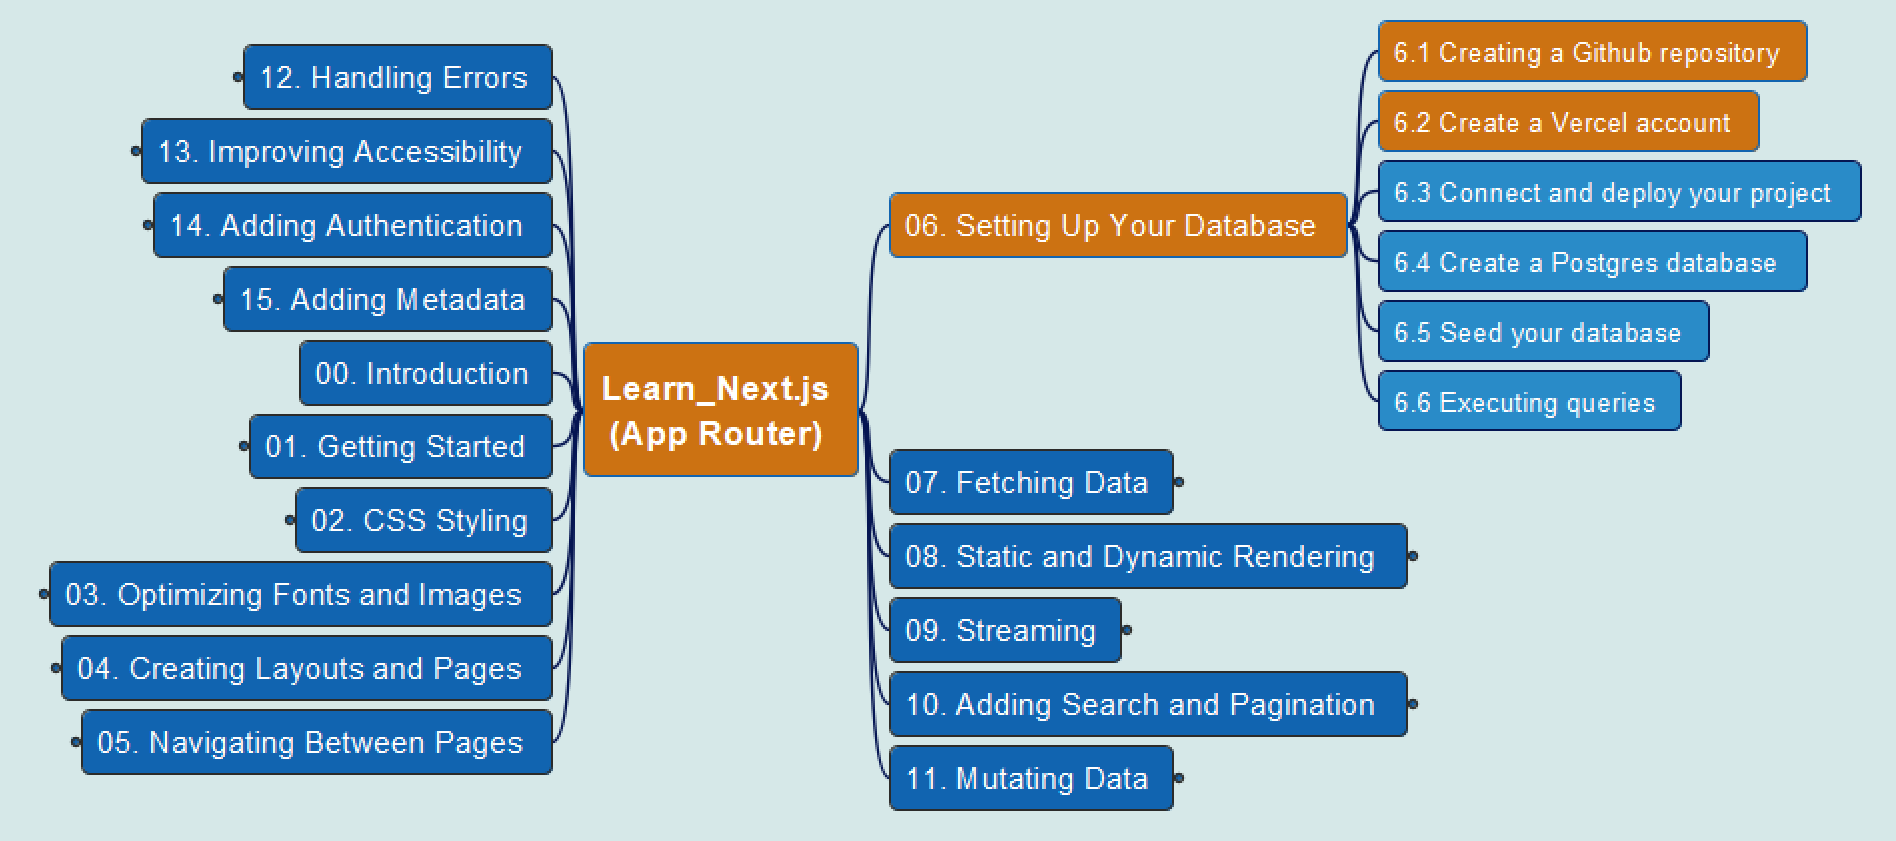


App Router
15
6. Setting Up Your Database
6.1 Create Github Repo and 6.2 Vercel Account

Slide 17
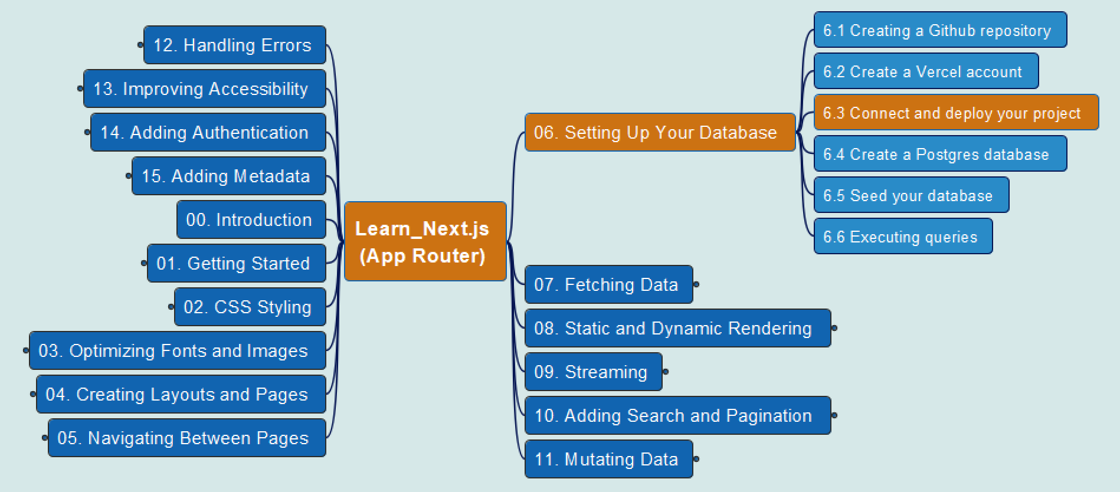
App Router
16
6. Setting Up Your Database
6.3 Connect and Deploy Project

Slide 18
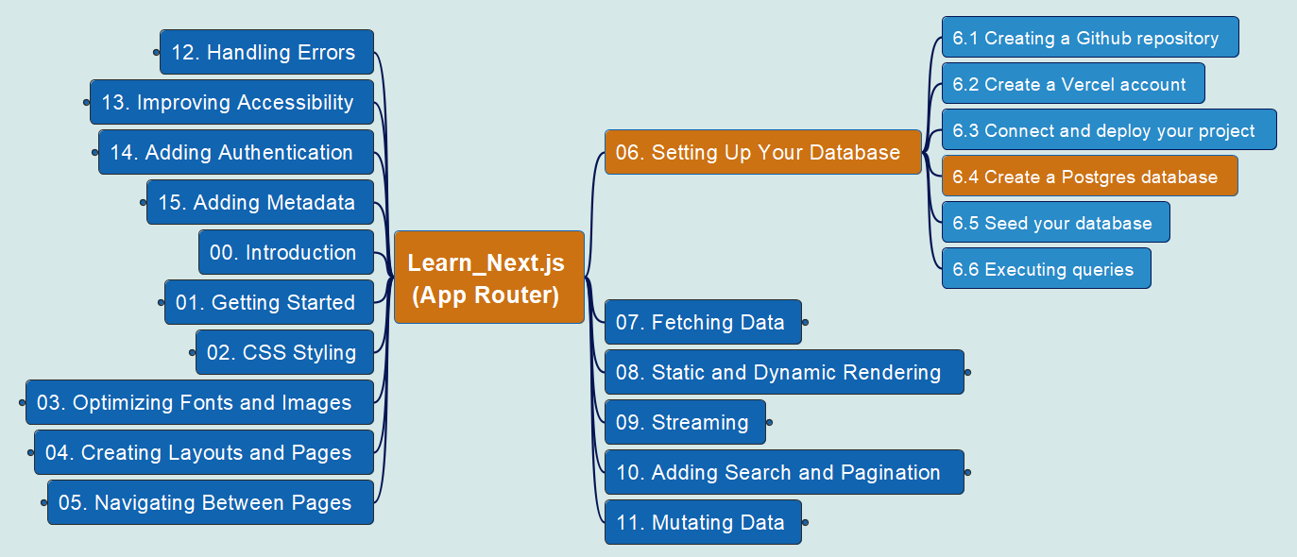
App Router
17
6. Setting Up Your Database
6.4 Create a Postgre Database

Slide 19
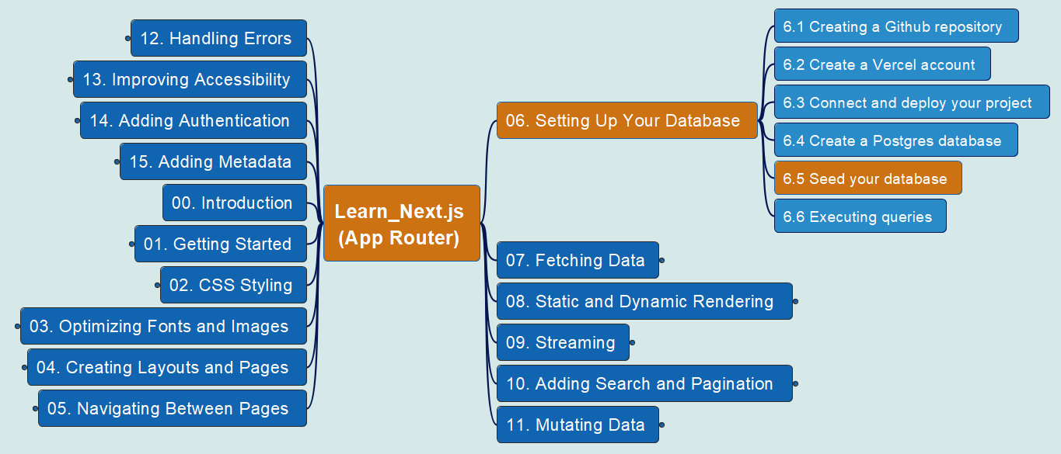
App Router
18
6. Setting Up Your Database
6.5 Seed your Database

Slide 20
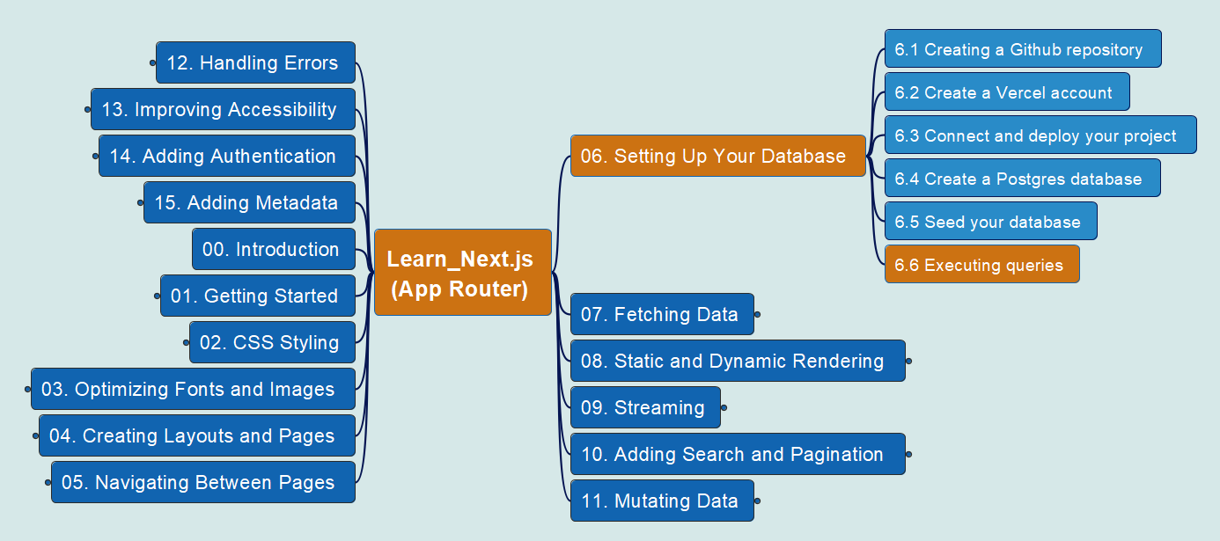
App Router
19
6. Setting Up Your Database
6.6 Executing Queries

Slide 21
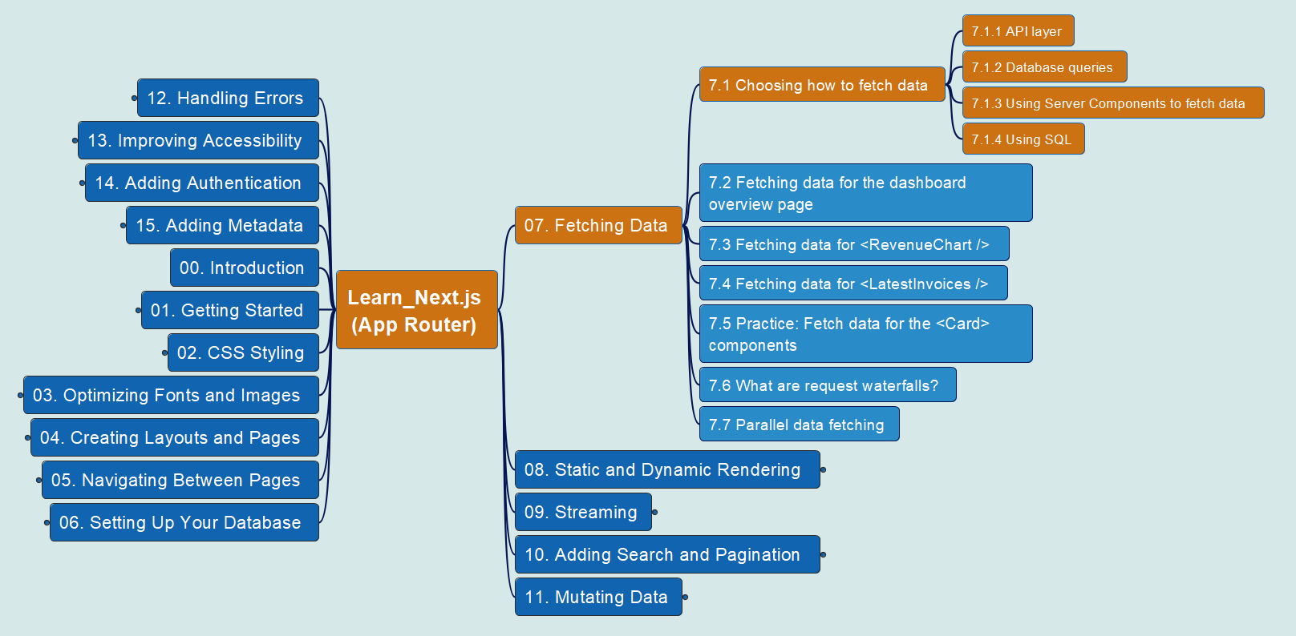
App Router
20
7. Fetching Data
7.1 Choosing how to fetch data

Slide 22
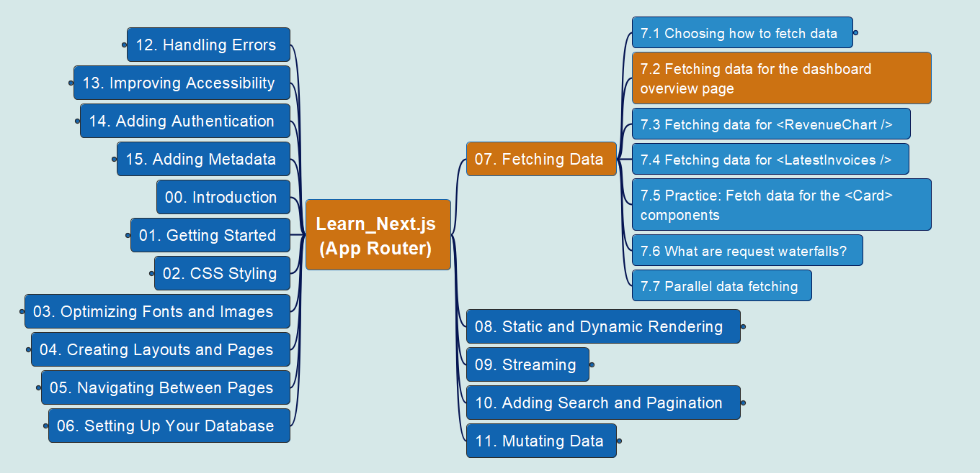
App Router
21
7. Fetching Data
7.2 Fetching data from app overview page

Slide 23
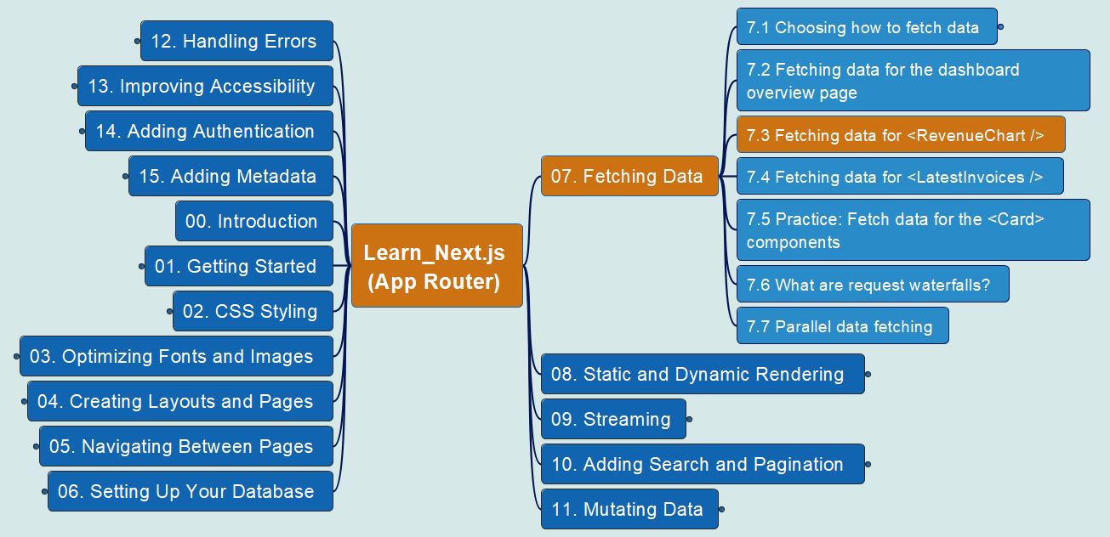
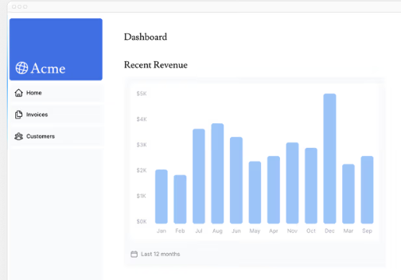
App Router
22
7. Fetching Data
7.3 Fetching data from <RevenueChart />

Slide 24
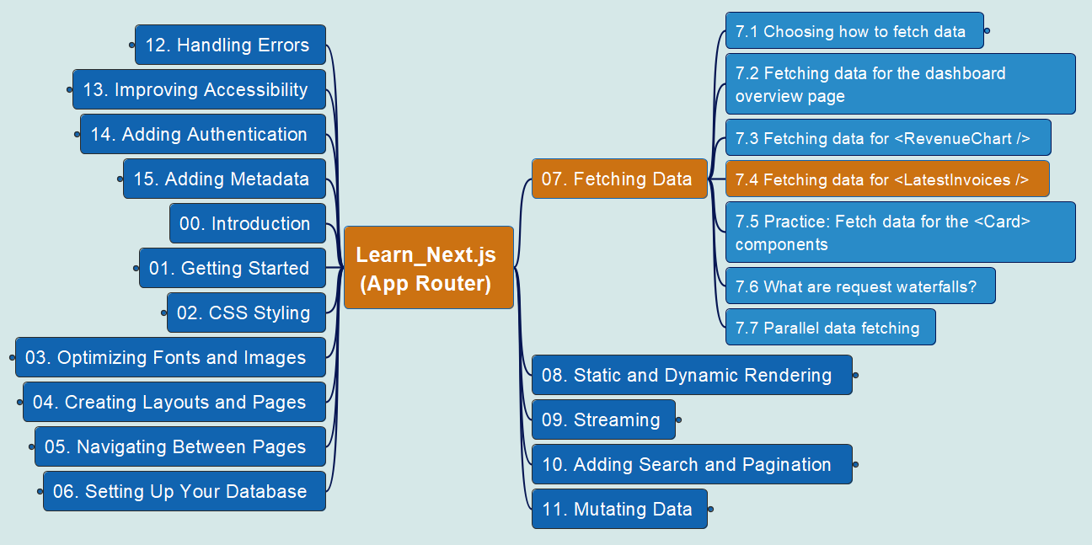
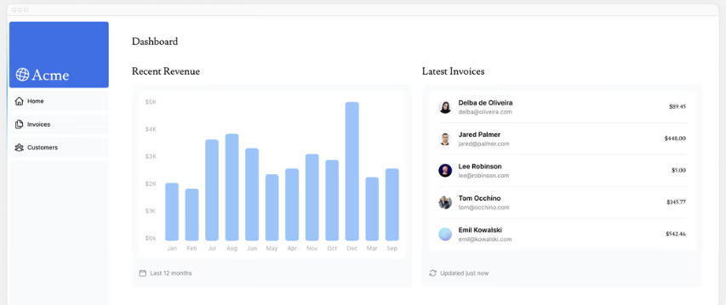
App Router
23
7. Fetching Data
7.4 Fetching data from <LatestInvoices />

Slide 25
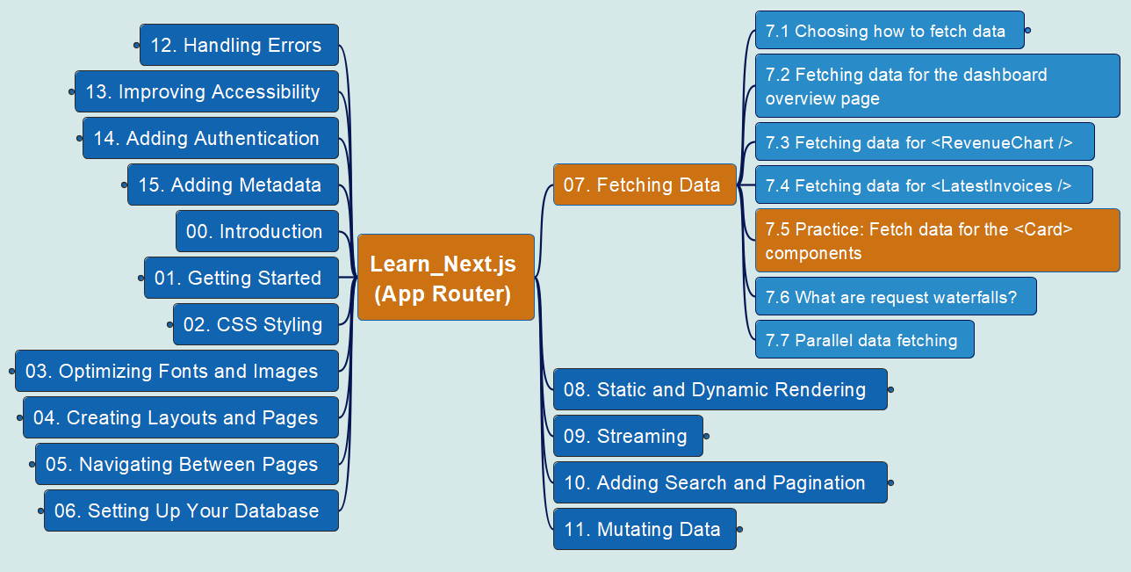
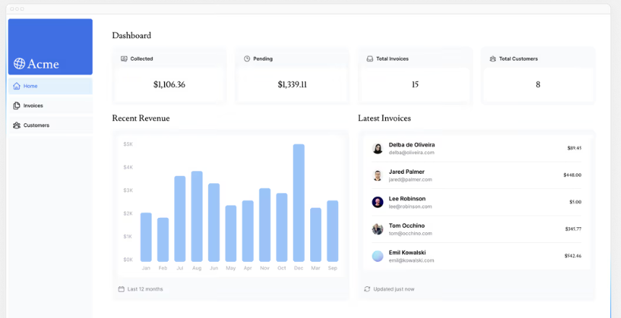
App Router
24
7. Fetching Data
7.5 Practice: Fetch data for <Card>

Slide 26
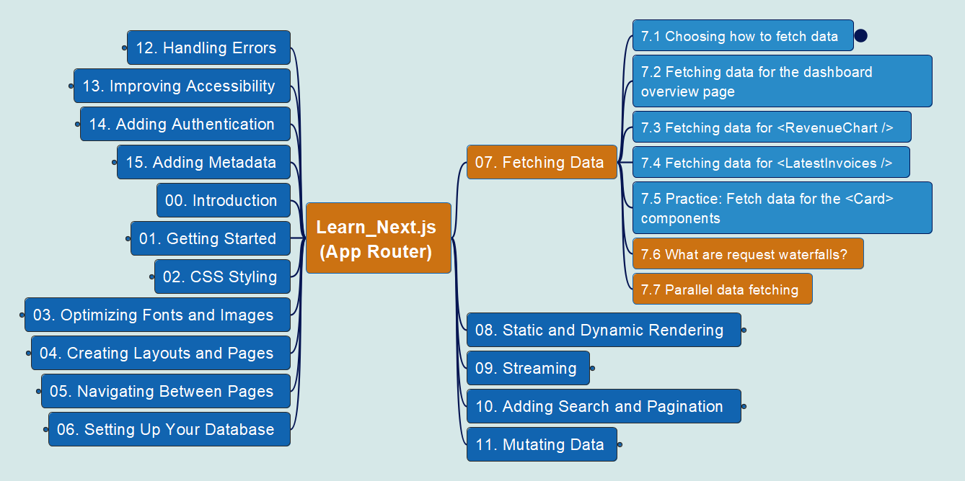
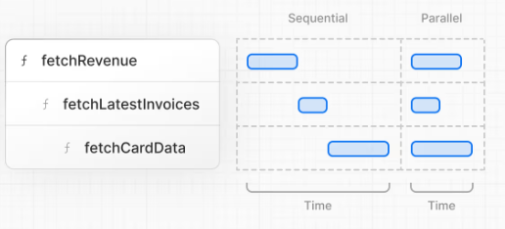
App Router
25
7. Fetching Data
7.6/7.7 Waterfall vs Parallel

Slide 27
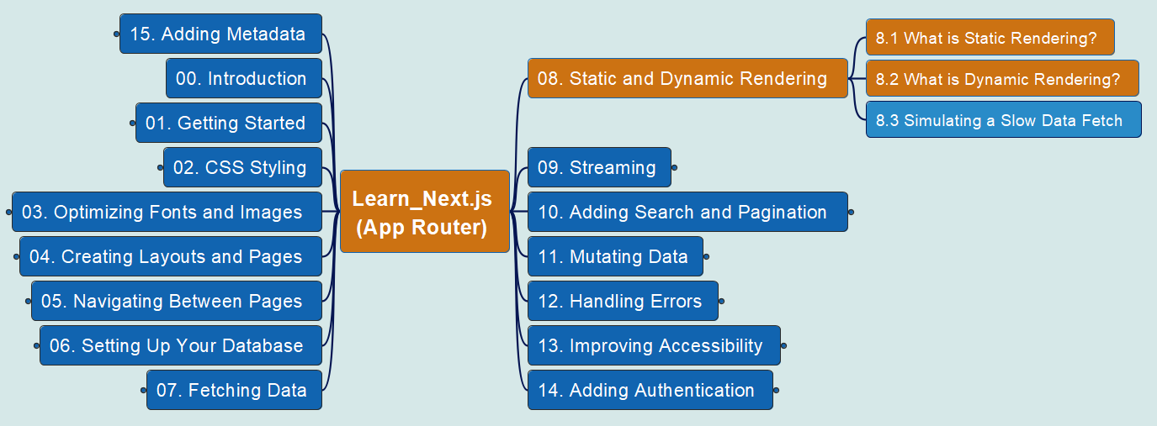
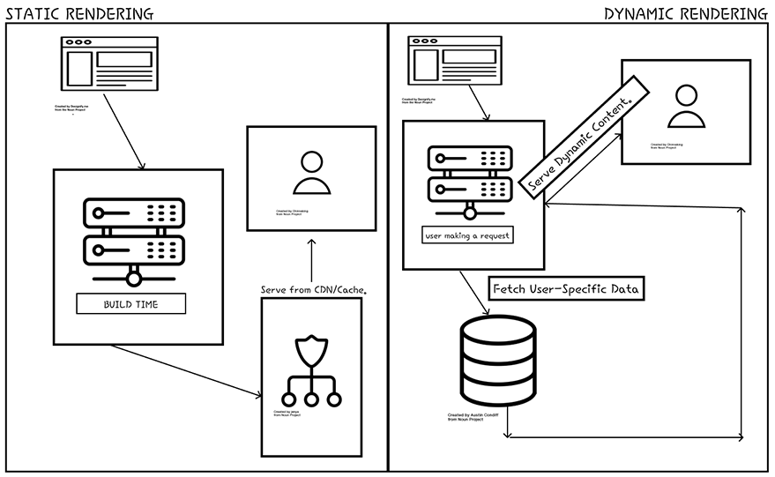
App Router
26
8. Static & Dynamic Rendering
8.1/8.2 Static vs. Dynamic Rendering

Slide 28
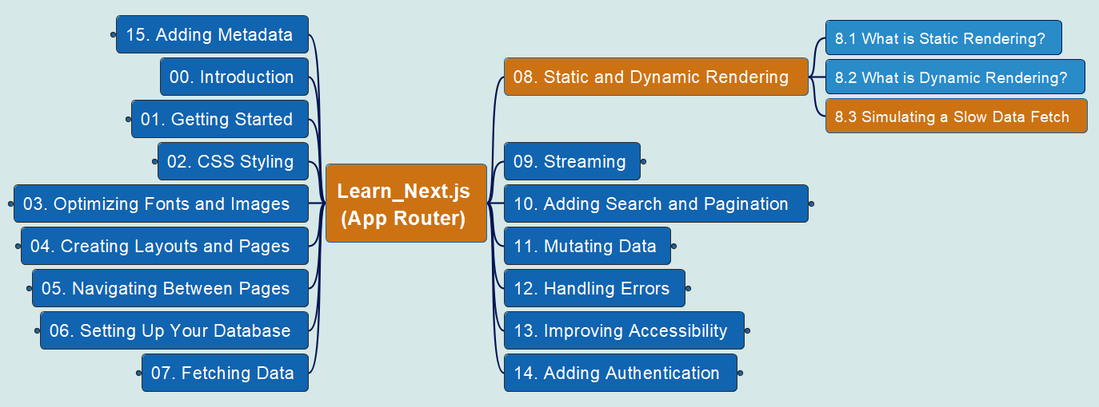

App Router
27
8. Static & Dynamic Rendering
8.3 Simulating a Slow Data Fetch

Slide 29
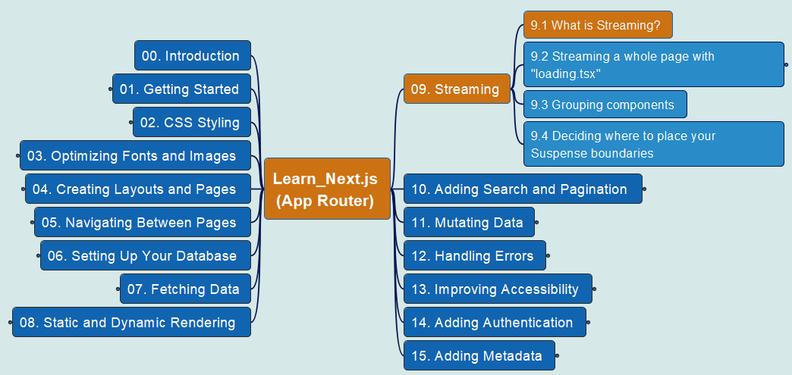
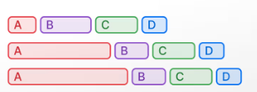
App Router
28
9. Streaming
9.1 What is Streaming?

Slide 30
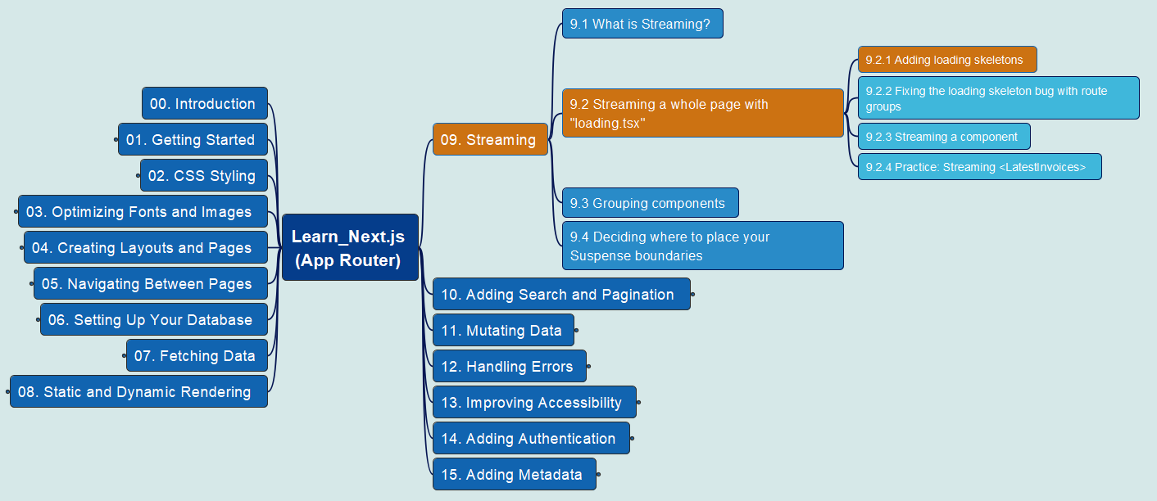
App Router
29
9. Streaming
9.2 Streaming page with ‘loading.tsx’ (0)

Slide 31
App Router
30
9. Streaming
9.2 Streaming page with ‘loading.tsx’ (1)

Slide 32
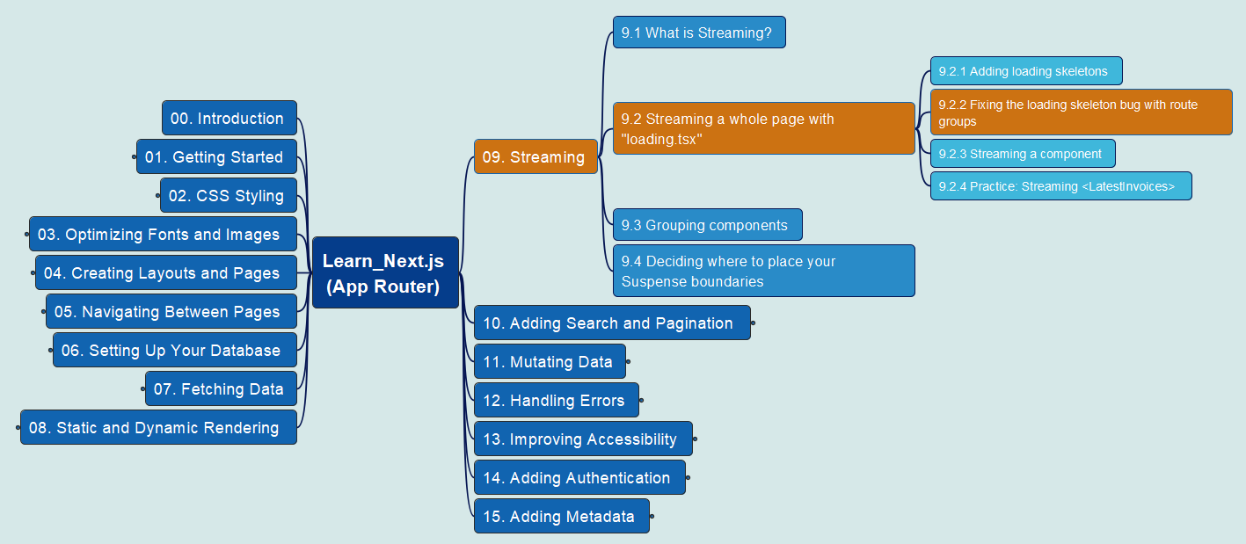

App Router
31
9. Streaming
9.2 Streaming page with ‘loading.tsx’ (2)

Slide 33
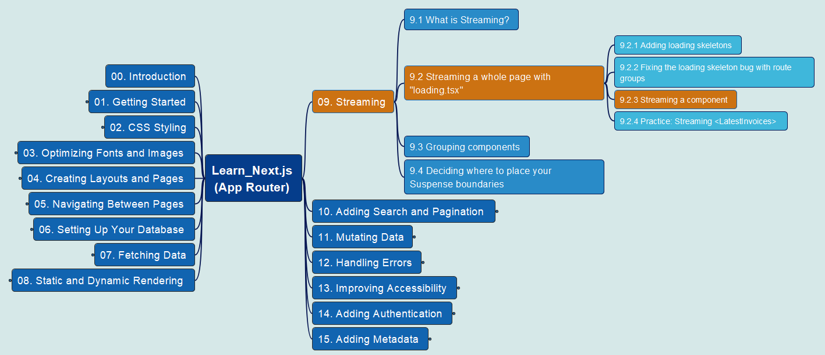
App Router
32
9. Streaming
9.2 Streaming page with ‘loading.tsx’ (3)

Slide 34
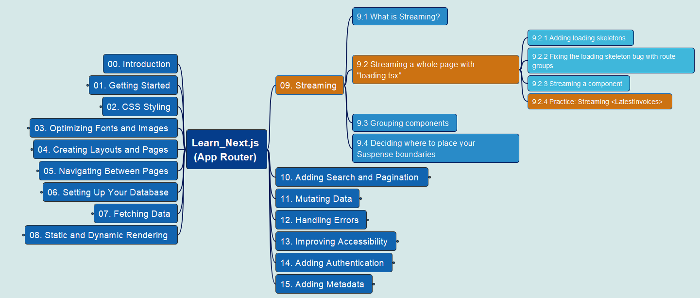

App Router
33
9. Streaming
9.2 Streaming page with ‘loading.tsx’ (4)

Slide 35
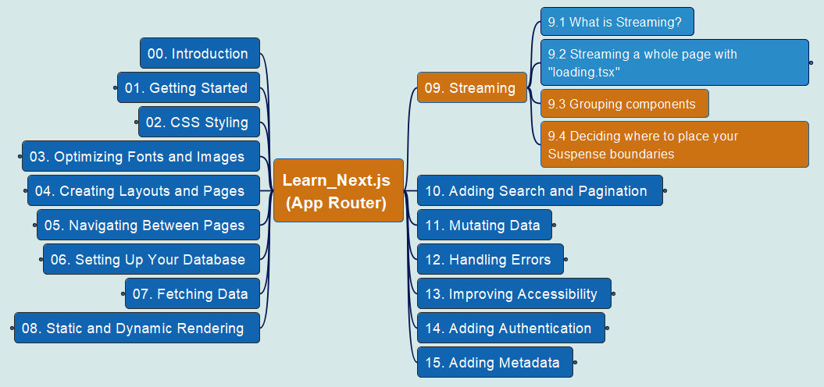
App Router
34
9. Streaming
9.3 Grouping Component 9.4 Deciding…

Slide 36
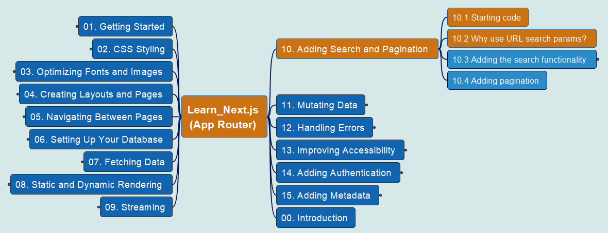
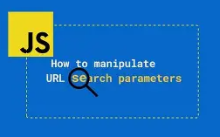
App Router
35
10. Adding Search & Pagination
10.1 Starting Code 10.2 Why URL Search Params?

Slide 37
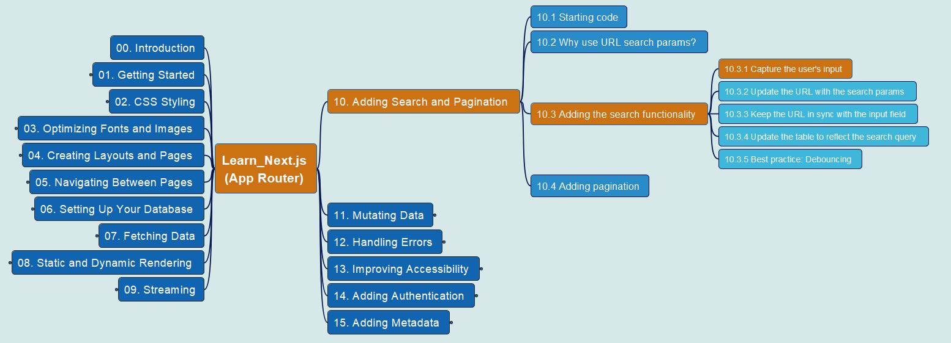

App Router
36
10. Adding Search & Pagination
10.3 Adding Search Functionality – 10.3.1

Slide 38
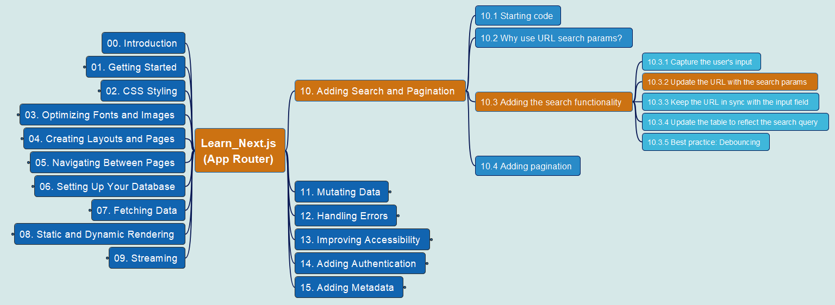
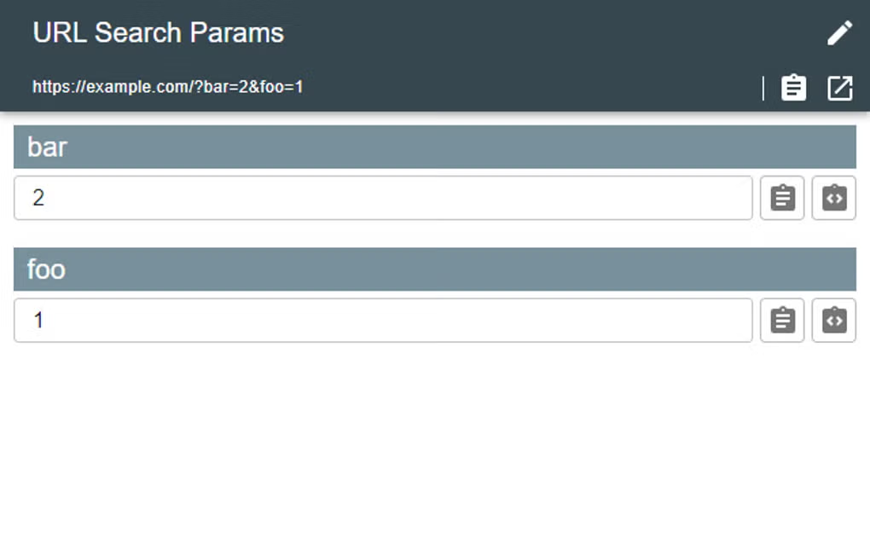
App Router
37
10. Adding Search & Pagination
10.3 Adding Search Functionality – 10.3.2

Slide 39


App Router
38
10. Adding Search & Pagination
10.3 Adding Search Functionality – 10.3.3

Slide 40
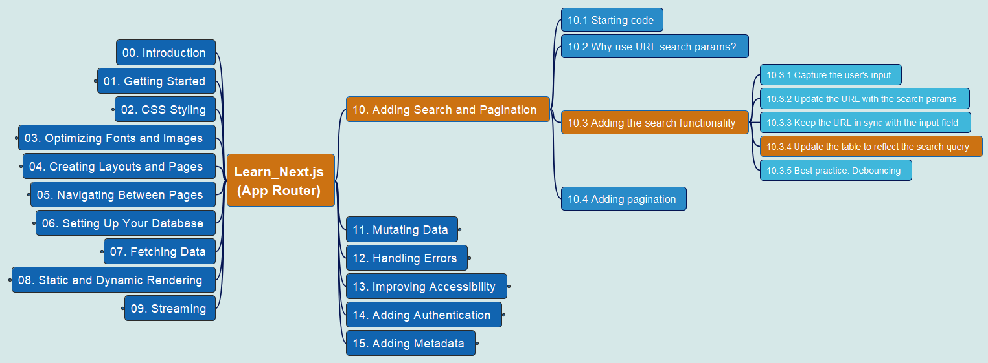

App Router
39
10. Adding Search & Pagination
10.3 Adding Search Functionality – 10.3.4

Slide 41
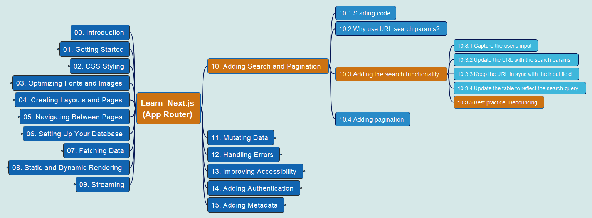

App Router
40
10. Adding Search & Pagination
10.3 Adding Search Functionality – 10.3.5

Slide 42


App Router
41
10. Adding Search & Pagination
10.4 Adding Pagination

Slide 43


App Router
42
11. Mutating Data
11.1 What’s Server Action? 11.2 Using Forms

Slide 44

App Router
43
11. Mutating Data
11.4 Create Invoice (1) Create a Form

Slide 45

App Router
44
11. Mutating Data
11.4 Create Invoice (2) Create a Server Action

Slide 46

App Router
45
11. Mutating Data
11.4 Create Invoice (3) Extract Data

Slide 47

App Router
46
11. Mutating Data
11.4 Create Invoice (4) Validate Data

Slide 48

App Router
47
11. Mutating Data
11.4 Create Invoice (5) Insert Data

Slide 49

App Router
48
11. Mutating Data
11.4 Create Invoice (6) Revalidate/Redirect Data

Slide 50

App Router
49
11. Mutating Data
11.5 Update Invoice (1) Create Dynamic Route

Slide 51

App Router
50
11. Mutating Data
11.5 Update Invoice (2) Read from Page

Slide 52

App Router
51
11. Mutating Data
11.5 Update Invoice (3) Fetch Data from DB

Slide 53

App Router
52
11. Mutating Data
11.5 Update Invoice (4) Pass ‘id’ to Server

Slide 54

App Router
53
11. Mutating Data
11.6 Deleting an Invoice

Slide 55


App Router
54
12. Handling Errors
12.1 Adding “try/catch” to Server Actions

Slide 56

App Router
55
12. Handling Errors
12.2 Handling all errors with “error.tsx”

Slide 57


App Router
56
12. Handling Errors
12.3 Handling 404 errors with “notFound”

Slide 58


App Router
57
13. Improving Accessibility
13.1/13.2 ESLint Accessibility Plug-in

Slide 59


App Router
58
13. Improving Accessibility
13.3/13.4 Form Accessibility

Slide 60

App Router
59
13. Improving Accessibility
13.5 Practice: Adding aria labels

Slide 61


App Router
60
14. Adding Authentication
14.1/14.2 Creating Login Route

Slide 62


App Router
61
14. Adding Authentication
14.3/14.4 Setting Up NextAuth.js

Slide 63

App Router
62
14. Adding Authentication
14.5 Protect Route with Next.js Proxy (1)

Slide 64


App Router
63
14. Adding Authentication
14.5 Protect Route with Next.js Proxy (2)

Slide 65


App Router
64
14. Adding Authentication
14.5 Protect Route with Next.js Proxy (3)

Slide 66

App Router
65
14. Adding Authentication
14.5 Protect Route with Next.js Proxy (4)

Slide 67

App Router
66
14. Adding Authentication
14.6 Adding Logout Functionality

Slide 68

App Router
67
15 Adding Metadata

Slide 69



App Router
68
16 Next Steps

Slide 70

Learn Next.js
React Foundations
App Router
Pages Router
SEO

Slide 71




Slide 72


