Slide 1
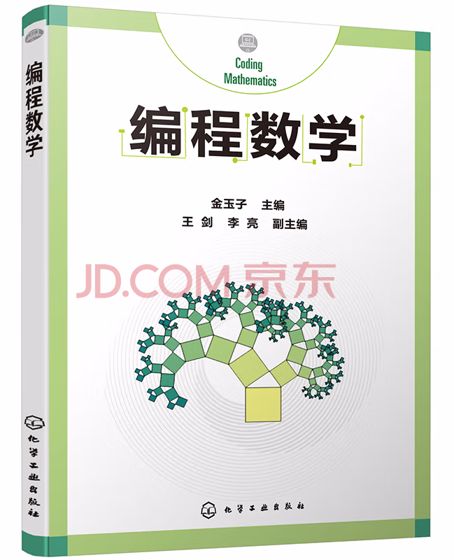

编程数学 Using Octave for Coding Mathematics
GitHub: https://github.com/yasenstar/learn_octave/tree/main/CodingMath

