Slide 1

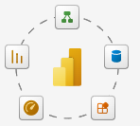
Microsoft Power BI Data Analyst Certification (Exam PL-300)

Slide 2
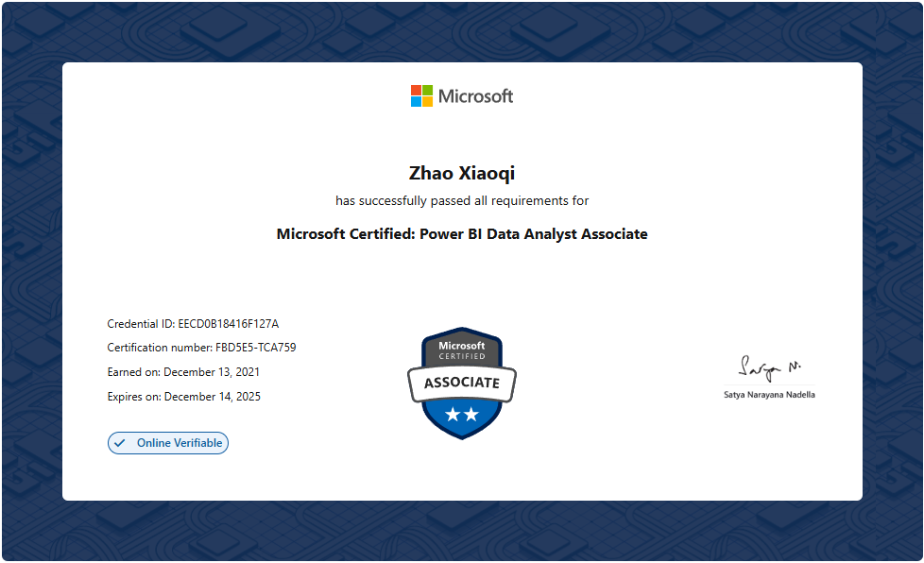
My PL-300 Certificate

