Slide 1

R in Action R语言实战
2nd Edition, by Robert I.Kabacoff
Learnt by Xiaoqi Zhao
GitHub: https://github.com/yasenstar/learn_r/tree/main/RinAction
Gitee: https://gitee.com/yasenstar/learn_r/tree/main/RinAction
001 – Opening 开篇

Slide 2

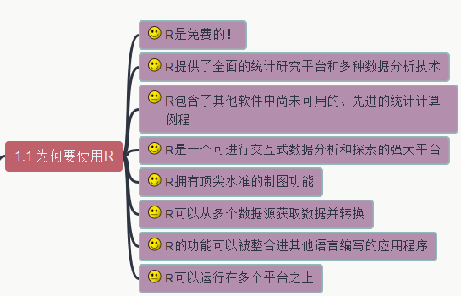
002 – 为何要使用R
R in Action R语言实战
GitHub: https://github.com/yasenstar/learn_r/tree/main/RinAction
Gitee: https://gitee.com/yasenstar/learn_r/tree/main/RinAction

Slide 3
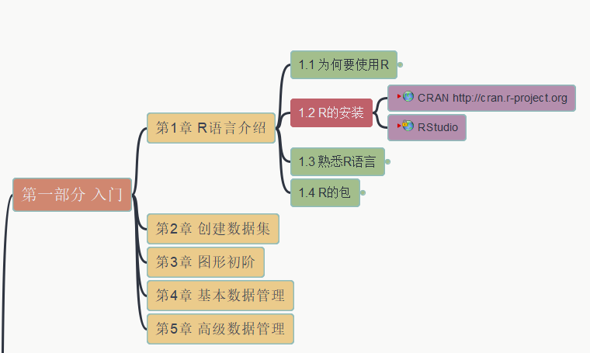
003 – 安装R和R Studio
R in Action R语言实战
GitHub: https://github.com/yasenstar/learn_r/tree/main/RinAction
Gitee: https://gitee.com/yasenstar/learn_r/tree/main/RinAction

Slide 4
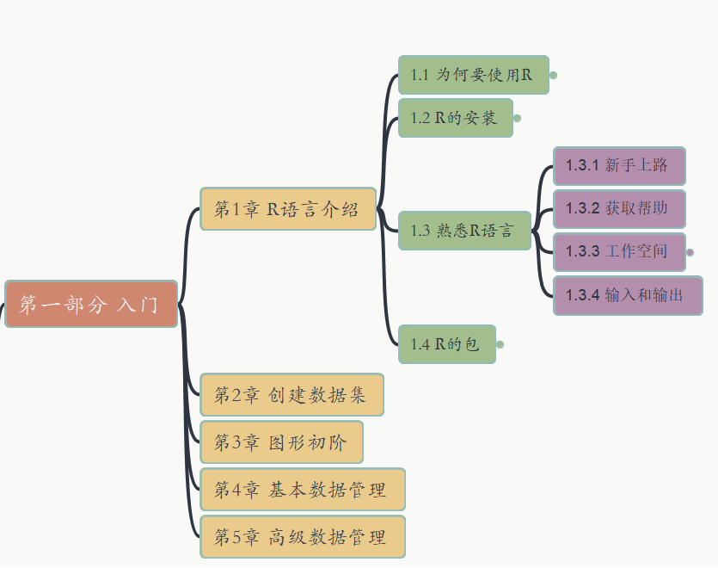
004 – 熟悉R语言
R in Action R语言实战
GitHub: https://github.com/yasenstar/learn_r/tree/main/RinAction
Gitee: https://gitee.com/yasenstar/learn_r/tree/main/RinAction

Slide 5
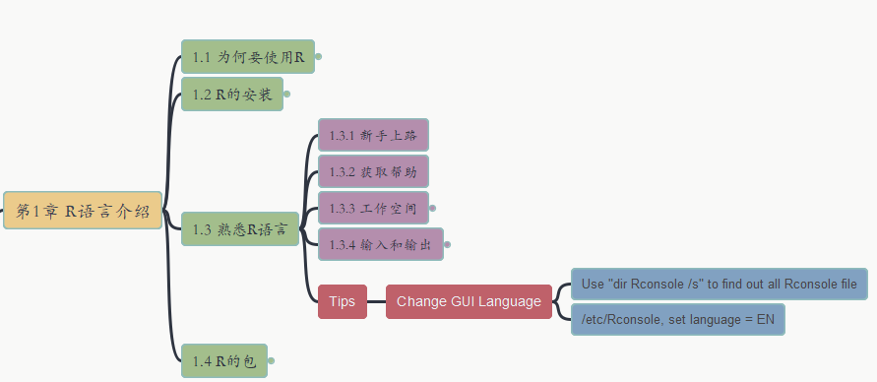
005 – 熟悉R语言
R in Action R语言实战
Tip: 如何改变R-GUI的显示语言？
GitHub: https://github.com/yasenstar/learn_r/tree/main/RinAction
Gitee: https://gitee.com/yasenstar/learn_r/tree/main/RinAction

Slide 6
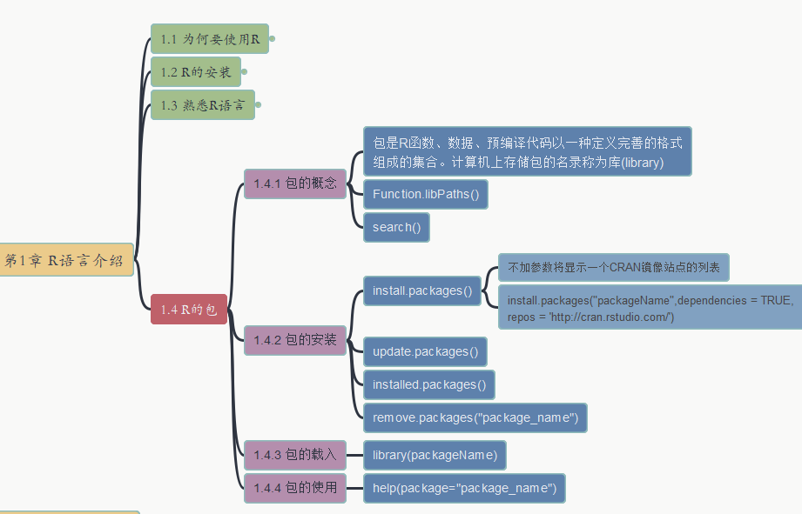
006 – 熟悉R语言
R in Action R语言实战
R的包（Packages）
GitHub: https://github.com/yasenstar/learn_r/tree/main/RinAction
Gitee: https://gitee.com/yasenstar/learn_r/tree/main/RinAction

Slide 7
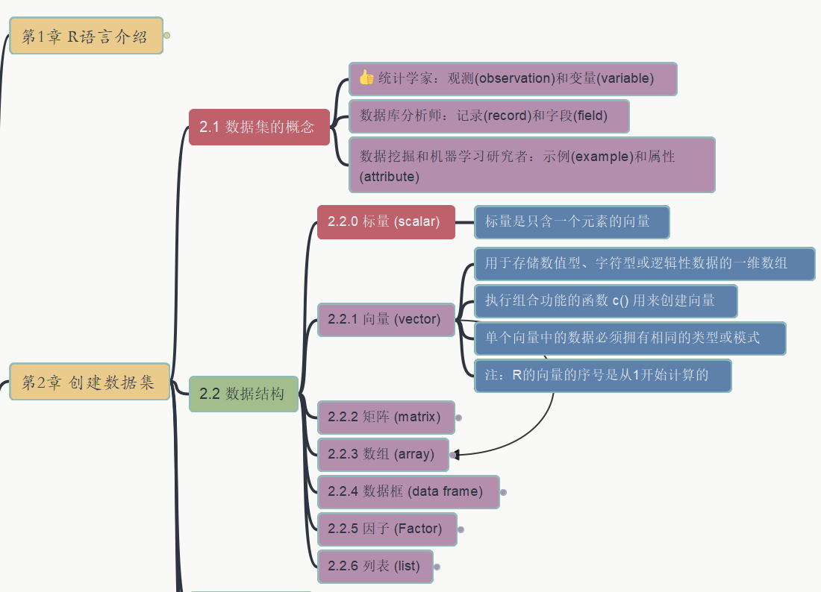
007 2. 创建数据集
R in Action R语言实战
数据集概念，标量/向量
GitHub: https://github.com/yasenstar/learn_r/tree/main/RinAction
Gitee: https://gitee.com/yasenstar/learn_r/tree/main/RinAction

Slide 8
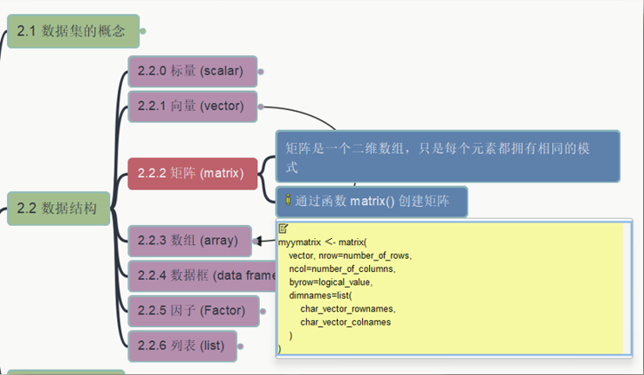
008 2. 创建数据集
R in Action R语言实战
2.2.2 矩阵
GitHub: https://github.com/yasenstar/learn_r/tree/main/RinAction
Gitee: https://gitee.com/yasenstar/learn_r/tree/main/RinAction

Slide 9
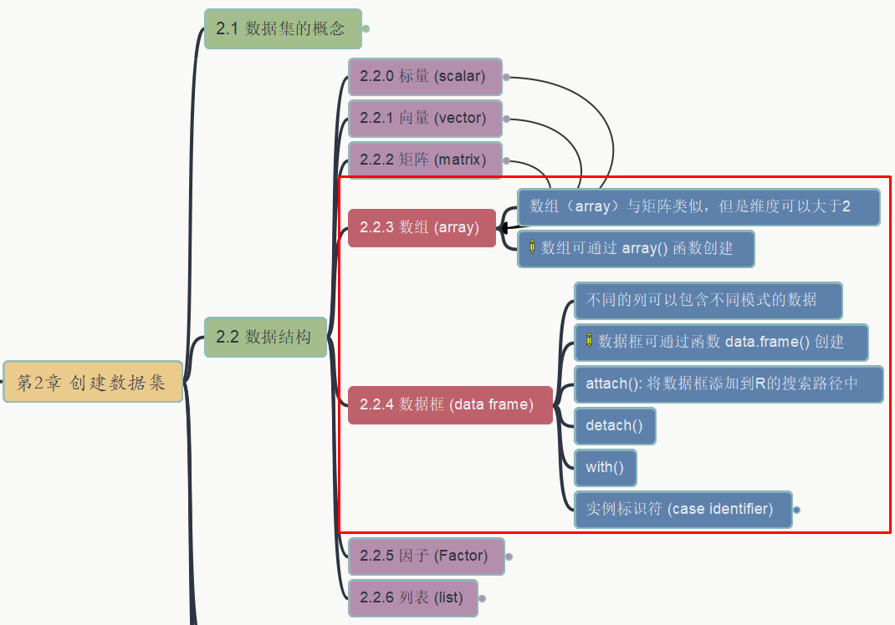
009 2. 创建数据集
R in Action R语言实战
2.2.3 数组 2.2.4 数据框
GitHub: https://github.com/yasenstar/learn_r/tree/main/RinAction
Gitee: https://gitee.com/yasenstar/learn_r/tree/main/RinAction

Slide 10
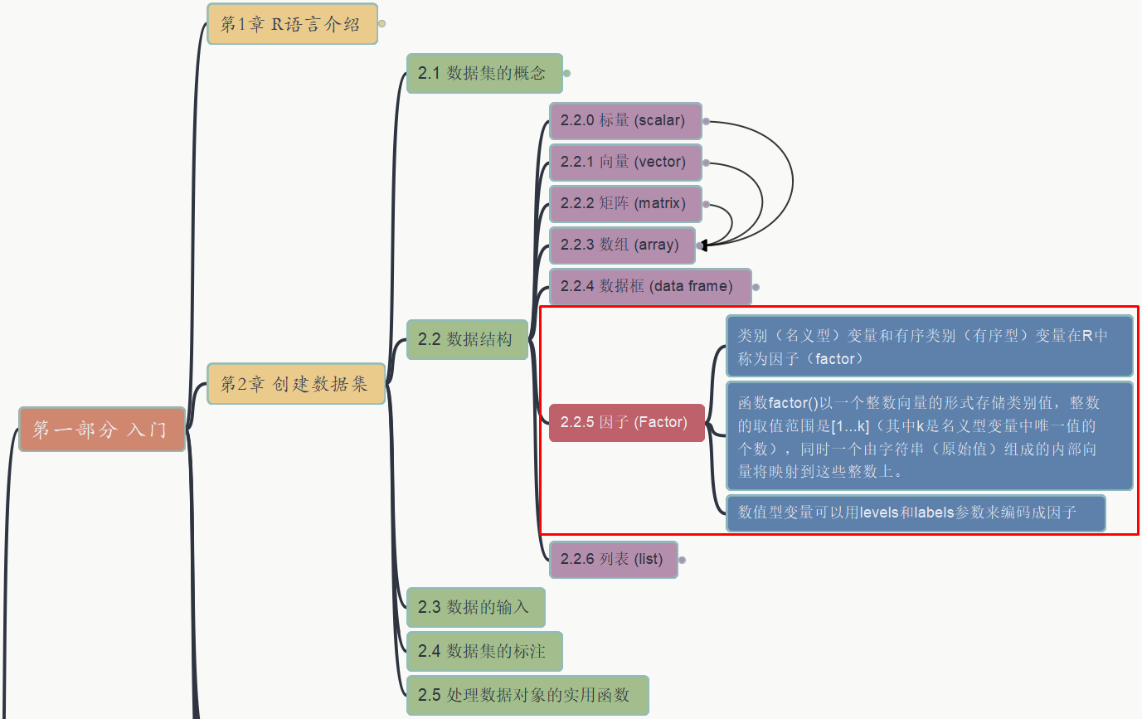
010 2. 创建数据集
R in Action R语言实战
2.2.5 因子
GitHub: https://github.com/yasenstar/learn_r/tree/main/RinAction
Gitee: https://gitee.com/yasenstar/learn_r/tree/main/RinAction

Slide 11
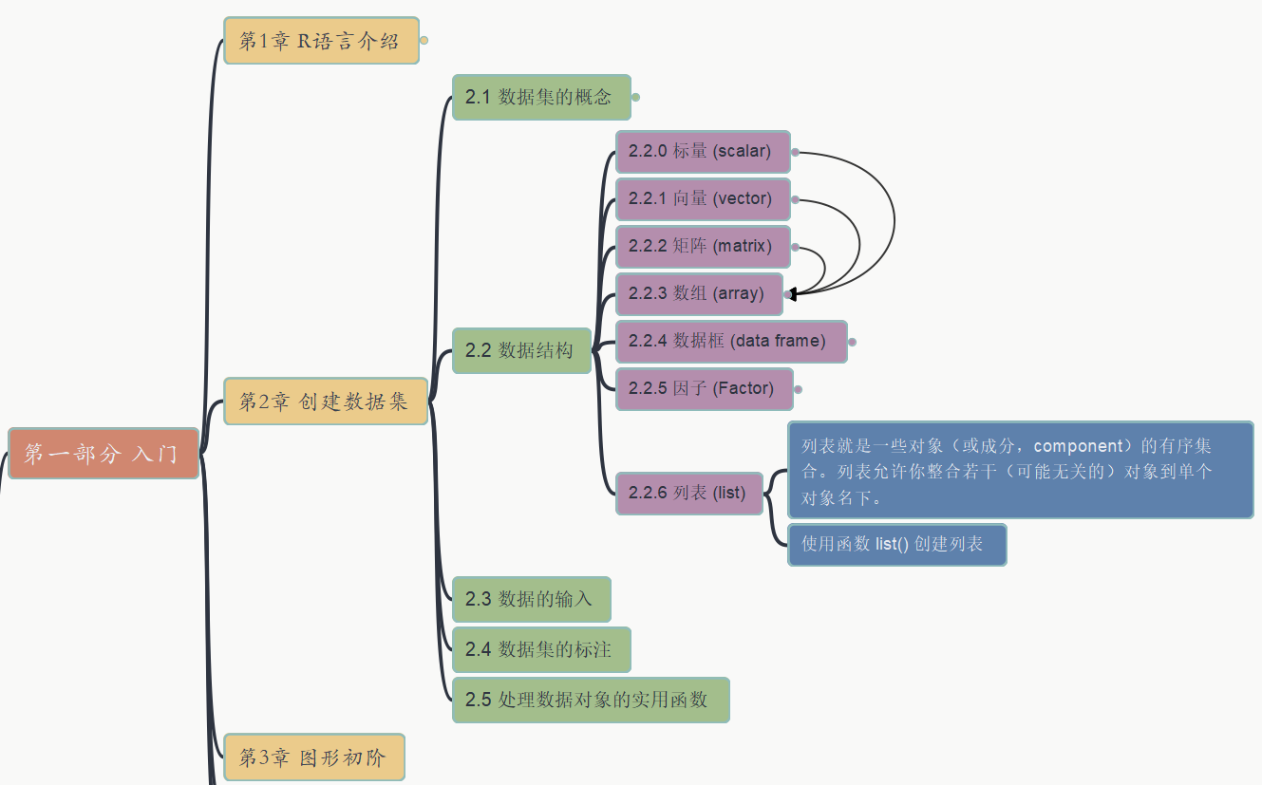
011 2. 创建数据集
R in Action R语言实战
2.2.6 列表 List
GitHub: https://github.com/yasenstar/learn_r/tree/main/RinAction
Gitee: https://gitee.com/yasenstar/learn_r/tree/main/RinAction

