Slide 1

R in Action R语言实战
2nd Edition, by Robert I.Kabacoff
Learnt by Xiaoqi Zhao
GitHub: https://github.com/yasenstar/learn_r/tree/main/RinAction
Gitee: https://gitee.com/yasenstar/learn_r/tree/main/RinAction
001 – Opening 开篇

Slide 2

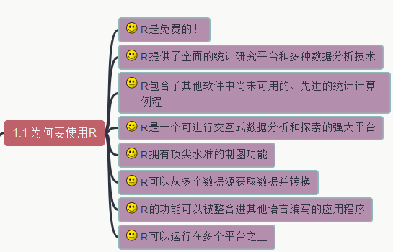
002 – 为何要使用R
R in Action R语言实战
GitHub: https://github.com/yasenstar/learn_r/tree/main/RinAction
Gitee: https://gitee.com/yasenstar/learn_r/tree/main/RinAction

Slide 3
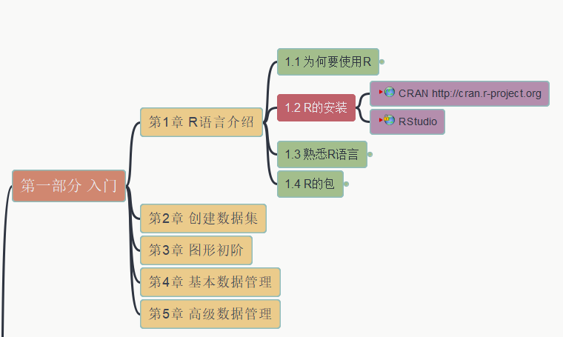
003 – 安装R和R Studio
R in Action R语言实战
GitHub: https://github.com/yasenstar/learn_r/tree/main/RinAction
Gitee: https://gitee.com/yasenstar/learn_r/tree/main/RinAction

Slide 4
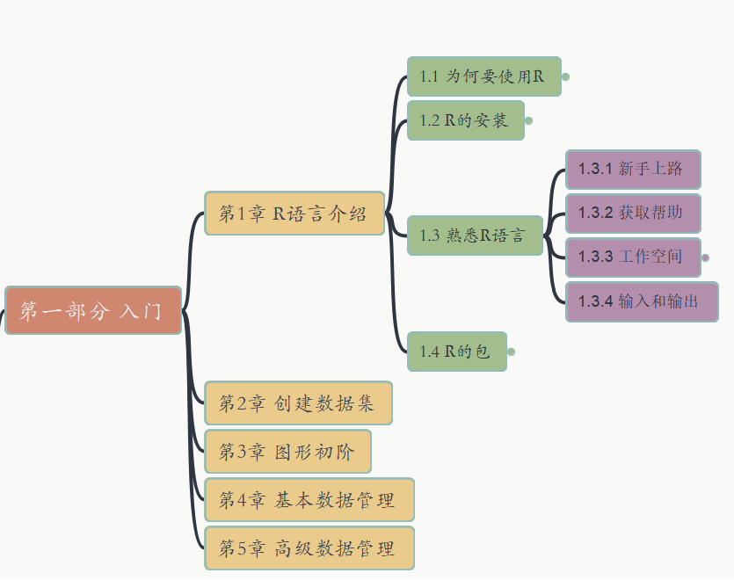
004 – 熟悉R语言
R in Action R语言实战
GitHub: https://github.com/yasenstar/learn_r/tree/main/RinAction
Gitee: https://gitee.com/yasenstar/learn_r/tree/main/RinAction

Slide 5
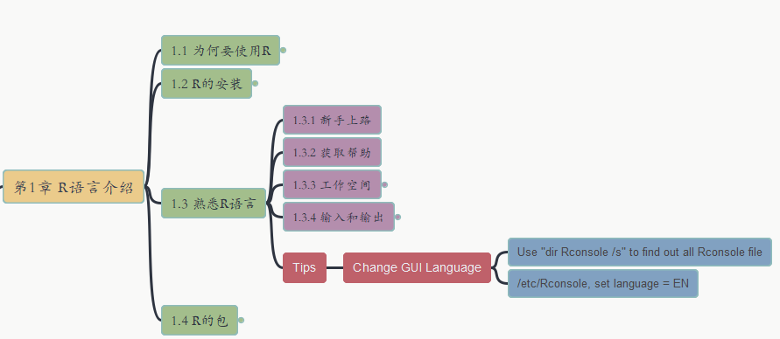
005 – 熟悉R语言
R in Action R语言实战
Tip: 如何改变R-GUI的显示语言？
GitHub: https://github.com/yasenstar/learn_r/tree/main/RinAction
Gitee: https://gitee.com/yasenstar/learn_r/tree/main/RinAction

Slide 6
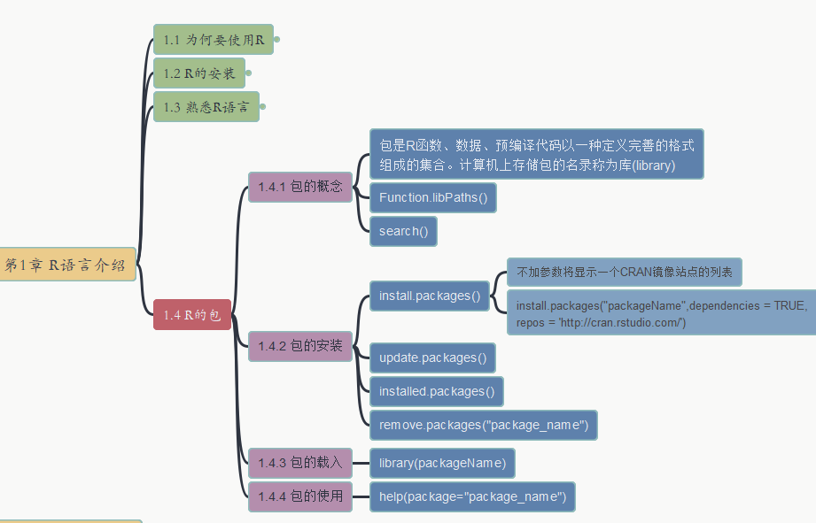
006 – 熟悉R语言
R in Action R语言实战
R的包（Packages）
GitHub: https://github.com/yasenstar/learn_r/tree/main/RinAction
Gitee: https://gitee.com/yasenstar/learn_r/tree/main/RinAction

Slide 7
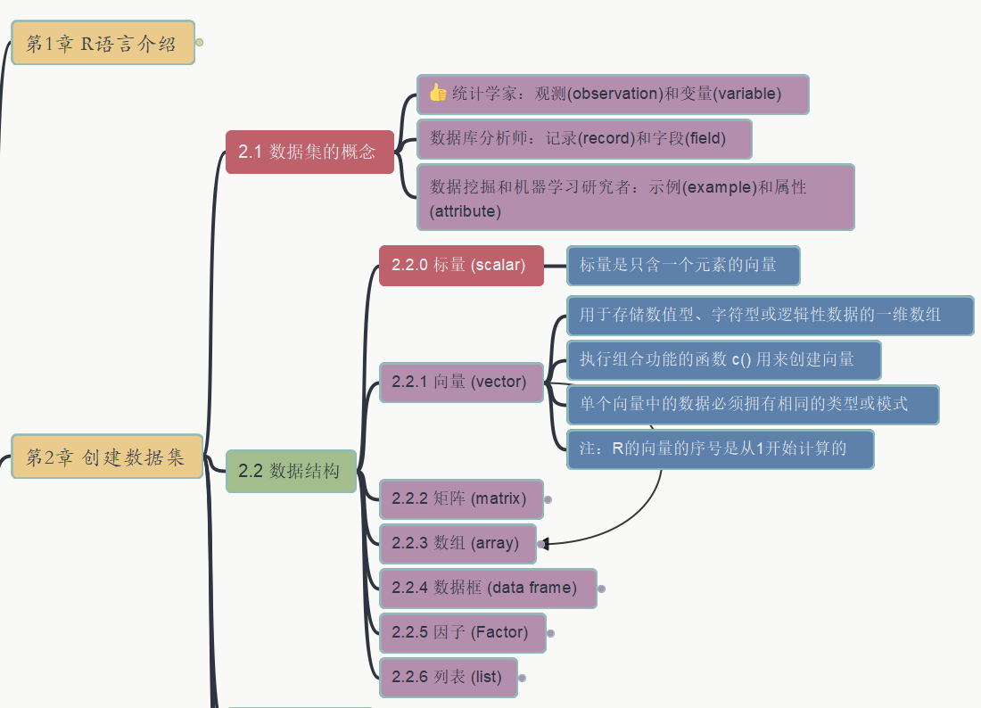
007 2. 创建数据集
R in Action R语言实战
数据集概念，标量/向量
GitHub: https://github.com/yasenstar/learn_r/tree/main/RinAction
Gitee: https://gitee.com/yasenstar/learn_r/tree/main/RinAction

Slide 8
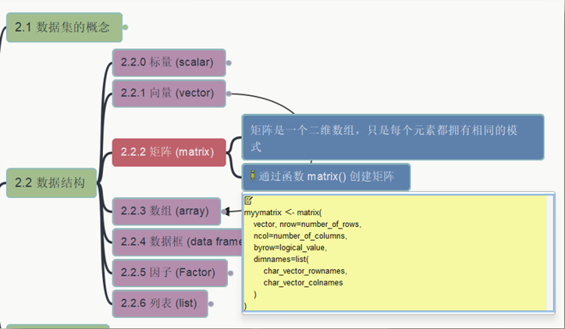
008 2. 创建数据集
R in Action R语言实战
2.2.2 矩阵
GitHub: https://github.com/yasenstar/learn_r/tree/main/RinAction
Gitee: https://gitee.com/yasenstar/learn_r/tree/main/RinAction

Slide 9
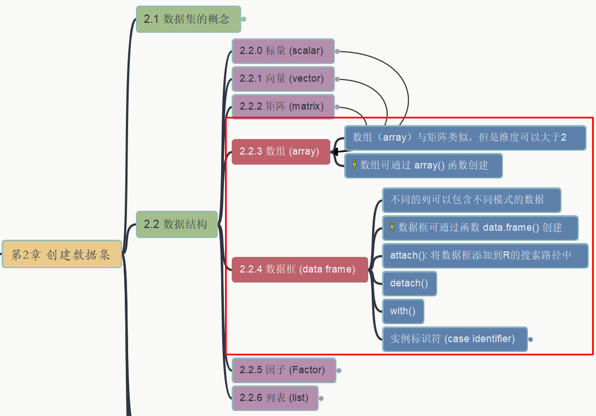
009 2. 创建数据集
R in Action R语言实战
2.2.3 数组 2.2.4 数据框
GitHub: https://github.com/yasenstar/learn_r/tree/main/RinAction
Gitee: https://gitee.com/yasenstar/learn_r/tree/main/RinAction

Slide 10
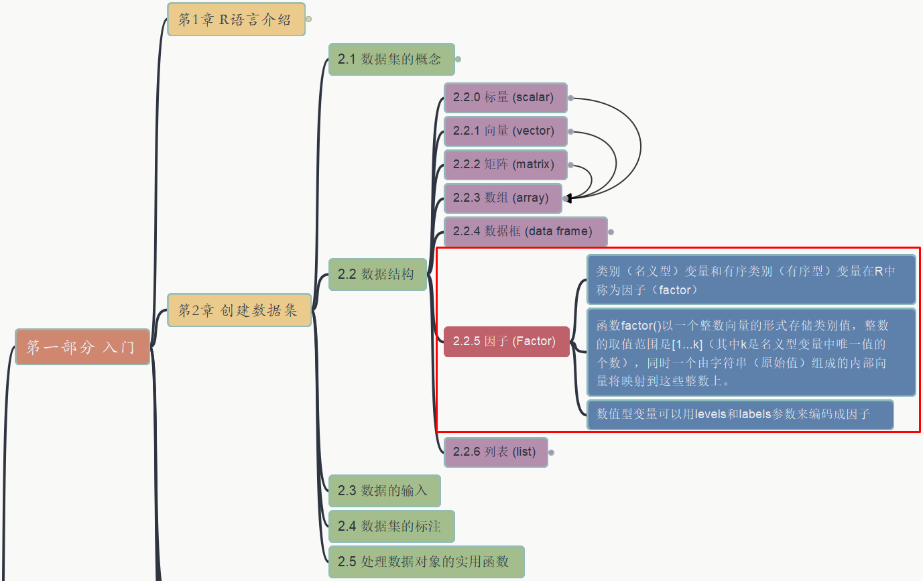
010 2. 创建数据集
R in Action R语言实战
2.2.5 因子
GitHub: https://github.com/yasenstar/learn_r/tree/main/RinAction
Gitee: https://gitee.com/yasenstar/learn_r/tree/main/RinAction

Slide 11
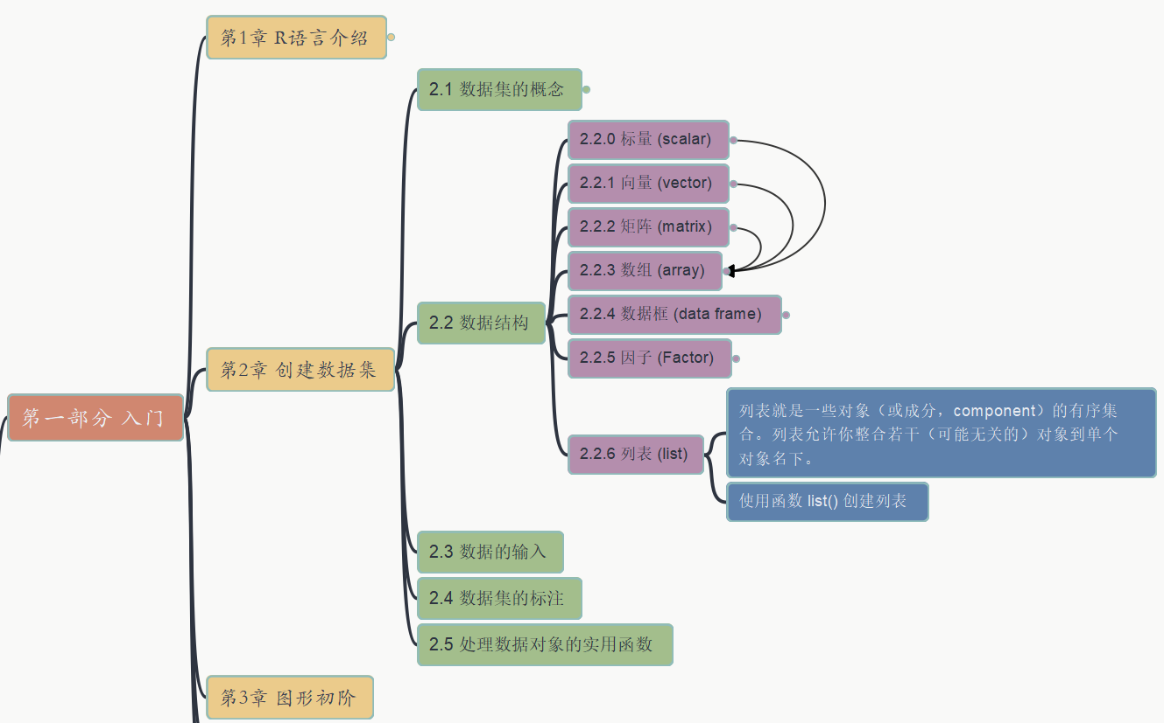
011 2. 创建数据集
R in Action R语言实战
2.2.6 列表 List
GitHub: https://github.com/yasenstar/learn_r/tree/main/RinAction
Gitee: https://gitee.com/yasenstar/learn_r/tree/main/RinAction

Slide 12
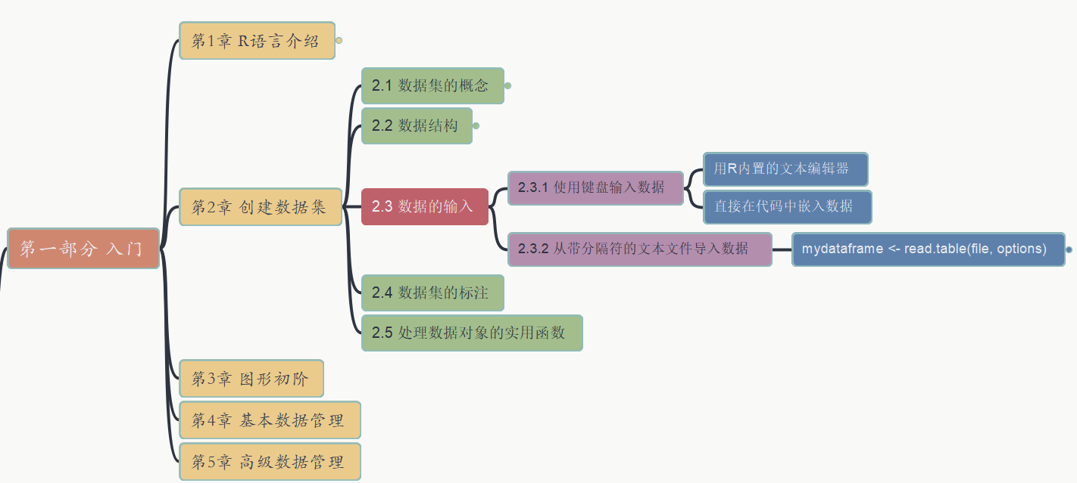
2. 创建数据集
012
2.3 数据的输入
2.3.1 键盘输入 2.3.2 CSV文本文件导入
R in Action R语言实战
GitHub: https://github.com/yasenstar/learn_r/tree/main/RinAction
Gitee: https://gitee.com/yasenstar/learn_r/tree/main/RinAction

Slide 13
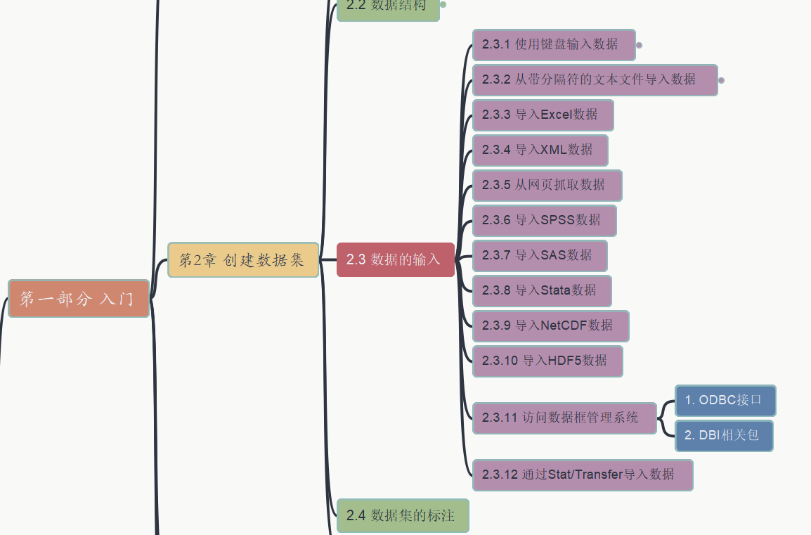
2. 创建数据集
013
2.3 数据的输入
2.3.3 ~ 2.3.12 其他多种数据输入方式
R in Action R语言实战
GitHub: https://github.com/yasenstar/learn_r/tree/main/RinAction
Gitee: https://gitee.com/yasenstar/learn_r/tree/main/RinAction

Slide 14
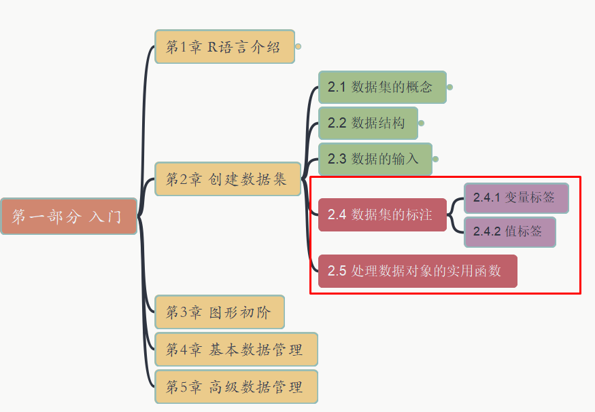
2. 创建数据集
014
2.4 数据集的标注
2.5 处理数据对象的实用函数
R in Action R语言实战
GitHub: https://github.com/yasenstar/learn_r/tree/main/RinAction
Gitee: https://gitee.com/yasenstar/learn_r/tree/main/RinAction

Slide 15
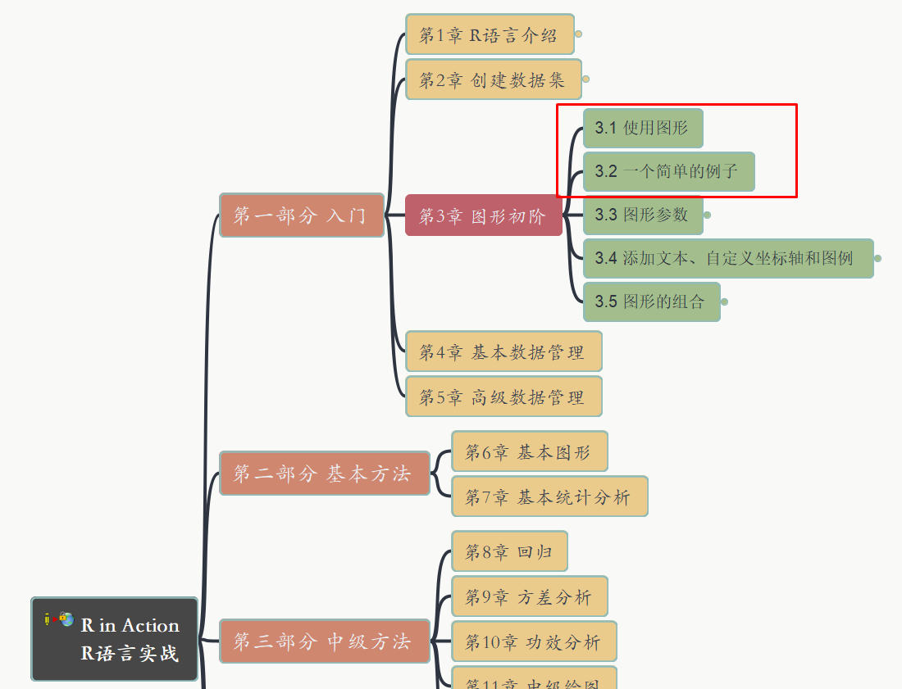
3. 图形初阶
015
3.1 使用图形 3.2 一个简单的例子
R in Action R语言实战
GitHub: https://github.com/yasenstar/learn_r/tree/main/RinAction
Gitee: https://gitee.com/yasenstar/learn_r/tree/main/RinAction

Slide 16
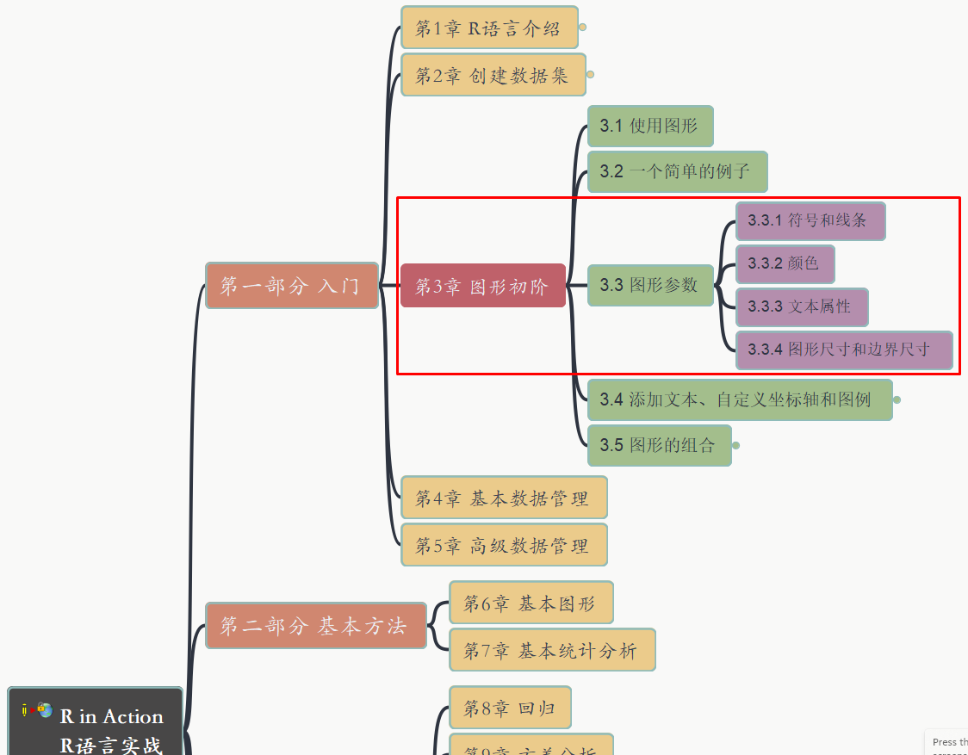
3. 图形初阶
016
3.3 图形参数
R in Action R语言实战
GitHub: https://github.com/yasenstar/learn_r/tree/main/RinAction
Gitee: https://gitee.com/yasenstar/learn_r/tree/main/RinAction

Slide 17
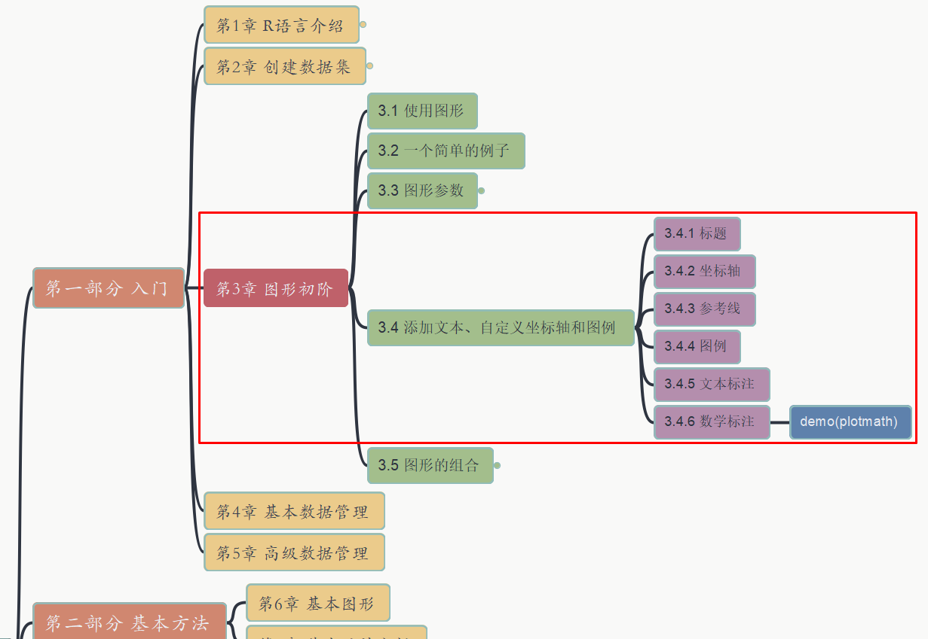
3. 图形初阶
017
3.4 添加文本、自定义坐标轴和图例
R in Action R语言实战
GitHub: https://github.com/yasenstar/learn_r/tree/main/RinAction
Gitee: https://gitee.com/yasenstar/learn_r/tree/main/RinAction

Slide 18
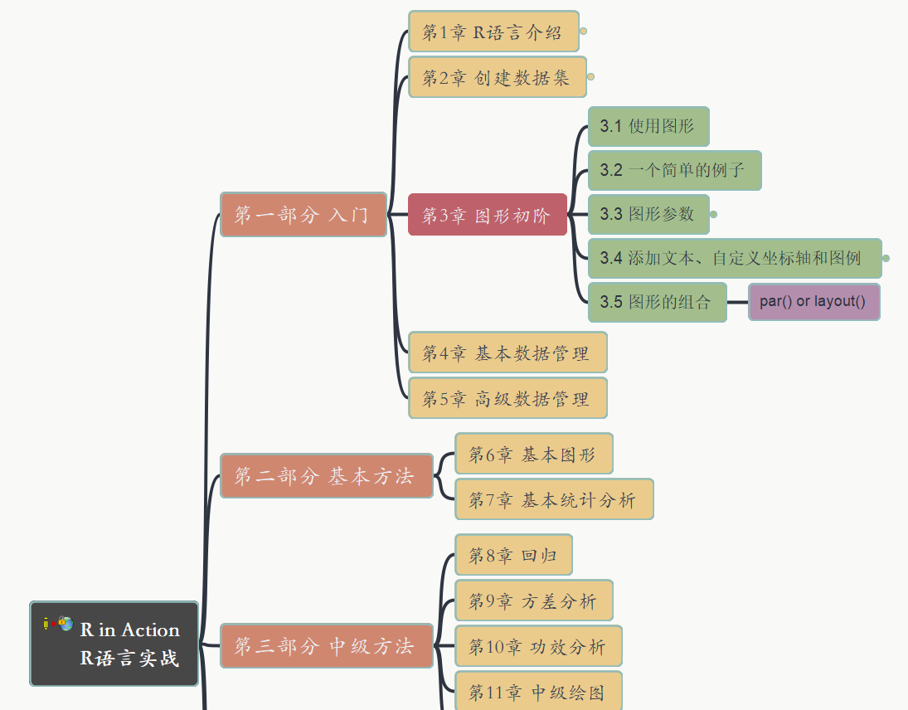
3. 图形初阶
018
3.5 图形的组合
R in Action R语言实战
GitHub: https://github.com/yasenstar/learn_r/tree/main/RinAction
Gitee: https://gitee.com/yasenstar/learn_r/tree/main/RinAction

